Slide 1

Report Writing Process
A Step-by-Step Guide to Effective Report Writing
Course Title : Technical Writing and Presentation
Course Code: CSE-3110
Prepared For: Mrittika Mahbub
Lecturer, Dept. of CSE
Presented by:
Md. Meahadi Hasan
Notes:
1

Slide 2

Introduction
Definition: A report is a structured document that presents information clearly and formally for a specific audience and purpose.
Importance of Reports:
Helps in decision-making
Provides documented evidence
Communicates findings professionally
Types of Reports:
Analytical Reports
Informational Reports
Research Reports
Business Reports
Page 1
Notes:
2

Slide 3
Pre-Writing Stage
Understanding the Purpose
Identifying the Audience
Gathering Information
Why is the report needed?
Who will read the report?
Primary Sources (Surveys, Interviews)
What are the objectives?
What is their level of understanding?
Secondary Sources (Books,
Articles, Reports)
Page 2
Notes:
3

Slide 4
Planning the Report
Structuring the Report
Title Page
Table of Contents
Executive Summary
Introduction
Methodology
Findings/Analysis
Conclusion
Recommendations
References & Appendices
Creating an Outline
Organize key points logically
Page 3
Notes:
4

Slide 5
Writing the Report
Drafting the Introduction
Background of the topic
Purpose & objectives
Scope & limitations
Methodology Section
How was data collected?
Tools & techniques used
Findings & Analysis
Present data clearly (tables, graphs)
Interpret results objectively
Page 4
Notes:
5

Slide 6
Writing the Conclusion & Recommendations
Conclusion
Recommendations
Summarize key findings
Actionable suggestions based on findings
Restate the purpose
Should be practical & relevant
Page 5
Notes:
6

Slide 7



Revising & Editing
Reviewing Content
Proofreading
Peer Review
Is the information accurate?
Check grammar, spelling, punctuation
Get feedback from colleagues
Is the structure logical?
Ensure consistency in formatting
Page 6
Notes:
7

Slide 8
Formatting & Finalizing
Professional Formatting
Adding References
Final Check
APA, MLA, or Harvard style
Ensure all sections are complete
Font style & size (e.g., Times New Roman, 12pt)
Avoid plagiarism
Headings & subheadings
Page numbers
Page 7
Notes:
8

Slide 9
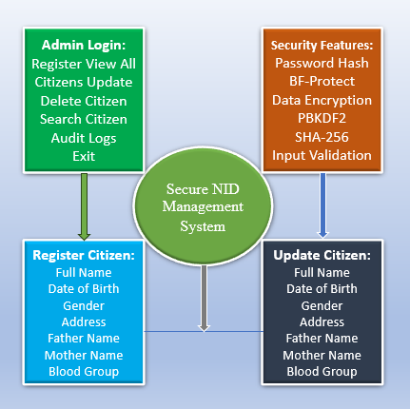
Project Overview
Title: Secure National ID Management System
Objective: A secure, database-driven system for managing citizen identification records with role-based access control and audit logging.
Key Features:
Citizen Record Management
Create, Read, Update, Delete (CRUD) operations
Unique National ID (NID) generation
Role-Based Access Control
Admin, Officer, Auditor roles (currently Admin-only)
Secure authentication (PBKDF2-HMAC-SHA256 with salt)
Audit & Security
Activity logging (registration, updates, deletions)
Tech Stack:
Language: C
Database: SQLite (embedded)
Crypto: OpenSSL (hashing, salting)
Page 8
Notes:
8

Slide 10
Common Mistakes to Avoid
Lack of clarity in objectives
Poor structure & organization
Overloading with unnecessary details
Ignoring the target audience
Grammatical & formatting errors
Page 9
Notes:
10

Slide 11
Conclusion
The report writing journey improved technical writing skills through structured processes, using tools like Microsoft Word, Grammarly, and GitHub, and teamwork, ensuring clarity and accuracy in academic standards.
Page 10
Notes:
10

