Slide 1

Blockchain Interoperability
By Muhammad Ahmad & Athar Ateeq

Slide 2

Blockchain Interoperability
The term Blockchain interoperability consists of two specific words:
Blockchain
Blockchain is a shared, immutable ledger that facilitates the process of recording transactions and tracking assets in a business network.
A blockchain is a database that is shared across a network of computers.
Interoperability
Execution of several operations among the same kinds.
Blockchain interoperability is defined as the ability to see, access, and share information across different blockchains or blockchain networks.

Slide 3
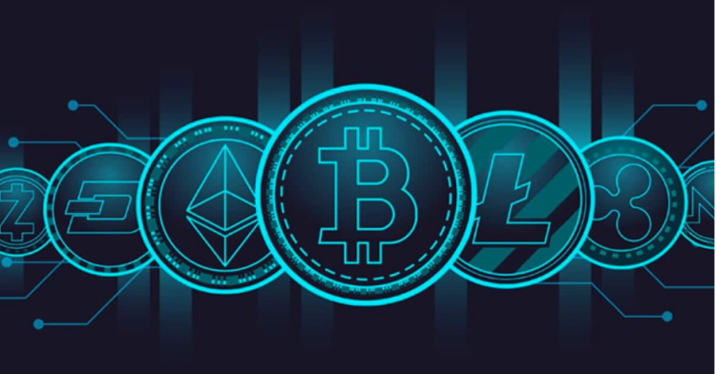
Why We Need Blockchain Interoperability?
Blockchain these days
Everyone creating their own blockchain
Each blockchain is for different purposes
Don’t communicate with each other
Work in their own echo system
But we is that?
Everyone’s idea of blockchain is different
According to project for what they needed

Slide 4
Use Cases of Interoperability
Cryptocurrency’s Liquidity
The transmission of a given cryptocurrency’s liquidity from one blockchain to another.
Trade an Asset
Allowing users to trade an asset on one chain for another asset on another chain.
Allowing Users to Borrow Assets
Enabling users to borrow assets on one chain by posting tokens or NFTs as collateral on another chain.

Slide 5
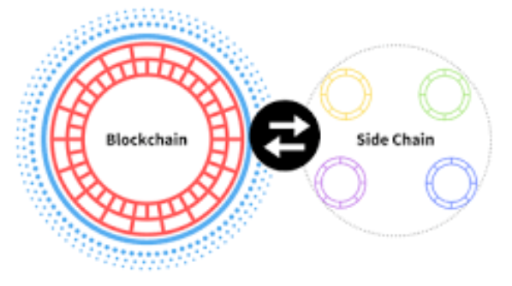
How Is Blockchain Interoperability Achieved?
Sidechains
A sidechain is a separate blockchain network
Connects to another blockchain – called a parent blockchain
These secondary blockchains have their own consensus protocols
Help other blockchain network to improve its privacy and security
Facilitate a smoother asset exchange between the mainnet and the secondary blockchain.
Allowing projects to expand their ecosystem in a decentralized manner.

Slide 6
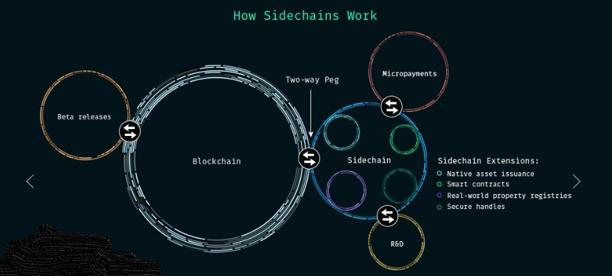
How Sidechains Work?
Two-Way Peg (2WP)
allows the transfer of bitcoins from the Bitcoin blockchain to a Secondary blockchain and vice-versa.

Slide 7
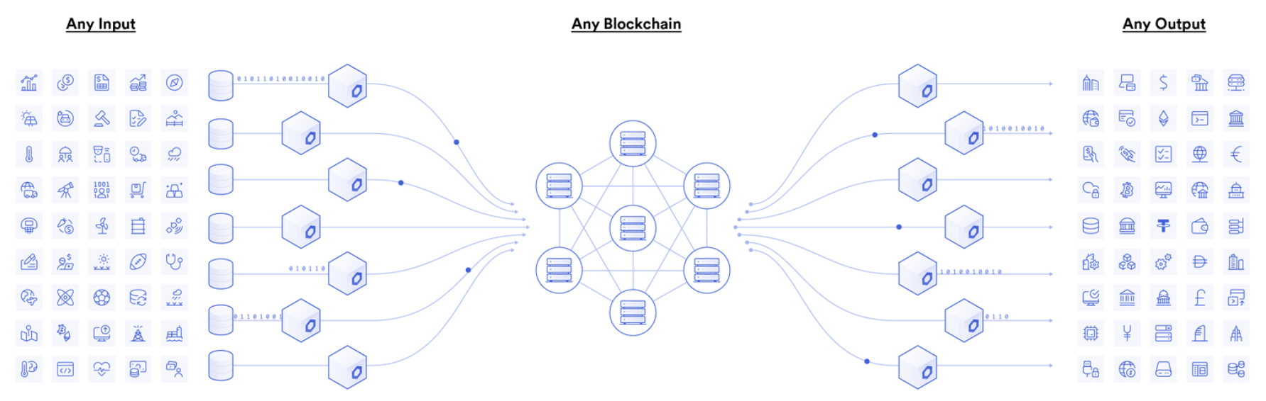
How Is Blockchain Interoperability Achieved?
Oracles
Blockchain oracles are entities that connect blockchains to external systems, thereby enabling smart contracts to execute based upon inputs and outputs from the real world.

Slide 8
How Is Blockchain Interoperability Achieved?
Bridges
A blockchain bridge is a protocol connecting two blockchains to enable interactions between them.
If you own bitcoin but want to participate in DeFi activity on the Ethereum network, a blockchain bridge allows you to do that without selling your bitcoin.
Two type of Bridges
Custodial Bridges
Require users to place their trust in a central entity to properly and safely operate the system.
Non-custodial Bridges
Operate in a decentralized manner, relying on smart contracts to manage the crypto locking and minting processes, removing the need to trust a bridge operator.

Slide 9
How Is Blockchain Interoperability Achieved?
Swaps
Swap allows users to easily exchange one cryptocurrency for another without leaving their Blockchain.com Wallet.
With Swap, you can exchange crypto in your Private Key Wallet or your Trading Account.
Swapping from your Private Key Wallet provides you with the benefits of non-custodial, on-chain trade settlement.
Swapping from your Trading Account provides faster settlement and no network fees.

Slide 10
projects of blockchain interoperability
Cosmos
Polkadot
Harmony
Wanchain
Chainlink
Hybrix
Loom network

Slide 11
Cosmos
Cosmos (ATOM) is a cryptocurrency that powers an ecosystem of blockchains designed to scale and interoperate with each other.
The team aims to “Create an Internet of Blockchains, a network of blockchains able to communicate with each other in a decentralized way."
Cosmos is a proof-of-stake chain.
ATOM holders can stake their tokens in order to maintain the network and receive more ATOM as a reward.

Slide 12
Polkadot
Polkadot unites and secures a growing ecosystem of specialized blockchains called parachains.
The Polkadot platform works with a relay chain that uses a variation of the proof of stake consensus mechanism.
Relay Chain
a podcast covering blockchain development and building the decentralized web.
Proof of Stake (PoS)
A cryptocurrency consensus mechanism used to validate transactions through randomly selected validators.
The DOT token gives the validators a voting power that enables them to take part in the decisions and evolution of the project.

Slide 13
Harmony
Harmony is a decentralized blockchain platform designed as a bridge between scalability and decentralization efforts.
It uses sharding and Effective Proof of Stake to achieve scalability, security, and decentralization.
Sharding
A validator doesn't need to maintain a full copy of the entire blockchain's transaction history.
Validators are randomly assigned to shards to prevent hostile shard takeovers.
After every Epoch, validators will likely move to a new shard, and leaders rotate.

Slide 14
Advantages
Increases the success of blockchain technology
Increases the ease of sharing and integration of data
Encourages blockchain transactions.
Enhances the future of emerging projects
Increase the advent and success rate of existing and emerging projects of the field.
Cross-Chain Transactions
Eased the process of cross-chain transactions.
It means they will all be able to communicate with each other and share data.
Multi-Token Transactions
A blockchain platform that is open-sourced and created to build the blockchain application that can work within the organisations or between the organisations.

Slide 15
Dis-Advantages
Reverse flow of blockchain is not possible
A blockchain registered on a network cannot go back to its original location.
Interoperability is not possible between two different networks
For example, Ethereum and Ripple cannot exchange their data with each other.
Highly restricted
The process of blockchain interoperability is highly restricted in nature. Though, this feature ensures safety while transferring data, but sometimes it becomes more complex and complicated for the users.

Slide 16

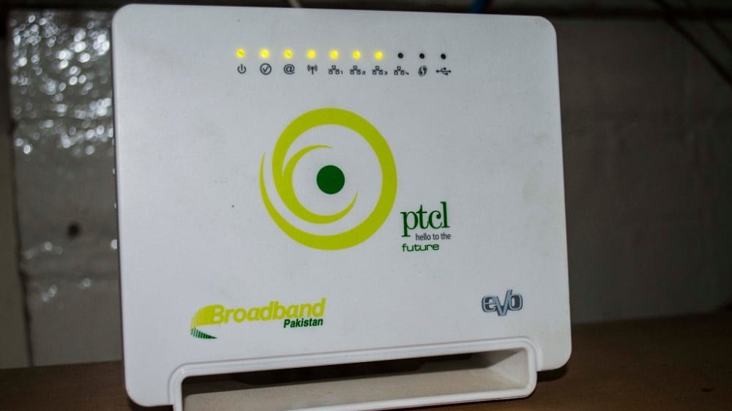
With interoperability

Slide 17

Without interoperability

Slide 18
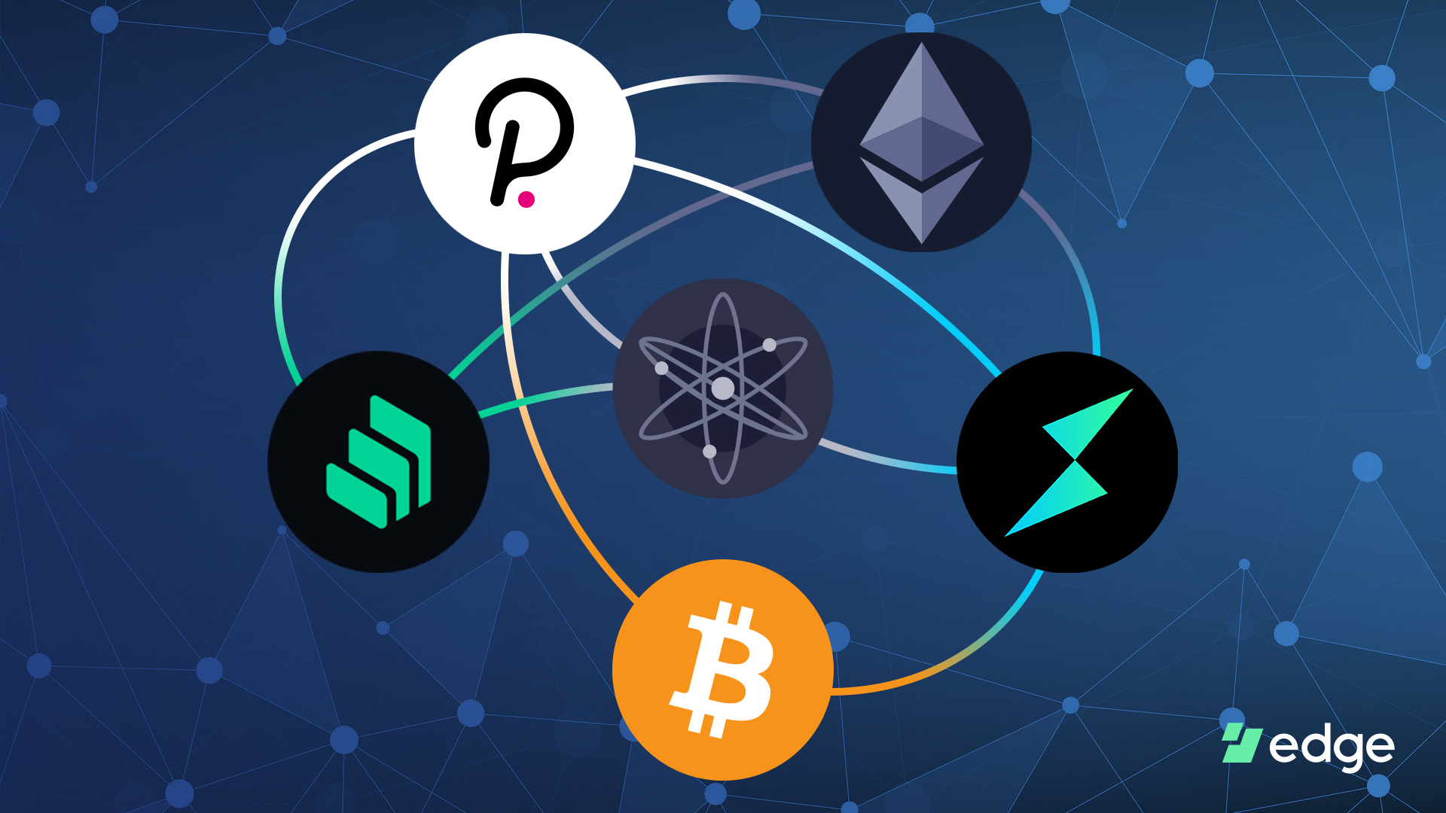
Blockchain Interoperability
Blockchain interoperability is not a set rule book. It refers to a broad range of techniques that allow different blockchains to listen to each other, transfer digital assets and data between one another and enable better collaboration

Slide 19
Why Not Mass Adoption?
MD5
SHA-1
SHA-2
NTLM
LANMAN
Ethash
X15
Quark
Proof-of-Work (PoW)
Proof-of-Stake (PoS)
Delegated Proof-of-Stake (DPoS)
Byzantine Fault Tolerance (BFT)
Practical Byzantine Fault Tolerance (PBFT)
SIEVE
Proof-of-Weight (PoW)
Different semantics of one thing for other blockchain
Private
Publics
Build on different languages

Slide 20
If Blockchain Interoperability Happen?
After all the reason interoperability is hard to achieve
But if it achieved and project has be built of blockchain interoperability
That’s mean more money
More project scope
More places to invest
Central Bank Digital Currencies (CBDCs) and supply chain are use case of blockchain interoperability

Slide 21
References
https://www.gemini.com/cryptopedia/why-is-interoperability-important-for-blockchain
https://www.analyticssteps.com/blogs/all-about-blockchain-interoperability-2022
https://www.coindesk.com/learn/an-introduction-to-sidechains/
https://www.youtube.com/watch?v=8I99WORewD8&ab_channel=AroundtheBlock
https://chain.link/education/blockchain-oracles#:~:text=Blockchain%20oracles%20are%20entities%20that,legacy%20systems%2C%20and%20advanced%20computations
https://academy.binance.com/en/articles/what-s-a-blockchain-bridge
https://support.blockchain.com/hc/en-us/articles/4417203503252-What-is-Swap-#:~:text=Swap%20is%20Blockchain.com's%20in,Wallet%20or%20your%20Trading%20Account.
https://www.coinbase.com/price/cosmos#:~:text=Cosmos%20(ATOM)%20is%20a%20cryptocurrency,proof%2Dof%2Dstake%20chain.
https://polkadot.network/
https://medium.com/2gether/inside-polkadot-d2234707ffe2
https://academy.binance.com/en/articles/what-is-harmony-one
https://cryptonews.com/coins/harmony_one/#:~:text=Harmony%20(ONE)%20is%20a%20blockchain,no%20expense%20of%20one%20another.

