Slide 1
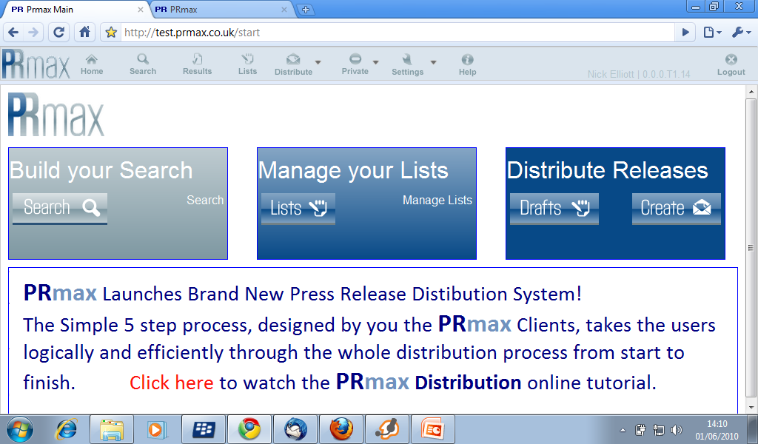

Slide 2
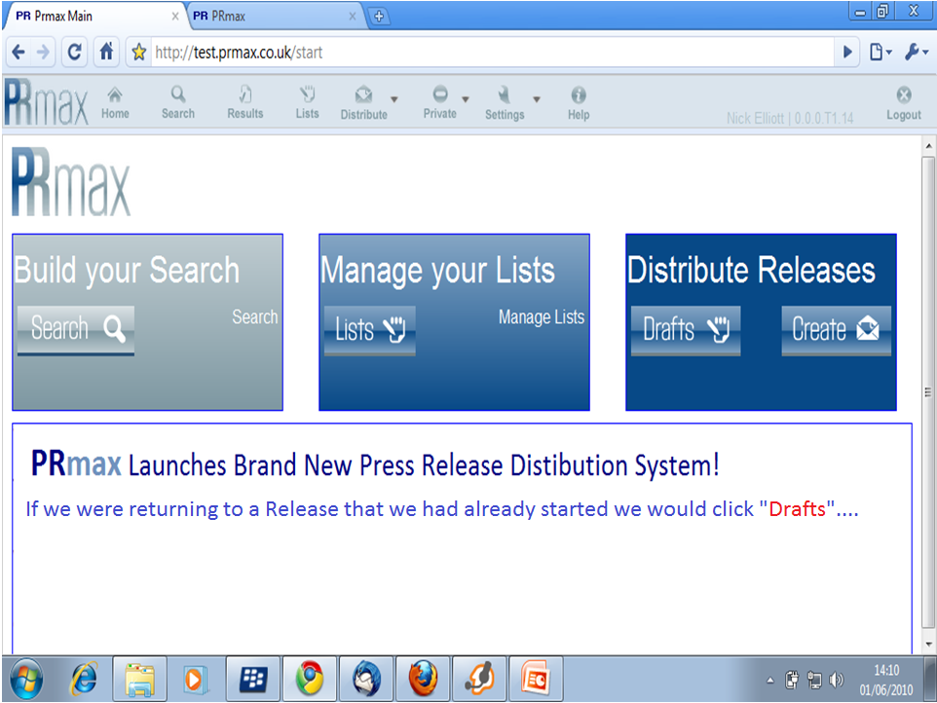

Slide 3
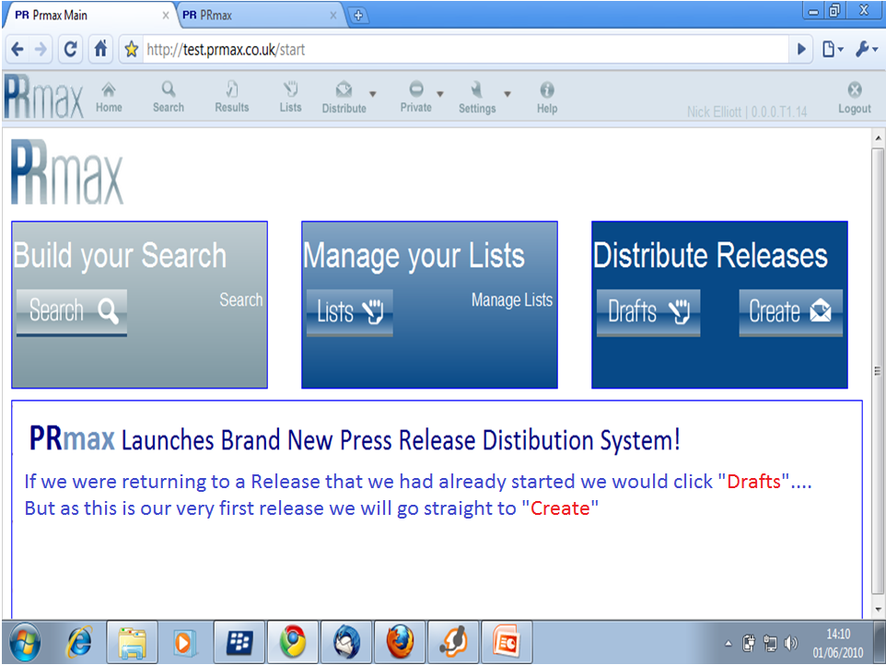

Slide 4
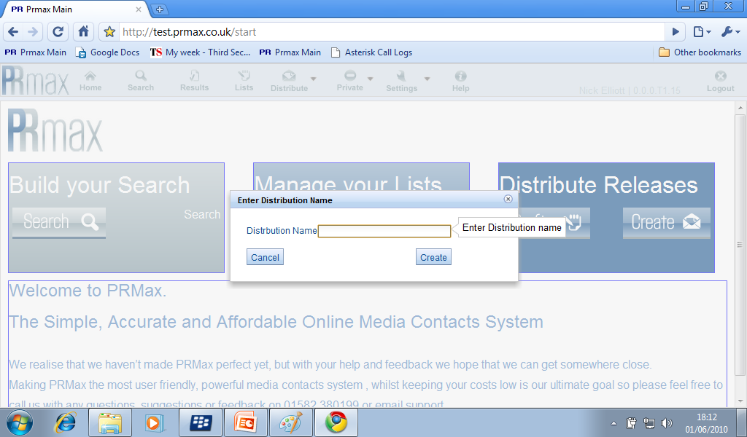
This is where we get to select the Internal title that we are going to use for this Press Release.

Slide 5
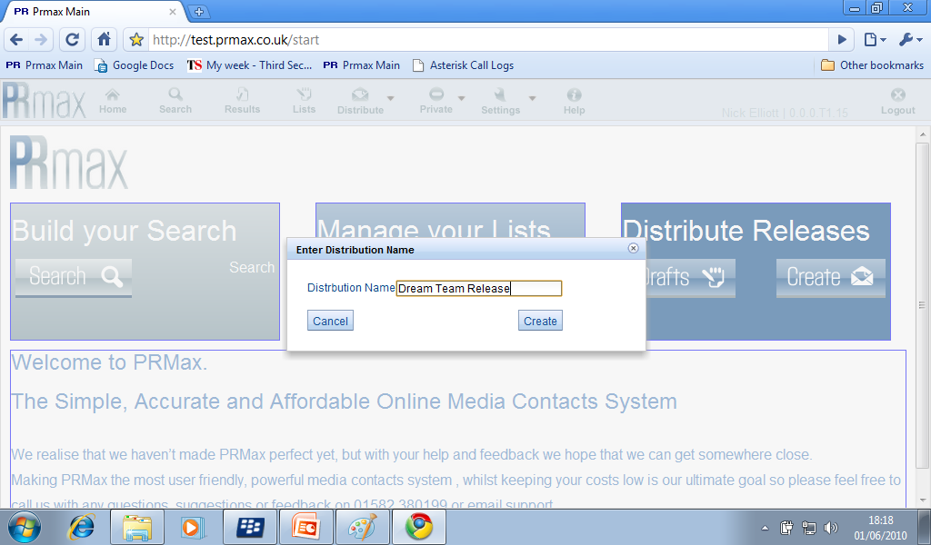
This is where we get to select the Internal title that we are going to use for this Press Release.
Note That this is not what the Journalists will see

Slide 6
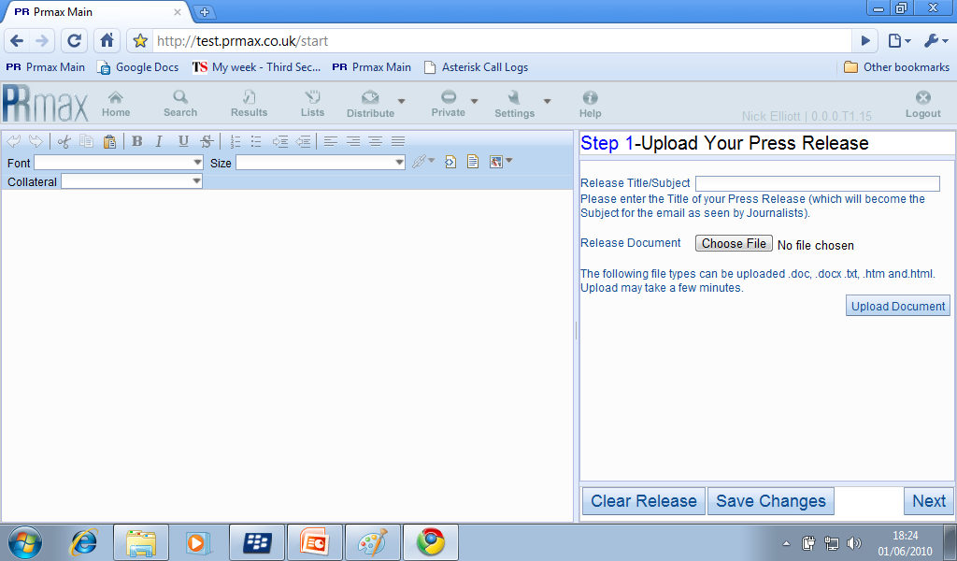
Step 1 is where we create the body of our Press Release
Give the Release a title which we be the Subject Line of the Email that goes to the Journalists

Slide 7
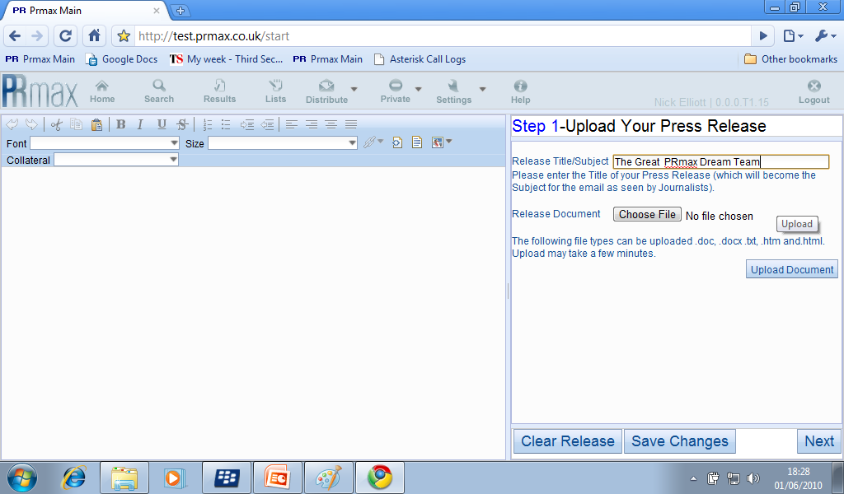
Step 1 is where we create the body of our Press Release
Give the Release a title which we be the Subject Line of the Email that goes to the Journalists
Select the Word Document which contains our Press Release Text – Which can now include Graphics! – Which will open up an Explorer window for you to make your selection.

Slide 8
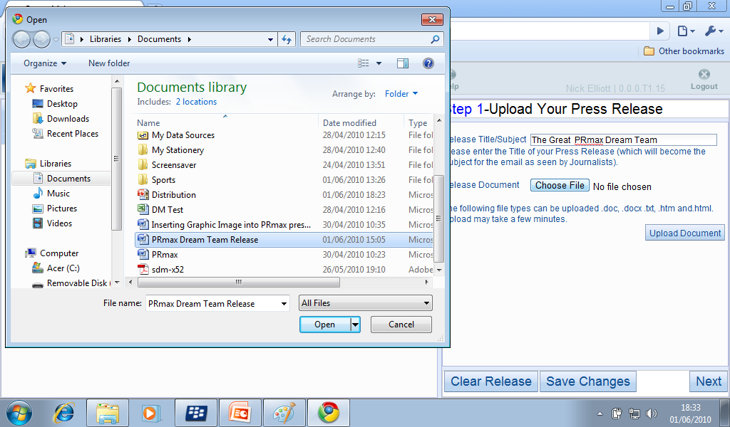

Slide 9
Step 1 is where we create the body of our Press Release
Give the Release a title which we be the Subject Line of the Email that goes to the Journalists
Select the Word Document which contains our Press Release Text – Which can now include Graphics! – Which will open up an Explorer window for you to make your selection.
Finally, when you have chosen your document select Upload Document.

Slide 10
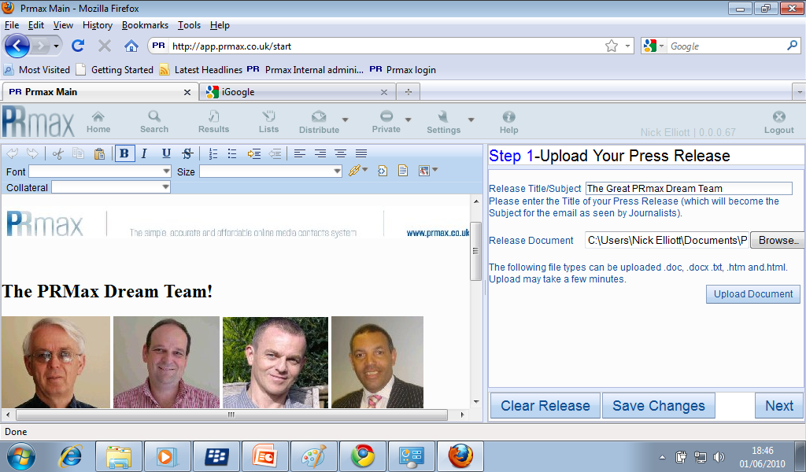
Once Uploaded The Press Release can be edited using the standard controls on the Toolbar to Centre selected Lines add in Hyper links and Change Fonts as required

Slide 11
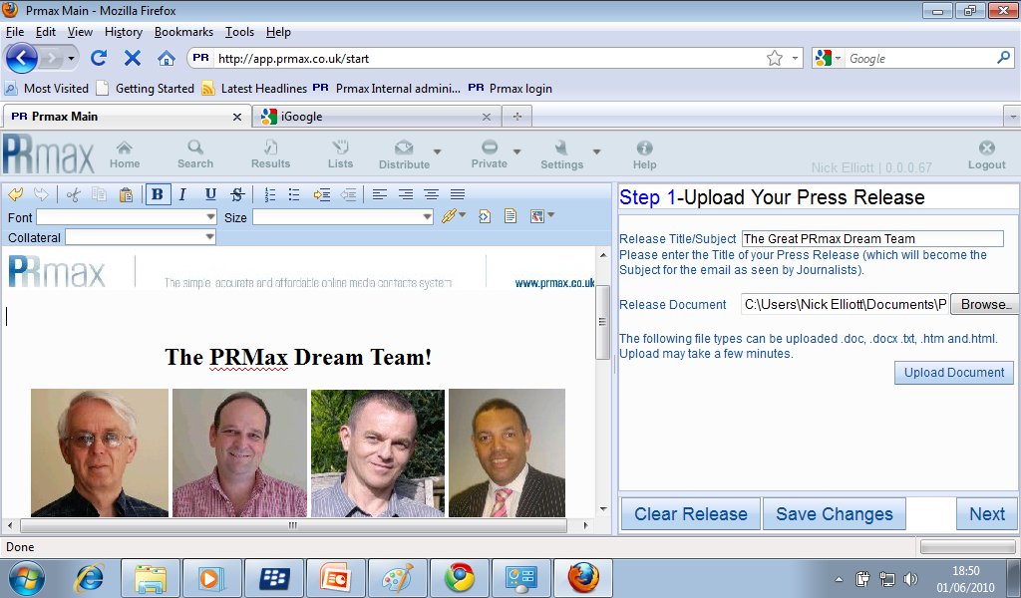

When you have finished Editing click next to move to Step 2

Slide 12
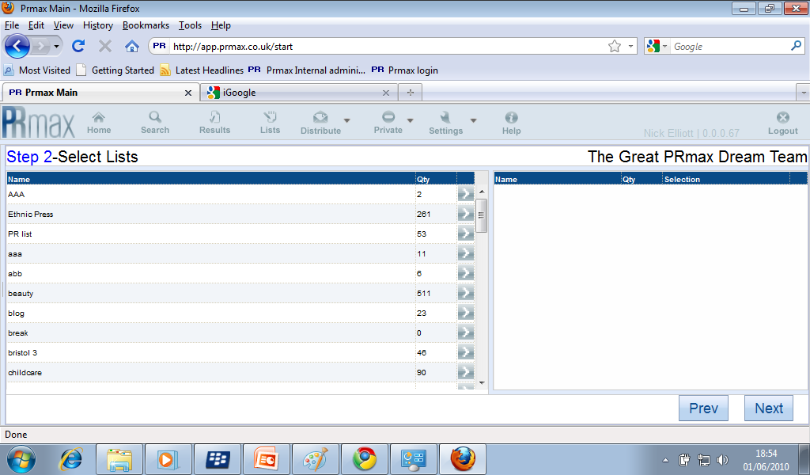
Step 2 is where we select which of our Media List or lists should receive our Press Release...
To select each list simply double click on the Arrow next to it....

Slide 13
DON’T PANIC!
If you select more than one list PRmax will automatically remove duplicates to ensure that each email address only gets one copy of your Release.
Step 2 is where we select which of our Media List or lists should receive our Press Release...
To select each list simply double click on the Arrow next to it....

Slide 14
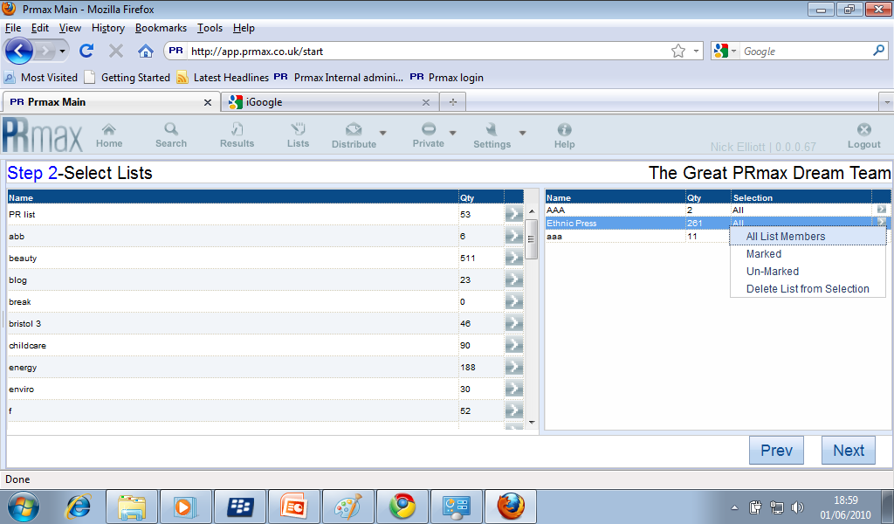
Of course you may have previously marked selected entries in a list that you want to exclude on this occasion or wish to remove a list from the selection at any time which you can do again from the Arrow next to the selected list.

Slide 15
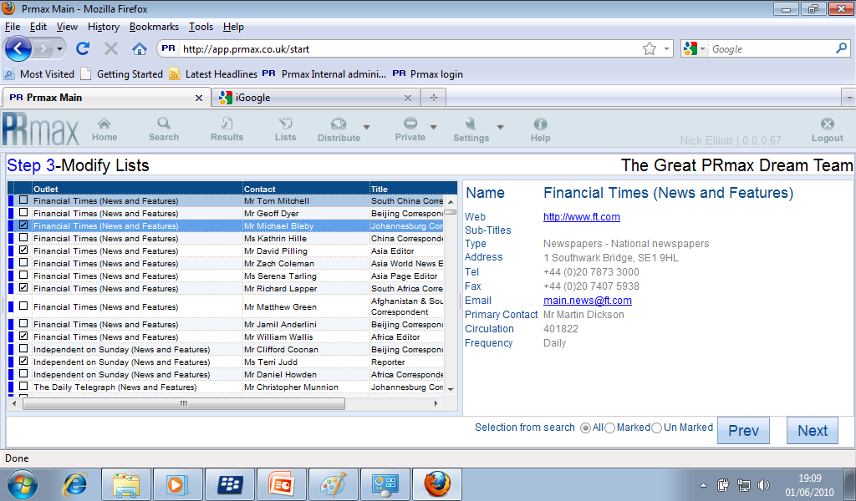
Step 3 Shows the consolidated Media List and gives a last opportunity to exclude entries from the Final distribution list by marking selected entries in the left hand boxes and choosing to included the marked, unmarked or All entries.

Slide 16
Step 3 Shows the consolidated Media List and gives a last opportunity to exclude entries from the Final distribution list by marking selected entries in the left hand boxes and choosing to included the marked, unmarked or All entries.

Slide 17
Step 3 Shows the consolidated Media List and gives a last opportunity to exclude entries from the Final distribution list by marking selected entries in the left hand boxes and choosing to included the marked, unmarked or All entries.

Slide 18
Step 3 Shows the consolidated Media List and gives a last opportunity to exclude entries from the Final distribution list by marking selected entries in the left hand boxes and choosing to included the marked, unmarked or All entries.

Slide 19
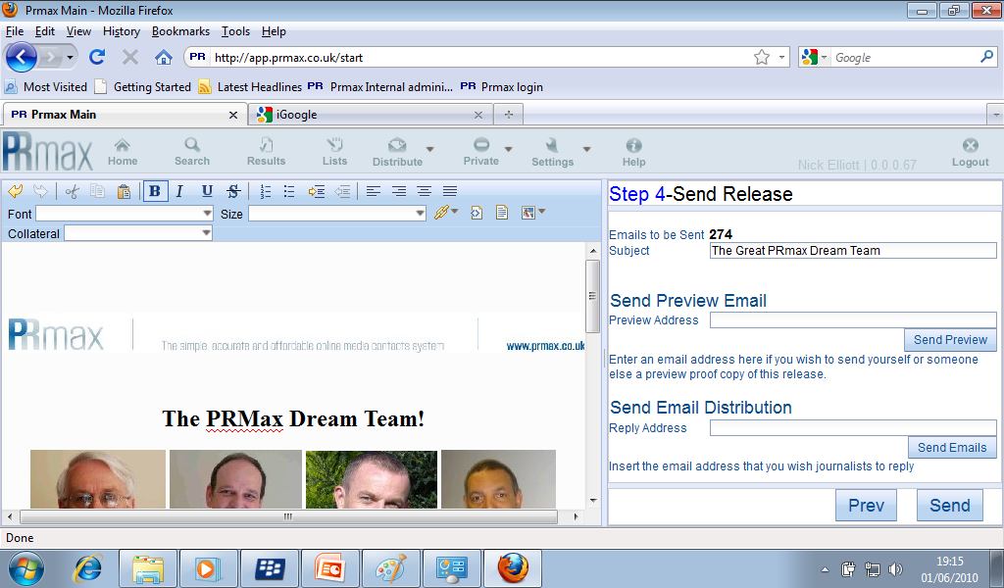
Step 4 Is the Send Phase in which we can:
See how many Journalist we are sending....

Slide 20
Step 4 Is the Send Phase in which we can:
Edit the Subject/Title of the Release....

Slide 21
Step 4 Is the Send Phase in which we can:
Preview the release on screen....

Slide 22
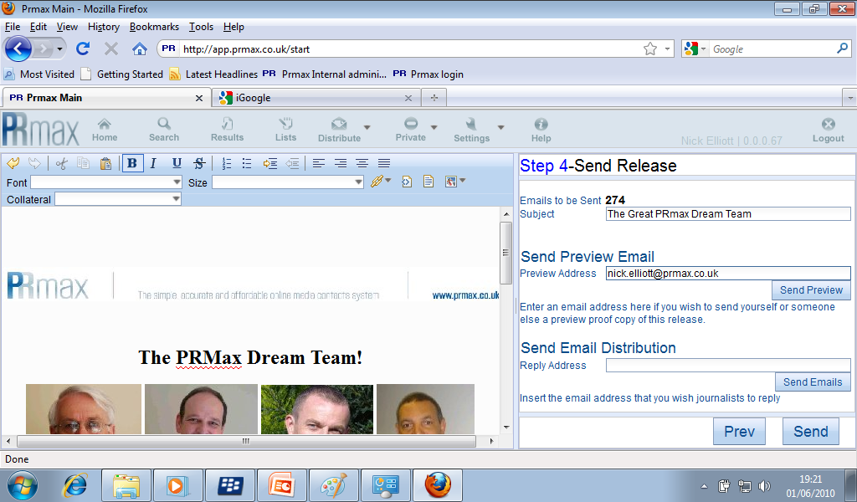
Step 4 Is the Send Phase in which we can:
Send yourself a preview copy by Email...

Slide 23

Step 4 Is the Send Phase in which we can:
Finally input the email address that you want the Release to have come from and be replied to.....

Slide 24
Step 4 Is the Send Phase in which we can:
And Send!

Slide 25
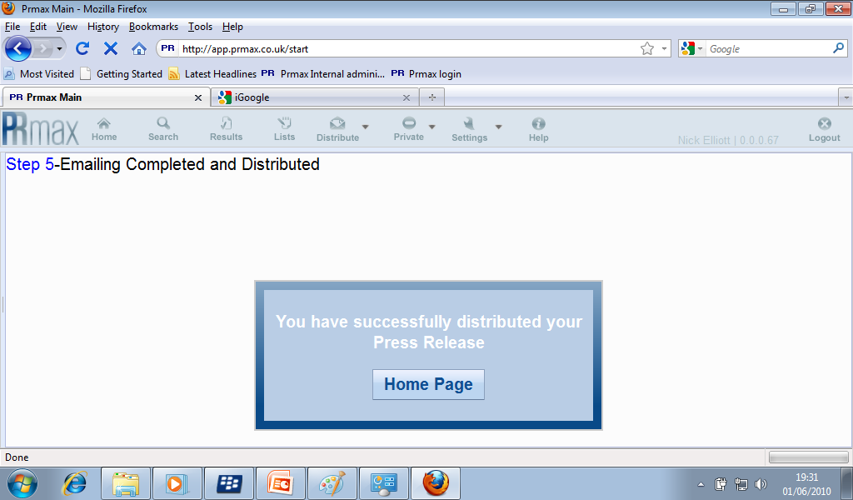
PRmax – Simple Efficient Distribution

