Slide 1
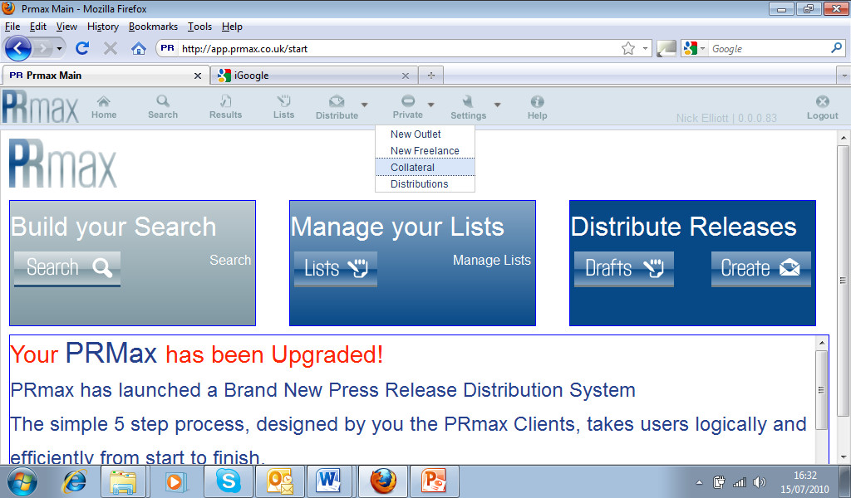
From The PRmax homepage Top Menu Bar select Private and
then Collateral

Slide 2
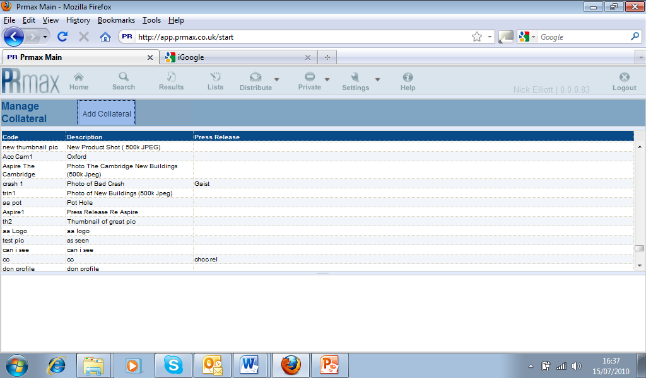
Choose Add Collateral

Slide 3
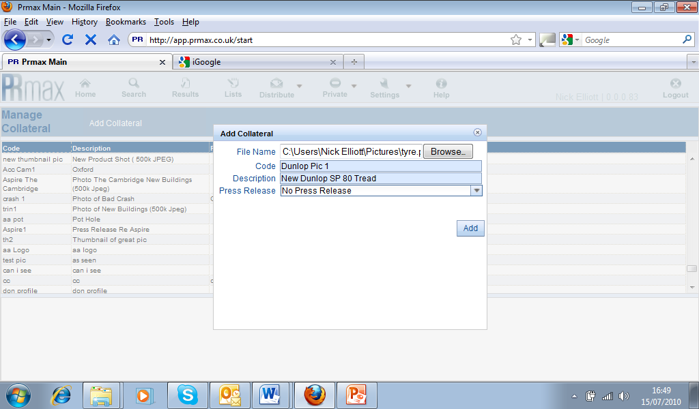
Complete the input Form by Browsing your PC to find your Photo.
Apply an internal code to the Photo.
Input the Description that you would want the Journalists to see and click Add

Slide 4
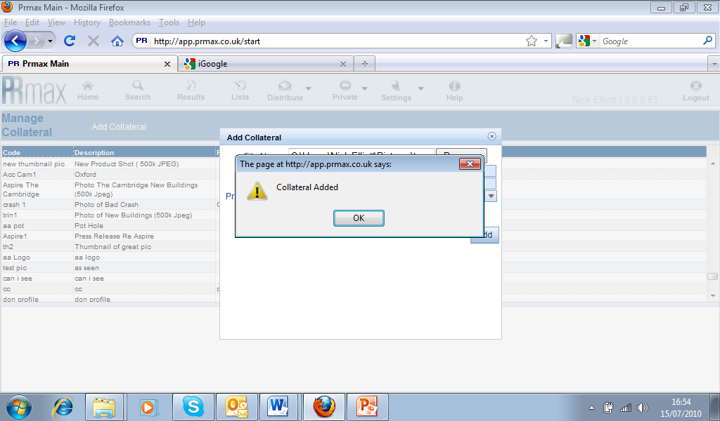

Slide 5
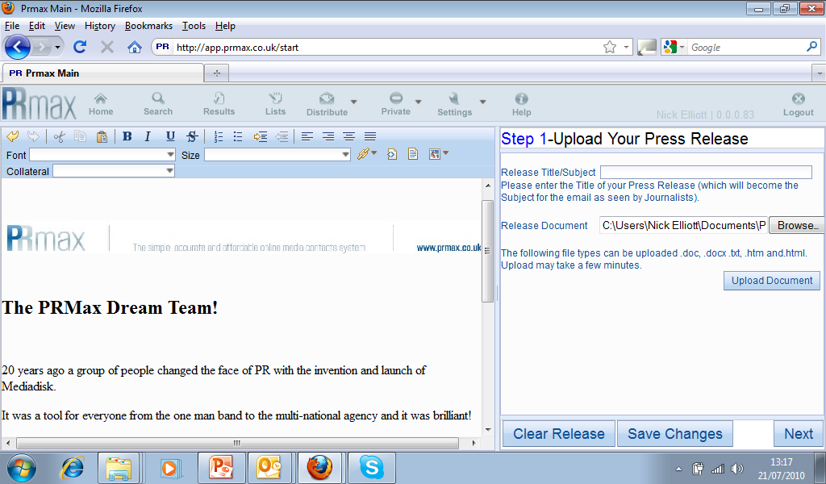
Having uploaded your Photograph as collateral, to use it in a press release simply put your cursor wherever your wish the image or link to appear within your Release Text

Slide 6
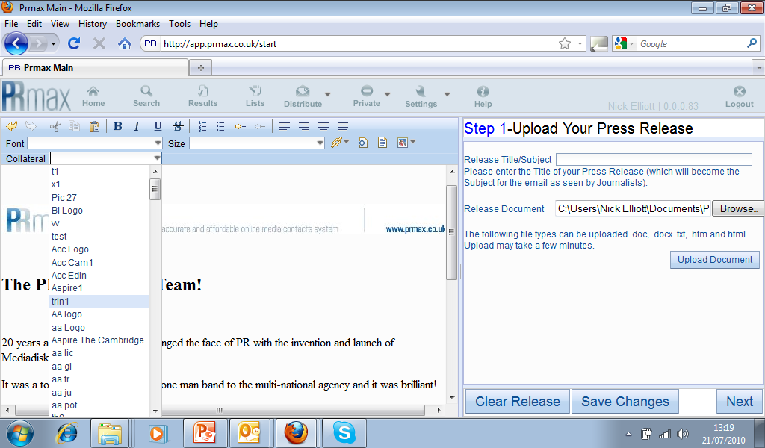
Select Collateral from the Press Release Editing Menu Bar and Identify the image you wish to insert.

Slide 7
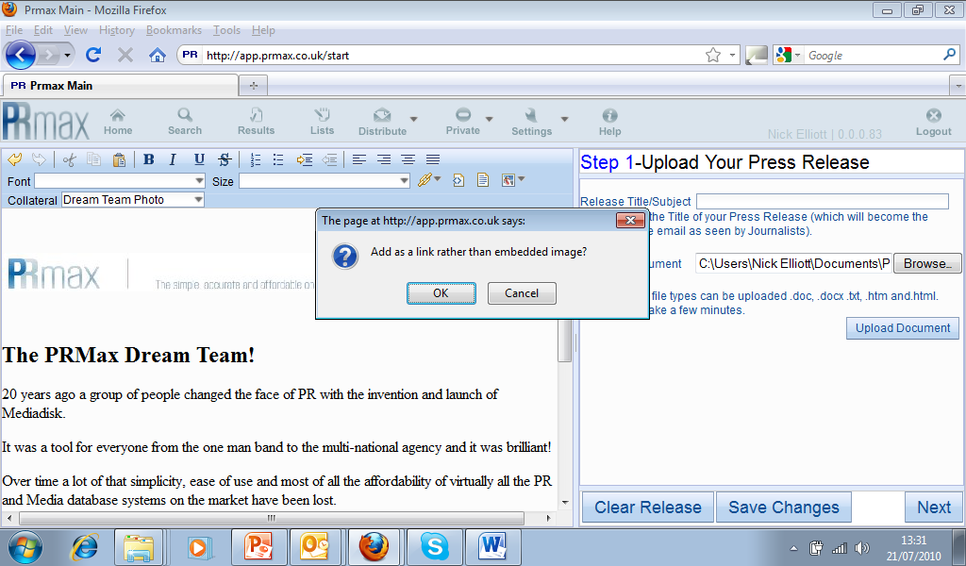
You will be asked if you wish to add as a link or as an image?

Slide 8
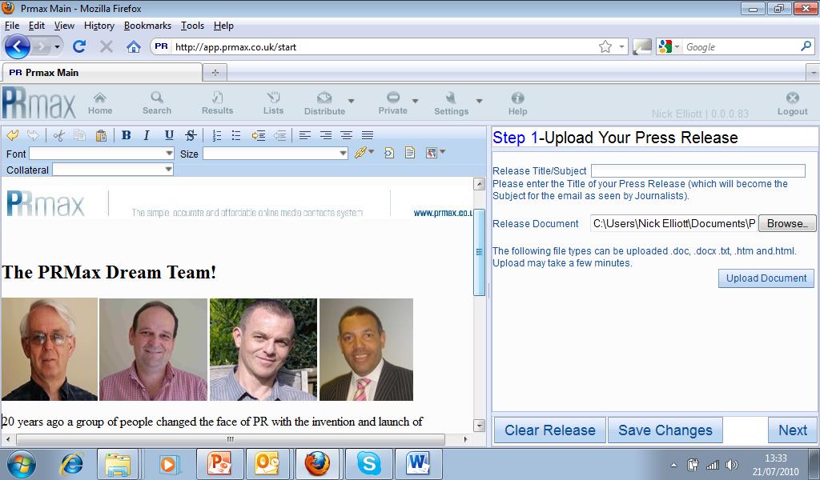
If you select No or Cancel – The Photo will be embedded as an image

Slide 9
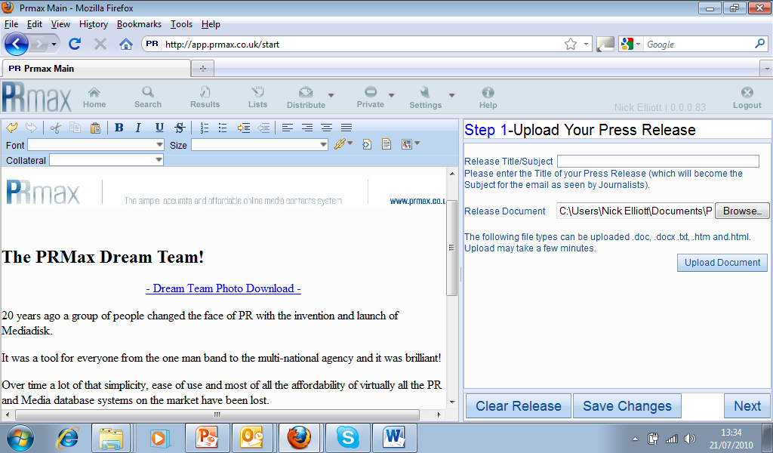
If you select Yes or OK– The Photo will be embedded as a Link

Slide 10
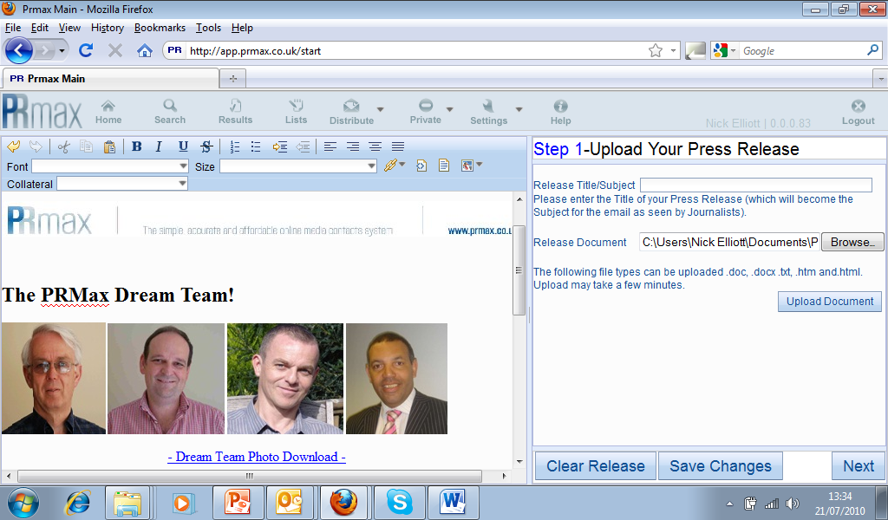
And of course you can add the Photograph twice and do Both!

Slide 11

Simple, Accurate and Affordable!

