Slide 1
Arrays

Slide 2
Arrays
Arrays are also a collection of variables. They used for lists of similar variables (i.e. a bunch of numbers, or images).
Arrays are indexed. Supplying the index (typically a number) to the array will return the variable at that index.
Array indexes start at zero (0), and progress upwards
To get an item out of the array, use the square brackets and the index

Slide 3
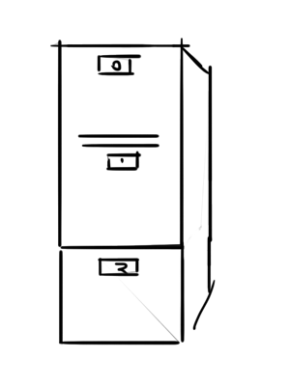
Metaphor(arrays)
You could think of arrays as a filing cabinet…
You can only put one item into each box, and you label them so you can find them with ease.
The labels are the indexes of the cabinet / array

Slide 4
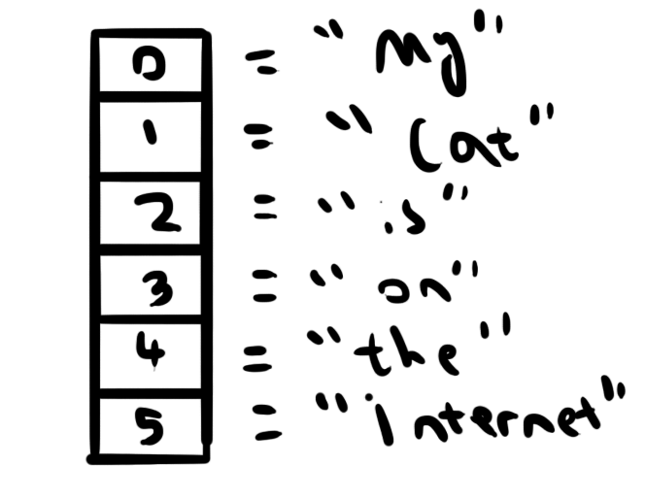
A classical array illustration

Slide 5
Making an array
var myArray = new Array();

Slide 6
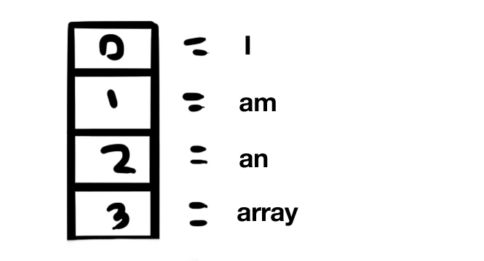
Making an array (prefilled)
var myArray = new Array(“I”,”am”,”an”,”array”);

Slide 7
Making an array (array syntax)
var myArray = ["This", "array", "already", "has", "some", "content"];

Slide 8
Getting a value out of an array
Write the square brackets, and inside the index you want.
var myArray = [5,4,3,2,1];
myArray[0]; // 5
myArray[2]; // 3
myArray[3]; // 2

Slide 9
Adding to the array
Write the square brackets to get to what is stored in that index of the array
Works just like a variable
myArray[0] = 5;
myArray[3] =39;

Slide 10
Useful array properties & methods
length: returns the number of elements in the array
push(something): adds an element at index zero, pushes all others back
pop(): takes a variable off the top of the array and returns it
shift(something): adds an element at the very end of the array
unshift(): takes a variable off the bottom of the array

Slide 11
Properties & methods continued
sort(): will sort the variables numerically or alphabetically
splice(index, number): removes and returns (number) of elements from the array, starting at (index)
toString(): Like number.toString. This returns a string of every entry in the array

Slide 12
Some array examples
var myArray = new Array("This", "array", "already", "has", "some", "content");
console.log(myArray[0]);
console.log(myArray[2]);
console.log(myArray.toString());
Output
This
already
This, array, already, has, some, content

Slide 13
Some array examples
var myArray = new Array("This", "array", "already", "has", "some", "content");
var firstWord = myArray.pop();
console.log(firstWord);
var lastWord = myArray.shift();
console.log(lastWord);
console.log("Length " + myArray.length);
Output
This
content
Length: 4

Slide 14
Splitting strings
Its possible to make an array out of strings by splitting them
Example:
var statement = “Some dogs have two teeth”;
var splitStatement = statement.split(“ “); //split on the spaces
The data in splitStatement will be
[ “some”, “dogs”, “have”, “two”, “teeth” ]

Slide 15
Splitting strings
Yep, you can split on anything
var source = “Dogs,cats,rats,mice”;
var split = source.split(“,”); // [ “Dogs”, “cats”, “rats”, “mice” ]
var source = “Dogs,cats,rats,mice”;
var split = source.split(“rats,”); // [ “Dogs,cats,”,“mice” ];

Slide 16
‘looping through’ an array
var myArray = [ 2, 4, 6, 8, 10 ];
for(var i =o; i , myArray.length; i++) {
var itemAtIndex = myArray[i];
console.log(itemAtIndex);
}

Slide 17
Summing up items in an array
var sum = 0;
var myArray = [ 2, 4, 6, 8, 10 ];
for(var i =o; i , myArray.length; i++) {
var itemAtIndex = myArray[i];
sum += itemAtIndex;
}

Slide 18
Searching arrays
var myArray = [ “Spock”, “Kirk”, “McCoy”, “Luffy” ];
var thingToLookFor = “Luffy”;
for(var i =0; i < myArray.length; i++) {
var itemAtIndex = myArra[i];
if( itemAtIndex == thingToLookFor) {
break;
}
}

