Slide 1
Eeeeee-vents
N221
IUPUI

Slide 2
Events are e-verywhere
Just about everything in the html/javascript world send out these wonderful things called events
What sends events?
The mouse
The keyboard
All of the visible elements
Yes, there's more too

Slide 3
What’s an event
Here's an example:
Click on an input: click event
Type 'some stuff': Keyup and keydown events
Move mouse over and out of divs: mouse over and mouse out events

Slide 4
Some other events
Image loaded
Sound has finished playing
Page has loaded
Mouse has moved

Slide 5
If a tree falls in a forest
An event is pretty worthless if we're not listening for it
The problem with these events is that we haven't been listening for them
If you want to 'hear' an event and respond to it, use addEventListener

Slide 6
The guts
There is two parts to dealing with events:
The event listener: this is a method on every DOM element reference
The event handler: this is a function that runs whenever the event 'fires'

Slide 7
Some examples

Slide 8
With a HTML tag
<div id=“myDiv” onClick=“handleClick(event
)”></div>
function handleClick(event) {
console.log("I've been hit!!");
}

Slide 9
Images can get click events
<img id="myImg" src="assets/someImage/jpg" click="onMouseClick(event)"/>
function onMouseClick(event) {
console.log("I've been hit!!");
}

Slide 10
Adding events via code
var divRef = document.getElementById(‘myDiv’);
divRef.addEventListener(“mouseover”, onMouseOver);
function onMouseOver(event) {
console.log("I've been found!");
}

Slide 11
Adding a click event via code
someDiv.addEventListener(‘click’, onMouseClick);
function onMouseClick(event):void {
console.log("I've been hit!!");
}

Slide 12
Some ‘gotchas’
domRef.addEventListener(“mouseover”, onMouseOver);
function onMouseOver(event) {
trace("I've been found!");
}
Note that the second argument to addEventListener is simply the name of the function
In other words, do not use () when doing an addEventListener call

Slide 13
Mouse Event
In addition to target, mouse events have two other properties that are useful as well:
y
x

Slide 14
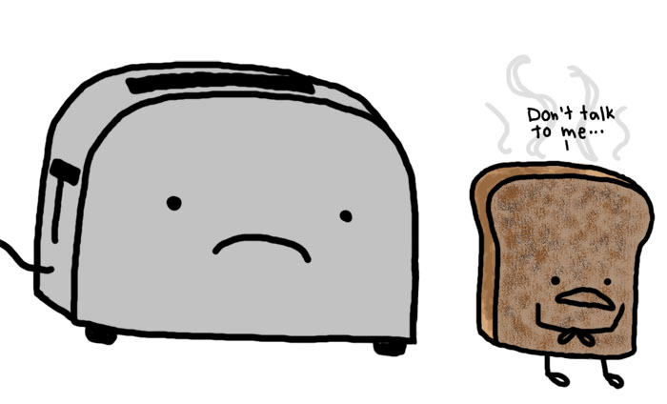
Removing event listeners
In order to stop listening for events, we call the reverse of addEventListener, removeEventListener
domRerference.removeEventListener(‘mouseover’, onMouseOver);
(Removing unneeded listeners is a great way to improve app performance)

Slide 15
event.target
All events have a property called ‘target’
targets are the item that was listening for the event
For instance, inside of a mouse event click handler on a div, you may get a reference to the div that was clicked:
var targDiv = event.target;

Slide 16
Events
Can respond to a myriad of events
Method here works in all modern browsers
A listing of all events and supported browsers:
http://www.quirksmode.org/dom/events/index.html

Slide 17
Short form of listener/handler
myDiv.addEventListener(“click”, onClick) {
function onClick(event) {
console.log(“Clicked!”);
}

Slide 18
Adding events to new objects
var newElement = document.createElement(“div”);
newElement.width = “100px”;
newElement.height = “100px”;
newElement.color = “#FF0000”;
newElement.addEventListener(“click”, function(event) {
console.log(“its been clicked!”);
});
domReference.appendChild(newElement);

Slide 19
Remove event listener
object.removeEventListener (eventName, function);

