Slide 1
IBM TechXchange Pre-Conference Watsonx Hackathon - Submission
Team – Tech Maverick Anirban Banerjee Ajoy Kumar Daga

Slide 2

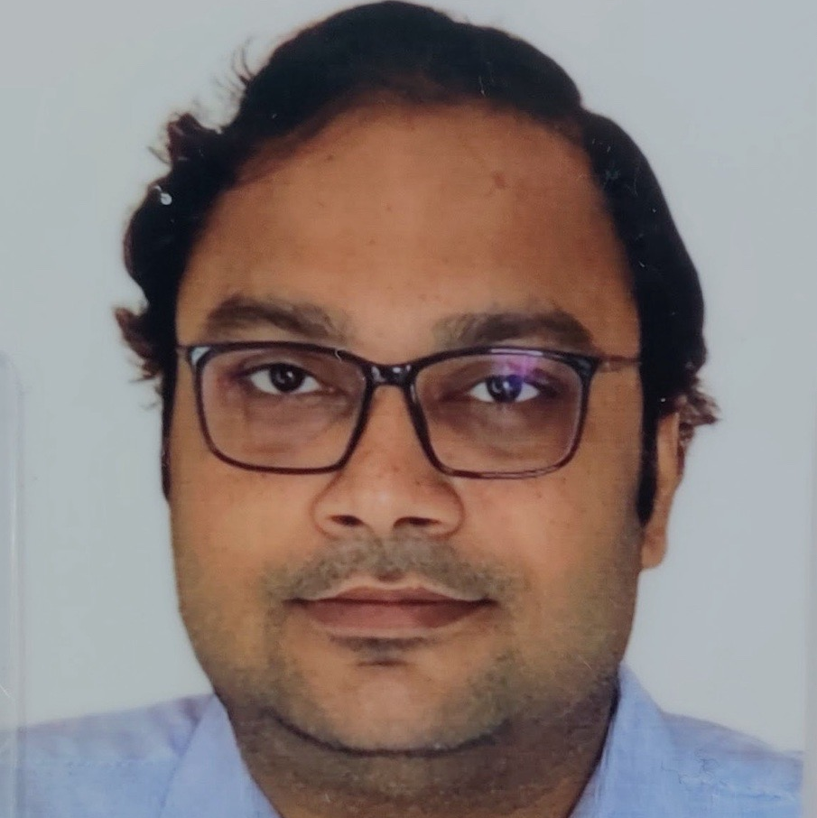
MEET THE TEAM
Team – Tech Maverick
AJOY KUMAR DAGA 14+ years of experience as Data engineer, Data architect and BI Consultant.
ANIRBAN BANERJEE 16+ years of experience as Architect and data engineer.

Slide 3
Use case - Enhanced Customer Experience & Improved Employee Productivity
Background An e-commerce platform faces a challenge with its call center data. Each day, the center handles a high volume of customer interactions through customer care calls, generating extensive data files of feedback and complaints. However, this wealth of data remains underutilized, offering limited insights into overall customer satisfaction and regional issues. The platform struggles to effectively analyze this data to identify trends, sentiment, and recurring problems, which hinders its ability to improve service quality and address customer concerns proactively.
Contd…

Slide 4
Use case - Enhanced Customer Experience & Improved Employee Productivity
Challenges
Sentiment Analysis: Accurately determining customer sentiment from call conversation.
Call Summarization: Call summarization for further analysis.
Regional Insights: Extracting and visualizing location-based trends and issues.
Contd…

Slide 5
Use case - Enhanced Customer Experience & Improved Employee Productivity
Solution Stack
Integrate IBM Watsonx for sentiment analysis, call summarization, feature extraction to address the challenges.

Slide 6
Tech Artifacts
Dataset Used:
Name - NebulaByte/E-Commerce_Customer_Support_Conversations Source – Hugging Face Column used - conversation URL - https://huggingface.co/datasets/NebulaByte/E-Commerce_Customer_Support_Conversations LLM Models (IBM Granite series): ibm/granite-13b-instruct-v2 (for sentiment analysis)
ibm/granite-13b-chat-v2 (for call summary & feature extraction) Others:
Language - Python
Git - https://github.com/meanirban100/IBM-Watsonx-Hackathon.git

Slide 7
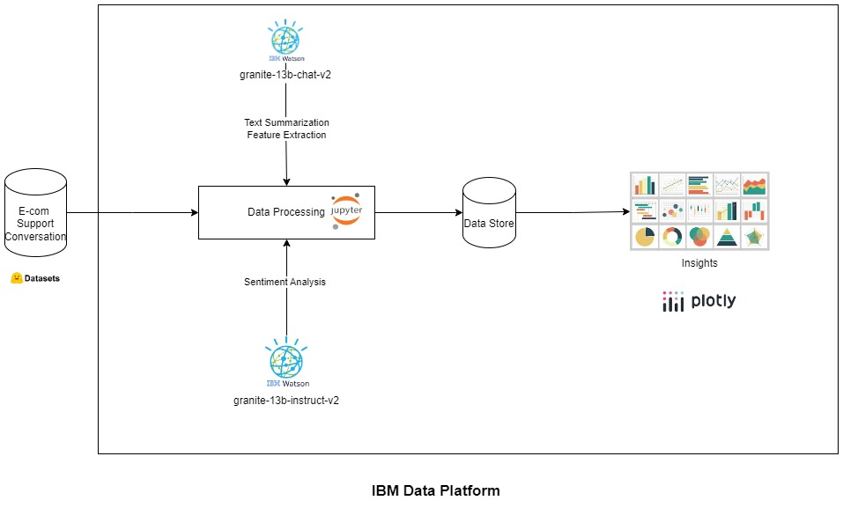
Solution Architecture

Slide 8
Key Improvements
Boosting Team Productivity Implementing sentiment analysis and text summarization will streamline processes and enhance focus on key tasks.
Performance Monitoring Call summarization will help monitor and improve team productivity by providing actionable insights.
Targeted Training Analyzing call summaries will identify improvement areas for tailored training initiatives.
HR Incentives Linked to Customer Satisfaction Year-end bonuses can be tied to customer satisfaction metrics derived from call summaries, promoting a customer-centric approach.
Product Improvement Feedback Identifying recurring negative feedback on products will enable collaboration with vendors for enhancements.

Slide 9
Challenges
Some conversations yield incorrect/no responses during sentiment analysis, which can be improved with refined prompting techniques.
It’s also essential to compare these results with other available models to identify potential areas for further enhancement.

Slide 10
WAY Forward
Improved Productivity & Efficiency:
Call summary analysis can enhance both call center productivity and overall efficiency.
Performance-Based Compensation:
Streamlined operations could lead to improved pay structures based on performance and growth metrics.
Real-Time Implementation:
The entire process can be deployed in real time by integrating with an event hub, pipeline orchestration layer, and data transformation layer.
Cloud Integration Flexibility:
The solution can seamlessly integrate with other cloud platforms such as AWS, Azure, and GCP, ensuring scalability and flexibility.

Slide 11
THANK YOU

Slide 12
THANK YOU

Slide 13
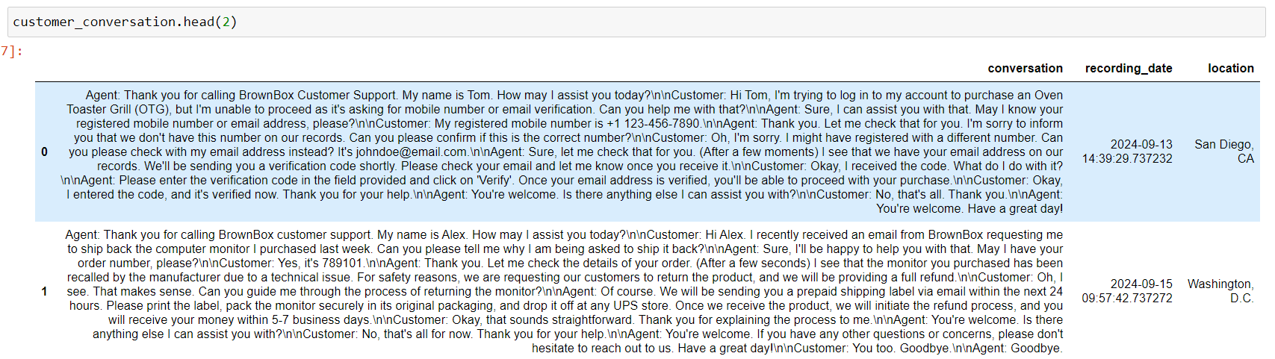
walkthrough
HuggingFace Dataset (With Synthetic data)
Contd…

Slide 14
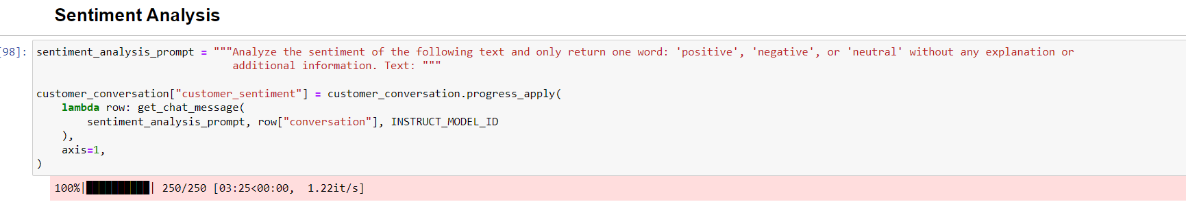
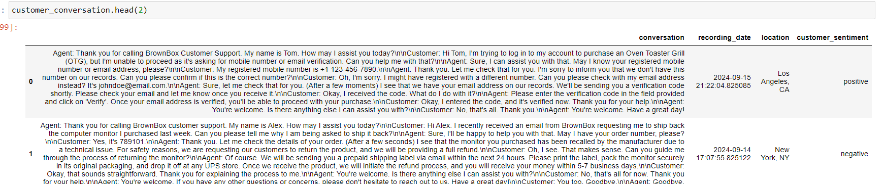
walkthrough
Sentiment Analysis (Model - granite-13b-instruct-v)
Contd…

Slide 15
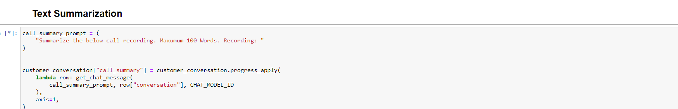
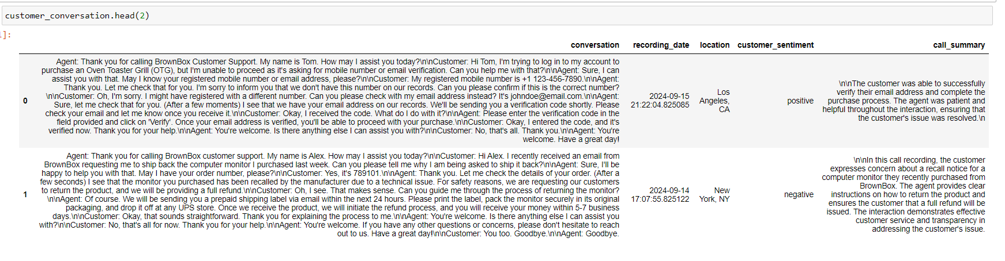
walkthrough
Text Summarization (Model - granite-13b-chat-v2)
Contd…

Slide 16
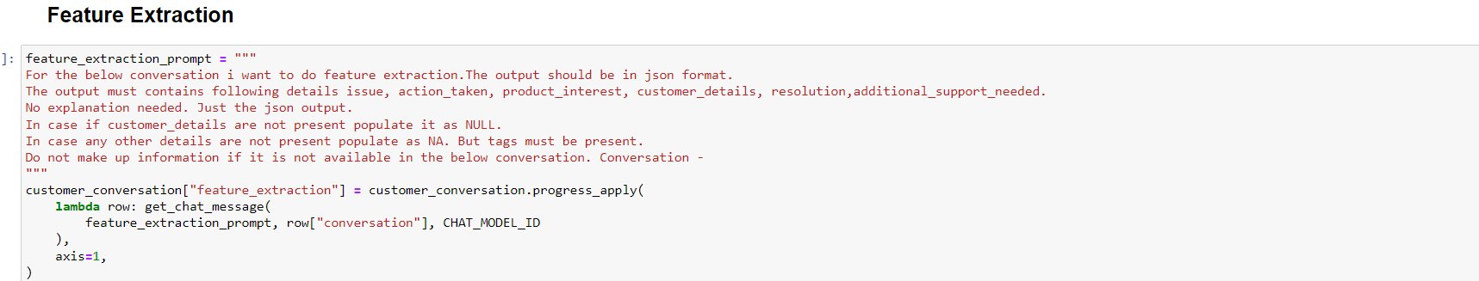
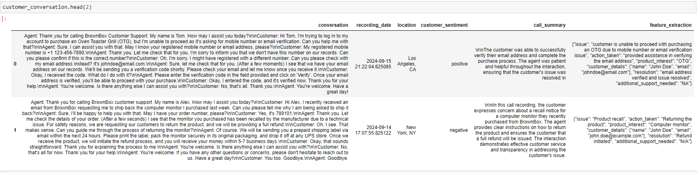
walkthrough
Feature Extraction(Model - granite-13b-chat-v2)
Contd…

Slide 17
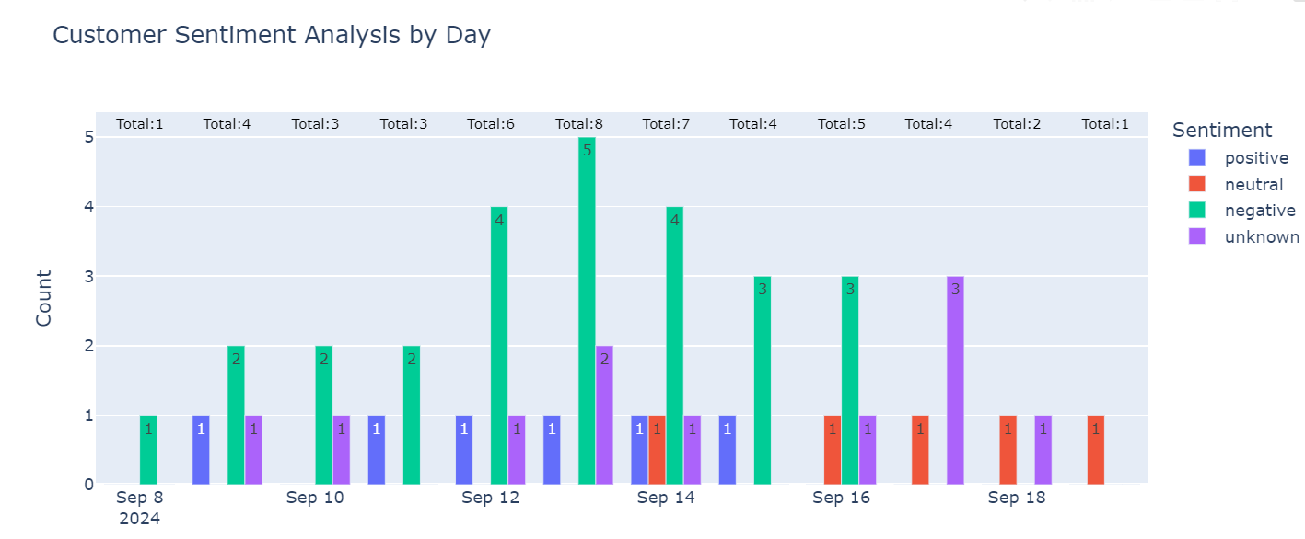
walkthrough
Customer Sentiments by Day (Plotly)
Contd…

Slide 18
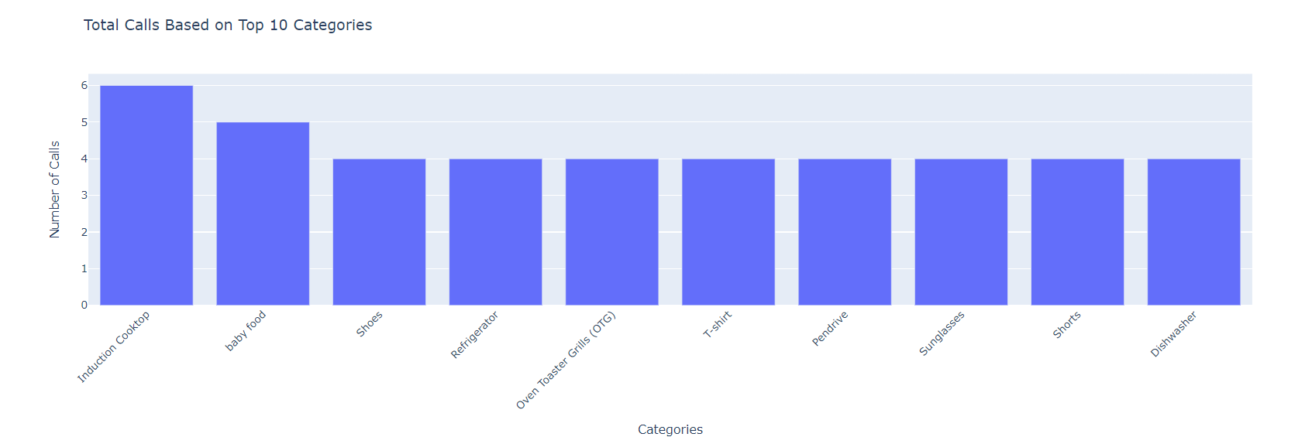
walkthrough
Top 10 User Interests (Categories) - Plotly
Contd…

Slide 19
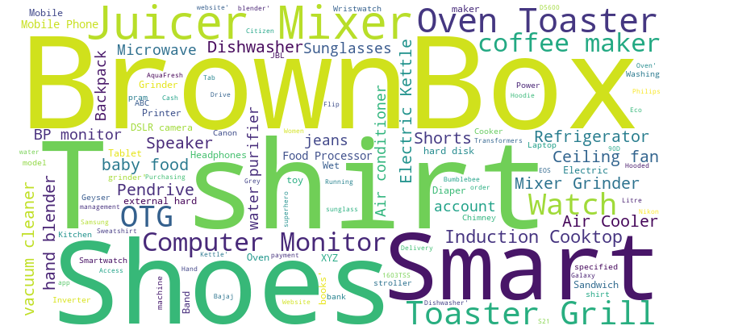
walkthrough
Word Cloud Dashboard (Plotly, Wordcloud)
Contd…

Slide 20
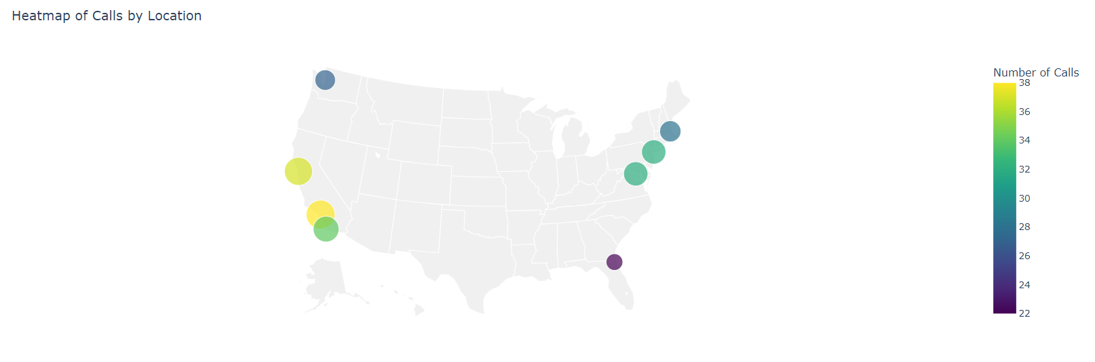
walkthrough
Location Wise call Volumes (Plotly)
Contd…

