Slide 1
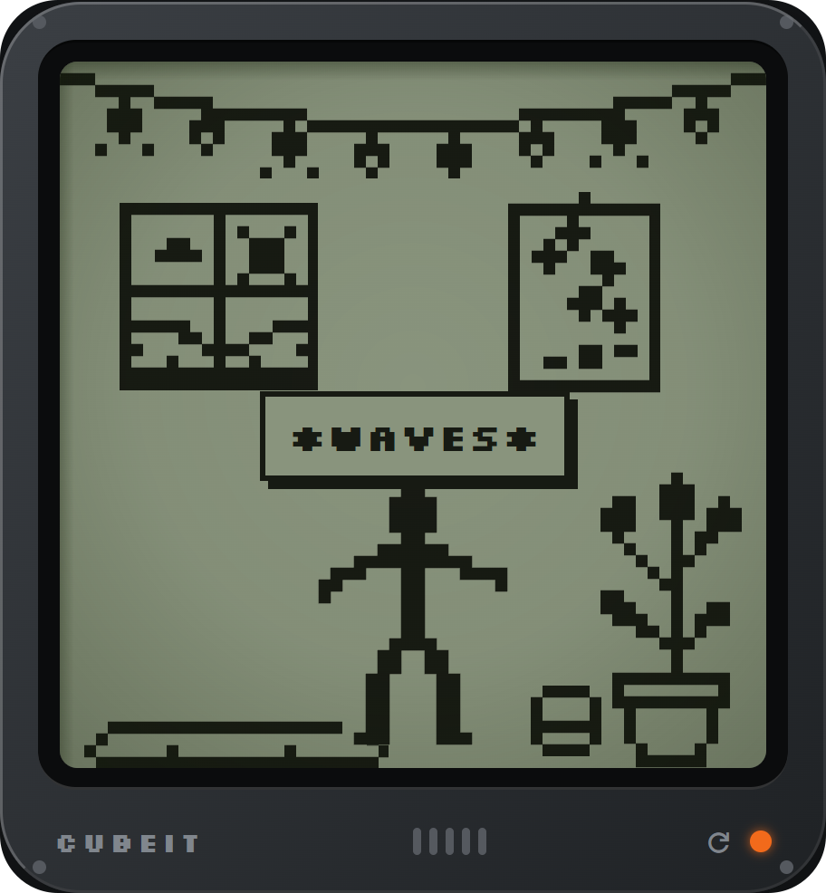


APPBUILDERSPH HACKATHON 2026 · LOCAL AI
dentist · tue 3pm
Most of life is
little things.
pay rent · fri 9am
Plans, routines, chores, and the thoughts in between. None of it is hard. There’s just a lot of it, and most of it lives in your head.
clean the bathroom · sat
cubeit
You’ve got a companion.
did I walk today?
what did I write last week?
Notes:
[0:00–0:30] HOOK
Rent's due Friday. The bathroom needs cleaning on Saturday. Did I actually go for my walk today? And what did I write last week, when things were rough?
None of this is hard. There's just a lot of it, and most of it lives in our heads.
We built Cubeit for those little things. It's a companion that helps you keep track of them, and it does that on your phone, without sending your life to a server.
→ Click to slide 2.

Slide 2
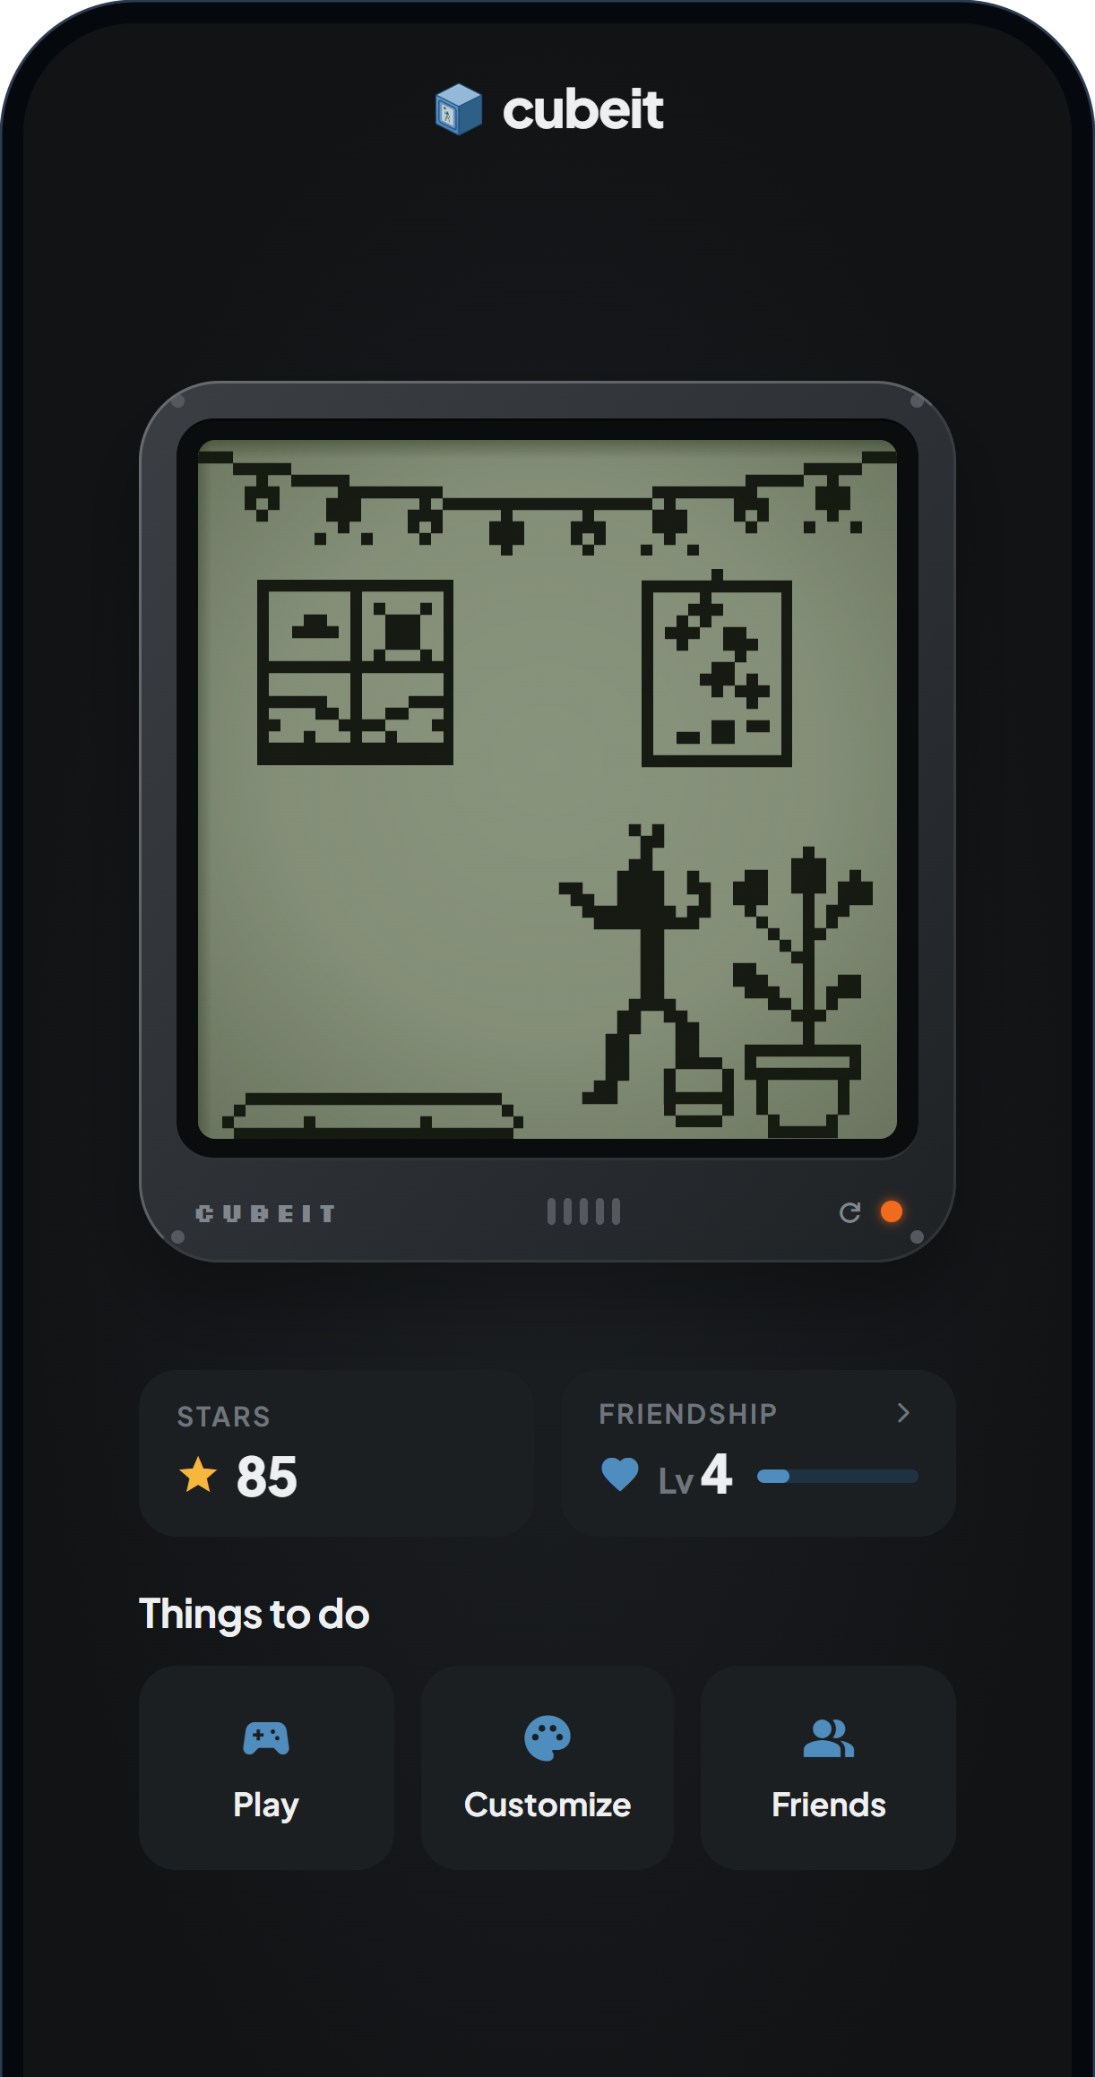
The companion makes it personal.
The assistant makes it useful.
01 MEET PIP
Pip, the companion
A pixel stickman in a little LCD room. It naps, dances and waves, and reacts when you tap it, pet it, pick it up or tilt the phone.
The assistant
Calendar, habits and routines, chores and a journal. Tell Pip what you need in plain words. It proposes, you confirm.
Where they meet
Finish a habit or a chore and Pip celebrates. You earn stars, and your friendship level grows.
Notes:
[0:30–1:10] MEET PIP
This is Pip. Pip lives in this little LCD room on your phone. It wanders around, naps, waves, plays with its ball. You can tap it, pet it, pick it up, and if you tilt the phone, it slides.
That's the companion. Underneath it is the useful part: a calendar, habits and routines, chores, and a journal.
And the two are connected. When you finish a habit or a chore, Pip celebrates and you earn stars.
So our idea is simple: the companion makes you want to open the app, and the assistant makes it worth opening.
→ Click to slide 3.

Slide 3
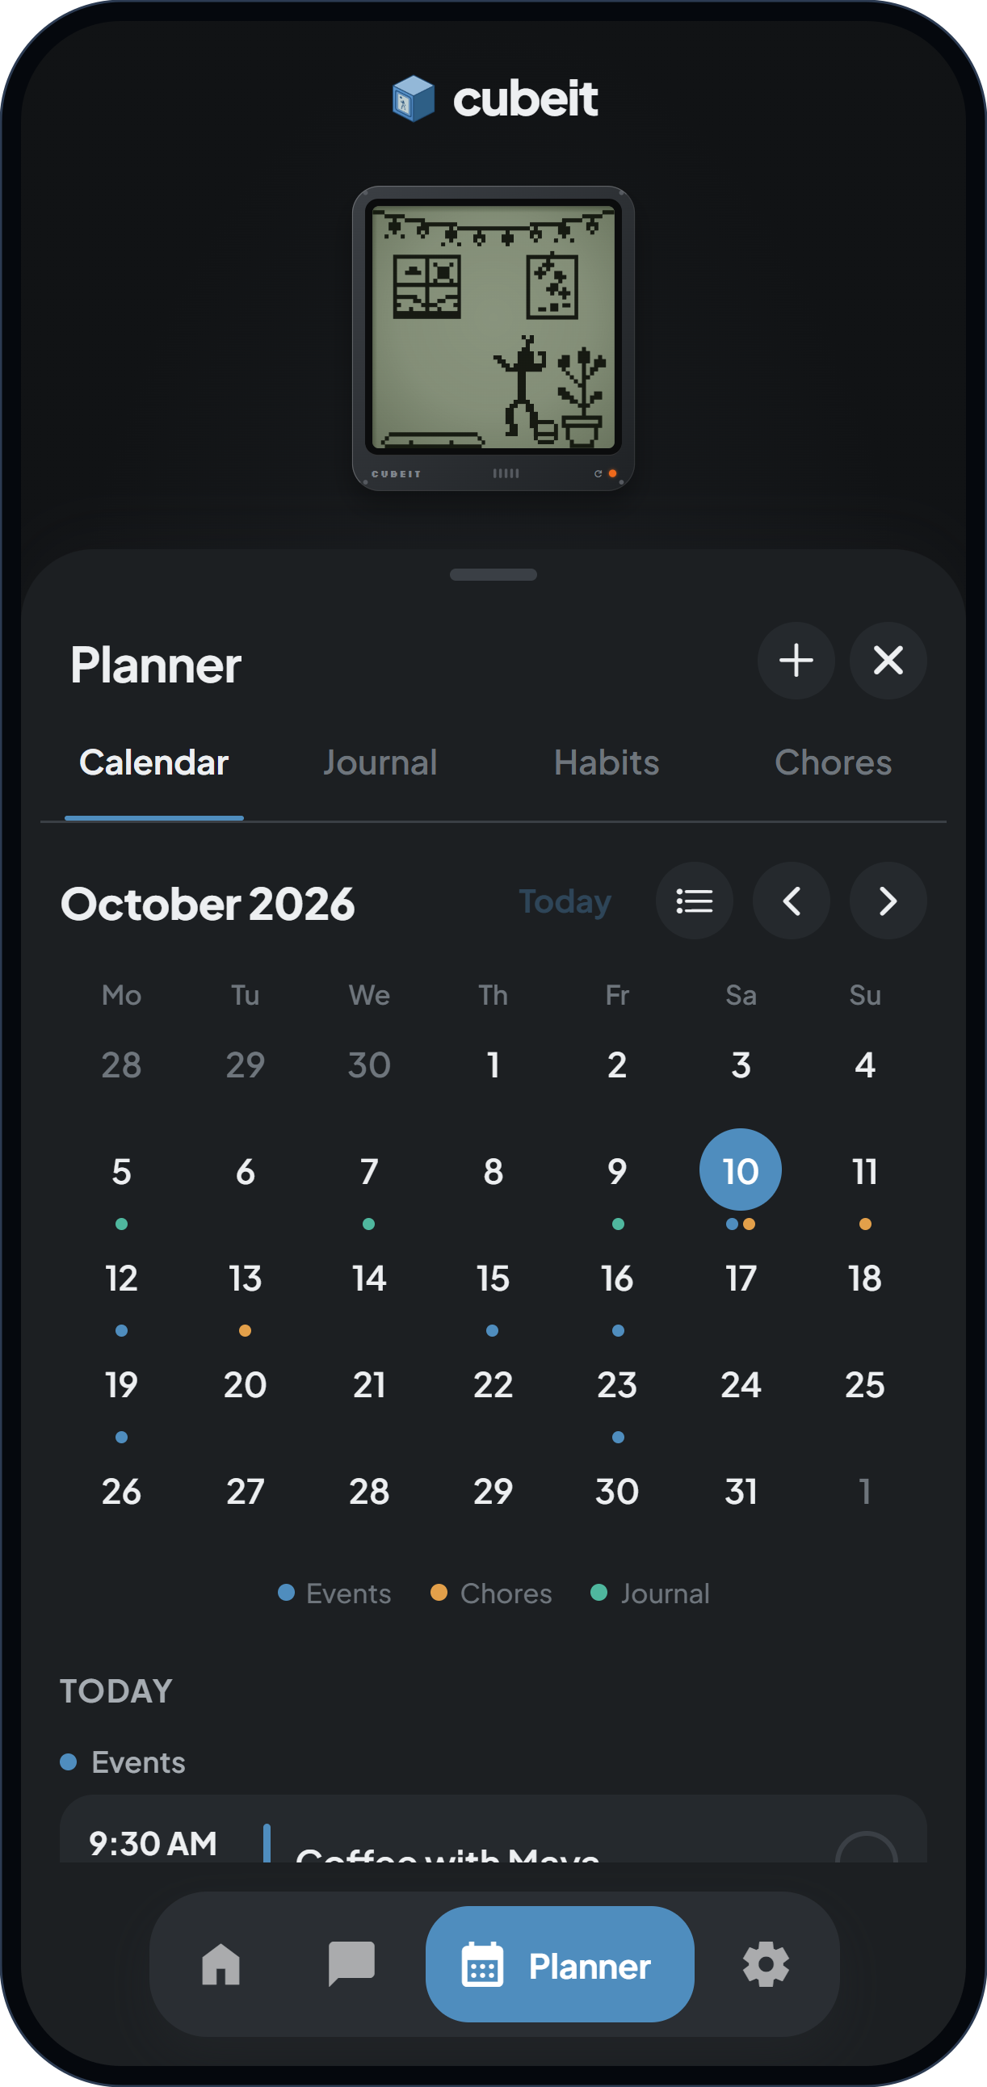
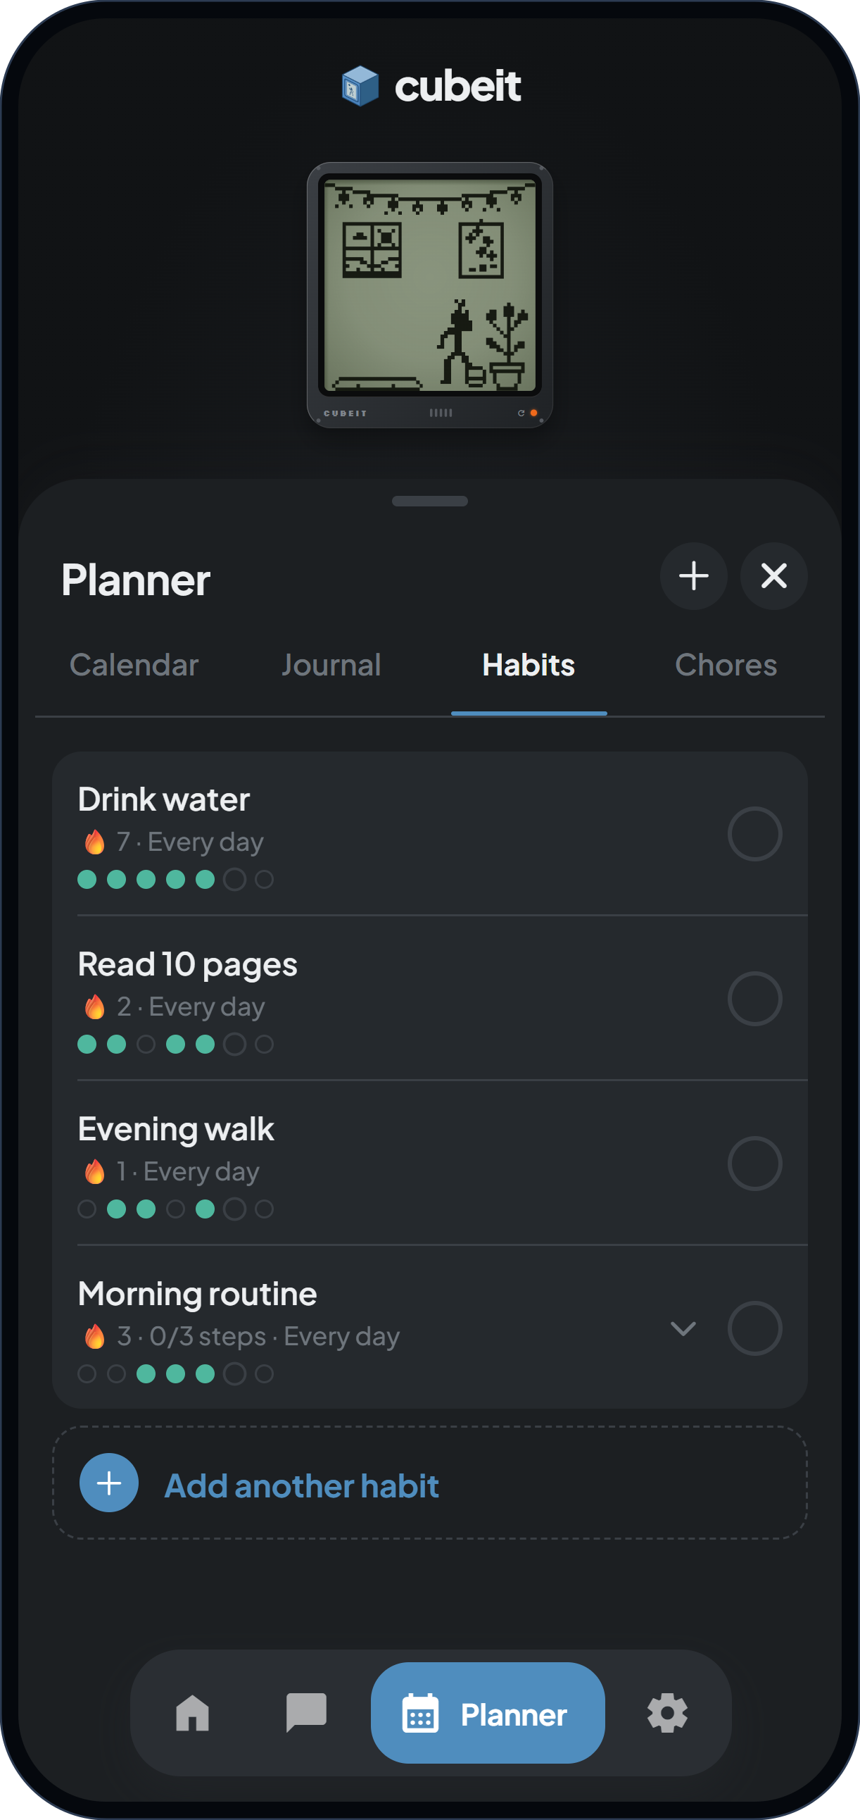
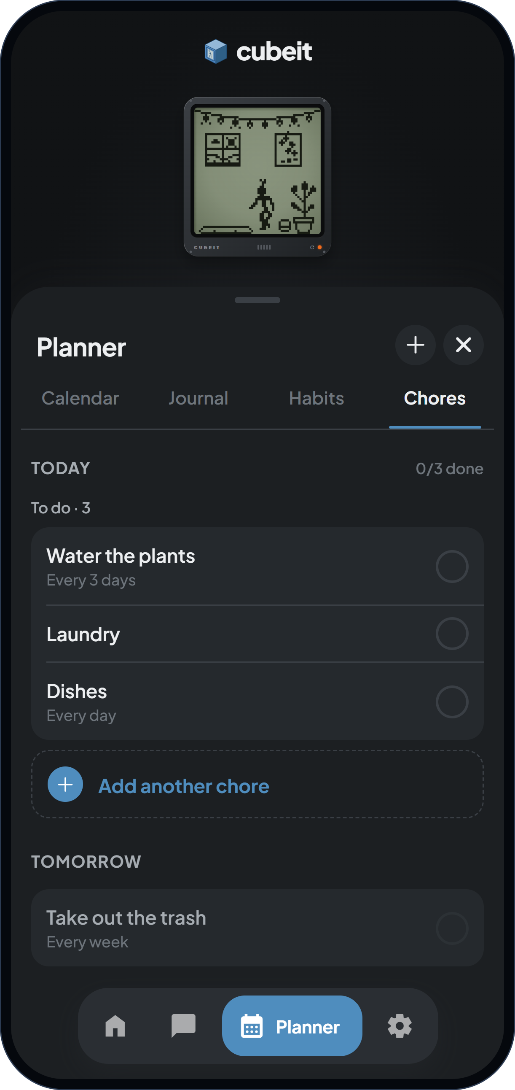
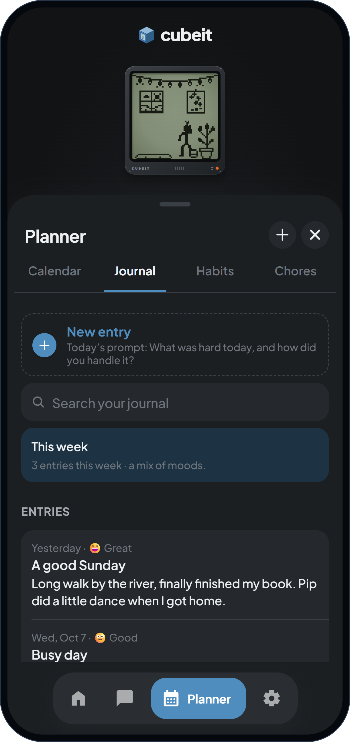
Four everyday jobs, one place
02 WHAT IT HELPS WITH
Remember what’s coming
Keep routines going
Keep the house running
Look back
Day, week and month views. Reminders on the phone.
Streaks count only the days you planned.
Due dates, repeats and checklists.
Moods, prompts, search and a weekly summary.
Notes:
[1:10–1:40] WHAT IT HELPS WITH
So what can you actually do with it? Four everyday jobs.
The calendar remembers what's coming and reminds you on the phone. Habits keep your routines going, and streaks only count the days you planned, so a rest day doesn't break them. Chores get due dates, repeats and checklists. And the journal lets you look back, with moods, prompts and search.
You can do all of that by hand. But the faster way is to just tell Pip. Let me show you.
→ Click to slide 4, then switch to the phone mirror.

Slide 4
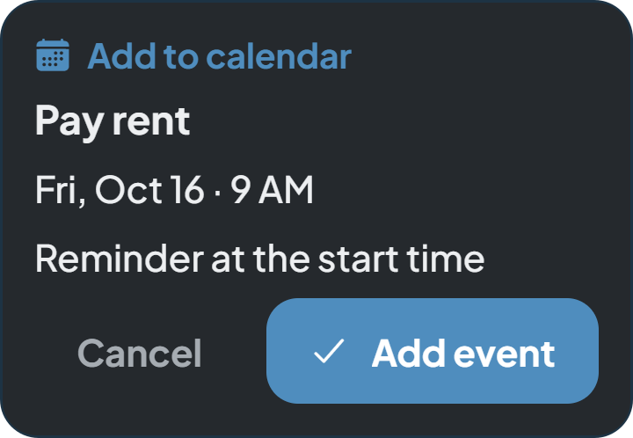
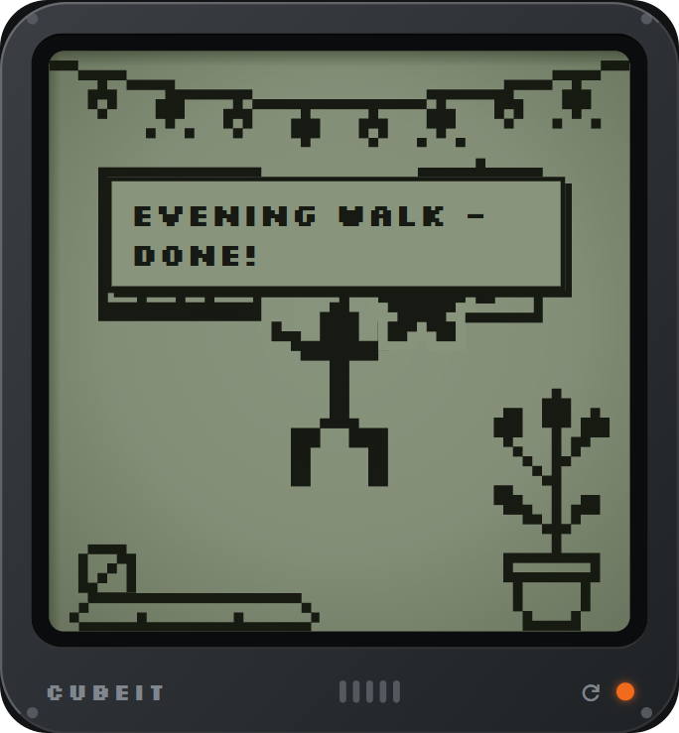
Four messages, no forms
03 LIVE DEMO
1
Remind me to pay rent on Friday at 9am
→ Calendar event with a reminder, after one tap
2
Add clean the bathroom to my chores every Saturday
→ A weekly chore
3
I finished my evening walk
Nothing is saved until you tap.
→ Habit logged. Pip celebrates. Stars earned.
4
What’s on my schedule this week?
→ Answered from your planner, nothing to confirm
Then open Planner: everything is in the calendar, chores and habits.
Notes:
[1:40–3:15] LIVE DEMO (phone mirrored; this slide is the backup)
PRE-CHECK: preview build with the model installed; Airplane Mode ON; habit "Evening walk" exists and is NOT done today; Talk opened less than 90 s ago (the model unloads after 90 s idle and when the app is backgrounded).
1. Home screen, Pip visible. Tap Talk. Point at the pill: "On-device AI." SAY: "This phone is in Airplane Mode."
Send: "Remind me to pay rent on Friday at 9am"
SAY: "I'll just tell it like I'd tell a friend." (while Pip shows the thinking dots) "That's the model running on the phone."
Card appears. SAY: "It hasn't saved anything. It shows me what it understood: Pay rent, Friday, 9 AM, with a reminder. The date comes from the phone's clock, not from the model." Tap Add event.
2. Send: "Add clean the bathroom to my chores every Saturday"
SAY: "A weekly chore." Tap Add chore.
3. Send: "I finished my evening walk" → tap Mark done.
Point at the room. SAY: "And there, Pip celebrates. My streak goes up and I get stars. That small moment is why people come back."
4. Send: "What's on my schedule this week?"
SAY: "Questions don't need a confirm. It just reads my planner."
5. Tap Planner. Calendar: Friday has a dot. Chores tab: Clean the bathroom. Habits tab: Evening walk ticked.
SAY: "Everything's there, in the normal planner."
IF THE MODEL STALLS (more than ~10 s): keep talking. If a reply is labeled "Built-in parser", say so: "That one was handled by our rule-based fallback, and the app tells you that." If a wrong card appears, tap Cancel: "This is exactly why nothing saves without a tap." Then rephrase.
→ Switch back to slides, click to slide 5.

Slide 5
Why it runs on the phone
04 LOCAL AI
Pip reads your calendar, routines and journal. That shouldn’t have to leave your phone.
01
02
03
04
05
You say it
Model reads it
App checks it
You confirm
Saved locally
Type it, or speak it. Speech-to-text runs on the phone.
Qwen2.5 0.5B on llama.rn (llama.cpp). Picks 1 of 16 intents and copies your words into a fixed JSON schema.
Dates come from the phone’s clock. Past dates are rejected. Missing details get a question.
A card shows exactly what will change.
SQLite on the phone. Rolled back if the write fails.
The model proposes. The app checks. You decide.
Internet: once
No account, no server
Honest labels
A one-time 491 MB model download, checked with SHA-256. The app makes no other network calls.
No analytics. Chats aren’t saved, only the items you confirm.
Each reply says whether the on-device model or the rule-based fallback answered.
Notes:
[3:15–4:25] WHY LOCAL
Why local? Because of what Cubeit reads: your calendar, your routines, your journal. A companion you trust with that shouldn't have to send it to someone else's server.
Here's what happens on the phone. You type, or speak, and speech-to-text runs on the device too. A small language model, Qwen 2.5 with half a billion parameters, runs through llama.cpp using llama.rn.
It doesn't answer freely. It picks one of sixteen intents and copies your words into JSON, and a schema locks the format. Then our code checks everything: it works out the date from the phone's clock, rejects dates in the past, finds the habit you meant, and asks if something's missing. Only after you tap does it save, into SQLite on the phone.
So the model proposes, the app checks, and you decide.
The internet is used once, to download the model, about 490 megabytes, checked with SHA-256. There's no account and no server. And every reply is labeled, so you always know whether the model or our rule-based fallback answered.
→ Click to slide 6.

Slide 6
cubeit
You’ve got a companion.
It keeps track of the little things, notices when you get them done, and keeps all of it on your phone.
Thank you · Questions?
Notes:
[4:25–4:50] CLOSING
Most apps either help you or keep you company. Cubeit tries to do both. It keeps track of the little things, notices when you get them done, and keeps all of it on your phone.
Cubeit. You've got a companion.
Thank you. We're happy to take questions.

