Slide 1
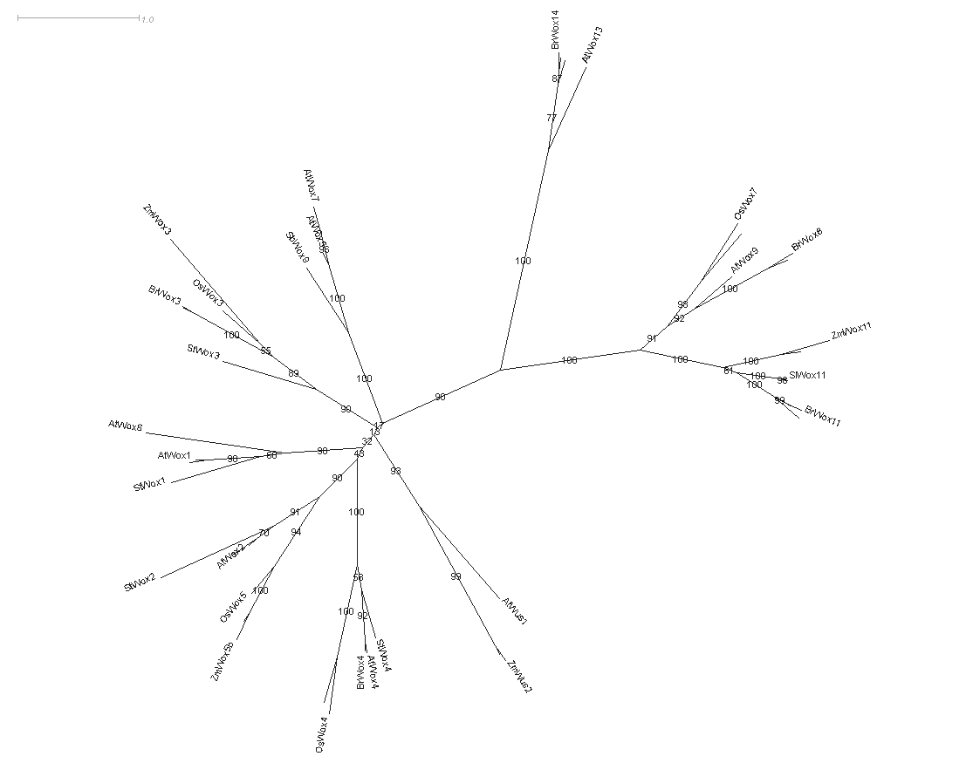
Intermediate
clade
Ancient clade
WUS clade

Slide 2
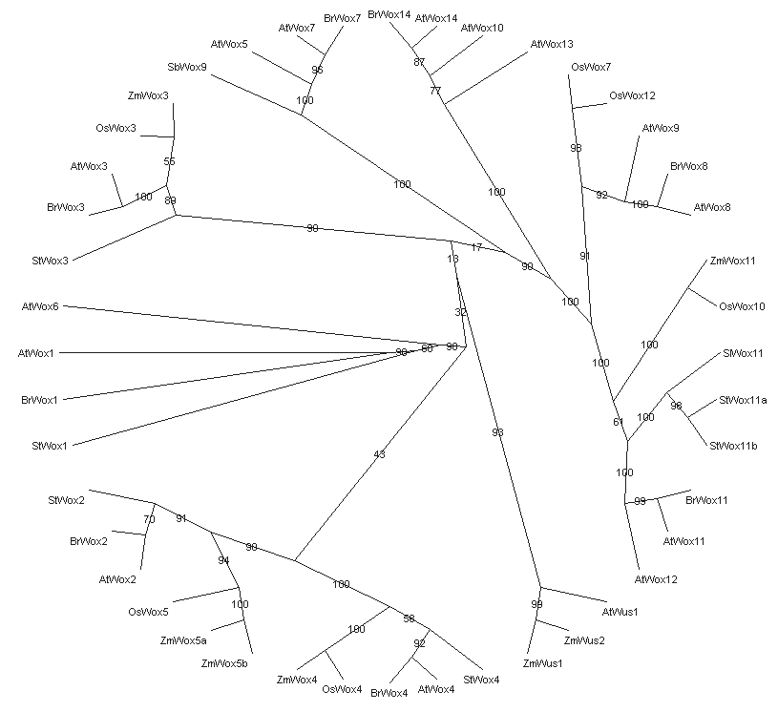
At
Br
Sl
St
Os
Zm
Sb

Slide 3
WOX family model
homeodomain

