Slide 1
Smart Revision Flashcard App - Prototype

Slide 2

LOGO + NAME
CREATE FLASHCARDS
LOGIN
SIGN UP
DESCRIPTION OF HOW IT WORKS
UPLOAD
FONT SIZE
LANGUAGE
Couple of other ideas:
Could give some examples below on how the flashcard shows or how to do it
Once loaded underneath the flashcards created will load up (animation)

Slide 3


LOGO + NAME
CREATE FLASHCARDS
LOGIN
SIGN UP
After the 10 flashcards have been read by the user, there’ll be a popup with 3 options. Summary of notes, Mini Quiz Generator, Export/Reflect.

Slide 4

LOGO + NAME
MY FLASHCARDS SETS
LOGIN
SIGN UP
CREATE A FLASHCARD
Name your flashcards
FLASHCARD

Slide 5

Smart Flashcard Generator
Turn Your Notes Into Flashcards Instantly
Upload Lecture Notes
Auto-Generate Flashcards
Review Anytime, Anywhere
Sign Up / Login
Secure AI-Powered Mobile-Ready
Ariba Naveed - 2025

Slide 6
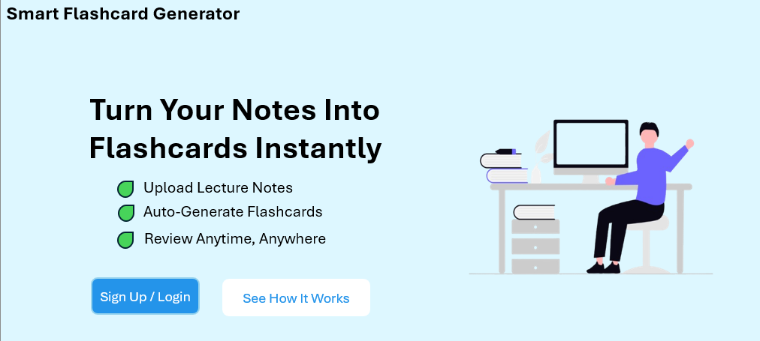
Secure AI-Powered Mobile-Ready

Slide 7
STEP 1:
UPLOAD YOUR NOTES
(PDF, DOCX, PNG)
STEP 2:
WE TURN THEM INTO FLASHCARDS!
STEP 3:
REVIEW, TEST YOURSELF, DOWNLOAD AND MANY MORE!

Slide 9
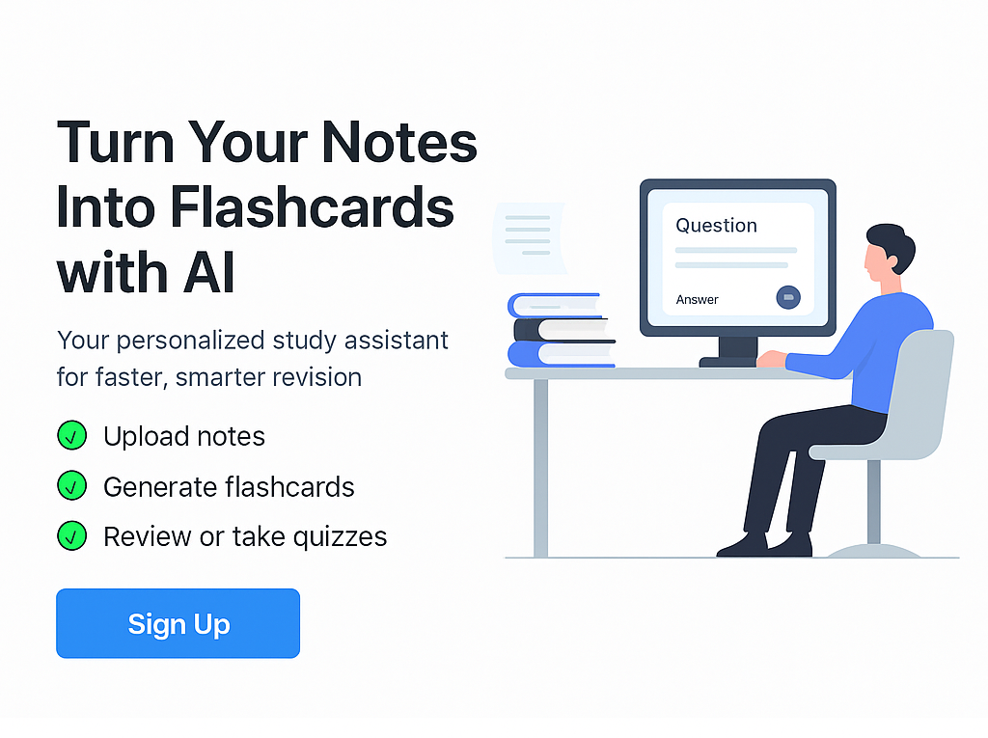

Smart Flashcard Generator
Login

Slide 10
STEP 3:
REVIEW, TEST YOURSELF, DOWNLOAD AND MANY MORE!
STEP 1:
UPLOAD YOUR NOTES
(PDF, DOCX, PNG)
STEP 2:
WE TURN THEM INTO FLASHCARDS!
REVIEW, TEST YOURSELF, DOWNLOAD AND MANY MORE!

Slide 11
STEP 1:
UPLOAD YOUR NOTES
(PDF, DOCX, PNG)

Slide 12
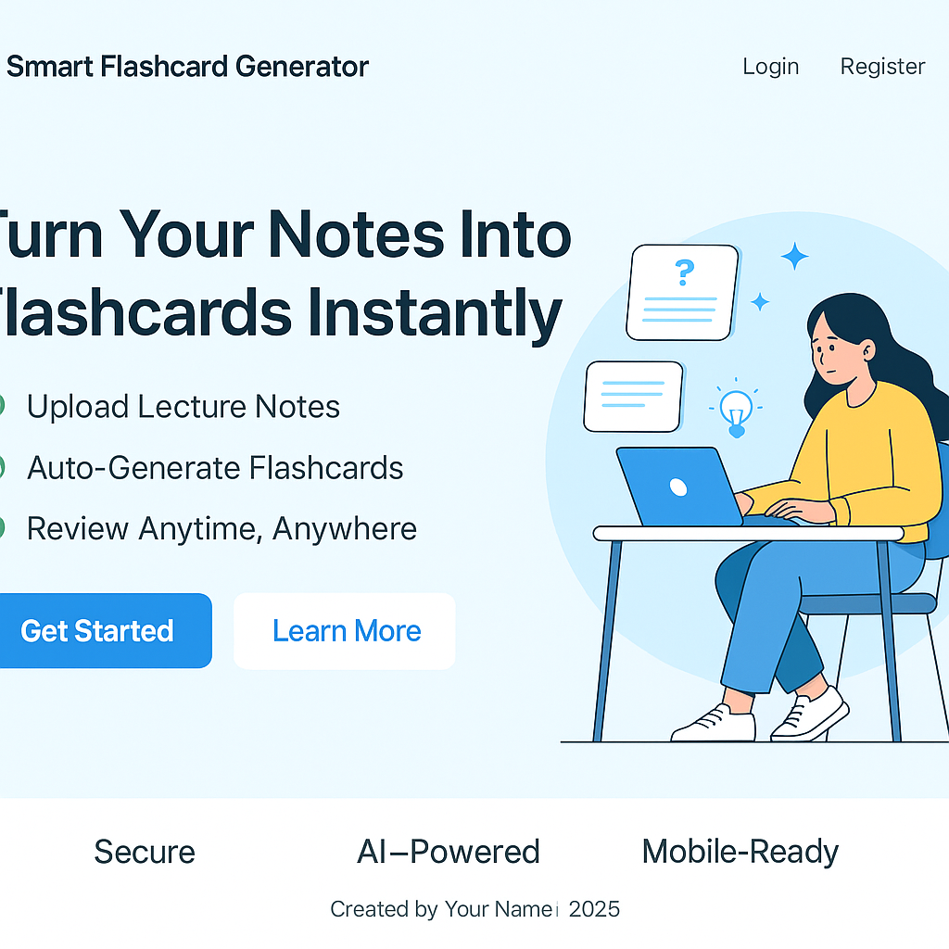
CHANGES:
Might take login/register since it has a get started box.
Learn more would be a how does it work box.

Slide 14
Getting Flask & Python Working
First, I made the layouts and set up Flask with Python. I installed the required packages through the command prompt so I could run the app on localhost:5000. Once Flask was synchronising properly with Python, I confirmed the walkthrough flow of the app was working as expected before moving onto database functionality.

Slide 15
Databases Setup with MongoDB
I decided to use MongoDB as the backend database for the prototype. At first, I had trouble getting MongoDB set up correctly on my laptop. I accidentally installed the wrong MongoDB version, but after uninstalling it and downloading the correct one, I was able to run the service and confirm it was listed in services.msc. I also had issues locating mongosh but I fixed it by downloading it separately and adding it to PATH. Once sorted, I used commands like use flashcarddb and db.users.find() to inspect my registered users in the database.

Slide 16
User Authentication
Th login and registration system was implemented early on. Passwords are hashed using Python before being saved to the database. Once logged in, users are greeted with a dashboard offering two main options: create a flashcard or log out. This ensured a secure and simple entry point the app for each user.

Slide 17
Manual Flashcard Creation
I started with manual flashcard creation (typing in a question and answer) as a way to test database interaction. Although my final goal is to upload lecture notes and use NLP to generate flashcards, starting manually helped me ensure all logic worked properly. The flashcards get saved into the MongoDB database under the logged-in user’s ID, with relevant fields like question, answer, and a future plan to add created timestamp, subject and language.

Slide 18
Flashcard Sets Problem
I initially ran into issues when trying to selecta flashcard creation. No sets were available to choose from, even though they should’ve been fetched. This led to errors where flashcards couldn’t be created. After investigating, I discovered it was an issue with the display logic or query not refreshing correcting after new sets were created. I confirmed the sets existed in the database, so this was a frontend refresh issue to fix later.

Slide 19
Improvements to Viewing Flashcards
Once flashcards sets are working, I used Jinja2 with Flask to dynamically display the available sets and flashcards for each user. This allowed users to pick from their existing sets, create new ones, and view flashcards within each. Jinja2 worked well for backend logic without needing to hardcode the front-end display. The user ID ensured each set and card belonged to the correct person.

Slide 20
Upload Notes Feature Begins
With the basic flashcard system working, I started building the “Upload Notes” feature – a key part of my project’s long-term plan. The goal is for users to upload lecture notes (PDF, DOCX or TXT) and generate flashcards automatically using NLP. Initially, I tested the file upload system and preview generation before actually saving anything.

Slide 21
Upload Notes – Backend Logic
I created an HTML form to allow uploads of .pdf, .docx, and .txt files. On the backend, I checked the file extension, saved it to an uploads/ folder, and processed it with a simple NLP script. This extracted text was split into basic questions/answer format based on sentence patterns, such as lines that started with “What” or “When”. For PDFs, I used the Fitz (PyMuPDF) module. I added a preview page using the /preview-generated-flashcards route to show generated flashcards before saving them.

Slide 22
Previewing Generated Flashcards
When users upload their notes, the system processes them and shows a list of flashcards as a preview. These are not immediately saved – the idea was to validate file handling, content extraction, and NLP logic. This confirmed the end-to-end process was working from upload -> processing -> previewing flashcards. I also fixed a small bug in Jinja2 where I was trying to use len() on a zip object, which needed to be wrapped in list().

