Slide 1
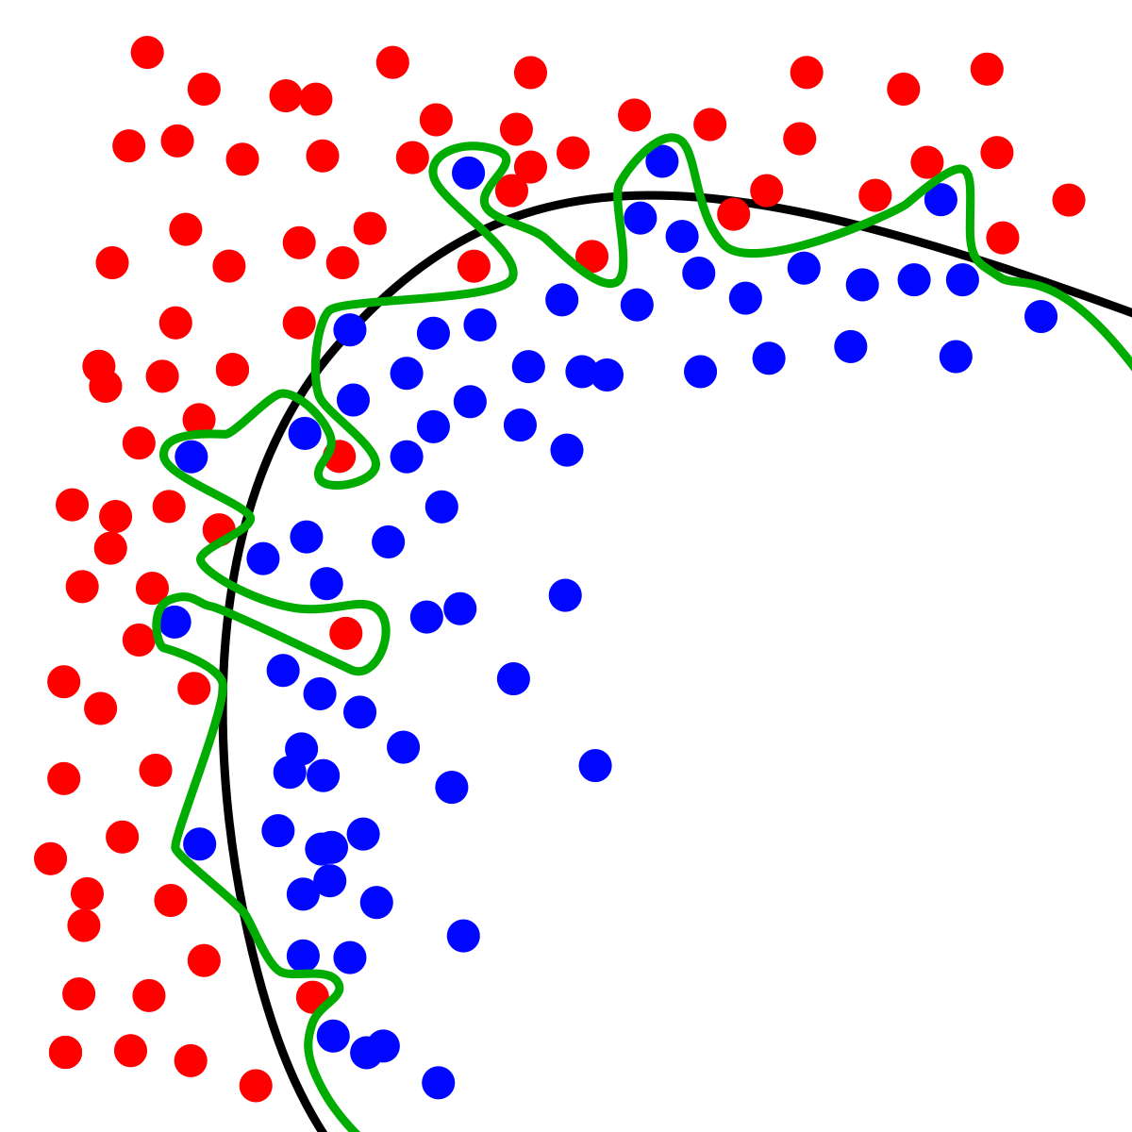
Dynamic Systems Thinking for
Psychologists
Michael E. Aristodemou
michael.aristodemou@psychologie.uzh.ch
Lecture 7: Time-Independent Predictors

Slide 2
If we choose the wrong model, what difference does it make?

Slide 3





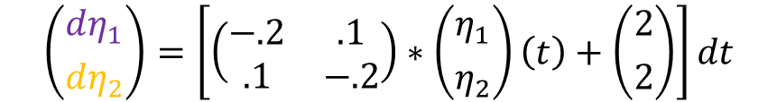
Let’s take Albert and the Rabbit to the lab
$$\left({dη_{1} \atop dη_{2}}\right)=\left[\left(\begin{matrix}−.2 & .1 \\ .1 & −.2\end{matrix}\right)∗\left({η_{1} \atop η_{2}}\right)\left(t\right)+\left({2 \atop 2}\right)\right]dt$$

Slide 4
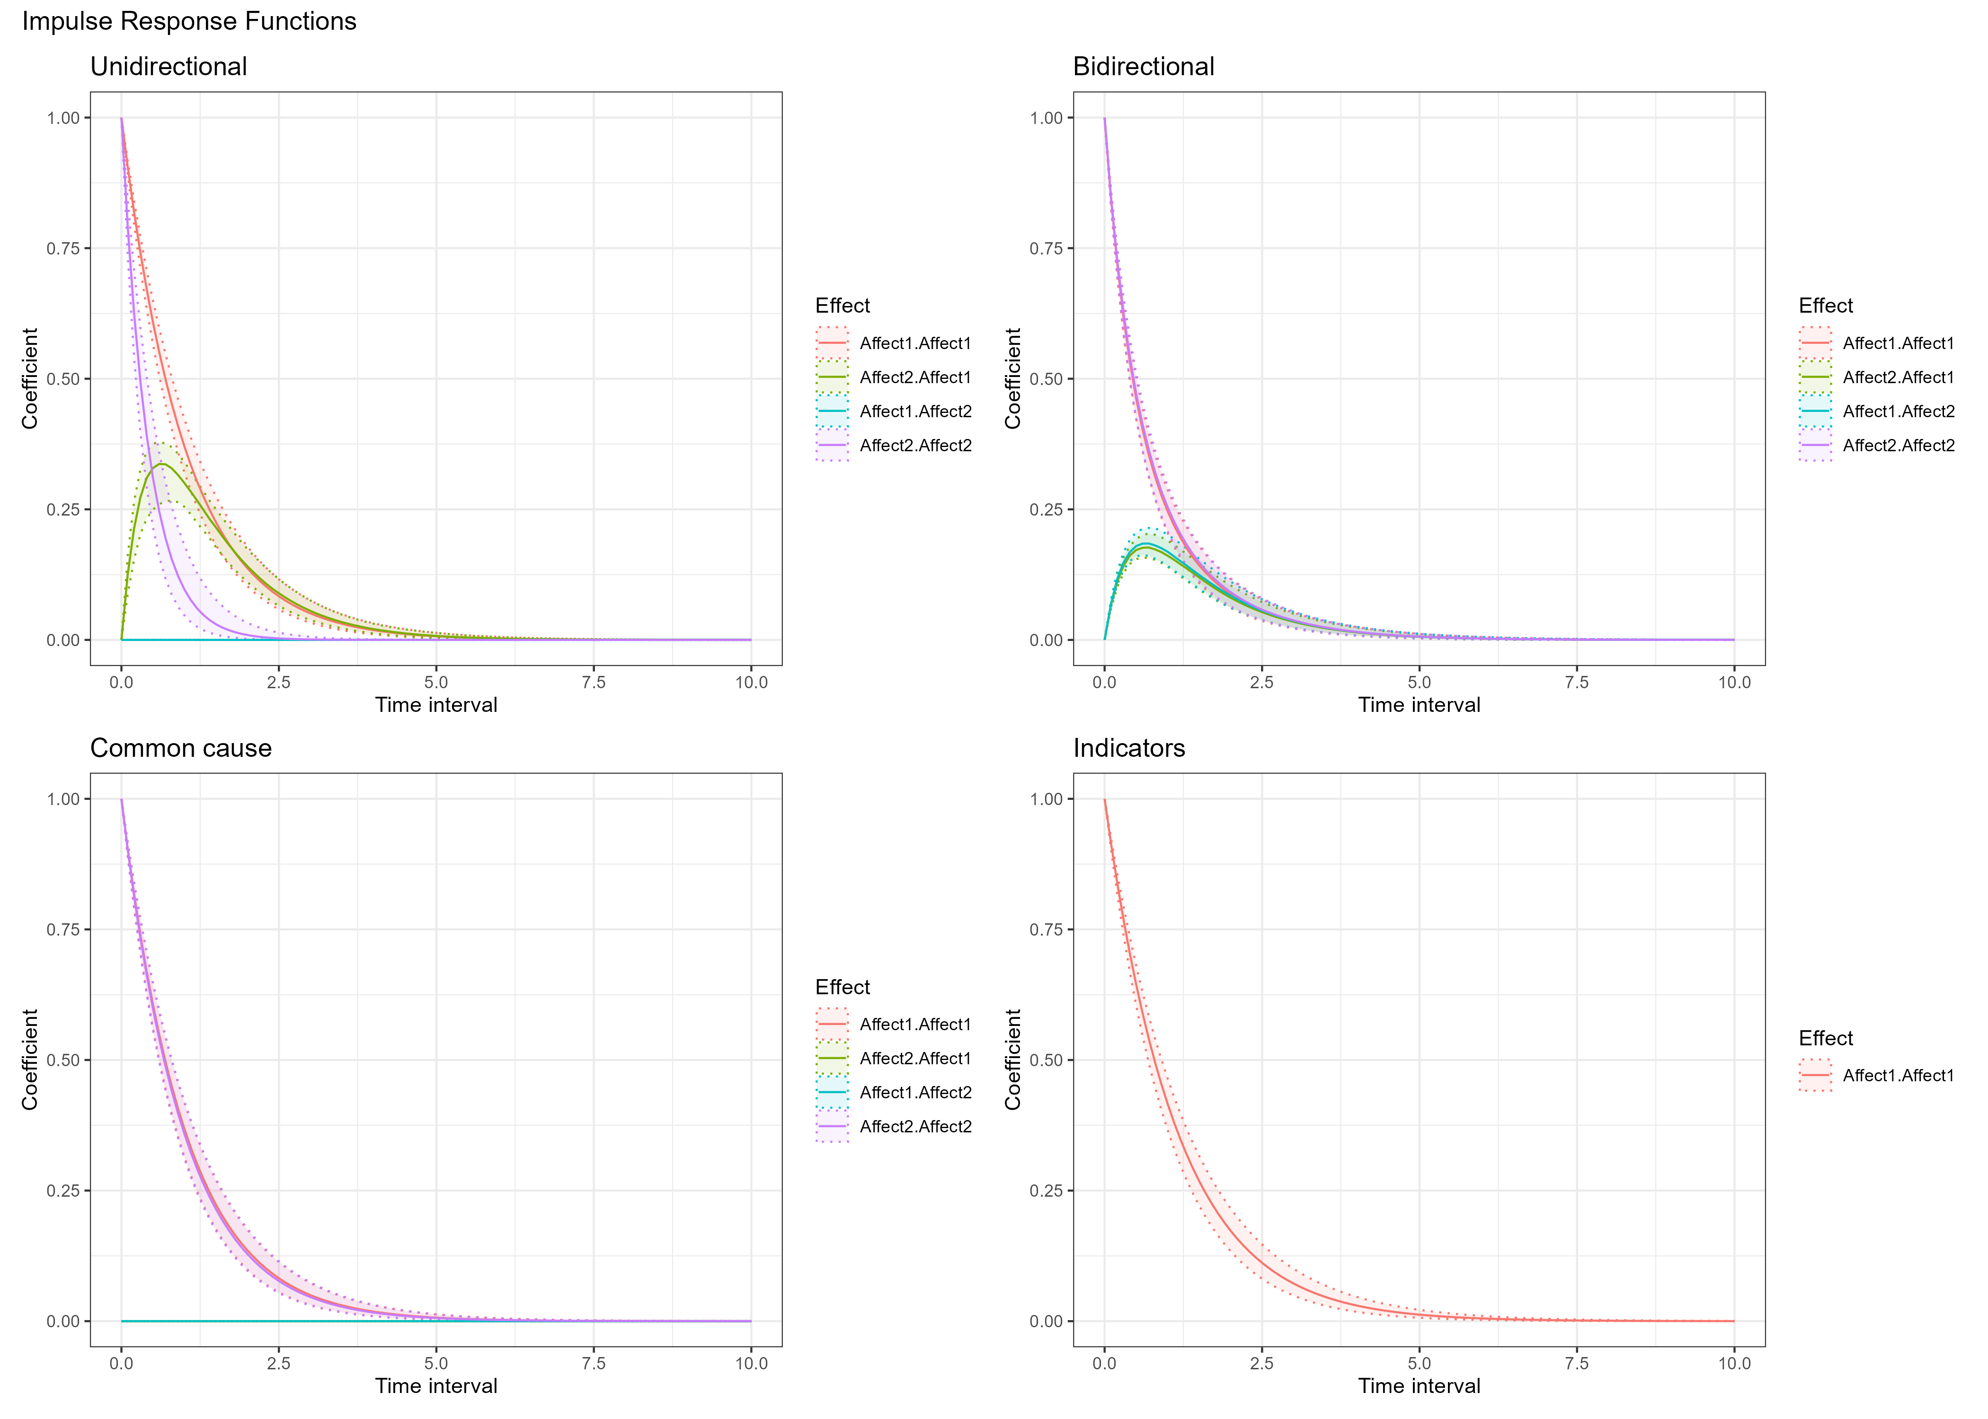
Let’s do a small experiment

Slide 5
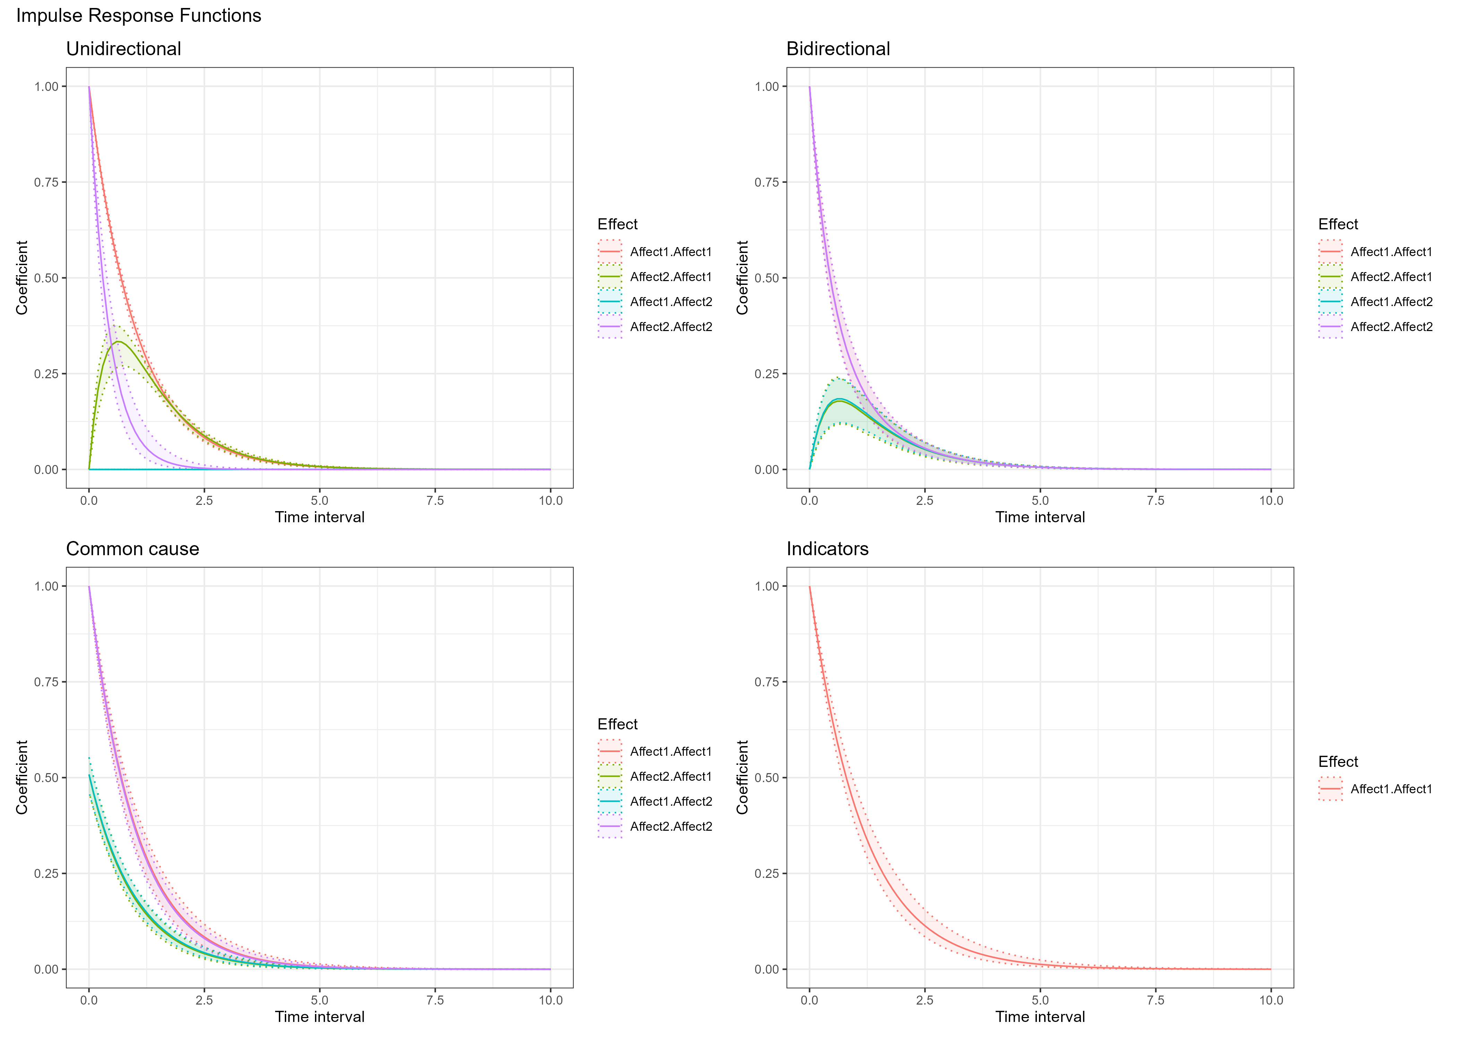
Let’s observe

Slide 6
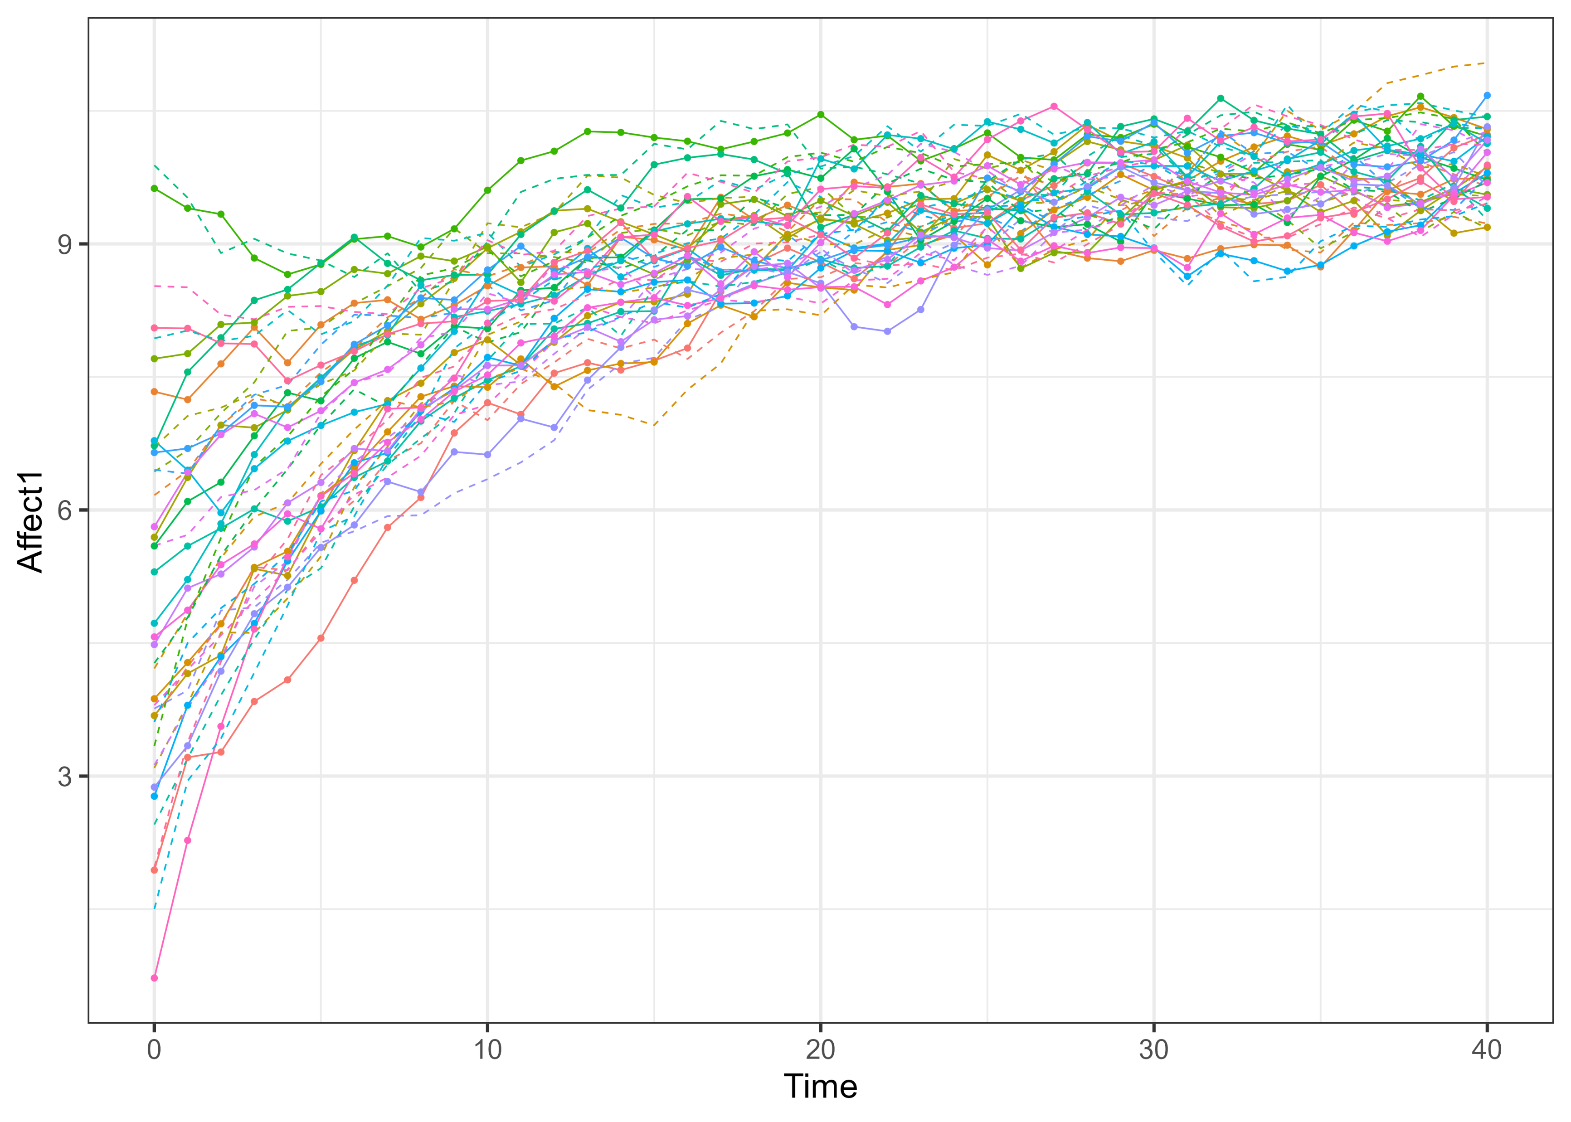
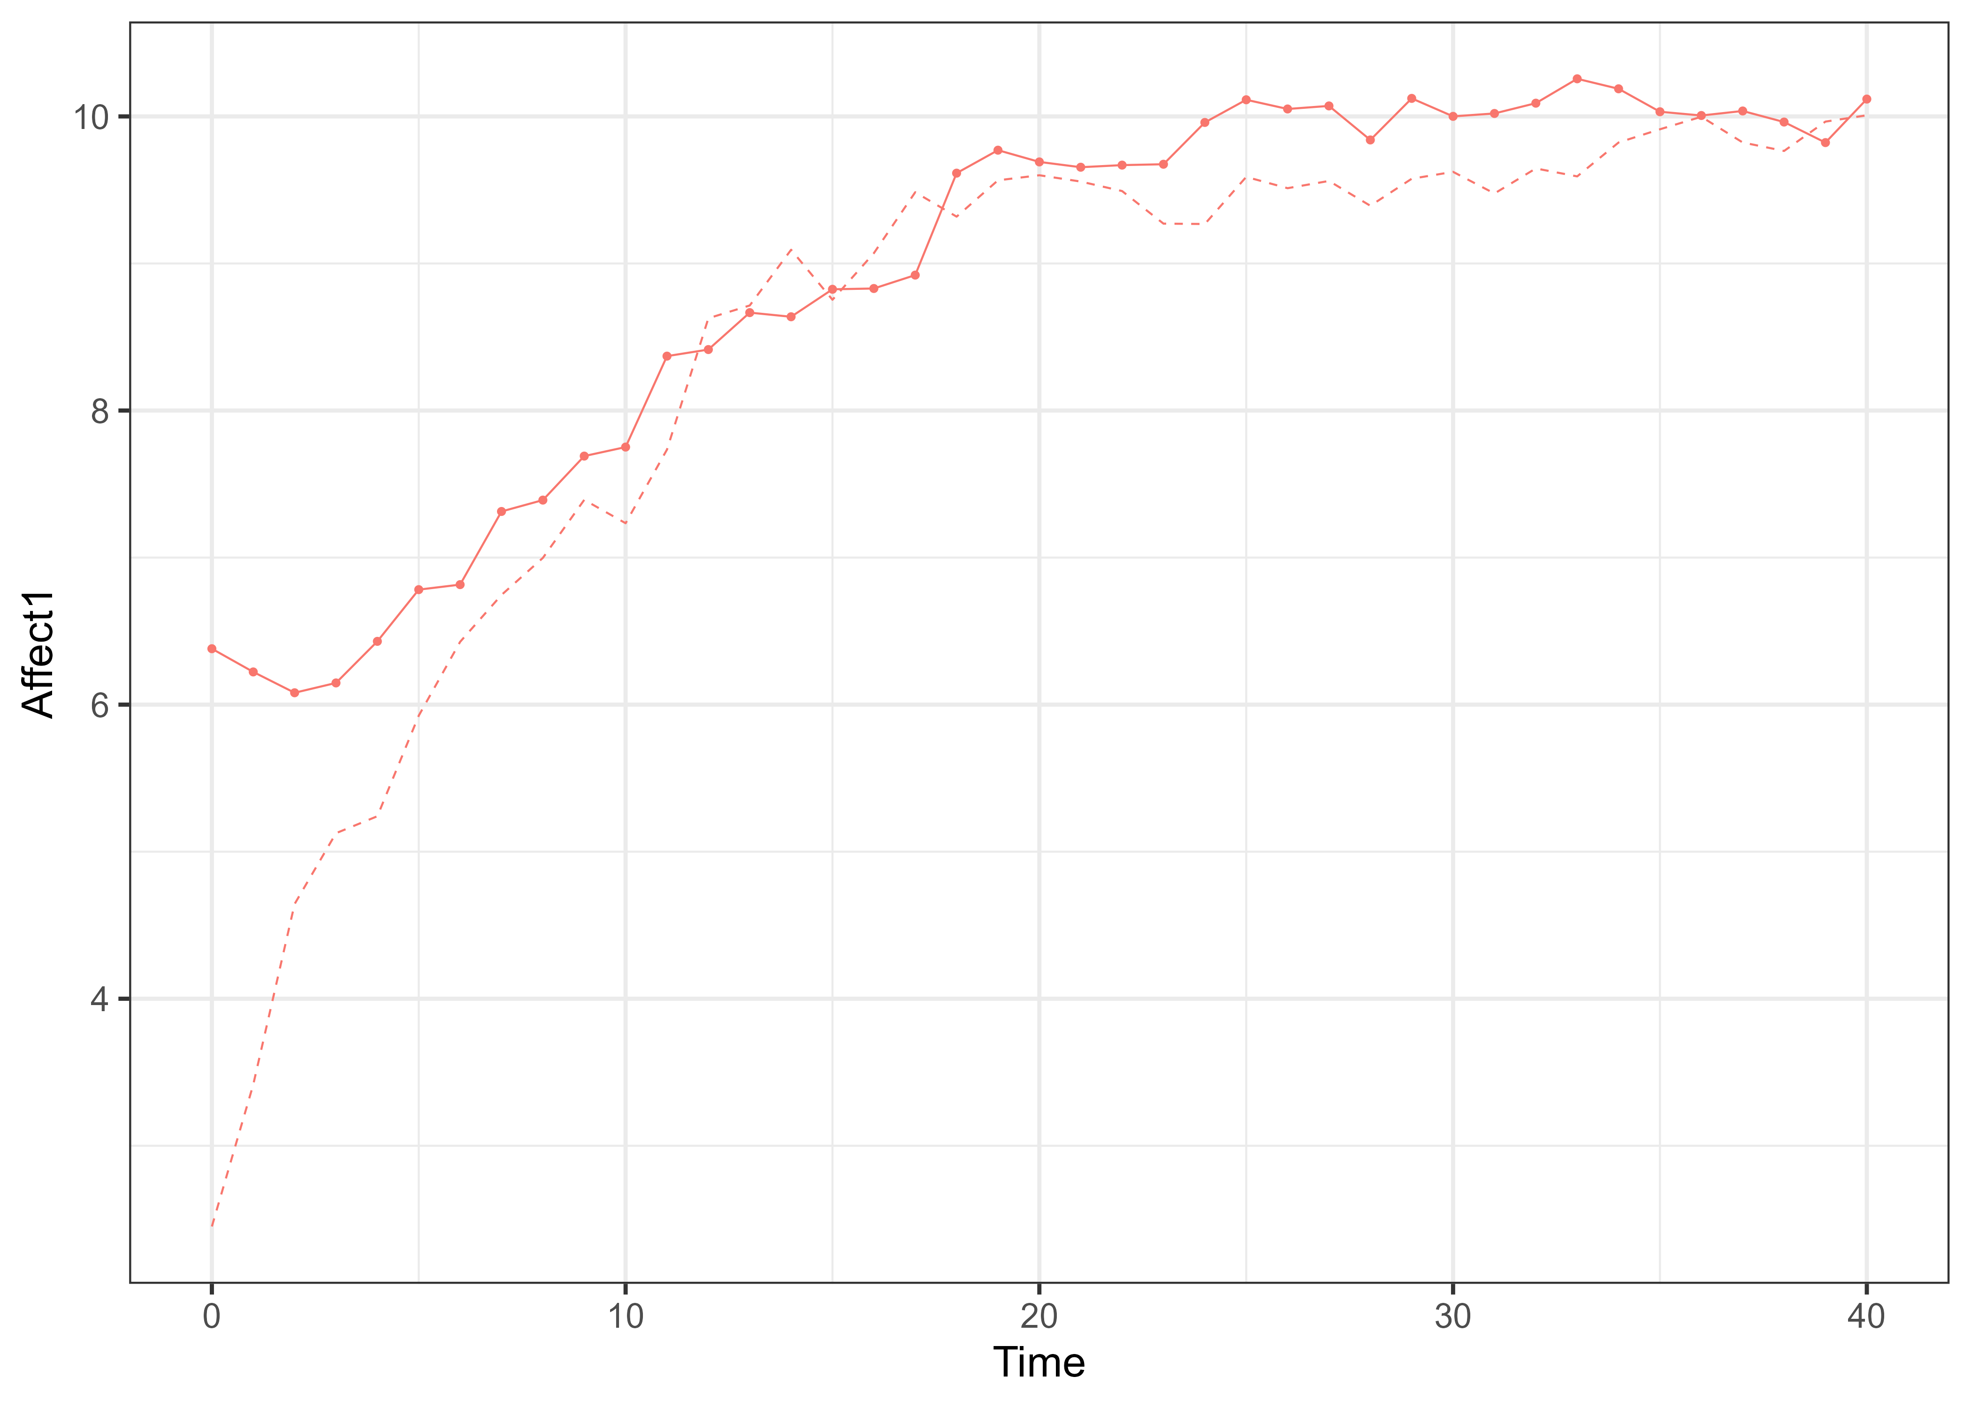
Back to our model: but with more people

Slide 7

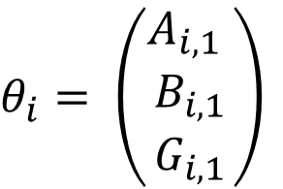
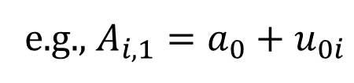
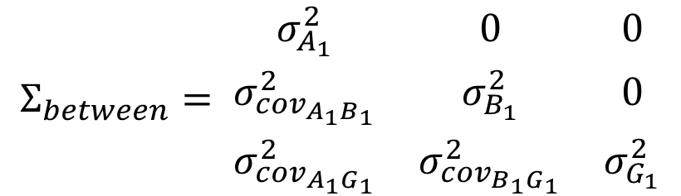
So far, we assumed everyone has the same dynamics
$$dη_{1}=\left(A_{1}η_{1t}+B_{1}\right)dt+G_{1}dW_{1}t$$
$θ_{i}= \left(\begin{matrix}A_{i,1} \\ B_{i,1} \\ G_{i,1}\end{matrix}\right)$
$$Σ_{between}= \begin{matrix}σ_{A_{1}}^{2} & 0 & 0 \\ σ_{{cov}_{A_{1}B_{1}}}^{2} & σ_{B_{1}}^{2} & 0 \\ σ_{{cov}_{A_{1}G_{1}}}^{2} & σ_{{cov}_{B_{1}G_{1}}}^{2} & σ_{G_{1}}^{2}\end{matrix}$$
e.g., $A_{i,1}=a_{0}+u_{0i}$
$$θ_{i}\sim N(θ, Σ_{between})$$

Slide 8

So far, we assumed everyone has the same dynamics
$$dη_{1}=\left(A_{1}η_{1t}+B_{1}\right)dt+G_{1}dW_{1}t$$
$θ_{i}= \left(\begin{matrix}A_{i,1} \\ B_{i,1} \\ G_{i,1}\end{matrix}\right)$
$$Σ_{between}= \begin{matrix}0 & 0 & 0 \\ 0 & 0 & 0 \\ 0 & 0 & 0\end{matrix}$$
e.g., $A_{i,1}=a_{0}+u_{0i}$
$$θ_{i}\sim N(θ, Σ_{between})$$

Slide 9
We can allow subjects to vary in all, or some, dynamics

Slide 10
Where do these individual differences come from?

Slide 11
Let’s add more information

Slide 12



Adding observed sources of individual differences

Slide 13
Time-Independent Predictors
Add a constant, person-specific*, value to the coefficient of a parameter
$${A_{1}}_{i}=A_{0}+TIPRED_{i}∗β+{τ_{0}}_{i}$$

Slide 14
Spending more time together leads to stronger coupling
Go to GitHub → Lecture7 → TI_couple_W7.R
Find out how the moderation is implemented in the R code
Increase the tendency of couples to achieve a similar affect by the end of therapy
Add therapist quality as a continuous time-independent moderator of B1 and B2

Slide 15
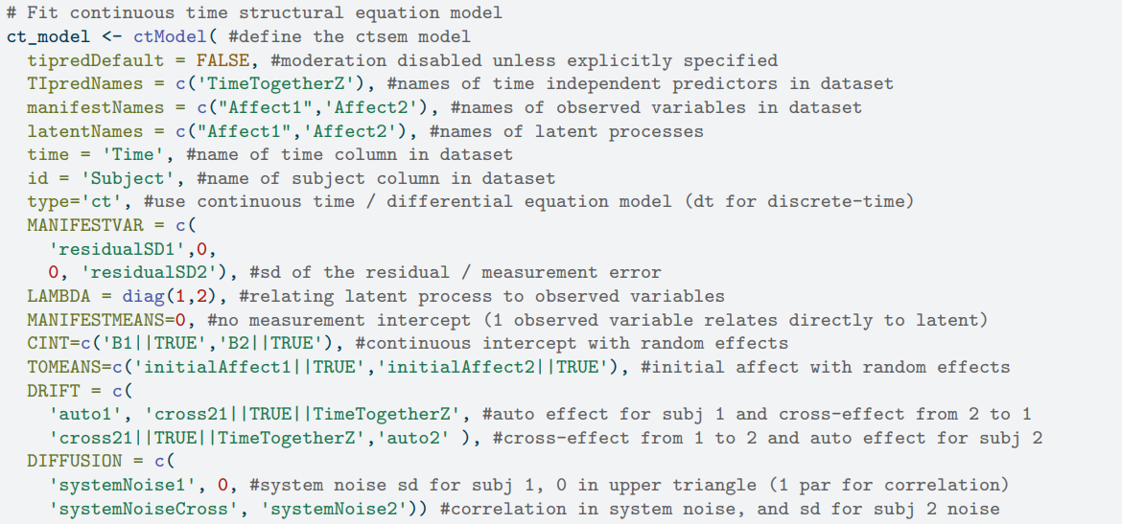
How to fit a model in ctsem

Slide 16
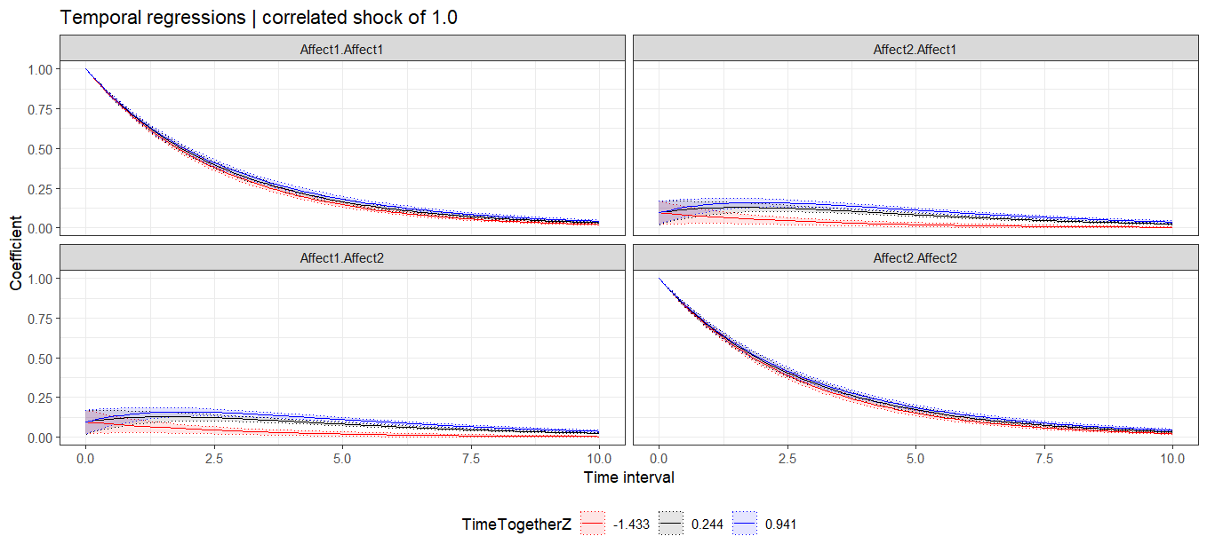
Seeing the moderation

Slide 17
Group exercise (~20 minutes)
Part 1: Formalize your process
Form your groups
Make a boxes and arrows sketch of the system of variables you think affects your psychological process of interest
Write the equation that determines the rate of change in your process (if you are not sure about the exact equation, use words)
Guiding questions:
Why are you creating a model of this process(es)?
Which factors affect your process?
Which factors are relevant to consider for you aim?

Slide 18


Let’s discuss (rest of the time)
Interview the other group about their model
Try to understand what they are doing
Find out how you could use their model if you were a practitioner, scientist, or just a curious human
Offer suggestions if you have them (but first ask questions!)

Slide 19
Thank you for listening ☺

