Slide 1
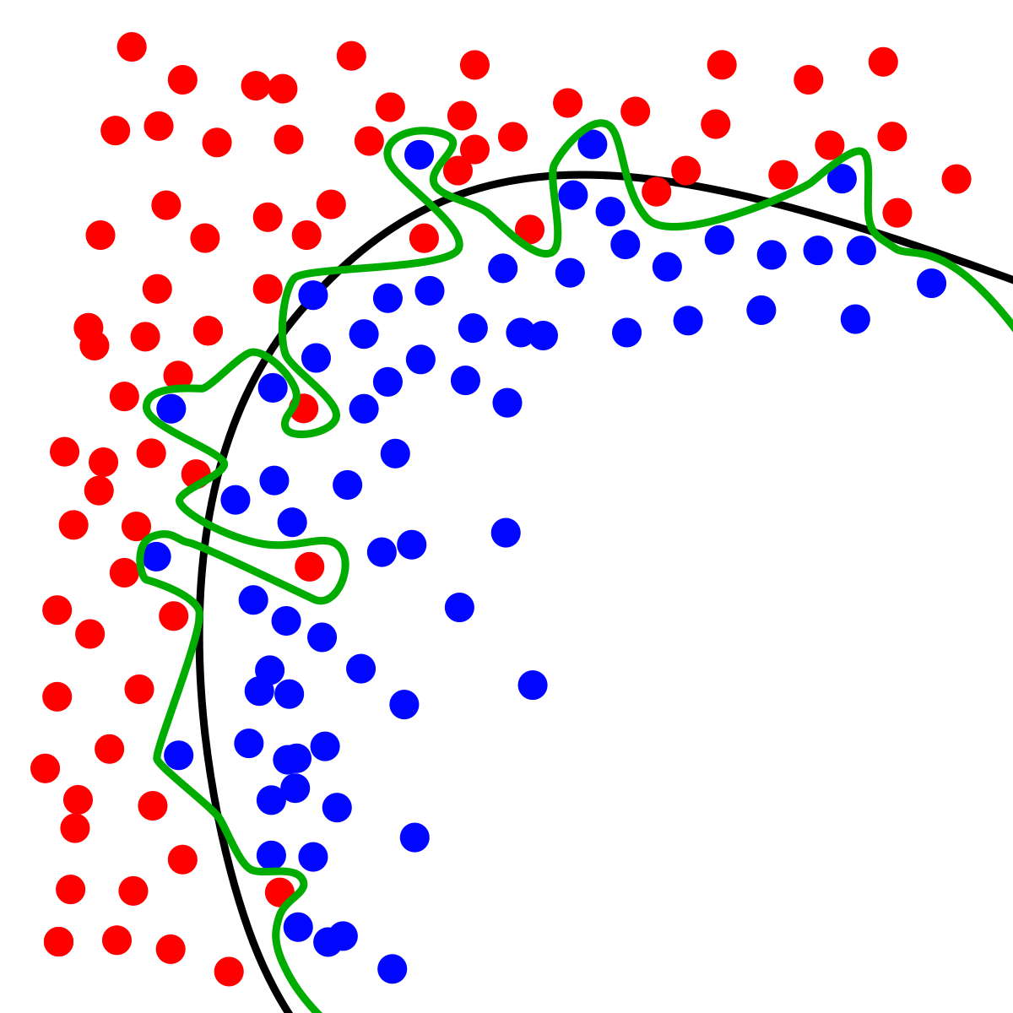
Dynamic Systems Thinking for
Psychologists
Michael E. Aristodemou
michael.aristodemou@psychologie.uzh.ch
Lecture 2: General Linear Model

Slide 2
We have (now not so little) Albert going to therapy
We did a diagnostic interview and found the main complaint to be mood.
21 weeks of therapy.
We need to set up a study to find out more information about his progress.
What do we need?
Notes:
Give students examples of ideas: (1) variables; (2) measurement occasions; (3) populations; (4) design; (5) interventions; (6)

Slide 3
Great ideas, but we don’t have money…
Measures: affect (continuous scale; 0 - 100)
Time interval: once every 7 days at 12:00 p.m.

Slide 4
We need to convince people to give us money

Slide 5
Let’s imagine the shape of change
Affect
Week

Slide 6
The simplest model of change?

Slide 7
Simulate data from a linear regression
21 observations
A slope, intercept, and error
Use a for loop
1 person

Slide 8
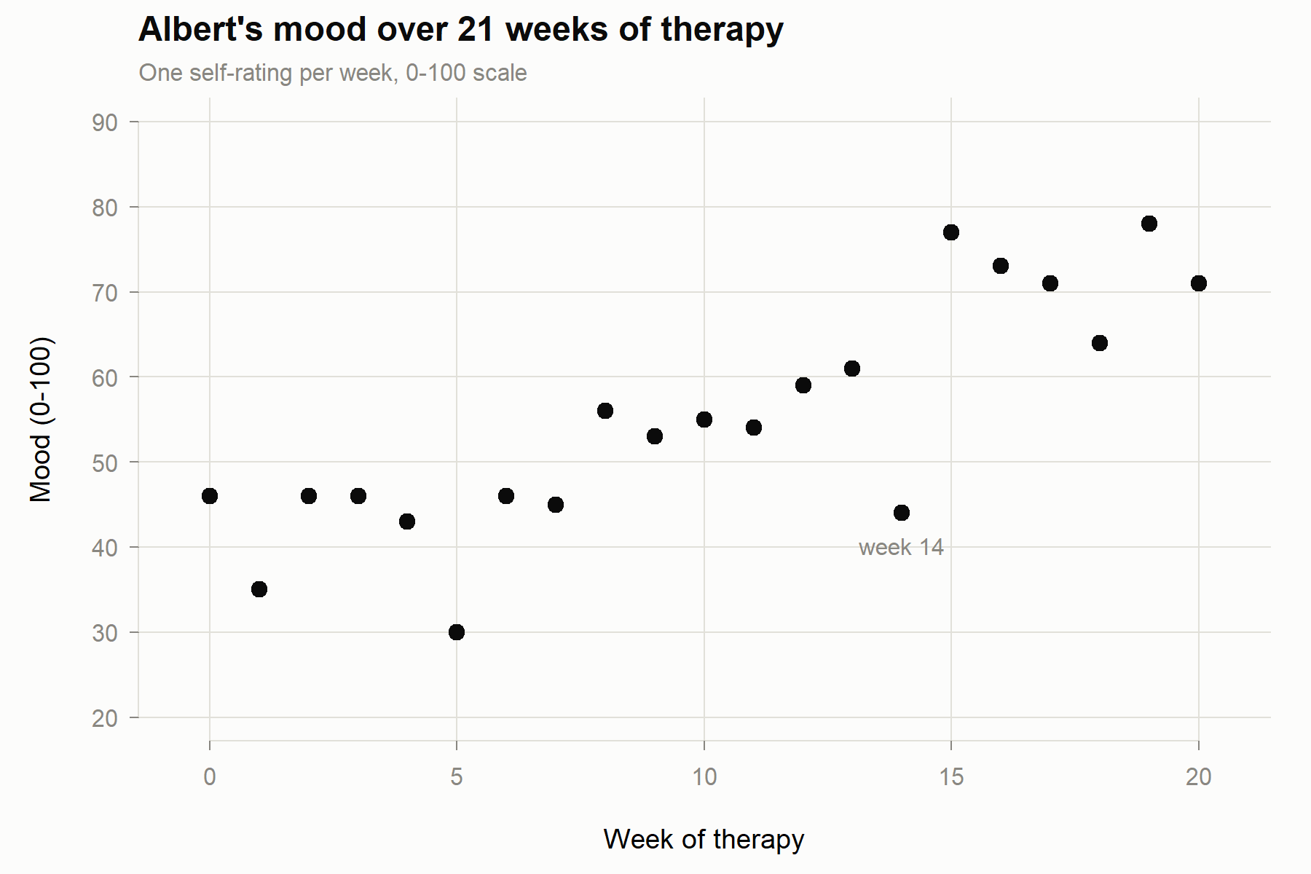

Slide 9
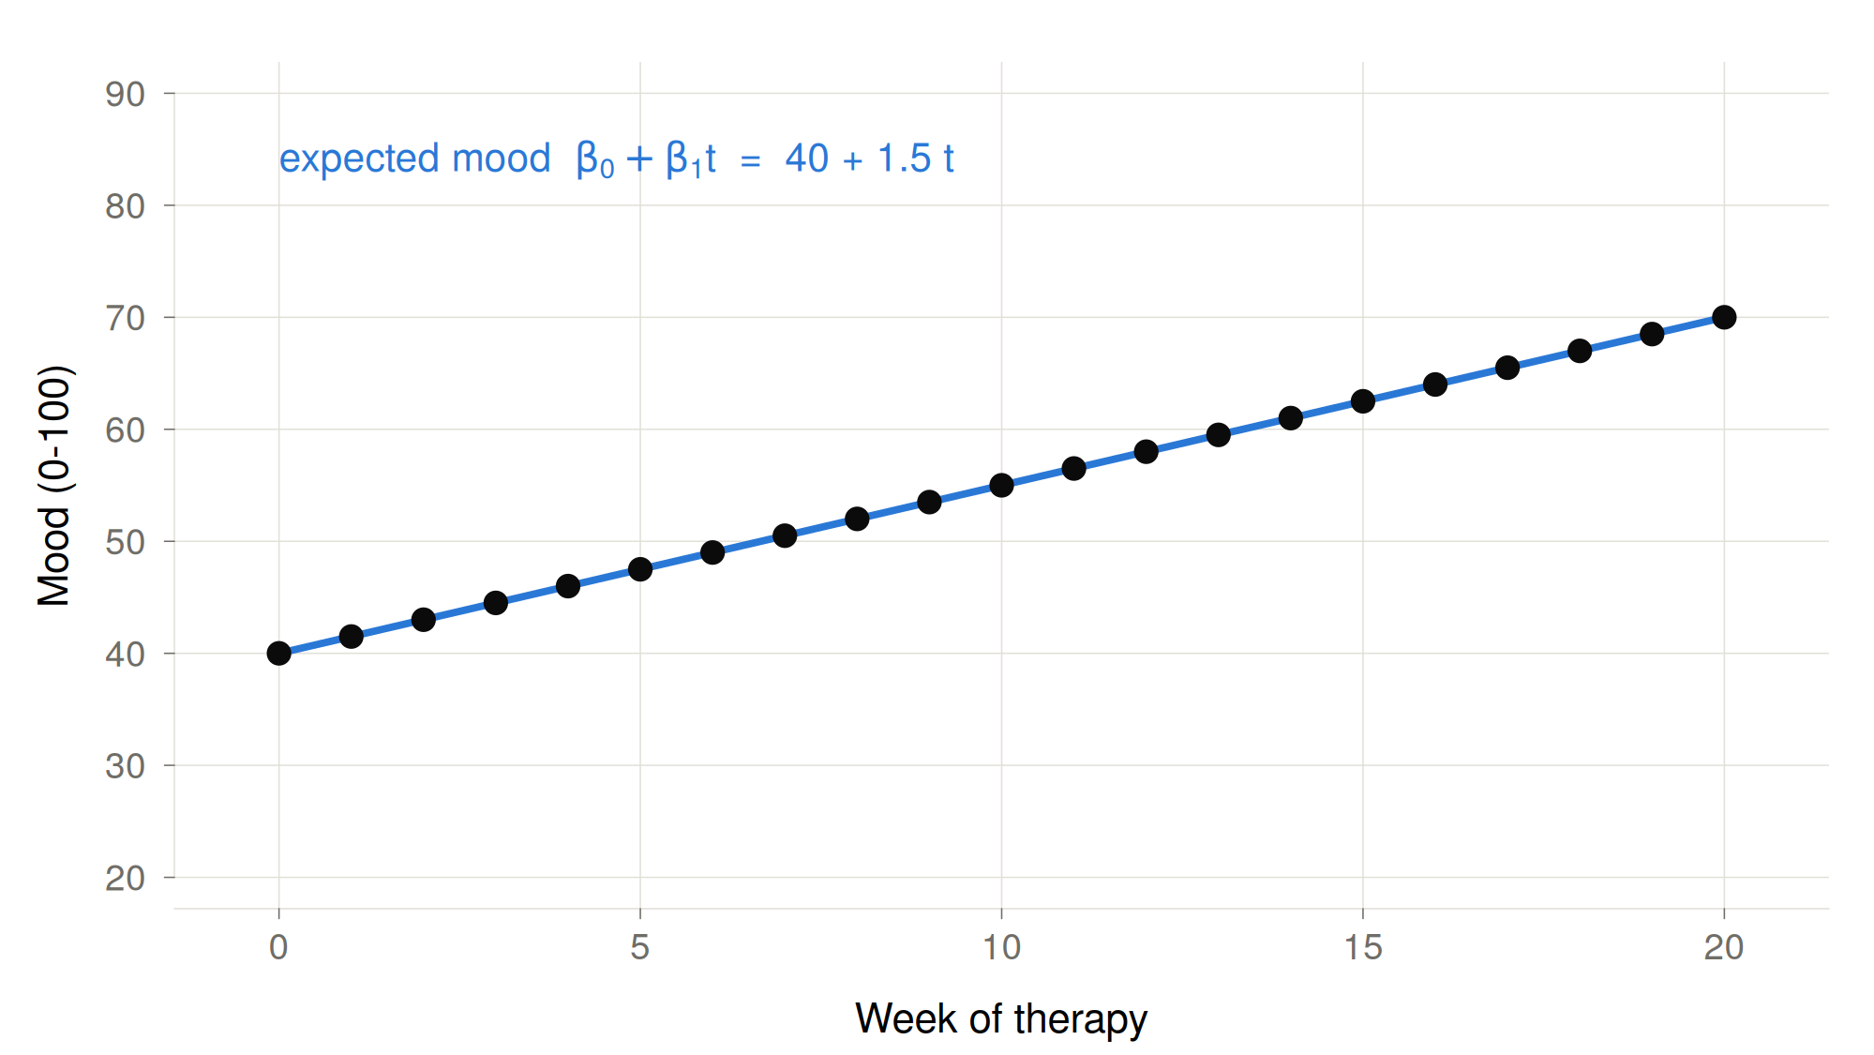

A linear model of change
$${Mood}_{t}=β_{0}+β_{1}∗{Week}_{t}$$

Slide 10
What is missing from the linear regression?

Slide 11
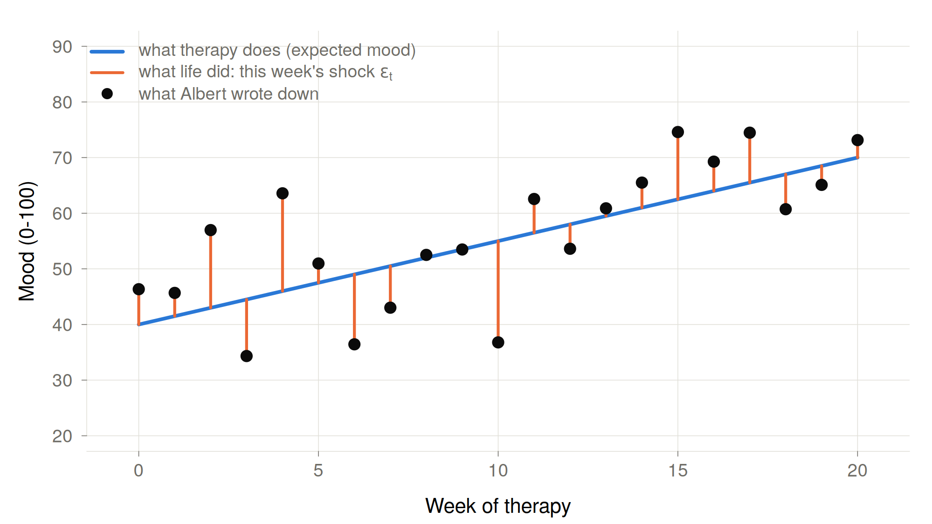

Slide 12
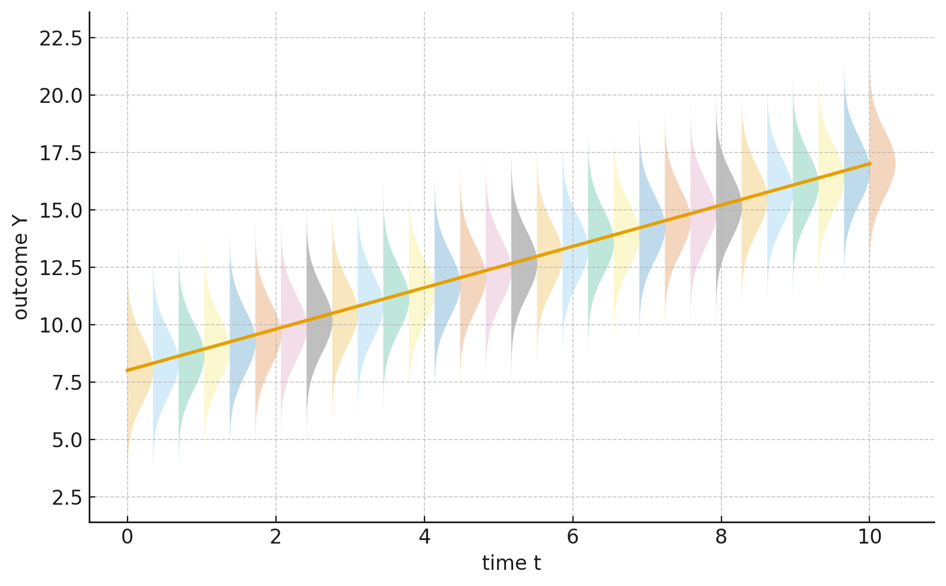

“The general linear model, models data as being randomly drawn from a distribution whose mean varies according to some parameter(s)”
$$Y_{t}\sim N(μ, σ^{2})$$

Slide 13
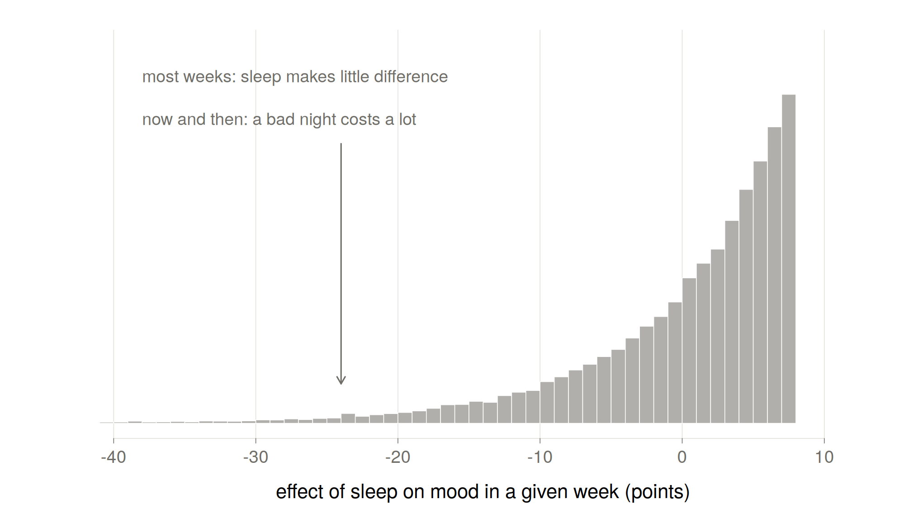
Why are deviations normally distributed?

Slide 14
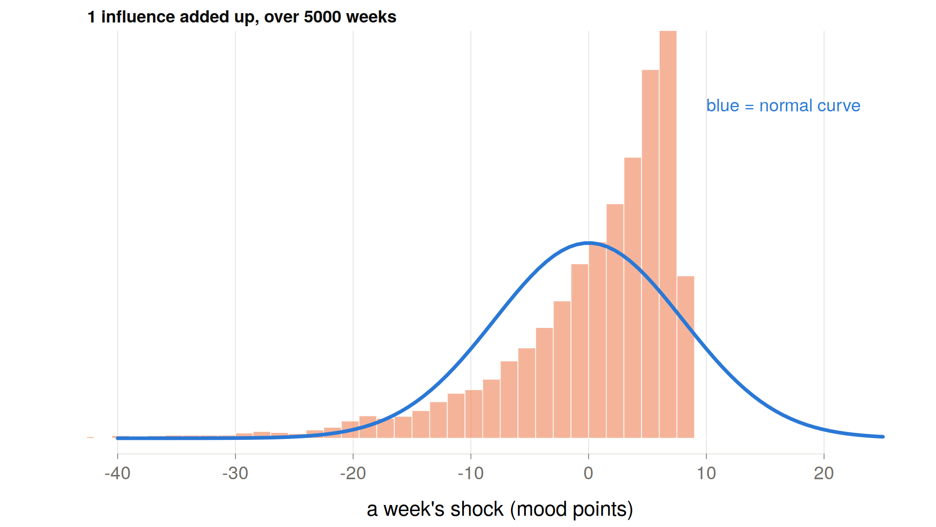
Notes:
Added as an explanation for students:
Think of 100 small things that nudge Albert's mood each week: sleep, his flatmate, the weather, work, a phone call… Each one on its own is lopsided. Most weeks it does nothing; now and then it lands a blow. Say each has a 1-in-10 chance of hitting him in a given week.
With one influence, the week is either fine or a blow, and the picture is completely lopsided. With 100, something different happens: every week a few of them hit. On average about 10, usually somewhere between 5 and 15. Hardly ever 0, hardly ever 25.
So, a week's shock is really asking how many of the 100 hit this time. That count bunches up around its typical value and thins out evenly on both sides, because there are many ways to get an ordinary week and very few ways to get an extreme one. Everything would have to go wrong at once, or right at once.
The lopsidedness of each single influence gets outnumbered. The sum comes out bell-shaped, even though none of its parts is. That's the central limit theorem.

Slide 15
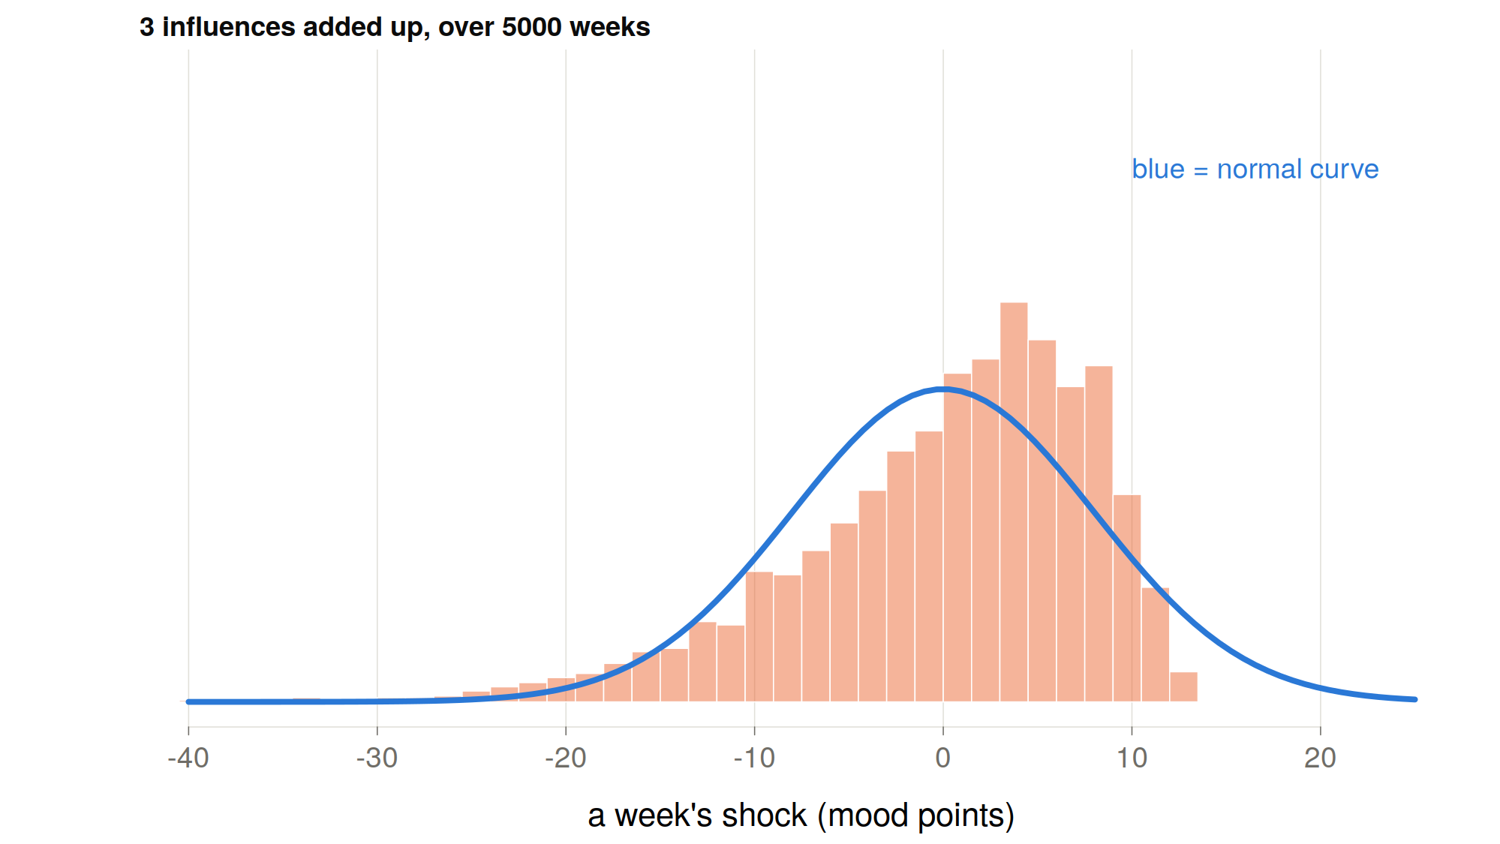
Notes:
Added as an explanation for students:
Think of 100 small things that nudge Albert's mood each week: sleep, his flatmate, the weather, work, a phone call… Each one on its own is lopsided. Most weeks it does nothing; now and then it lands a blow. Say each has a 1-in-10 chance of hitting him in a given week.
With one influence, the week is either fine or a blow, and the picture is completely lopsided. With 100, something different happens: every week a few of them hit. On average about 10, usually somewhere between 5 and 15. Hardly ever 0, hardly ever 25.
So a week's shock is really asking how many of the 100 hit this time. That count bunches up around its typical value and thins out evenly on both sides, because there are many ways to get an ordinary week and very few ways to get an extreme one. Everything would have to go wrong at once, or right at once.
The lopsidedness of each single influence gets outnumbered. The sum comes out bell-shaped, even though none of its parts is. That's the central limit theorem.

Slide 16
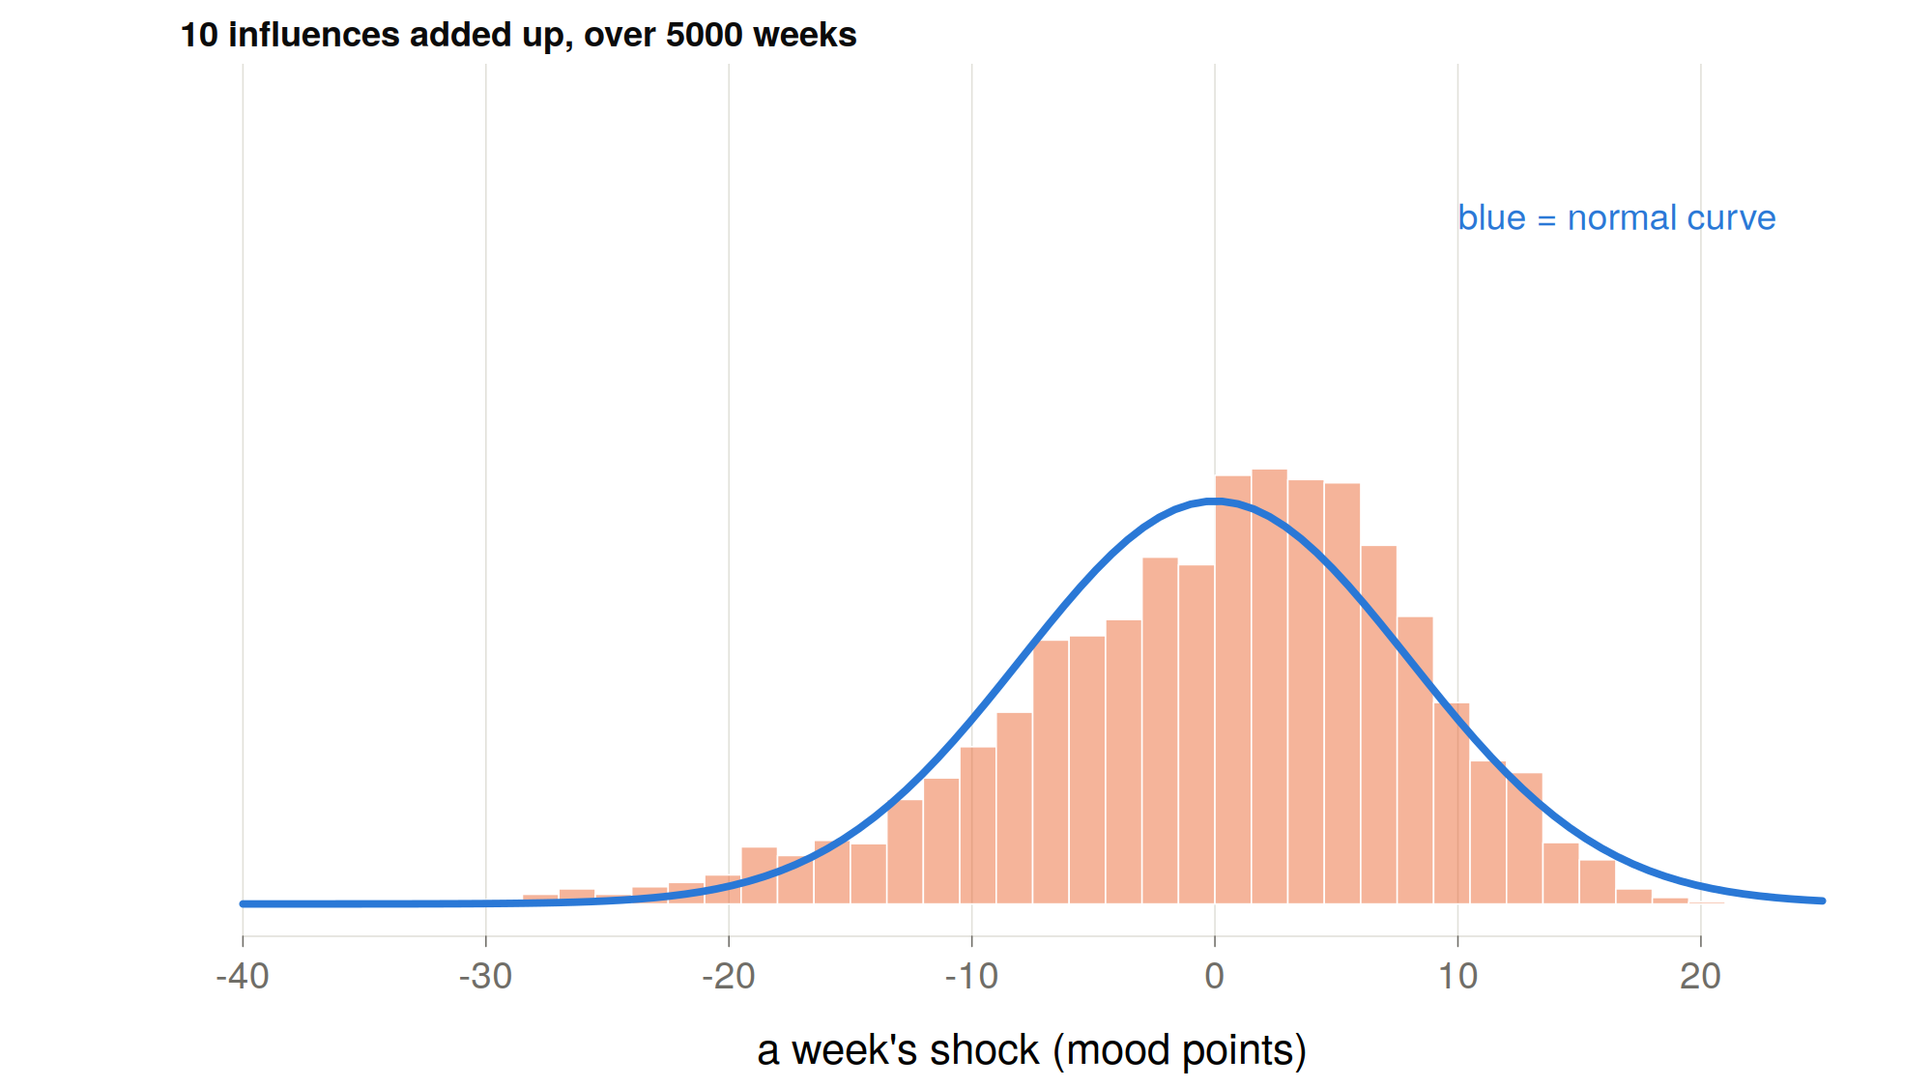
Notes:
Added as an explanation for students:
Think of 100 small things that nudge Albert's mood each week: sleep, his flatmate, the weather, work, a phone call… Each one on its own is lopsided. Most weeks it does nothing; now and then it lands a blow. Say each has a 1-in-10 chance of hitting him in a given week.
With one influence, the week is either fine or a blow, and the picture is completely lopsided. With 100, something different happens: every week a few of them hit. On average about 10, usually somewhere between 5 and 15. Hardly ever 0, hardly ever 25.
So, a week's shock is really asking how many of the 100 hit this time. That count bunches up around its typical value and thins out evenly on both sides, because there are many ways to get an ordinary week and very few ways to get an extreme one. Everything would have to go wrong at once, or right at once.
The lopsidedness of each single influence gets outnumbered. The sum comes out bell-shaped, even though none of its parts is. That's the central limit theorem.

Slide 17
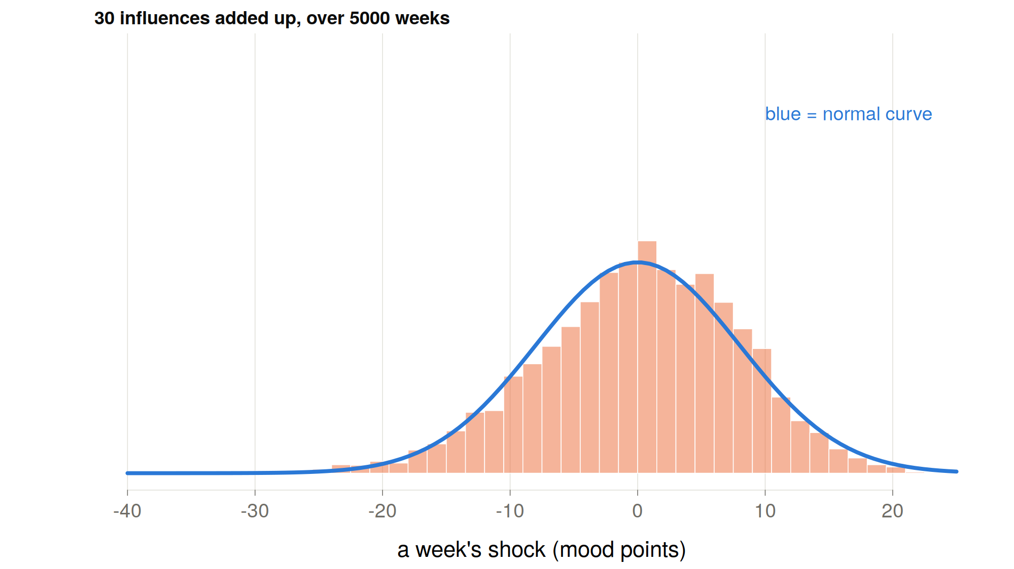

Slide 18
https://seeing-theory.brown.edu/probability-distributions/index.html

Slide 19
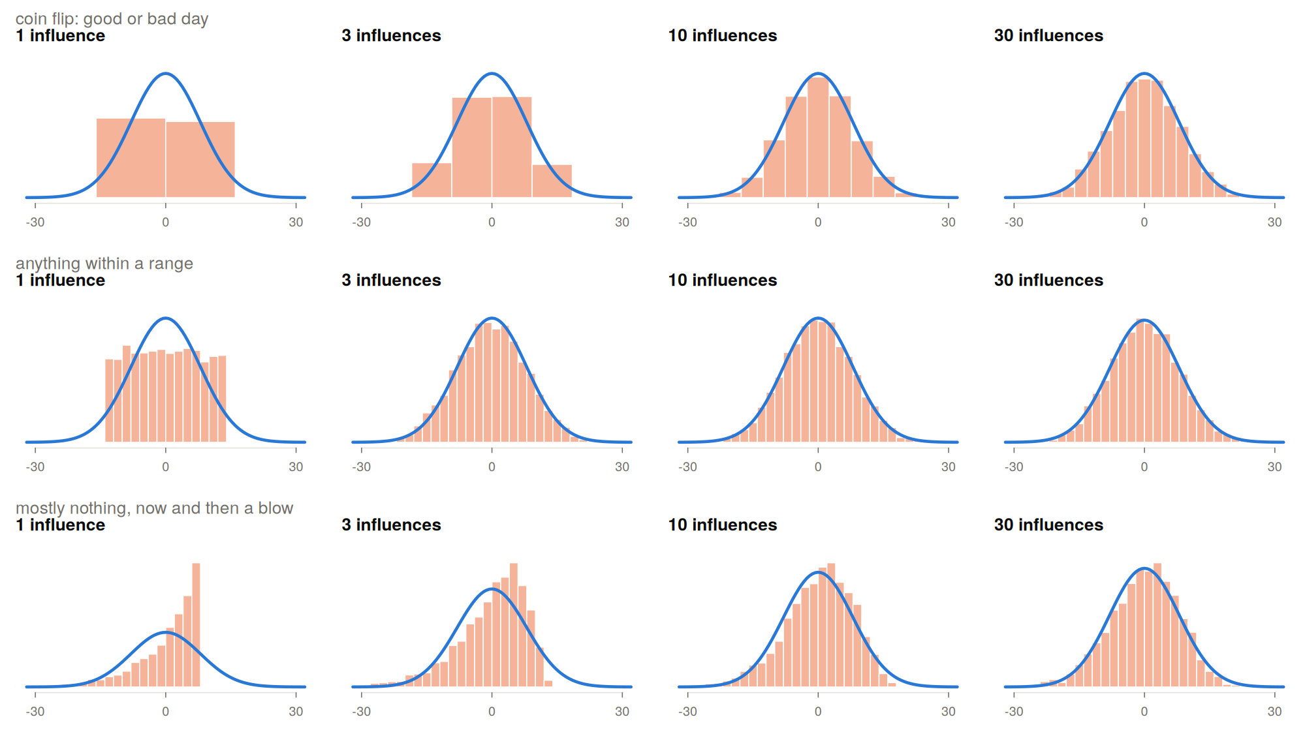

Slide 20
Who has questions?

Slide 21
Can we identify if Albert’s data is generated by a linear model?

Slide 22
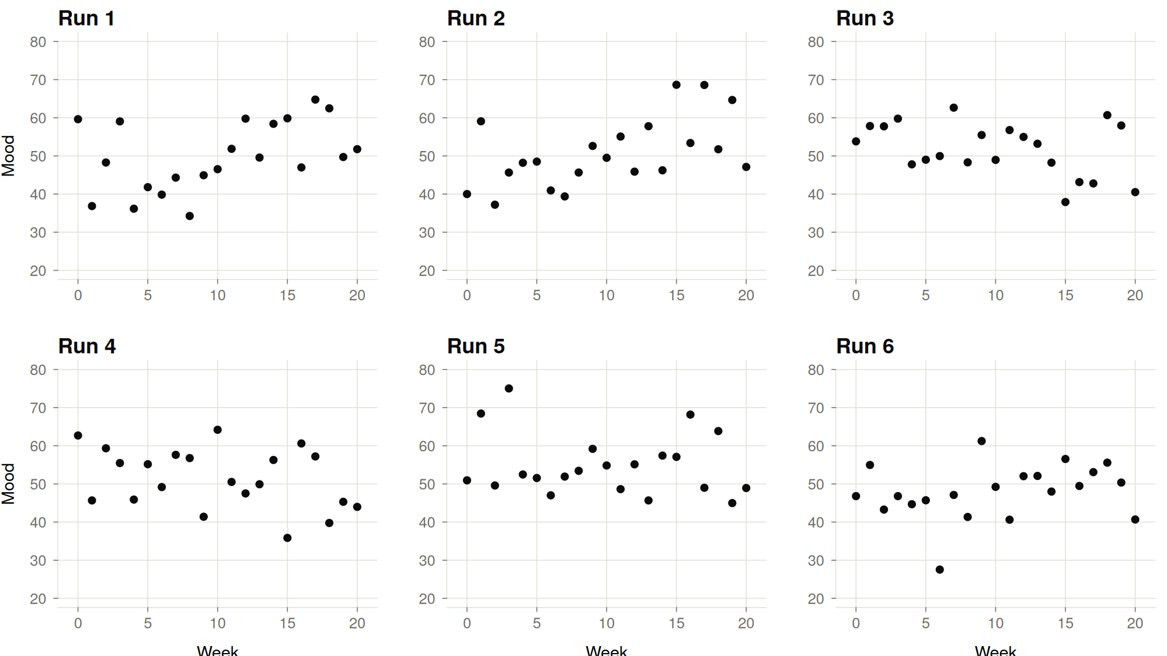

Slide 23
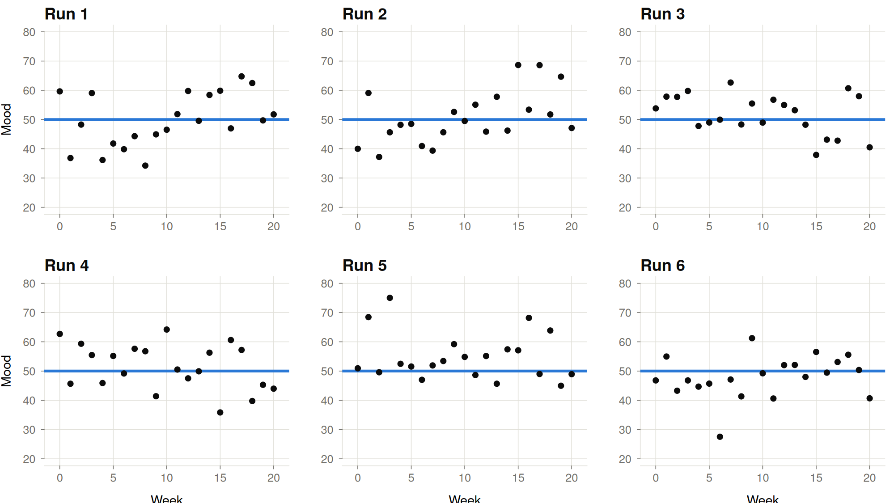

Slide 24
What determines how easy patterns are to detect?

Slide 25
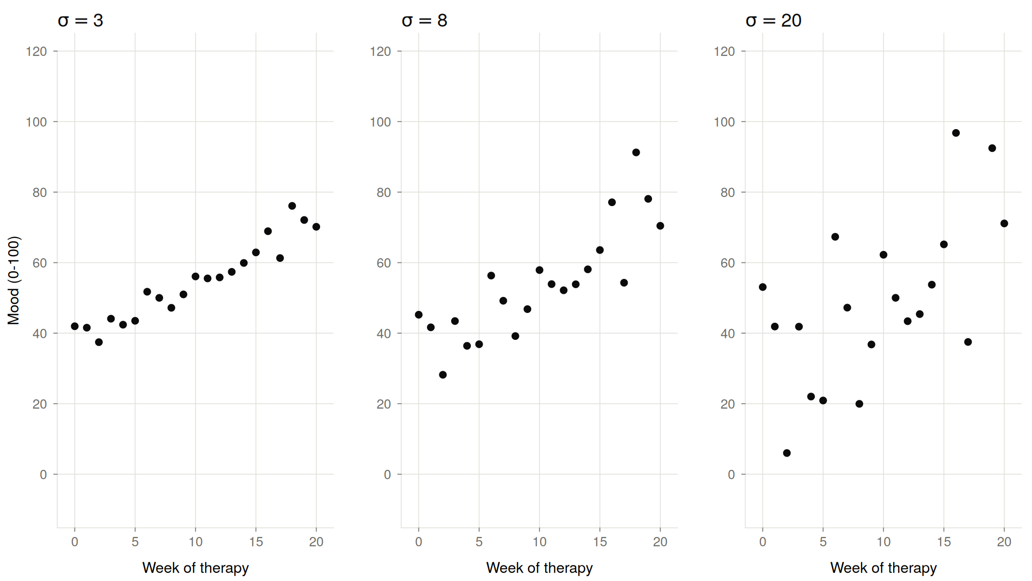

Slide 26
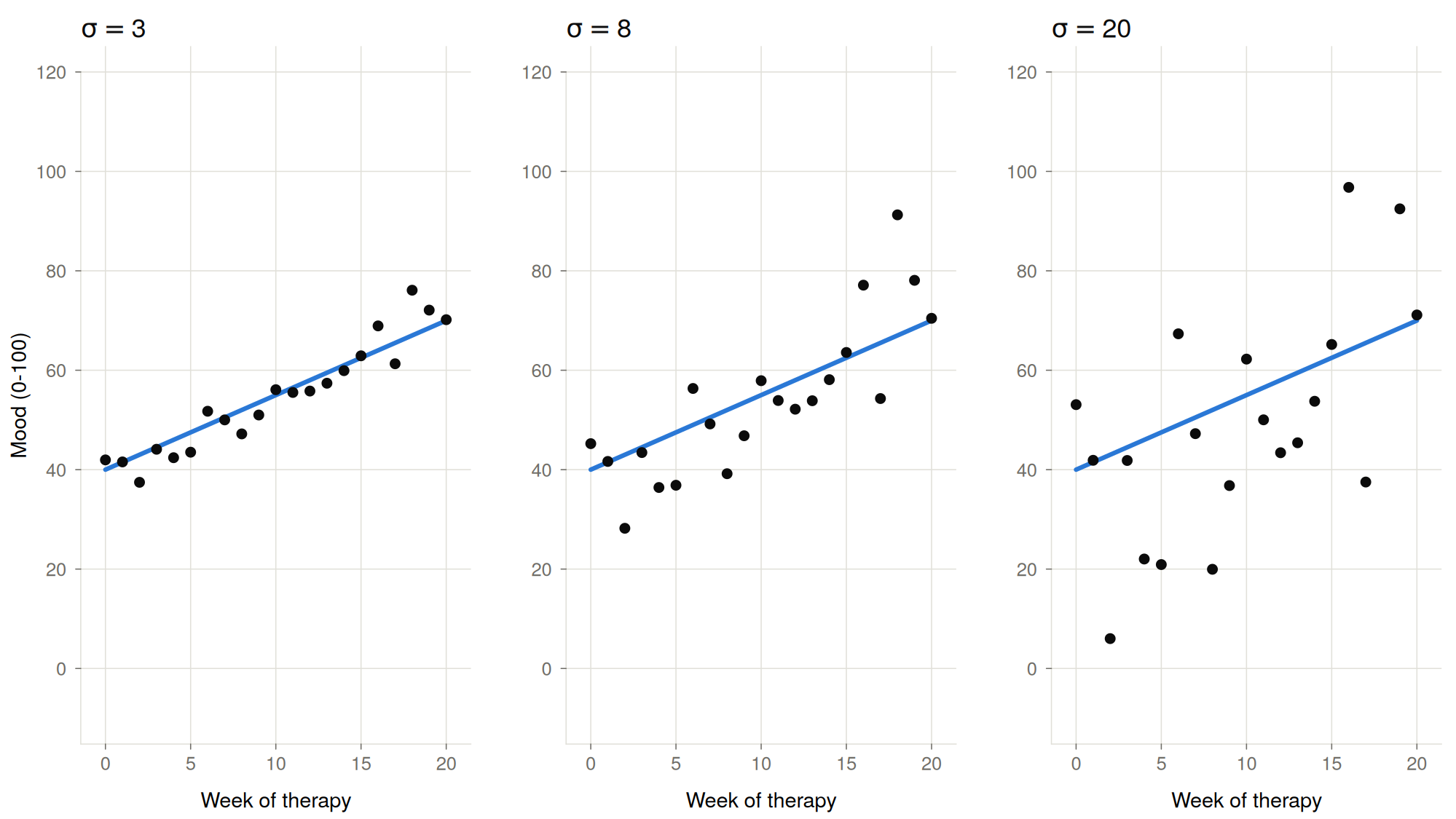

Slide 27
What patterns do we expect from our model?

Slide 28
How often do positive weeks follow positive weeks?

Slide 29
How often do positive weeks follow positive weeks?

Slide 30
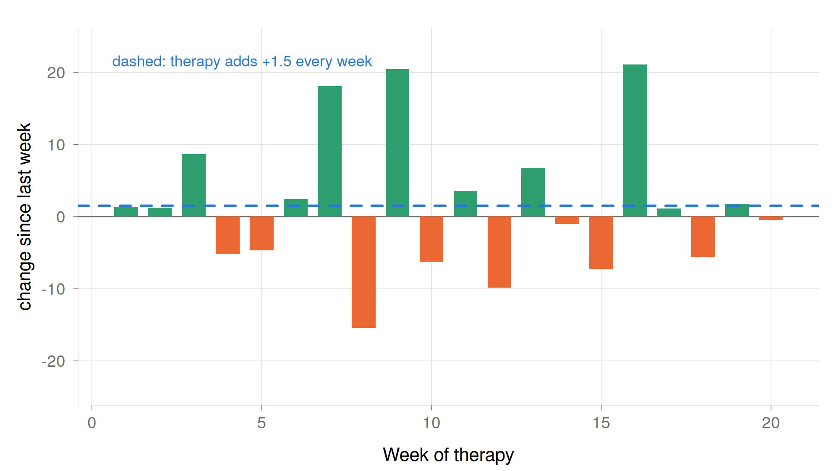

Slide 31
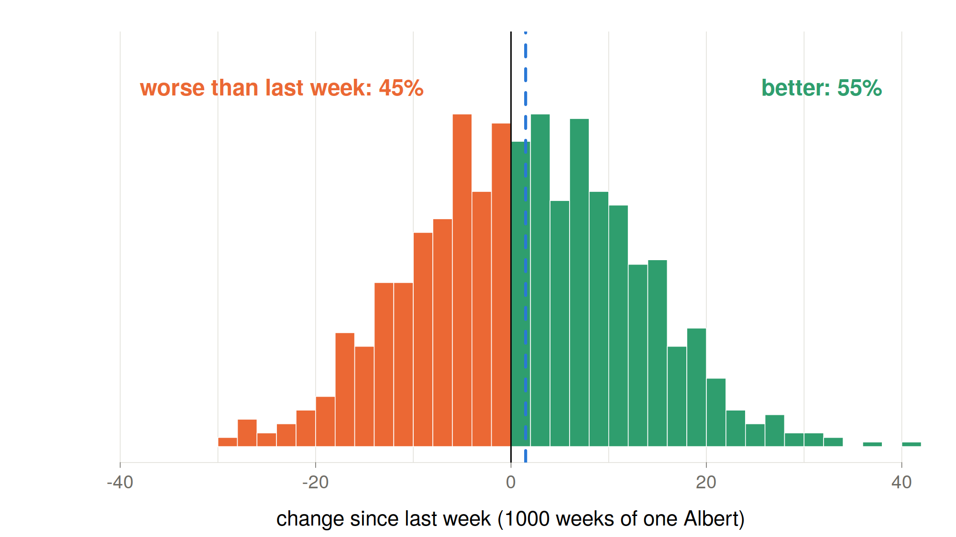

Slide 32
What about in this linear regression?

Slide 33
Does therapy reduce mood fluctuations?

Slide 34
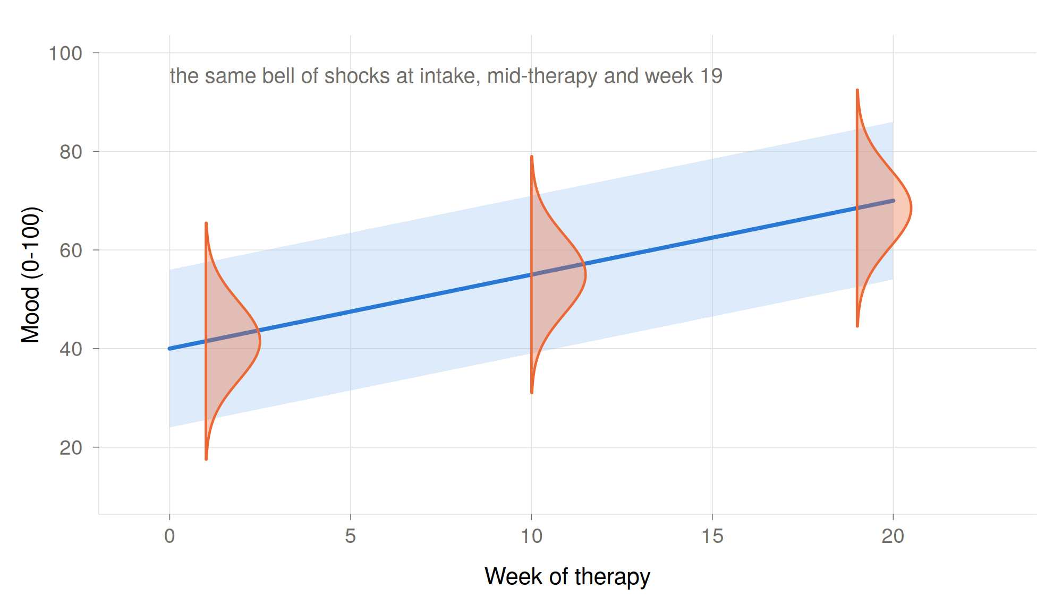

Slide 35
What happens if Albert goes to therapy for 80 weeks?

Slide 36
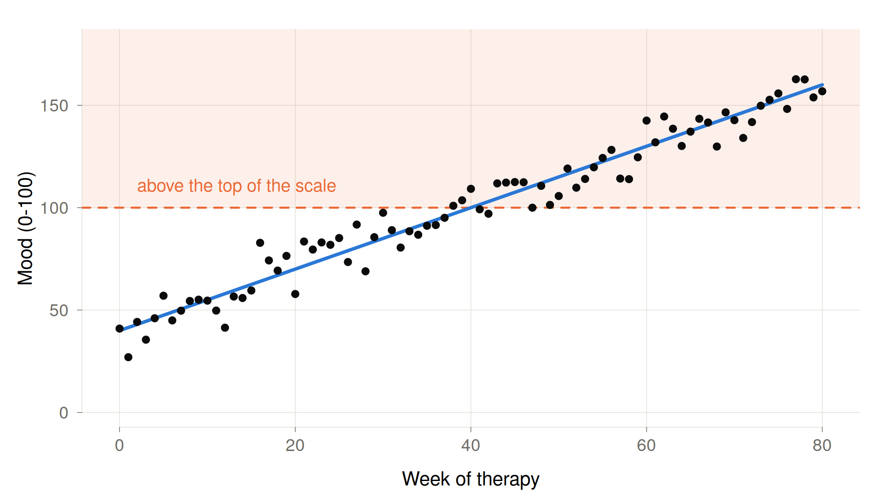
Albert after 80 weeks of therapy

Slide 37
Criticize the linear model of change

Slide 38
Forming teams for group projects

Slide 39
Materials for revision
Github → mearistodemou → dynamic-systems-uzh → Lecture02 → lecture01_linear_change.Rmd: interactive lecture sheet
  Open with R → install.packages(“shiny”) → press
Tutorial paper: https://osf.io/preprints/psyarxiv/4q9ex_v4

Slide 40
Thank you for listening ☺

