Slide 1
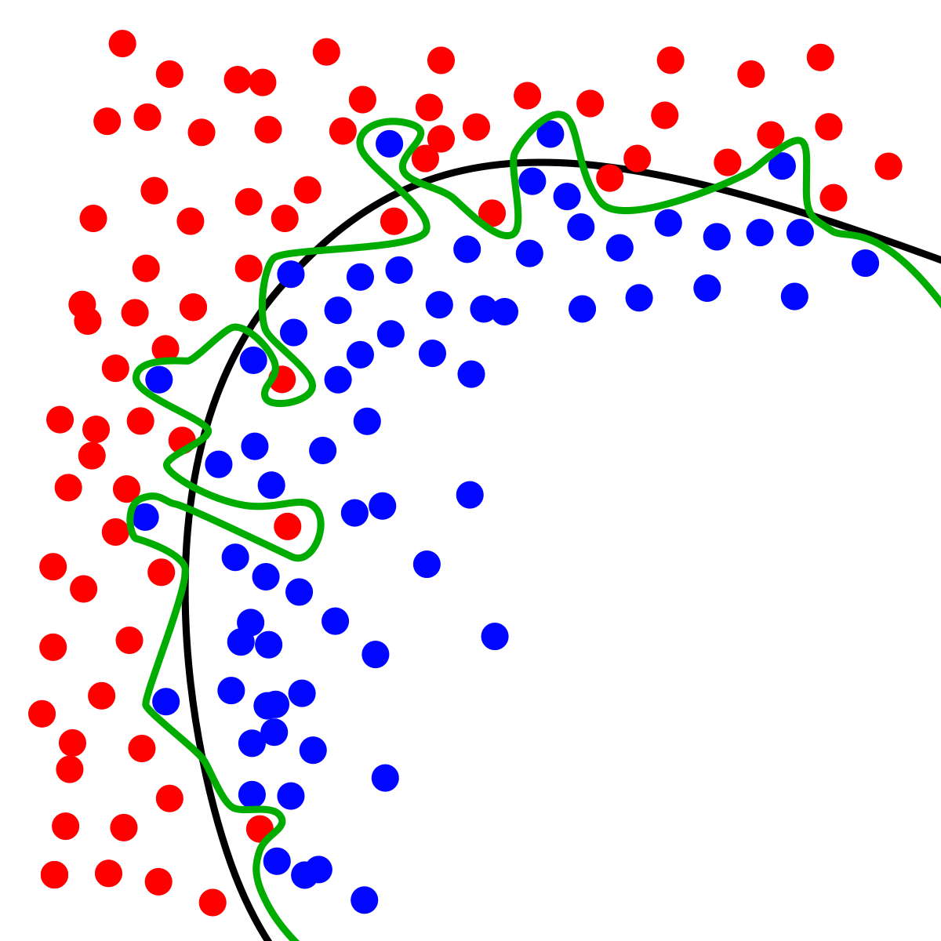
Dynamic Systems Thinking for Psychologists
Michael E. Aristodemou
michael.aristodemou@psychologie.uzh.ch

Slide 2



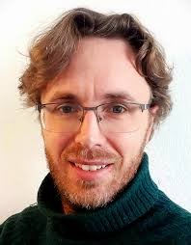
Hi, I’m Michael
BSc Psychology (Clinical Specialization) – Erasmus University Rotterdam
MSc (Research) Clinical and Health Psychology – Leiden University
PhD Medical Neuroscience – Donders Institute for Brain, Cognition and Behavior
Postdoc Quantitative Methods – University of Zurich

Slide 3
You are… (alt txt: introduction round)
Your name, which part of psychology interests you most, what do you want to learn here

Slide 4
I want to convince you that formal modeling is worth the trouble

Slide 5
What is a mental disorder?

Slide 6
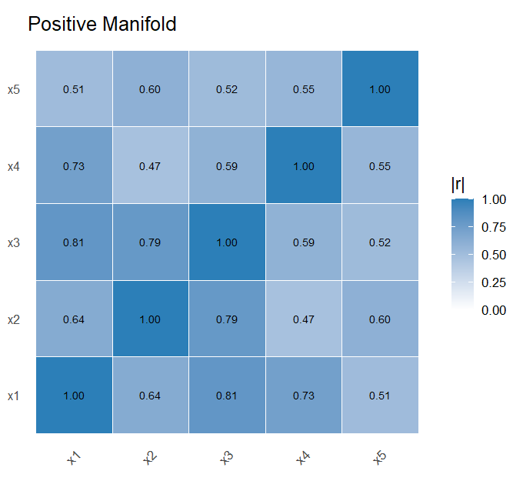

Slide 7
Theories make distinct predictions about the structure of change

Slide 8

Questions, questions, more questions
Notes:
Which symptoms?
How much?
All connections equal?
When does this causal interaction happen?
Does it increase with frequency?
Does the rate of influence increase with symptom severity?
Does the state of each symptom matter?

Slide 9
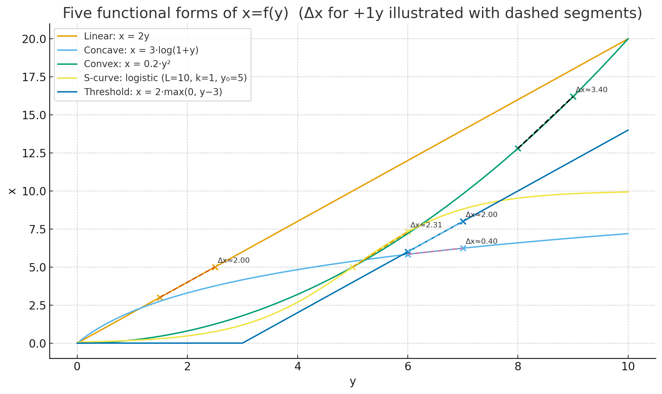

Slide 10
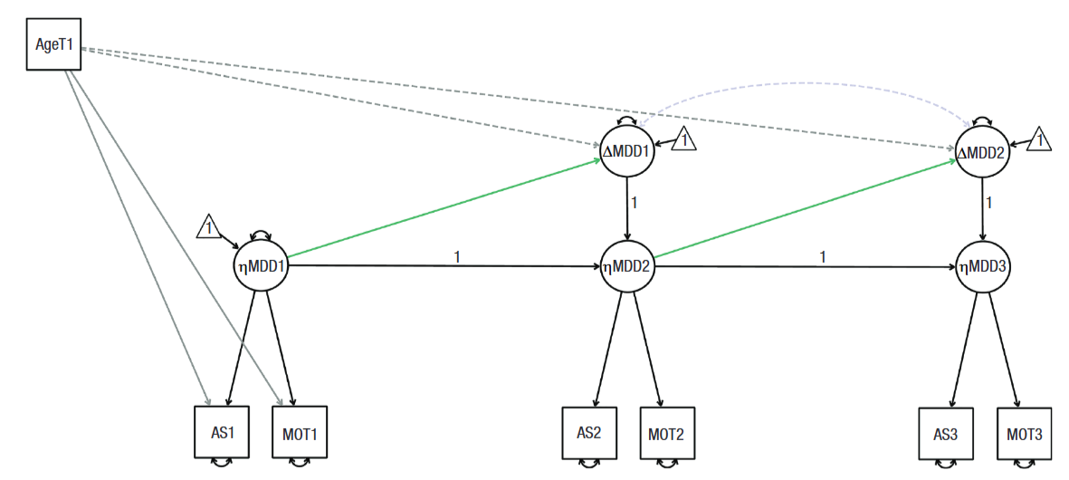
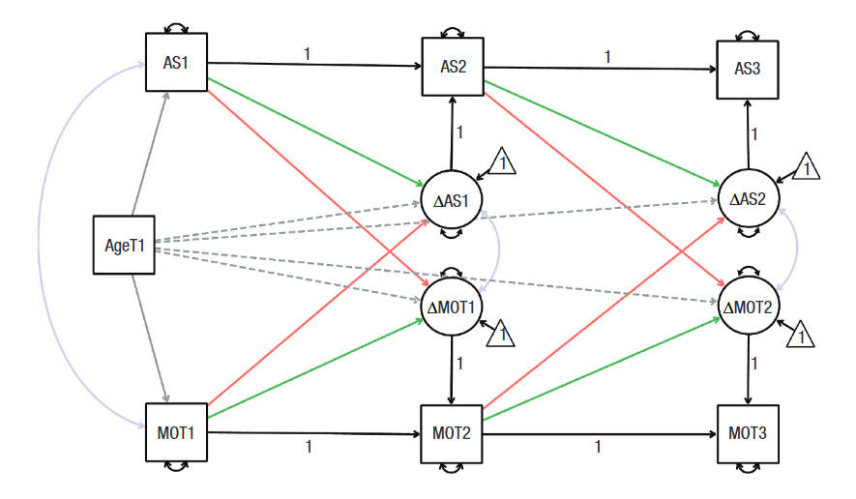
Ended up with stupid models, and that’s okay…

Slide 11
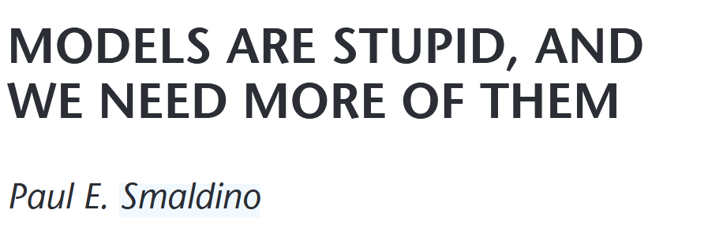
Because…
Notes:
12 functions served by false models:
An oversimplified model may be a starting point in a series of models of increasing complexity and realism.
A know incorrect but otherwise suggestive model may undercut the too ready acceptance of a preferred hypothesis by suggesting new alternative lines for the explanation of phenomena.
An incorrect model may suggest new predictive test or new refinements of an established model, or highlight specific features of it as particularly important.
An incomplete model may be use as a template, which captures larger or otherwise more obvious effects that can then be factored out to detect phenomena that would otherwise be masked or be too small to be seen.
A model that is incomplete may be used as a template for estimating the magnitude of parameters that are not included in the model.
An oversimplified model may provide a simpler arena for answering questions about properties of more complex models, which also appear in this simpler case, and answers derived here can sometimes be extended to cover the more complex models.
An incorrect simpler model can be used as a reference standard to evaluate causal claims about the effects of variables left out of it but included in more complete models, or in different competing models to determine how these models fare if these variables are left out.
Two false models may be used to define the extremes of a continuum of cases in which the real case in presumed to lie, but for which the more realistic intermediate models are too complex to analyze or the information available is too incomplete to guide their construction or to determine a choice between them. In the defining these extremes, the limiting models specify a property of which the real case is supposed to have an intermediate value.
A false model can specify the functional form of the relationships, that can then be explained by a mechanical model.
A family of models of the same phenomenon, each of which makes various false assumptions have uses: (1) look for results that are true in all of the models, thus presumably independent of different specific assumptions which vary across models; (2) one may determine conclusions that are irrelevant to a given conclusion. (3) the dependence of differences in results on some assumptions.
A model that is incorrect be being incomplete may serve as a limiting case to test the adequacy of new, more complex models.

Slide 12
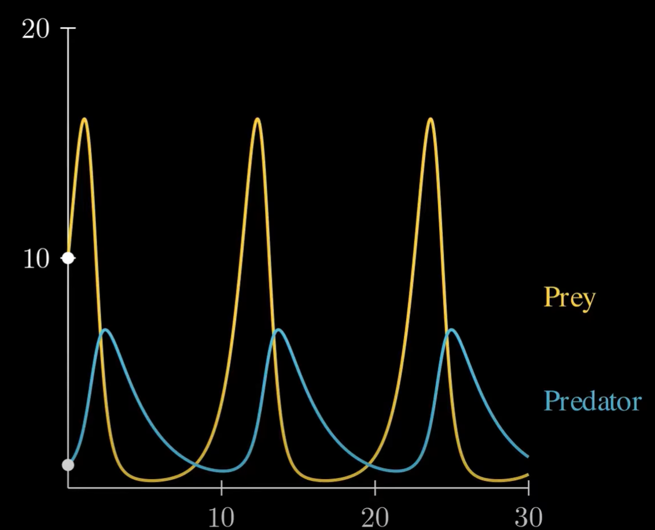
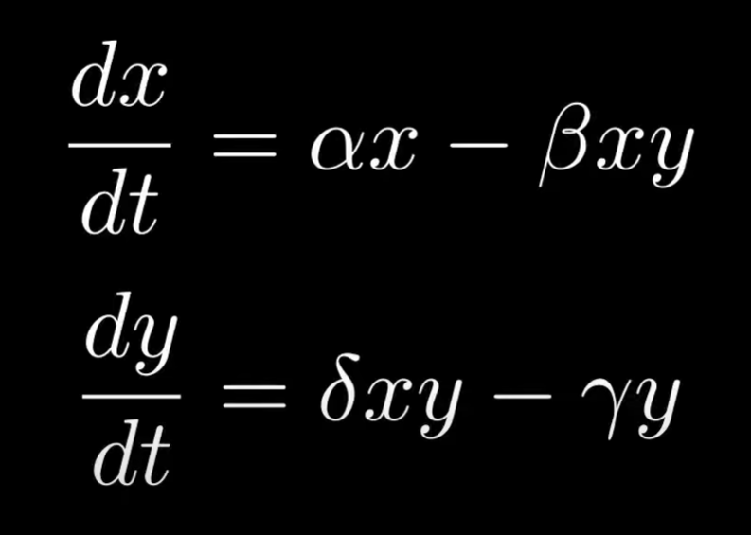


Prey-predator model (Lotka-Volterra model)
Notes:
Source: https://www.youtube.com/watch?v=Tc05IbqTsFM

Slide 13
Desirable properties of models…
Words are a good/necessary starting point
Precise
Transparent
Independently Replicable
Allow us to understand complex phenomena

Slide 14
Desirable properties of models…
Words are a good/necessary starting point
Precise
Transparent
Independently Replicable
Allow us to understand complex phenomena

Slide 15
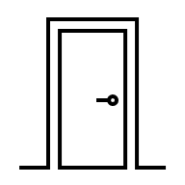


The Monty Hall Problem

Slide 16
You pick door 1

Slide 17
Host reveals a goat

Slide 18
Should you…
a. Switch
b. Stay
c. Does not matter

Slide 19
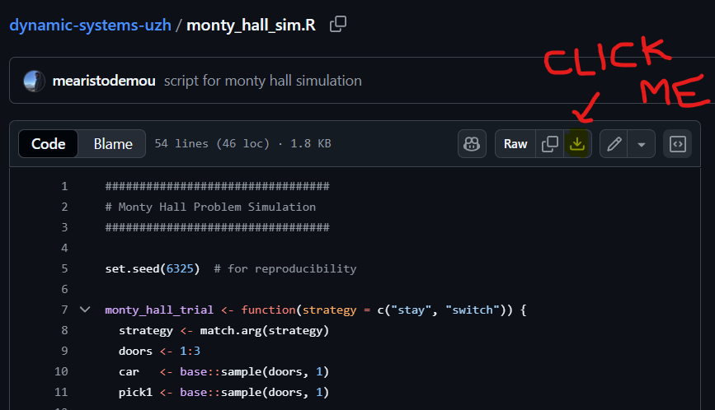
Let’s simulate…
Go to GitHub: github.com
Search: mearistodemou
Find the repository: dynamic-systems-uzh
Download the R script: “monty_hall_sim.R”

Slide 20
An example closer to home

Slide 21
My mood increases every week
At a steady rate

Slide 22
Let’s formalize: Linear regression
Y(t) = a + B(time)
Y(1) = 5 + 1(time == 1)

Slide 23
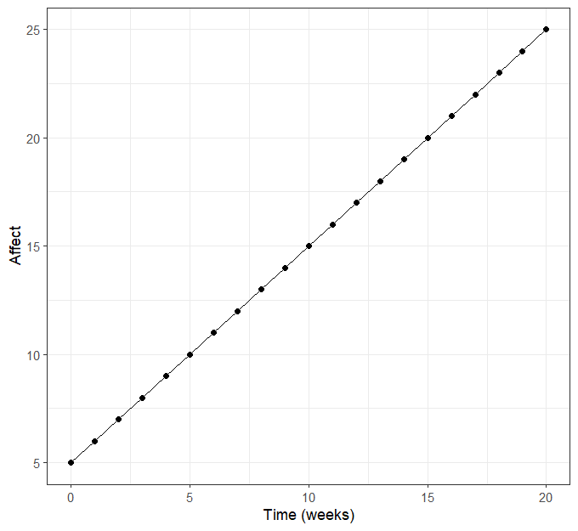
One process in a vacuum, let’s shock it!
Y(t) = a + B(time)
Y(t) = 5 + 1(time)

Slide 24
One process in a vacuum, let’s shock it!

Slide 25
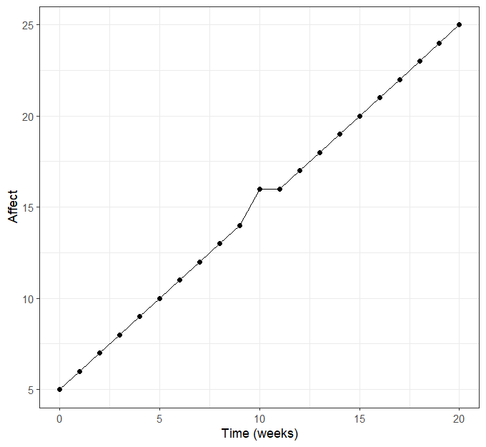
One process in a vacuum, let’s shock it!

Slide 26
Let’s make it slightly more complicated
My mood is a function of a constant influence (some trait) and half the value of my mood during the previous week (state dependence).

Slide 27
Formalize: autoregressive process
My mood is a function of a constant influence (some trait) and half the value of my mood during the previous week (state dependence).
Y(t) = a + c*(Y(t-1))
Y(2) = 2 + 0.8*(Y(1) == 2)

Slide 28
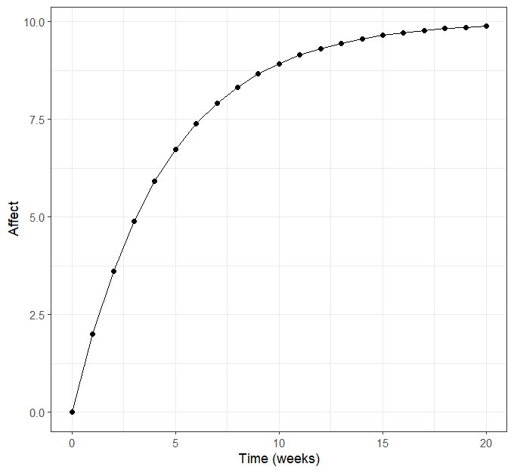
A state-dependent process in a vacuum

Slide 29
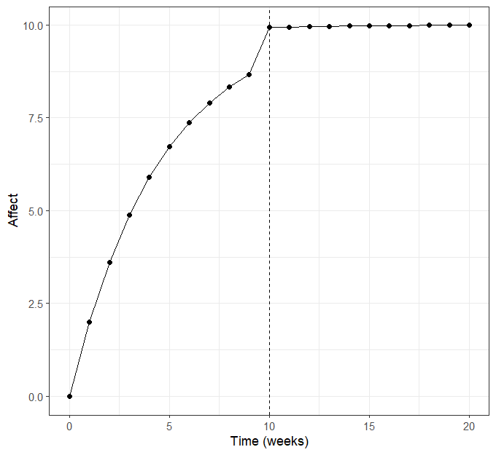
A state-dependent process in a vacuum

Slide 30
Back to Lotka-Volterra
https://visualize-it.github.io/lotka_volterra/simulation.html

Slide 31
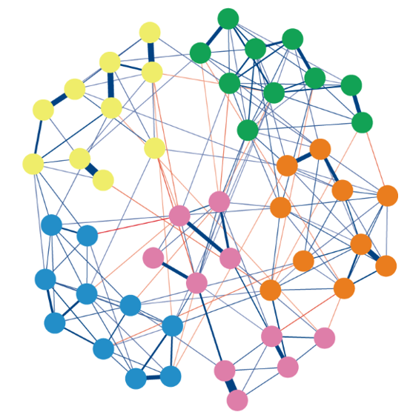
What is the expected trajectory of green nodes?

Slide 32
What happens if I poke here…

Slide 33
Break

Slide 34
We are going to model change

Slide 35
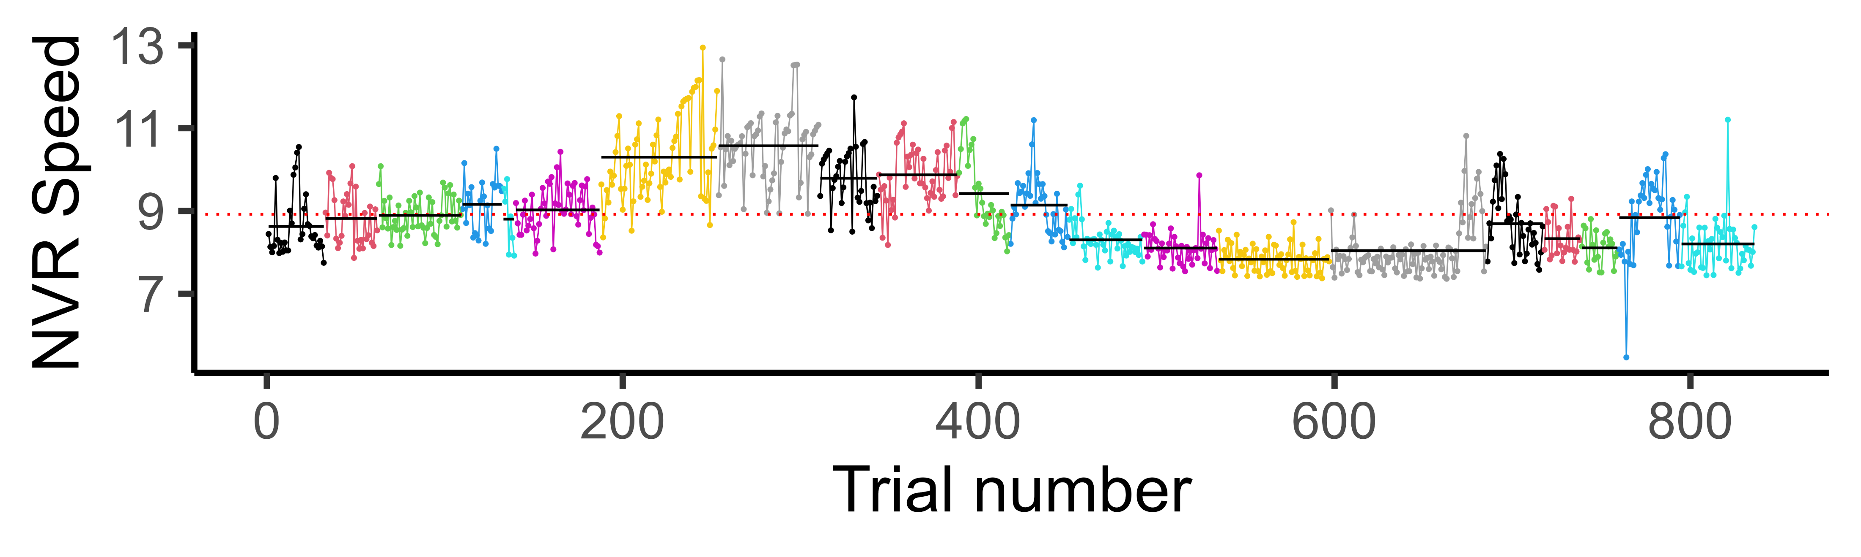
“Why” questions are often about changes
Causality requires change
Mental life is (often) dynamic

Slide 36
To study change, you need to measure change
Hypothesis: exercising increases your heart rate
Between-subject data: people who exercise more have a lower heart rate
The non-equivalence of between-subject relations and within-subject relations are the rule in psychology (Molenaar, 2009)

Slide 37

So, you are going to learn how to model change!

Slide 38
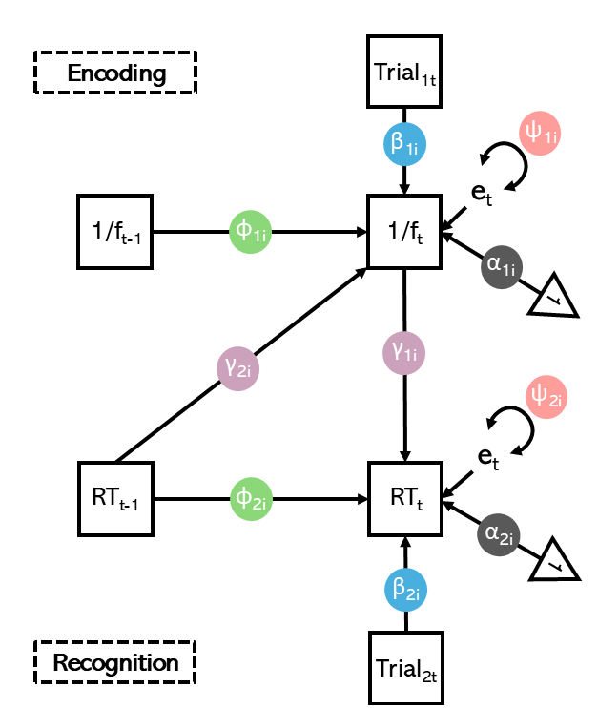
Specifically, systems of change

Slide 39
How we are going to learn…

Slide 40



Case of little Albert going to therapy…

Slide 41
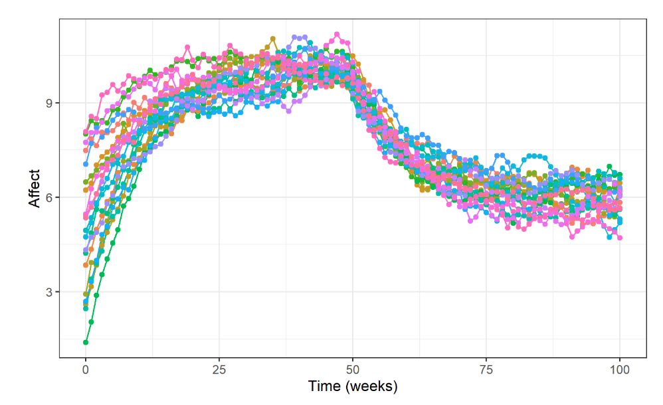
We have data…
We need to explain it!

Slide 42
Start simple, incrementally add complexity

Slide 43
Things you will learn
Think about psychological processes as dynamic systems
Using simulations to understand complex models
Model evaluation & selection

Slide 44
Questions about course content

Slide 45

Formalities
Assessment:
1. Group presentation (30%)
2. Report + Oral exam (70%)
3. Active participation (Pass/Fail)
You can use LLMs, hence the oral exam
Be critical of output (ask for links/references)
Break instructions into small steps (e.g. code line-by-line)
Take the time to understand each step
Do not use output that you don’t understand!

Slide 46

Participation
Come to the seminars (with reasonable exceptions of course)
Participate in group work/in-class assignments

Slide 47
Group presentation (30%)
Pick a psychological phenomenon
Create a story explaining how this phenomenon changes over time and variation across people (consider any factors you like!; environment, interpersonal dynamics, maturation trajectories)
Visualization – to convey your ideas about the system’s dynamics! (simulate, plot, draw stuff, equations)
Background research – not necessary, but can help you think through things! Always cite if you use existing work ☺
10-15 minute talk + questions!

Slide 48
Report (+/- 70%)
Main aim: show the ability to consider psychological concepts from a dynamic systems perspective
This is based on the group presentation (but individual)
Incorporate feedback from presentations + extend in new direction
Embed R code for simulations/visualizations
1000-3000 words

Slide 49

Oral exam (+/- 70%)
15 minutes
Questions based on the content of your report
Show understanding of your work

Slide 50
Discussion & Questions

Slide 51
Thank you for being here ☺

