Slide 1
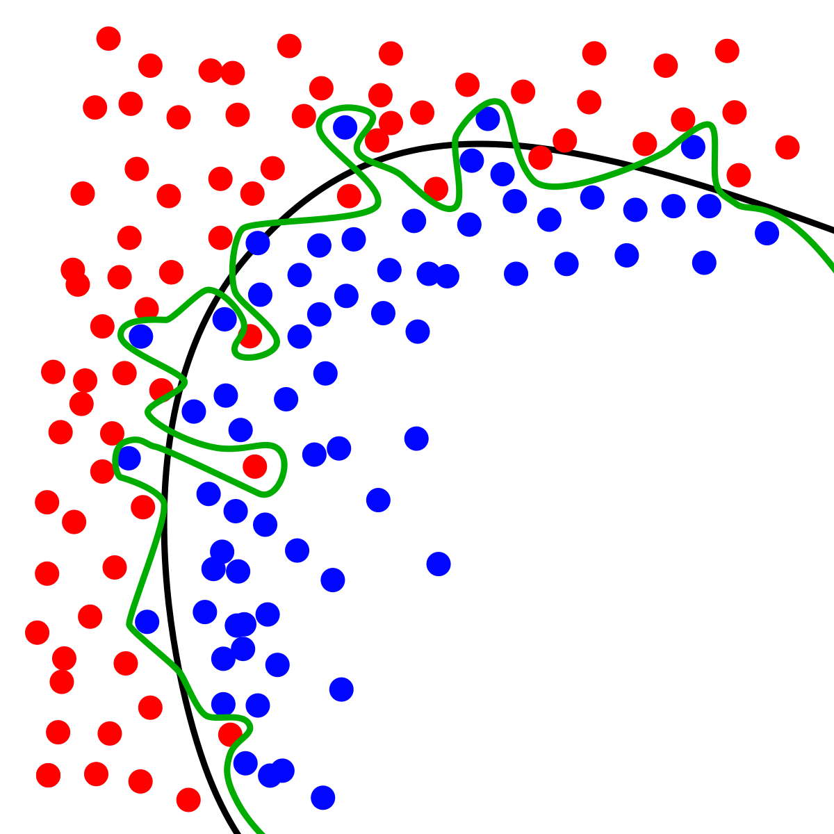
Dynamic Systems Thinking for Psychologists
Michael E. Aristodemou
michael.aristodemou@psychologie.uzh.ch
Lecture 3: Hierarchical Linear Models & Magic Cats

Slide 2
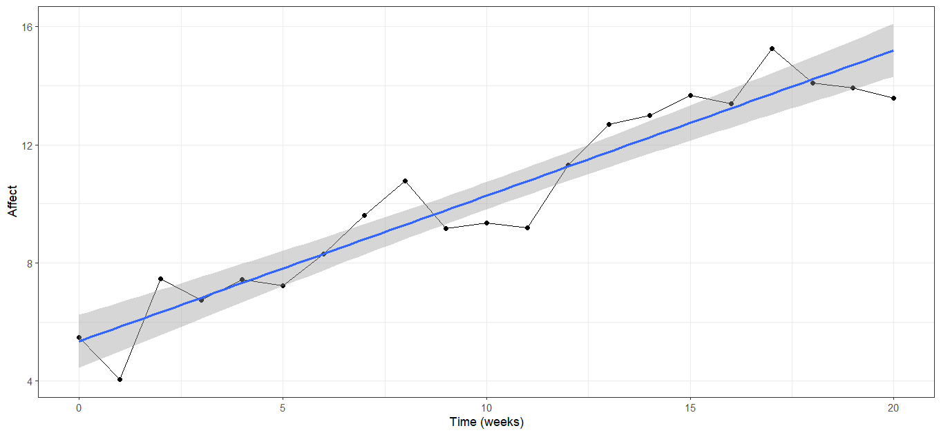
Is therapy going well?

Slide 3








A way to find out…

Slide 4
Individual differences
Let’s imagine we recruit 20 more people who will start the same therapy at the same time as Albert for the same duration.
What’s the simplest world we can imagine?

Slide 5
$$Y_{\left\{1, t\right\}}=β_{1}+γ_{1}∗time_{\left\{1,t\right\}}+ε_{\left\{1,t\right\}}$$
$$Y_{\left\{2, t\right\}}=β_{2}+γ_{2}∗time_{\left\{2,t\right\}}+ε_{\left\{2,t\right\}}$$
Beta{1}
Beta{2}
1
1
1
1
1
1
1
1
Y{1,1}
Y{1,2}
Y{1,3}
Y{1,4}
Y{1,1}
Y{1,2}
Y{1,3}
Y{1,4}
2
3
2
3
0
1
0
1
Gamma{1}
Gamma{2}
Notes:
The errors are missing for visual clarifty but you can imagine individual arrows going to the boxes for each error term (epsilon)

Slide 6

Individual differences
Let’s imagine we recruit 20 more people who will start the same therapy at the same time as Albert for the same duration.
What’s the simplest world we can imagine?
$$Y_{\left\{i, t\right\}}=β+γ∗time_{\left\{i,t\right\}}+ε_{\left\{i,t\right\}}$$
$$ε_{\left\{i,t\right\}}\sim N(0,σ^{2})$$

Slide 7
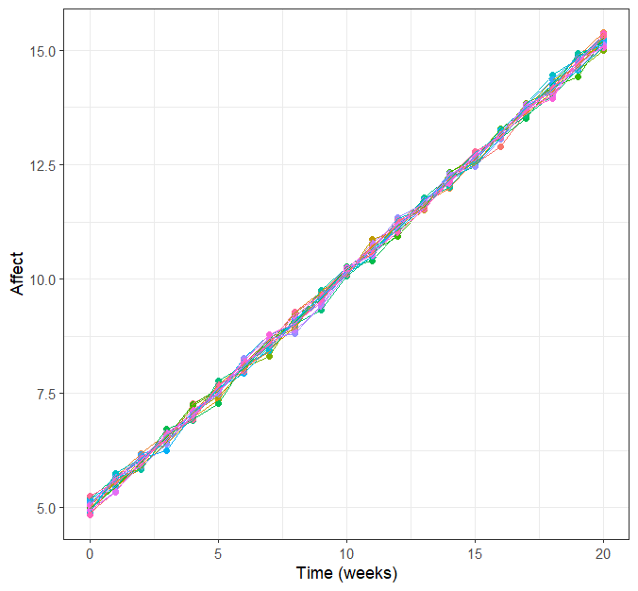
Many people, same intercept and slope
Notes:
This is what we call a fixed effects model

Slide 8

What if people actually differ?
What do we need to change in this model?
$$Y_{\left\{i, t\right\}}=β+γ∗time_{\left\{i,t\right\}}+ε_{\left\{i,t\right\}}$$
$$ε_{\left\{i,t\right\}}\sim N(0,σ^{2})$$

Slide 9

What if people actually differ?
What do we need to change in this model?
$$Y_{\left\{i, t\right\}}=β_{i}+γ_{i}∗time_{\left\{i,t\right\}}+ε_{\left\{i,t\right\}}$$
$$ε_{\left\{i,t\right\}}\sim N(0,σ^{2})$$

Slide 10
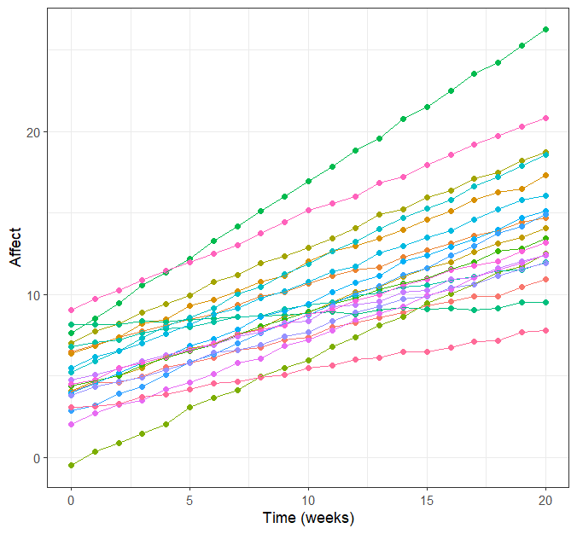

Slide 11
A finite data problem…

Slide 12


Hierarchical modeling
We can reconceptualize subject-specific lines, as deviations from a common line.
$$Y_{\left\{i, t\right\}}=β_{i}+γ_{i}∗time_{\left\{i,t\right\}}+ε_{\left\{i,t\right\}}$$
$$β_{i}=\left(β+τ_{0i}\right)$$
$$γ_{i}= (γ+τ_{1i})$$

Slide 13




Hierarchical modeling
We can reconceptualize subject-specific lines, as deviations from a common line. These deviations are assumed to come from a normal distribution with a mean of zero.
$$Y_{\left\{i, t\right\}}=β_{i}+γ_{i}∗time_{\left\{i,t\right\}}+ε_{\left\{i,t\right\}}$$
$$β_{i}=\left(β+τ_{0i}\right),$$
$$τ_{0i}\sim N(0,σ_{t0}^{2})$$
$$γ_{i}= \left(γ+τ_{1i}\right),$$
$$τ_{1i}\sim N(0,σ_{ti}^{2})$$

Slide 14
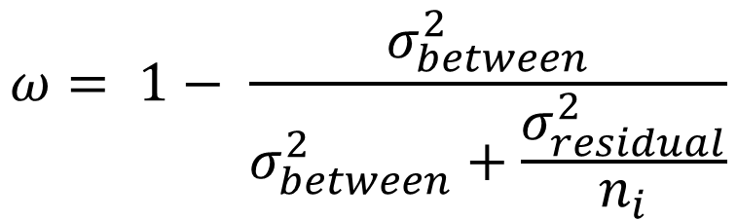
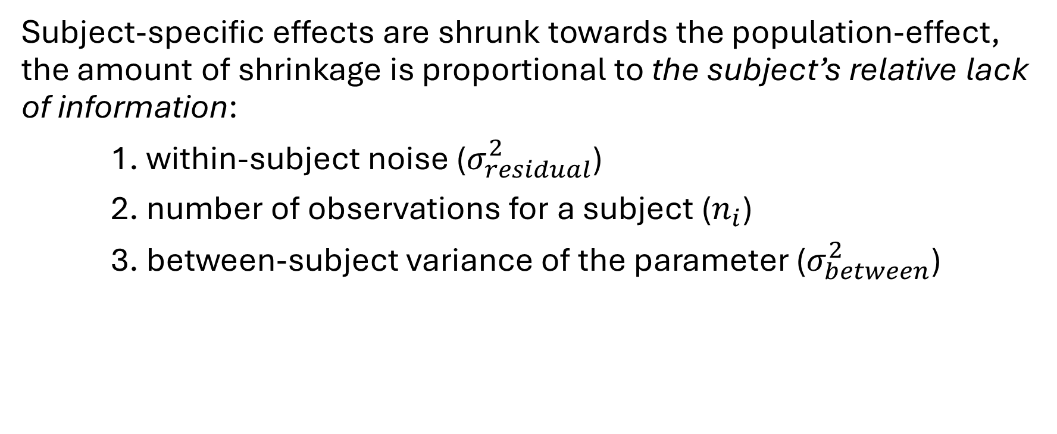
Partial pooling
Subject-specific effects are shrunk towards the population-effect, the amount of shrinkage is proportional to the subject’s relative lack of information:
1. within-subject noise ($σ_{residual}^{2}$)
2. number of observations for a subject ($n_{i}$)
3. between-subject variance of the parameter ($σ_{between}^{2}$)
$$ω= 1− \frac{σ_{between}^{2}}{σ_{between}^{2}+\frac{σ_{residual}^{2}}{n_{i}}}$$

Slide 15
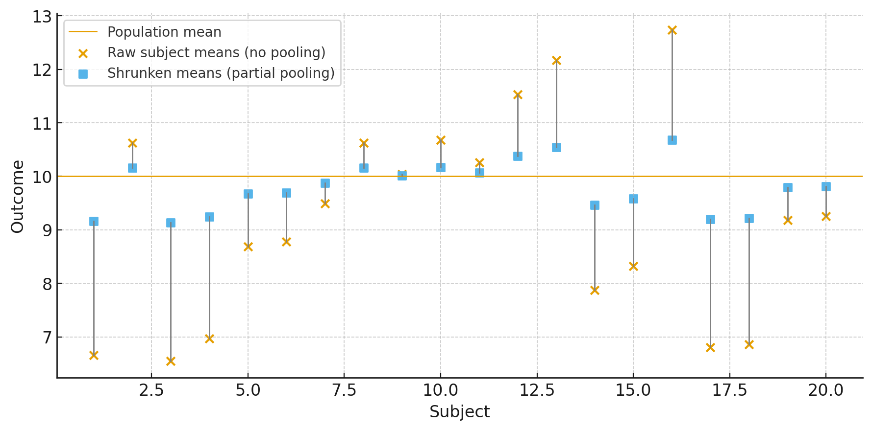
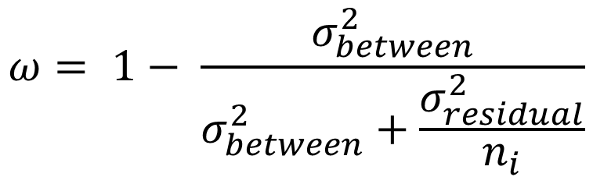

Partial pooling
$$ω= 1− \frac{σ_{between}^{2}}{σ_{between}^{2}+\frac{σ_{residual}^{2}}{n_{i}}}$$
$$β_{i}=ω∗β+\left(1−ω\right)∗τ_{0i}$$

Slide 16
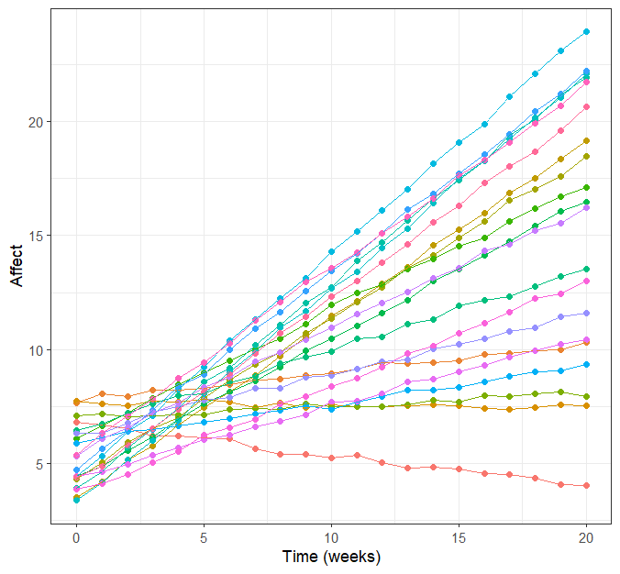
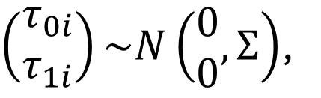
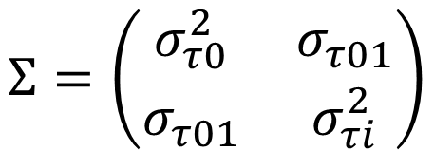


Correlated intercept and slope
$$Y_{\left\{i, t\right\}}=β_{i}+γ_{i}∗time_{\left\{i,t\right\}}+ε_{\left\{i,t\right\}}$$
$$β_{i}=\left(β+τ_{0i}\right)$$
$$γ_{i}= \left(γ+τ_{1i}\right)$$
$\left(\begin{matrix}τ_{0i} \\ τ_{1i}\end{matrix}\right)\sim N\left(\begin{matrix}0 \\ 0\end{matrix}, Σ\right)$,
$$Σ=\left(\begin{matrix}σ_{τ0}^{2} & σ_{τ01} \\ σ_{τ01} & σ_{τi}^{2}\end{matrix}\right)$$

Slide 17

Group activity
https://github.com/mearistodemou
Find the code in dynamic-systems-uzh → Lecture2 → lgcm_sim.R
Think of how you can fit your conceptual idea to this model
Move the parameters around to fit your idea
Tell me what you would like to model, but can’t easily change

Slide 18
Break

Slide 19
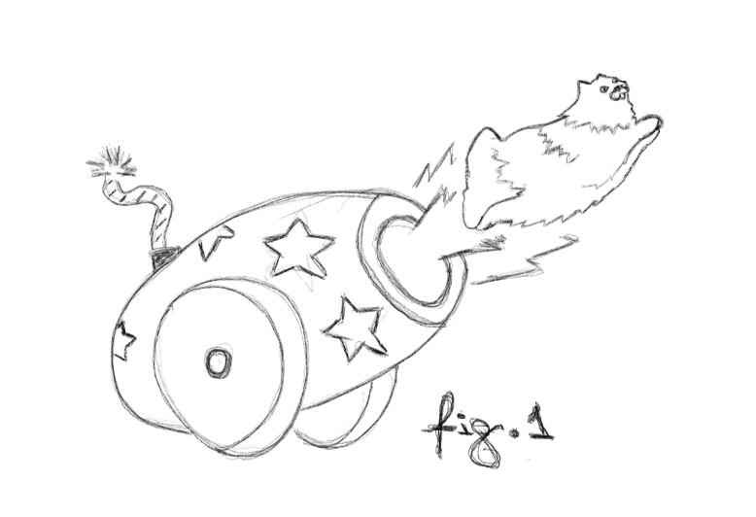
Magic cats?

Slide 20
Formalize this model
“Every 1 second, they fall by half of their current distance from the ground”

Slide 21
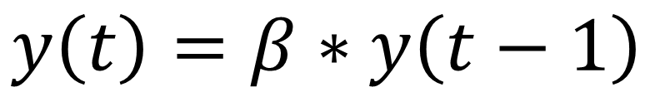
Formalize this model
“Every 1 second, they fall by half of their current distance from the ground”
$$y\left(t\right)=β∗y\left(t−1\right)$$

Slide 22
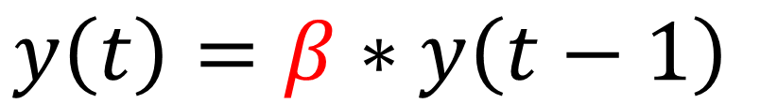
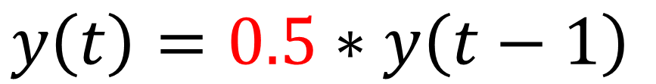
Let’s launch some cats
Launch them 20 meters in the air (T0)
Model their fall using the AR-1 model
By hand calculate where they will be after 4 seconds it by time point (T4)
Draw a graph of their current height at each time point
$$y\left(t\right)=β∗y\left(t−1\right)$$
$$y\left(t\right)=0.5∗y\left(t−1\right)$$

Slide 23
Let’s add some shocks!
Two people getting in an argument, John and Luca.
John (reactive, composes himself quick)
Luca (hard to shake, slow to compose himself)

Slide 24
Let’s add some shocks!
Two people getting in an argument, John and Luca.
John (reactive, composes himself quick)
Luca (hard to shake, slow to compose himself)
$$y\left(i,t\right)=β_{i}∗y\left(i,t−1\right)+e_{i,t}$$

Slide 25


Let’s add some shocks!
Two people getting in an argument, John and Luca.
John (reactive, composes himself quick)
Luca (hard to shake, slow to compose himself)
$$y\left(i,t\right)=β_{i}∗y\left(i,t−1\right)+e_{i,t}$$
$$β_{1}=0.2$$
$$β_{2}=0.6$$

Slide 26


Let’s add some shocks!
Two people getting in an argument, John and Luca.
John (reactive, composes himself quick)
Luca (hard to shake, slow to compose himself)
$$y\left(i,t\right)=β_{i}∗y\left(i,t−1\right)+e_{i,t}$$
$$β_{1}=0.2$$
$$β_{2}=0.6$$

Slide 27


Simulated arguing
Draw the ebb and flow of John and Luca’s emotions as they argue
$$y\left(John,t\right)=0.2∗y\left(i,t−1\right)+e_{i,t}$$
$$y\left(Luca,t\right)=0.6∗y\left(i,t−1\right)+e_{i,t}$$
$$e_{John,t}=6,0,8,0$$
$$e_{Luca,t}=0,2,0,6$$

Slide 28
Two questions about these models
What happens in between the observations?
How can we stop noise from carrying over to the next occasion?

Slide 29
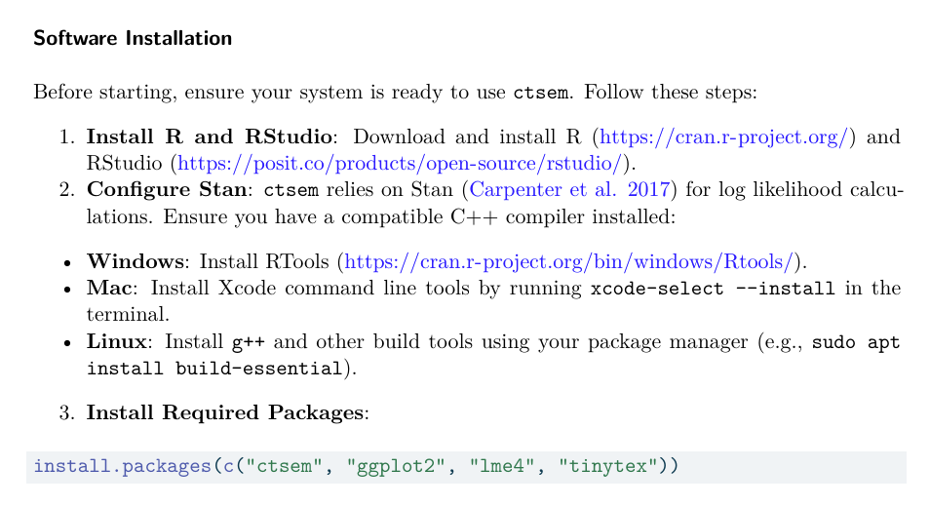
Download ctsem package in R

Slide 30
Extra: Visualizing covariance
Paper: https://psyarxiv.com/gwu8b
Game: https://www.guessthecorrelation.com/

Slide 31
Thank you for listening ☺

