Slide 1
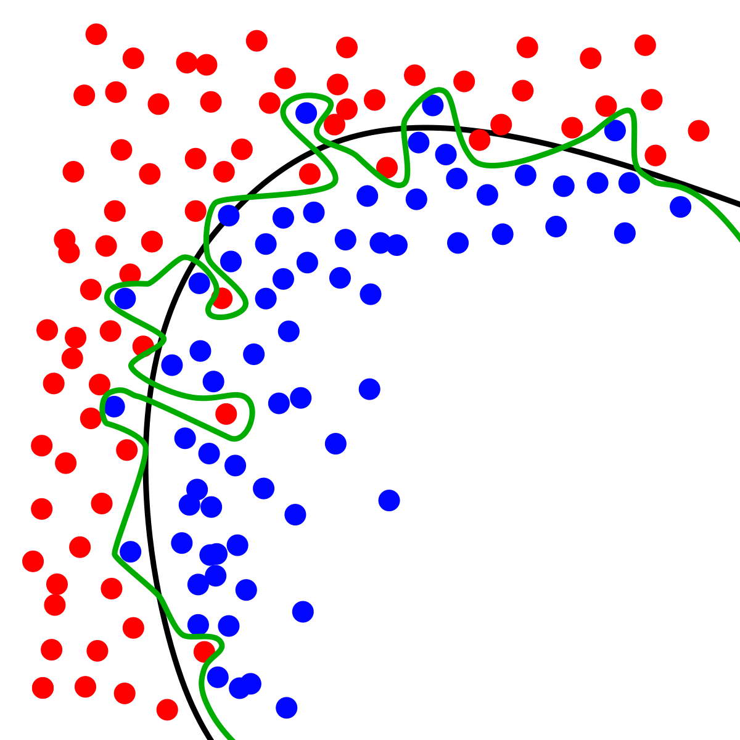
Dynamic Systems Thinking for
Psychologists
Michael E. Aristodemou
michael.aristodemou@psychologie.uzh.ch
Lecture 4: Magic cats & Continuous-time models

Slide 2
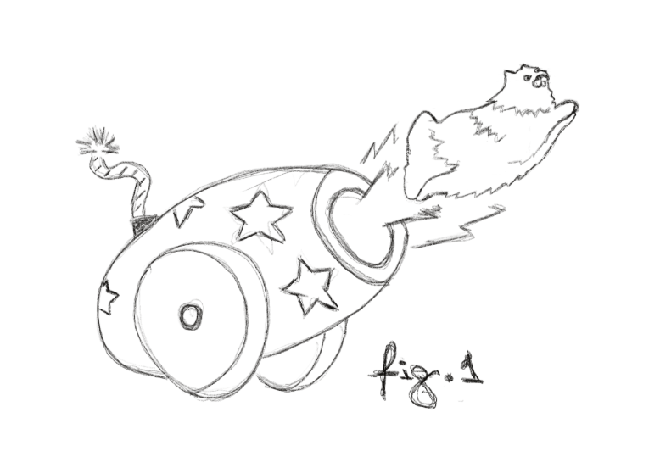
Magic cats?

Slide 3
Formalize this model
“Every 1 second, they fall by half of their current distance from the ground”
Notes:
So, if they are currently at 10 meters in 1-second they will be at 5, then after a second at 2.5, then 1.25 and so on.

Slide 4
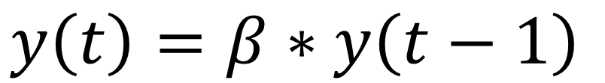
Formalize this model
“Every 1 second, they fall by half of their current distance from the ground”
$$y\left(t\right)=β∗y\left(t−1\right)$$

Slide 5
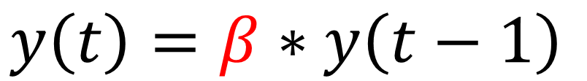
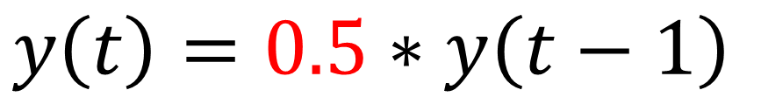
Let’s launch some cats
Launch them 20 meters in the air (T0)
Model their fall using the AR-1 model
By hand calculate where they will be after 4 seconds, i.e., by time point (T4)
Draw a graph of their current height at each time point
$$y\left(t\right)=β∗y\left(t−1\right)$$
$$y\left(t\right)=0.5∗y\left(t−1\right)$$

Slide 6
Let’s add some shocks!
Two people getting in an argument, John and Luca.
John (reactive, composes himself quick)
Luca (hard to shake, slow to compose himself)

Slide 7
Let’s add some shocks!
Two people getting in an argument, John and Luca.
John (reactive, composes himself quick)
Luca (hard to shake, slow to compose himself)
$$y\left(i,t\right)=β_{i}∗y\left(i,t−1\right)+e_{i,t}$$

Slide 8


Let’s add some shocks!
Two people getting in an argument, John and Luca.
John (reactive, composes himself quick)
Luca (hard to shake, slow to compose himself)
$$y\left(i,t\right)=β_{i}∗y\left(i,t−1\right)+e_{i,t}$$
$$β_{1}=0.2$$
$$β_{2}=0.6$$

Slide 9


Let’s add some shocks!
Two people getting in an argument, John and Luca.
John (reactive, composes himself quick)
Luca (hard to shake, slow to compose himself)
$$y\left(i,t\right)=β_{i}∗y\left(i,t−1\right)+e_{i,t}$$
$$β_{1}=0.2$$
$$β_{2}=0.6$$

Slide 10
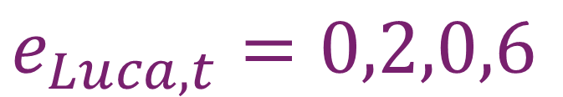
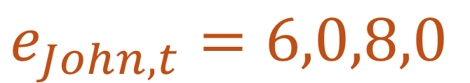
Simulated arguing
Draw the ebb and flow of John and Luca’s emotions as they argue
$$y\left(John,t\right)=0.2∗y\left(i,t−1\right)+e_{i,t}$$
$$y\left(Luca,t\right)=0.6∗y\left(i,t−1\right)+e_{i,t}$$
$$e_{John,t}=6,0,8,0$$
$$e_{Luca,t}=0,2,0,6$$

Slide 11
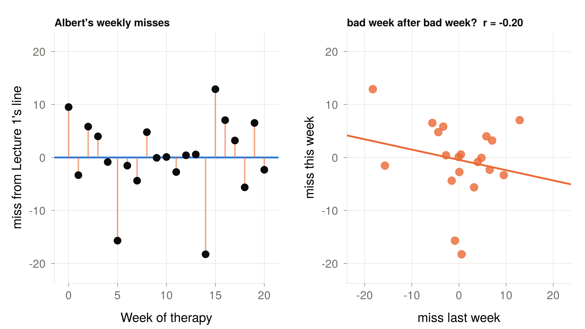
Back to Albert
, 95% CI [-0.59, 0.26]

Slide 12
Why are we seeing no carryover?

Slide 13
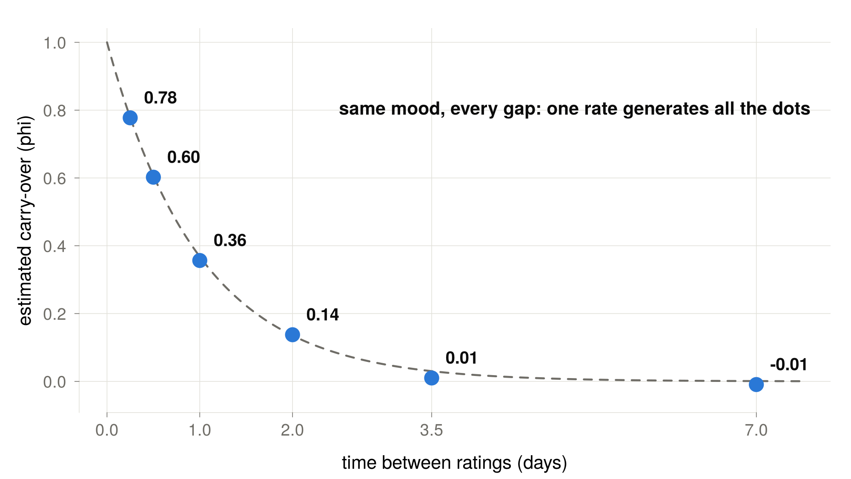

Slide 14
Two questions about these models
What happens in between the observations?
How can we stop noise from carrying over to the next occasion?

Slide 15
Break

Slide 16






Discrete time is status-quo in psychology
$$Y_{t−2}$$
$$Y_{t−1}$$
$$Y_{t}$$
$$X_{t−2}$$
$$X_{t−1}$$
$$X_{t}$$

Slide 17
Three assumptions in discrete time models

Slide 18


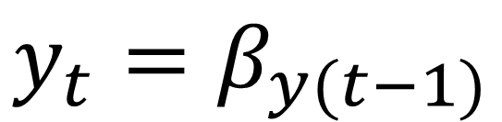

A1: Time lags are equidistant
0.5
0.5
$$y_{t−2}$$
$$y_{t−1}$$
$$y_{t}$$
$$y_{t}=β_{y(t−1)}$$

Slide 19



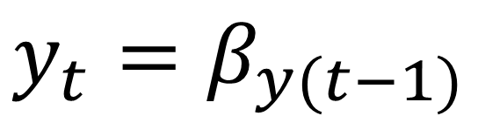

A1: What happens when they are not?
0.5
0.5
?
$$y_{t−2}$$
$$y_{t−1}$$
$$y_{t}$$
$$y_{t+1}$$
1 week
1 week
2 weeks
$$y_{t}=β_{y(t−1)}$$

Slide 20
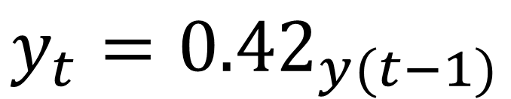
A1: What happens when they are not?
0.5
0.5
0.25
$$y_{t−2}$$
$$y_{t−1}$$
$$y_{t}$$
$$y_{t+1}$$
$$y_{t}={0.42}_{y(t−1)}$$
Notes:
0.416

Slide 21
A2: We have the correct time lag
1
2
3

Slide 22
A2: We have the correct time lag
1
2
3

Slide 23
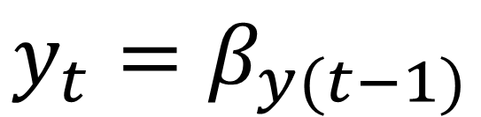
A3.1: Processes only change and interact when observations occur
$$y_{t}=β_{y(t−1)}$$

Slide 24
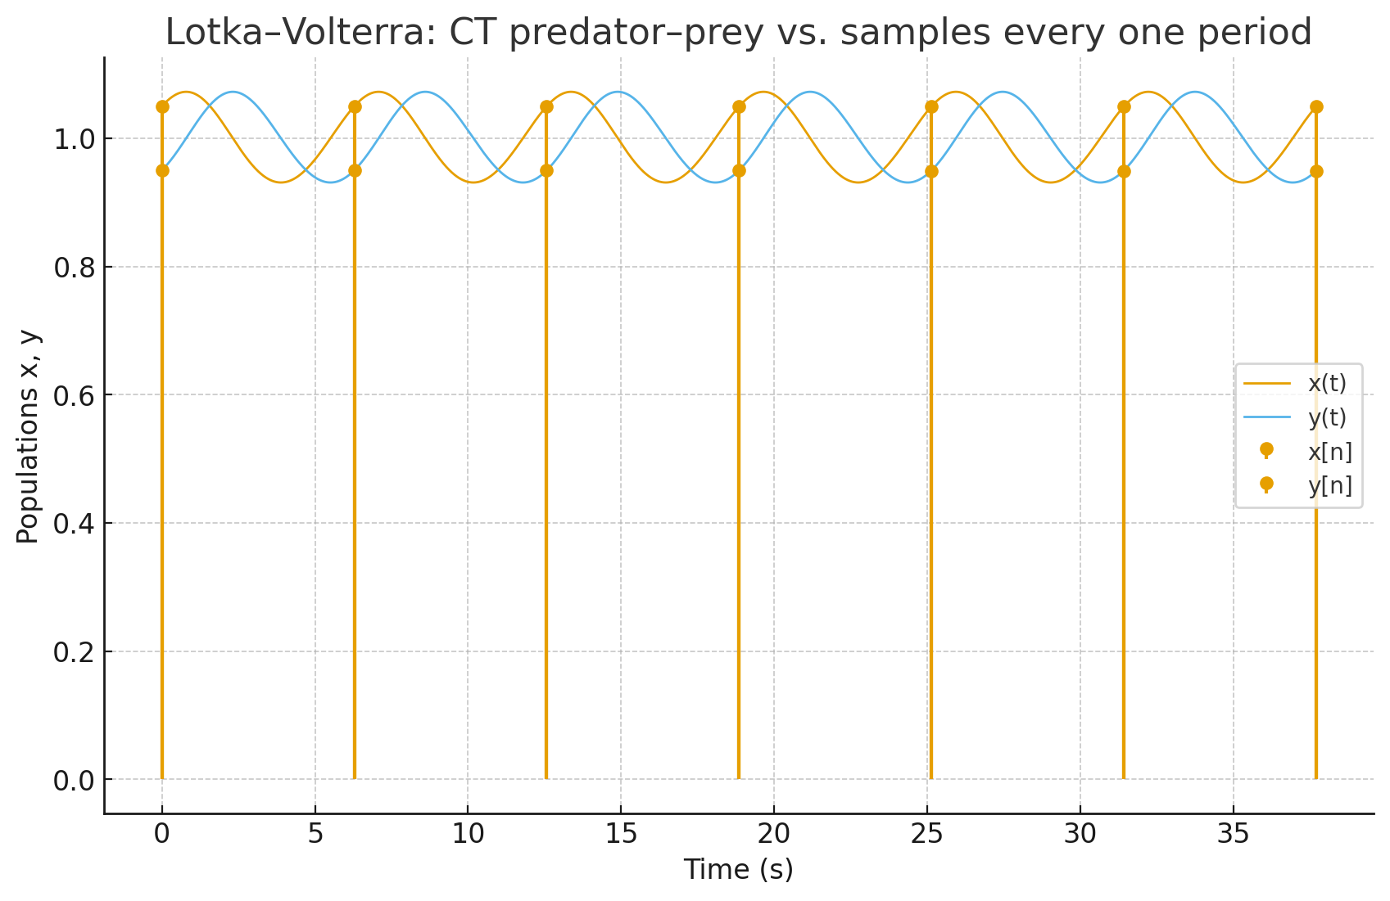
What if we have a continuous process?

Slide 25
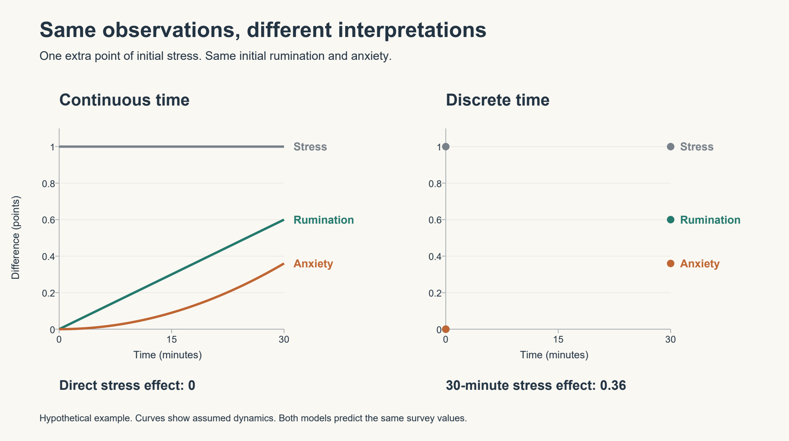
A3.2: The DT model represents the total effect of the system’s underlying changes over each model interval
S → R → A

Slide 26
Continuous-time models formalize the instantaneous rate of change

Slide 27
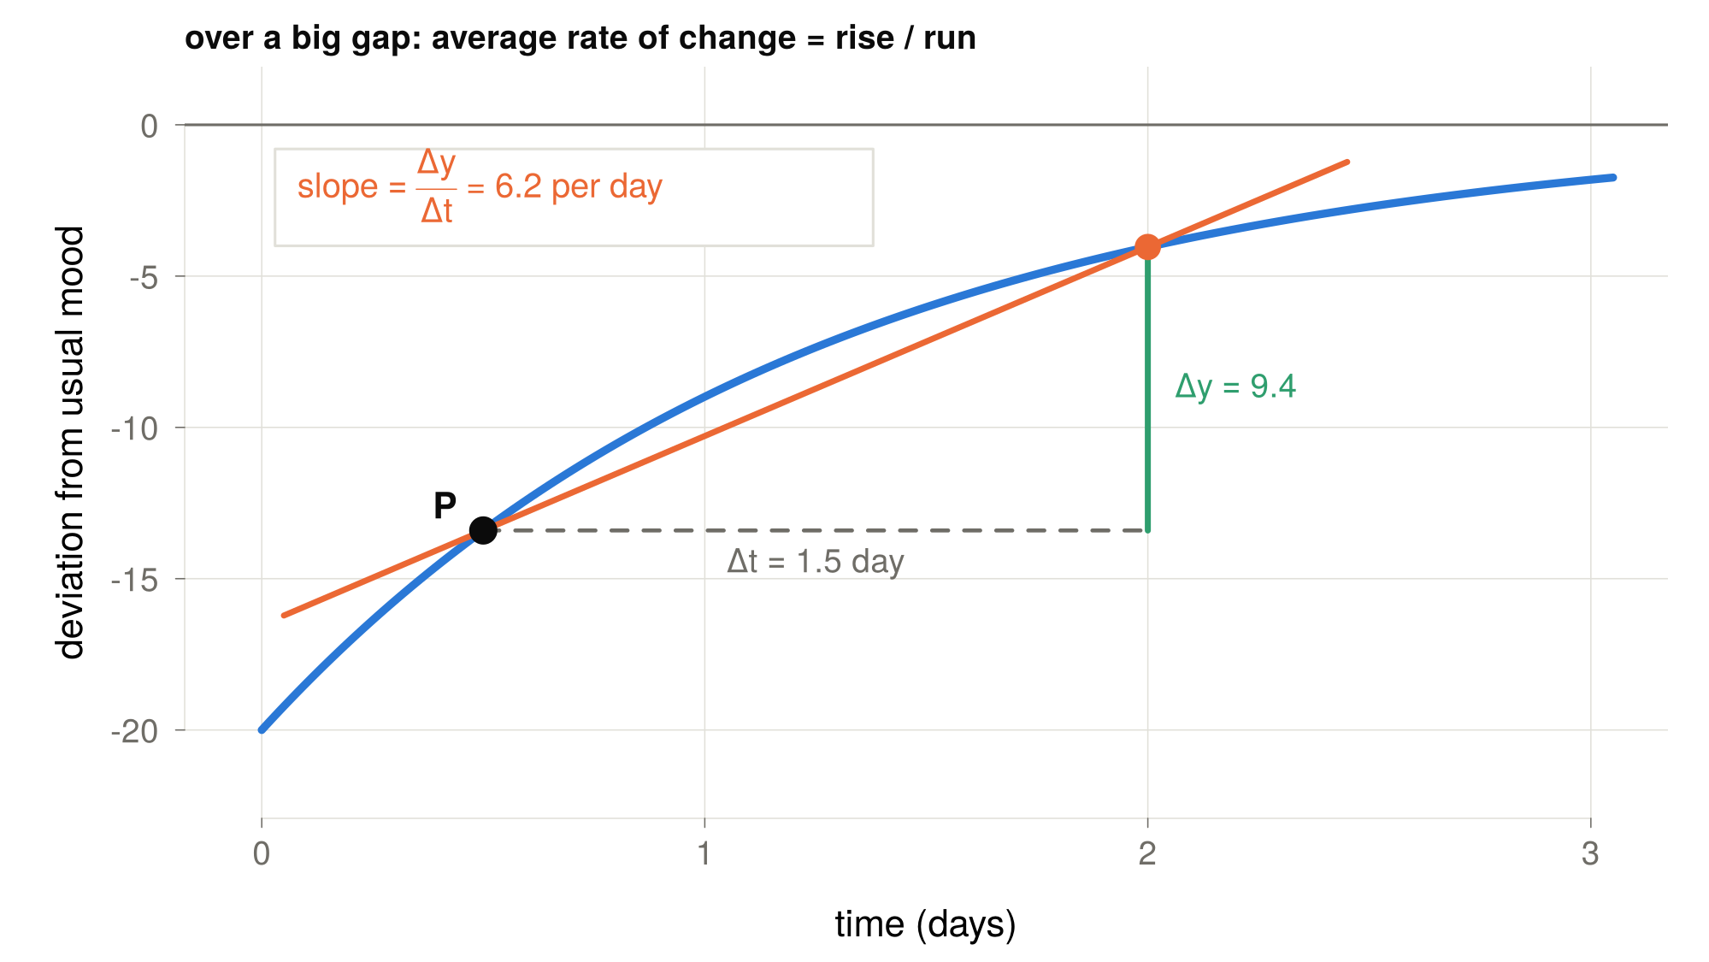

Slide 28
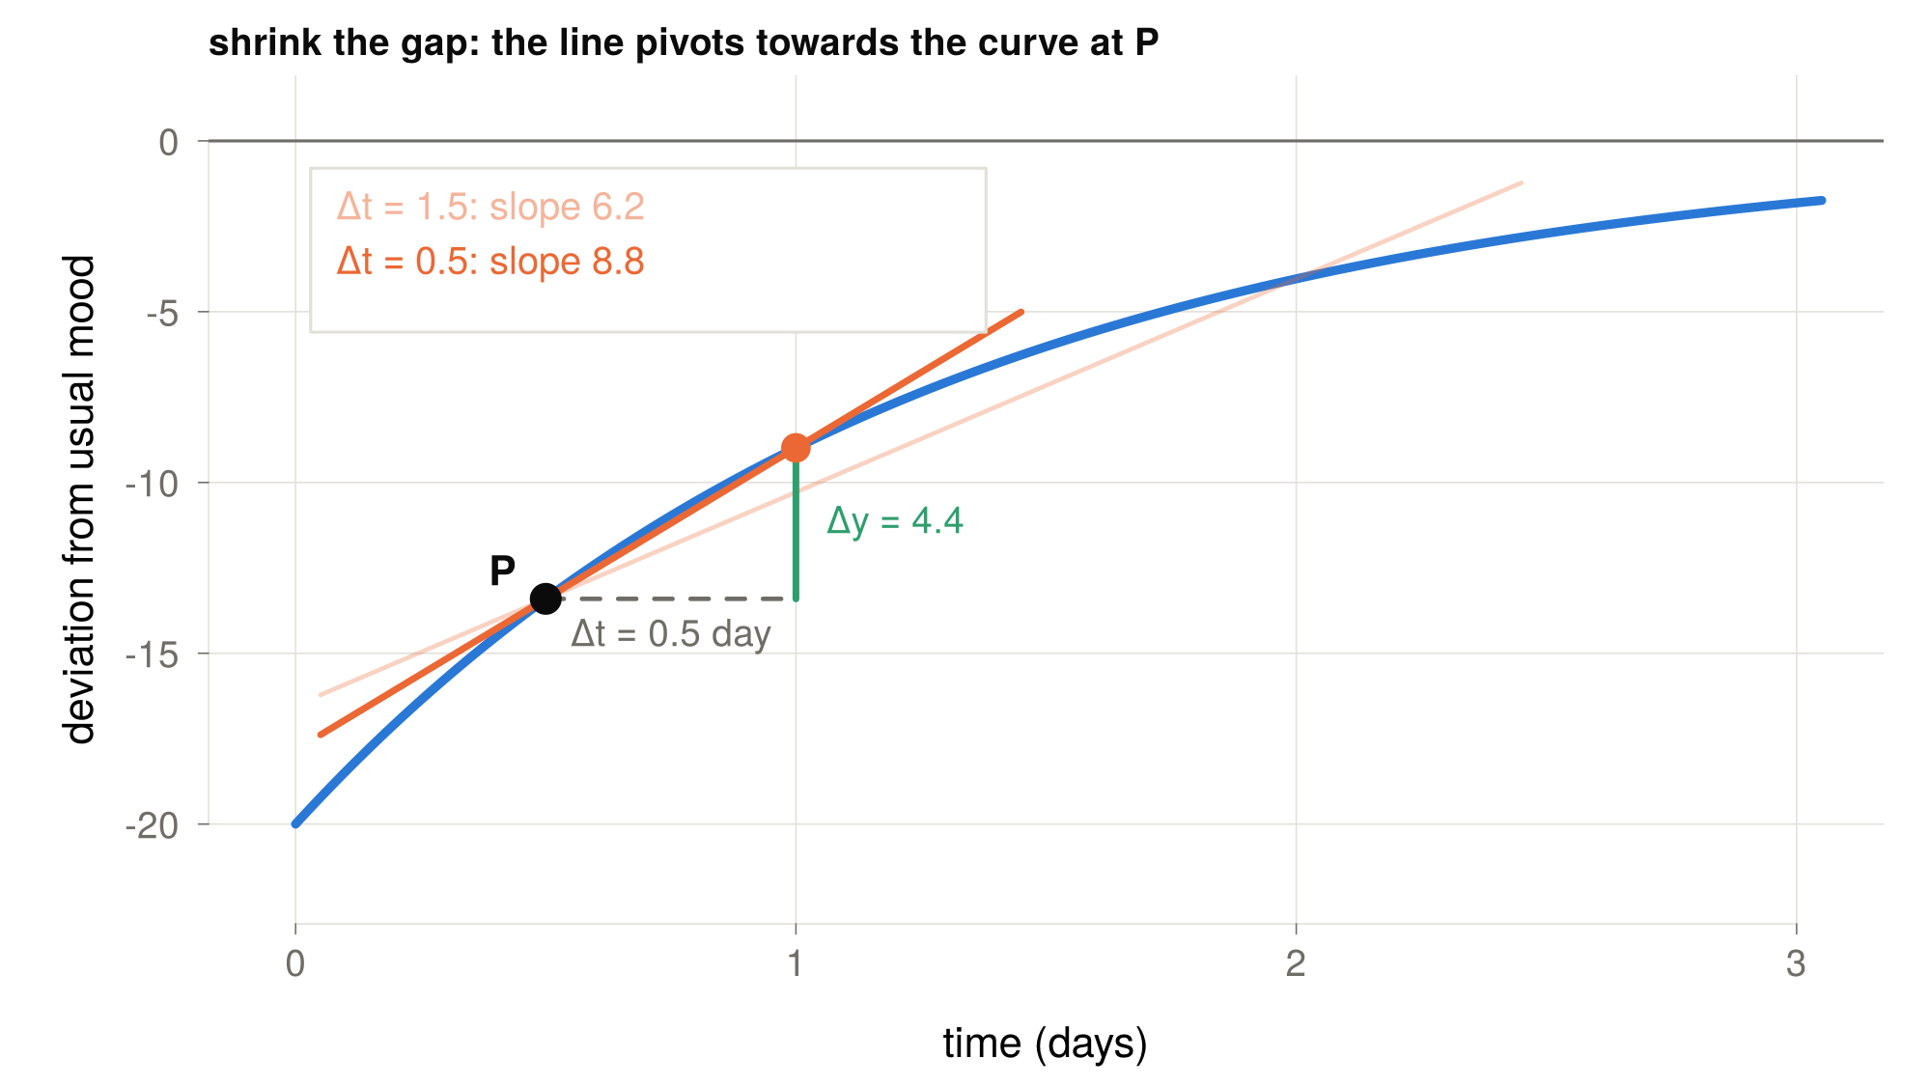

Slide 29
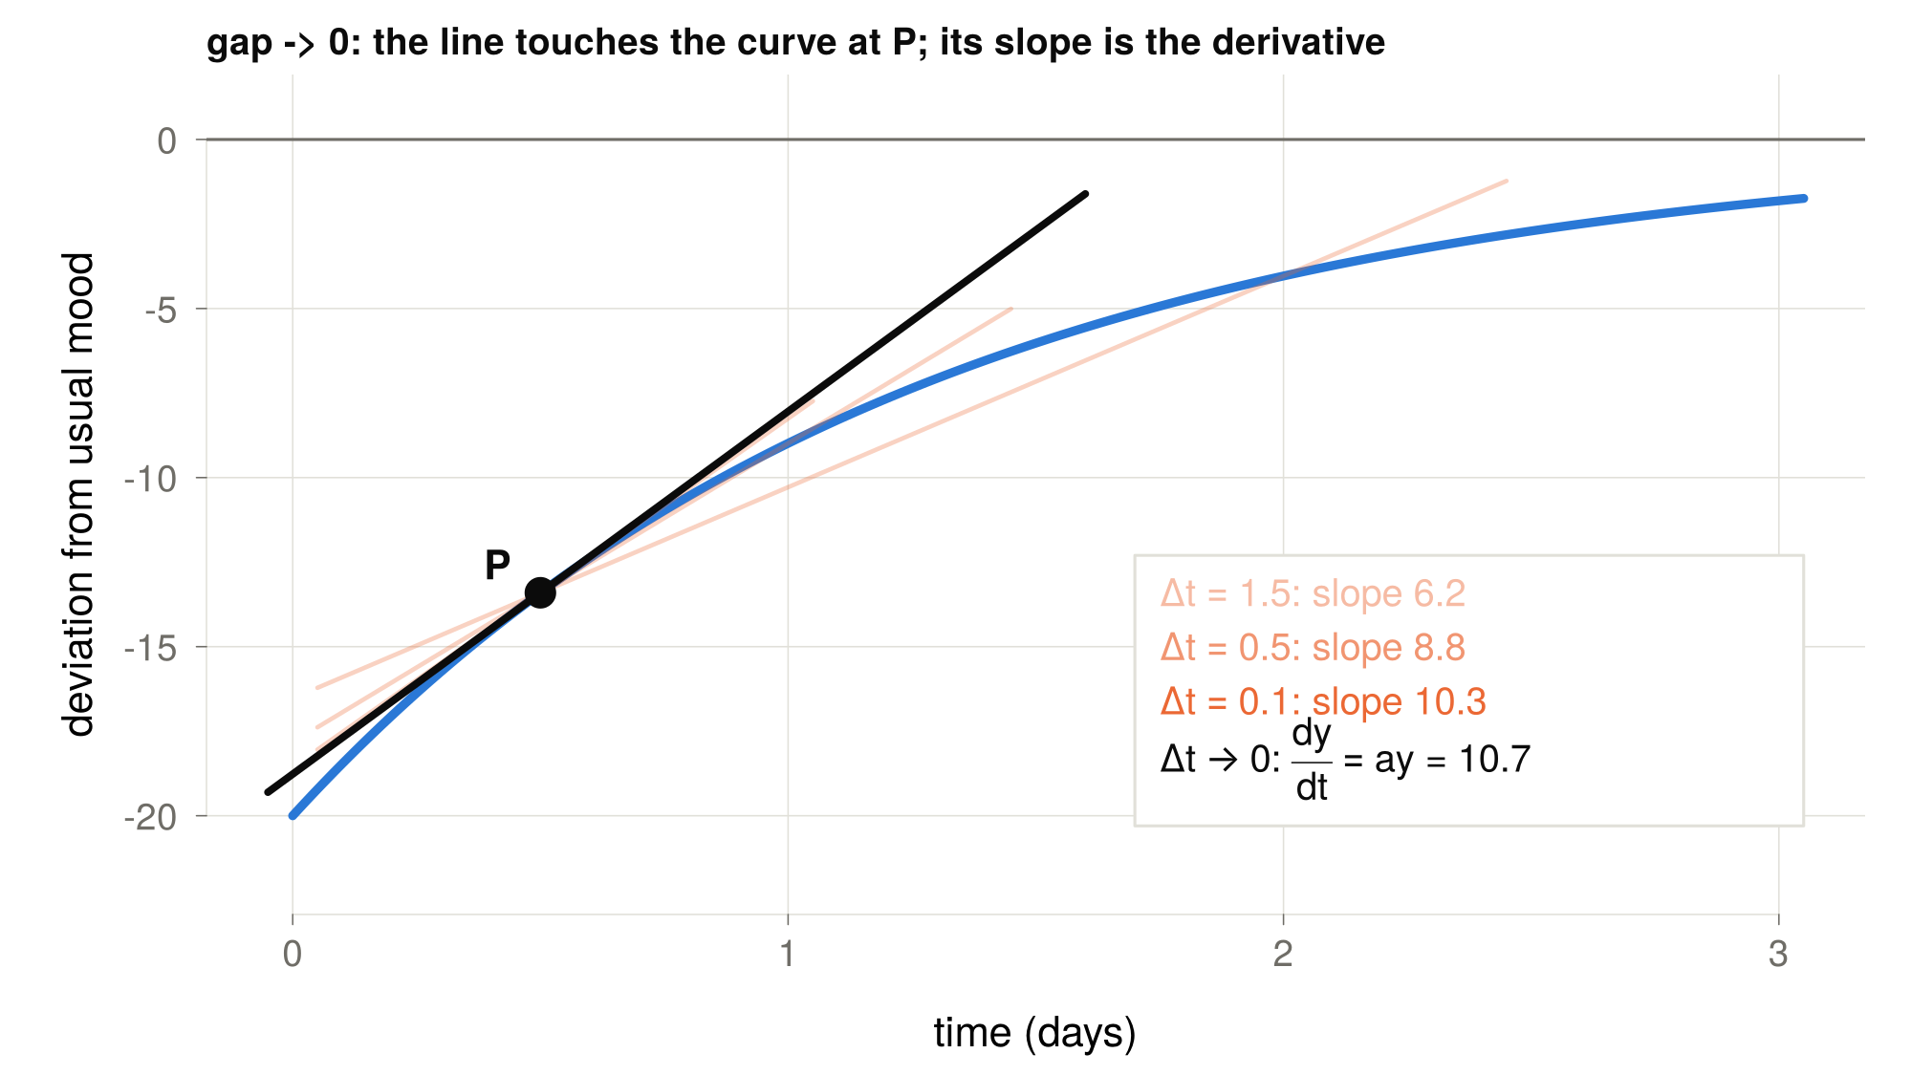

Slide 30



Continuous-time models
$$y_{t−2}$$
$$y_{t−1}$$
$$y_{t}$$

Slide 31
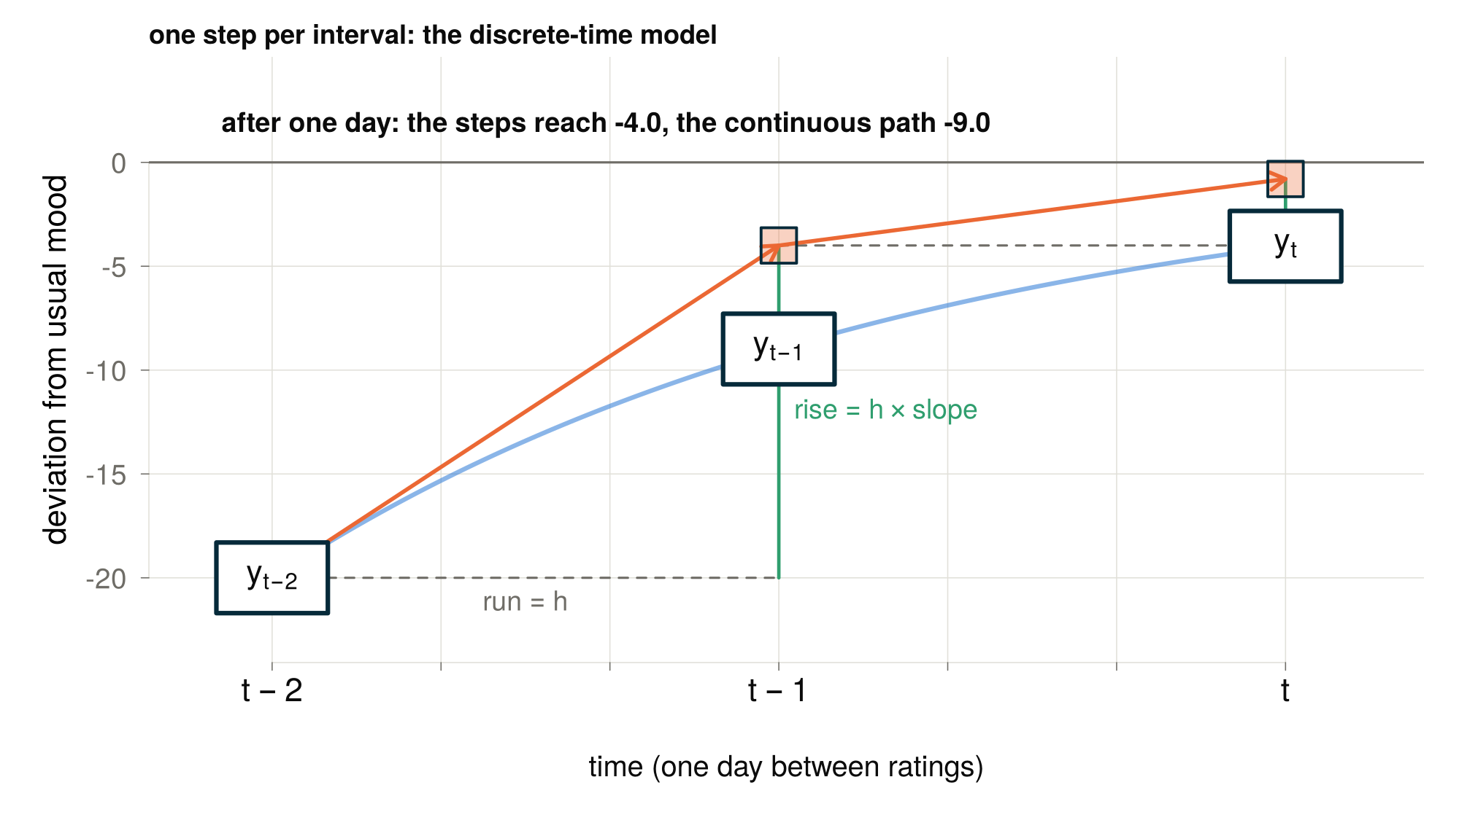

Slide 32
Continuous-time models
$$y_{t−2}$$
$$y_{t−1}$$
$$y_{t}$$

Slide 33
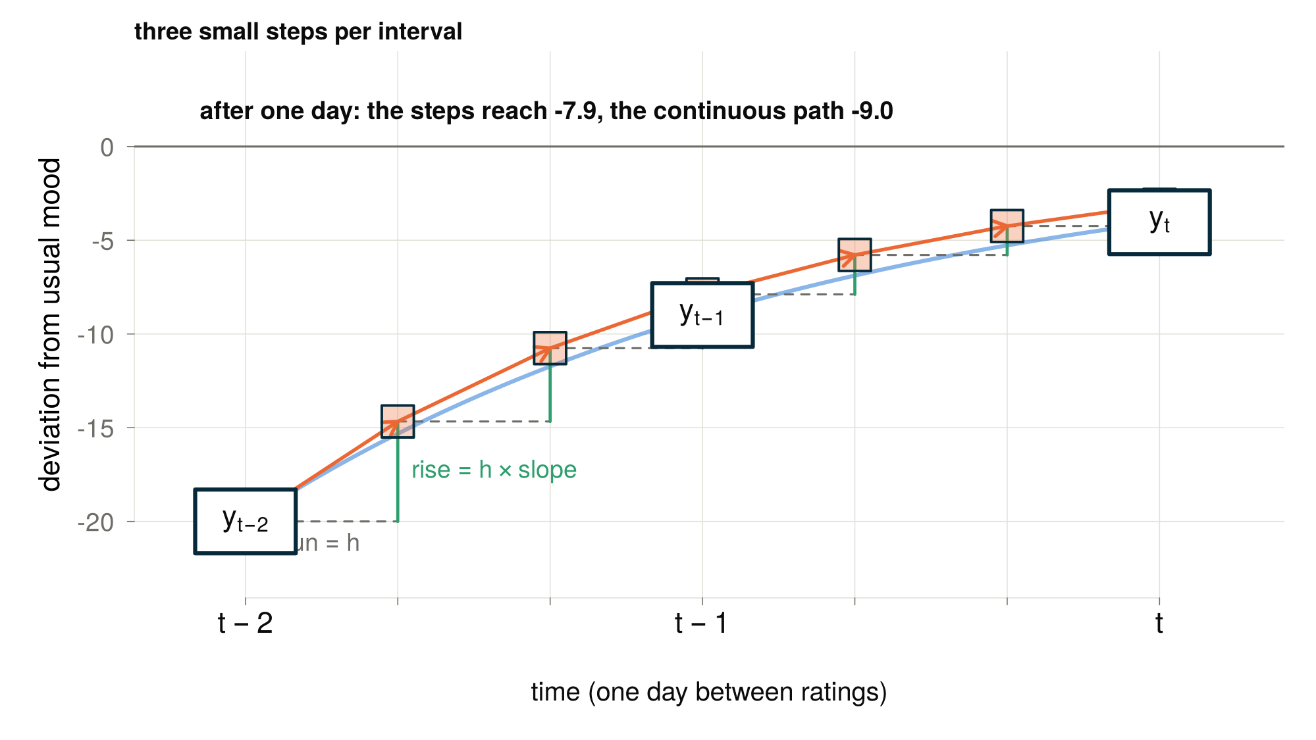

Slide 34
Continuous-time models
$$y_{t−2}$$
$$y_{t−1}$$
$$y_{t}$$

Slide 35
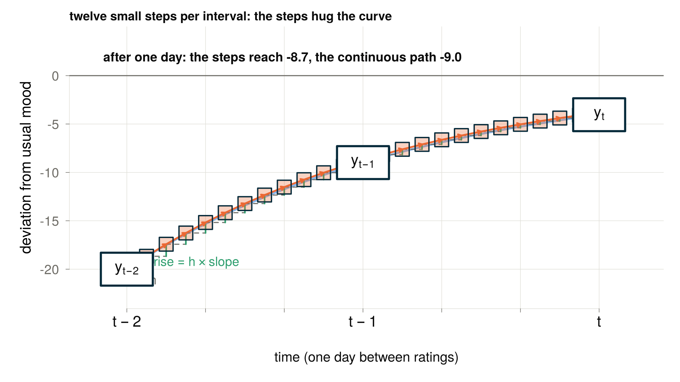

Slide 36
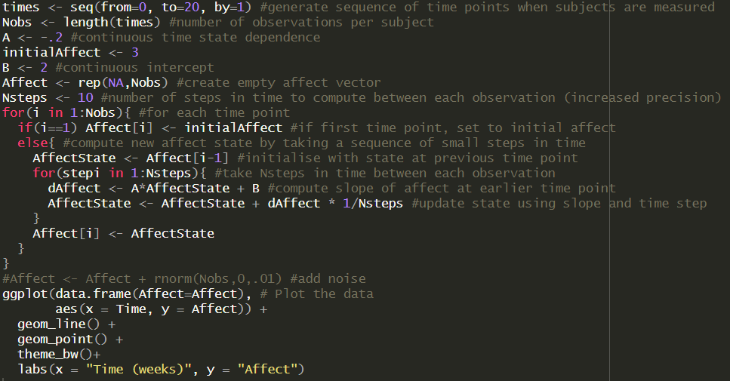
Euler-Maruyama approximation
We break continuous time into small time slices
We update the state of our growth process at each step based on the dynamics of our model
Notes:
A & B are per unit time rates of change (e.g. B = 2 per second). This is different to a discrete time parameter which describes the total effect over a whole sampling interval, not an instantaneous rate.

Slide 37
Simulate for yourself
Find the code on GitHub → Lecture04 → euler_W4.R
Increase the number of steps to 50, then back to 1. Observe the difference
Adapt the model to represent a constant rate of change
Add measurement error

Slide 38
Learn more about derivatives (extra)
https://www.youtube.com/watch?v=WUvTyaaNkzM
https://www.youtube.com/watch?v=9vKqVkMQHKk

Slide 39
Thank you for listening ☺

