Slide 1
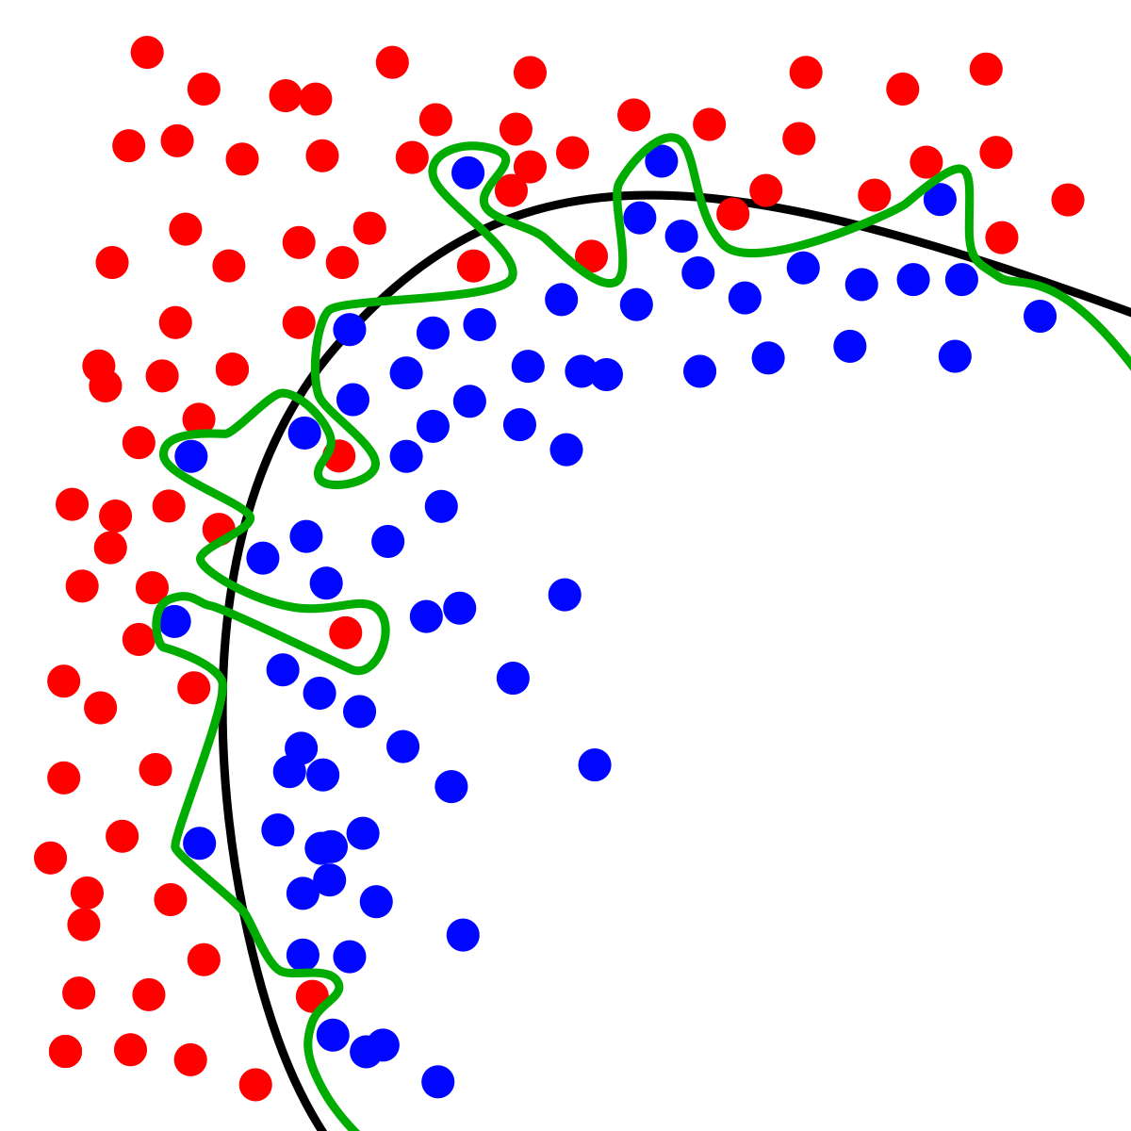
Dynamic Systems Thinking for Psychologists
Michael E. Aristodemou
michael.aristodemou@psychologie.uzh.ch
Lecture 2: General Linear Model

Slide 2

We have (now not so little) Albert going to therapy
We did a diagnostic interview and found the main complaint to be mood.
21 weeks of therapy.
We need to set up a study to find out more information about his progress.
What do we need?

Slide 3



Great ideas, but we don’t have money…
Measures: affect (continuous scale; 0 - 100)
Time interval: once every 7 days at 12:00 p.m.

Slide 4
We need to convince people to give us money

Slide 5
Let’s imagine the shape of change
Affect
Week

Slide 6
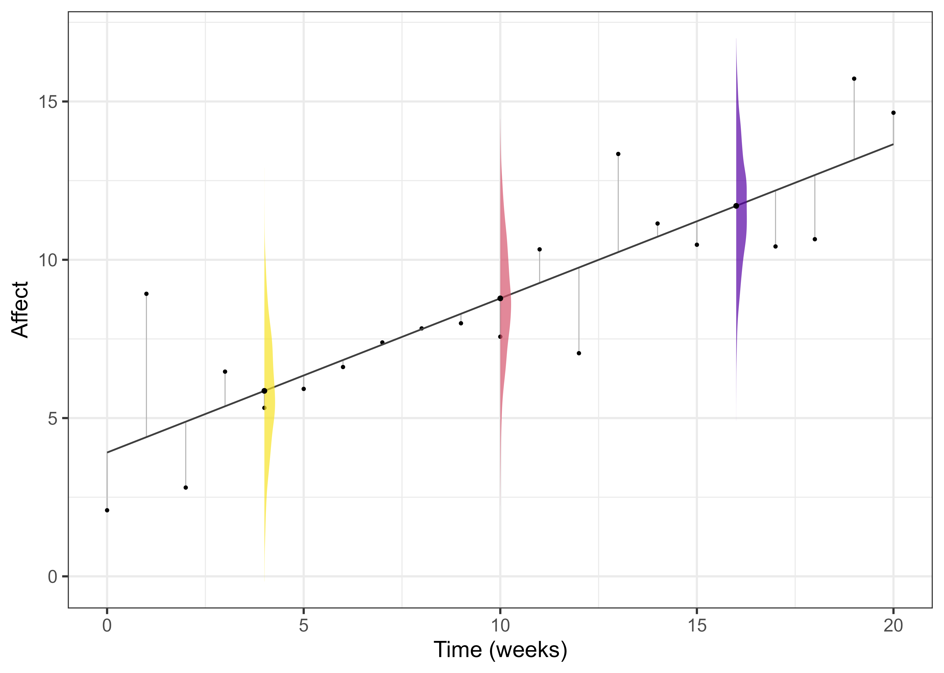
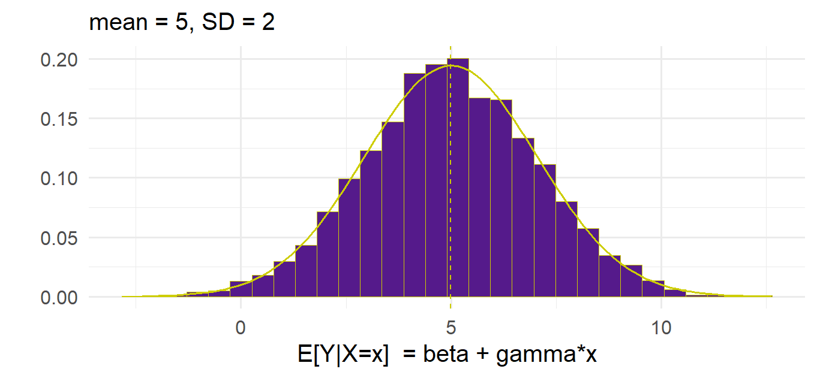


A linear model of change
$$Y_{\left\{t\right\}}=β+γ∗time_{\left\{t\right\}}+ε_{\left\{t\right\}}$$
$$ε_{\left\{t\right\}}\sim N(0,σ^{2})$$

Slide 7
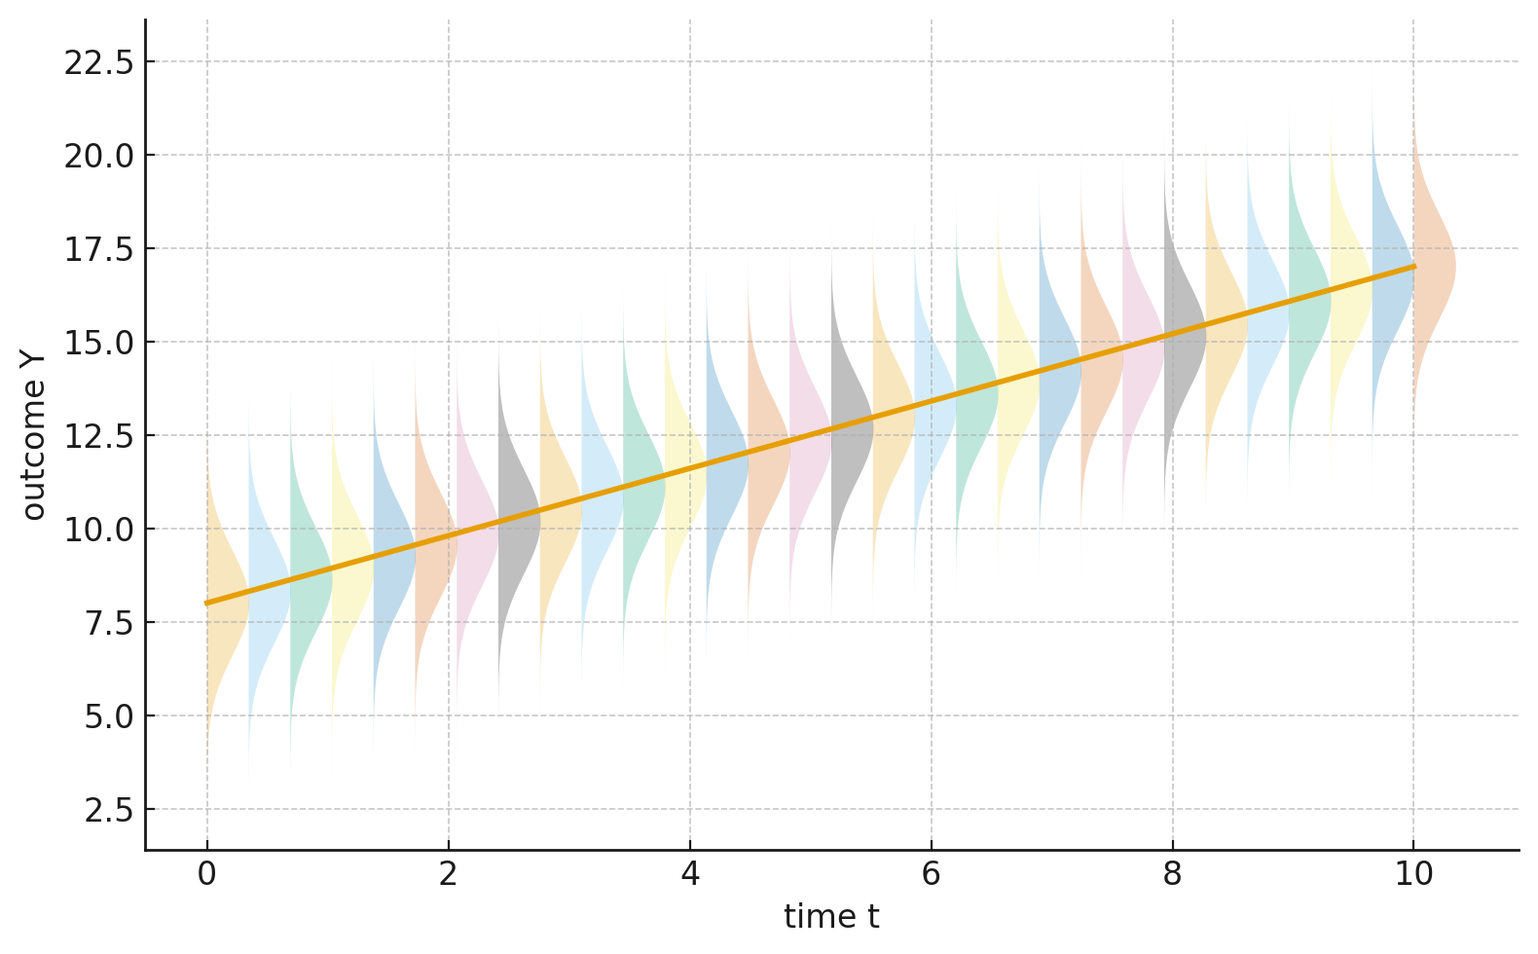

“The general linear model, models data as being randomly drawn from a distribution whose mean varies according to some parameter(s)”
$$Y_{\left\{t\right\}}\sim N(β+γ∗time_{\left\{t\right\}}, σ^{2})$$

Slide 8
Who has questions?

Slide 9
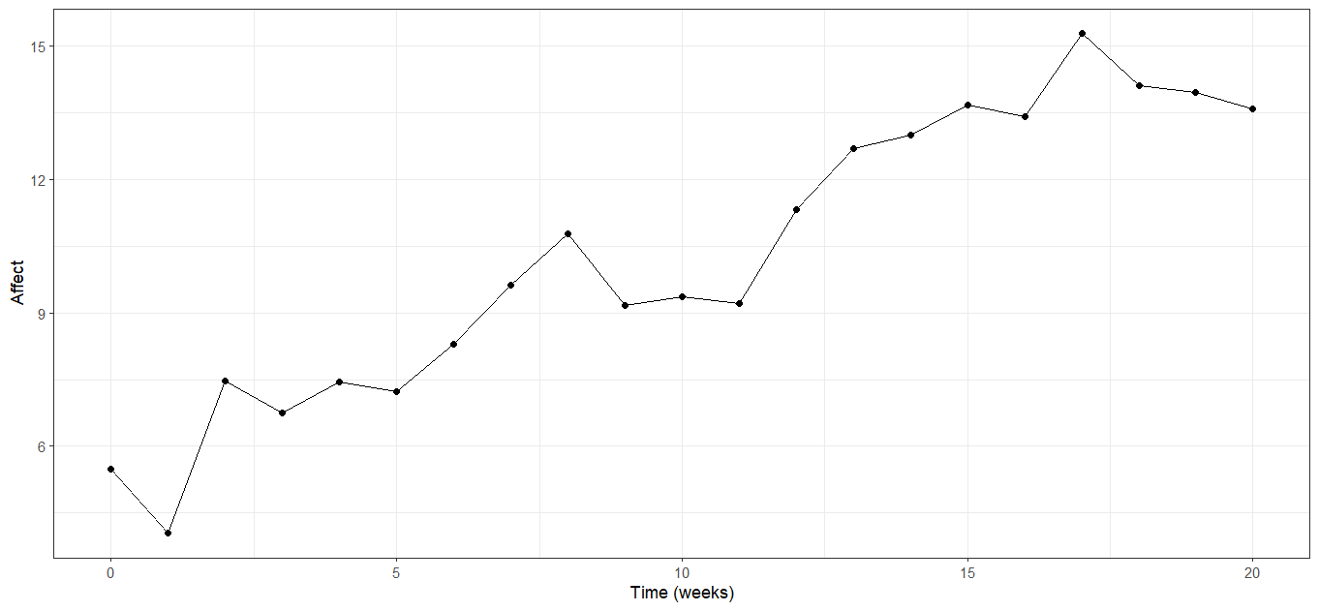
Let’s simulate the model-implied trajectory

Slide 10
Generate 21 time points

Slide 11
Generate 21 time points
Time = 0:20

Slide 12
Generate affect according to?

Slide 13
Generate “Affect” according to?
$${Affect}_{\left\{t\right\}}=β+γ∗time_{\left\{t\right\}}+ε_{\left\{t\right\}}$$

Slide 14
Generate “Affect” according to?
Beta = 5
$${Affect}_{\left\{t\right\}}=β+γ∗time_{\left\{t\right\}}+ε_{\left\{t\right\}}$$

Slide 15
Generate “Affect” according to?
Beta = 5
$${Affect}_{\left\{t\right\}}=β+γ∗time_{\left\{t\right\}}+ε_{\left\{t\right\}}$$
gamma = 0.51

Slide 16
Generate “Affect” according to?
epsilon =
rnorm(1, mean = 0, sd = 1)
Beta = 5
$${Affect}_{\left\{t\right\}}=β+γ∗time_{\left\{t\right\}}+ε_{\left\{t\right\}}$$
gamma = 0.51

Slide 17
How do we run this model for each {t}?
$${Affect}_{\left\{t\right\}}=β+γ∗time_{\left\{t\right\}}+ε_{\left\{t\right\}}$$
Time = 0:20
beta = 5
gamma = 0.51
epsilon = rnorm(n = length(Time), mean = 0, sd = 1)
Affect = NA # just a placeholder for Affect values

Slide 18
How do we run this model for each {t}?
$${Affect}_{\left\{t\right\}}=β+γ∗time_{\left\{t\right\}}+ε_{\left\{t\right\}}$$
Time = 0:20
beta = 5
gamma = 0.51
epsilon = rnorm(n = length(Time), mean = 0, sd = 1)
Affect = NA # just a placeholder for Affect values
for (t in 1:length(Time)) {
Affect[t] <- beta + gamma * Time[t] + epsilon[t]
}
data <- data.frame(Time = Time, Affect = Affect)

Slide 19
Now we need to visualize it…
Recreate this plot
Add a line depicting the trajectory of the expected mean

Slide 20
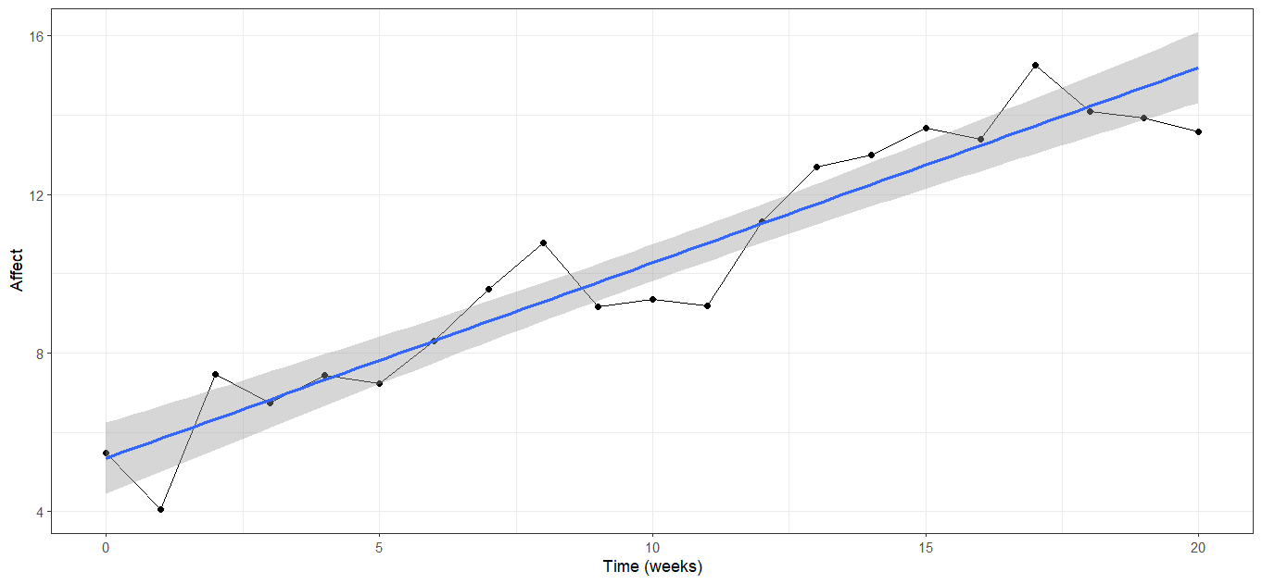
Let’s criticize this model…
$${Affect}_{\left\{t\right\}}=β+γ∗time_{\left\{t\right\}}+ε_{\left\{t\right\}}$$

Slide 21
Thank you for listening ☺

