Slide 1
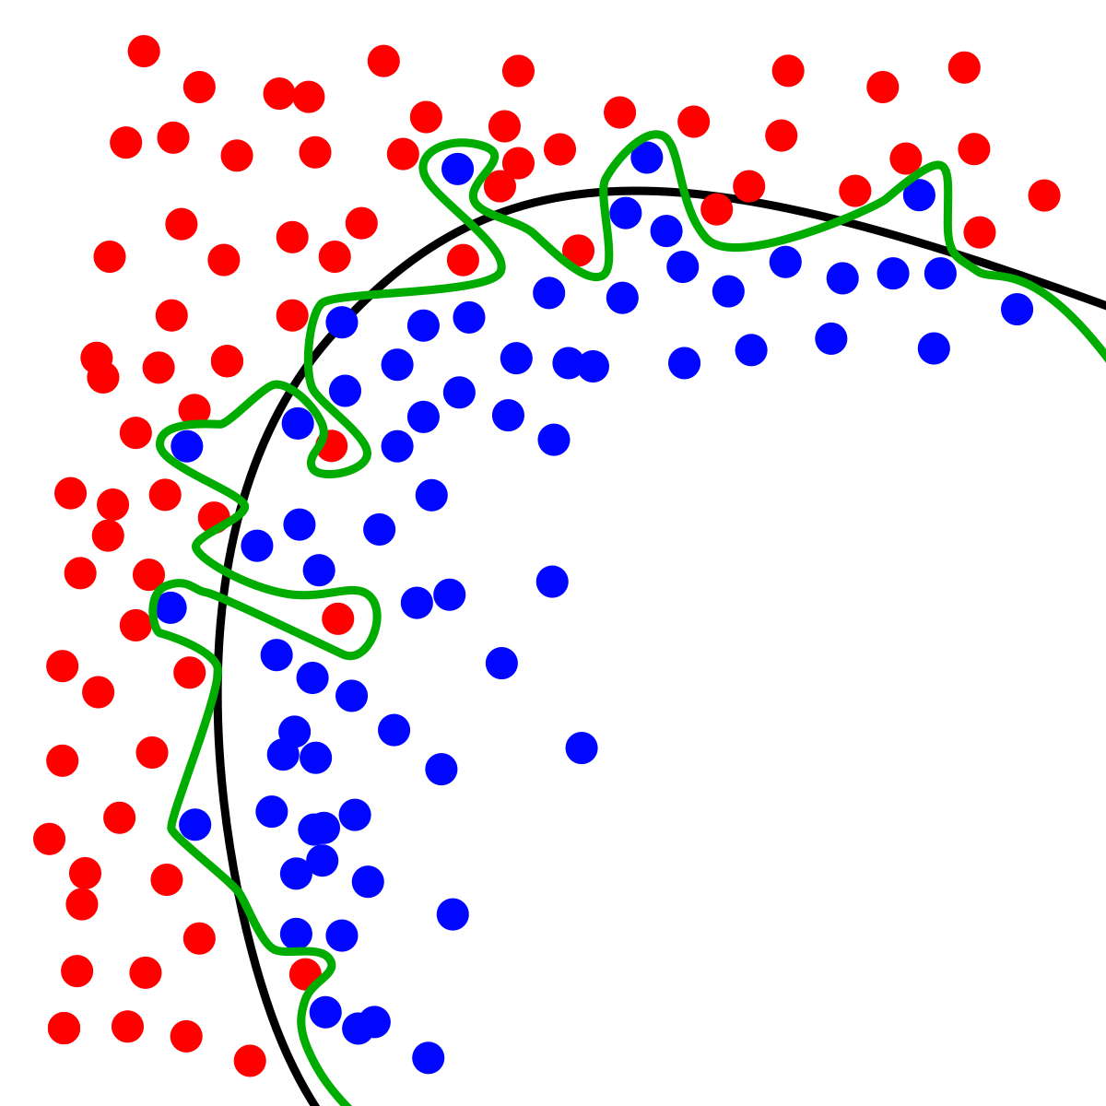
Dynamic Systems Thinking for Psychologists
Michael E. Aristodemou
michael.aristodemou@psychologie.uzh.ch
Lecture 5: Multidimensional Systems

Slide 2
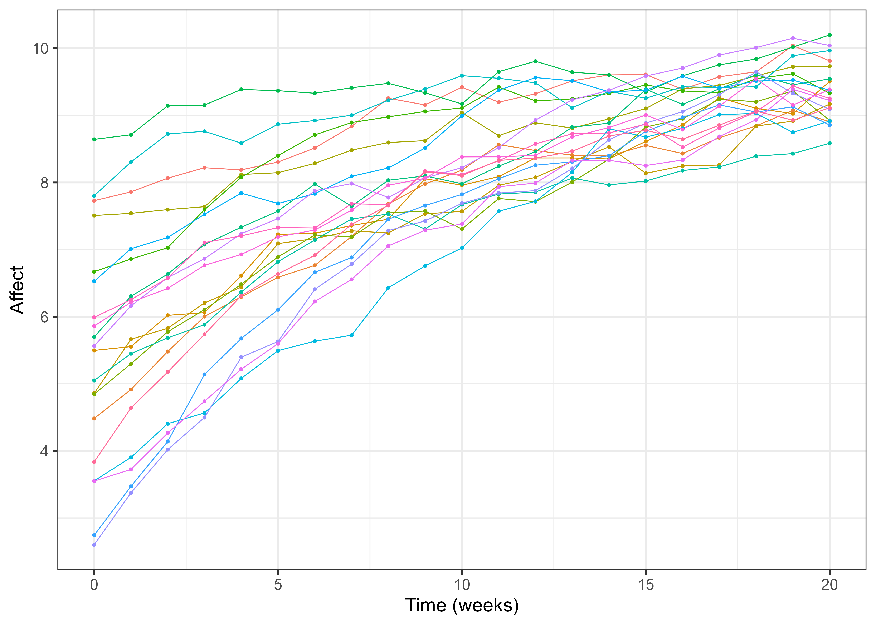


What can we still do with the amount of information we have?
$$Affect\left(t\right)=Λ∗η_{t}+ε_{1t}$$
$${dη}_{t}=\left(A_{t}+B\right)dt+GdW_{t}$$
$$η_{t0}\sim N(μ_{0},Σ_{0})$$
Affect once a week, at 12:00 pm
21 weeks
Notes:
We have a continuous time model, with system noise, state dependence, constant rate of change, individual differences in our parameters.
We can add a more complicated measurement model, random effects on all parameters, rate of change in the rate of change depends on state.

Slide 3
Can we make a case for more information?

Slide 4
What do we want to know?

Slide 5
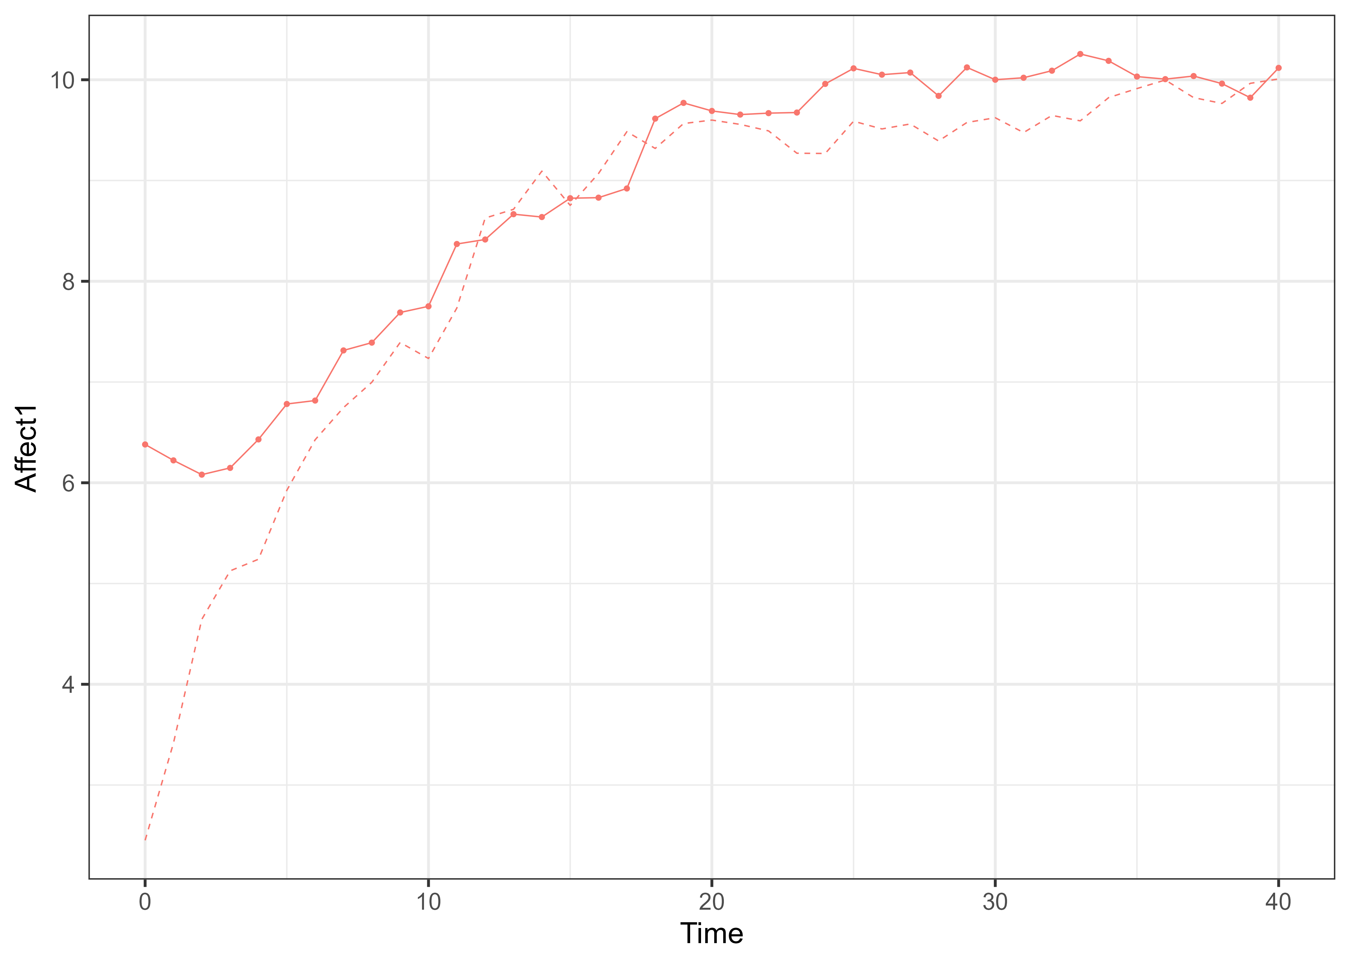
Albert is going to couple’s therapy so…

Slide 6


We can assume that little Albert’s rate of change depends on their partner’s affect
$$dη_{1}=\left(A_{1}η_{1t}+A_{cross}η_{2t}+B\right)dt+G_{11}dW_{1}t$$
$$dη_{2}=\left(A_{2}η_{2t}+B\right)dt+G_{22}dW_{2}t$$

Slide 7
Matrix form
$$dη_{1}=\left(A_{1}η_{1t}+A_{cross_{12}}η_{2t}+B\right)dt+G_{11}dW_{1}t$$
$$dη_{2}=\left(A_{2}η_{2t}+B\right)dt+G_{22}dW_{2}t$$
$$\left({dη_{1} \atop dη_{2}}\right)=\left[\left(\begin{matrix}A_{1} & A_{cross_{12} } \\ 0 & A_{2}\end{matrix}\right)∗\left({η_{1} \atop η_{2}}\right)\left(t\right)+\left({B_{1} \atop B_{2}}\right)\right]dt+\left(\begin{matrix}G_{11} & 0 \\ 0 & G_{22}\end{matrix}\right)d\left({W_{1} \atop W_{2}}\right)$$

Slide 8
Matrix form
$$dη_{1}=\left(A_{1}η_{1t}+A_{cross_{12}}η_{2t}+B_{1}\right)dt+G_{11}dW_{1}t$$
$$dη_{2}=\left(A_{2}η_{2t}+B_{2}\right)dt+G_{22}dW_{2}t$$
1
2
1
2
1
$$\left({dη_{1} \atop dη_{2}}\right)=\left[\left(\begin{matrix}A_{1} & A_{cross_{12} } \\ 0 & A_{2}\end{matrix}\right)∗\left({η_{1} \atop η_{2}}\right)\left(t\right)+\left({B_{1} \atop B_{2}}\right)\right]dt+\left(\begin{matrix}G_{11} & 0 \\ 0 & G_{22}\end{matrix}\right)d\left({W_{1} \atop W_{2}}\right)(t)$$
1
1
2
2
2

Slide 9


Derive the individual equations from the matrix format
1
2
1
2
1
1
$$\left({dη_{1} \atop dη_{2}}\right)=\left[\left(\begin{matrix}A_{1} & A_{cross_{12} } \\ 0 & A_{2}\end{matrix}\right)∗\left({η_{1} \atop η_{2}}\right)\left(t\right)+\left({B_{1} \atop B_{2}}\right)\right]dt+\left(\begin{matrix}G_{11} & 0 \\ 0 & G_{22}\end{matrix}\right)d\left({W_{1} \atop W_{2}}\right)(t)$$
1
2
2
2
$$dη_{1}=$$
$$dη_{2}=$$

Slide 10
Let’s simulate
GitHub → Lecture5 → coupling_sim_W5.R
Run code, identify which parts of the code correspond to which parameters in the model
Allow Albert’s current state to influence his partner’s rate of change (i.e., Across_21)
$$\left({dη_{1} \atop dη_{2}}\right)=\left[\left(\begin{matrix}A_{1} & A_{cross_{12} } \\ 0 & A_{2}\end{matrix}\right)∗\left({η_{1} \atop η_{2}}\right)\left(t\right)+\left({B_{1} \atop B_{2}}\right)\right]dt+\left(\begin{matrix}G_{11} & 0 \\ 0 & G_{22}\end{matrix}\right)d\left({W_{1} \atop W_{2}}\right)(t)$$

Slide 11
What about unobserved common influences?
Standing outside in the rain together
Getting a traffic ticket
Meeting your dog at the door
$$\left({dη_{1} \atop dη_{2}}\right)=\left[\left(\begin{matrix}A_{1} & A_{cross_{12} } \\ 0 & A_{2}\end{matrix}\right)∗\left({η_{1} \atop η_{2}}\right)\left(t\right)+\left({B_{1} \atop B_{2}}\right)\right]dt+\left(\begin{matrix}G_{11} & 0 \\ 0 & G_{22}\end{matrix}\right)d\left({W_{1} \atop W_{2}}\right)(t)$$

Slide 12
What about unobserved common influences?
Standing outside in the rain together
Getting a traffic ticket
Meeting your dog at the door
$$\left({dη_{1} \atop dη_{2}}\right)=\left[\left(\begin{matrix}A_{1} & A_{cross_{12} } \\ 0 & A_{2}\end{matrix}\right)∗\left({η_{1} \atop η_{2}}\right)\left(t\right)+\left({B_{1} \atop B_{2}}\right)\right]dt+\left(\begin{matrix}G_{11} & G_{cross_{12}} \\ G_{cross_{21}} & G_{22}\end{matrix}\right)d\left({W_{1} \atop W_{2}}\right)(t)$$

Slide 13
Simulate shared noise
Add shared noise by modifying → Lecture5 → coupling_sim_W5.R
For the answer → Lecture5 → sharedshocks_sim_W5.R
Run code, modulate parameter values see what happens
Extend the model by adding Albert’s anxiety as a variable
$$\left({dη_{1} \atop dη_{2}}\right)=\left[\left(\begin{matrix}A_{1} & A_{cross_{12} } \\ 0 & A_{2}\end{matrix}\right)∗\left({η_{1} \atop η_{2}}\right)\left(t\right)+\left({B_{1} \atop B_{2}}\right)\right]dt+\left(\begin{matrix}G_{11} & G_{cross_{12}} \\ G_{cross_{21}} & G_{22}\end{matrix}\right)d\left({W_{1} \atop W_{2}}\right)(t)$$

Slide 14
Admin stuff
Group presentations on December 4th
Review session (course feedback + questions) December 11th
Hand-in individual reports December 12th
Oral exam December 18-19th
Revision paper: GitHub → dynamic_sys_primer → ctsemTutorial.pdf

Slide 15
Thank you for listening ☺

