Slide 1
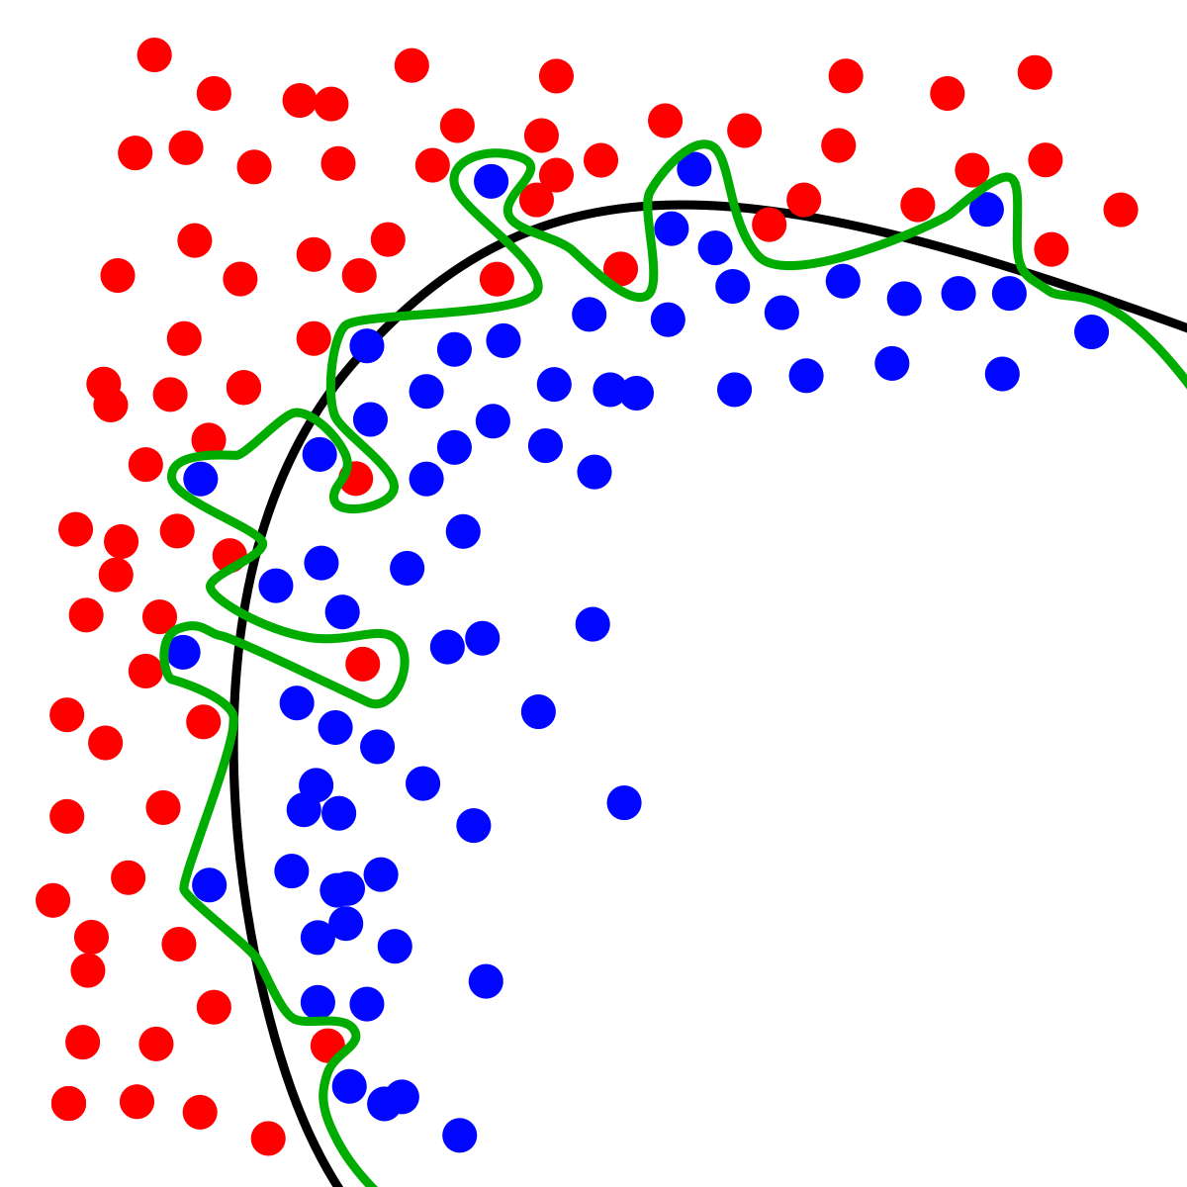
Dynamic Systems Thinking for
Psychologists
Michael E. Aristodemou
michael.aristodemou@psychologie.uzh.ch
Lecture 9: Time-Independent and Time-Dependent Predictors

Slide 2
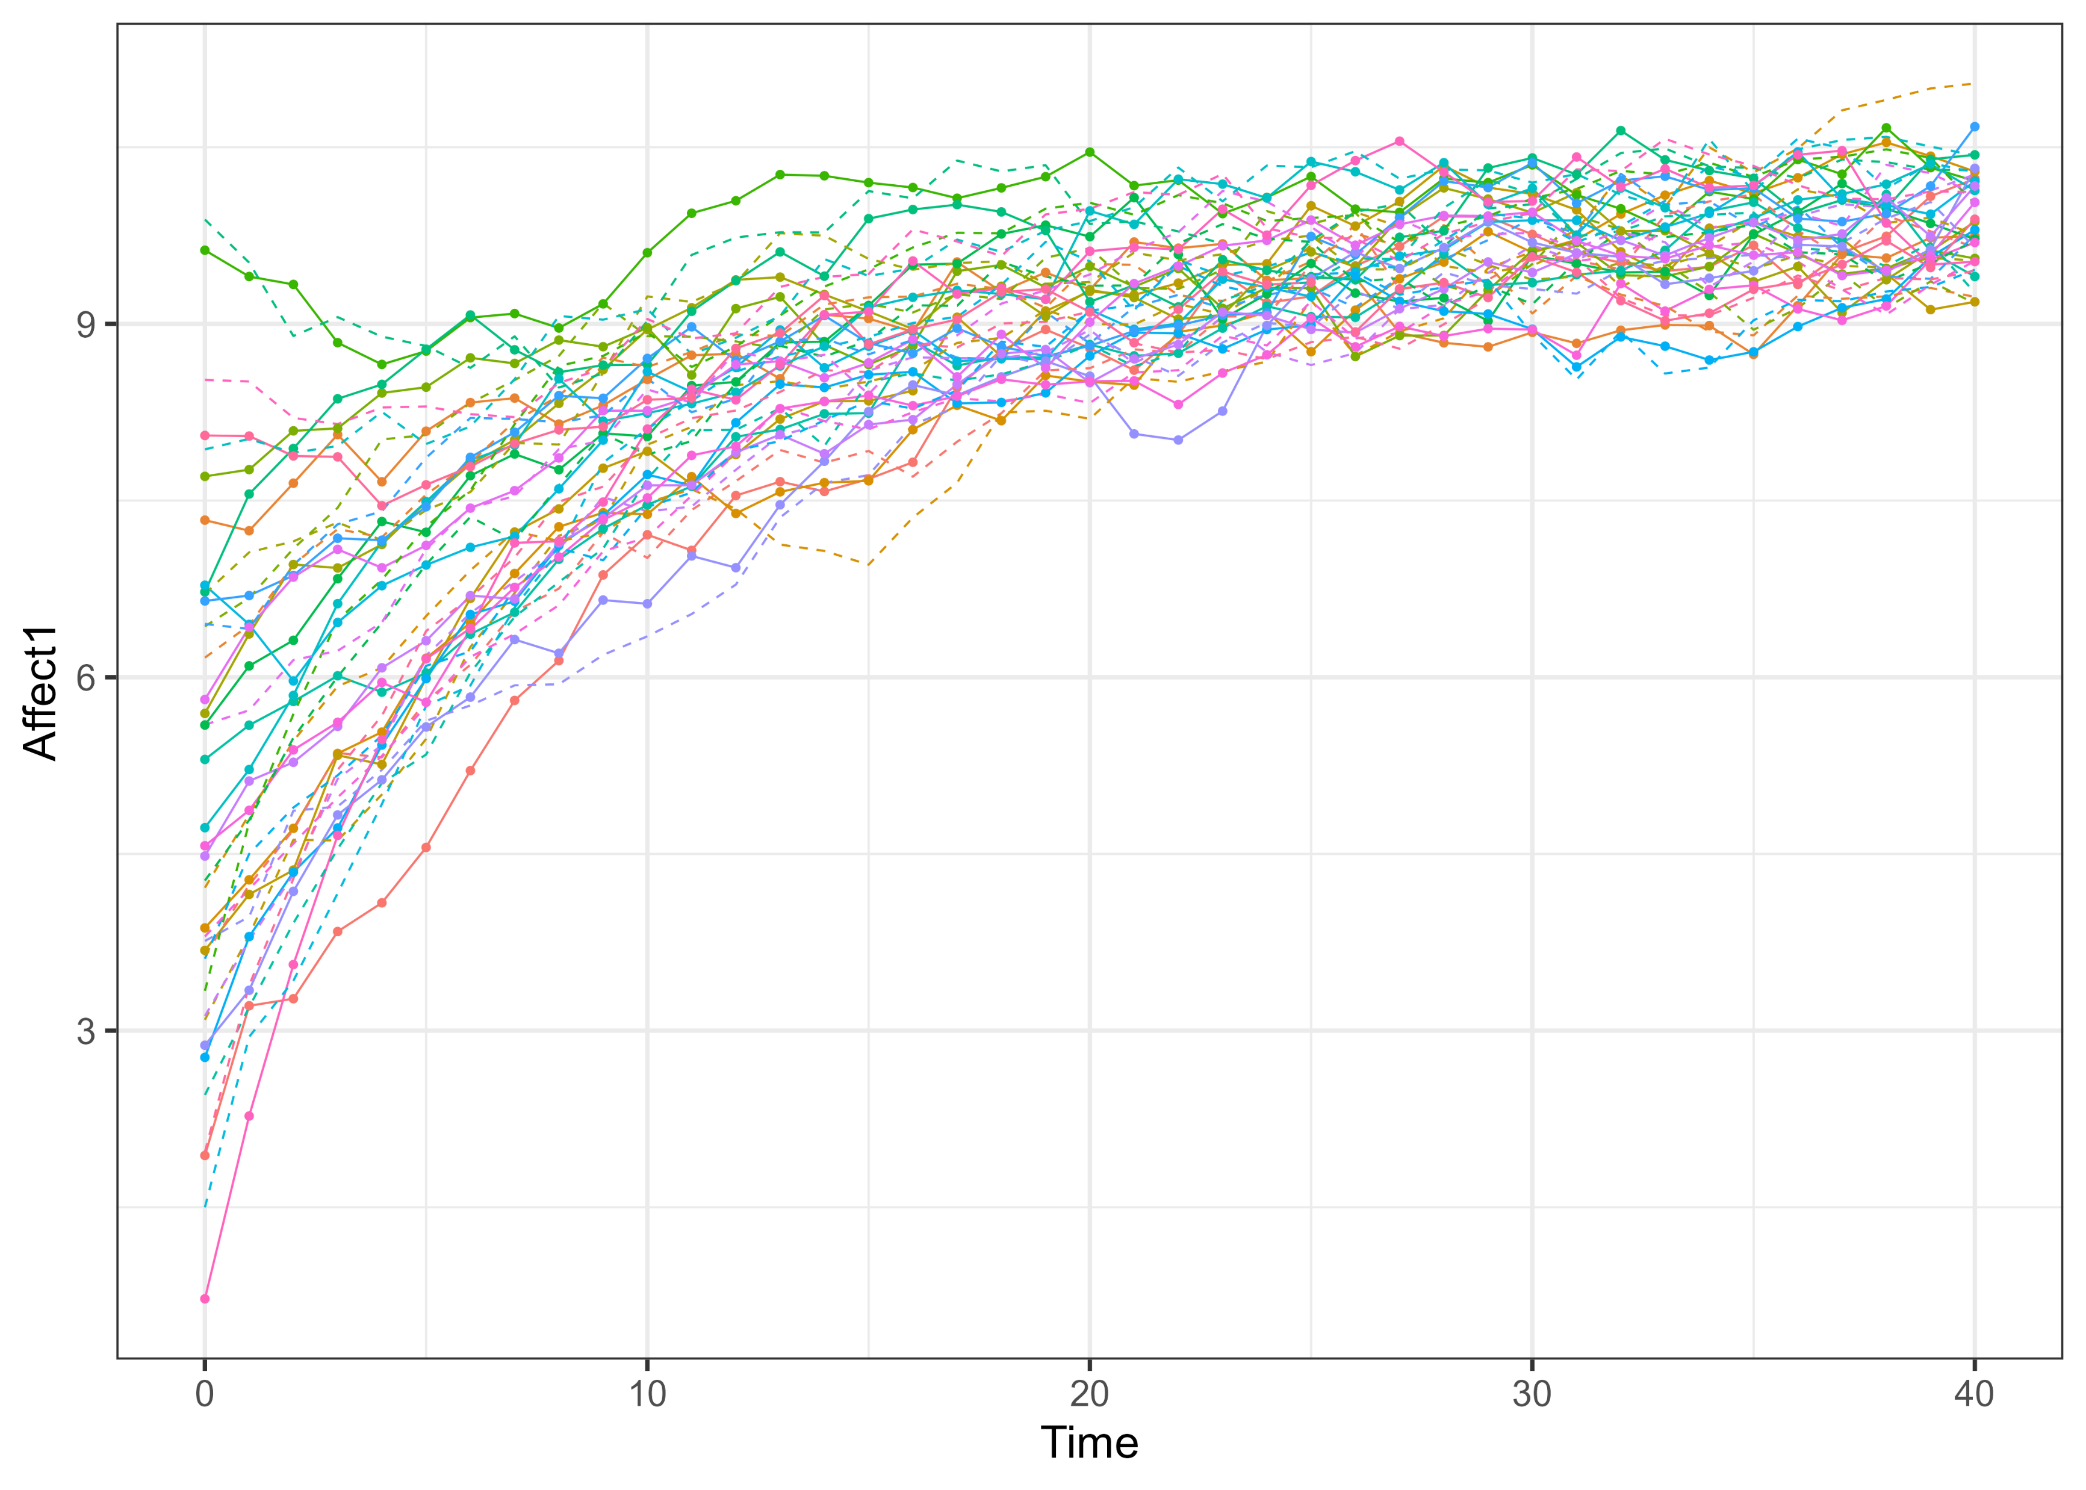
Back to a univariate model, but with more people
$$dη_{1i,t}=\left(A_{1}η_{1i,t}+B_{1}\right)dt+G_{1}dW_{1}t$$

Slide 3

So far, we assumed everyone has the same dynamics
$$dη_{1Robin,t}=\left(A_{1}η_{1Robin,t}+B_{1}\right)dt+G_{1}dW_{1}t$$
$$dη_{1Alex,t}=\left(A_{1}η_{1Alex,t}+B_{1}\right)dt+G_{1}dW_{1}t$$
$${e.g. A}_{1}η_{1i,t}=−0.5$$

Slide 4
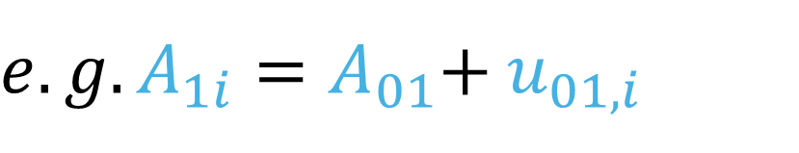
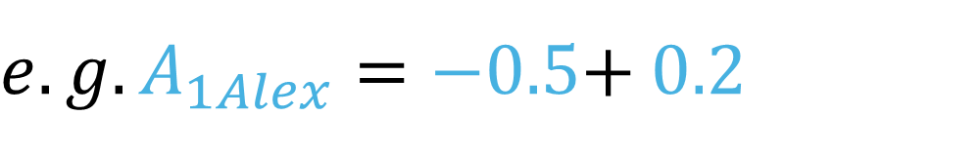
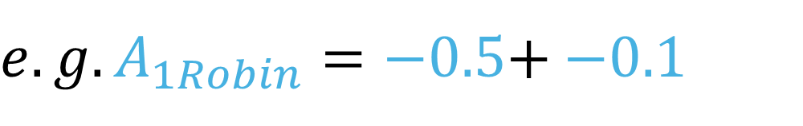
Now, we can assume that people differ in some or all parameters
$$dη_{1Robin,t}=\left(A_{1,i}{∗η}_{1Robin,t}+B_{1}\right)dt+G_{1}dW_{1}t$$
$$dη_{1Alex,t}=\left(A_{1,i}{∗η}_{1Alex,t}+B_{1}\right)dt+G_{1}dW_{1}t$$
${e.g. A}_{1i}=A_{01}$+ $u_{01,i}$
${e.g. A}_{1Robin}=−0.5$+ $−0.1$
${e.g. A}_{1Alex}=−0.5$+ $0.2$

Slide 5
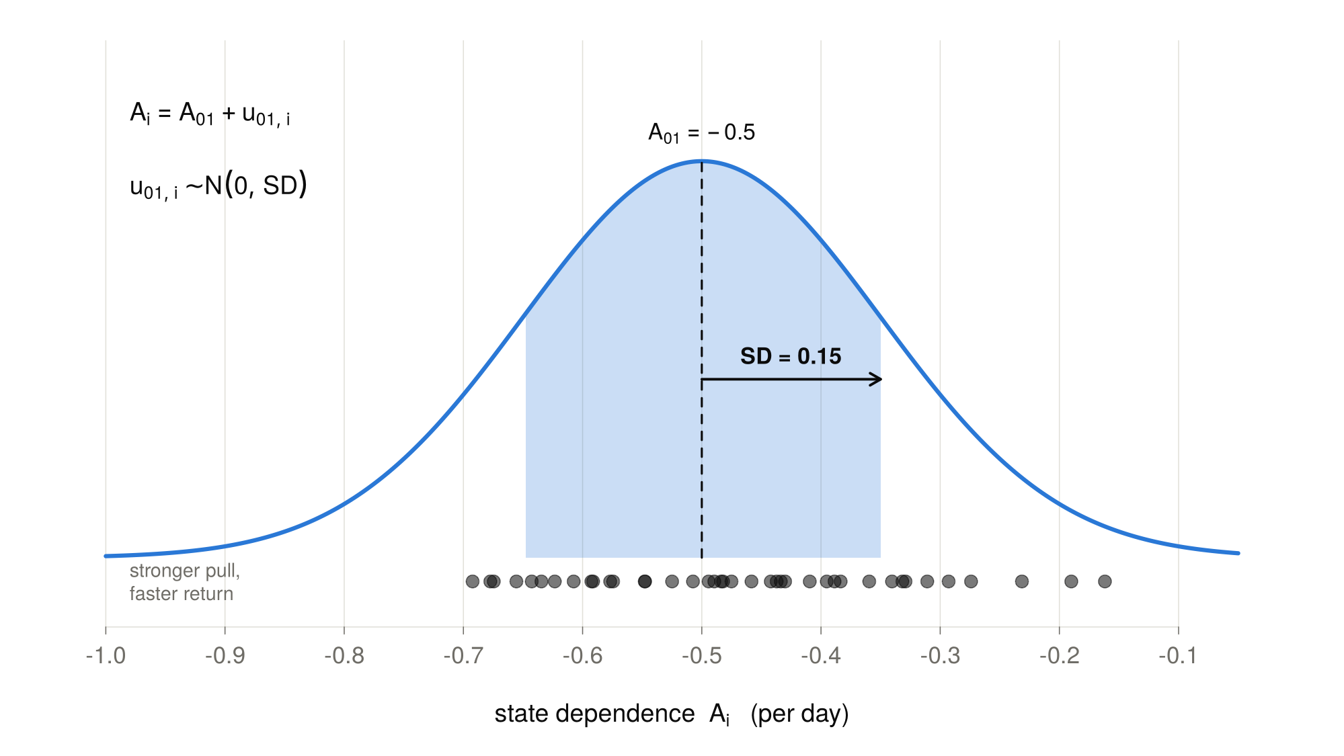
u = subject-specific deviations

Slide 6
Where do these individual differences come from?

Slide 7
Let’s add more information

Slide 8
Adding observed sources of individual differences

Slide 9
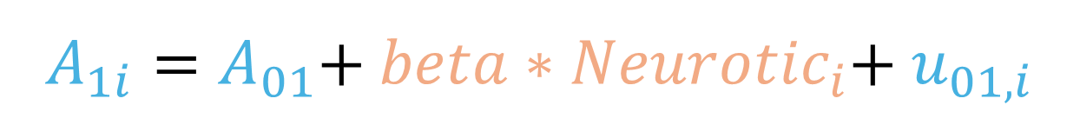
Time-Independent Predictors
Add a constant, person-specific, value to the coefficient of a parameter
$A_{1i}=A_{01}$+ $beta∗{Neurotic}_{i}$+ $u_{01,i}$

Slide 10
Shifting system properties with time-independent predictors (neuroticism)
System equilibrium
State-dependence
Fluctuations

Slide 11
What gives us the equilibrium of our system?
$$dη_{1i,t}=\left(A_{1,i}{∗η}_{1i,t}+B_{1}\right)dt+G_{1}dW_{1}t$$

Slide 12

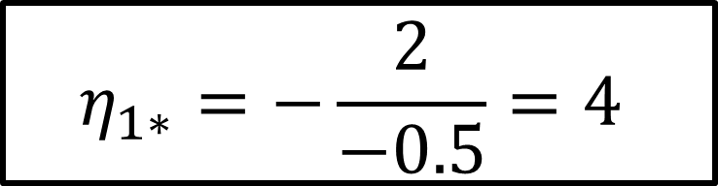

What gives us the equilibrium of our system?
$$dη_{1i,t}=\left(A_{1,i}{∗η}_{1i,t}+B_{1}\right)dt+G_{1}dW_{1}t$$
$$A_{1,i}{∗η}_{1}+B_{1}=0$$
$$η_{1∗}=−\frac{2}{−0.5}=4$$
$$η_{1∗}=−B_{1}{/A}_{1,i}$$

Slide 13
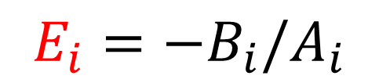
Modulating the equilibrium across neuroticism levels
$$E_{i}=−B_{i}/A_{i}$$
$$E_{i}= E_{0}+beta∗Neurotic_{i}+u_{i}$$

Slide 14
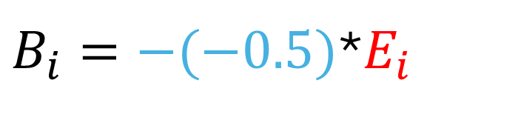

Modulating the equilibrium across neuroticism levels
$$E_{i}=−B_{i}/A_{i}$$
$$E_{i}= E_{0}+beta∗Neurotic_{i}+u_{i}$$
$$A_{i}=−0.5$$
$B_{i}=−(−0.5)$*$E_{i}$

Slide 15
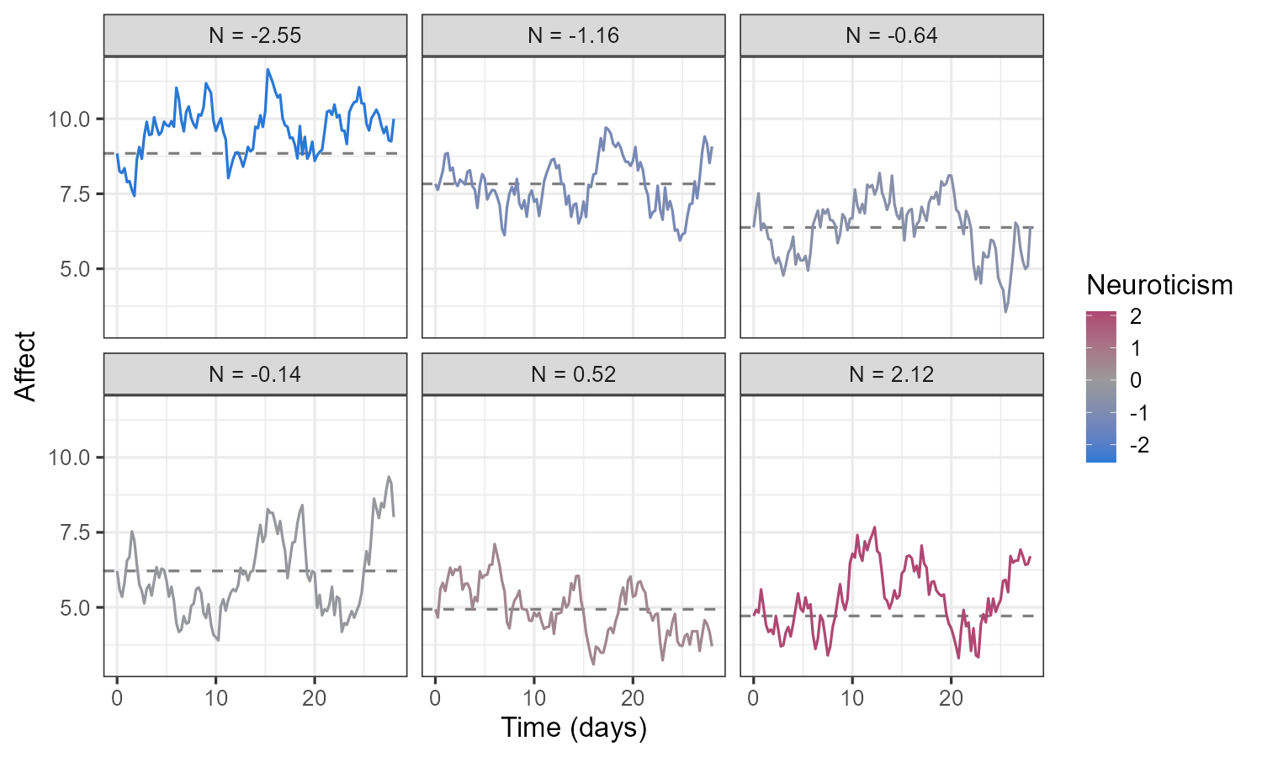
Neuroticism linearly predicts equilibrium level

Slide 16
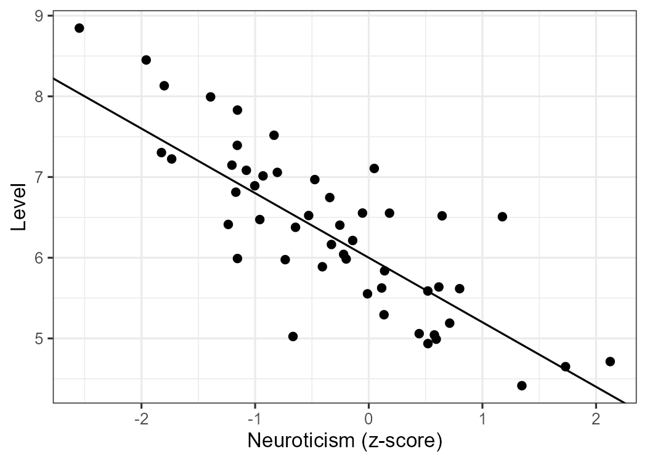
Neuroticism linearly predicts equilibrium level

Slide 17
Modulating state-dependence through neuroticism
$$A_{i}=A_{01}∗exp(beta_{1}∗Neurotic_{i})∗{exp⁡(u}_{o1i})$$

Slide 18
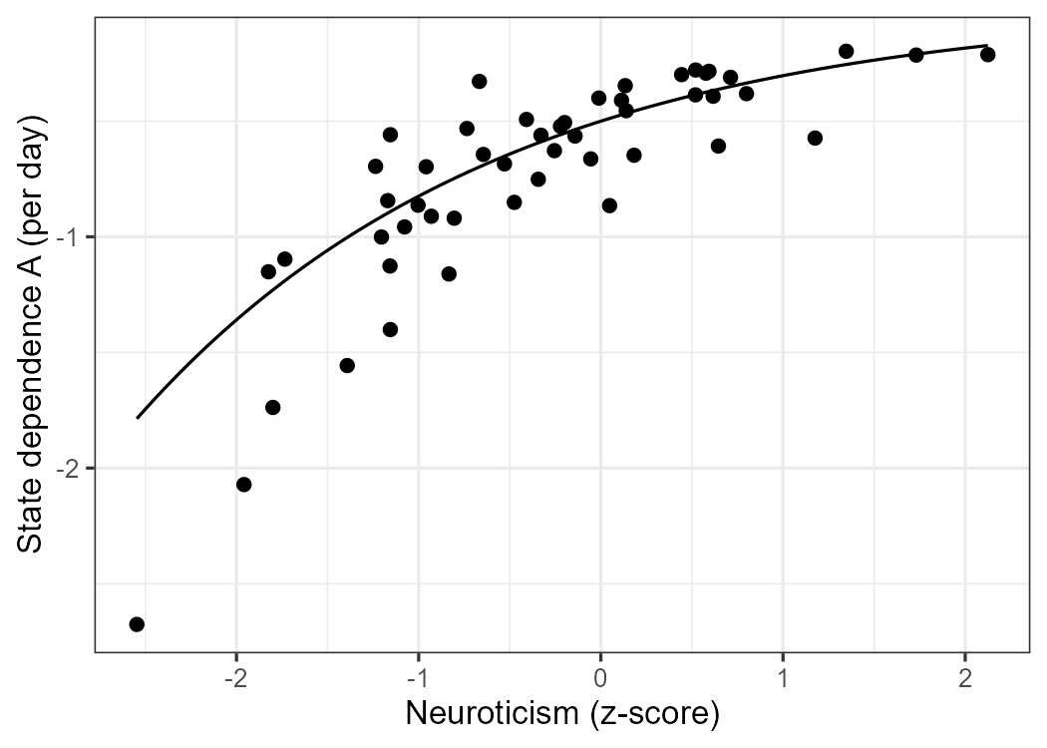
Neuroticism nonlinearly modulates state-dependence

Slide 19
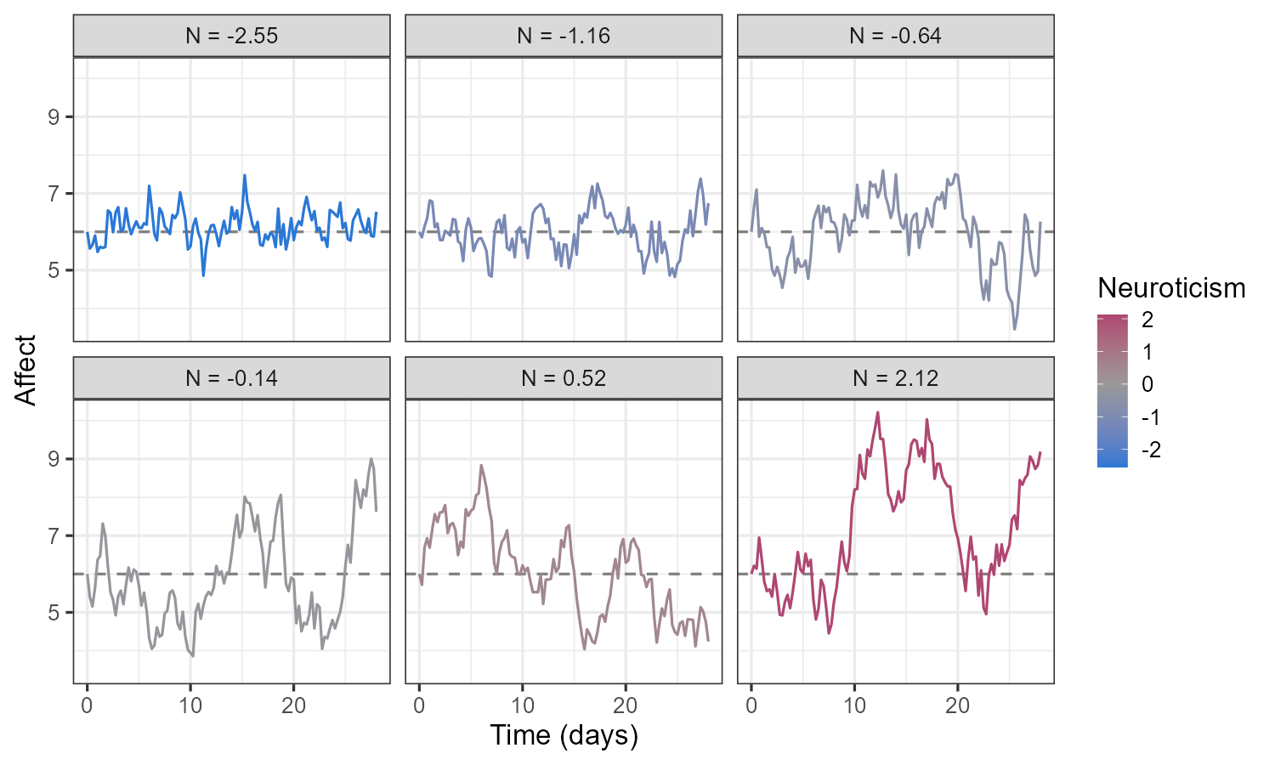
Neuroticism nonlinearly modulates state-dependence

Slide 20
Think about individual differences and moderators in your models
Add at least one source of random effects (unexplained heterogeneity)
Add at least one source of time-independent predictor (explained heterogeneity)
Code examples on GitHub → Lecture09 →
  Moderating equilibrium: lecture09_simulate_level.R
  Moderating state-dependence: lecture09_simulate_statedependence.R
  Moderating diffusion: lecture09_simulate_kicks.R

Slide 21
Break

Slide 22
Time-Invariant Predictor
$$B=B_{0}+TIPRED_{i}∗β+{τ_{0}}_{i}$$
$$B_{i}=B_{0}+TDPRED_{i,t}∗β+{τ_{0}}_{i}$$

Slide 23
Thresholded Equilibrium
$$dη_{1}=\left(A_{1}η_{1t}+B_{1}\right)dt+G_{1}dW_{1}t$$
$$B_{1}=B_{0}+TDPRED_{i,t}∗β+{τ_{0}}_{i}$$
$$TDPRED_{i,t}=0, if mood≥50$$
$$TDPRED_{i,t}=1, if mood<50$$

Slide 24
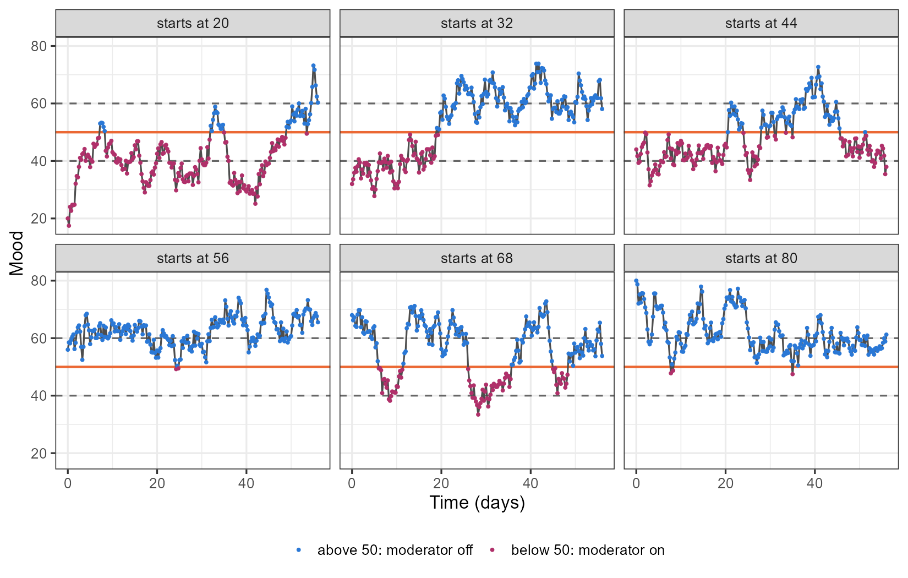

Slide 25
Hysteresis: states with memory
$$dη_{1}=\left(A_{1}η_{1t}+B_{1}\right)dt+G_{1}dW_{1}t$$
$$B_{1}=B_{0}+TDPRED_{i,t}∗β+{τ_{0}}_{i}$$
$$TDPRED_{i,t}=0, if mood>60$$
$$TDPRED_{i,t}=1, if mood<40$$
$$TDPRED_{i,t−}=1, if 40≤mood≤60$$

Slide 26
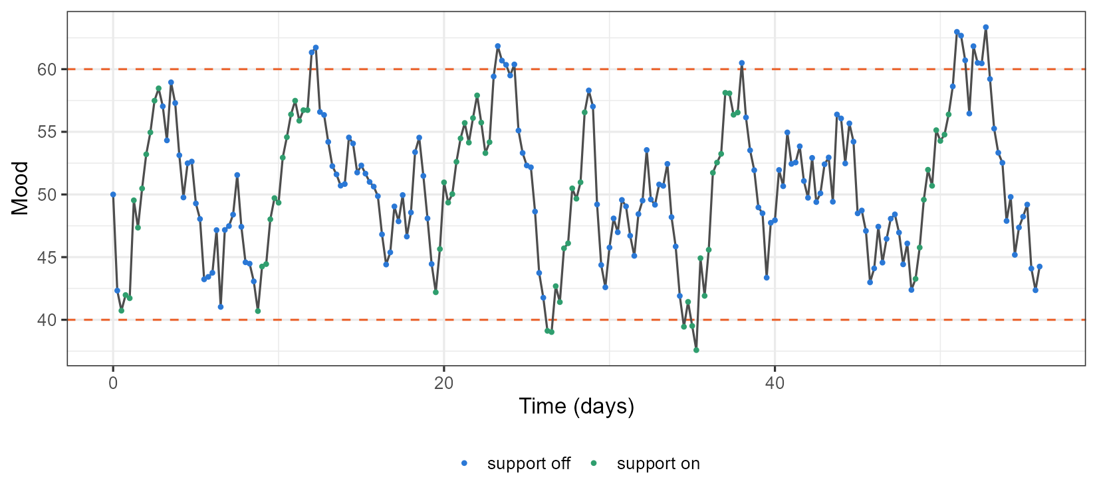

Slide 27
Think about time-dependent moderators in your models
Code example on GitHub → Lecture09 → lecture09_simulate_threshold.R

Slide 28
Thank you for listening ☺

