Slide 1
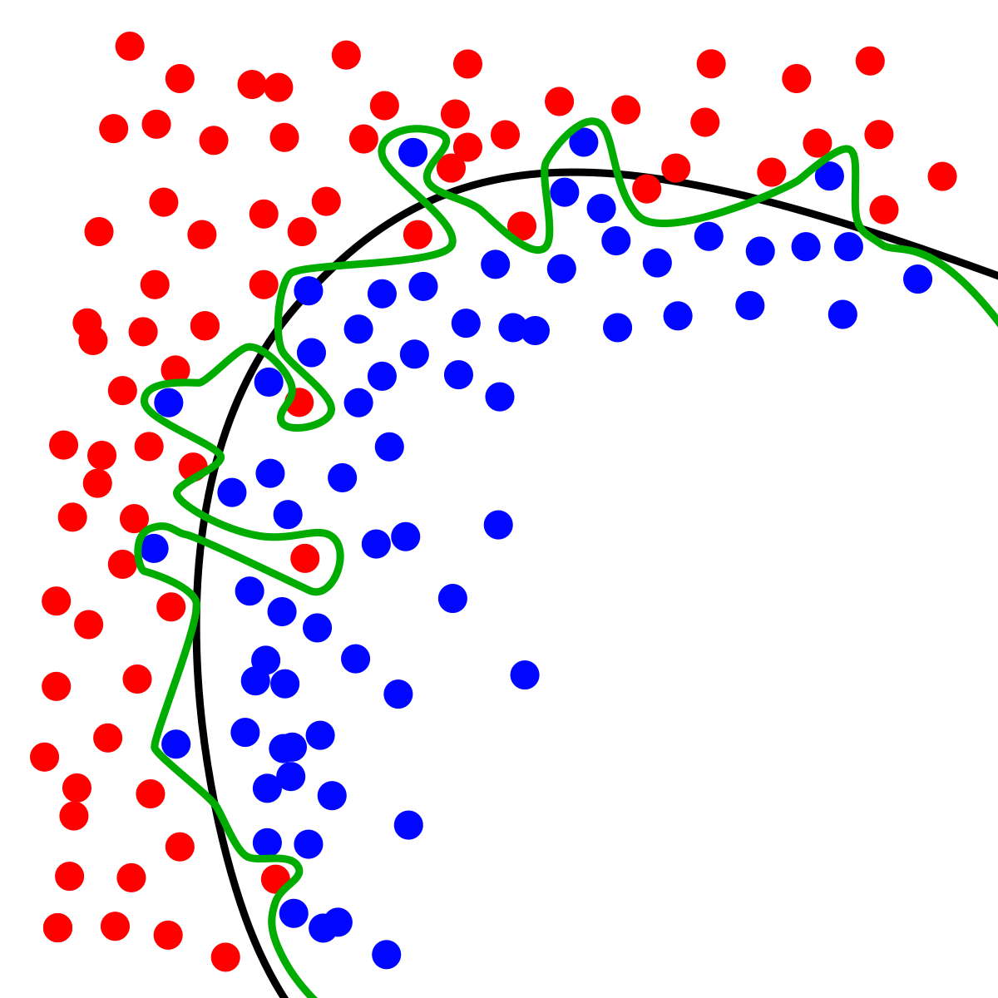
Dynamic Systems Thinking for
Psychologists
Michael E. Aristodemou
michael.aristodemou@psychologie.uzh.ch
Lecture 3: Hierarchical Linear Models & Magic Cats

Slide 2
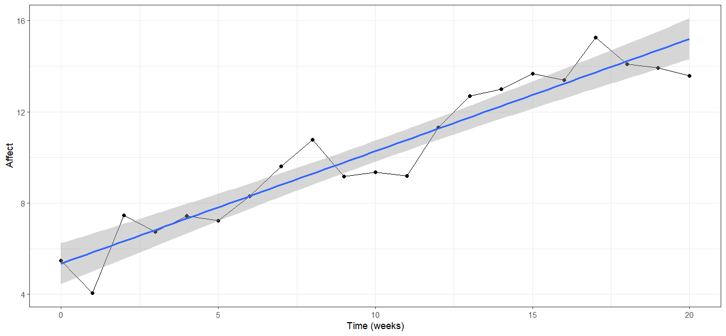
Is therapy going well?

Slide 3
A way to find out…

Slide 4
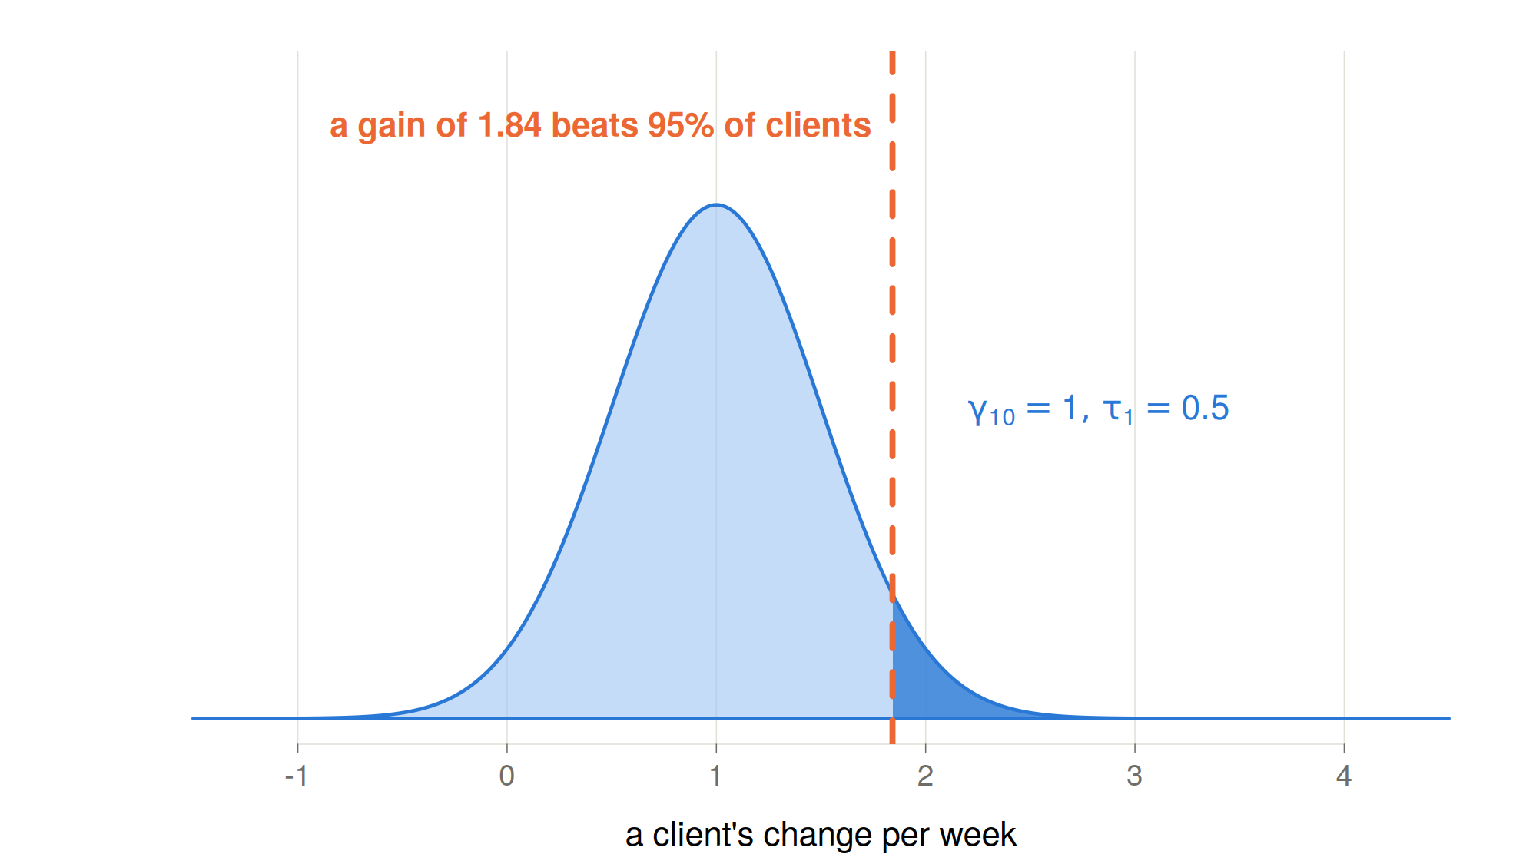
We need a reference, is 1.84 large or small?

Slide 5
Many people
Let’s imagine we recruit 20 more people who will start the same therapy at the same time as Albert for the same duration.
What’s the simplest world we can imagine?

Slide 6
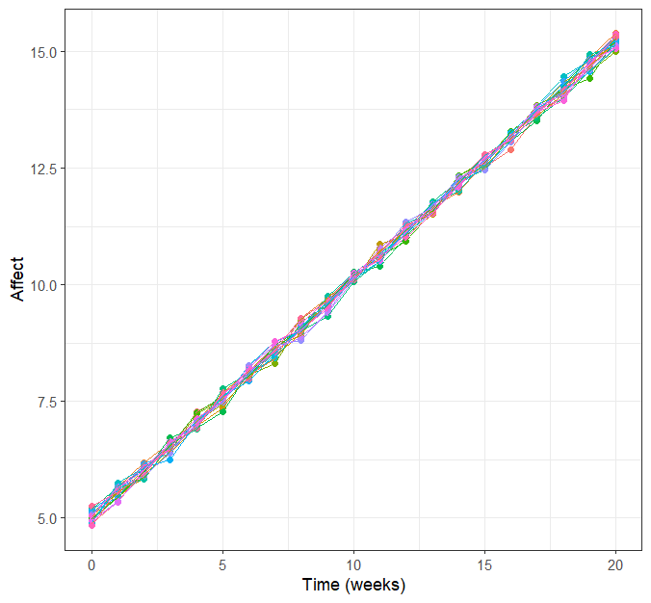
Many people, same intercept and slope
Notes:
This is what we call a fixed effects model

Slide 7


Individual differences
Let’s imagine we recruit 20 more people who will start the same therapy at the same time as Albert for the same duration.
What’s the simplest world we can imagine?
$$Y_{i,t}=β_{0}+β_{1}∗time_{i,t}+ε_{i,t}$$
$$ε_{i,t}\sim N(0,σ^{2})$$

Slide 8


What if people actually differ?
What do we need to change in this model?
$$Y_{i,t}=β_{0}+β_{1}∗time_{i,t}+ε_{i,t}$$
$$ε_{i,t}\sim N(0,σ^{2})$$

Slide 9

What if people actually differ?
What do we need to change in this model?
$$Y_{i,t}=β_{0i}+β_{1i}∗time_{i,t}+ε_{i,t}$$
$$ε_{i,t}\sim N(0,σ^{2})$$

Slide 10
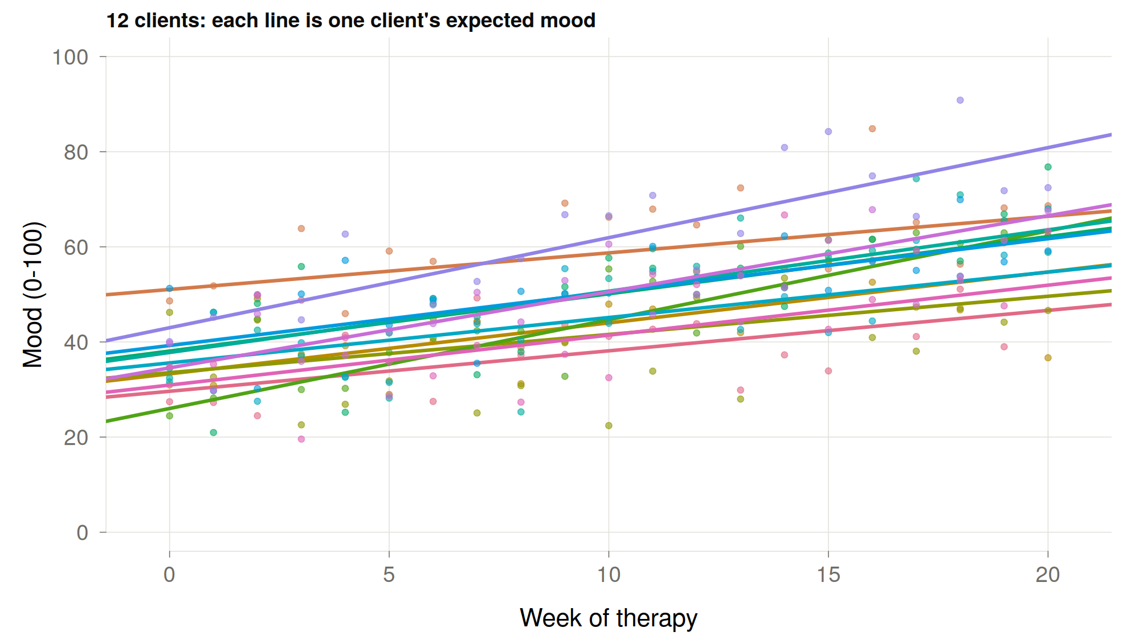

Slide 11
Where do differences in intercept and slope come from?

Slide 12
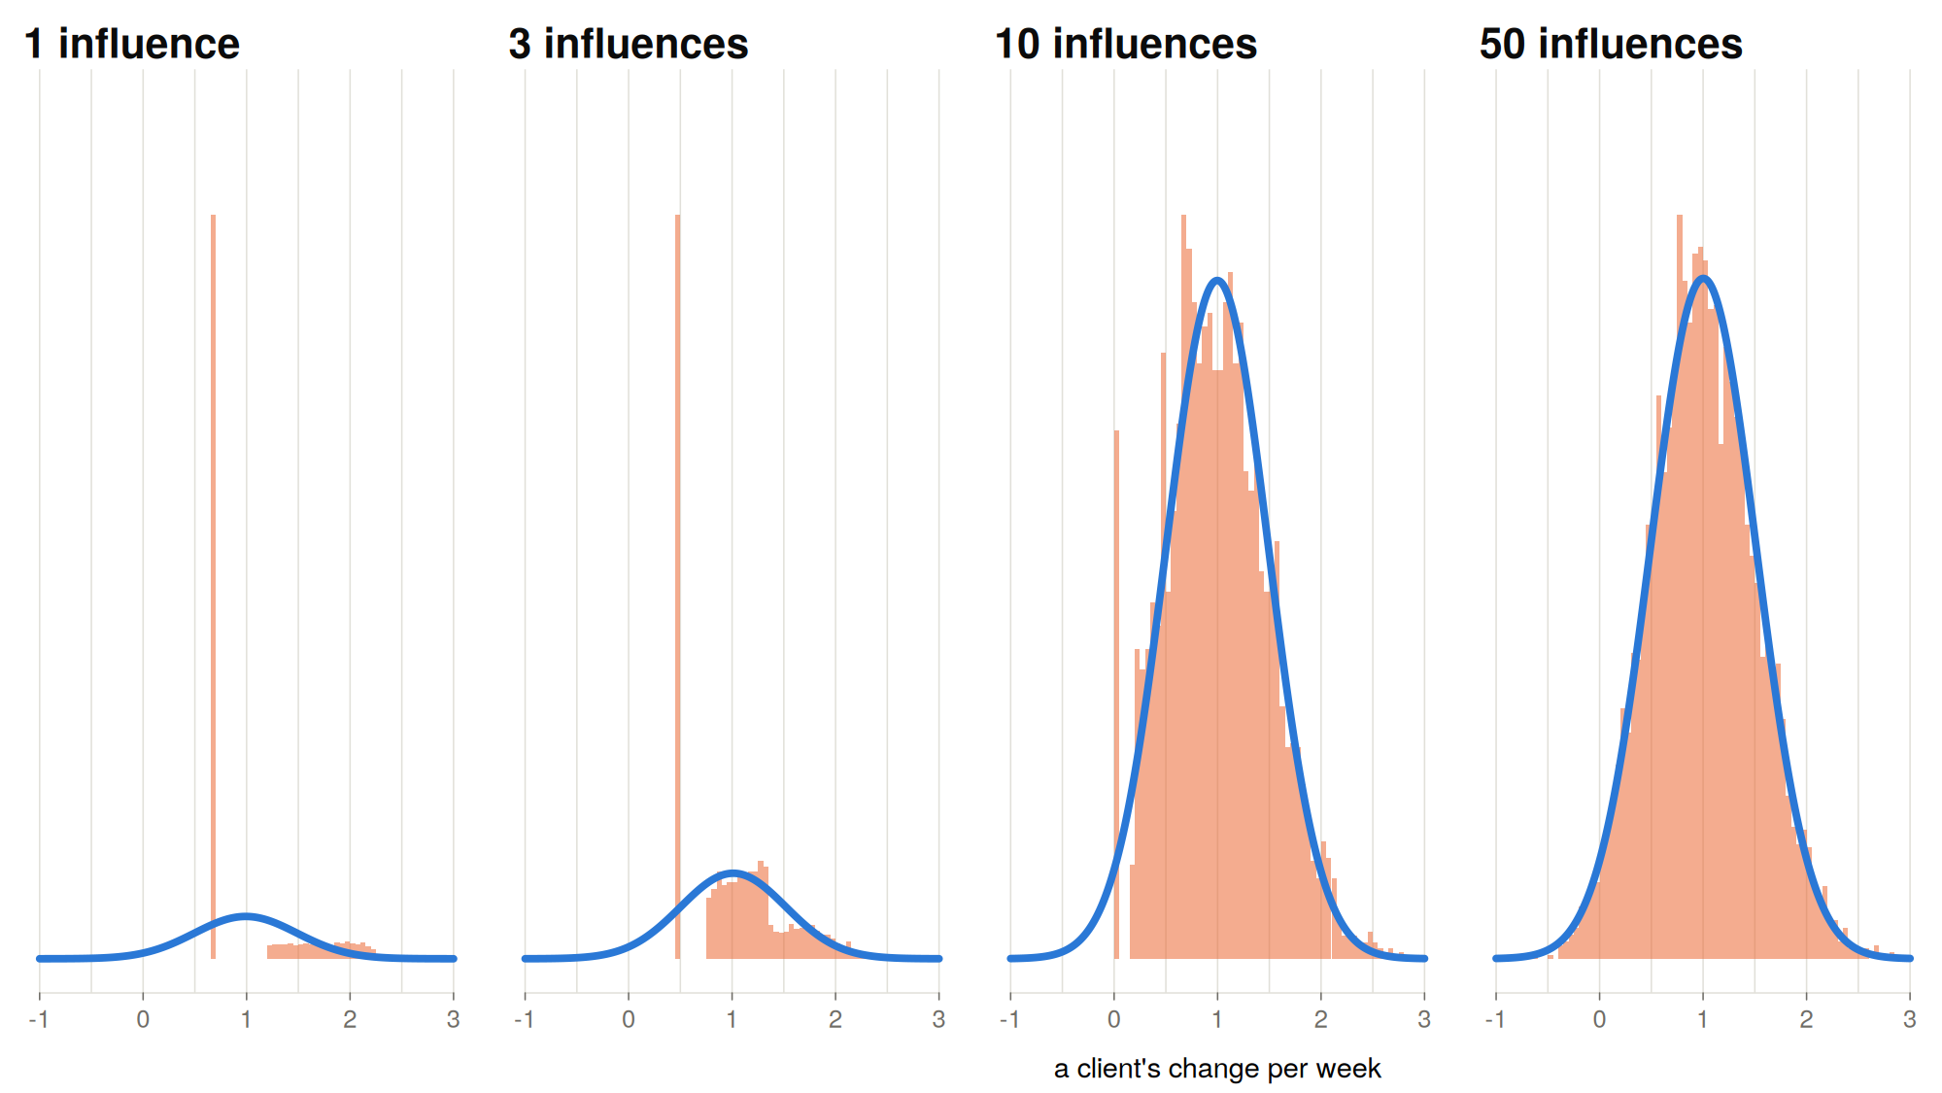
Where do differences in intercept and slope come from?

Slide 13
Always normal?

Slide 14
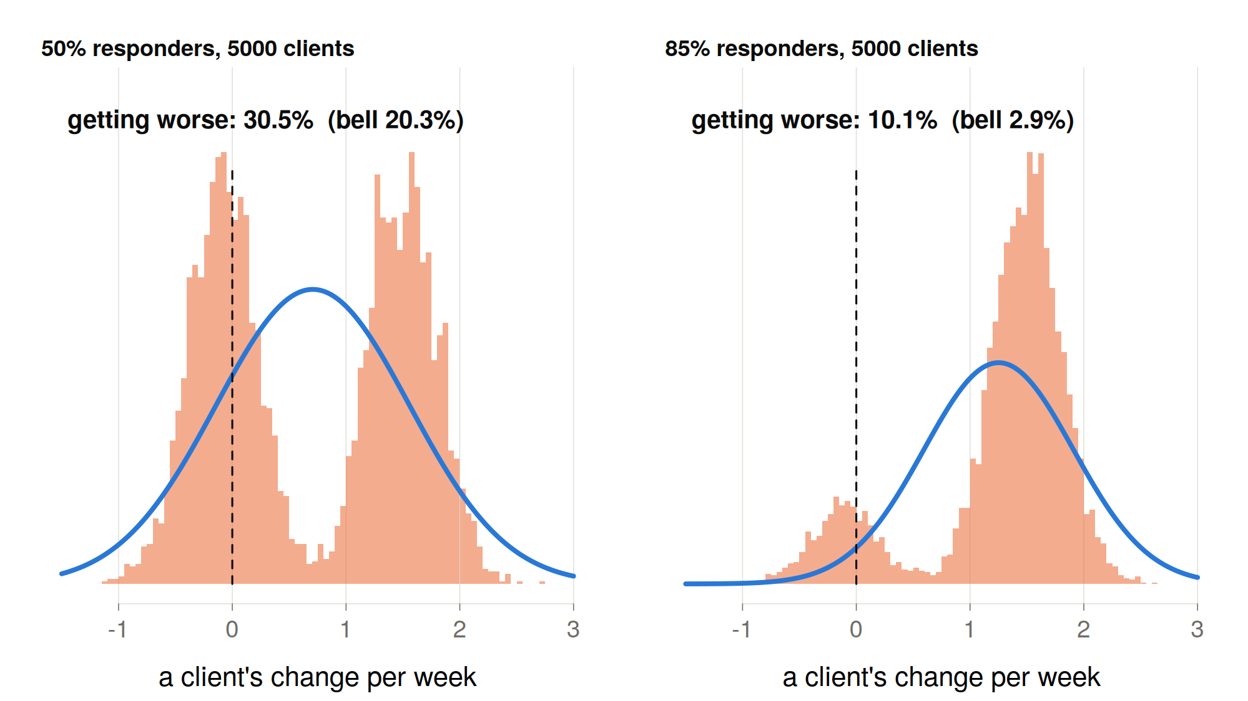
Always normal?

Slide 15

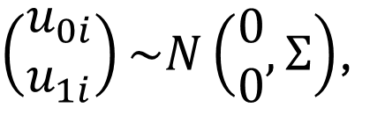
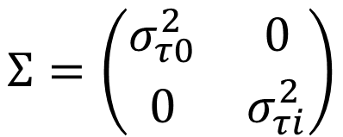
Normal for simplicity, a starting assumption
$$Y_{i,t}=β_{0i}+β_{1i}∗time_{i,t}+ε_{i,t}$$
$$ε_{i,t}\sim N(0,σ^{2})$$
$$β_{0i}=γ_{00}+u_{0i}$$
$$β_{1i}=γ_{01}+u_{1i}$$
$\left(\begin{matrix}u_{0i} \\ u_{1i}\end{matrix}\right)\sim N\left(\begin{matrix}0 \\ 0\end{matrix}, Σ\right)$,
$$Σ=\left(\begin{matrix}σ_{τ0}^{2} & 0 \\ 0 & σ_{τi}^{2}\end{matrix}\right)$$

Slide 16
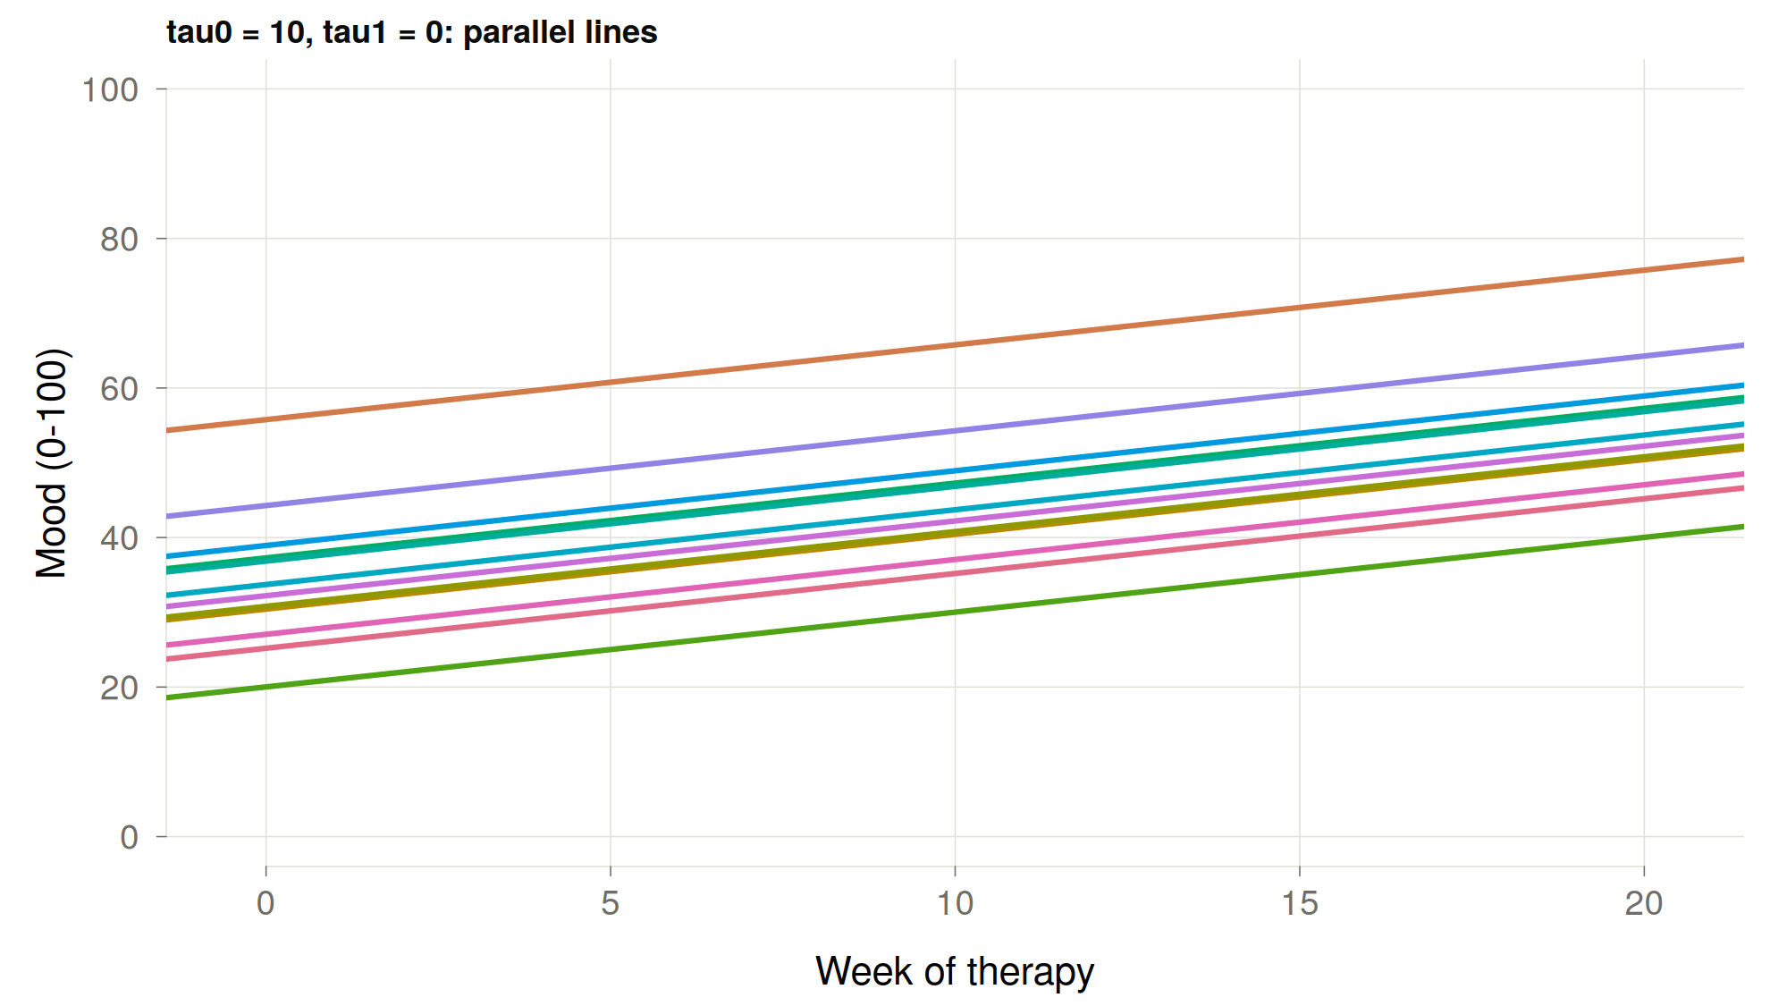
Normal for simplicity, a starting assumption
$$Y_{i,t}=β_{0i}+β_{1i}∗time_{i,t}+ε_{i,t}$$
$$ε_{i,t}\sim N(0,σ^{2})$$
$$β_{0i}=γ_{00}+u_{0i}$$
$$β_{1i}=γ_{01}+u_{1i}$$
$\left(\begin{matrix}u_{0i} \\ u_{1i}\end{matrix}\right)\sim N\left(\begin{matrix}0 \\ 0\end{matrix}, Σ\right)$,
$$Σ=\left(\begin{matrix}σ_{τ0}^{2} & 0 \\ 0 & σ_{τi}^{2}\end{matrix}\right)$$

Slide 17
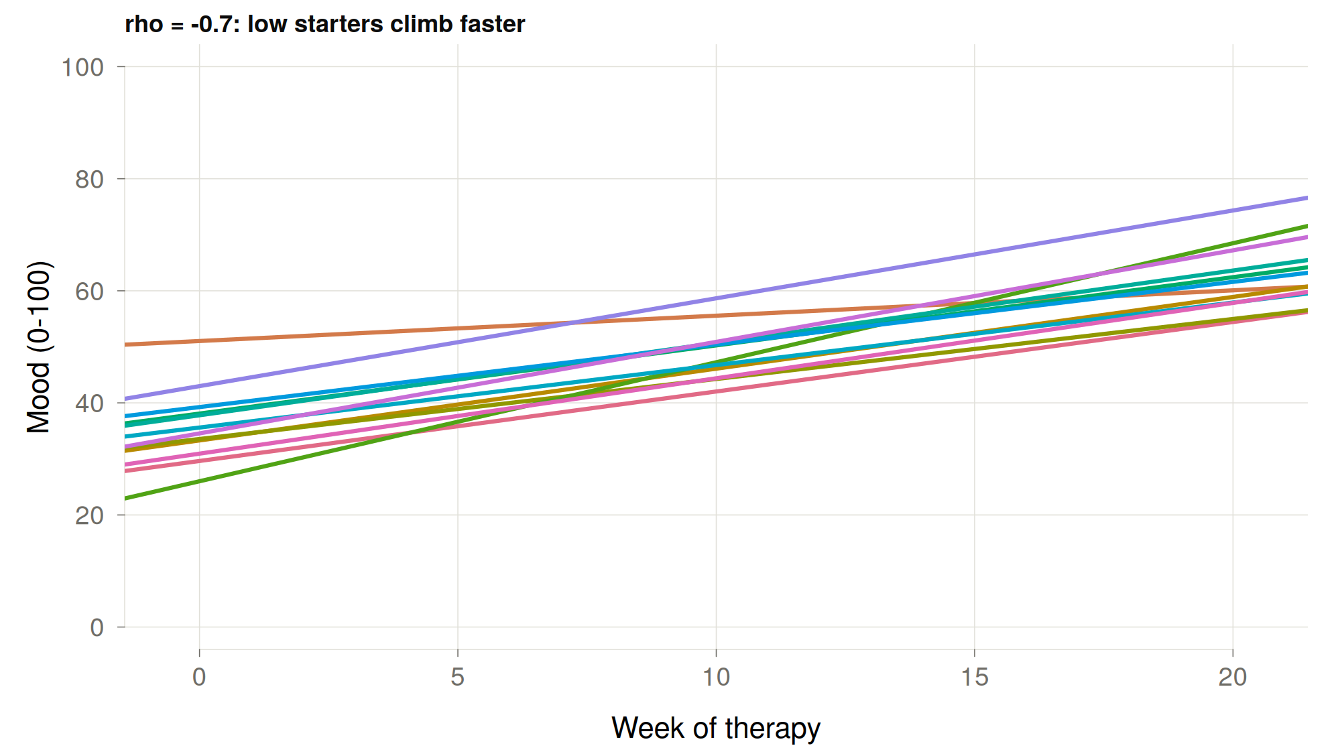
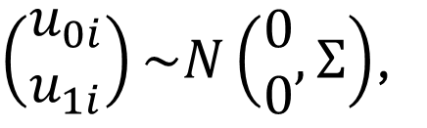
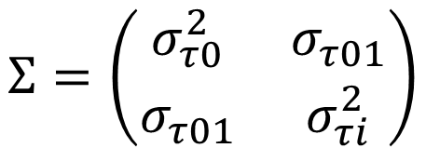



Correlated intercept and slope
$$Y_{i,t}=β_{0i}+β_{1i}∗time_{i,t}+ε_{i,t}$$
$$ε_{i,t}\sim N(0,σ^{2})$$
$$β_{0i}=γ_{00}+u_{0i}$$
$$β_{1i}=γ_{01}+u_{1i}$$
$\left(\begin{matrix}u_{0i} \\ u_{1i}\end{matrix}\right)\sim N\left(\begin{matrix}0 \\ 0\end{matrix}, Σ\right)$,
$$Σ=\left(\begin{matrix}σ_{τ0}^{2} & σ_{τ01} \\ σ_{τ01} & σ_{τi}^{2}\end{matrix}\right)$$

Slide 18
A finite data problem…

Slide 19
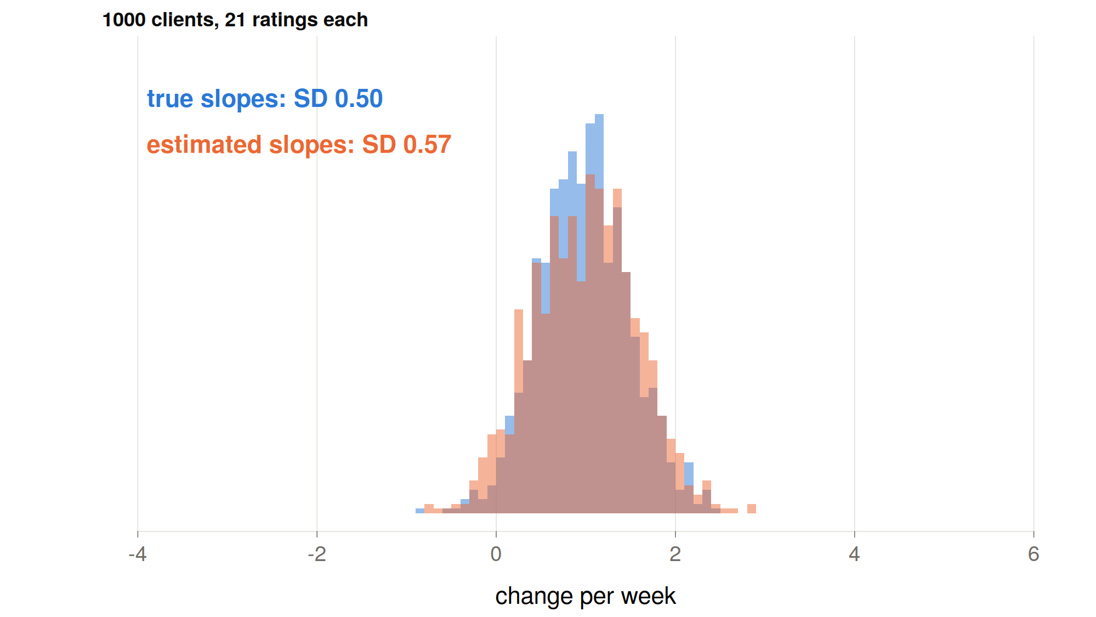

Slide 20
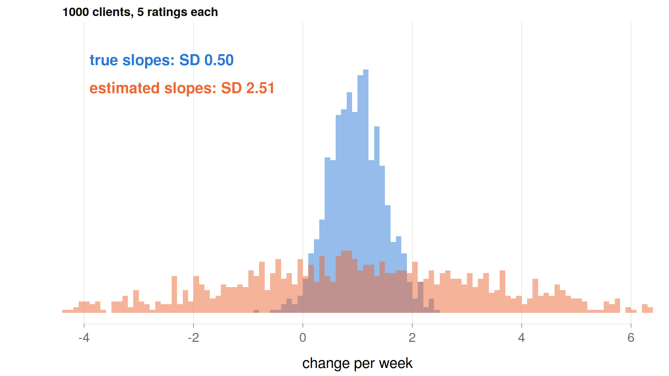

Slide 21
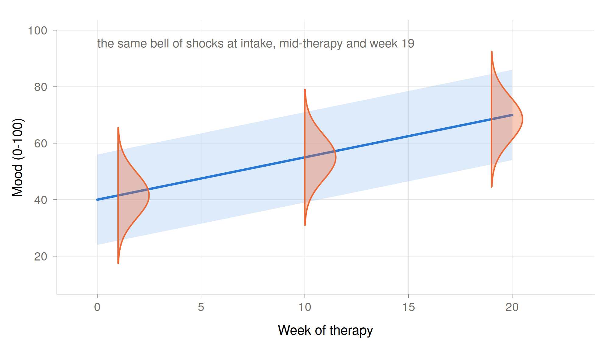

Slide 22
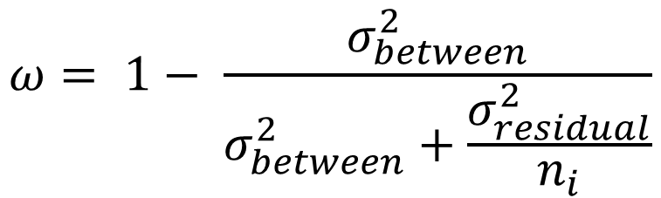
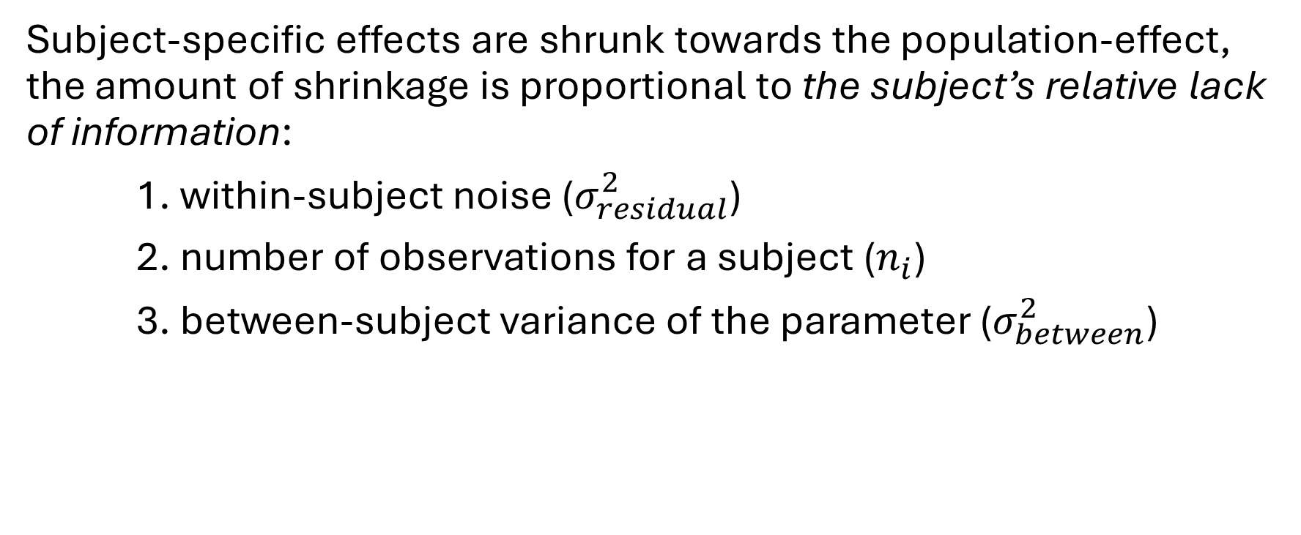
Partial pooling
Subject-specific effects are shrunk towards the population-effect, the amount of shrinkage is proportional to the subject’s relative lack of information:
1. within-subject noise ($σ_{residual}^{2}$)
2. number of observations for a subject ($n_{i}$)
3. between-subject variance of the parameter ($σ_{between}^{2}$)
$$ω= 1− \frac{σ_{between}^{2}}{σ_{between}^{2}+\frac{σ_{residual}^{2}}{n_{i}}}$$

Slide 23
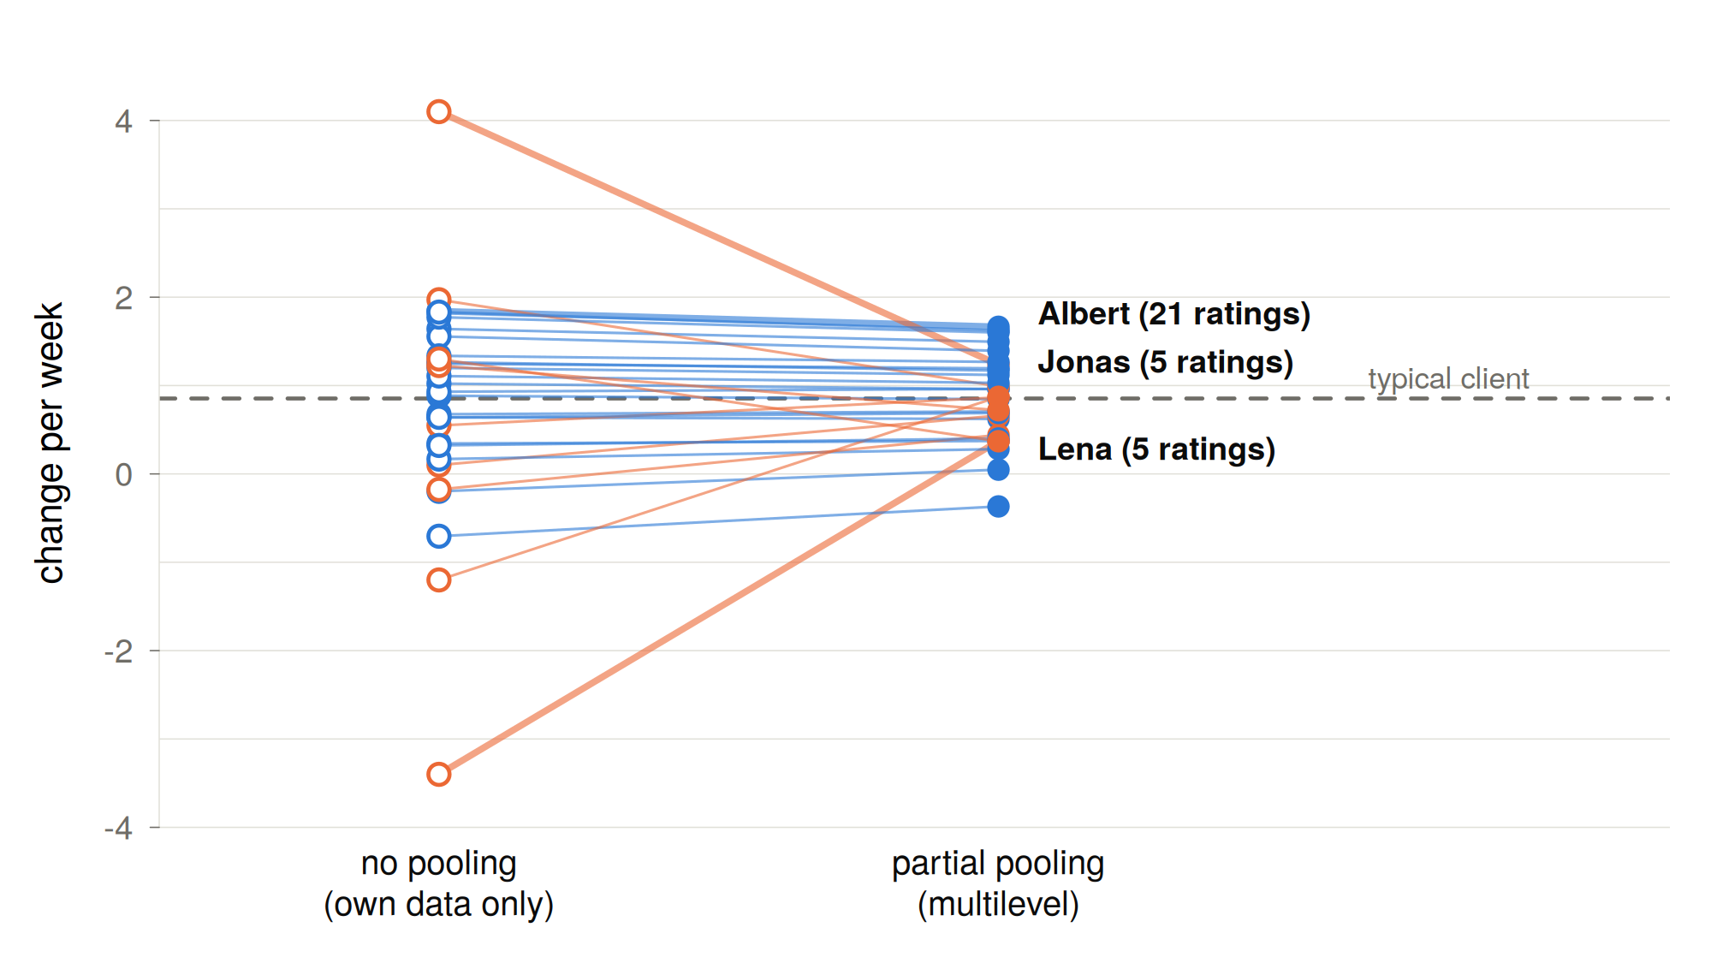
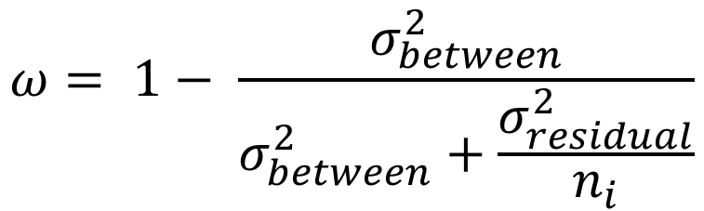
Partial pooling
$$ω= 1− \frac{σ_{between}^{2}}{σ_{between}^{2}+\frac{σ_{residual}^{2}}{n_{i}}}$$
$$β_{0i}=ω∗γ_{00}+\left(1−ω\right)∗u_{0i}$$

Slide 24
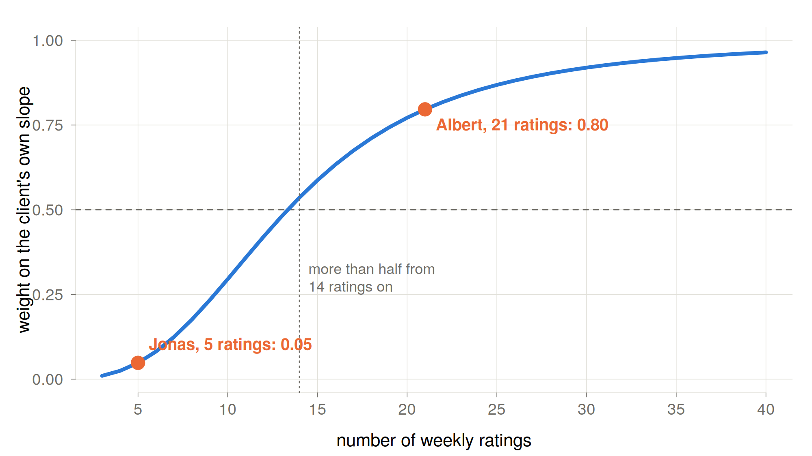

Slide 25
Group activity
https://github.com/mearistodemou
Find the code in dynamic-systems-uzh → Lecture03 → lgcm_sim.R
Think of how you can fit your conceptual idea to this model
Move the parameters around to fit your idea
Tell me what you would like to model, but can’t easily change

Slide 26
Break

Slide 27
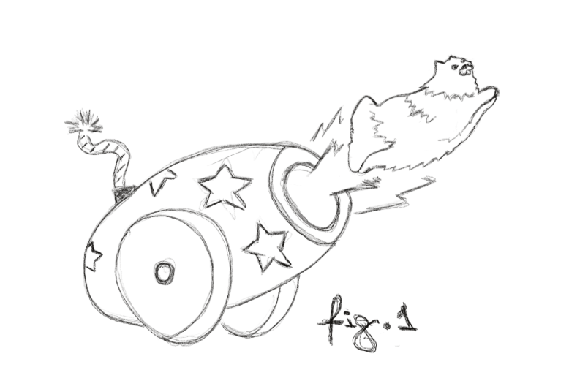
Magic cats?
Notes:
Today, we are going to launch cats in the air. Some days ago, two cats showed up on our doorstep and told us that they are magic—because they could fall from any distance and remain unscathed. These self-proclaimed magic cats bragged about how they learned a simple transformation that allows them to soften their fall. Instead of falling like normal cats, they fall by half of their current distance from the ground every second.

Slide 28
Formalize this model
“Every 1 second, they fall by half of their current distance from the ground”
Notes:
So, if they are currently at 10 meters in 1 second they will be at 5, then after a second at 2.5, then 1.25 and so on. We are convinced by the charisma of these cats and we decide to do an experiment. But as you can imagine our proposal was not very popular with the ethics committee.

Slide 29
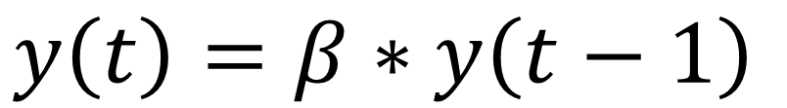
Formalize this model
“Every 1 second, they fall by half of their current distance from the ground”
$$y\left(t\right)=β∗y\left(t−1\right)$$

Slide 30
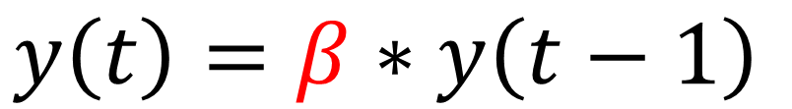
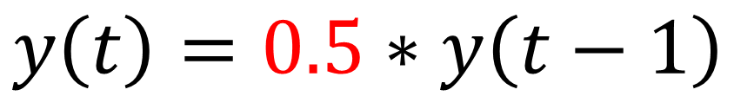
Let’s launch some cats
Launch them 20 meters in the air (T0)
Model their fall using the AR-1 model
By hand calculate where they will be after 4 seconds, i.e., by time point (T4)
Draw a graph of their current height at each time point
$$y\left(t\right)=β∗y\left(t−1\right)$$
$$y\left(t\right)=0.5∗y\left(t−1\right)$$

Slide 31
Let’s add some shocks!
Two people getting in an argument, John and Luca.
John (reactive, composes himself quick)
Luca (hard to shake, slow to compose himself)

Slide 32
Let’s add some shocks!
Two people getting in an argument, John and Luca.
John (reactive, composes himself quick)
Luca (hard to shake, slow to compose himself)
$$y\left(i,t\right)=β_{i}∗y\left(i,t−1\right)+e_{i,t}$$

Slide 33


Let’s add some shocks!
Two people getting in an argument, John and Luca.
John (reactive, composes himself quick)
Luca (hard to shake, slow to compose himself)
$$y\left(i,t\right)=β_{i}∗y\left(i,t−1\right)+e_{i,t}$$
$$β_{1}=0.2$$
$$β_{2}=0.6$$

Slide 34


Let’s add some shocks!
Two people getting in an argument, John and Luca.
John (reactive, composes himself quick)
Luca (hard to shake, slow to compose himself)
$$y\left(i,t\right)=β_{i}∗y\left(i,t−1\right)+e_{i,t}$$
$$β_{1}=0.2$$
$$β_{2}=0.6$$

Slide 35


Simulated arguing
Draw the ebb and flow of John and Luca’s emotions as they argue
$$y\left(John,t\right)=0.2∗y\left(i,t−1\right)+e_{i,t}$$
$$y\left(Luca,t\right)=0.6∗y\left(i,t−1\right)+e_{i,t}$$
$$e_{John,t}=6,0,8,0$$
$$e_{Luca,t}=0,2,0,6$$

Slide 36
Two questions about these models
What happens in between the observations?
How can we stop noise from carrying over to the next occasion?

Slide 37
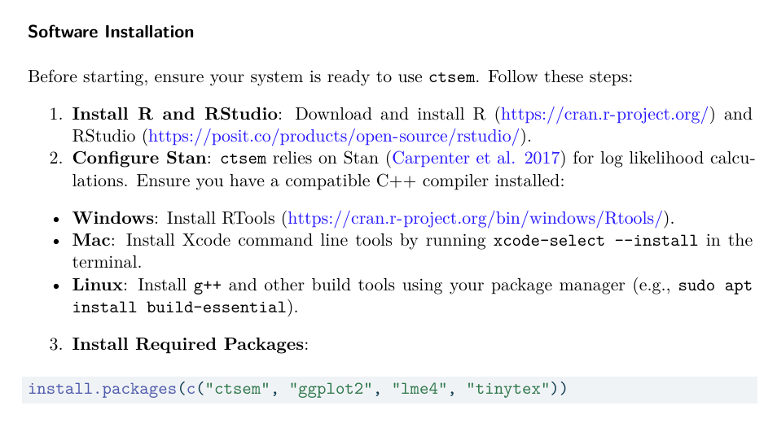
Download ctsem package in R

Slide 38
Extra: Visualizing covariance
Paper: https://psyarxiv.com/gwu8b
Game: https://www.guessthecorrelation.com/

Slide 39
Thank you for listening ☺

