Slide 1
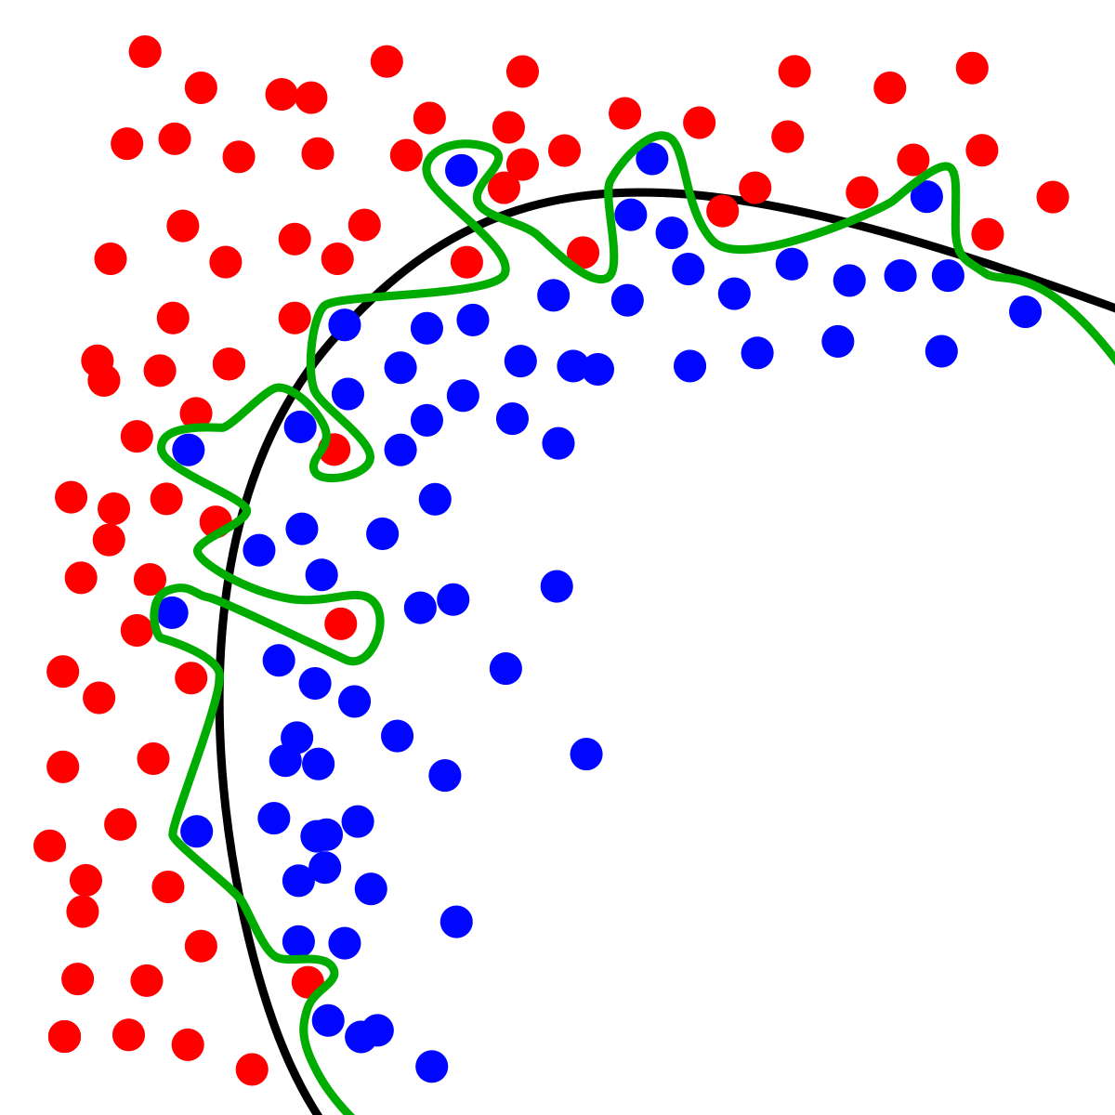
Dynamic Systems Thinking for Psychologists
Michael E. Aristodemou
michael.aristodemou@psychologie.uzh.ch
Lecture 4: Continuous time models

Slide 2






Discrete time is status-quo in psychology
$$Y_{t−2}$$
$$Y_{t−1}$$
$$Y_{t}$$
$$X_{t−2}$$
$$X_{t−1}$$
$$X_{t}$$

Slide 3
Three assumptions in discrete time models

Slide 4


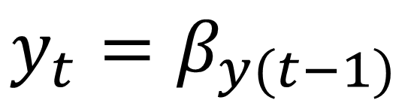

A1: Time lags are equidistant
0.5
0.5
$$y_{t−2}$$
$$y_{t−1}$$
$$y_{t}$$
$$y_{t}=β_{y(t−1)}$$

Slide 5



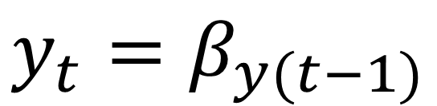

A1: What happens when they are not?
0.5
0.5
?
$$y_{t−2}$$
$$y_{t−1}$$
$$y_{t}$$
$$y_{t+1}$$
1 week
1 week
2 weeks
$$y_{t}=β_{y(t−1)}$$

Slide 6
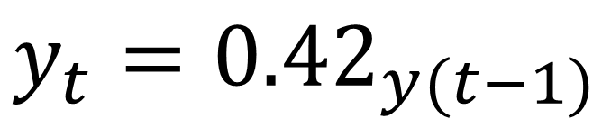
A1: What happens when they are not?
0.5
0.5
0.25
$$y_{t−2}$$
$$y_{t−1}$$
$$y_{t}$$
$$y_{t+1}$$
$$y_{t}={0.42}_{y(t−1)}$$
Notes:
0.416

Slide 7
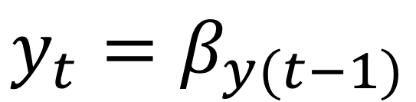
A2.1: Processes only change and interact when observations occur
$$y_{t}=β_{y(t−1)}$$

Slide 8
A2.2: The discrete-time model represents the net (aggregated) effect of the system’s underlying changes over each model interval
$$y_{t}=β_{y(t−1)}$$

Slide 9






A3: We have the correct time lag
1
2
3

Slide 10

A3: We have the correct time lag
1
3

Slide 11
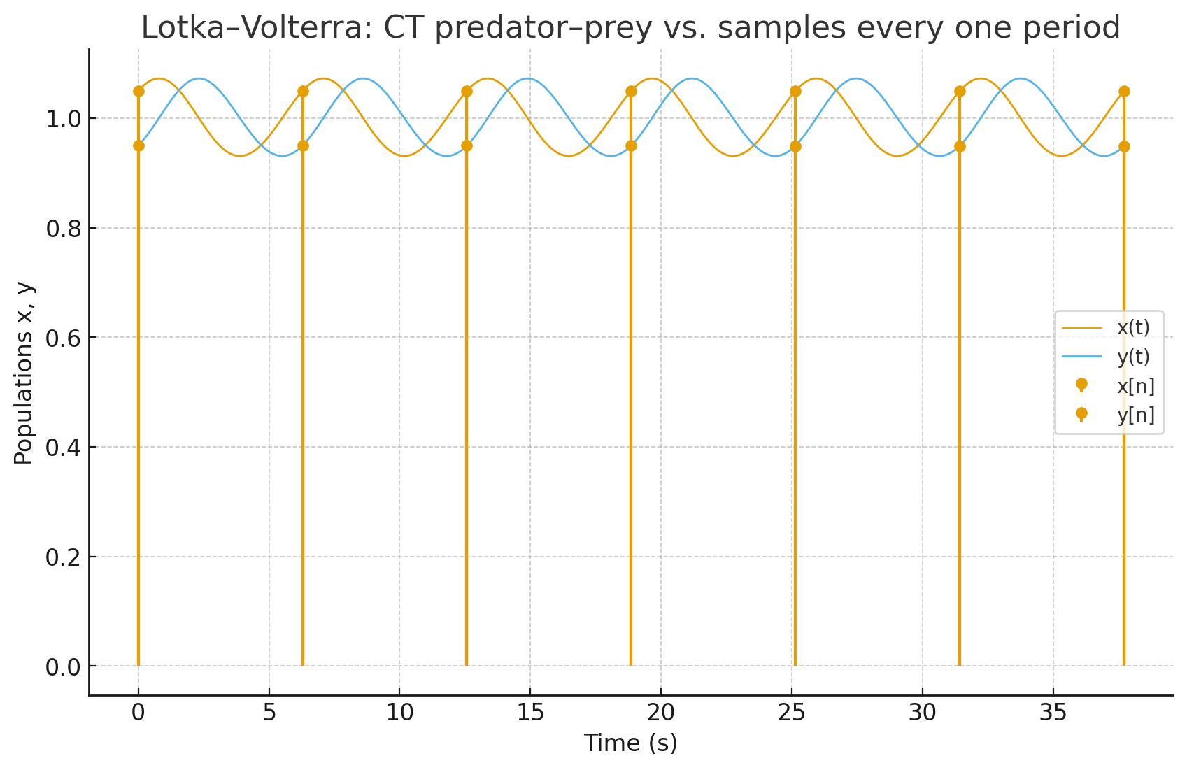
What if we have a continuous process?

Slide 12
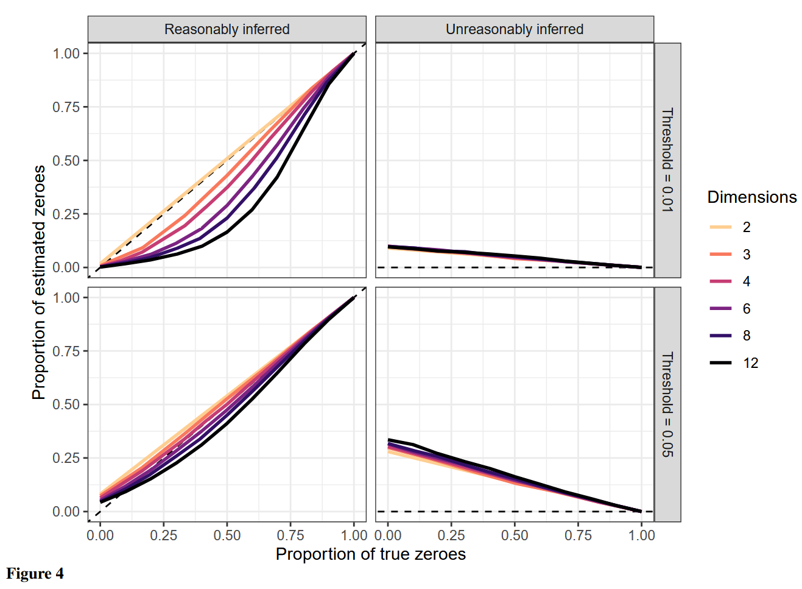
DT models tend overparameterize
Notes:
Reasonably inferred: correct absence of a causal path.
Unreasonably inferred: incorrect absence of a causal path.
Reason:

Slide 13



Continuous time models
$$y_{t−2}$$
$$y_{t−1}$$
$$y_{t}$$

Slide 14
Continuous time models
$$y_{t−2}$$
$$y_{t−1}$$
$$y_{t}$$

Slide 15
Continuous time models
$$y_{t−2}$$
$$y_{t−1}$$
$$y_{t}$$

Slide 16
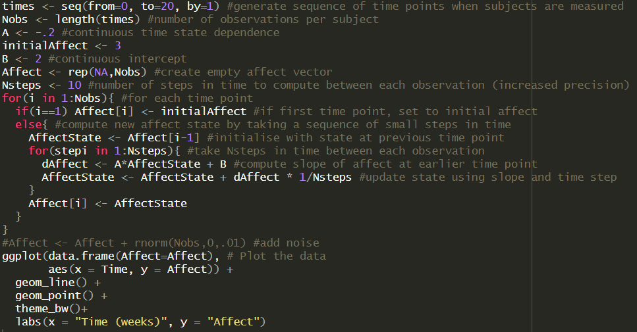
Euler-Maruyama approximation
We break continuous time into small time slices
We update the state of our growth process at each step based on the dynamics of our model
Notes:
A & B are per unit time rates of change (e.g. B = 2 per second). This is different to a discrete time parameter which describes the total effect over a whole sampling interval, not an instantaneous rate.

Slide 17
Simulate for yourself
Find the code on Github → Lecture4 → euler_W4.R
Increase the number of steps to 50, then back to 1. Observe the difference
Adapt the model to represent a constant rate of change
Add measurement error

Slide 18
Break

Slide 19
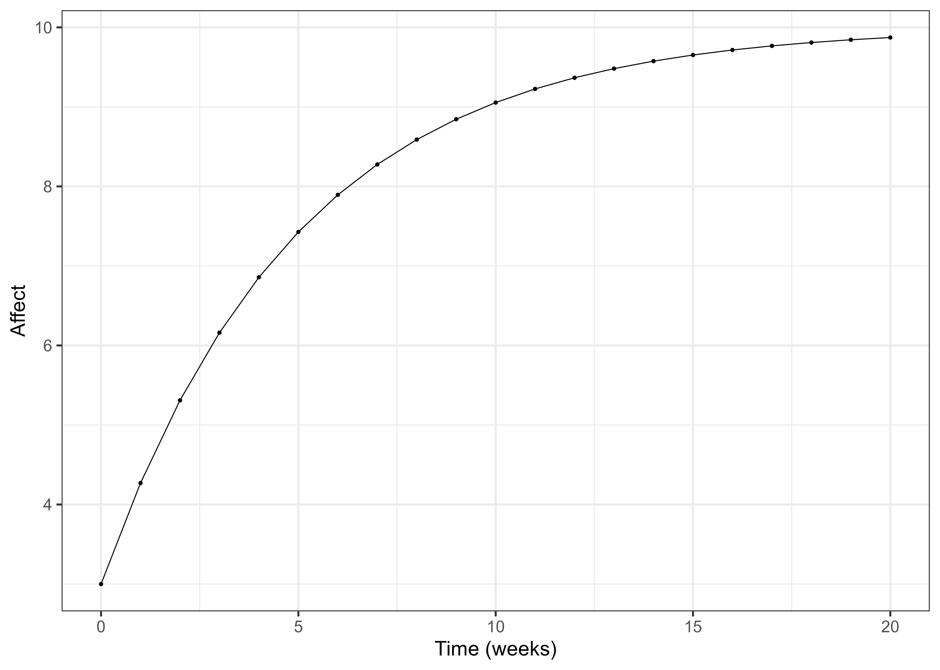
This is Jill’s trajectory up to now

Slide 20
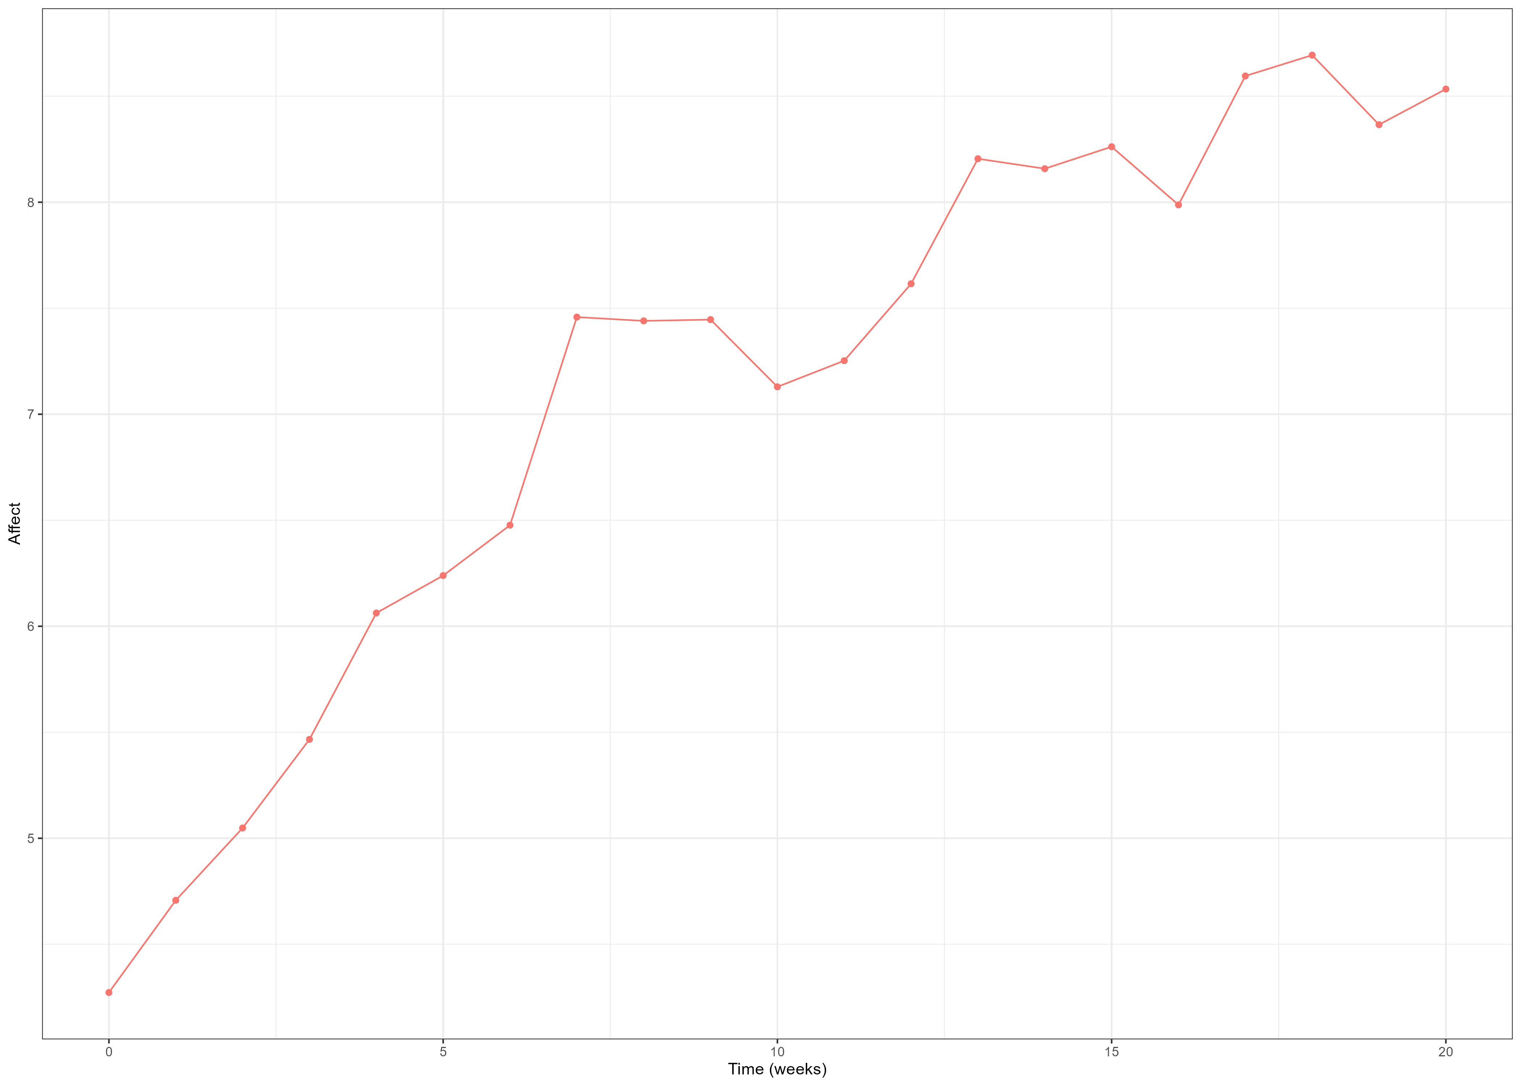


Unpredictable fluctuations
$$d_{Affect}=\left(A_{t}+B\right)dt+GdW_{(t)}$$
$$W_{\left(t\right)}\sim N(0, 1∗Δt)$$

Slide 21
How do we know it’s not measurement error?
Go to Github → Lecture4 → sysnoise_W4.R
Try to figure out what the difference between measurement and system noise is

Slide 22
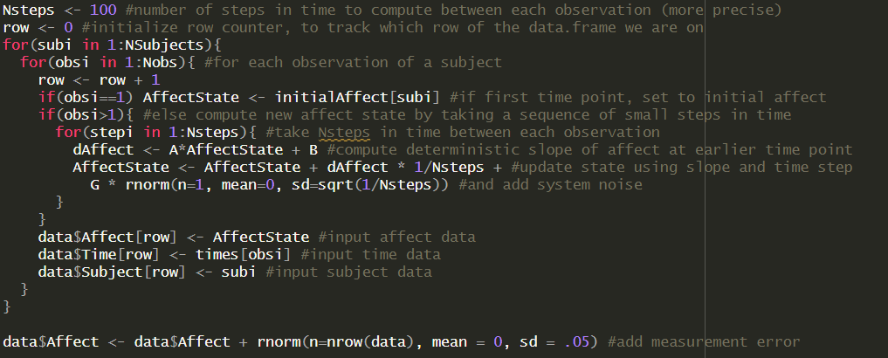
System noise helps us predict the future
Notes:
Therefore, noise depends on when the future is. Sometimes, noise that looks uninformative on one time scale, could be informative (predictive) on a shorter time scale. Consider a model of life satisfaction -- if we are looking at data that were only collected yearly, changes in satisfaction due to the weather would be unlikely to offer any predictive capacity for the future and might be thought of as measurement error. If we were looking on an hourly time scale, changes in how we feel due to the weather may be thought of as 'real', in that if we measured a participant 1 hour later, such a change is still in the system.

Slide 23

State-space models
$$Affect\left(t\right)=Λ∗η_{t}+ε_{1t}$$
Measurement model
$${dη}_{t}=\left(A_{t}+B\right)dt+GdW_{t}$$
Latent process model
$$η_{t0}\sim N(μ_{0},Σ_{0})$$
Latent initial state

Slide 24
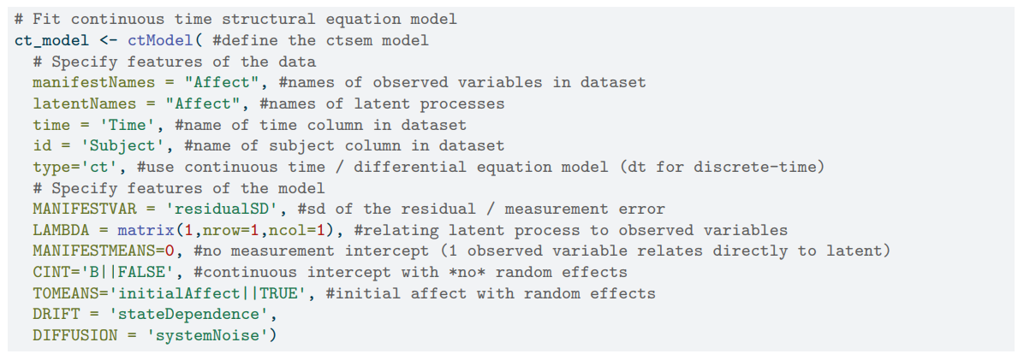


Continuous time structural equation modeling
$$Affect\left(t\right)=Λ∗η_{t}+ε_{1t}$$
Measurement model
$${dη}_{t}=\left(A_{t}+B\right)dt+GdW_{t}$$
Latent process model
$$η_{t0}\sim N(μ_{0},Σ_{0})$$
Latent initial state

Slide 25
Fit your own ctsem model
Go to Lecture4 → ctsem_SD_W4.R
Fit the ctsem model
Write down if parameters match the simulated values
Visualize the fit between the data and the model-implied values

Slide 26
Thank you for listening ☺

