Slide 1
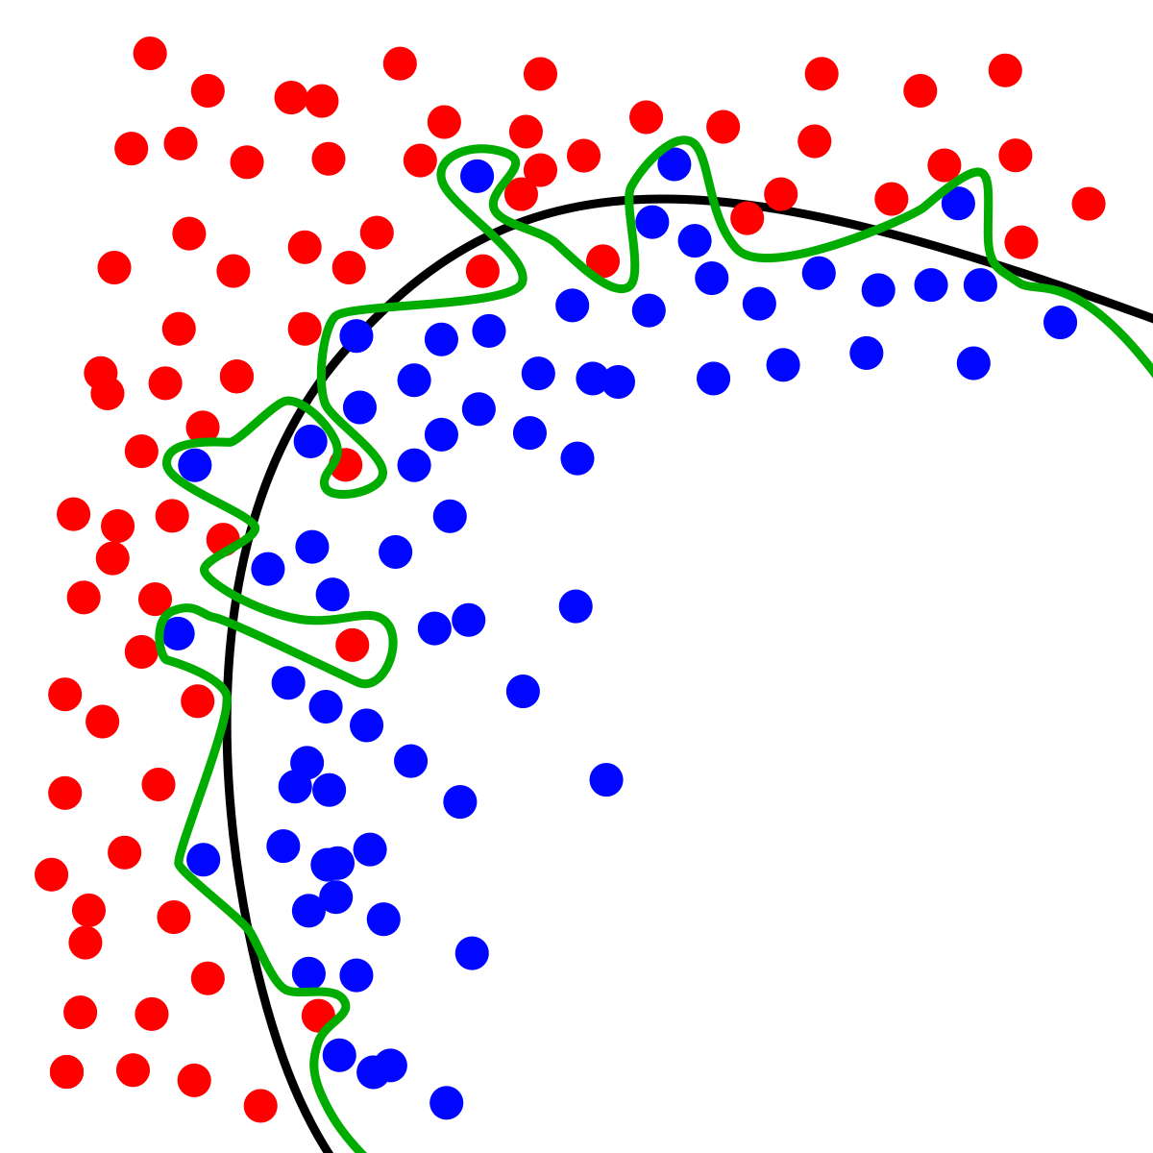
Dynamic Systems Thinking for
Psychologists
Michael E. Aristodemou
michael.aristodemou@psychologie.uzh.ch
Lecture 8: Time-Dependent Predictors

Slide 2
Group exercise
Part 1: Formalize your process
Form your groups
Make a boxes and arrows sketch of the system of variables you think affects your psychological process of interest
Write the equation that determines the rate of change in your process (if you are not sure about the exact equation, use words)
Guiding questions:
Why are you creating a model of this process(es)?
Which factors affect your process?
Which factors are relevant to consider for you aim?

Slide 3


Let’s discuss
Interview the other group about their model
Try to understand what they are doing
Find out how you could use their model if you were a practitioner, scientist, or just a curious human
Offer suggestions if you have them (but first ask questions!)

Slide 4
What conceptual components do you have trouble fitting into models?

Slide 5
Moderating parameters

Slide 6
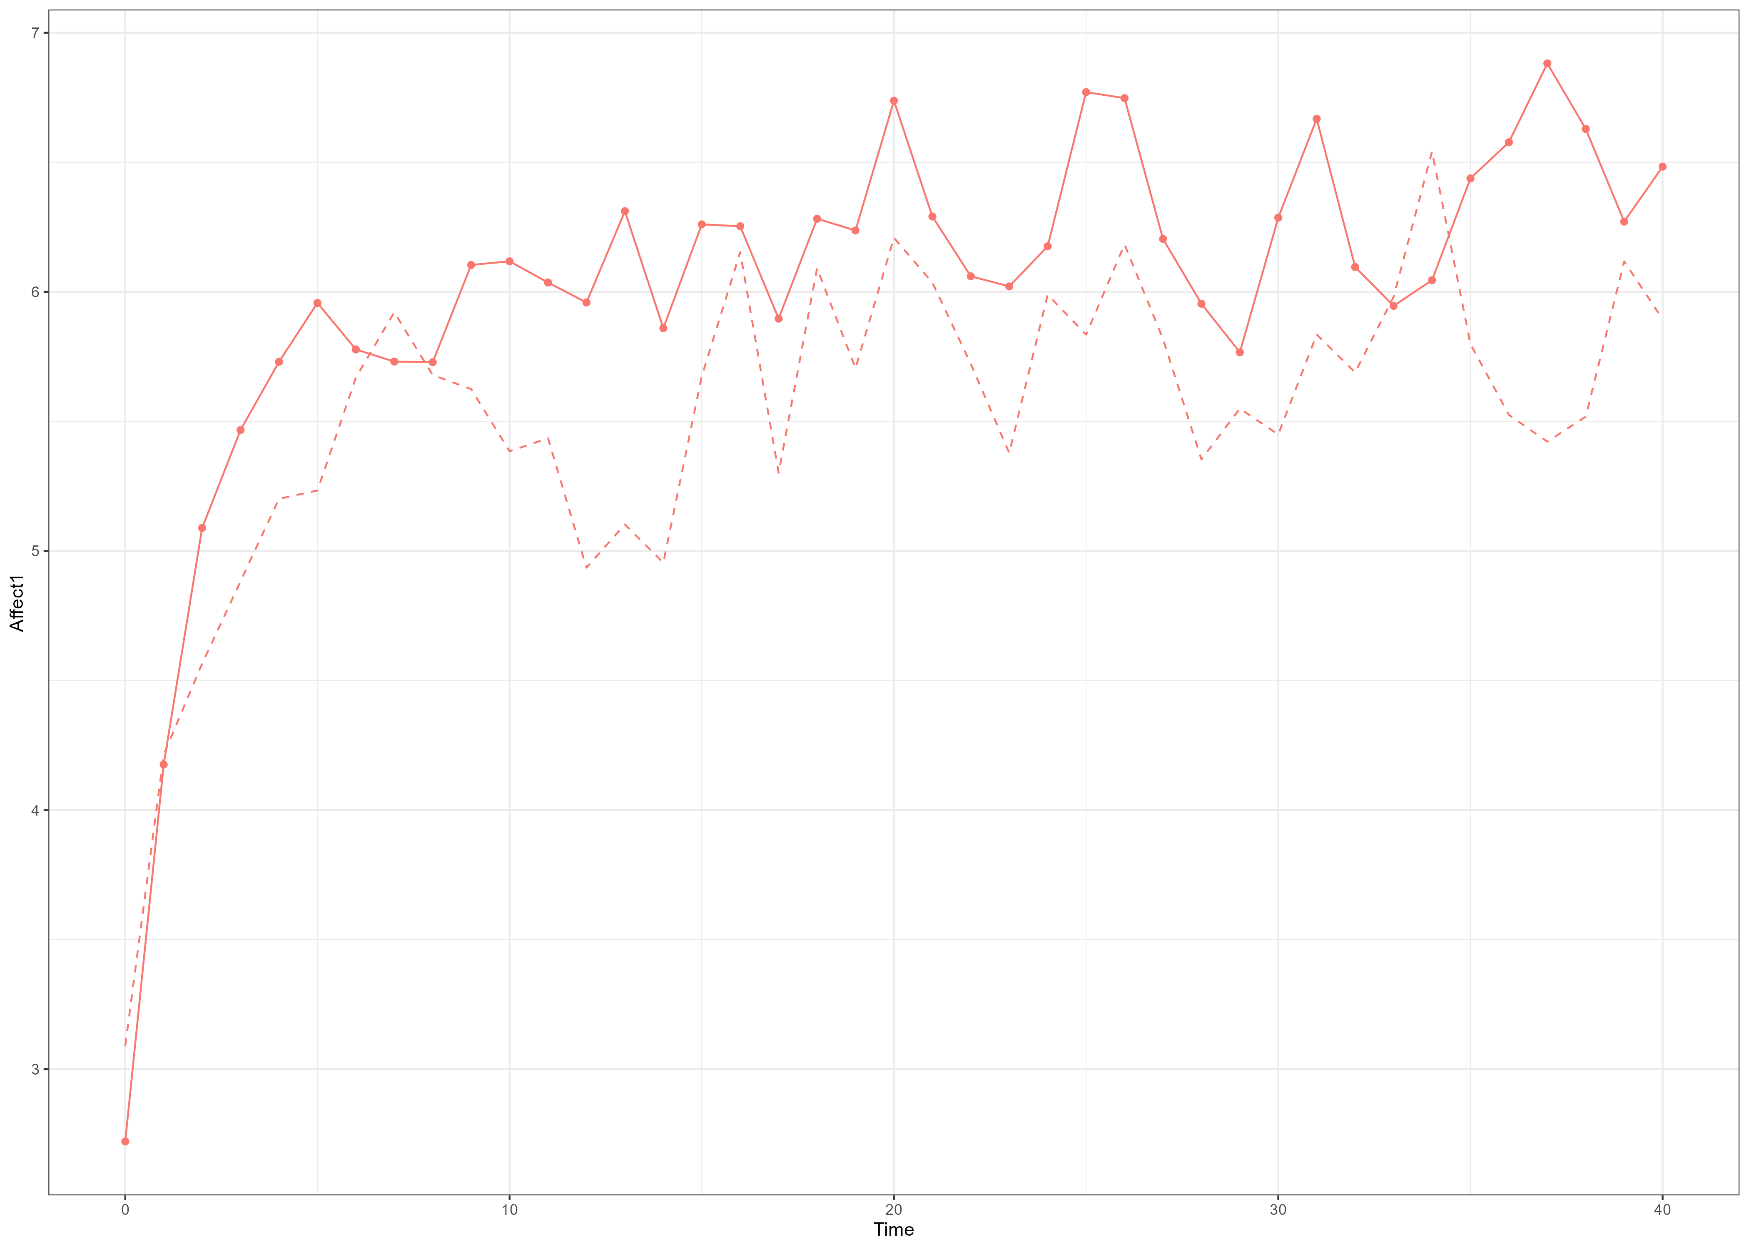
Back to a simpler model
$$dη_{1}=\left(A_{1}η_{1t}+B_{1}\right)dt+G_{1}dW_{1}t$$
$$dη_{2}=\left(A_{2}η_{2t}+B_{2}\right)dt+G_{2}dW_{2}t$$

Slide 7
A different type of predictor
$${A_{1}}_{i}=A_{0}+TIPRED_{i}∗β+{τ_{0}}_{i}$$
$${A_{1}}_{i}=A_{0}+TDPRED_{i,t}∗β+{τ_{0}}_{i}$$

Slide 8
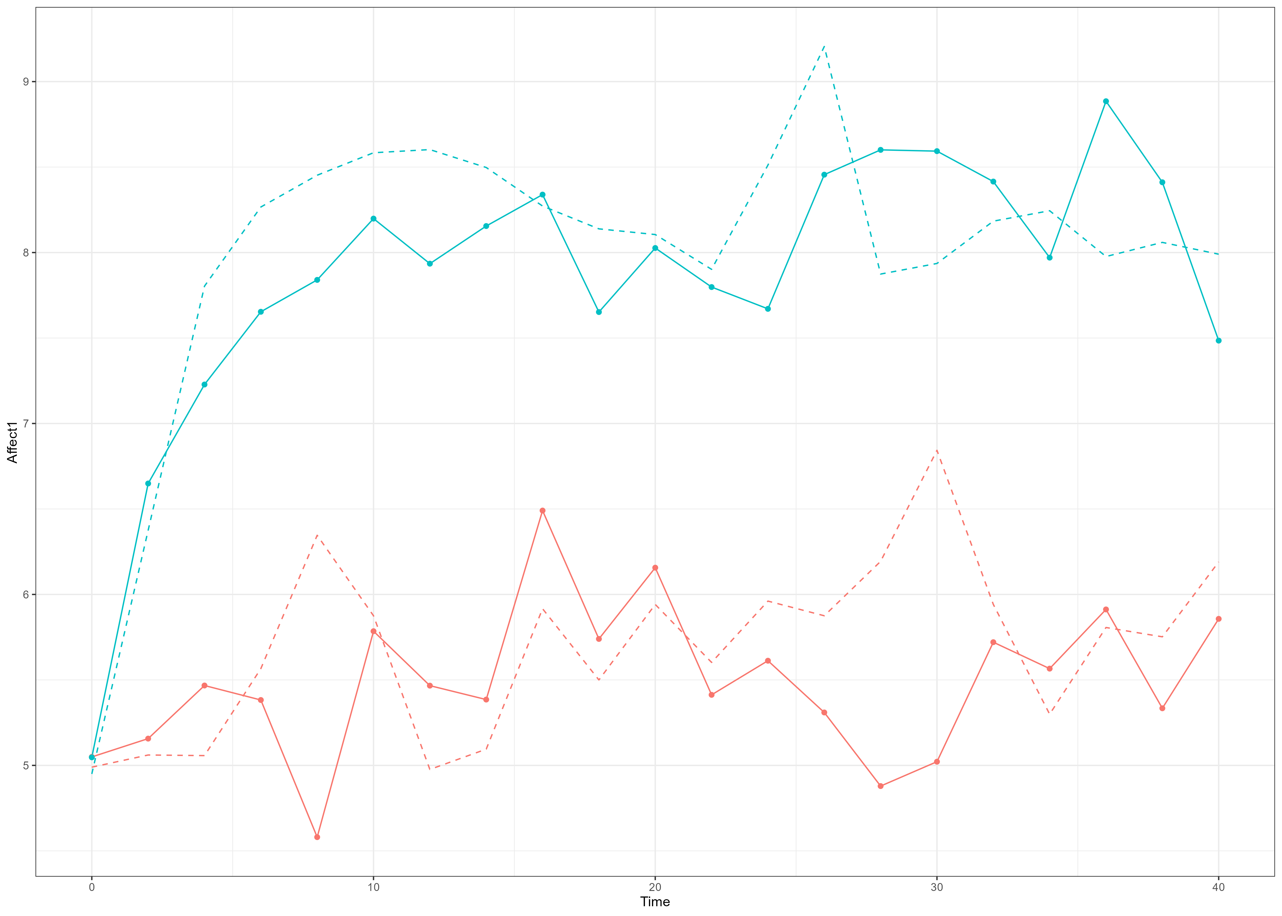
State-dependence varying due to TIPRED
$${A_{1}}_{i}=A_{0}+TIPRED_{i}∗β+{τ_{0}}_{i}$$
Notes:
Couple RED with stronger negative state-dependence (A1red).
Couple Blue with weaker negative state-dependence (A1blue).

Slide 9
Time-dependent predictors

Slide 10
Things that vary with time and influence our parameters
$${A_{1}}_{i}=A_{0}+TDPRED_{i,t}∗β+{τ_{0}}_{i}$$
OR
$${A_{1}}_{i}={(A}_{0}+{τ_{0}}_{i})∗TDPRED_{i,t}∗β$$

Slide 11
An example with state-dependence

Slide 12
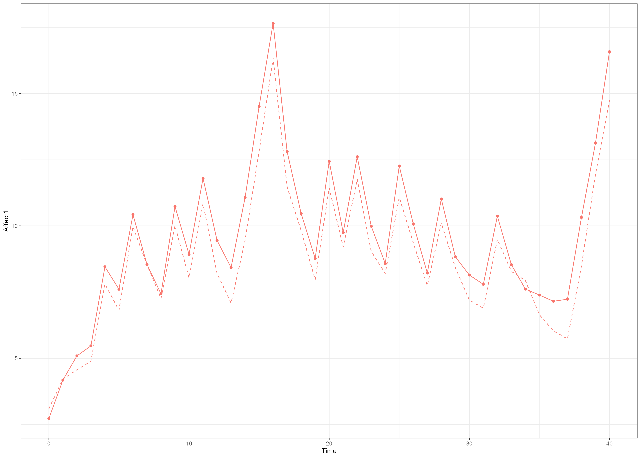
Turning State-Dependence on and off
$${A_{1}}_{i}={(A}_{0}+{τ_{0}}_{i})∗TDPRED_{i,t}∗β$$
$$dη_{1}=\left(A_{1}η_{1t}+B_{1}\right)dt+G_{1}dW_{1}t$$

Slide 13
Always on
On and off

Slide 14
Thresholded State-Dependence
$$dη_{1}=\left(A_{1}η_{1t}+B_{1}\right)dt+G_{1}dW_{1}t$$
$${A_{1}}_{i}=A_{0}+TDPRED_{i,t}∗β+{τ_{0}}_{i}$$
$$TDPRED_{i,t}=1, if mood≥0$$
$$TDPRED_{i,t}=−1, if mood<0$$

Slide 15
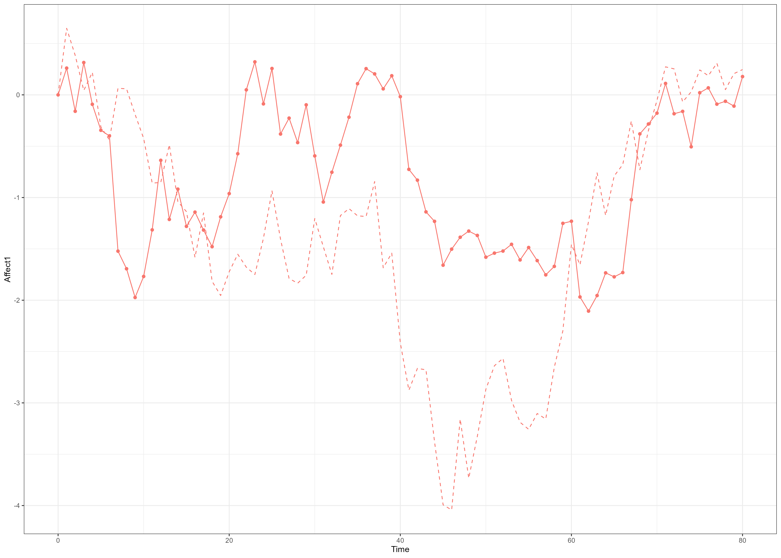
Thresholded State-Dependence
Affect >= 0
AR1 = -1.2
Affect < 0
AR1 = 0

Slide 16
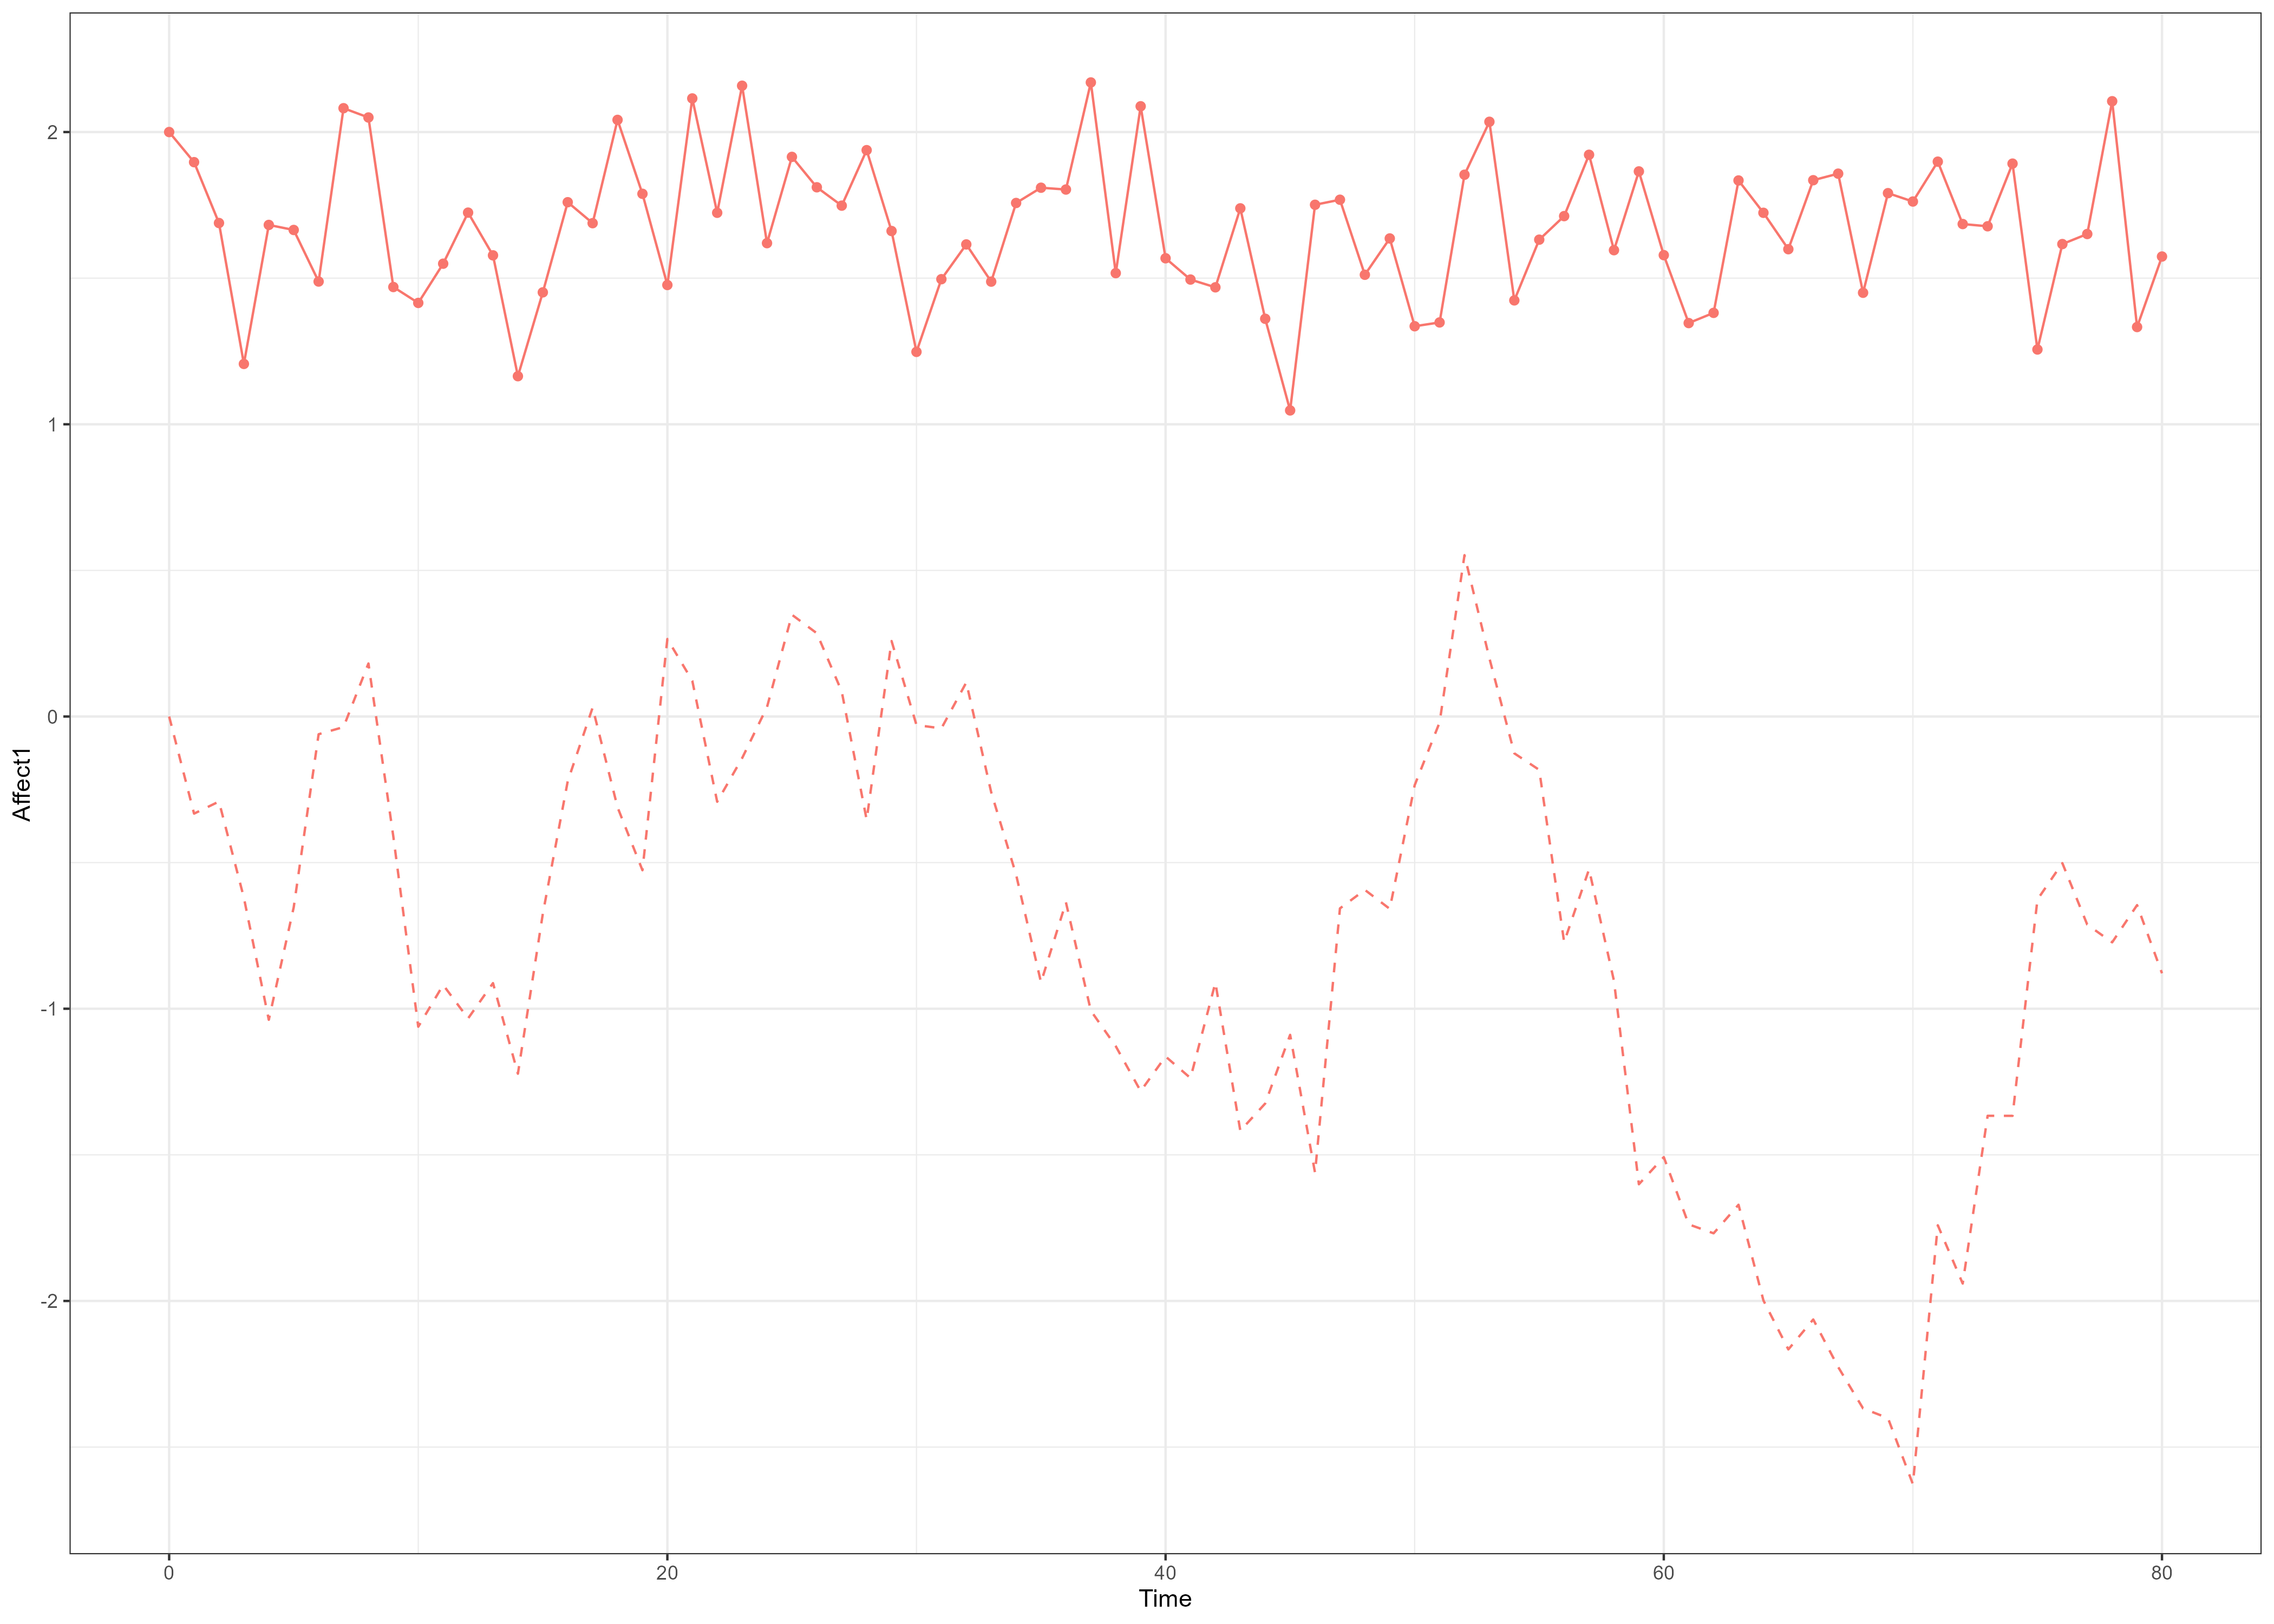
Thresholded State-Dependence
Affect >= 0
AR1 = -1.2
Affect < 0
AR1 = 0

Slide 17
Thank you for listening ☺

