Slide 1
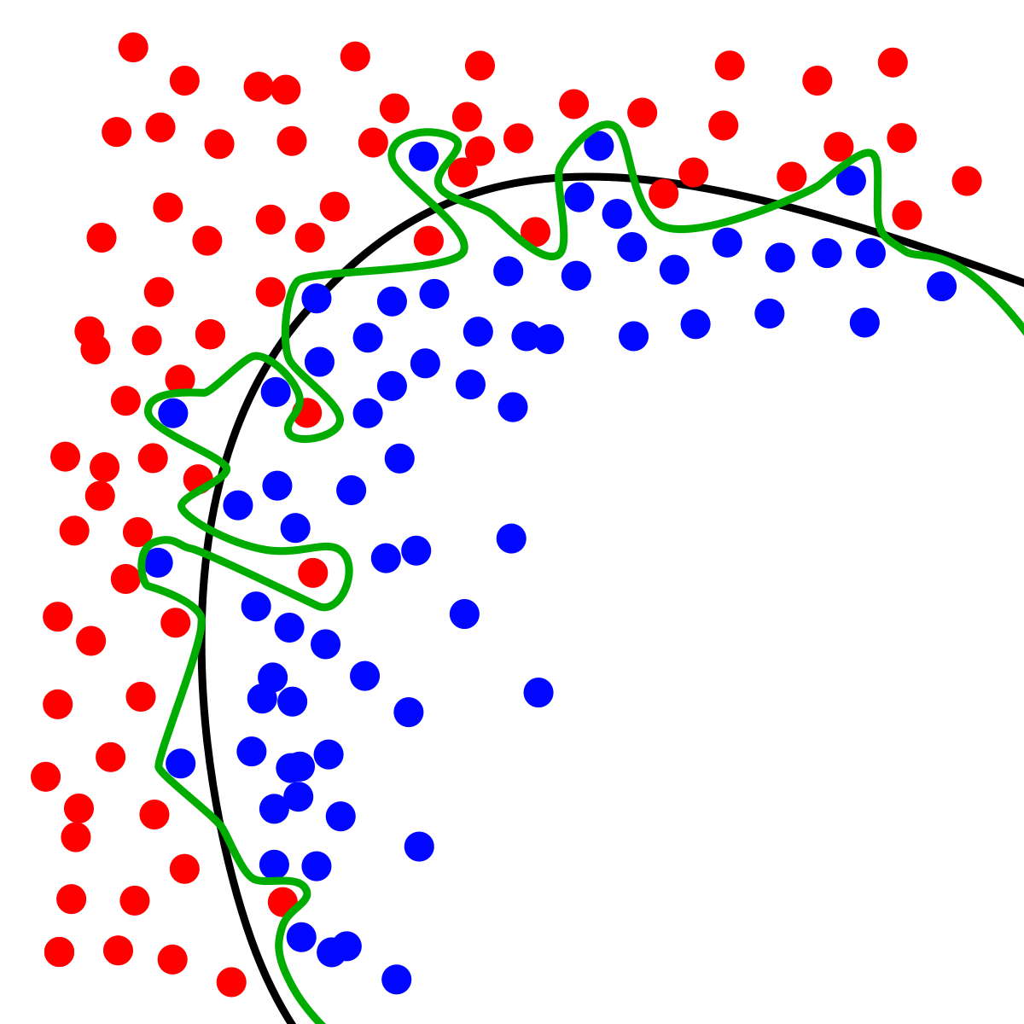
Dynamic Systems Thinking for
Psychologists
Michael E. Aristodemou
michael.aristodemou@psychologie.uzh.ch

Slide 2
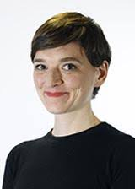

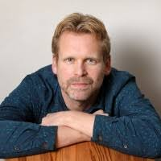
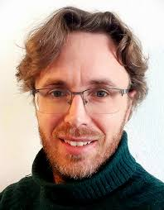
Hi, I’m Michael
Helen Tibboel
BSc Psychology (Clinical Specialization) – Erasmus University Rotterdam
MSc (Research) Clinical and Health Psychology – Leiden University
PhD Medical Neuroscience – Donders Institute for Brain, Cognition and Behavior
Postdoc Quantitative Methods – University of Zurich
Eiko Fried
Rogier Kievit
Charles Driver

Slide 3
You are… (alt txt: introduction round)
Your name, which part of psychology interests you most, what do you want to learn here

Slide 4
I want to convince you that formal theories are worth the trouble

Slide 5
What is a mental disorder?

Slide 6
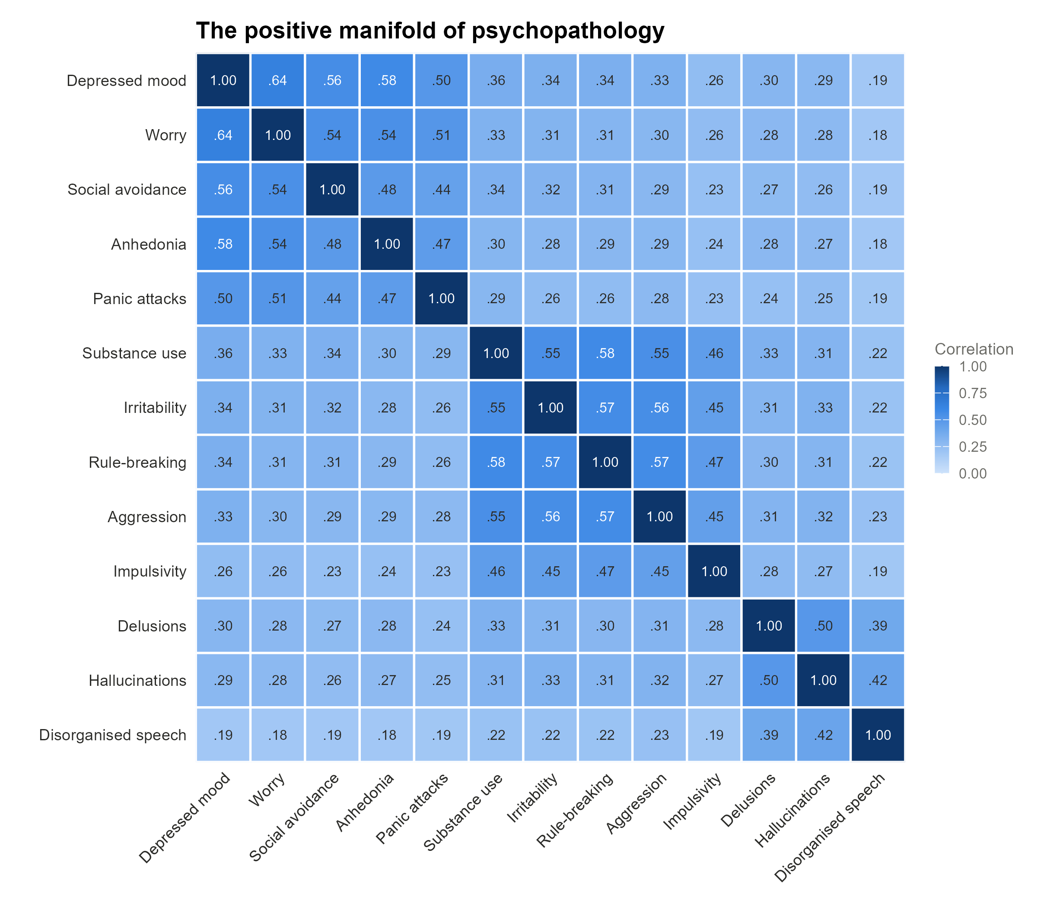
Notes:
Cross-sectionally both predict the same structure – that is people who have higher symptom severity in one domain have more severe severity in other domains as well.
This is what the field believed in 2016 see., recent paper on nomorbidity for alt take: https://osf.io/preprints/psyarxiv/3t2cm

Slide 7
Theories make distinct predictions about the structure of change

Slide 8

Questions, questions, more questions
Notes:
Which symptoms?
How much?
All connections equal?
When does this causal interaction happen?
Does it increase with frequency?
Does the rate of influence increase with symptom severity?
Does the state of each symptom matter?

Slide 9
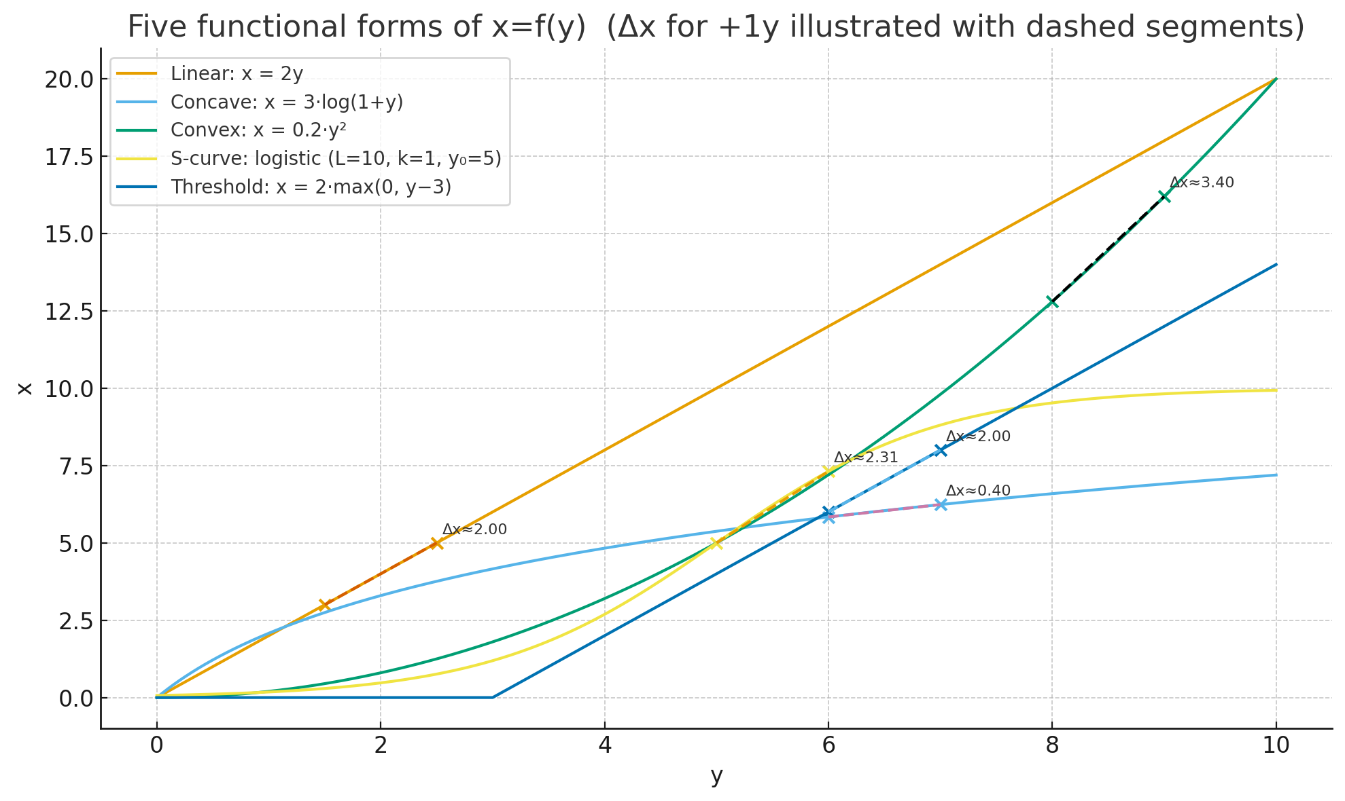

Slide 10
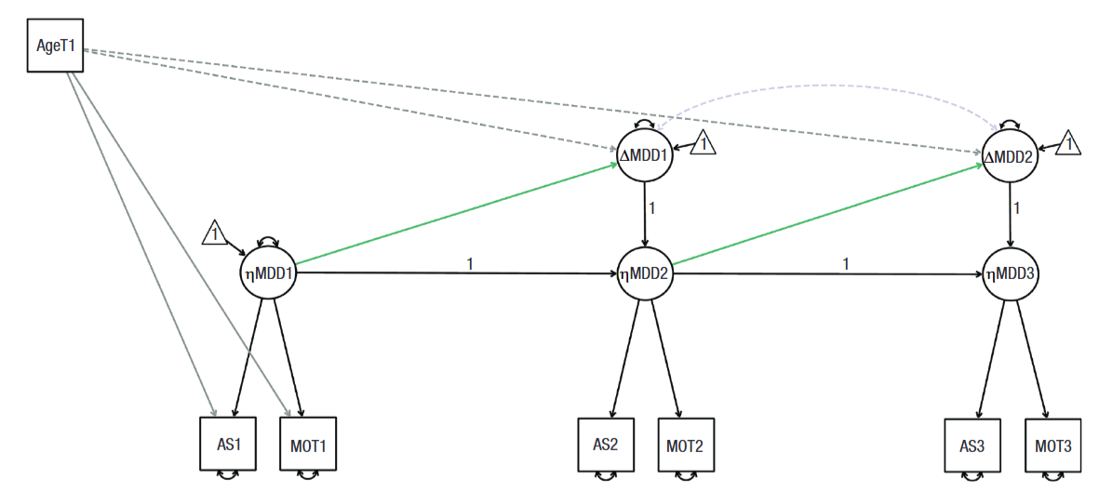
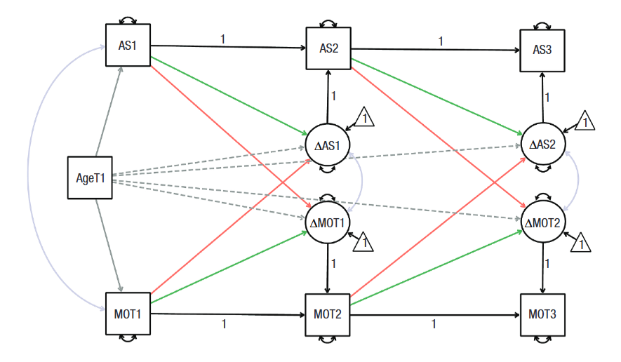
Ended up with stupid models, and that’s okay…

Slide 11
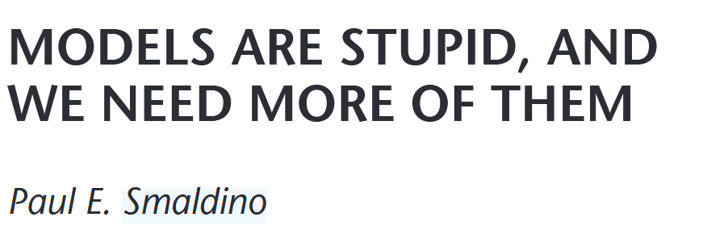
Because…
Notes:
12 functions served by false models:
An oversimplified model may be a starting point in a series of models of increasing complexity and realism.
A know incorrect but otherwise suggestive model may undercut the too ready acceptance of a preferred hypothesis by suggesting new alternative lines for the explanation of phenomena.
An incorrect model may suggest new predictive test or new refinements of an established model, or highlight specific features of it as particularly important.
An incomplete model may be use as a template, which captures larger or otherwise more obvious effects that can then be factored out to detect phenomena that would otherwise be masked or be too small to be seen.
A model that is incomplete may be used as a template for estimating the magnitude of parameters that are not included in the model.
An oversimplified model may provide a simpler arena for answering questions about properties of more complex models, which also appear in this simpler case, and answers derived here can sometimes be extended to cover the more complex models.
An incorrect simpler model can be used as a reference standard to evaluate causal claims about the effects of variables left out of it but included in more complete models, or in different competing models to determine how these models fare if these variables are left out.
Two false models may be used to define the extremes of a continuum of cases in which the real case in presumed to lie, but for which the more realistic intermediate models are too complex to analyze or the information available is too incomplete to guide their construction or to determine a choice between them. In the defining these extremes, the limiting models specify a property of which the real case is supposed to have an intermediate value.
A false model can specify the functional form of the relationships, that can then be explained by a mechanical model.
A family of models of the same phenomenon, each of which makes various false assumptions have uses: (1) look for results that are true in all of the models, thus presumably independent of different specific assumptions which vary across models; (2) one may determine conclusions that are irrelevant to a given conclusion. (3) the dependence of differences in results on some assumptions.
A model that is incorrect be being incomplete may serve as a limiting case to test the adequacy of new, more complex models.

Slide 12
Models help us think about the world
Precise, transparent, independently replicable

Slide 13

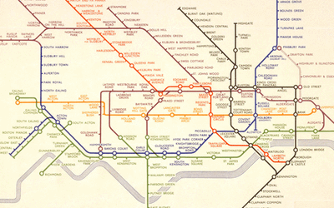
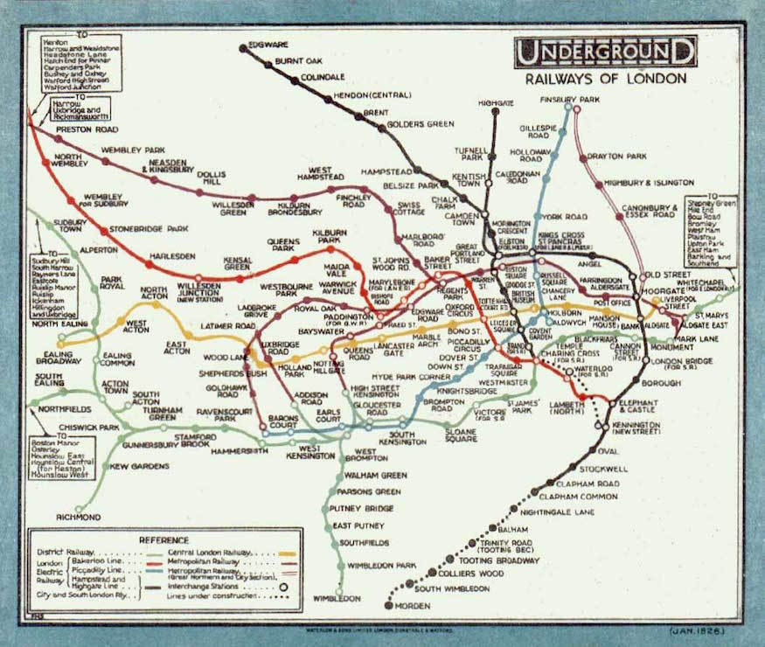
Models are stupid by design
“A model that refuses to do violence to reality has become reality, and reality was the thing we couldn't understand in the first place.”
Notes:
which line, which order, where to change

Slide 14
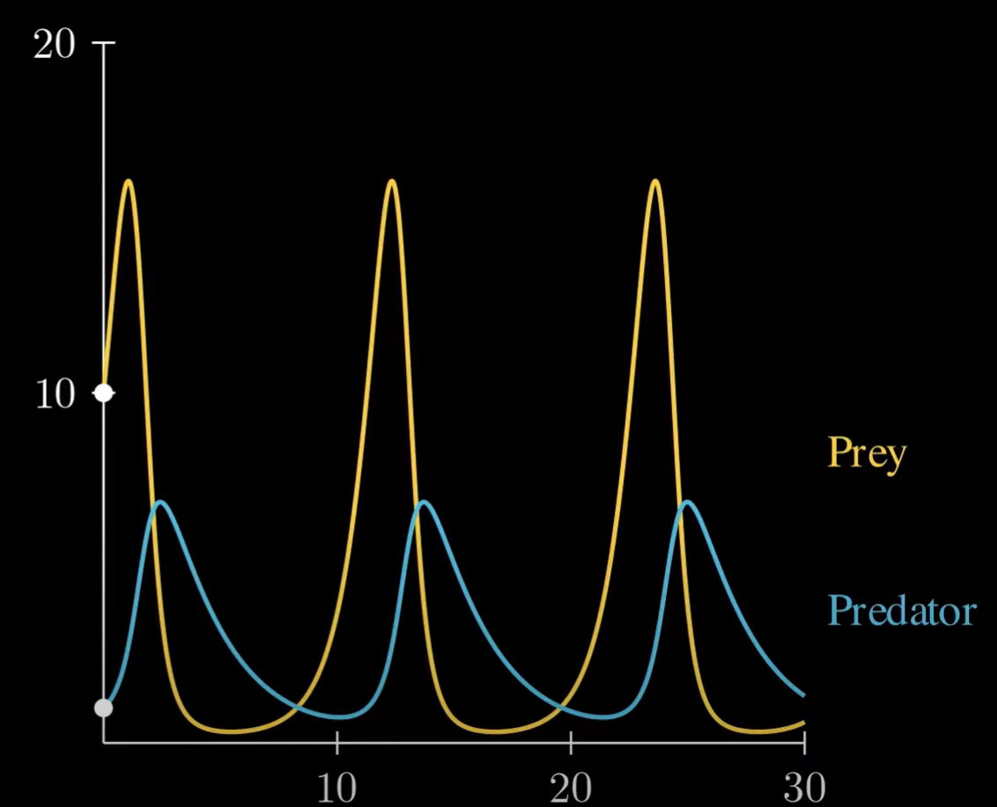
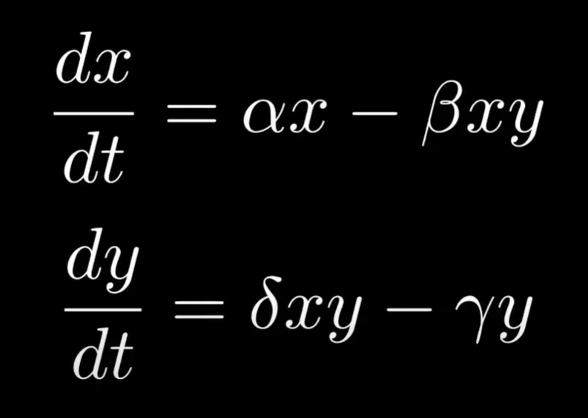
Prey-predator model (Lotka-Volterra model)
Notes:
Source: https://www.youtube.com/watch?v=Tc05IbqTsFM

Slide 15
Models help us understand complex phenomena

Slide 16
The Monty Hall Problem

Slide 17
You pick door 1

Slide 18
Host reveals a goat

Slide 19
Should you…
a. Switch
b. Stay
c. Does not matter

Slide 20
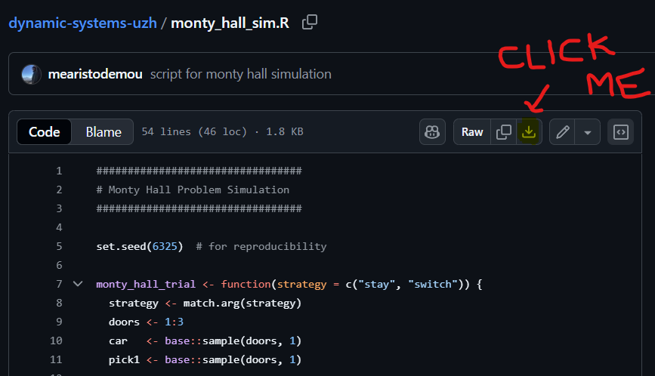
Let’s simulate…
Go to GitHub: github.com
Search: mearistodemou
Find the repository: dynamic-systems-uzh
Download the R script: “monty_hall_sim.R”

Slide 21
An example closer to home

Slide 22
My mood increases every week
At a steady rate

Slide 23
Let’s formalize: Linear regression
Y(t) = a + B(time)
Y(1) = 5 + 1(time == 1)

Slide 24
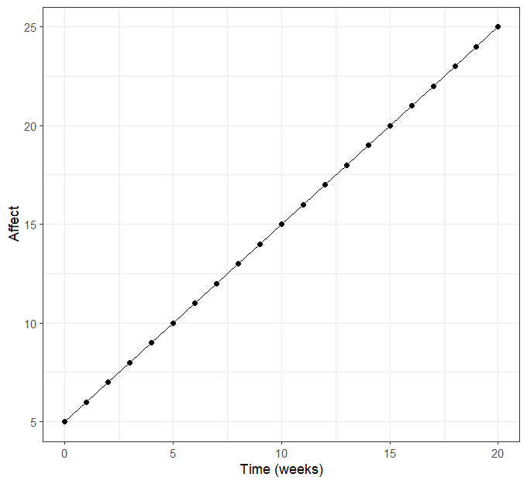
One process in a vacuum, let’s shock it!
Y(t) = a + B(time)
Y(t) = 5 + 1(time)

Slide 25
One process in a vacuum, let’s shock it!

Slide 26
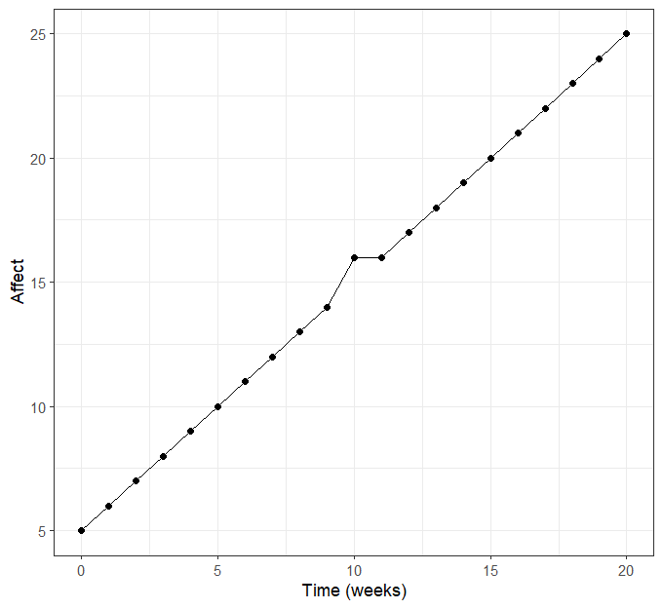
One process in a vacuum, let’s shock it!

Slide 27
Let’s make it slightly more complicated
My mood is a function of a constant influence (some trait) and half the value of my mood during the previous week (state dependence).

Slide 28
Formalize: autoregressive process
My mood is a function of a constant influence (some trait) and half the value of my mood during the previous week (state dependence).
Y(t) = a + c*(Y(t-1))
Y(2) = 2 + 0.8*(Y(1) == 2)

Slide 29
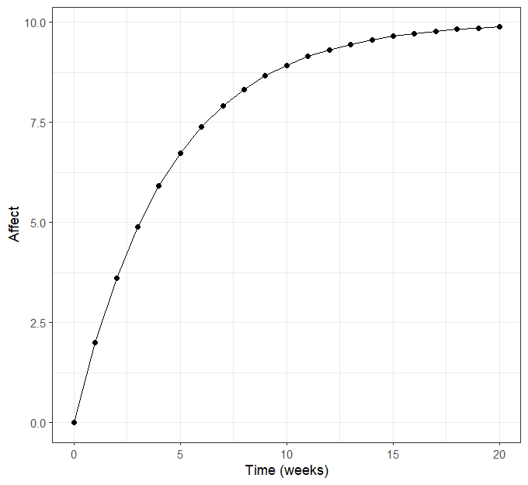
A state-dependent process in a vacuum

Slide 30
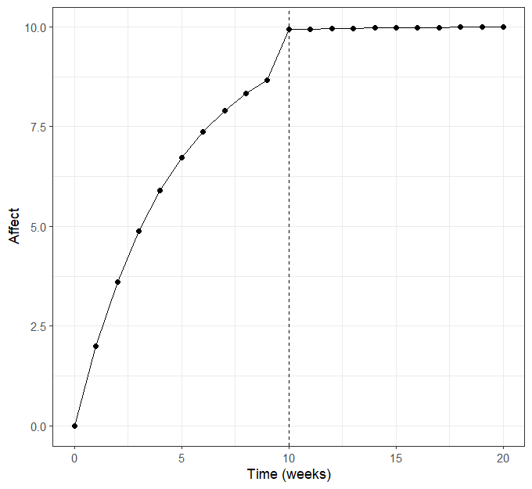
A state-dependent process in a vacuum

Slide 31
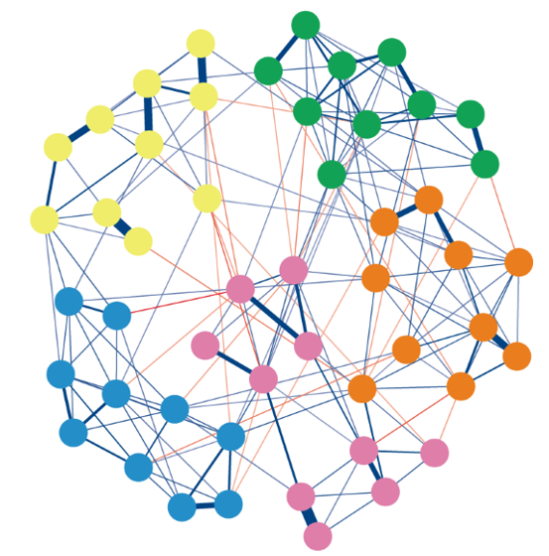
What is the expected trajectory of green nodes?

Slide 32

What happens if I poke here…

Slide 33
“A good scientific theory allows you infer what would happen to things in certain situations without creating the situations. Thus, scientific theories are crystal balls that actually work.”
Borsboom, D. (2013). Theoretical Amnesia

Slide 34
Back to Lotka-Volterra
https://visualize-it.github.io/lotka_volterra/simulation.html

Slide 35
Break

Slide 36
Why dynamic systems?

Slide 37
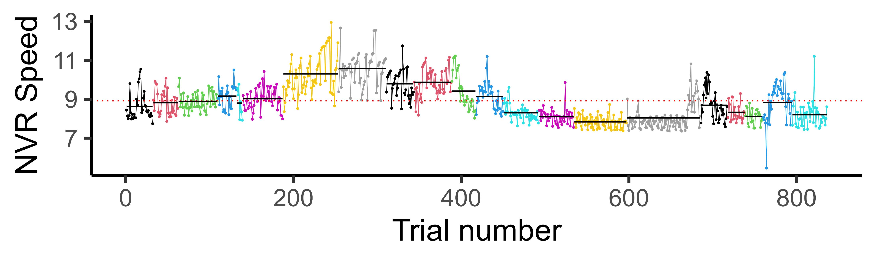
“Why” questions are often about changes
To know the causal mechanisms within a person we need change
Mental life is (often) dynamic

Slide 38
To study change, you need to measure change
Hypothesis: exercising increases your heart rate
Between-subject data: people who exercise more have a lower heart rate
The non-equivalence of between-subject relations and within-subject relations are the rule in psychology (Molenaar, 2009)

Slide 39

So, you are going to learn how to model change!

Slide 40
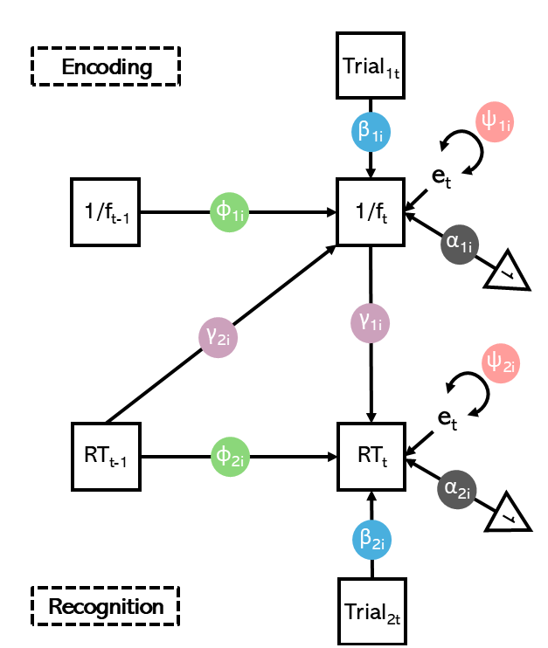
Specifically, systems of change

Slide 41
How we are going to learn…

Slide 42
Case of little Albert going to therapy…

Slide 43
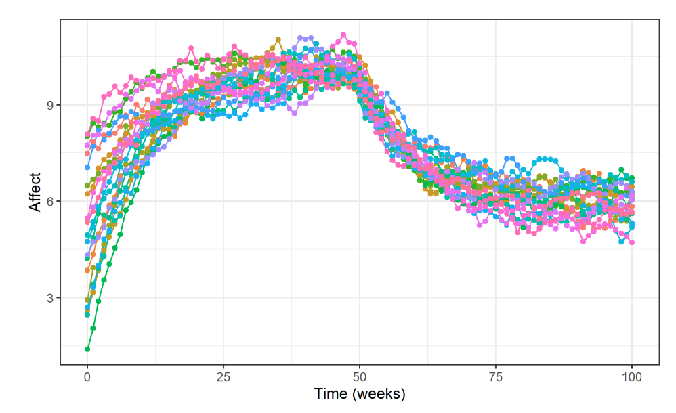
We have data…
We need to explain it!

Slide 44
Start simple, incrementally add complexity

Slide 45
Things you will learn
Think about psychological processes as dynamic systems
Using simulations to understand complex models
Model evaluation & selection

Slide 46
Questions about course content

Slide 47


Formalities
Assessment:
  Report + Oral exam (100%)
  Active participation (Pass/Fail)
  You can use LLMs, hence the oral exam
    Be critical of output (ask for links/references)
    Break instructions into small steps (e.g., code line-by-line)
    Take the time to understand each step
    Do not use output that you don’t understand!

Slide 48

Participation
Ask questions
Be stubborn, try to understand
Help your classmates/ask for help

Slide 49
Group project structure
Pick a psychological phenomenon
Create a story explaining how this phenomenon changes over time and varies across people (consider any factors you like!; environment, interpersonal dynamics, maturation trajectories)
Visualization – to convey your ideas about the system’s dynamics! (simulate, plot, draw stuff, equations)
Background research – not necessary, but can help you think through things! Always cite if you use existing work ☺

Slide 50
Report: on GitHub in “Assessment” folder
Main aim: show the ability to consider psychological concepts from a dynamic systems perspective
This is based on the group work (but report is individual)
Extend in new directions
Embed R code for simulations/visualizations
1000-3000 words

Slide 51

Oral exam
15 minutes
Questions based on the content of your report
Show understanding of your work

Slide 52
Discussion & Questions

Slide 53
Thank you for being here ☺

