Slide 1
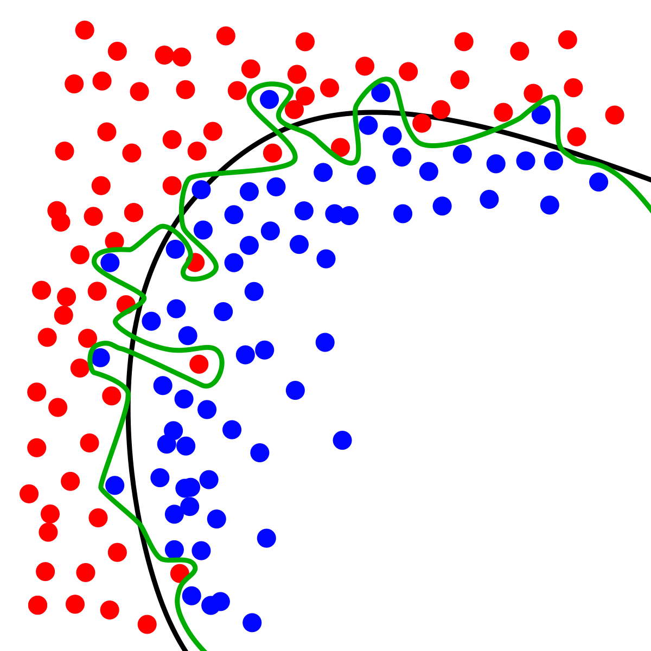
Dynamic Systems Thinking for
Psychologists
Michael E. Aristodemou
michael.aristodemou@psychologie.uzh.ch
Lecture 6: Noise, measurement error, and coupling

Slide 2
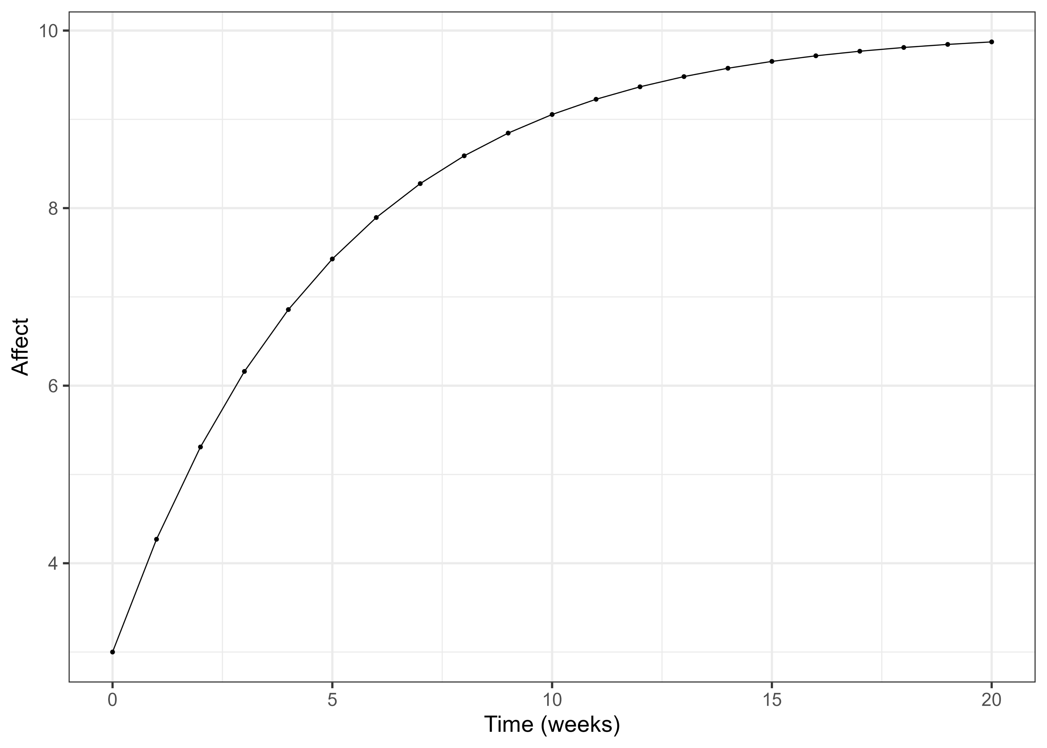
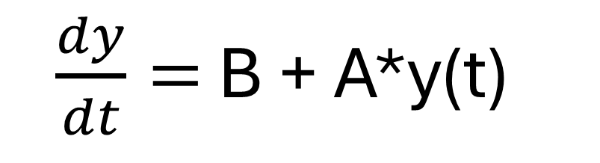
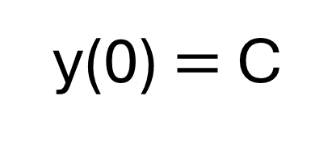
This is Albert’s trajectory up to now
$\frac{dy}{dt}=$ B + A*y(t)
y(0) $=$ C

Slide 3
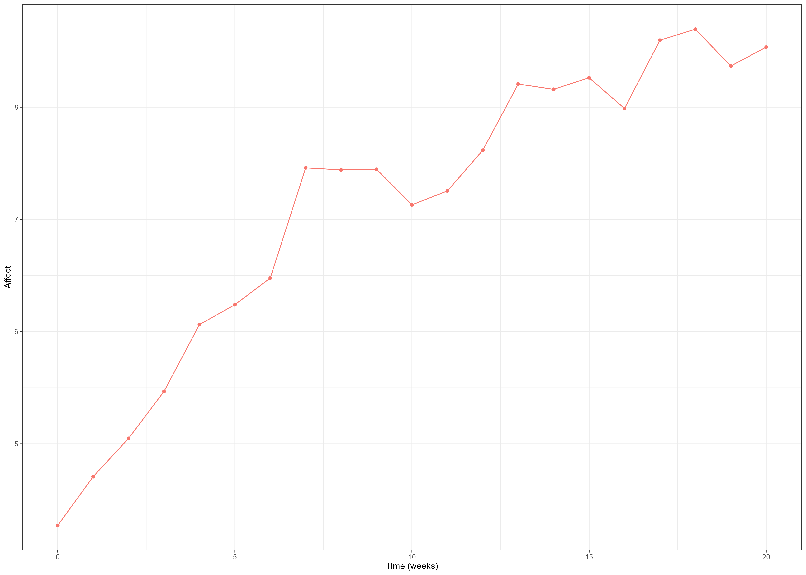
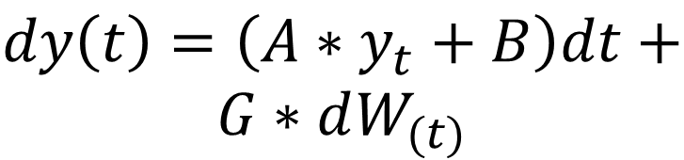

Process noise (diffusion)
$$dy\left(t\right)=\left({A∗y}_{t}+B\right)dt+$$
$$G∗dW_{(t)}$$
$$W_{\left(t\right)}\sim N(0, 1∗dt)$$

Slide 4
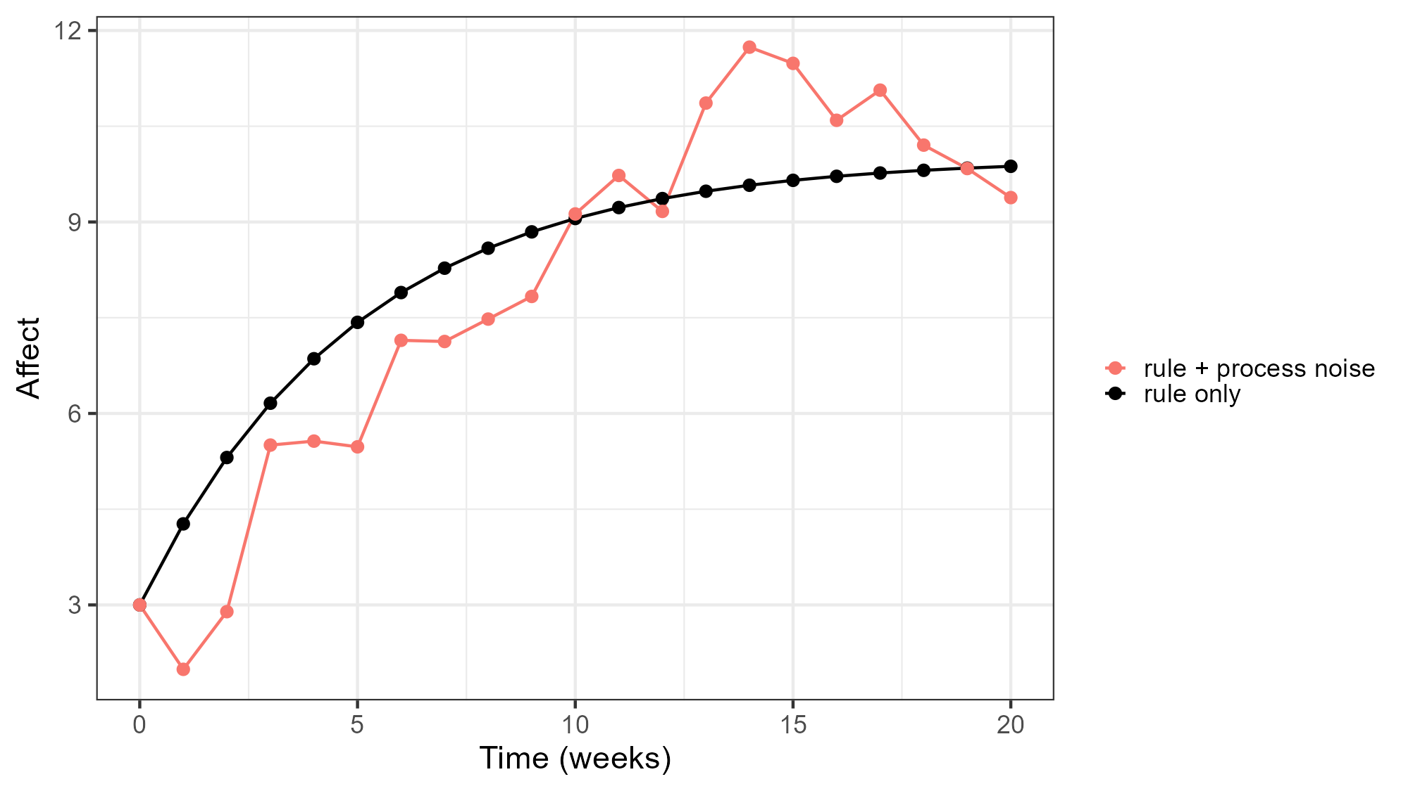
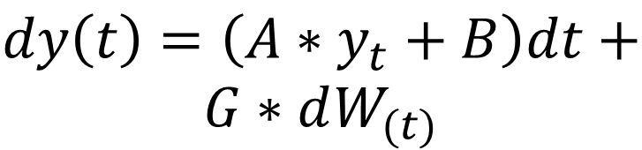

Process noise (diffusion)
$$dy\left(t\right)=\left({A∗y}_{t}+B\right)dt+$$
$$G∗dW_{(t)}$$
$$W_{\left(t\right)}\sim N(0, 1∗dt)$$

Slide 5
Why process noise?

Slide 6
The model leaves out most of Albert’s life
A friendly message
A conflict
Poor sleep
Hunger
A passing thought

Slide 7
The shocks actually change Albert’s mood
The shocks are not measurement error. The dynamics then carry the effect forward. After a bad conversation, you’re still a bit down an hour later.

Slide 8
Why are shocks independent?
The independence is a modelling choice. It has a clear meaning: everything predictable from the past belongs in the deterministic rule, and the process noise is only what is genuinely new at each moment.

Slide 9
Linking back to data

Slide 10
The world is noisy, but so are our measurements

Slide 11
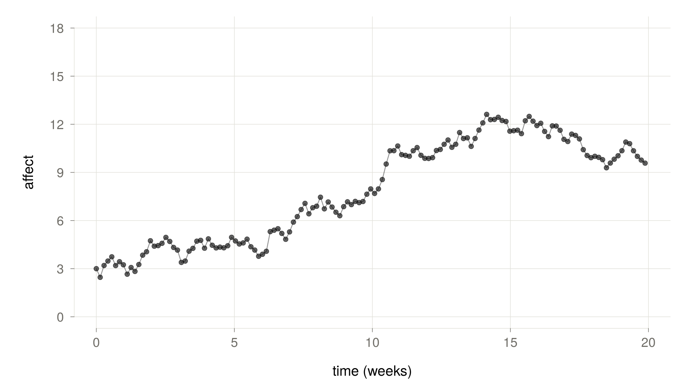
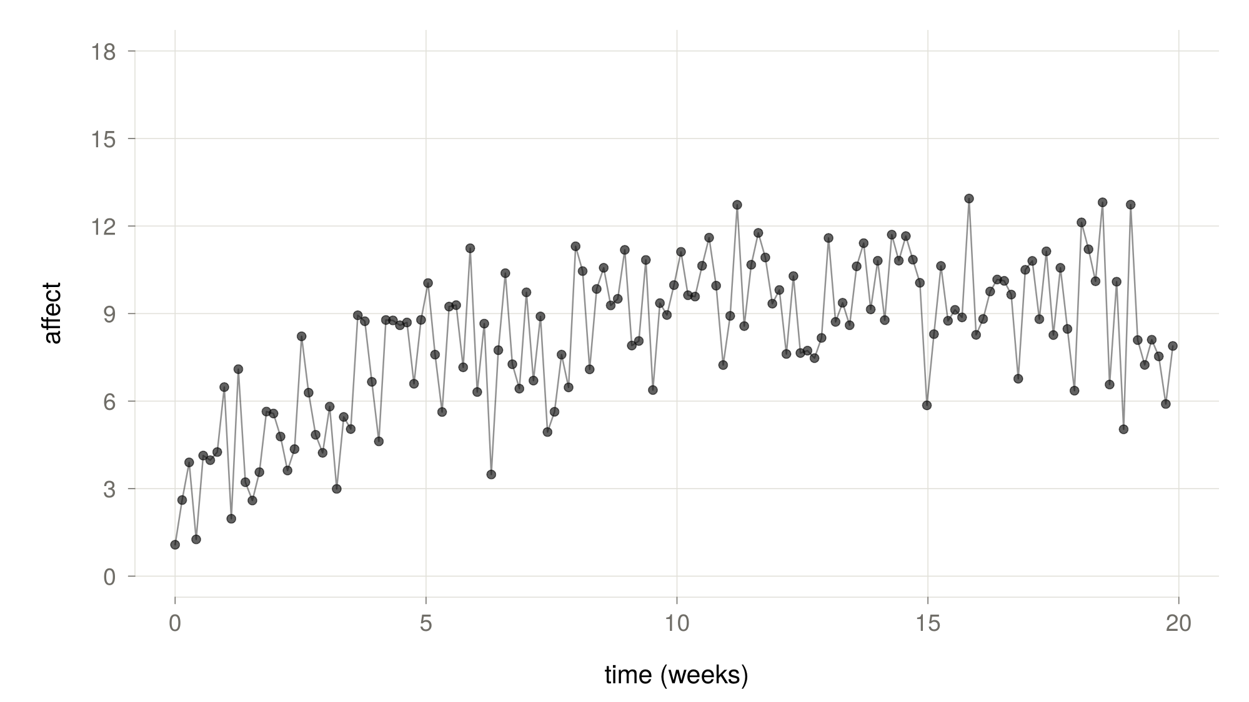
How can a model tell error versus process noise?

Slide 12
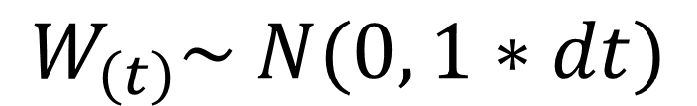
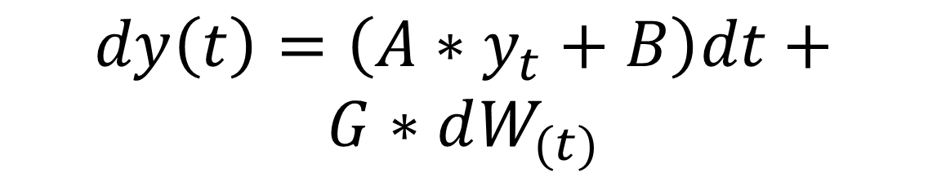
State-space models
?
$$dy\left(t\right)=\left({A∗y}_{t}+B\right)dt+$$
$$G∗dW_{(t)}$$
$$W_{\left(t\right)}\sim N(0, 1∗dt)$$

Slide 13
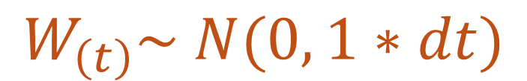
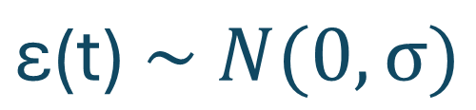
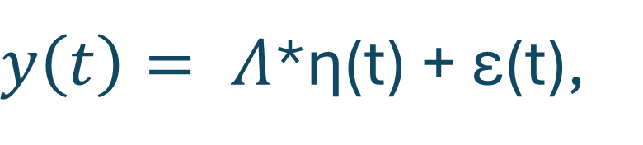
State-space models
Measurement model
$y\left(t\right)= Λ$*η(t) + ε(t),
$$\text{ε}\text{(t)} \sim N(0,σ)$$
Latent-state model
$$d\text{η}\left(t\right)=\left({A∗\text{η}}_{t}+B\right)dt+G∗dW_{\left(t\right)},$$
$$W_{\left(t\right)}\sim N(0, 1∗dt)$$

Slide 14
What is the assumption that a state-space model makes about error vs process noise?

Slide 15
Process noise affects the future, measurement error does not

Slide 16
Simulate noise-model and fit
Go to GitHub → Lecture06 → simulate_and_fit_ctsem.R
Go through the code (read the comments, think of questions)
Try to identify which parts of the model correspond to ctsem syntax
Ask me questions about the code, models etc.

Slide 17
Thank you for listening

