Slide 1
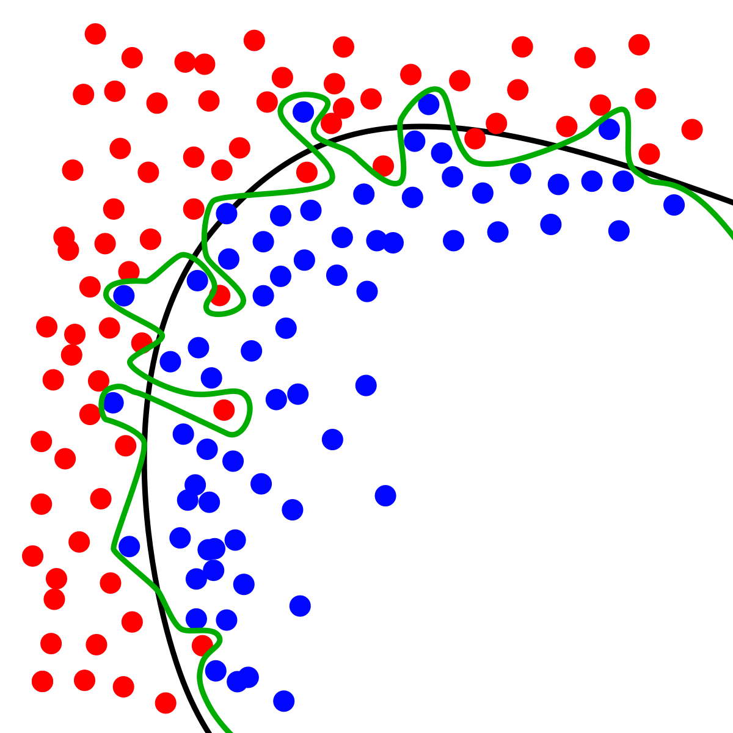
Dynamic Systems Thinking for Psychologists
Michael E. Aristodemou
michael.aristodemou@psychologie.uzh.ch
Lecture 6: Model evaluation and Comparison

Slide 2
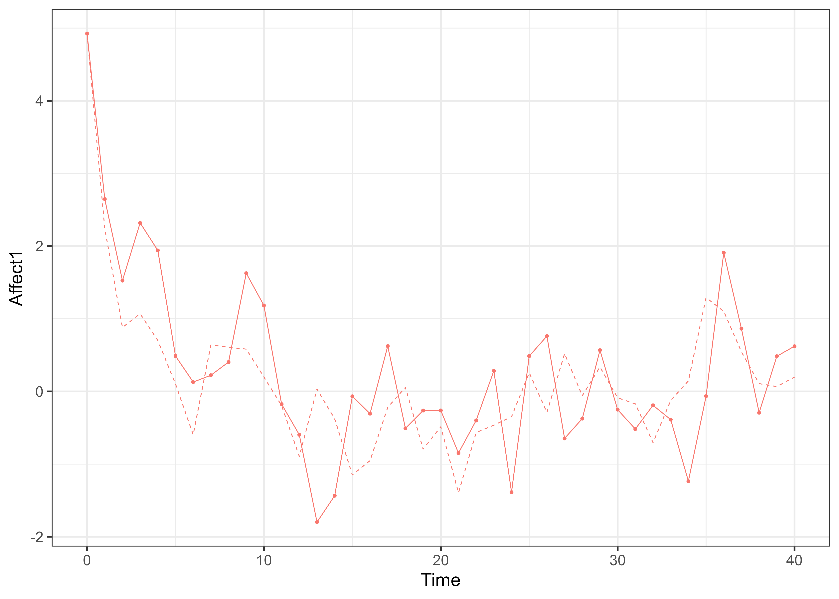
Many interpretations of correlated processes

Slide 3
Many interpretations of correlated processes
Unidirectional causation
Bidirectional causation
Two indicators one process
Two processes with a hidden common cause

Slide 4
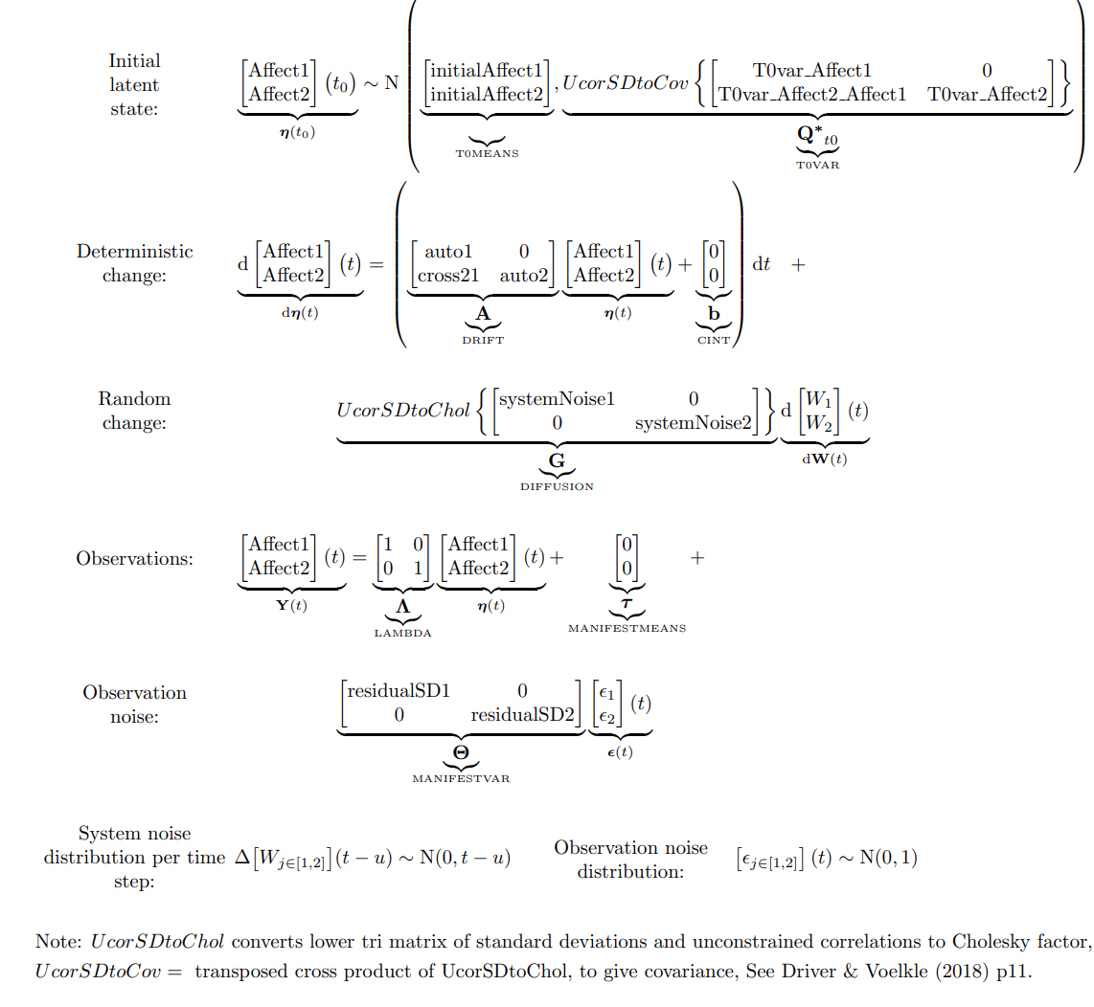
Unidirectional causation

Slide 5
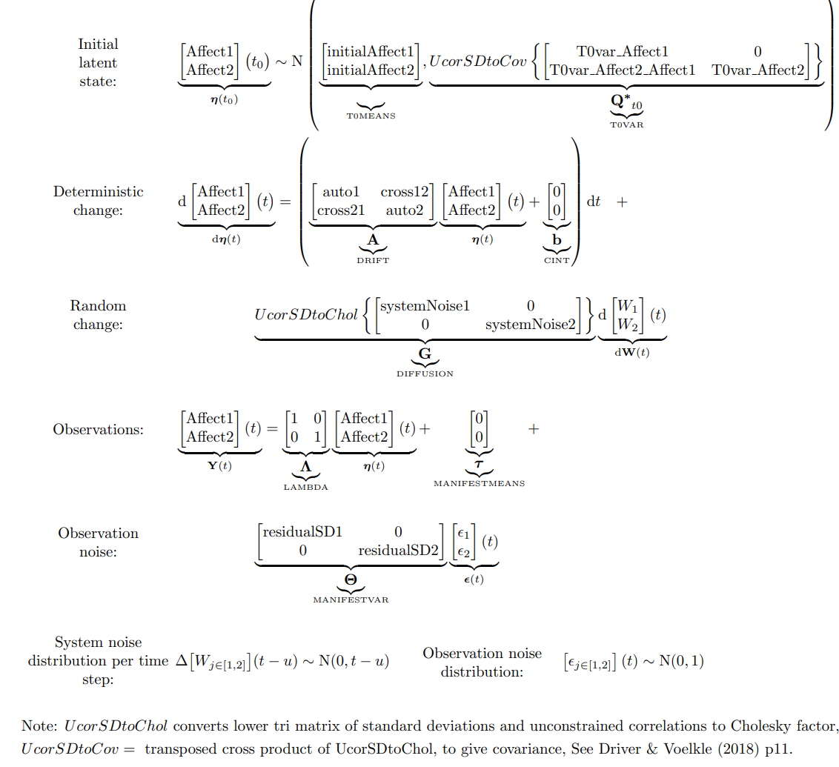
Bidirectional causation

Slide 6
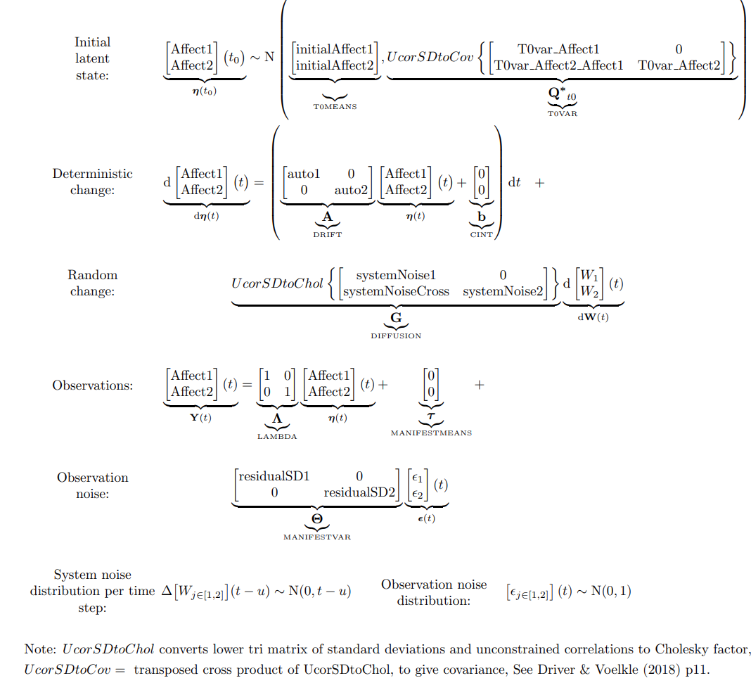
Unobserved common cause

Slide 7
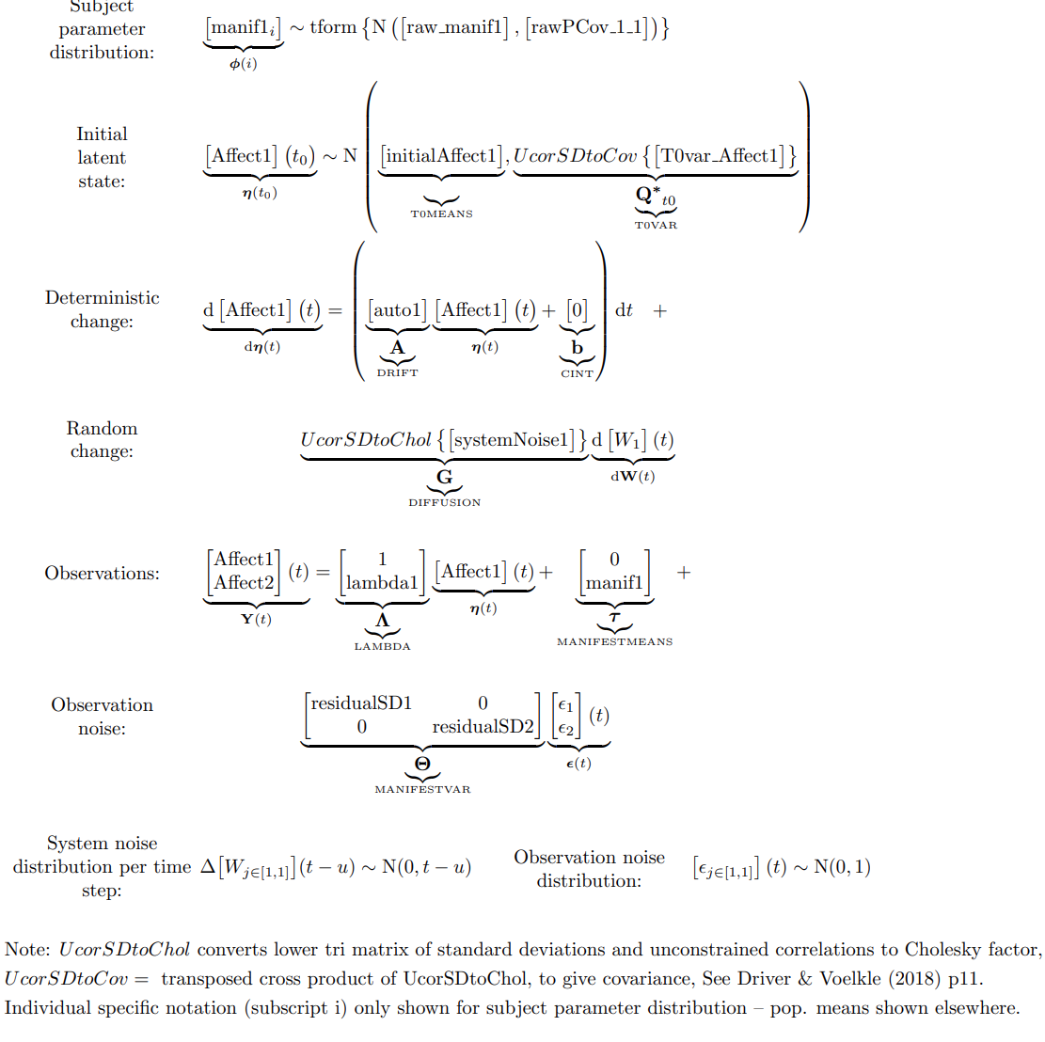
Multiple indicator model

Slide 8
Model fit and evaluation
https://rpsychologist.com/likelihood/

Slide 9

Find out which by fitting a model with ctsem
Fit competing models → Lecture6 → ctsem_modcomp_W6.R
Compare their fit to data
Tell me what you think the ground truth is
$$AIC=2p −2ln⁡(L)$$
p = number of parameters
L = probability of observing your data given a specific set of model parameters

Slide 10
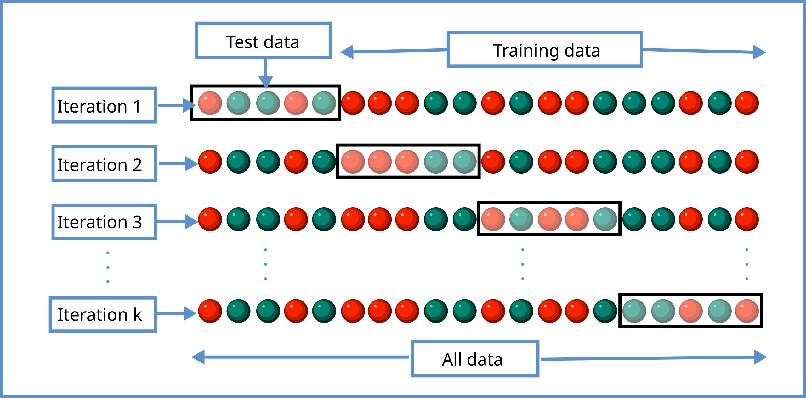
k-fold cross validation
By Gufosowa - Own work, CC BY-SA 4.0, https://commons.wikimedia.org/w/index.php?curid=82298768

Slide 11
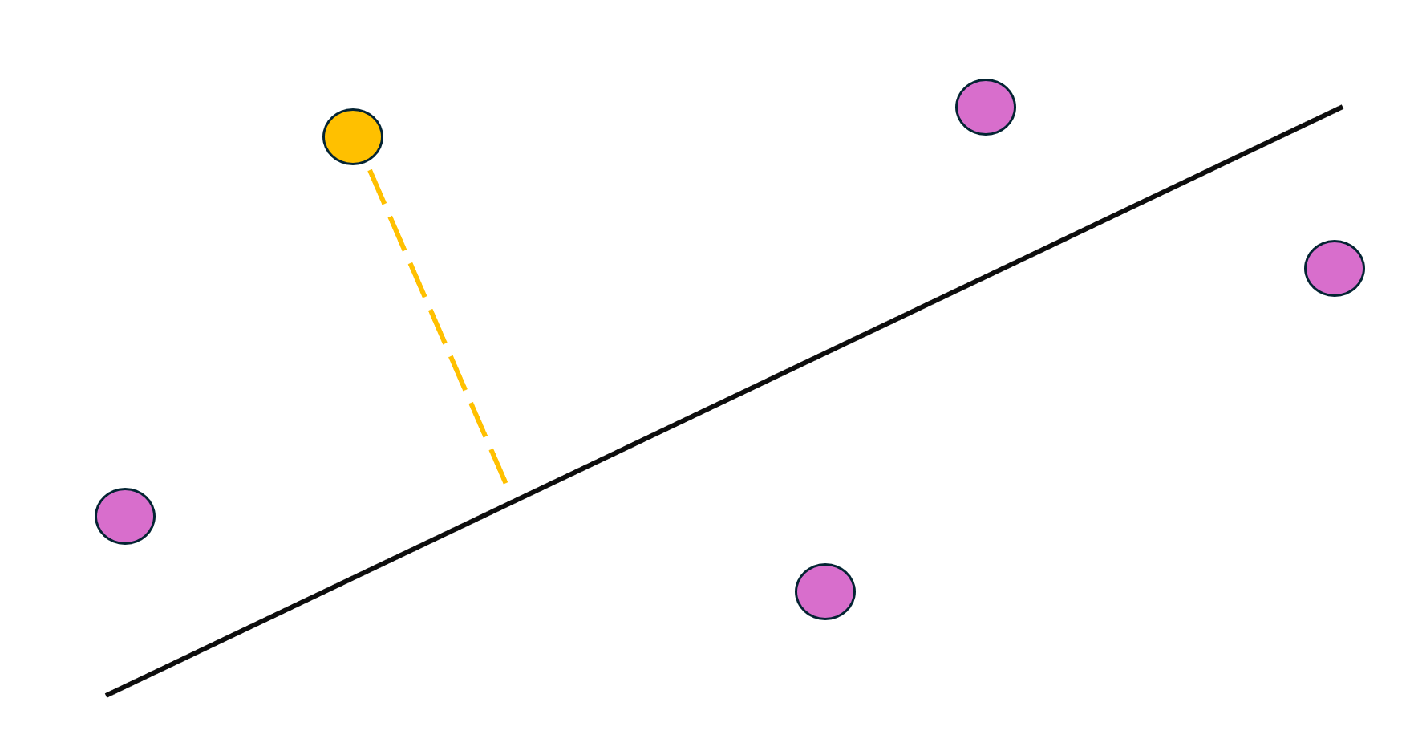
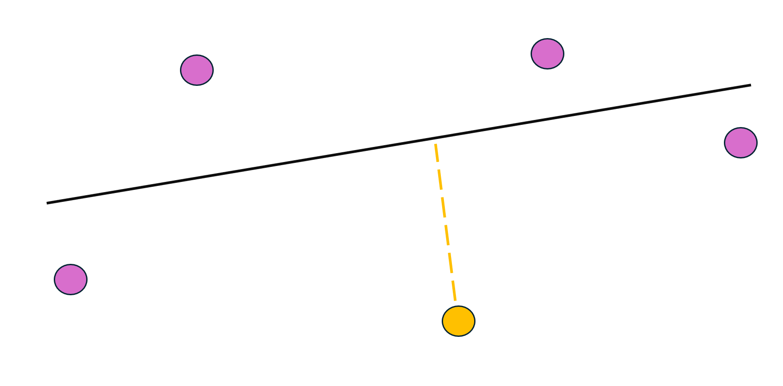

Slide 13
Thank you for listening ☺

