Slide 1
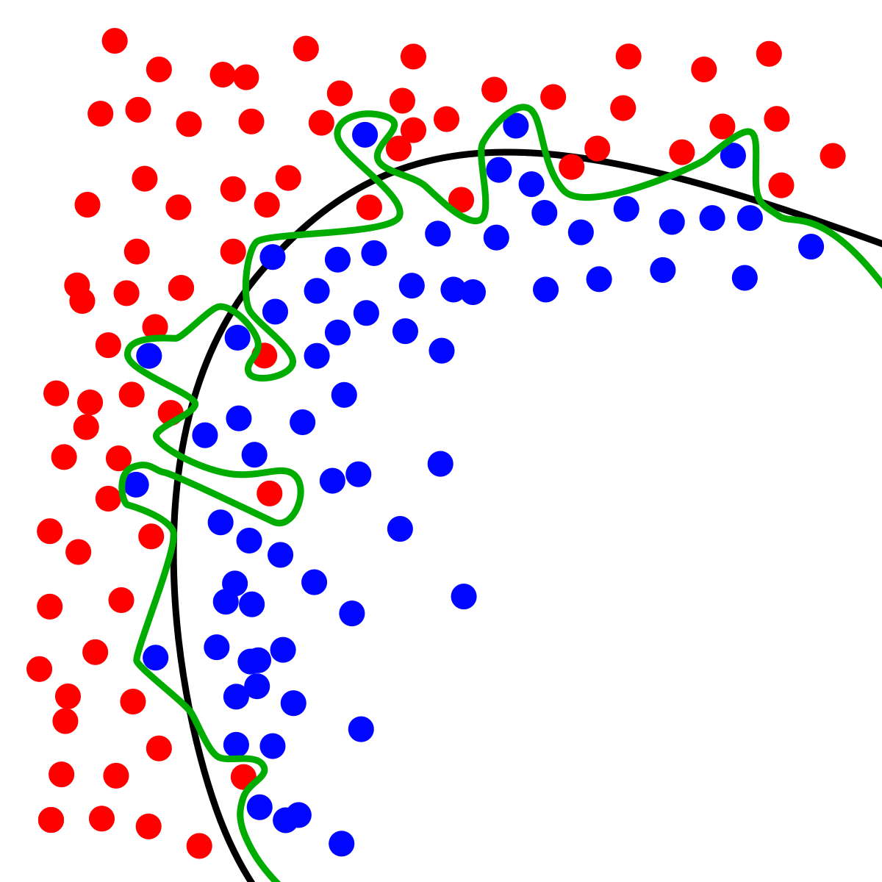
Dynamic Systems Thinking for
Psychologists
Michael E. Aristodemou
michael.aristodemou@psychologie.uzh.ch
Lecture 5: Continuous-Time Systems & Therapy

Slide 2
Three things you need to know about continuous-time models

Slide 3
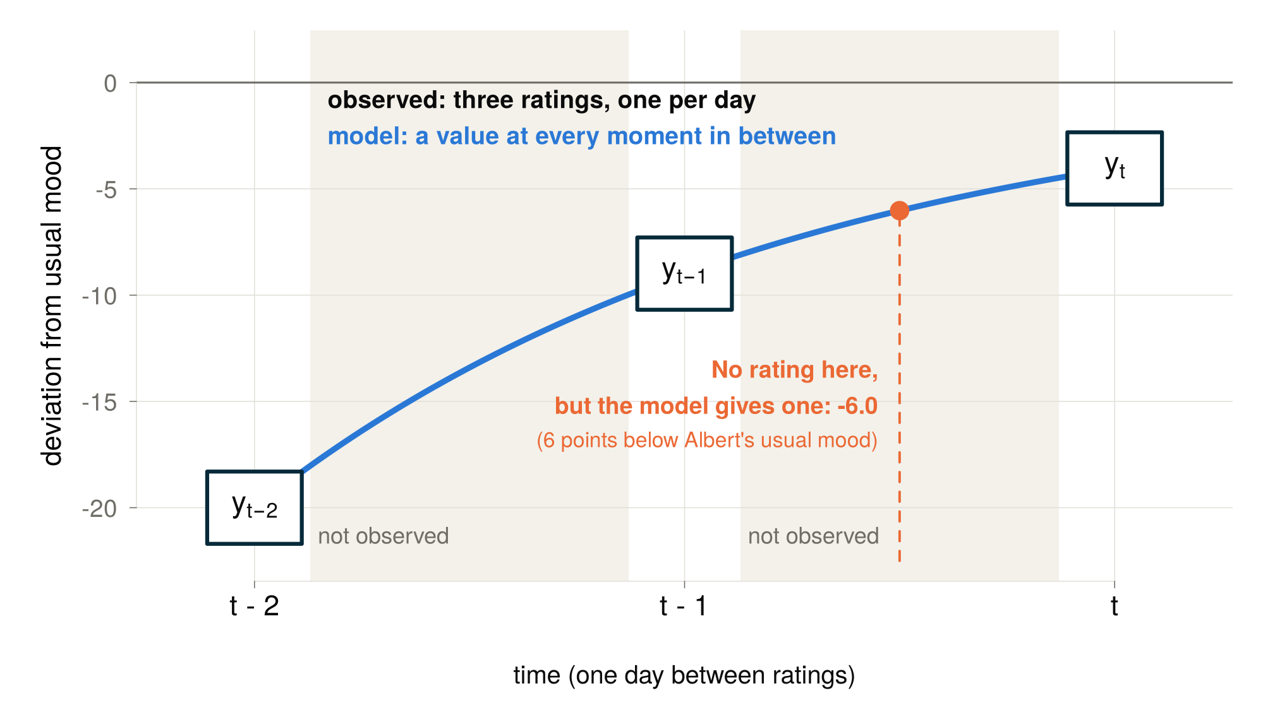
1. Continuous-time models fill in the gaps between observations

Slide 4
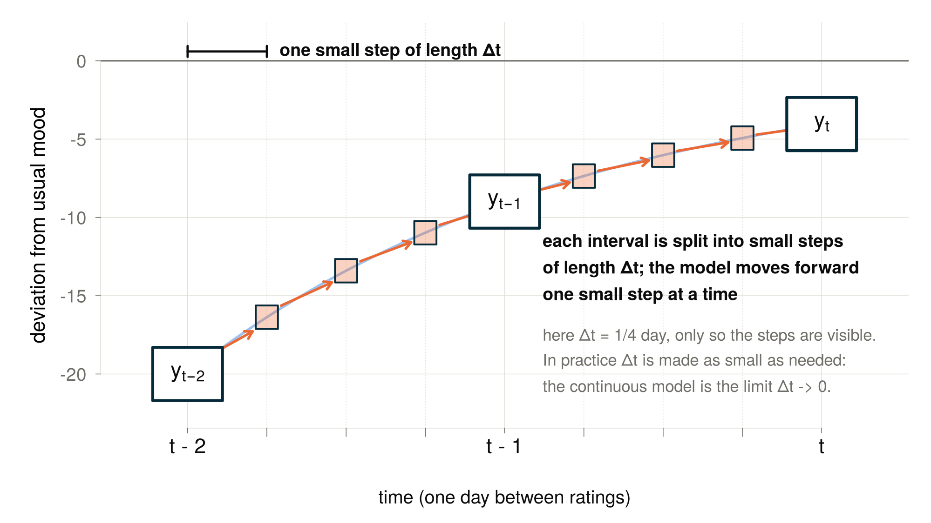
2. By splitting intervals into small time steps

Slide 5
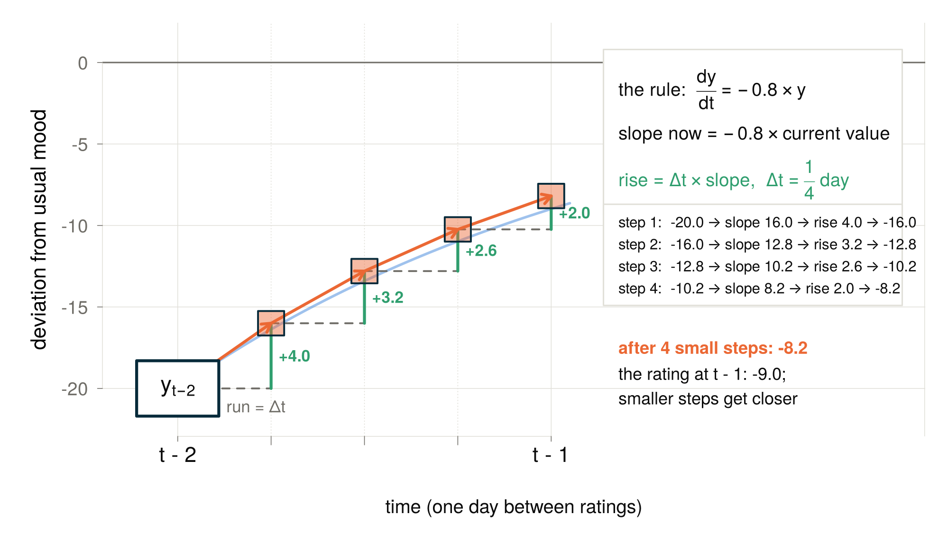
3. Computing the change over each small step using a rule

Slide 6
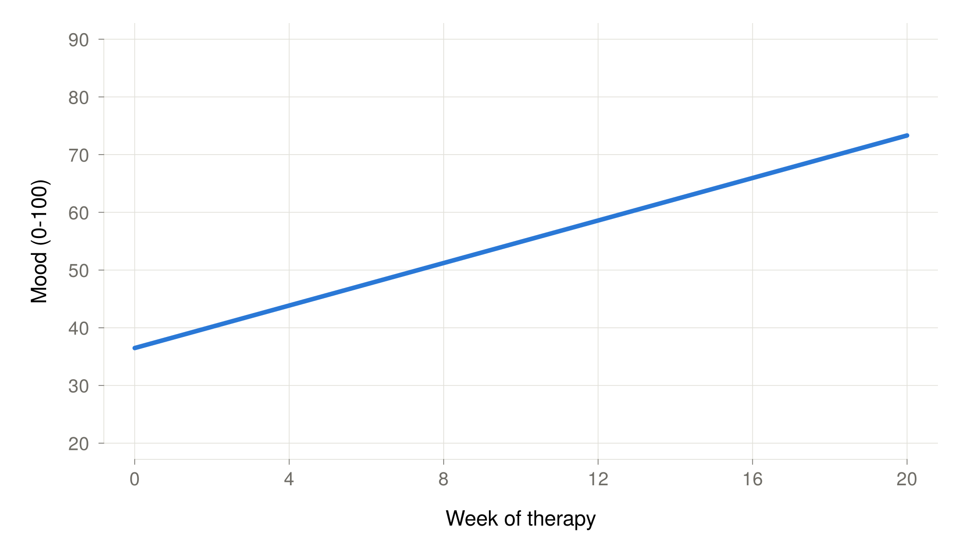
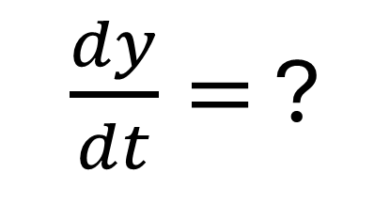
Albert in a (continuous) linear world
$\frac{dy}{dt}=$ ?

Slide 7
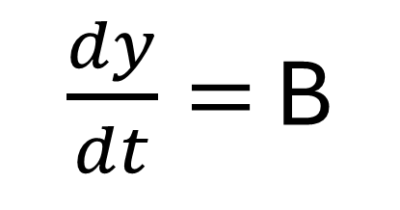
Albert in a (continuous) linear world
$\frac{dy}{dt}=$ B

Slide 8
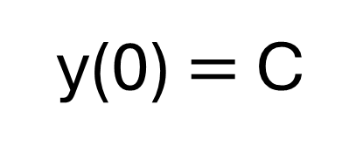
Albert in a (continuous) linear world
$\frac{dy}{dt}=$ B
y(0) $=$ C

Slide 9
Let’s make the growth plateau
Progress slows down as Albert gets better (higher mood)

Slide 10
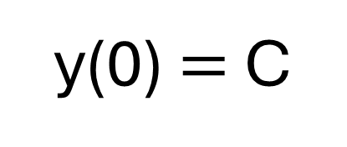
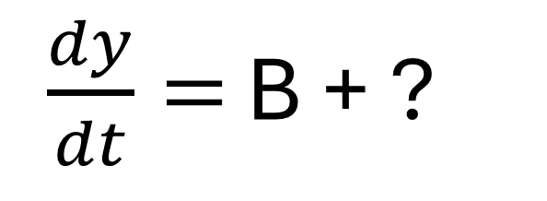
The rate of change depends on the current state
$\frac{dy}{dt}=$ B + ?
y(0) $=$ C

Slide 11
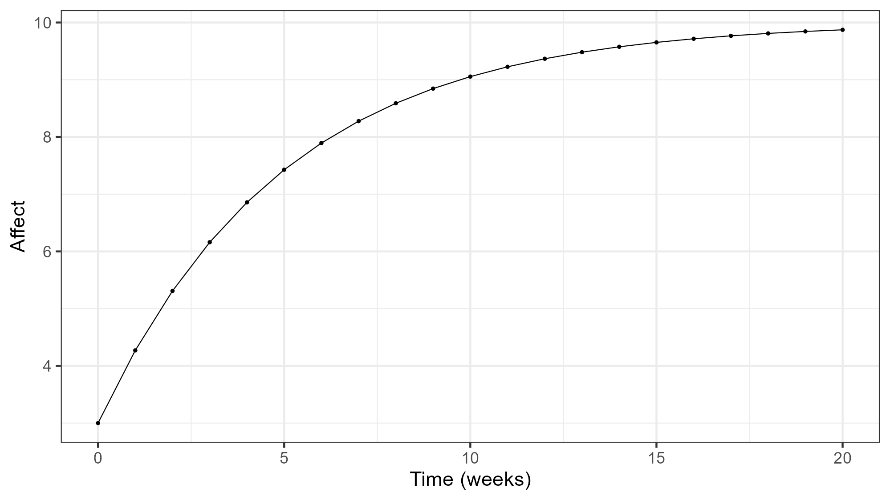
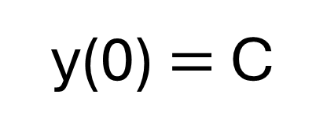
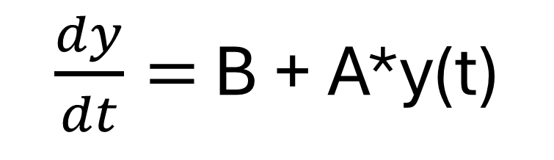
The rate of change depends on the current state
$\frac{dy}{dt}=$ B + A*y(t)
y(0) $=$ C

Slide 12
Look at the code and write down every question you have
Go to GitHub → Lecture05 → simulate_statedep_w5.R
Take 10 minutes to write all your questions about the code
Then we can go through the code together

Slide 13
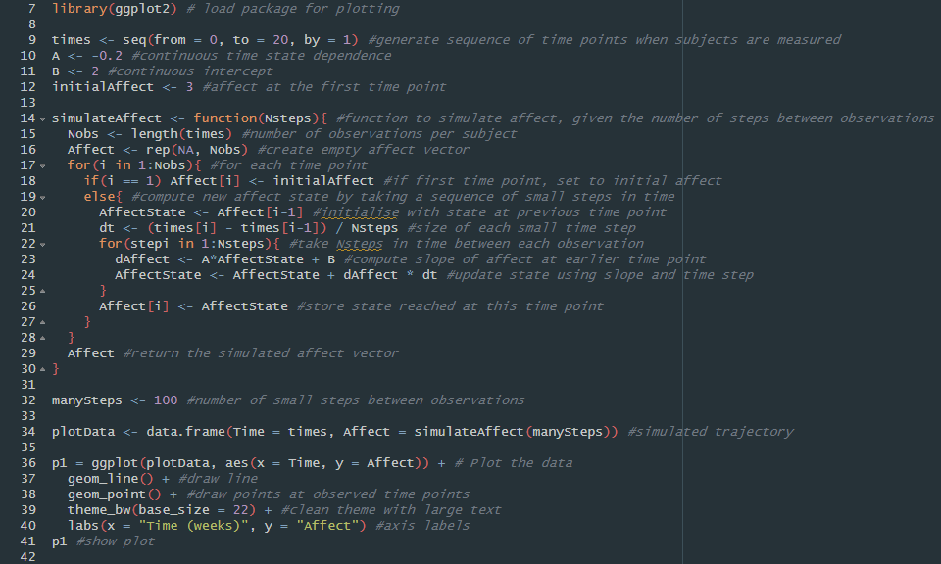

Slide 14
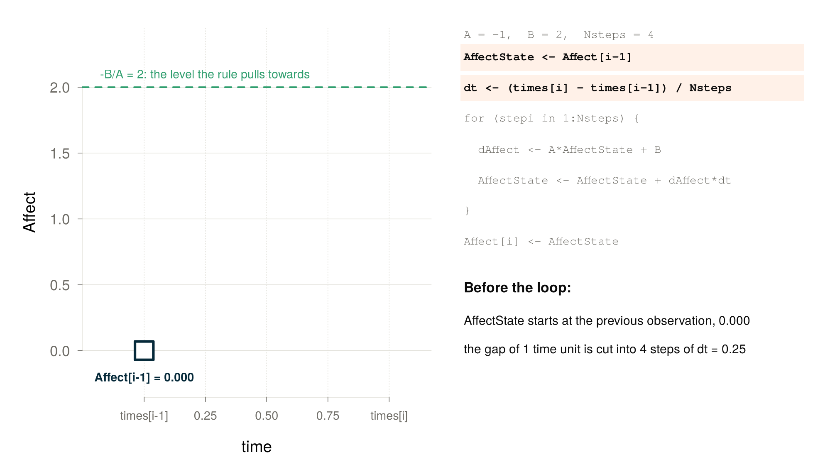

Slide 15
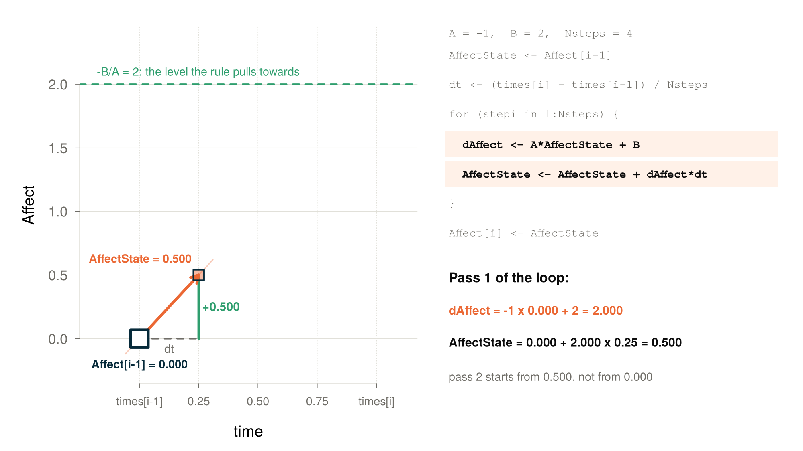

Slide 16
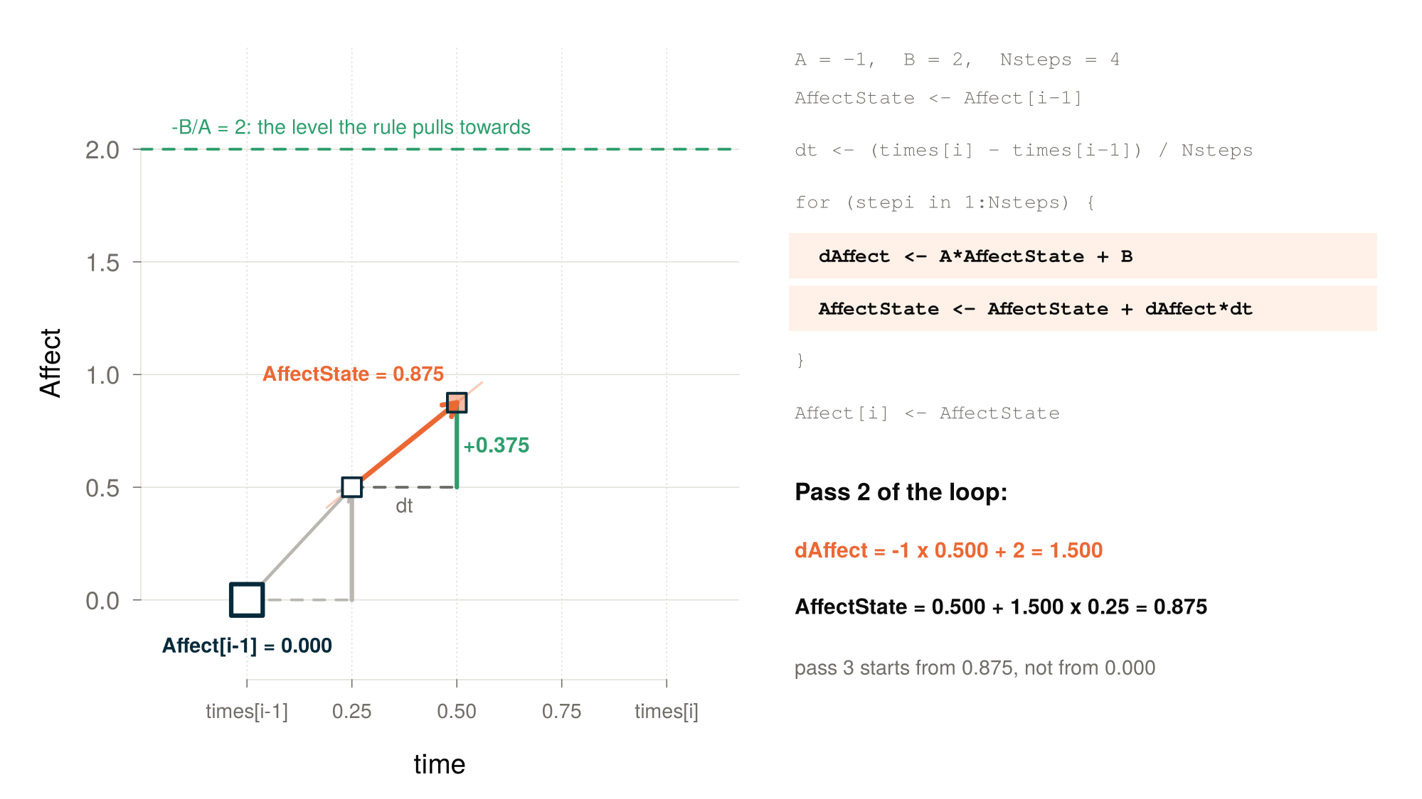

Slide 17
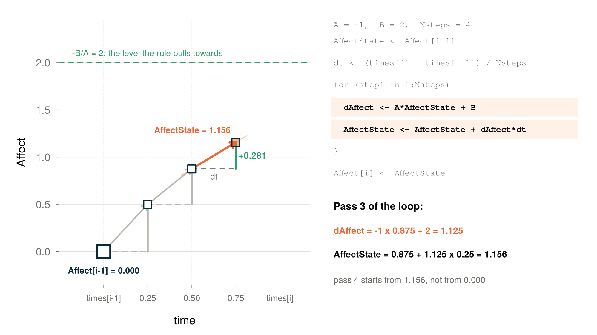

Slide 18
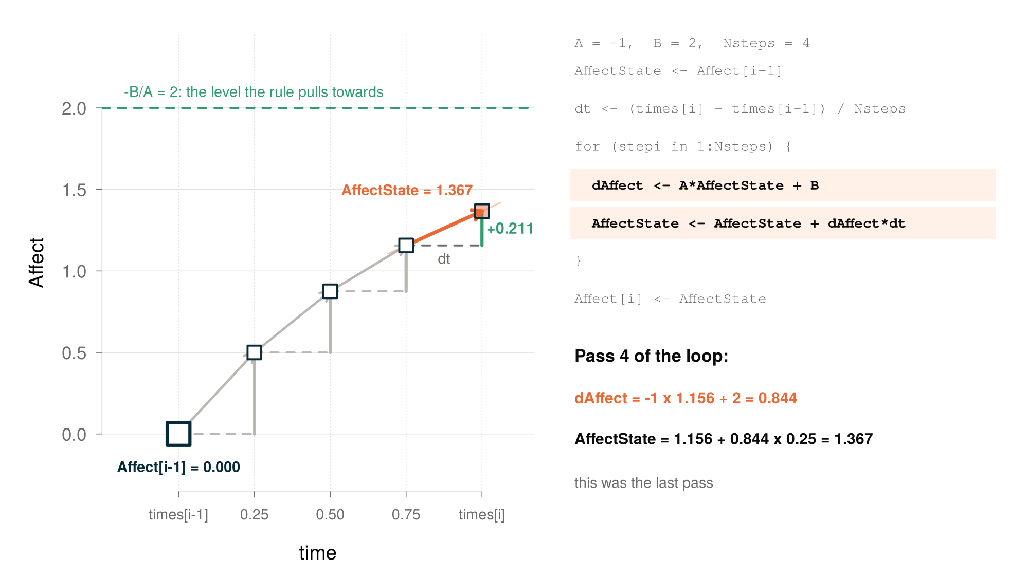

Slide 19
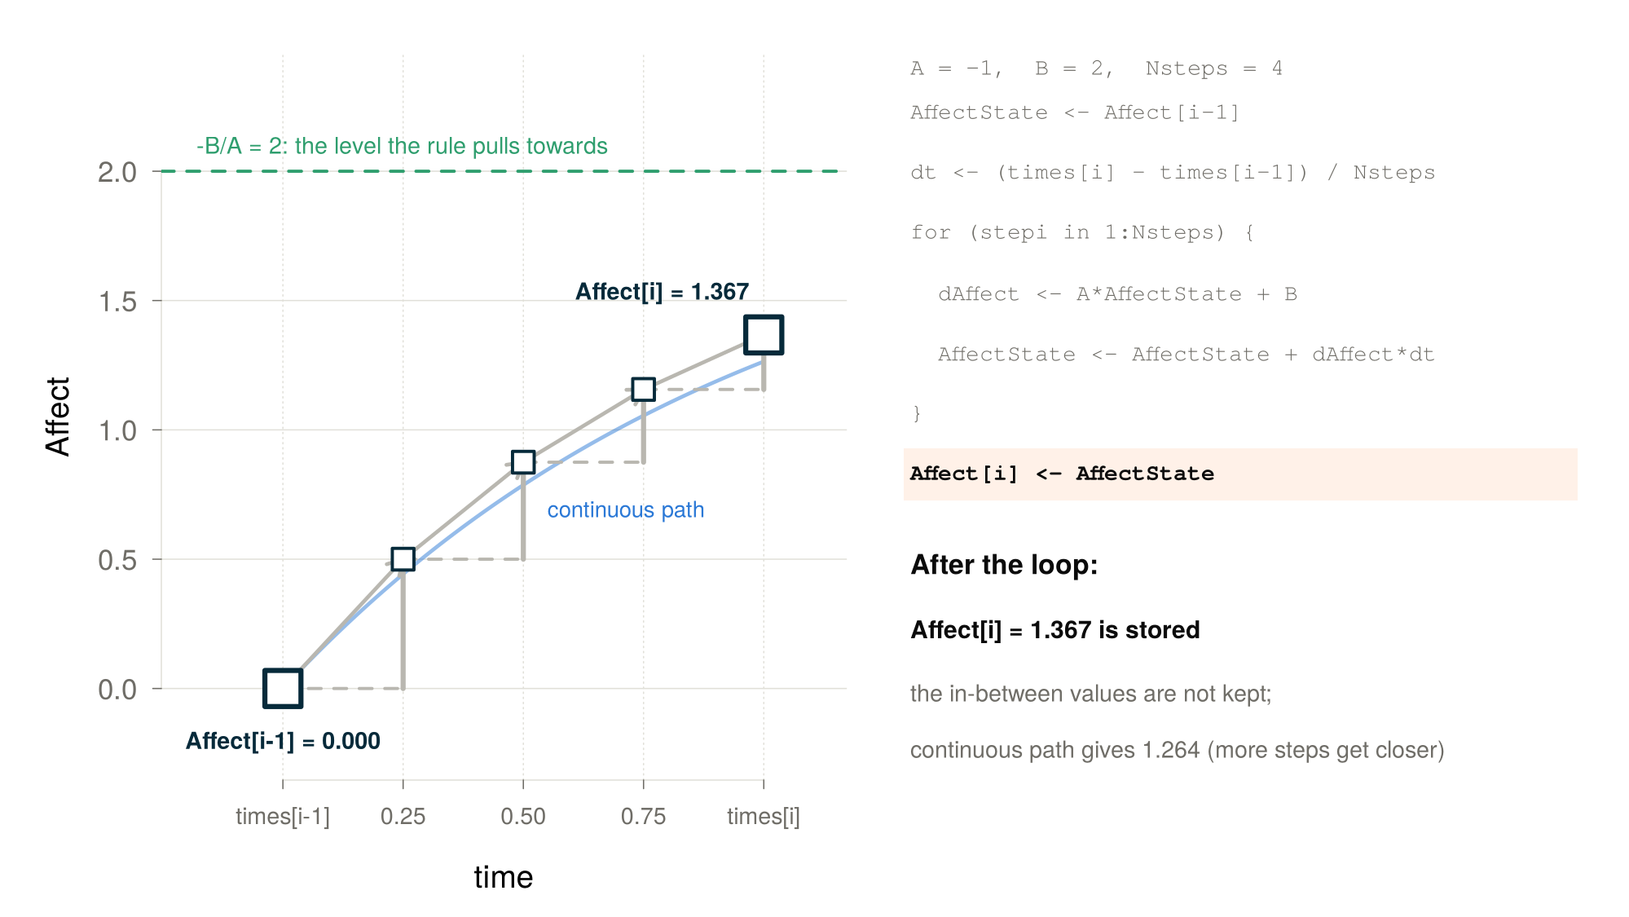

Slide 20
Exercise sheet
GitHub → Lecture05 → lecture05_therapy_exercises.Rmd
for(i in 1:3) {
  Solve Exercise[i]
  Discuss Exercise[i] together
}

Slide 21
Thank you for listening ☺

