Slide 1
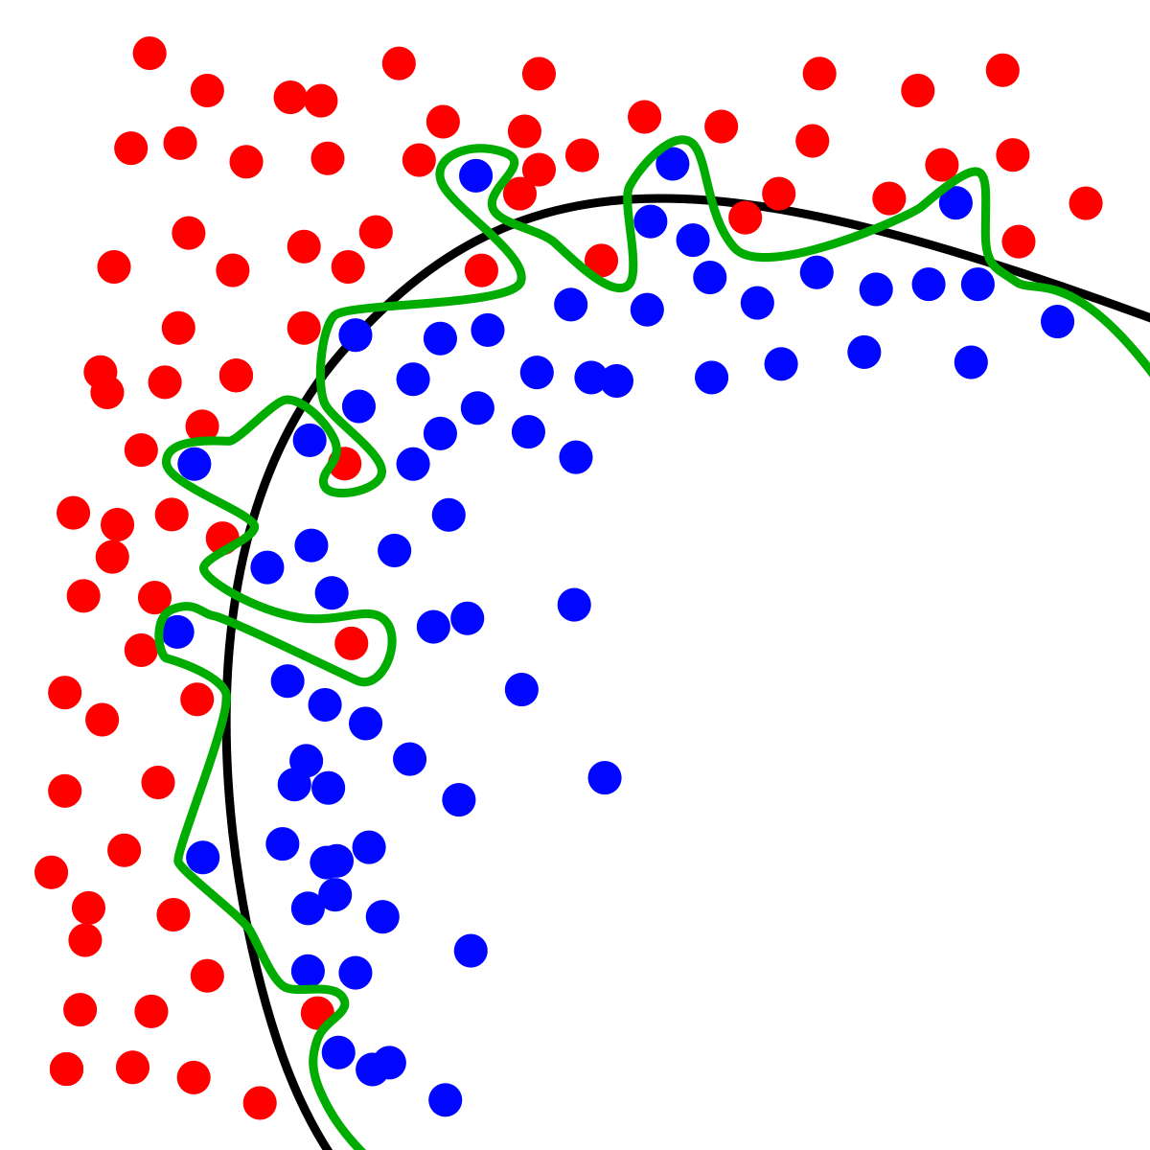
Dynamic Systems Thinking for
Psychologists
Michael E. Aristodemou
michael.aristodemou@psychologie.uzh.ch
Lecture 7: Multidimensional systems

Slide 2
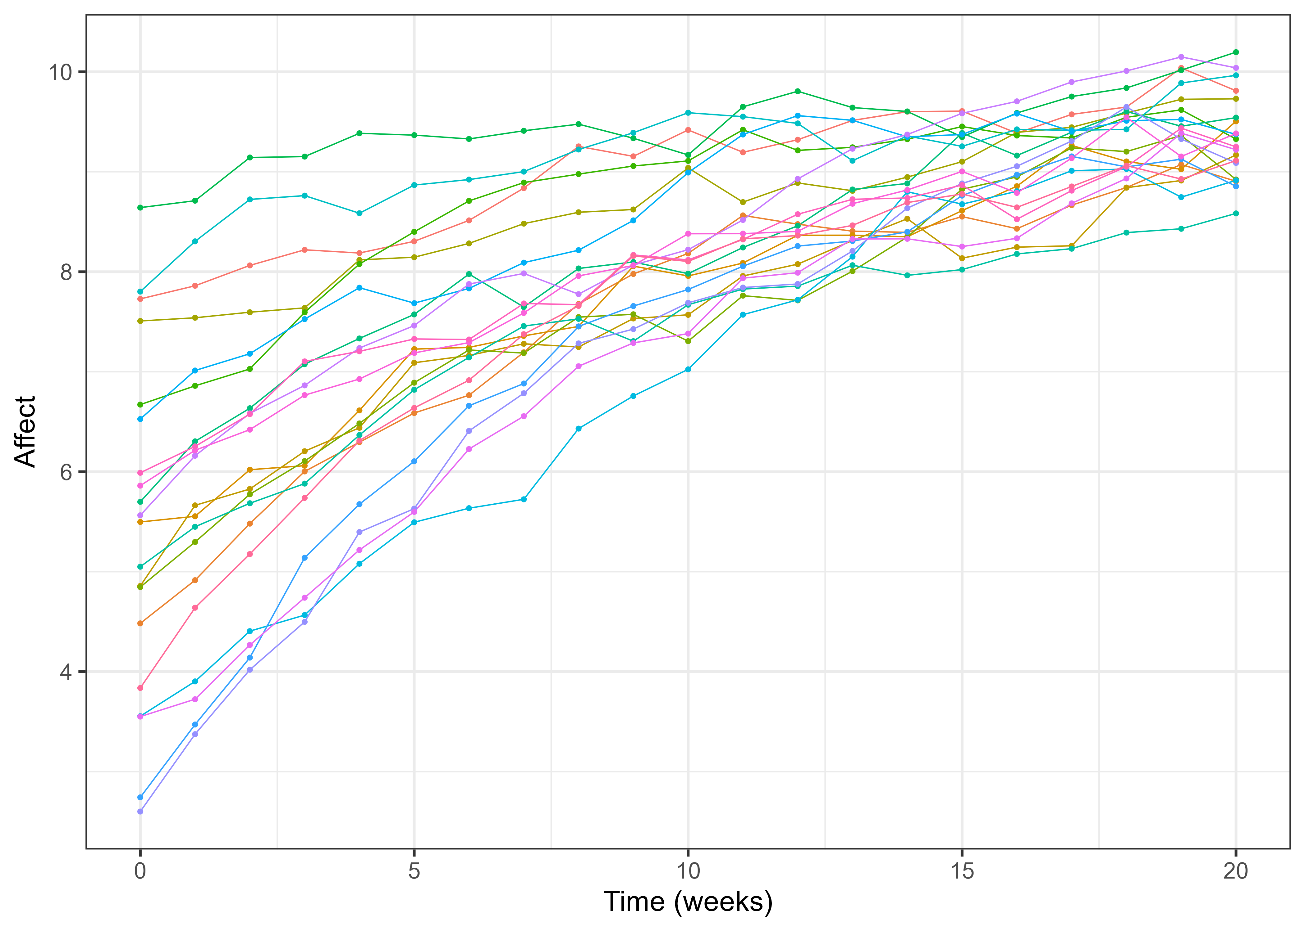


What can we still do with the amount of information we have?
$$Affect\left(t\right)=Λ∗η_{t}+ε_{t}$$
$${dη}_{t}=\left(A_{t}+B\right)dt+GdW_{t}$$
$$η_{t0}\sim N(μ_{0},Σ_{0})$$
Affect once a week, at 12:00 pm
21 weeks
Notes:
We have a continuous time model, with system noise, state dependence, constant rate of change, individual differences in our parameters.
We can add a more complicated measurement model, random effects on all parameters, rate of change in the rate of change depends on state.

Slide 3
What is our goal with this model?

Slide 4
Our goal is to understand how we can further improve Albert’s mood

Slide 5
How have we intervened so far?

Slide 6
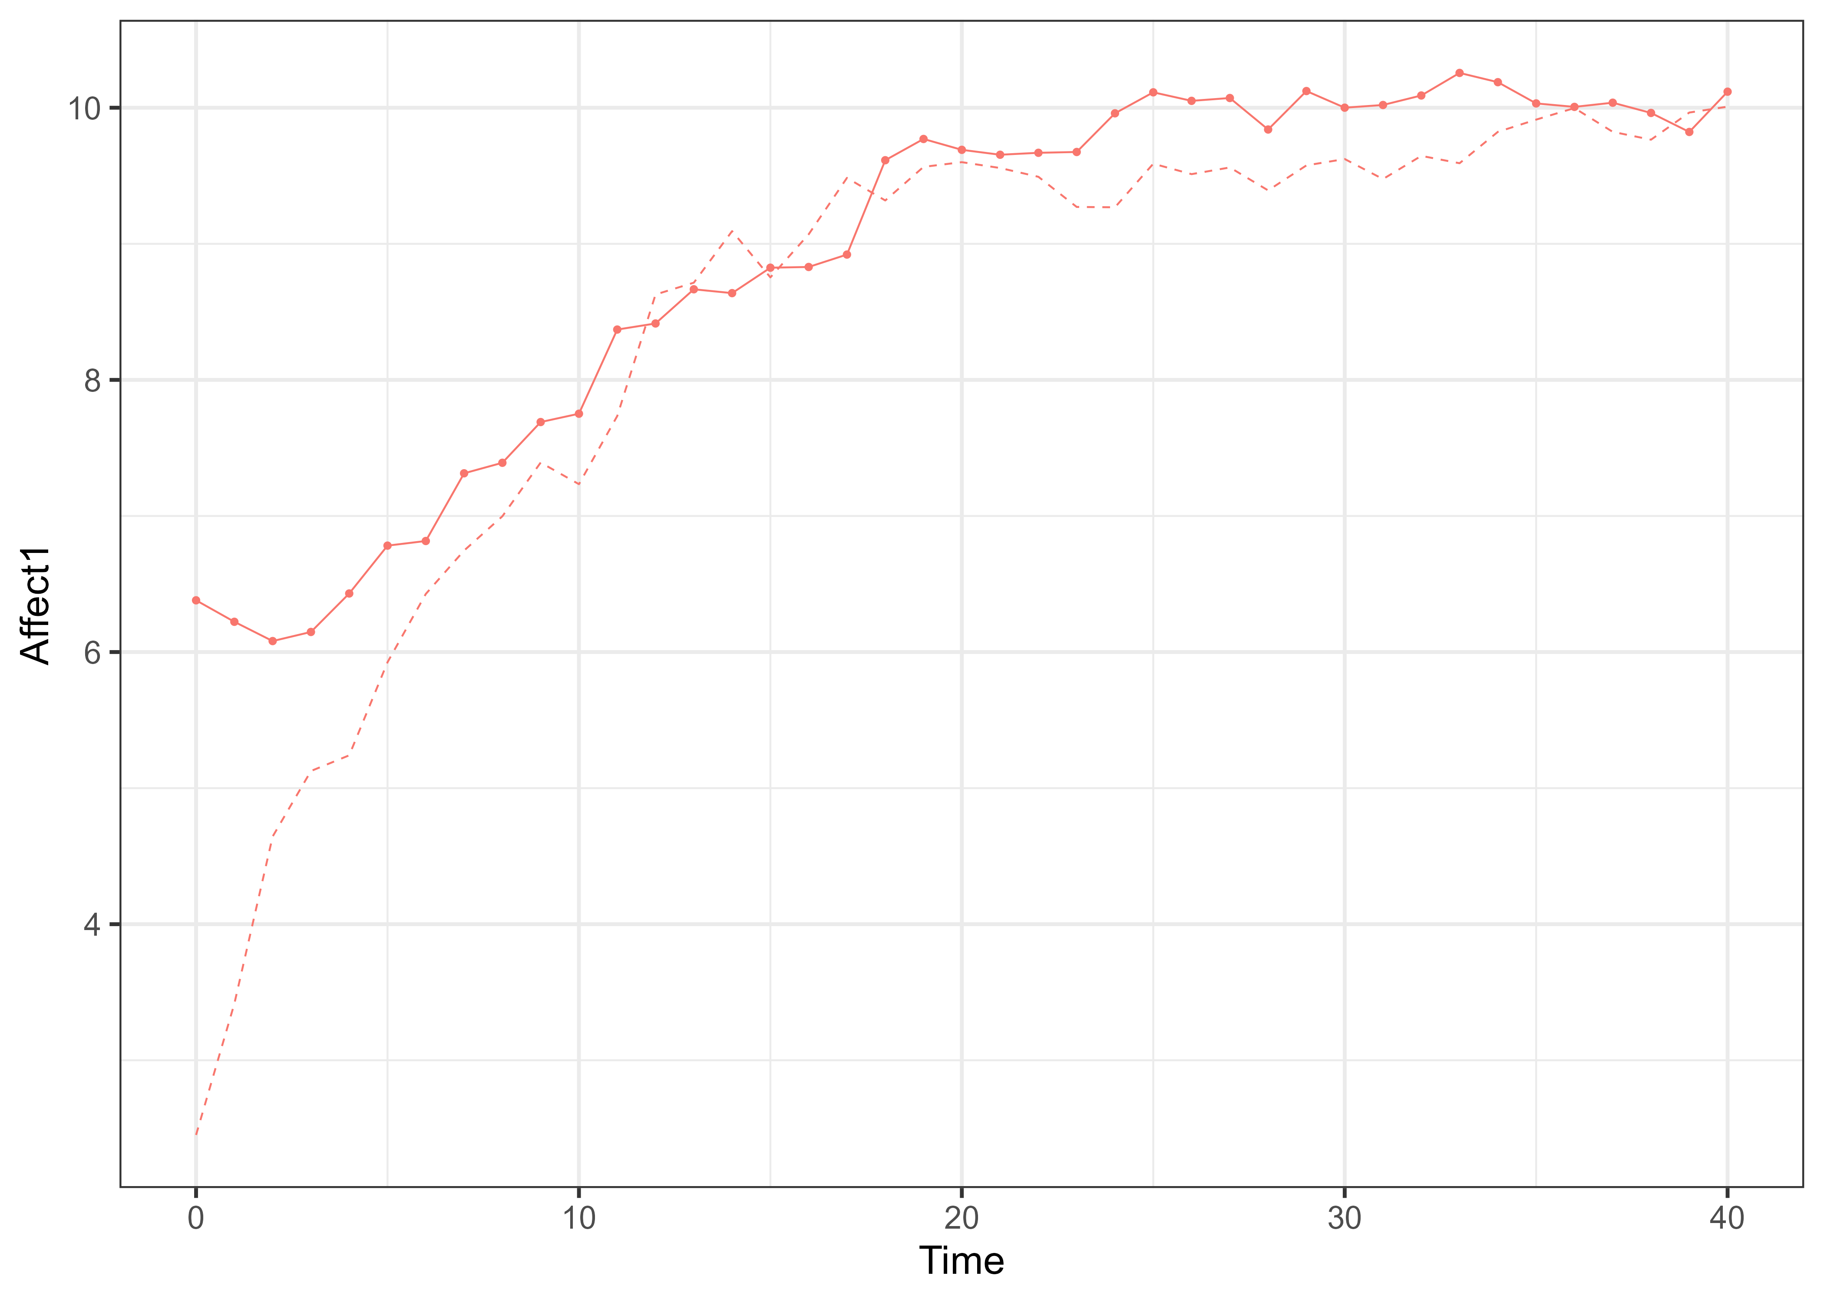
Albert is not an isolated entity, so…

Slide 7
We can make a case for more information

Slide 8
Let us model how Albert interacts with their partner

Slide 9
Let us model how Albert interacts with their partner

Slide 10
We can assume that little Albert’s rate of change depends on their partner’s affect
$$dη_{1}=\left(A_{1}η_{1t}+A_{cross}η_{2t}+B\right)dt+G_{11}dW_{1}t$$
$$dη_{2}=\left(A_{2}η_{2t}+B\right)dt+G_{22}dW_{2}t$$

Slide 11
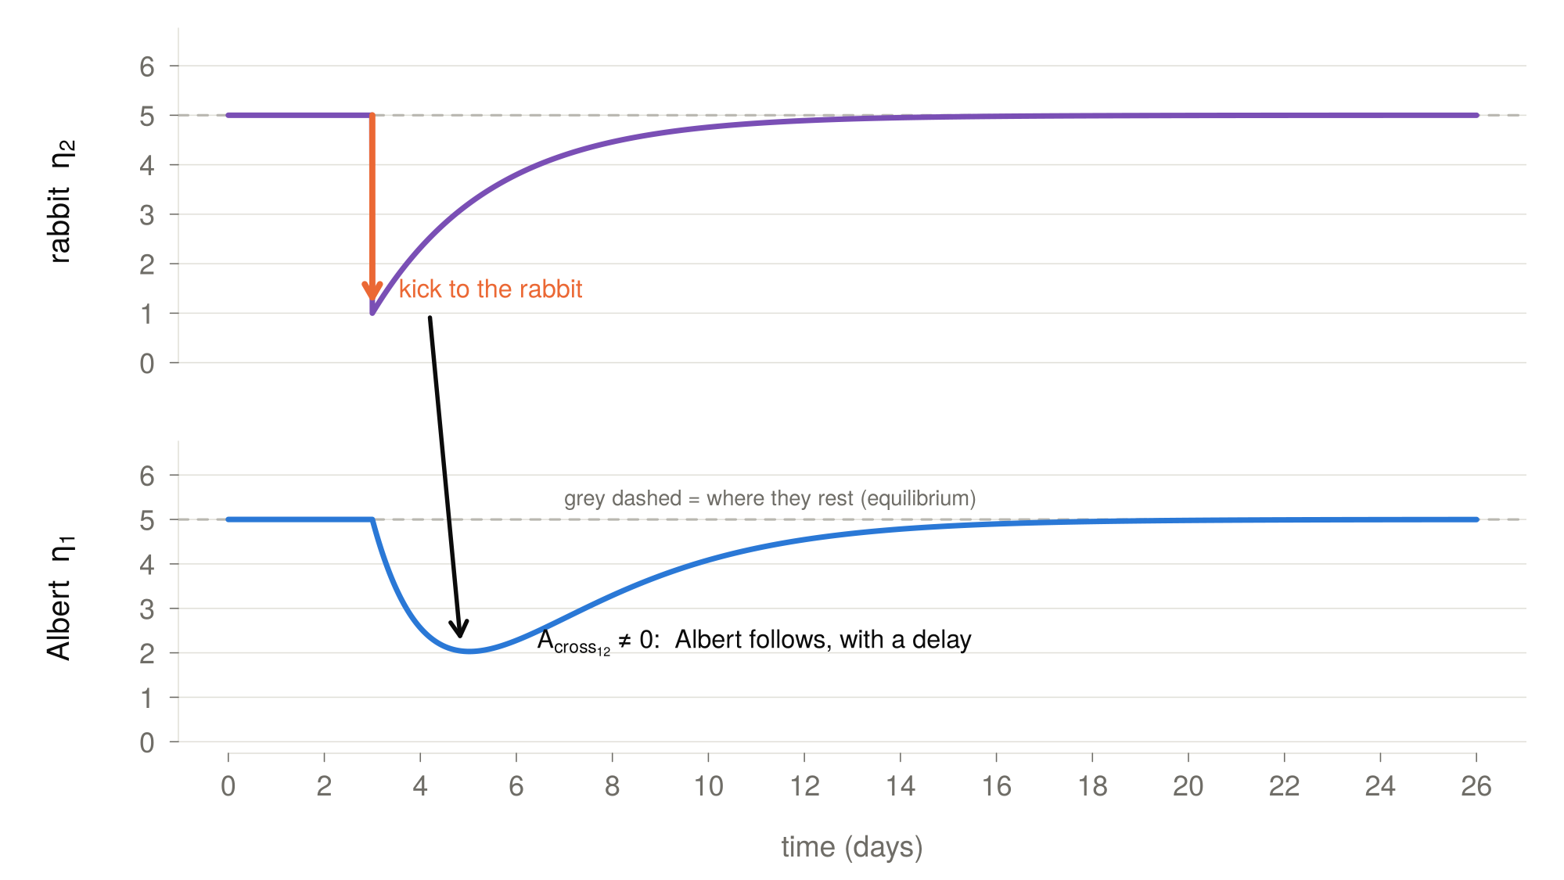

Slide 12
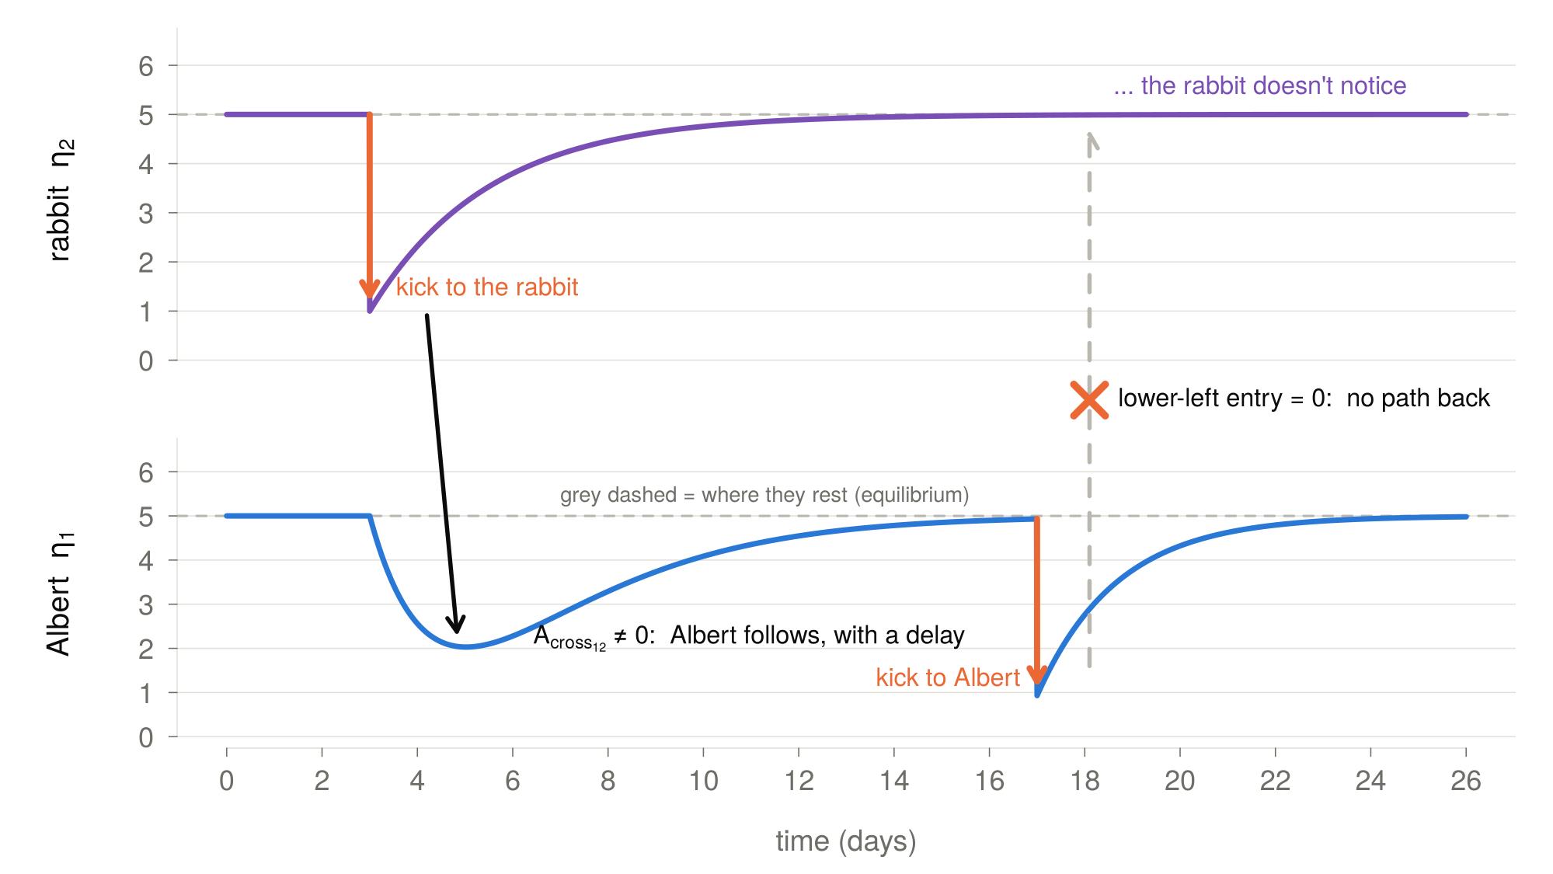

Slide 13
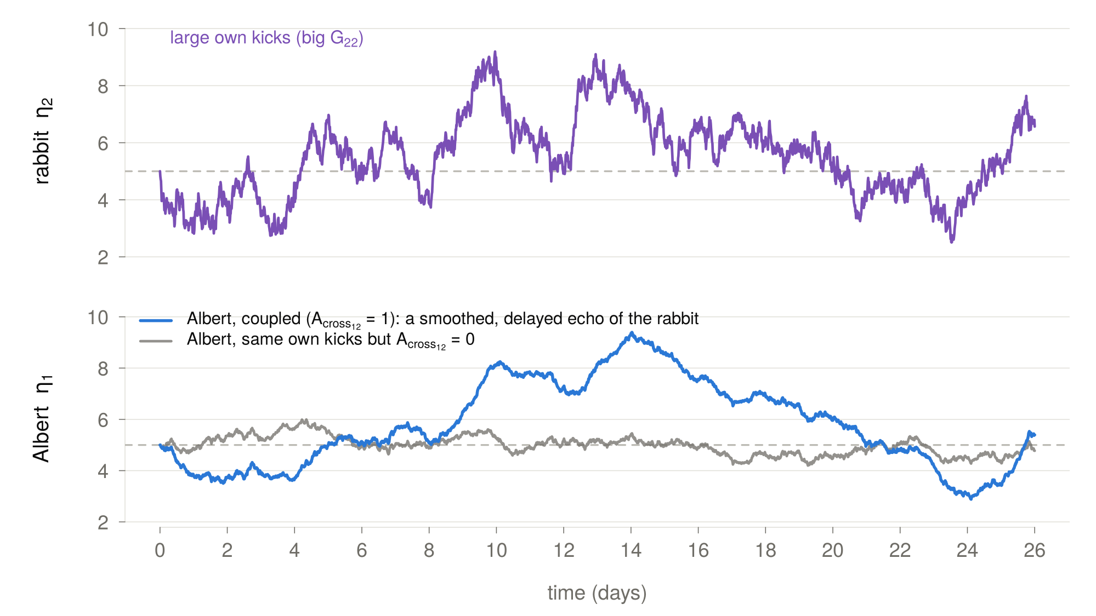

Slide 14
Let’s learn an algorithm

Slide 15
Matrix form
$$dη_{1}=\left(A_{1}η_{1t}+A_{cross_{12}}η_{2t}+B_{1}\right)dt+G_{11}dW_{1}t$$
$$dη_{2}=\left(A_{2}η_{2t}+B_{2}\right)dt+G_{22}dW_{2}t$$
$$\left({dη_{1} \atop dη_{2}}\right)=\left[\left(\begin{matrix}A_{1} & A_{cross_{12} } \\ 0 & A_{2}\end{matrix}\right)∗\left({η_{1} \atop η_{2}}\right)\left(t\right)+\left({B_{1} \atop B_{2}}\right)\right]dt+\left(\begin{matrix}G_{11} & 0 \\ 0 & G_{22}\end{matrix}\right)d\left({W_{1} \atop W_{2}}\right)$$

Slide 16
Matrix form
$$dη_{1}=\left(A_{1}η_{1t}+A_{cross_{12}}η_{2t}+B_{1}\right)dt+G_{11}dW_{1}t$$
$$dη_{2}=\left(A_{2}η_{2t}+B_{2}\right)dt+G_{22}dW_{2}t$$
1
2
1
2
1
1
$$\left({dη_{1} \atop dη_{2}}\right)=\left[\left(\begin{matrix}A_{1} & A_{cross_{12} } \\ 0 & A_{2}\end{matrix}\right)∗\left({η_{1} \atop η_{2}}\right)\left(t\right)+\left({B_{1} \atop B_{2}}\right)\right]dt+\left(\begin{matrix}G_{11} & 0 \\ 0 & G_{22}\end{matrix}\right)d\left({W_{1} \atop W_{2}}\right)(t)$$
1
2
2
2

Slide 17


Derive the individual equations from the matrix format
1
2
1
2
1
1
$$\left({dη_{1} \atop dη_{2}}\right)=\left[\left(\begin{matrix}A_{1} & A_{cross_{12} } \\ 0 & A_{2}\end{matrix}\right)∗\left({η_{1} \atop η_{2}}\right)\left(t\right)+\left({B_{1} \atop B_{2}}\right)\right]dt+\left(\begin{matrix}G_{11} & 0 \\ 0 & G_{22}\end{matrix}\right)d\left({W_{1} \atop W_{2}}\right)(t)$$
1
2
2
2
$$dη_{1}=$$
$$dη_{2}=$$

Slide 18
Exercise on coupling (~20 minutes)
GitHub → Lecture07 → lecture07_coupling_exercises_short.Rmd
Go through exercises 1 & 2
Do bonus if you have time
$$\left({dη_{1} \atop dη_{2}}\right)=\left[\left(\begin{matrix}A_{1} & A_{cross_{12} } \\ 0 & A_{2}\end{matrix}\right)∗\left({η_{1} \atop η_{2}}\right)\left(t\right)+\left({B_{1} \atop B_{2}}\right)\right]dt+\left(\begin{matrix}G_{11} & 0 \\ 0 & G_{22}\end{matrix}\right)d\left({W_{1} \atop W_{2}}\right)(t)$$

Slide 19
What about unobserved common influences?
Standing outside in the rain together
Getting a traffic ticket
Meeting your dog at the door
$$\left({dη_{1} \atop dη_{2}}\right)=\left[\left(\begin{matrix}A_{1} & A_{cross_{12} } \\ 0 & A_{2}\end{matrix}\right)∗\left({η_{1} \atop η_{2}}\right)\left(t\right)+\left({B_{1} \atop B_{2}}\right)\right]dt+\left(\begin{matrix}G_{11} & 0 \\ 0 & G_{22}\end{matrix}\right)d\left({W_{1} \atop W_{2}}\right)(t)$$

Slide 20
What about unobserved common influences?
Standing outside in the rain together
Getting a traffic ticket
Meeting your dog at the door
$$\left({dη_{1} \atop dη_{2}}\right)=\left[\left(\begin{matrix}A_{1} & A_{cross_{12} } \\ 0 & A_{2}\end{matrix}\right)∗\left({η_{1} \atop η_{2}}\right)\left(t\right)+\left({B_{1} \atop B_{2}}\right)\right]dt+\left(\begin{matrix}G_{11} & 0 \\ G_{cross_{s}} & G_{22}\end{matrix}\right)d\left({W_{1} \atop W_{2}}\right)(t)$$

Slide 21
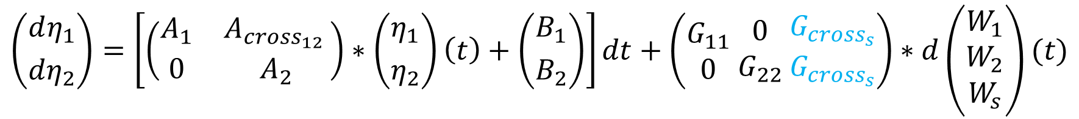
What about unobserved common influences?
Standing outside in the rain together
Getting a traffic ticket
Meeting your dog at the door
$$\left({dη_{1} \atop dη_{2}}\right)=\left[\left(\begin{matrix}A_{1} & A_{cross_{12} } \\ 0 & A_{2}\end{matrix}\right)∗\left({η_{1} \atop η_{2}}\right)\left(t\right)+\left({B_{1} \atop B_{2}}\right)\right]dt+\left(\begin{aligned}G_{11} \\ 0\end{aligned} \begin{aligned}0 \\ G_{22}\end{aligned} \begin{aligned}G_{cross_{s}} \\ G_{cross_{s}}\end{aligned}\right)∗d\left({W_{1} \atop \begin{aligned}W_{2} \\ W_{s}\end{aligned}}\right)(t)$$

Slide 22
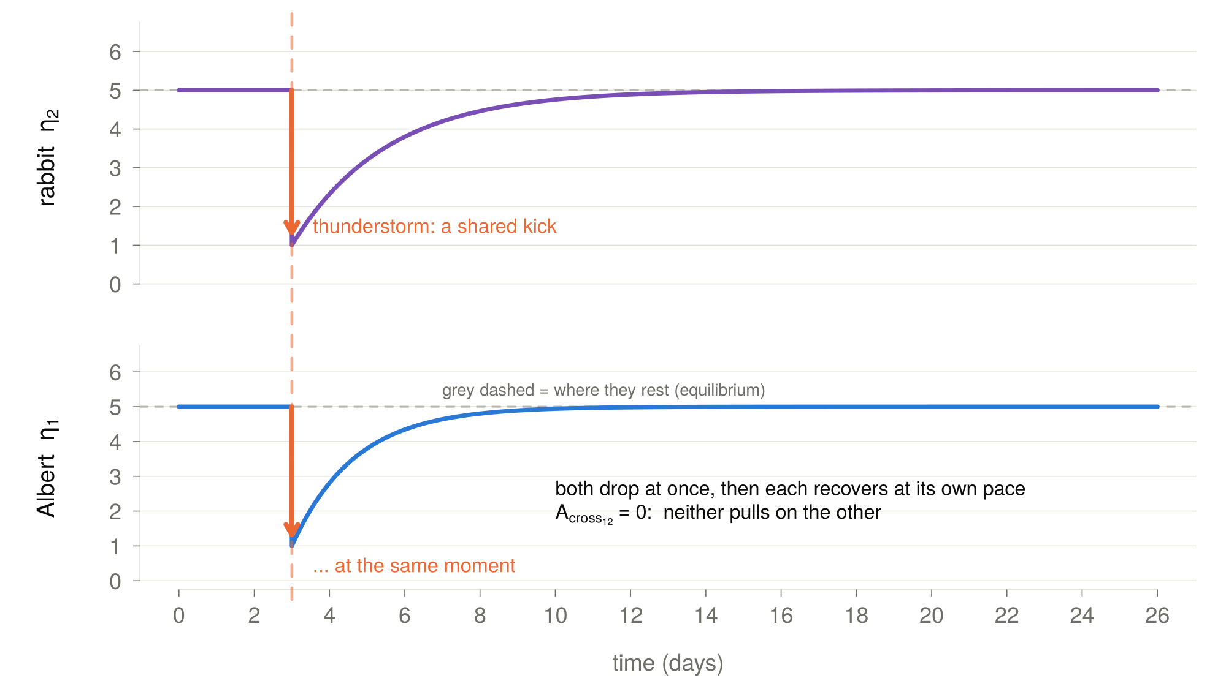

Slide 23
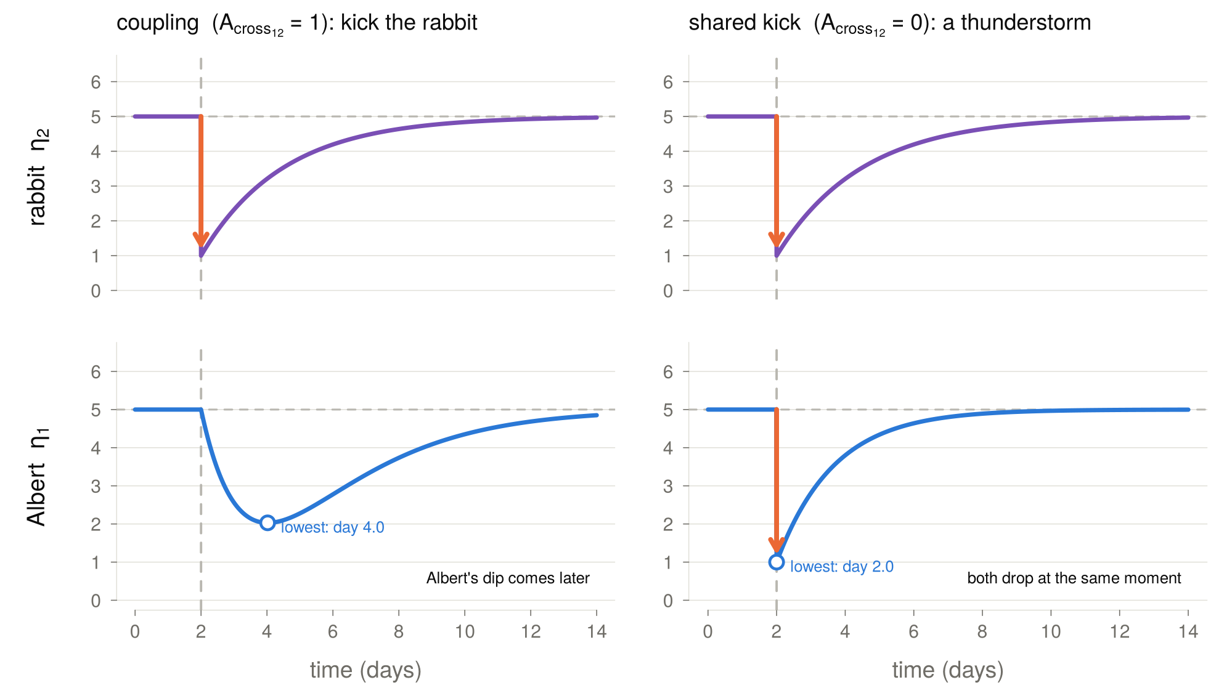

Slide 24
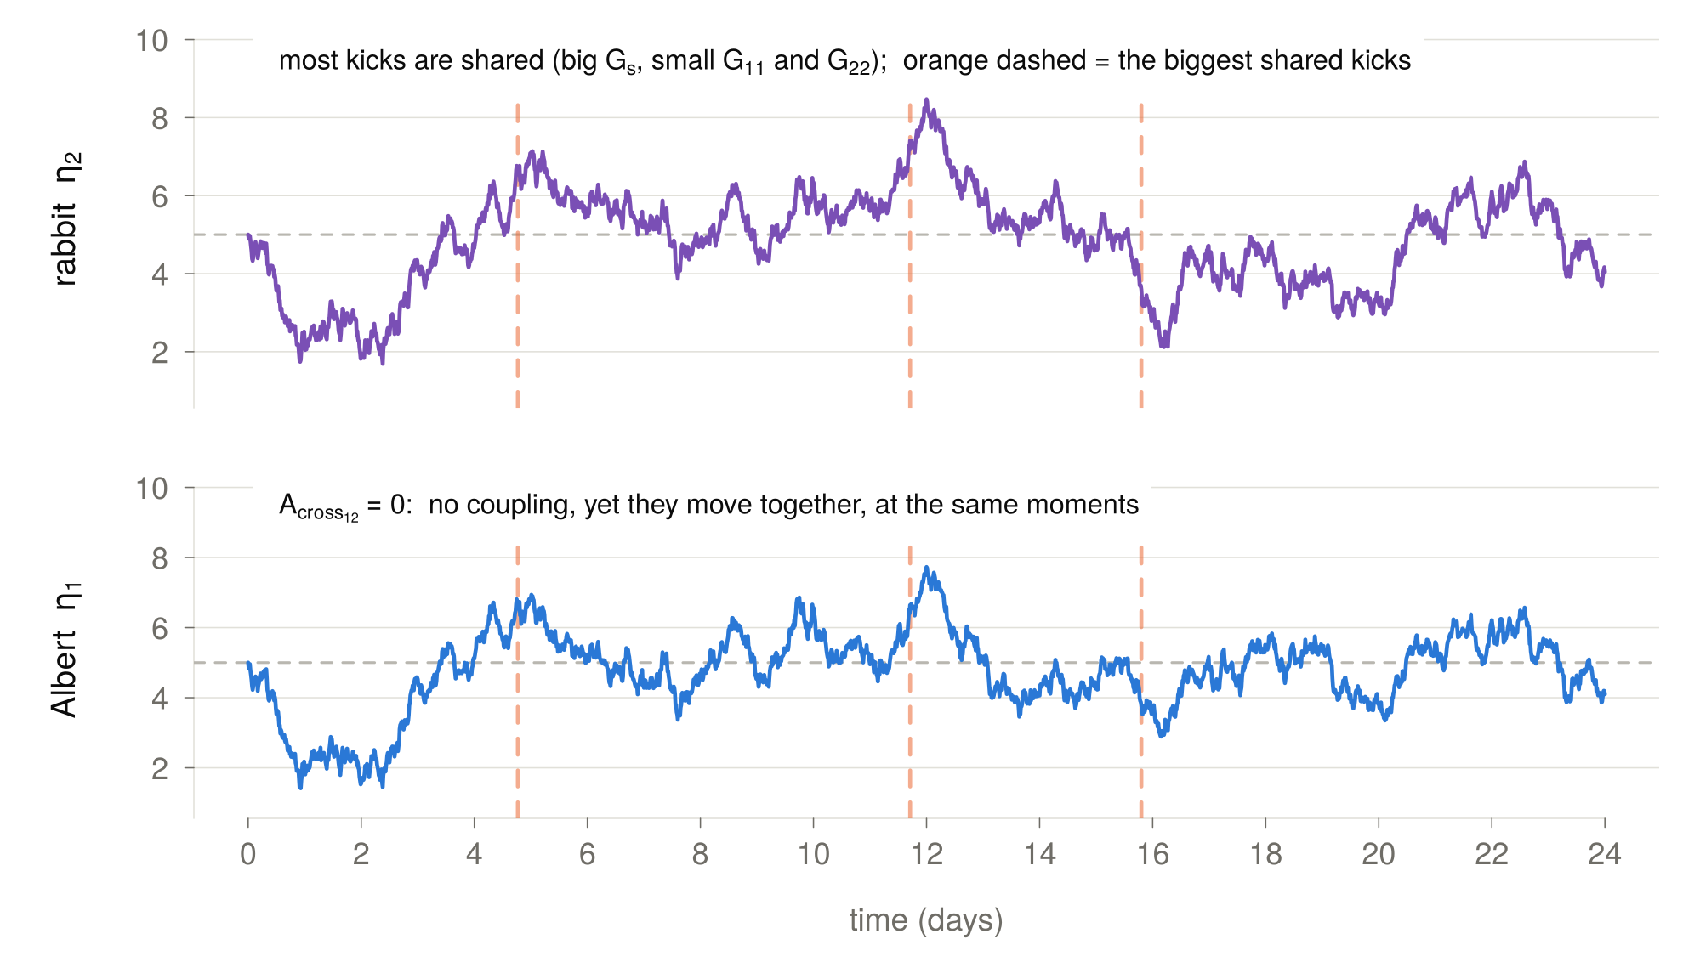

Slide 25

Simulate shared noise
Add shared noise by modifying → Lecture07 → coupling_sim_W7.R
For the answer → Lecture07 → sharedshocks_sim_W7.R
Run code, modulate parameter values see what happens
Extend the model by adding Albert’s anxiety as a variable
$$\left({dη_{1} \atop dη_{2}}\right)=\left[\left(\begin{matrix}A_{1} & A_{cross_{12} } \\ 0 & A_{2}\end{matrix}\right)∗\left({η_{1} \atop η_{2}}\right)\left(t\right)+\left({B_{1} \atop B_{2}}\right)\right]dt+\left(\begin{aligned}G_{11} \\ 0\end{aligned} \begin{aligned}0 \\ G_{22}\end{aligned} \begin{aligned}G_{cross_{s}} \\ G_{cross_{s}}\end{aligned}\right)∗d\left({W_{1} \atop \begin{aligned}W_{2} \\ W_{s}\end{aligned}}\right)(t)$$

Slide 26
Group exercise (~30 minutes)
Part 1: Formalize your process
Form your groups
Make a boxes and arrows sketch of the system of variables you think affects your psychological process of interest
Write the equation that determines the rate of change in your process (if you are not sure about the exact equation, use words)
Guiding questions:
Why are you creating a model of this process(es)?
Which factors affect your process?
Which factors are relevant to consider for you aim?

Slide 27
Thank you for listening ☺

