Slide 1


IndyGo Ridership PowerBI Dashboard
Team 15
Project Sponsor: IndyGo

Slide 2






MEET THE TEAM
Anish R Khatavkar Rishikesh Kumar Arnav Srivastava Shruthi Nagappan Uthra Sridhar

Slide 3





Stakeholder Needs & Goals
Statistics of Dataset
Agenda
Data Analysis Visualisation methods
Discussion of actionable insights
Conclusion

Slide 4
  Promote Transparency
  Empower Decision Making
  Establish Scalability
  Encourage Research and Innovation
Crucial Goals
  Present Service Reliability Metrics
  Answer Critical Operability Questions
  Provide Intuitive Access to Performance Data
  Showcase Ridership Trends
How to Achieve Them
  Overall Monthly Performance
  Ridership Variance Across Routes and Hours
  Ridership Route Trends
  Ridership Changes Across Different Time Frames
Business Questions

Slide 5
Stakeholder Needs
The Ridership Dashboard project has multiple stakeholders such as the general public, riders, transit authorities, IndyGo planners, city planners and government agencies, each with their own needs:
General Public & Riders
To have on-demand and online access to real-time and historical ridership data to make informed travel decisions.
Easy to use very interactive dashboard for better route planning
1
General Public & Riders
Transit Authorities & Indygo Riders
Transit Authorities & IndyGo Planners:
Information on ridership trends for service concentration.
Identify routes with high demand and underused services.
Analysis of scheduled versus actual ridership patterns
2
City Planners & Government Agencies
City Planners & Government Agencies:
Future transit investments based on data-driven decisions.
New Insights Into Geographic Transit Demand.
Assistance on policy development for sustainable mobility.
3
‹#›

Slide 6
STATISTICS OF DATASET
DATASET
DimDate
BASE DATA
ADDITIONAL DATA
Number of Records: 1,096
Number of Entities: 19
Major Attributes: DateKey, CalendarDate, CalendarDateChar, MonthNumber, MonthName
DimRoute
DimDate
FactTimepointAdherence
FactHeadwayAdherence
FactSegmentAdherence
DimStop
DimBlock
DimUser
DimTrip
FactTimepointAdherence
DimRoute
Number of Records: 1,923,871
Number of Entities: 7
Major Attributes: TransitAuthorityKey, DateKey, RouteKey, TripKey, UserKey
Number of Records: 1,236
Number of Entities: 44
Major Attributes: RouteKey, RouteRecordID, TransitAuthorityKey, RouteReportLabel, RouteDesc
DimStop
FactHeadwayAdherence
Number of Records: 19,787,279
Number of Entities: 5
Major Attributes: DateKey, RouteKey, TripKey, DepartIntervalVarianceSecs, PrevDepartTimeActual
Number of Records: 19,349
Number of Entities: 43
Major Attributes: StopKey, StopRecordID, TransitAuthorityKey, StopReportLabel, StopDesc

Slide 7
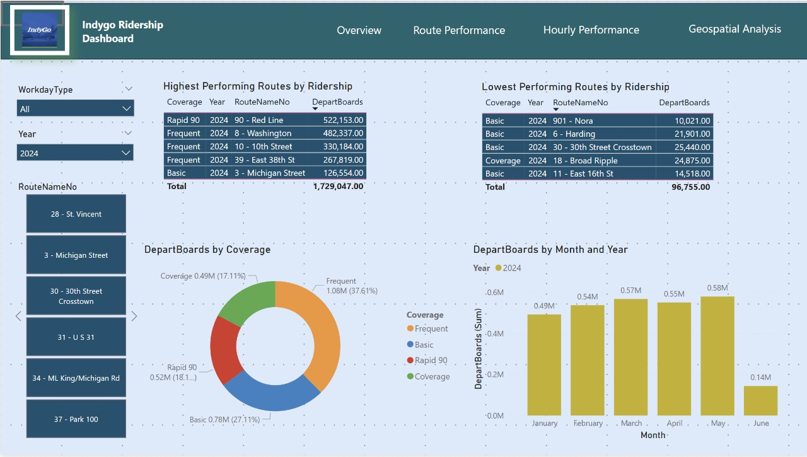
DASHBOARD

Slide 8
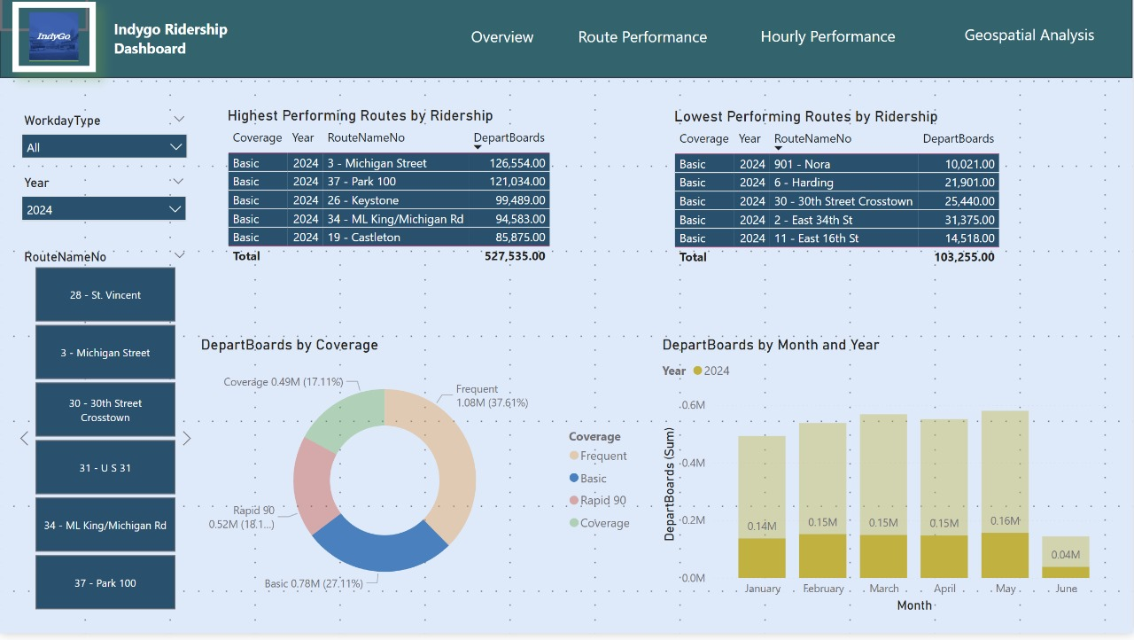
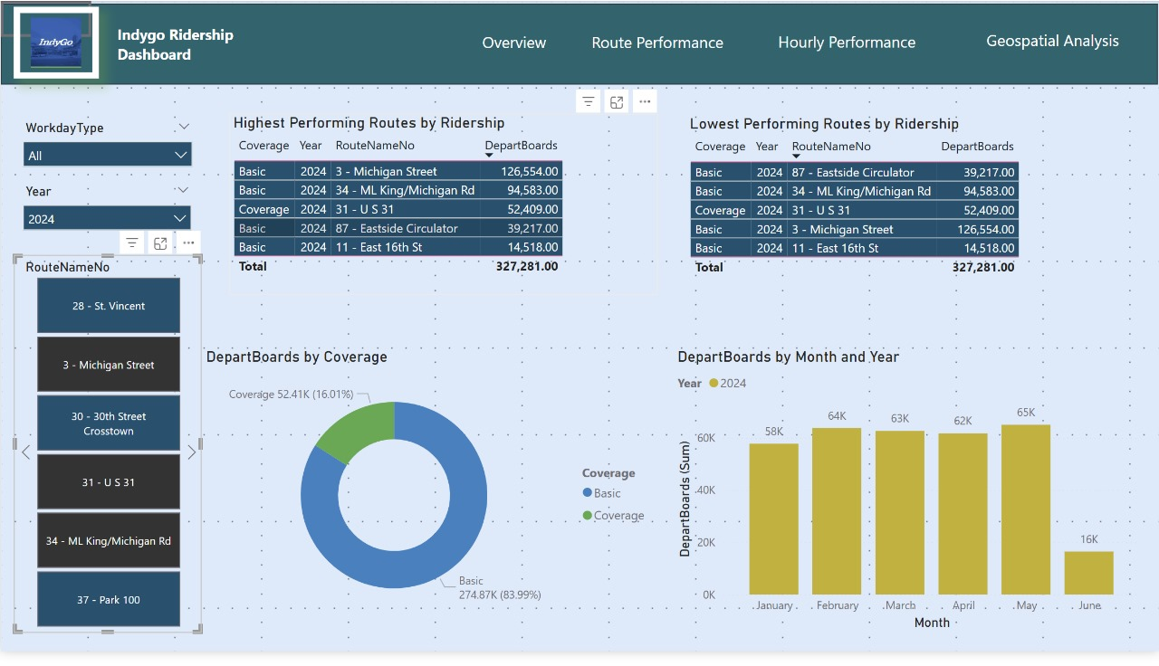
DASHBOARD

Slide 9
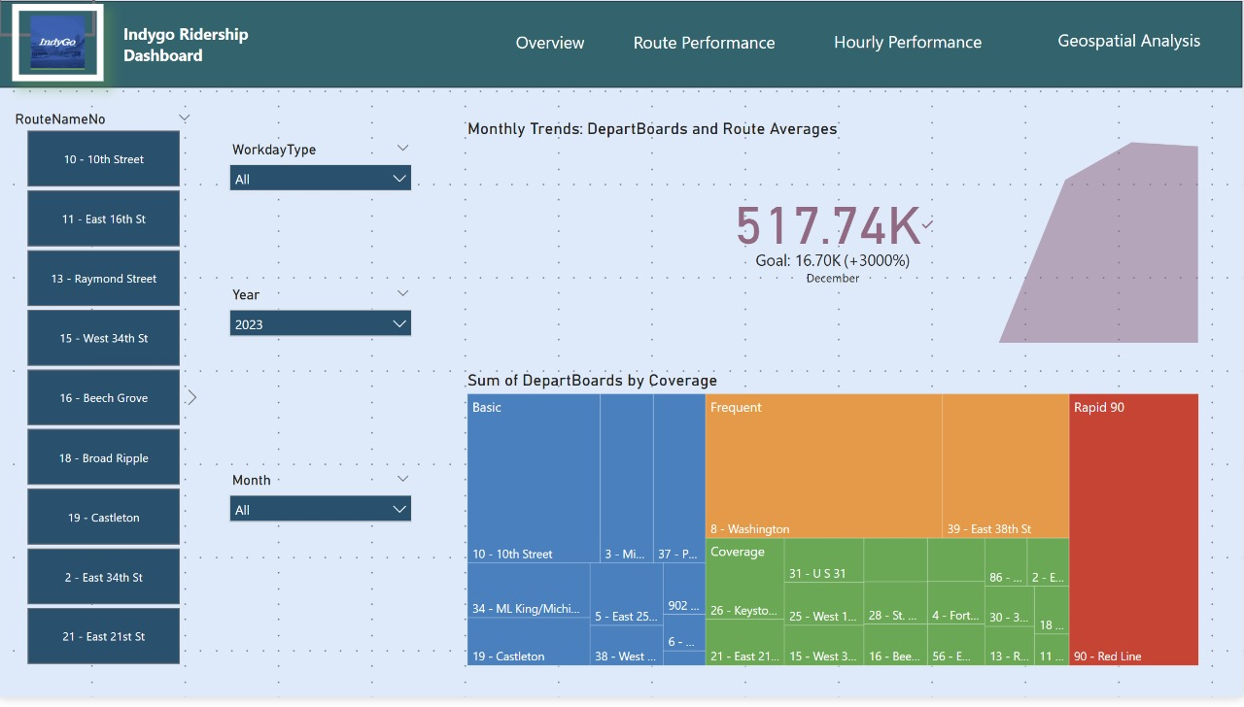
DASHBOARD

Slide 10
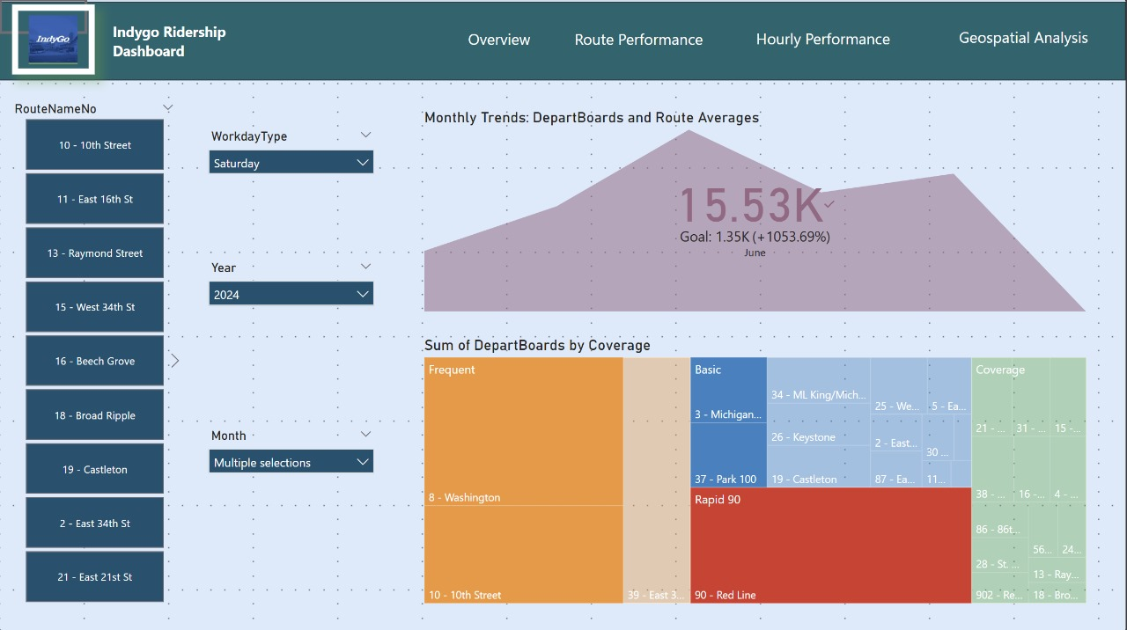
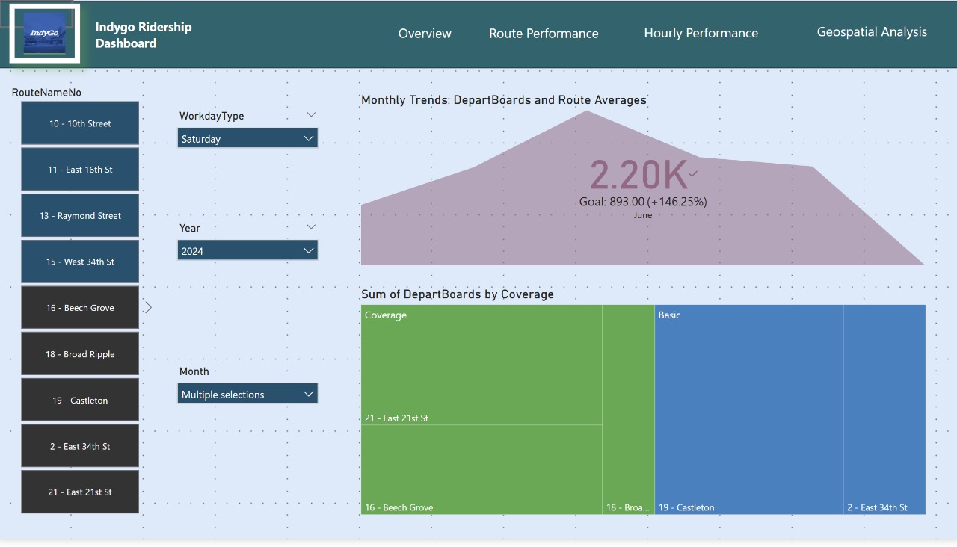
DASHBOARD

Slide 11
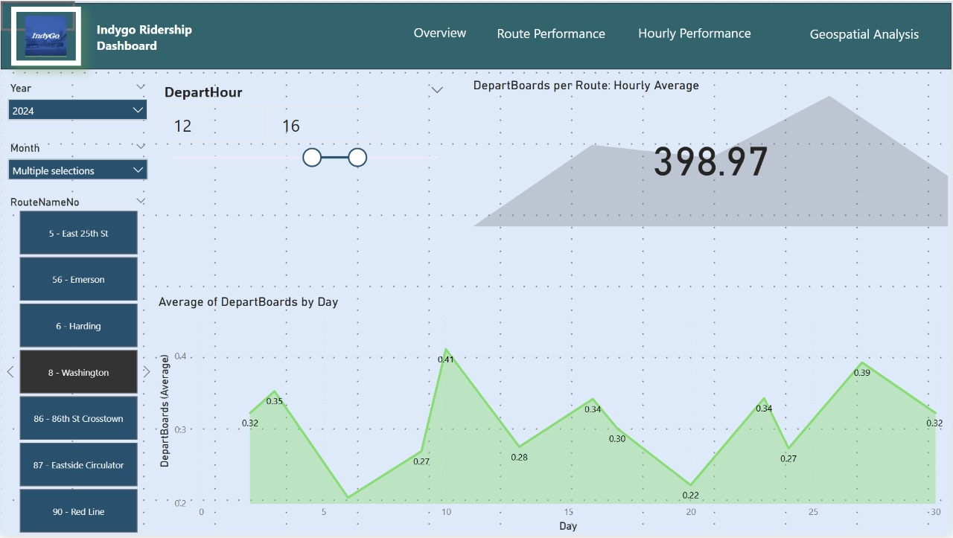
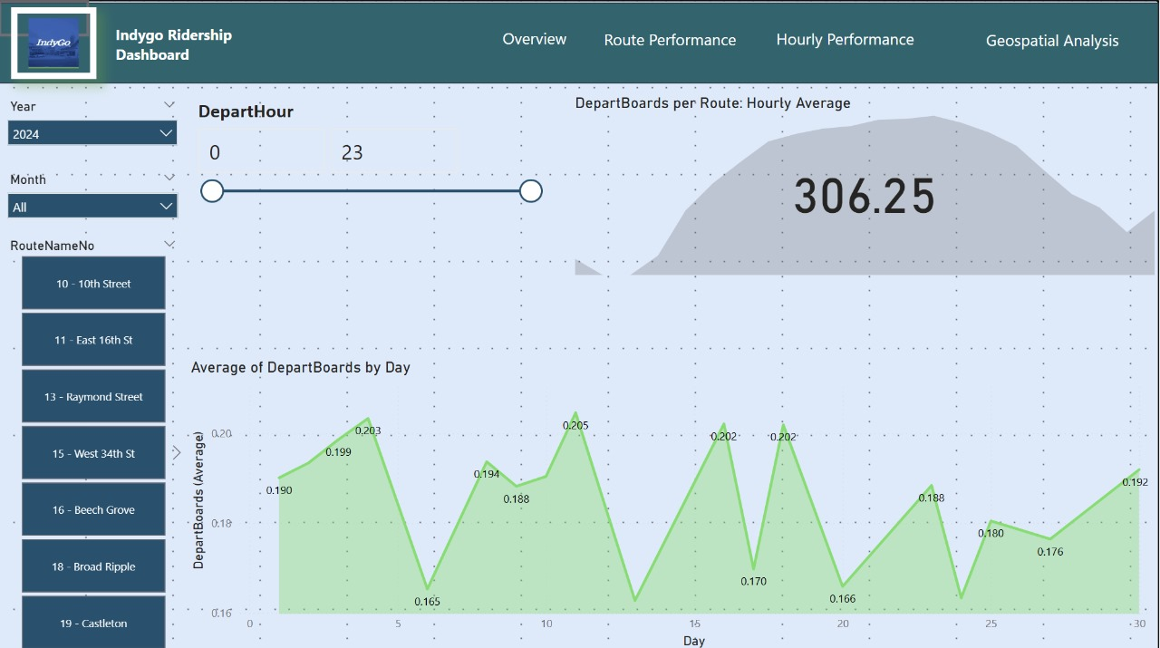
DASHBOARD

Slide 12
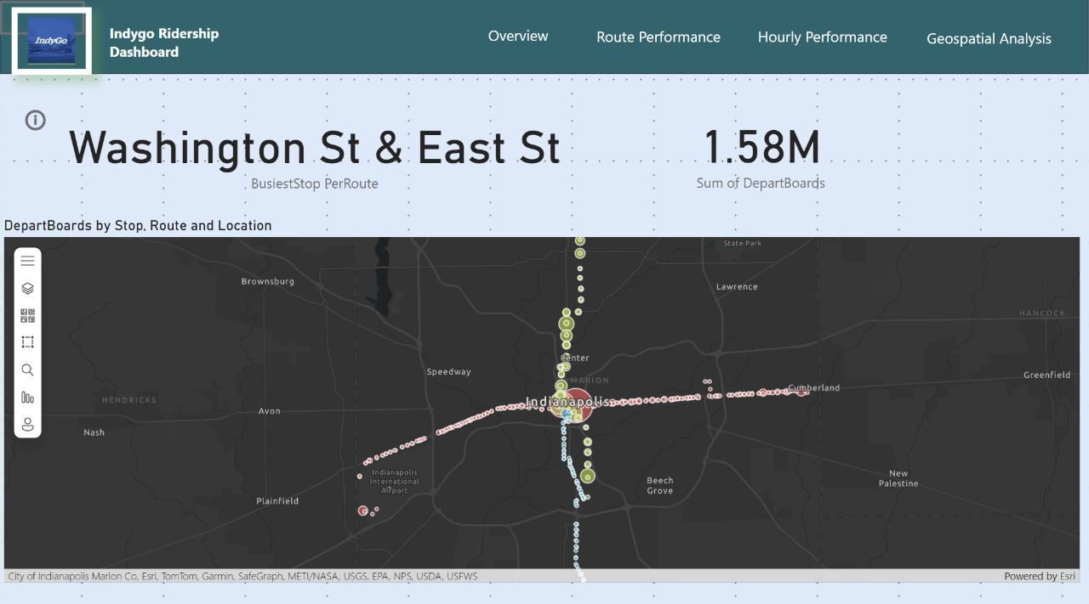
DASHBOARD

Slide 13
INSIGHTS AND DISCUSSION
Insights on Visualisations
Insights on Visualisation
Routes 90 (Red Line), 8 (Washington), and 10 (10th Street) are the backbone of the system, collectively accounting for over 1.3M DepartBoards. The "Frequent" service category delivers the highest return on service investment (37.61% of ridership), indicating that frequency drives usage more effectively than coverage alone.
Washington St & East St intersection (1.58M DepartBoards) represents the system's most crucial connection point outside the Central Transit Center. January through May shows stable ridership patterns (0.49M-0.58M monthly DepartBoards), with March and May performing strongest. With an average of 306.25 DepartBoards per route per hour, the hourly performance metrics enable precise targeting of service frequency adjustments to match demand patterns throughout the day.
The oscillating pattern in daily ridership throughout the month (peaks around days 4, 10, 16, 20) indicates potential correlation with pay periods or other recurring community events. While coverage routes account for only 17.11% of total ridership, they fulfill an essential equity function by providing service to lower-density areas. The substantial difference between highest (Route 90: 522,153) and lowest (Route 901: 10,021) performing routes highlights opportunities for targeted route restructuring or service level adjustments. The geospatial visualization reveals concentrated ridership in downtown with gradually decreasing density in outlying areas.

Slide 14
THANK YOU
You can view our final project results, including our dashboard, presentation, and supporting materials here: https://drive.google.com/drive/u/1/folders/1_04FAP_MlGrf9mlPyD9f1fmMpluFTywJ
Anish R Khatavkar, Arnav Srivastava, Shruthi Nagappan, Uthra Sridhar, Rishikesh Vittal

