Slide 1


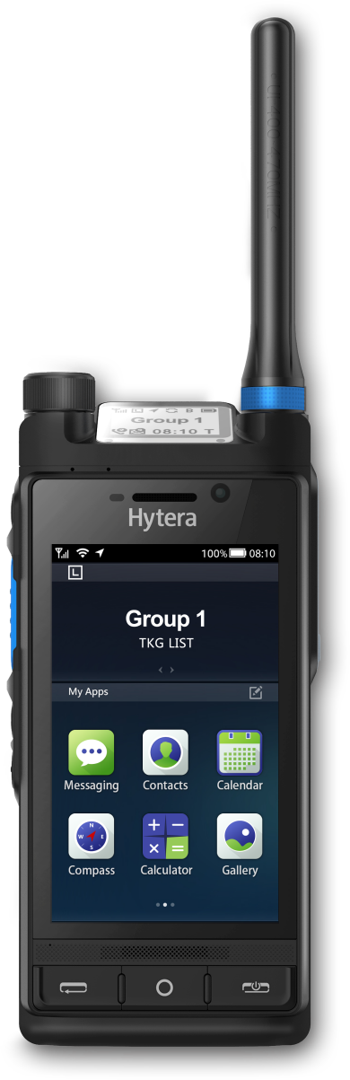
HYTERA × GLOBE TELECOM
450 MHz Mission-Critical
Network for the
Philippines
A coverage and resilience layer for utilities,
public safety, transport and remote communities.
Philippines · October 2026
Terminal · Network · Application

Slide 2

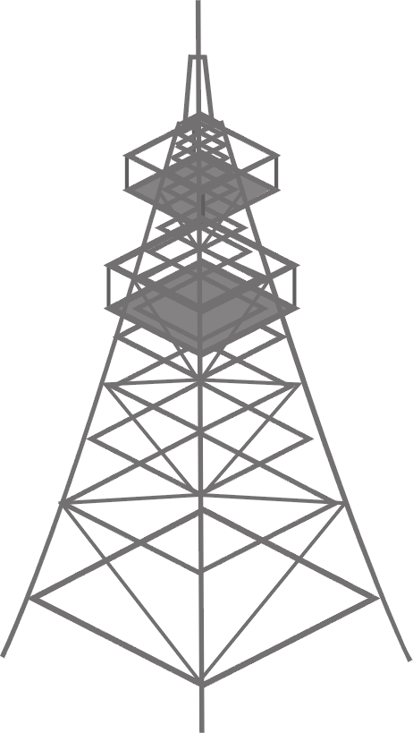
Islands, mountains and typhoons
02
THE GAP
Public 4G and 5G reach the cities. What is missing is coverage that is still there after the storm.
7,641
#1
7,641 islands.
One grid has to reach
across all of them.
islands, much of the terrain mountainous
WorldRiskIndex 2025 - highest disaster risk
~20
1.4M
tropical cyclones enter PAR every year
electricity consumers without power after Typhoon Tino (Nov 2025)
Mountains, storm landfall and
2,000 km of sea between
the islands.
450 MHz is the layer that stays up. Coverage and resilience, not capacity - alongside Globe’s 4G and 5G, not instead of them.
Source: WorldRiskReport 2025; PAGASA; NAMRIA; Department of Energy, Typhoon Tino power situation (5 Nov 2025)

Slide 3


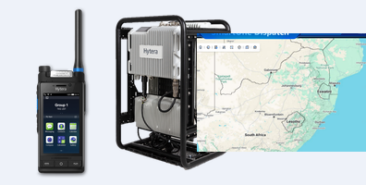
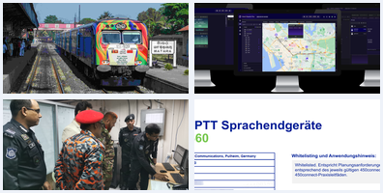
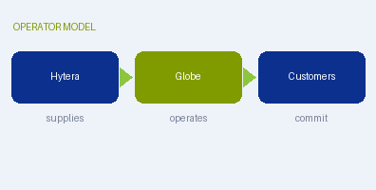
What we will cover
03
AGENDA
Five sections. The first two are the argument, the last three are the delivery.
01
02
03
04
05
Why 450 MHz & Hytera
Industry solutions
End-to-end architecture
Reference cases
Business model
Global trend, the band itself, and what MCS means
Power · Water · Police · Emergency · Rail · Port
Terminal · Network · Application
Global 450 MHz networks, and three customer cases
Who does what, six revenue streams, next steps
P4 – P6
P7 – P13
P14
P15 – P18
P19 – P21
One network, six industries. The same 450 MHz layer serves all of them, on the same sites.
Source: Hytera proposal structure

Slide 4
From a niche band to critical infrastructure
04
GLOBAL TREND
Regulators, utilities and public safety agencies have settled on what this band is for.
OUR POSITION
86%
Named at both ends of the chain
of the world’s population lives in countries where the 400 MHz bands are allocated or under consultation
The Alliance lists Hytera in its device supplier list and in its macro eNB supplier list.
77 / 39
Through operator acceptance
countries with networks deployed at 380 / 410 / 450 MHz - and the 39 of them already running LTE
PNC660 450M is whitelisted by 450connect to −115 dBm RSRP - the operator’s own document.
1.8M / 14M
A 5G-ready 450 MHz portfolio
broadband and sensor connections forecast by 2030, from 420k and 1.2M in 2026
Handheld, vehicle radio, base station and core, with a 5G model in development.
The band is no longer experimental. It is assigned, standardised in 3GPP, and carrying utility and public-safety traffic today.
Source: 450 MHz Alliance, Annual Global Update (Dec 2025) p4, p11 Table 1, p12 Table 6; Annual Equipment Report (May 2025) p5

Slide 5
One site replaces several mid-band sites
05
WHY 450 MHZ
Low-band physics is the whole argument. The numbers below reuse one grid at three frequencies.
WHAT THAT BUYS
Bends around ridges and into valleys instead of needing line of sight
Reaches meter boxes, basements and tunnels that mid-band cannot
Fewer sites is what makes extensive backup power affordable
410 / 450 MHz
740 MHz
2350 MHz
1× sites · 100% covered
2.5-3× sites · 91.3% from the same grid
12-15× sites · 58.7% from the same grid
Same area, same grid. Only the low band covers it with one site - which is what makes island and
mountain coverage affordable, and what makes extensive backup power affordable.
What it is not: with 3-5 MHz it carries voice, low-rate video and telemetry. It stays outside the capacity game.
Source: 450 MHz Alliance, Brief (Jun 2022) p15 - reference grid modelled at 410 MHz

Slide 6



What MCS means - and how it sits on the band
06
THE SERVICE LAYER
The customer cases in section 04 run MCS. This page explains what it is, because the term carries the delivery.
HOW THE LAYERS STACK
3GPP mission-critical services (MCS / MCX)
Applications
MCPTT
dispatch, recording, device management
push-to-talk voice, with priority and pre-emption
MCVideo
MCS service layer
live and recorded video from the scene
MCPTT / MCVideo / MCData
MCData
messaging, file transfer and location data
LTE or 5G radio
Band 31 / 72 at 450 MHz
Defined by 3GPP, not by a single vendor - so the network stays multi-vendor and the
terminals are not locked to one supplier.
In this deck: the band carries the traffic, MCS provides the service.
450 MHz gives the coverage; MCS gives the service. MCS runs on any 3GPP LTE or 5G radio, so it carries over to a 450 MHz layer unchanged.
Source: 3GPP mission-critical services; Hytera HyTalk MC platform documentation

Slide 7
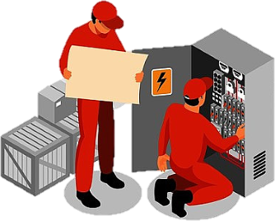

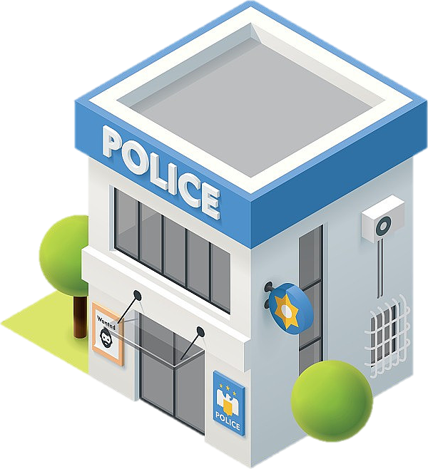
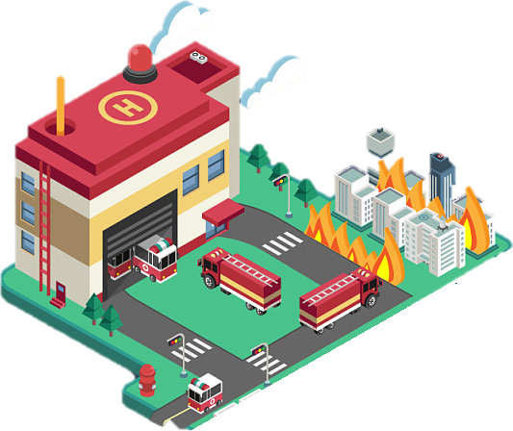

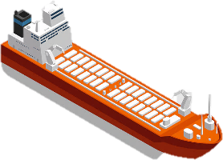
One network, six industries
07
INDUSTRY SOLUTIONS
The same 450 MHz layer serves all six, on the same sites. Each of the next pages takes one.
Power
Water
Police
Grid dispatch, feeder automation and smart metering
Metering, pressure sensing and reservoir telemetry
Cross-agency group calls and live video from the scene
Emergency
Rail
Port
Rapid deployment and coverage after the storm
Corridor coverage and train-to-ground voice and data
Quay dispatch, ship-to-shore and coast guard patrols
Utilities anchor it commercially. Public safety, emergency, rail and port add national value on the same sites.
Source: 450 MHz Alliance (Dec 2025); Hytera industry solutions

Slide 8


Power: the grid, the crews and the meters
08
INDUSTRY 1 OF 6 · POWER
Electric cooperatives have spread-out assets, a 10-15 year horizon and a willingness to pay for reliability.
PAIN POINT
Mountain and island lines have no reliable signal, and feeder automation needs a private data path that does not depend on the public network.
WHAT 450 MHZ DOES
Wide-area push-to-talk, video and lone-worker alarms along the lines
A private data channel for SCADA, feeder automation and substation control
Smart meters on the same sites, with deep indoor coverage
Grid repair crews and line assets. Illustrative imagery.
In the Philippines: 121 electric cooperatives under NEA.
Source: National Electrification Administration; Hytera power industry solutions

Slide 9

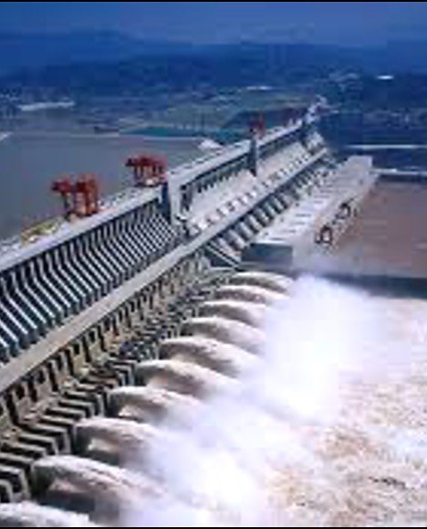
Water: locate the losses instead of estimating them
09
INDUSTRY 2 OF 6 · WATER
Non-revenue water is usually estimated, not located. Pump, well and reservoir sites sit exactly where mid-band cannot reach.
PAIN POINT
Most water districts know their losses as a percentage, not as an address - because the meters and pressure sensors cannot report.
WHAT 450 MHZ DOES
Meters and pressure sensors that locate losses instead of estimating them
Pump, well and reservoir telemetry from remote and underground sites
Backup-powered sites keep alarms flowing when the public network is down
Reservoir and pumping assets. Illustrative imagery.
In the Philippines: only 149 of 532 water districts kept losses within LWUA’s 20% limit (2025).
Source: LWUA non-revenue water data, end-2025 (reported Aug 2026); Hytera water industry solutions

Slide 10

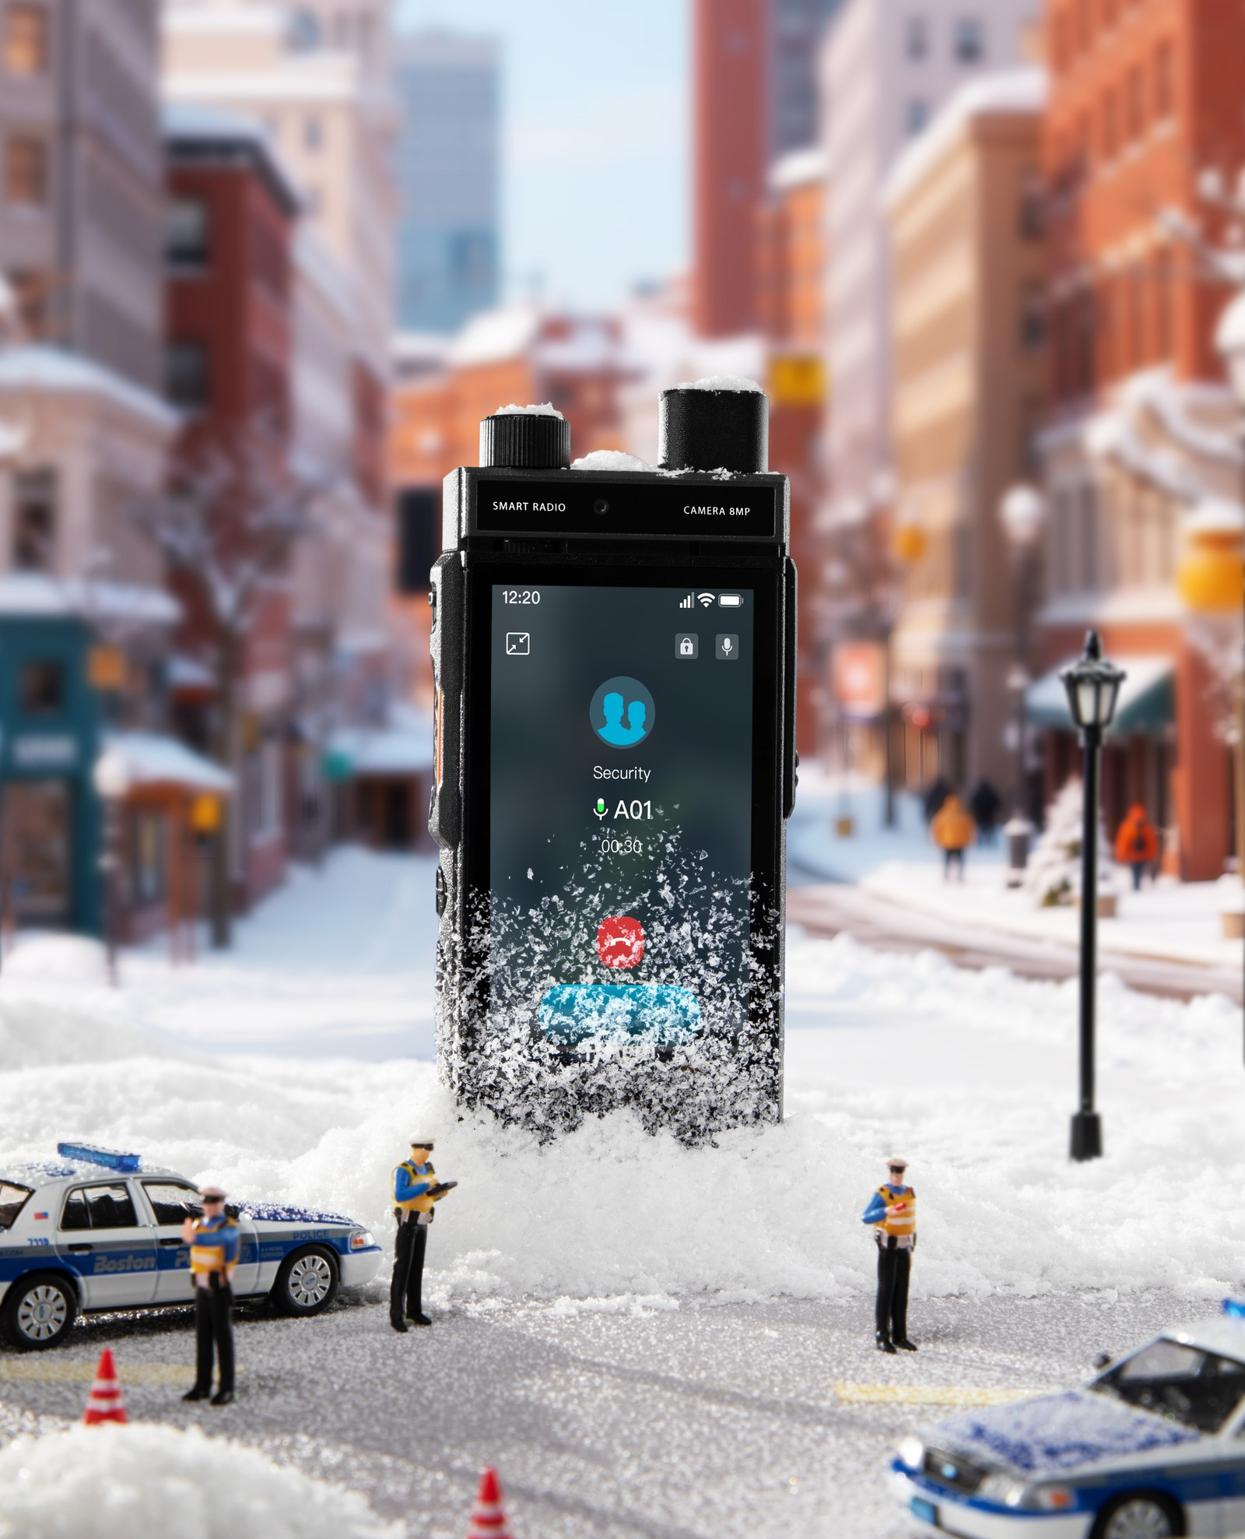
Police: one group call across the agencies
10
INDUSTRY 3 OF 6 · POLICE
The requirement is not another private network. It is interoperability between the agencies that already have one.
PAIN POINT
Different agencies cannot talk to each other, and the public network congests exactly at the moment it is needed most.
WHAT 450 MHZ DOES
One group call across police, fire and civil defence
Live video from the scene, with priority and pre-emption when the network congests
Interworking with the DMR and TETRA networks already in service
Police on traffic duty, and a handheld in the field. Illustrative imagery.
Reference: Singapore has assigned 450 MHz band 31 to public safety, in service.
Source: 450 MHz Alliance, Annual Global Update (Dec 2025) p8; Hytera public-safety references

Slide 11

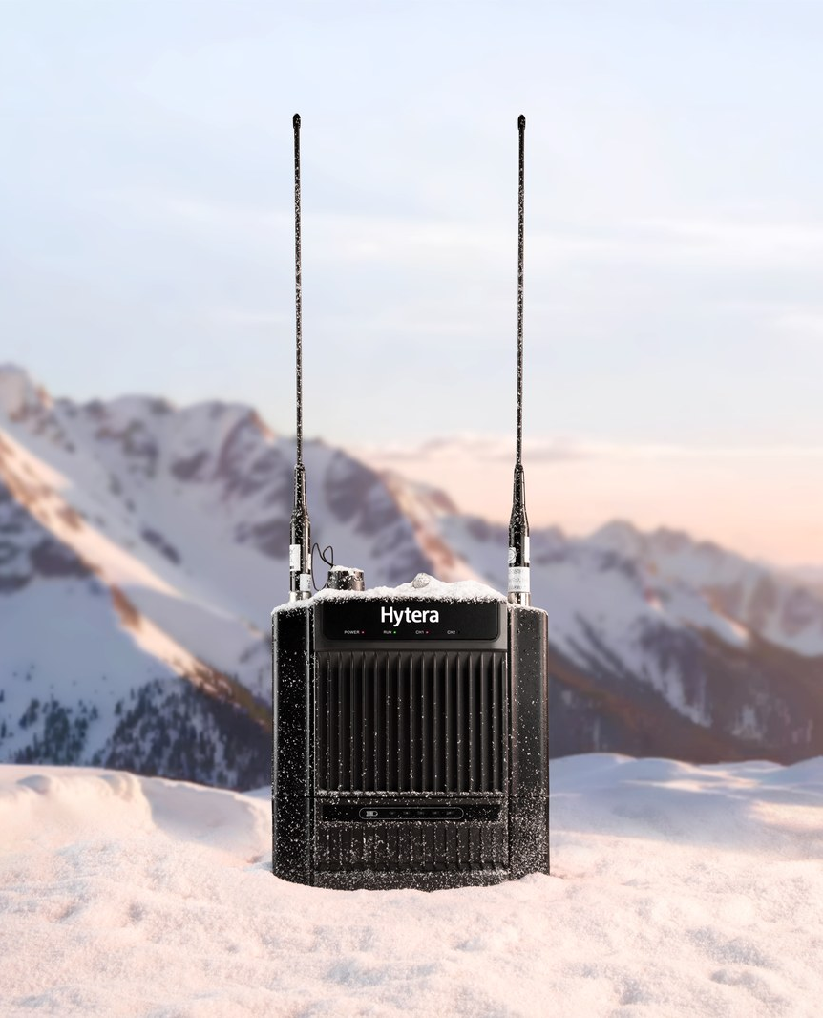
Emergency: coverage that survives the storm
11
INDUSTRY 4 OF 6 · EMERGENCY
After a typhoon the public network fails exactly where the response is needed. This is the layer that has to survive.
PAIN POINT
Rapid response needs communications within hours, not days - and it needs them where there is no grid and no backhaul.
WHAT 450 MHZ DOES
Portable base stations and satellite backhaul deployed within hours
A field command post that reaches the provincial EOC and the national agency
Sites that keep running on backup power when the grid does not
Flood rescue, and a portable base station in the field. Illustrative imagery.
Reference: rapid deployment kits and container command posts in service.
Source: Hytera emergency and rapid-deployment product documentation

Slide 12

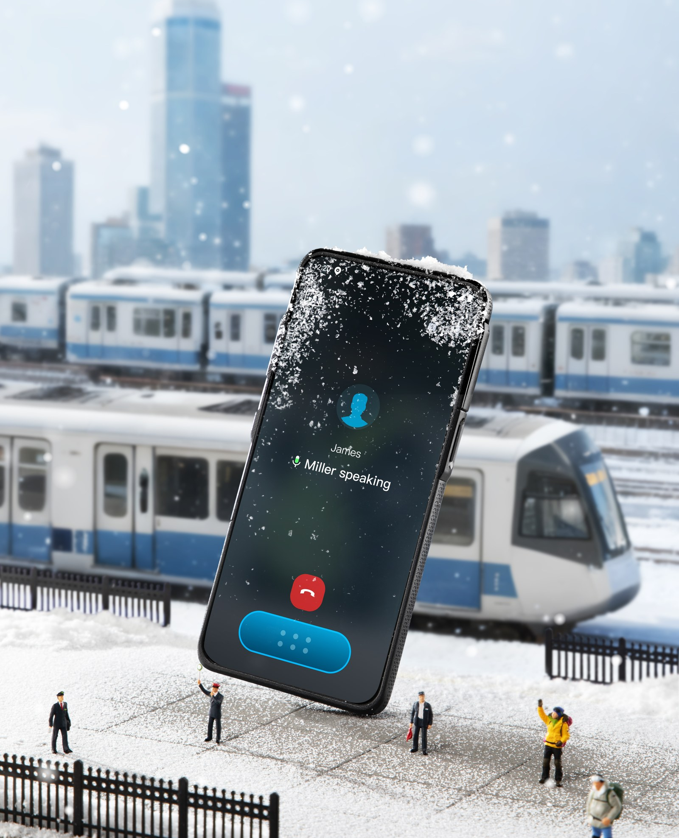
Rail: continuous coverage along a narrow corridor
12
INDUSTRY 5 OF 6 · RAIL
A rail corridor is a narrow strip, often in cuttings. It is one of the two shapes mid-band handles worst.
PAIN POINT
Coverage has to follow the track, not the population - so a network built for towns leaves the corridor uncovered.
WHAT 450 MHZ DOES
Continuous coverage along the corridor, including cuttings and tunnels
Train-to-ground voice, data and video for operations and security
Runs on the operator’s network rather than a separate private system
An elevated rail line, and a handheld on board. Illustrative imagery.
Reference: South Africa has assigned the band to Transnet for rail.
Source: 450 MHz Alliance, Annual Global Update 2025 p6; Hytera railway references

Slide 13

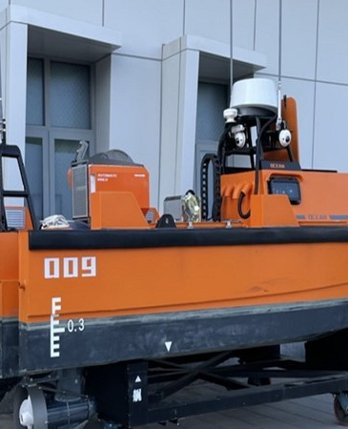
Port: from the quay out to sea
13
INDUSTRY 6 OF 6 · PORT
Ports are dense and metallic, and coast guard patrols run far beyond mid-band reach. One network covers both.
PAIN POINT
Quay operations, ship-to-shore traffic and patrol boats all need the same group call, across water and steel.
WHAT 450 MHZ DOES
Port and terminal dispatch on one group call across the quay
Ship-to-shore voice and data from coastal sites
Coast guard patrols covered far out to sea, on the same network as the port
A sea crossing, and a rescue boat. Illustrative imagery.
The same coastal sites also serve island and rural communities.
Source: 450 MHz Alliance (Dec 2025); Hytera transport and maritime references

Slide 14
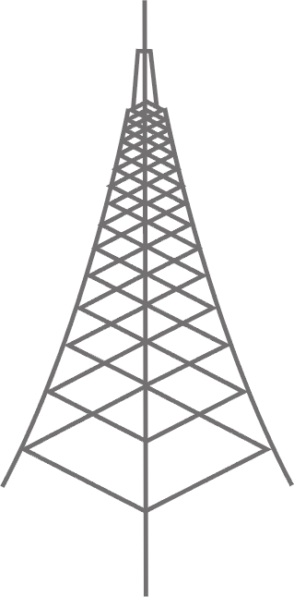



End to end: terminal - network - application
14
ARCHITECTURE
One architecture, in three layers. Each layer is described by what it contains, not by who supplies it.
TERMINAL
NETWORK
APPLICATION
What the field carries
Radio, core and backhaul
Dispatch, recording and management
PNC660 450M handheld
450 MHz macro eNB
MCS services
B31/B72, IP68, dual SIM
wide area coverage, few sites
MCPTT / MCVideo / MCData
MNC650 450M
Private core
Dispatch console
vehicle radio
or the operator’s own core
voice, video, GIS and presence
P70 5G+450M
Backhaul
Recording
radio-style handheld, 2026 Q4
fibre, microwave or satellite
multimedia capture and playback
PNC660Ex
Rapid deployment
Device management
ATEX variant, 2027 Q2
portable base station and satellite kit
zero-touch deployment
THE SAME ARCHITECTURE SERVES ALL SIX INDUSTRIES
Power
Water
Police
Emergency
Rail
Port
Only the terminals, the applications and the coverage area change. The network layer is the same build.
Source: 450M Roadmap; HyTalk MC V6.1; 450 MHz Alliance, Equipment Report (May 2025)

Slide 15
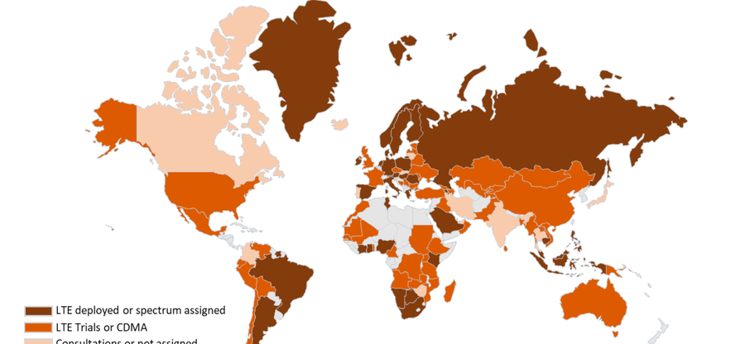
450 MHz operators worldwide: the model works
15
REFERENCE · 450 MHZ
Two things are the same in every market: a licensed operator carries the traffic, and utilities anchor the demand.
Germany
Band 72, nationwide utility network; more than 95% of Germany covered
450connect
Austria
Band 72; regional CDMA and LTE networks for utilities
ArgoNET
Poland
Band 31 and band 87; smart grid and field services
PGE / Polkomtel
Malaysia
Band 31; procurement for initial deployment in four regions
TNB
Indonesia
Band 31; rural LTE over satellite backhaul, and a private LTE network for MCX
SeaTelSat
South Africa
Band 31 allocated for rail, with wider use under discussion
Transnet
Figure 2. The world map of 380 MHz, 410 MHz and 450 MHz deployment.
Singapore
Band 31 allocated for public safety, in service
Public safety
The pattern is the same everywhere. A licensed operator carries the traffic; utilities and public safety anchor the demand.
Source: 450 MHz Alliance, Annual Global Update (Dec 2025) p7-p9, p14; RFI for devices (2025) p5-p7

Slide 16

Sri Lanka Railways: a national network on public LTE
16
CASE 1 OF 3 · 450 MHZ LICENCE HOLDER
Nine lines and 403 stations on a public LTE network. Dialog, the operator, also holds Sri Lanka’s 450 MHz licence.
1,950+
MCS terminals delivered across the island network
9 / 403
railway lines and stations covered
450 MHz
the operator, Dialog, holds Sri Lanka’s 450 MHz licence
Sri Lanka Railways - the customer’s own network, photographed on site.
−10%
−60%
−40%
30 min
train delays
management cost
track repair time
landslide response
Source: Hytera showroom briefing (SRC-0134/0135) L211; Hytera PNC660 450MHz&MCX case records; 450 MHz Alliance, Annual Global Update (Dec 2025) p8

Slide 17
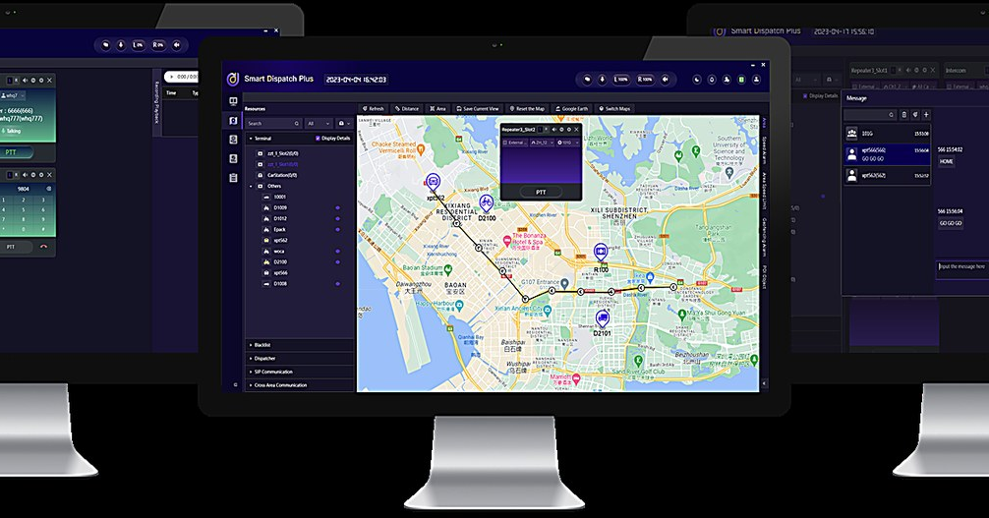
Hong Kong Light Rail: the first MCS over 5G
17
CASE 2 OF 3 · RAILWAY MCX OVER 5G
The world’s first railway MCS over 5G - replacing TETRA rather than overlaying it.
810
terminals: 511 handheld, 152 bus-mounted and 147 vehicle
5G
the world’s first railway MCS running over 5G
Full
redundancy, including the wireless links between sites
Illustrative operations imagery; the customer’s own site photography is not cleared for external use.
TETRA
Shared
Train-borne
One
replaced, not overlaid
operator core network and RAN
MCS-compliant dispatch
network for operations and security
Source: Hytera showroom briefing L170; Hytera PNC660 450MHz&MCX case records

Slide 18

Papua New Guinea: a national command centre
18
CASE 3 OF 3 · PUBLIC SAFETY
A police headquarters command centre on Hytera ICC, used for daily operations and for APEC summit security.
3,000
police officers and 600 police vehicles served by one centre
APEC
summit security: 15,000 foreign visitors and more than 200 meetings
360°
city-wide video surveillance, with protection around the clock
Illustrative operations imagery; the customer’s own site photography is not cleared for external use.
60 s
VIP
City-wide
24/7
police dispatch after the alarm bell rings
automatic vehicle route monitoring
emergency video communication
protection during the summit
Source: Hytera case records (Papua New Guinea Police HQ command centre), slides 2-4

Slide 19
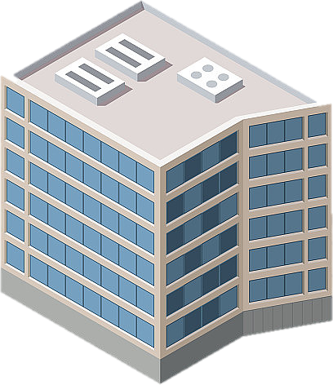
Who does what
19
BUSINESS MODEL
Three parties, one chain. The question is not whether the technology works, but who commits first.
Hytera
Globe Telecom
Anchor customers
supplies the radio, terminals, platform and integration
holds the spectrum, builds and operates the network, owns the customer relationship
utilities, public safety, transport and ports contract capacity before build-out
THREE WAYS TO CUT THE COST
Reuse what Globe already has
Far fewer sites for the same coverage
Contract the demand before the build
Towers, fibre, equipment rooms and power are already in place along the routes that matter.
The site count for the same area is a fraction of mid-band - which is what makes backup power affordable.
Anchor customers commit capacity first, so the network is built against revenue rather than in front of it.
A lesson from the Alliance’s country reports: Portugal’s 450 MHz trial stalled on commercial terms, not on the technology - so the sequencing matters most.
Source: 450 MHz Alliance, Annual Global Update (Dec 2025) p9 (Portugal: trial network, licence award pending on commercial terms); Hytera proposal

Slide 20

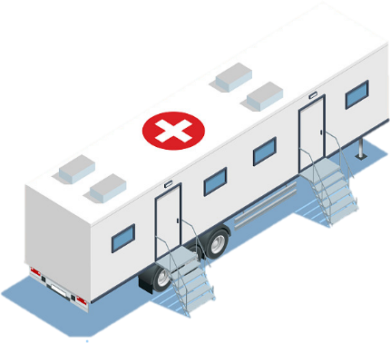
Six revenue streams on one network
20
BUSINESS MODEL
A single 450 MHz build supports six commercial lines. None of them depends on consumer take-up.
IoT connectivity
MCX as a service
Capacity packages
Monthly fee per meter, sensor or asset, on the same sites as the voice service.
Hosted push-to-talk, video and data, charged per user per month.
Reserved network share for an anchor customer, on a fixed annual fee.
Device as a service
Integration and O&M
Emergency readiness
Terminals bundled with the service, billed monthly rather than bought outright.
SCADA, telemetry and smart-city projects, delivered and maintained.
Rapid deployment kit on standby, retained by the province or the agency.
One build, six lines. The utility contract funds the coverage that the other five then use.
Source: Hytera proposal; 450 MHz Alliance business model material

Slide 21
Roadmap: pilot first, then scale
21
NEXT STEPS
One typhoon-belt province, two anchor customers, and the data Globe needs for a national decision.
01
02
03
04
05
Confirm the spectrum
Pick the pilot region
Build the pilot
Prove the case
Scale nationwide
Band, bandwidth and licence term
One province, plus two anchors
Sites, platform, terminals, meters
Coverage, availability and cost data
Emergency, transport, smart city
What we need from Globe
Spectrum parameters
A candidate province
Anchor introductions
The band and bandwidth, so the coverage and capacity modelling is exact.
One region, ideally in the typhoon belt, where the gap is visible.
One electric cooperative and one water district willing to trial.
We are not proposing a build. The next step is a joint pilot design, so Globe can test the assumptions in its own terrain.
The technical case is settled. What decides the outcome is whether demand is contracted before build-out.
Source: Hytera proposal

Slide 22
HYTERA × GLOBE TELECOM
Thank you
Mission First · Safety Always
Hytera × Globe Telecom · 450 MHz for critical infrastructure
and remote communities.
Next step: confirm the spectrum parameters and nominate a pilot region,
and we will design the pilot with you.
Hytera Communications Corporation Limited
Thank you for your time

