Slide 1


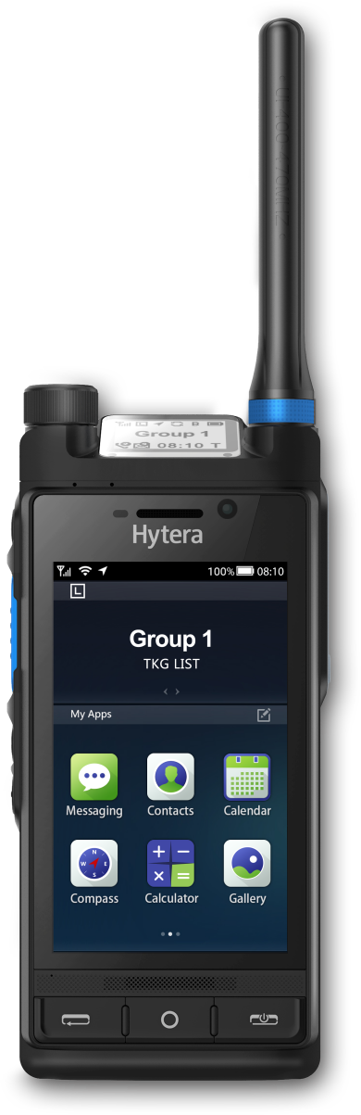
HYTERA × GLOBE TELECOM
450 MHz
Mission-Critical Network
for the Philippines
Coverage and resilience for utilities,
public safety and transport
Initial technical exchange · October 2026
Hytera Communications Corporation Limited

Slide 2






A THE ANSWER
02
450 MHz: the coverage that stays up after the storm
WHAT IT IS
A resilience layer
Alongside 4G and 5G
WHY NOW
A mainstream band
77 countries deployed · 39 on LTE
WHO PAYS FIRST
The utilities
Power and water anchor the build
WHAT WE PROPOSE
One pilot province
Two anchor customers
One low-band layer across 7,641 islands
Today’s ask
Confirm the spectrum · Nominate a pilot province
Source: 450 MHz Alliance, Annual Global Update (Dec 2025) p11 Table 1; NAMRIA

Slide 3






B THE GAP
03
What is missing is coverage that survives the storm
7,641
#1
islands, mostly mountainous
WorldRiskIndex 2025
~20
1.4M
tropical cyclones a year
consumers cut off by Typhoon Tino
Flood rescue. Illustrative imagery.
4G / 5G
capacity in the cities
450 MHz
coverage that stays up
Source: NAMRIA; WorldRiskReport 2025; PAGASA; Department of Energy (5 Nov 2025)

Slide 4


B WHY 450 MHZ
04
One low-band grid covers what mid-band leaves dark
WHAT THAT BUYS
410 / 450 MHZ
740 MHZ
2350 MHZ
Reaches over ridges
and into valleys
Deep indoor: meter boxes
and basements
Few sites, so backup
power is affordable
100%
91%
59%
covered
covered
covered
1×
2.5–3×
12–15×
Not a capacity layer
sites to close the gap
sites to close the gap
sites to close the gap
3–5 MHz: voice, telemetry, low-rate video
covered
not covered
site
Source: 450 MHz Alliance, Brief (Jun 2022) p15 - same site grid, reference modelled at 410 MHz

Slide 5





B WHY NOW
05
The band is mainstream, and the operator model is proven
86%
of the world lives where it
is allocated or consulted
OPERATORS RUNNING IT
Germany
Utilities · >95% coverage
B72
450connect
Malaysia
Utility grid · 4 areas
B31
77 / 39
countries with networks /
already on LTE
TNB
Poland
Smart grid, field service
B31
PGE
Singapore
Public safety, in service
14M
sensor connections by 2030,
plus 1.8M broadband
B31
Public safety
Indonesia
Rural LTE via satellite
B31
SeaTelSat
Same pattern everywhere one licensed operator carries it; utilities anchor the demand
Source: 450 MHz Alliance, Annual Global Update (Dec 2025) p4, p8-p9, p11-p12; RFI for devices (2025) p5

Slide 6









C WHO PAYS FIRST
06
Start with the utilities: they pay first and fit best
ABILITY TO PAY
FIT WITH 450
SPEED TO REVENUE
KEY POINT
1
Power
Proven anchor abroad
2
Water
Same sites as power
3
Emergency
Typhoon readiness
4
Police
Interoperate, not replace
5
Rail
Long project cycles
6
Port
No 450 MHz precedent yet
Green rows: the anchor customers
Our reading, to be tested in the pilot
Source: Hytera assessment; 450 MHz Alliance, Annual Global Update (Dec 2025) p8-p9; LWUA NRW data (2025)

Slide 7






C PRIORITY 1 OF 6 · POWER
07
Power anchors the network, as it does in Germany and Malaysia
121
1.4M
electric cooperatives
under NEA
consumers cut off
by Typhoon Tino
WHAT 450 MHZ DOES
SCADA &
feeder automation
Push-to-talk
for line crews
Smart meters,
deep indoors
Illustrative imagery
PROOF POINT
WHAT GLOBE SELLS
Germany 450connect
B72 · >95% coverage
Capacity package
IoT per meter
SCADA O&M
Malaysia TNB
B31 · 4 areas
Source: NEA; Department of Energy (5 Nov 2025); 450 MHz Alliance, RFI for devices (2025) p5, Annual Global Update (Dec 2025) p8

Slide 8


C PRIORITY 2 OF 6 · WATER
08
Water: find the losses instead of estimating them
532
149
water districts
under LWUA
kept losses within
the 20% limit
WHAT 450 MHZ DOES
Meters that
report
Pressure sensing,
leak location
Pump & reservoir
telemetry
Illustrative imagery
PROOF POINT
WHAT GLOBE SELLS
Bahrain EWA
water-meter network
IoT per meter
Telemetry
Integration
Kenya
band reserved for utilities
Source: LWUA NRW data, end-2025 (reported Aug 2026); 450 MHz Alliance, Annual Global Update (Dec 2025) p6, p8

Slide 9



C PRIORITY 3 OF 6 · EMERGENCY
09
Emergency: the layer that has to survive the storm
#1
~20
WorldRiskIndex
2025
tropical cyclones
a year
WHAT 450 MHZ DOES
Deployed
within hours
Satellite
backhaul
Field command
post
Illustrative imagery
PROOF POINT
WHAT GLOBE SELLS
Indonesia SeaTelSat
B31 over satellite
Readiness retainer
Standby kits
MCX service
Hytera E-pack200
rapid-deployment kit
Source: WorldRiskReport 2025; PAGASA; 450 MHz Alliance, RFI for devices (2025) p5; Hytera product documentation

Slide 10



C PRIORITY 4 OF 6 · POLICE
10
Police: one group call across the agencies
Interop
Priority
with DMR and TETRA
already in service
when the public
network congests
WHAT 450 MHZ DOES
Cross-agency
group call
Live video
from the scene
DMR / TETRA
interworking
Illustrative imagery
PROOF POINT
WHAT GLOBE SELLS
Singapore
B31 · public safety
MCX per user
Devices as service
Integration
Russia Rostelecom
B31 · public safety
Source: 450 MHz Alliance, Annual Global Update (Dec 2025) p8-p9; Hytera public-safety references

Slide 11


C PRIORITY 5 OF 6 · RAIL
11
Rail: coverage that follows the track, not the towns
Corridor
Train
coverage, including
cuttings and tunnels
to ground voice,
data and video
WHAT 450 MHZ DOES
Dispatch
along the line
On-board
video
One network,
not a private one
Illustrative imagery
PROOF POINT
WHAT GLOBE SELLS
South Africa Transnet
B31 for rail
MCX per user
Devices as service
Capacity
Hytera Sri Lanka
MCS on 9 lines
Source: 450 MHz Alliance, Annual Global Update (Dec 2025) p6; Hytera showroom briefing L211

Slide 12



C PRIORITY 6 OF 6 · PORT
12
Port: the case rests on coverage over open water
Quay
Coastal
to open sea on
one group call
sites also serve
island communities
WHAT 450 MHZ DOES
Quay
dispatch
Ship-to-shore
voice & data
Coast guard
patrols
Illustrative imagery
PROOF POINT
WHAT GLOBE SELLS
Precedent
no 450 MHz port yet
MCX per user
Capacity
Coastal coverage
Basis
low-band reach over sea
Source: 450 MHz Alliance reports (no port deployment listed); Hytera transport and maritime references

Slide 13





D HOW WE DELIVER
13
One build serves all six industries; only terminals and apps change
Terminal
Network
Application
PNC660 450M
450 MHz macro eNB
MCS
handheld, B31/B72
wide area, few sites
MCPTT · MCVideo · MCData
MNC650 450M
Core
Dispatch
vehicle radio
private or Globe’s own
voice, video, GIS
P70 5G+450M
Backhaul
Recording
handheld, 2026 Q4
fibre, microwave, satellite
capture and playback
PNC660Ex
Rapid deployment
Device management
ATEX, 2027 Q2
portable site kit
zero-touch
MCS
HYTERA
a 3GPP standard: runs on any LTE or 5G radio
Alliance-listed device and eNB supplier; 450connect whitelisted
Source: 450M Roadmap; HyTalk MC V6.1; 450 MHz Alliance, Equipment Report (May 2025) p5; 450connect whitelist certificate

Slide 14


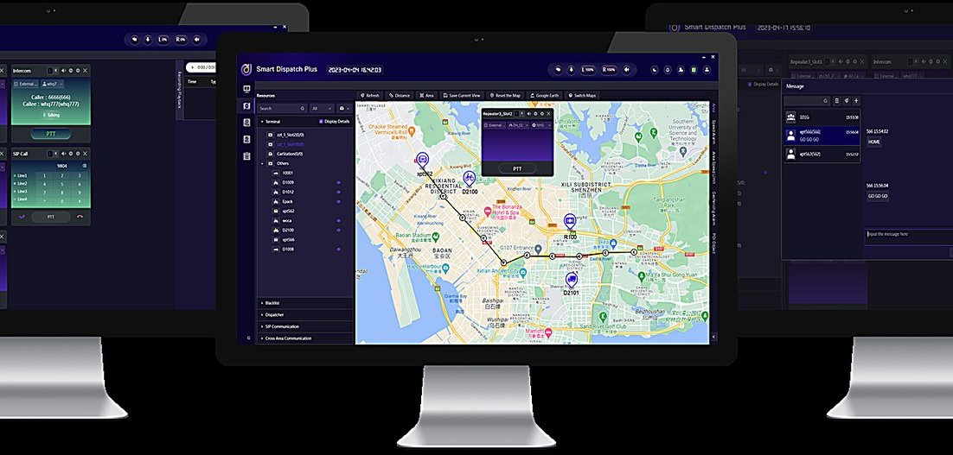

D DELIVERY RECORD
14
We already run mission-critical services at national scale
Read this right: these run MCS on public LTE and 5G, not on 450 MHz. They prove the service layer.
SRI LANKA
HONG KONG
PAPUA NEW GUINEA
Sri Lanka Railways
Light Rail
Police HQ
1,950+
810
3,000
MCS terminals
terminals
officers, one centre
9 lines · 403 stations
First railway MCS over 5G
APEC summit security
Public LTE (Dialog)
Replaced TETRA
60 s dispatch
Hong Kong and Papua New Guinea images are illustrative.
Source: Hytera showroom briefing L170, L211; Hytera PNC660 450MHz&MCX case records; PNG Police HQ case records

Slide 15





D BUSINESS MODEL
15
The utility contract funds the coverage; five more lines use it
Hytera
Globe Telecom
Anchor customers
Radio, terminals, platform
Spectrum, network, customers
Contract capacity first
SIX REVENUE LINES · AND WHO BUYS THEM
IoT connectivity
MCX as a service
Capacity packages
Power · Water
Police · Rail · Port
Power · Port
Devices as a service
Integration & O&M
Emergency readiness
Police · Rail
Power · Water
Emergency
Sign demand before the build: Portugal’s 450 MHz trial stalled on commercial terms, not technology
Source: Hytera proposal; 450 MHz Alliance, Annual Global Update (Dec 2025) p9

Slide 16



D NEXT STEPS
16
Pilot first: test the case in Globe’s own terrain
STEP 1
STEP 2
STEP 3
STEP 4
STEP 5
Confirm the spectrum
Pick a province
Build the pilot
Measure
Decide on scale
band, bandwidth
typhoon belt
sites, terminals, meters
coverage, uptime, cost
national roll-out
WHAT WE NEED FROM GLOBE
Spectrum parameters
One candidate province
Two introductions
B31 or B72 · 3 or 5 MHz
ideally in the typhoon belt
a cooperative, a water district
Not a build. The next step is a joint pilot design, in Globe’s own terrain.
Source: Hytera proposal

Slide 17
HYTERA × GLOBE TELECOM
Thank you
NEXT STEP
Confirm the spectrum
Nominate a pilot province
Design the pilot together
Mission First · Safety Always
Hytera Communications Corporation Limited

