Slide 1
A · THE ANSWER
02
450 MHz does one job well: coverage that is still there after the storm
01
WHAT IT IS
02
WHY NOW
A coverage and resilience layer
The band is mainstream
Alongside Globe’s 4G and 5G, not instead of them. Voice, telemetry and low-rate video, not capacity.
Networks in 77 countries, 39 of them already on LTE. Globe already holds the spectrum.
03
WHO PAYS FIRST
04
WHAT WE PROPOSE
The utilities anchor the build
A pilot, not a build
Electric cooperatives and water districts first; public safety and transport use the same sites.
One typhoon-belt province and two anchor customers, measured in Globe’s own terrain.
Today’s ask: confirm the spectrum parameters and nominate a pilot province.
Source: 450 MHz Alliance, Annual Global Update (Dec 2025) p11 Table 1; Brief (Jun 2022) p15

Slide 2
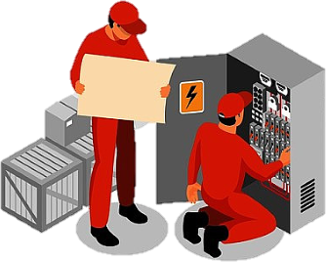

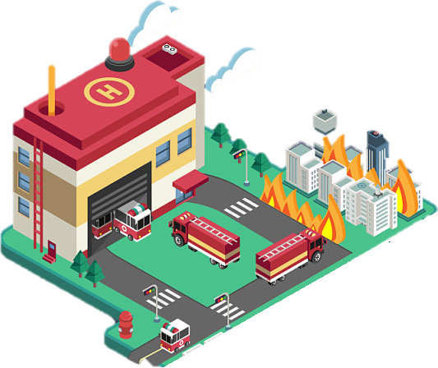
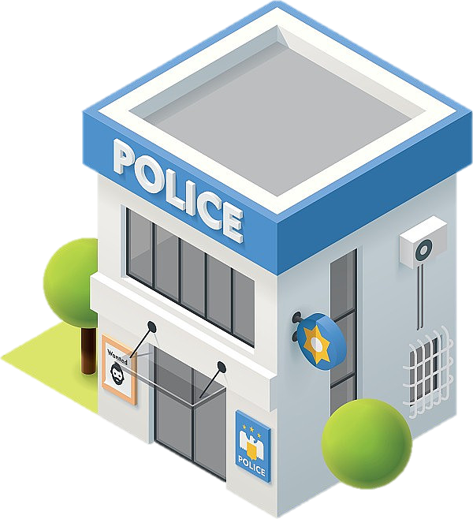
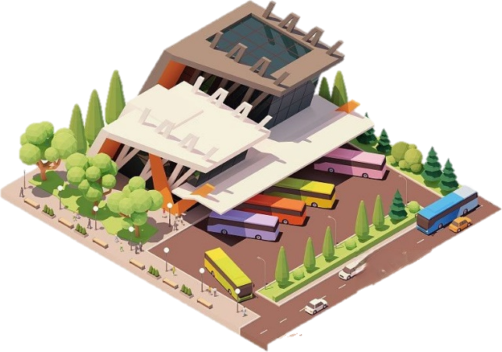
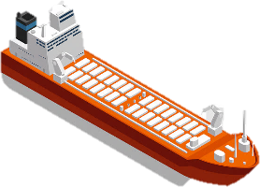
C · WHO PAYS FIRST
06
Start where the money and the fit are both highest: the utilities
INDUSTRY
ABILITY TO PAY
FIT WITH 450 MHZ
TIME TO REVENUE
WHY
1
Power
The utilities anchor 450connect in Germany and TNB in Malaysia; scattered assets need a private data path.
2
Water
Same sites and same IoT as power. Budgets vary: only 149 of 532 districts meet the 20% loss limit.
3
Emergency
The direct answer to the typhoon risk. Paid as standby readiness, not by usage.
4
Police
Large user base, but DMR and TETRA are already in service. The entry point is interoperability.
5
Rail
Corridor coverage suits the band, but the rail network is limited and projects run long.
6
Port
Coverage over water is an advantage, but there is no 450 MHz port deployment to point to yet.
GREEN ROWS = ANCHOR CUSTOMERS
Our reading, to be tested in the pilot. Three dots = strongest. Police has the largest budget but the slowest path to revenue.
Source: Hytera assessment; 450 MHz Alliance, Annual Global Update (Dec 2025) p8-p9; LWUA NRW data (2025)

Slide 3

C · PRIORITY 1 OF 6 · POWER
07
Power is the anchor customer - as it is for 450connect in Germany and TNB in Malaysia
121
electric cooperatives under NEA serve the rural grid
1.4M
electricity consumers without power after Typhoon Tino, Nov 2025
WHAT 450 MHZ DOES
1
A private data path for SCADA, feeder automation and substations
2
Push-to-talk, video and lone-worker alarms for line crews
3
Smart meters on the same sites, reaching boxes deep indoors
Line crews on a repair job. Illustrative imagery.
PROOF POINT
WHAT GLOBE SELLS
Germany: 450connect, Band 72, more than 95% national coverage. Malaysia: TNB, Band 31, initial deployment in four areas.
A capacity package for the cooperative, IoT connectivity per meter, and SCADA integration and O&M.
Source: NEA; Department of Energy (5 Nov 2025); 450 MHz Alliance, RFI for devices (2025) p5, Annual Global Update (Dec 2025) p8

