Slide 1


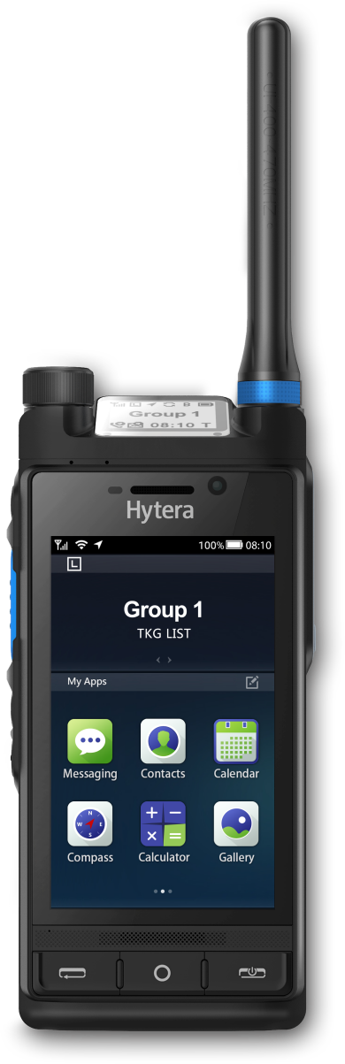
HYTERA × GLOBE TELECOM
450 MHz Mission-Critical
Network for the
Philippines
A coverage and resilience layer for utilities,
public safety, transport and remote communities.
Philippines · October 2026
Terminal · Network · Application
Notes:
Thank you for the time today. Globe has already answered the commercial question - you hold 450 MHz spectrum. What we want to discuss is what to do with it. This is a working session, not a proposal. I will take about fifteen minutes across five sections: the case for the band, the six industries it serves, the end-to-end architecture, the reference cases, and the business model. Please interrupt at any point.

Slide 2

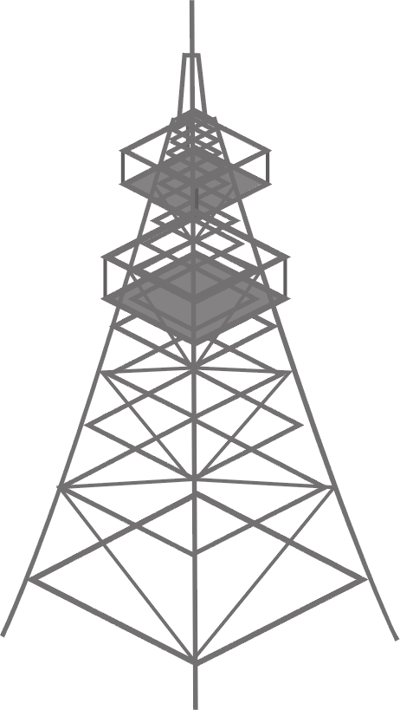
Islands, mountains and typhoons
02
THE GAP
Public 4G and 5G reach the cities. What is missing is coverage that is still there after the storm.
7,641
#1
7,641 islands.
One grid has to reach
across all of them.
islands, much of the terrain mountainous
WorldRiskIndex 2025 - highest disaster risk
~20
1.4M
tropical cyclones enter PAR every year
households lost power in Typhoon Tino
Mountains, storm landfall and
2,000 km of sea between
the islands.
450 MHz is the layer that stays up. Coverage and resilience, not capacity - alongside Globe’s 4G and 5G, not instead of them.
Source: WorldRiskReport 2025; PAGASA; Philippine Statistics Authority
Notes:
Start with the geography, because it shapes everything. Seven thousand six hundred and forty-one islands, much of it mountainous. First in the World Risk Index, and around twenty tropical cyclones entering the area of responsibility every year. That has a specific consequence for network planning: the public network tends to fail at exactly the moment it is needed most. What is missing is not speed. It is coverage that is still standing after the storm.

Slide 3


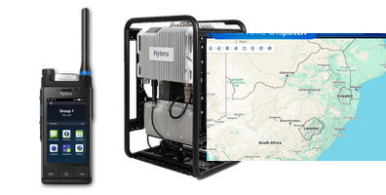
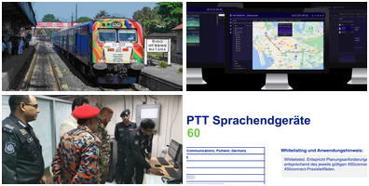
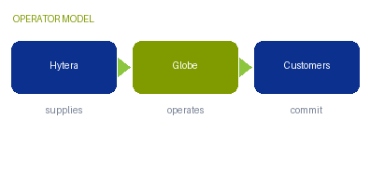
What we will cover
03
AGENDA
Five sections. The first two are the argument, the last three are the delivery.
01
02
03
04
05
Why 450 MHz & Hytera
Industry solutions
End-to-end architecture
Reference cases
Business model
Global trend, the band itself, and what MCS means
Power · Water · Police · Emergency · Rail · Port
Terminal · Network · Application
Global 450 MHz networks, and four customer cases
Who does what, six revenue streams, next steps
P4 – P6
P7 – P13
P14
P15 – P18
P19 – P21
One network, six industries. The same 450 MHz layer serves all of them, on the same sites.
Source: Hytera proposal structure
Notes:
Five sections. The first two are the argument - why this band, and what six industries do with it. The last three are the delivery - the architecture, the cases, and the business model. I will keep the industry section to one page each, so we can spend the time on the model at the end.

Slide 4
From a niche band to critical infrastructure
04
GLOBAL TREND
Regulators, utilities and public safety agencies have settled on what this band is for.
OUR POSITION
86%
Named at both ends of the chain
of the world’s population lives in countries where the 400 MHz bands are allocated or under consultation
The Alliance lists Hytera in its device supplier list and in its macro eNB supplier list.
39
Through operator acceptance
countries have already deployed networks in these bands, out of 77 with allocations at 380 / 410 / 450 MHz
PNC660 450M is whitelisted by 450connect to −115 dBm RSRP - the operator’s own document.
1.8M / 14M
A 5G-ready 450 MHz portfolio
broadband and sensor connections forecast by 2030, from 420k and 1.2M in 2026
Handheld, vehicle radio, base station and core, with a 5G model in development.
The band is no longer experimental. It is assigned, standardised in 3GPP, and carrying utility and public-safety traffic today.
Source: 450 MHz Alliance, Annual Global Update (Dec 2025) p4, p11, p12; Annual Equipment Report (May 2025) p5
Notes:
The world has settled on what this band is for. Eighty-six percent of the world's population lives where the 400 MHz bands are allocated or under consultation. Thirty-nine countries have already deployed networks, out of seventy-seven with allocations. The forecast is one point eight million broadband and fourteen million sensor connections by 2030. On our side: the Alliance lists Hytera in both its device and macro eNB supplier lists, and our handheld is through 450connect acceptance.

Slide 5
One site replaces several mid-band sites
05
WHY 450 MHZ
Low-band physics is the whole argument. The numbers below reuse one grid at three frequencies.
WHAT THAT BUYS
Bends around ridges and into valleys instead of needing line of sight
Reaches meter boxes, basements and tunnels that mid-band cannot
Fewer sites is what makes extensive backup power affordable
450 MHz
740 MHz
2350 MHz
1 site · 100% covered
2.5-3× sites · 91.3% from the same grid
12-15× sites · 58.7% from the same grid
Same area, same grid. Only the low band covers it with one site - which is what makes island and
mountain coverage affordable, and what makes extensive backup power affordable.
What it is not: with 3-5 MHz it carries voice, low-rate video and telemetry. It stays outside the capacity game.
Source: 450 MHz Alliance, Brief (Jun 2022) p15
Notes:
Low-band physics is the whole argument. Reuse one grid at a higher frequency and part of the area is left uncovered: ninety-one percent at 740 megahertz, fifty-nine percent at 2.35 gigahertz. Closing that gap costs two and a half to three times the sites. What it buys is diffraction around terrain, deep penetration, and a site count small enough to afford backup power. What it does not buy is capacity: at three to five megahertz, this is a voice, telemetry and low-rate video layer.

Slide 6



What MCS means - and how it sits on the band
06
THE SERVICE LAYER
Every case in this deck runs MCS. This page explains what it is, because the term carries the delivery.
HOW THE LAYERS STACK
3GPP mission-critical services (MCS / MCX)
Applications
MCPTT
dispatch, recording, device management
push-to-talk voice, with priority and pre-emption
MCVideo
MCS service layer
live and recorded video from the scene
MCPTT / MCVideo / MCData
MCData
messaging, file transfer and location data
LTE or 5G radio
Band 31 / 72 at 450 MHz
Defined by 3GPP, not by a single vendor - so the network stays multi-vendor and the
terminals are not locked to one supplier.
In this deck: the band carries the traffic, MCS provides the service.
450 MHz gives the coverage; MCS gives the service. The two are specified together, and the cases that follow run both.
Source: 3GPP mission-critical services; Hytera HyTalk MC platform documentation
Notes:
Before the industries, one definition, because every case later runs on it. MCS is mission-critical services: MCPTT for push-to-talk voice with priority and pre-emption, MCVideo for live video from the scene, and MCData for messaging and location. It is defined by 3GPP, not by a single vendor, so the network stays multi-vendor and the terminals are not locked in. The division of labour is simple: 450 MHz gives the coverage, MCS gives the service.

Slide 7
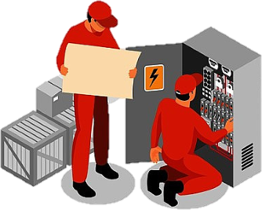

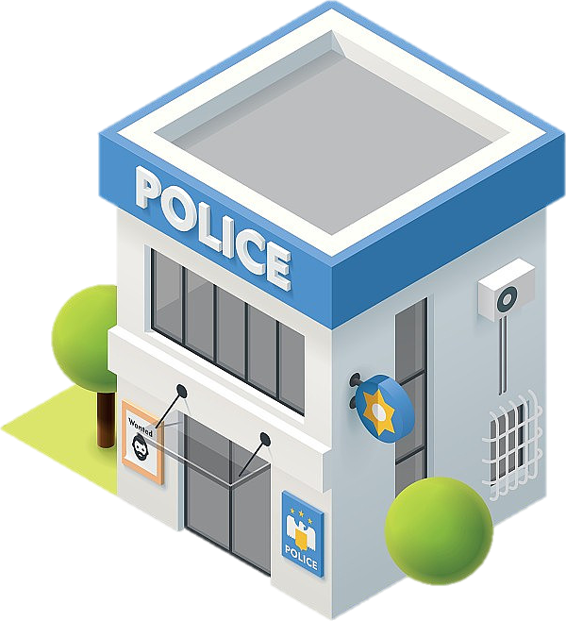
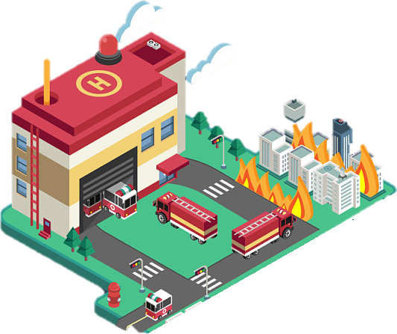
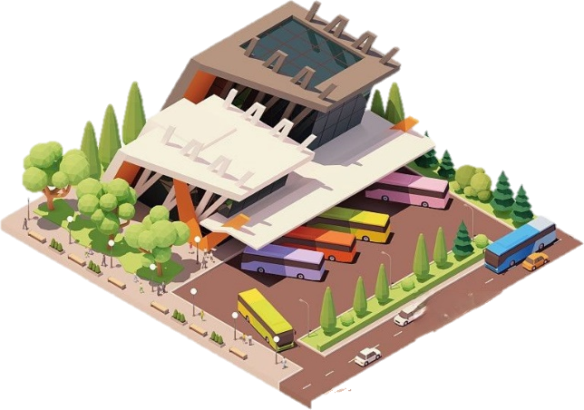
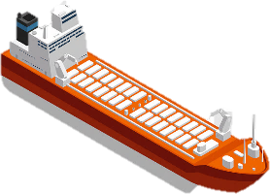
One network, six industries
07
INDUSTRY SOLUTIONS
The same 450 MHz layer serves all six, on the same sites. Each of the next pages takes one.
Power
Water
Police
Grid dispatch, feeder automation and smart metering
Metering, pressure sensing and reservoir telemetry
Cross-agency group calls and live video from the scene
Emergency
Rail
Port
Rapid deployment and coverage after the storm
Corridor coverage and train-to-ground voice and data
Quay dispatch, ship-to-shore and coast guard patrols
Utilities anchor it commercially. Public safety, emergency, rail and port add national value on the same sites.
Source: 450 MHz Alliance (Dec 2025); Hytera industry solutions
Notes:
The same network serves six industries, on the same sites. Power and water come first because they pay for reliability over a ten to fifteen year horizon. Police and emergency add national value, and they need interoperability more than they need another network. Rail and port are the two shapes mid-band handles worst: a narrow corridor, and a run out to sea. Each of the next six pages takes one of them.

Slide 8
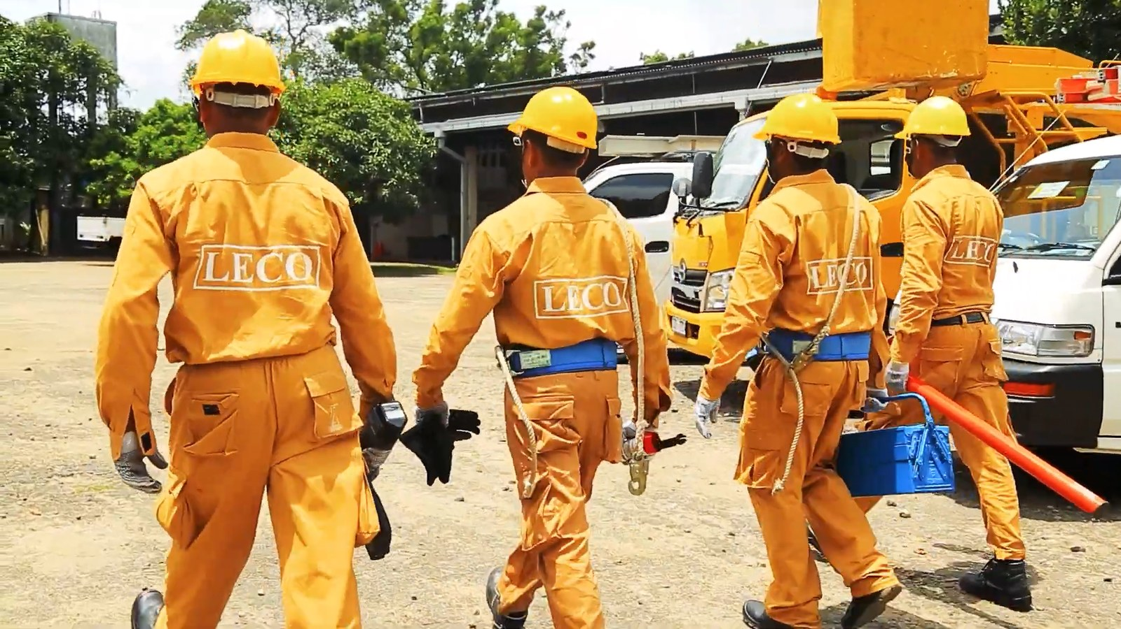

Power: the grid, the crews and the meters
08
INDUSTRY 1 OF 6 · POWER
Electric cooperatives have spread-out assets, a 10-15 year horizon and a willingness to pay for reliability.
PAIN POINT
Mountain and island lines have no reliable signal, and feeder automation needs a private data path that does not depend on the public network.
WHAT 450 MHZ DOES
Wide-area push-to-talk, video and lone-worker alarms along the lines
A private data channel for SCADA, feeder automation and substation control
Smart meters on the same sites, with deep indoor coverage
Grid repair crews and line assets. Illustrative imagery.
In the Philippines: 121 electric cooperatives under NEA.
Source: 450 MHz Alliance (Dec 2025); NEA; Hytera power industry solutions
Notes:
Power is where nearly every 450 MHz network starts, and it starts here for commercial reasons. One hundred and twenty-one electric cooperatives under NEA have assets spread across mountains and islands, they buy connectivity for ten to fifteen years, and they pay for reliability rather than speed. Three things run on the network: voice and lone-worker protection along the lines, a private data channel for SCADA and feeder automation, and smart meters on the same sites.

Slide 9

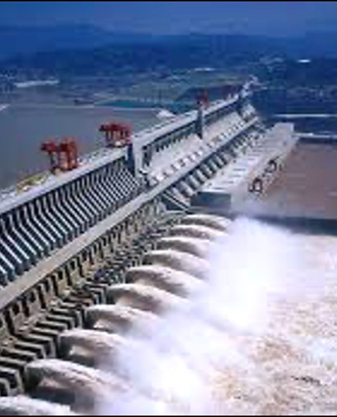
Water: locate the losses instead of estimating them
09
INDUSTRY 2 OF 6 · WATER
Non-revenue water is usually estimated, not located. Pump, well and reservoir sites sit exactly where mid-band cannot reach.
PAIN POINT
Most water districts know their losses as a percentage, not as an address - because the meters and pressure sensors cannot report.
WHAT 450 MHZ DOES
Meters and pressure sensors that locate losses instead of estimating them
Pump, well and reservoir telemetry from remote and underground sites
Backup-powered sites keep alarms flowing when the public network is down
Reservoir and pumping assets. Illustrative imagery.
In the Philippines: 149 water districts under LWUA.
Source: 450 MHz Alliance (Dec 2025); LWUA; Hytera water industry solutions
Notes:
Water is the same commercial logic with a different payoff. Most water districts know their losses as a percentage, not as an address, because the meters and pressure sensors cannot report. On this network they can: metering and pressure sensing that locate losses instead of estimating them, pump and reservoir telemetry from remote and underground sites, and backup-powered sites that keep alarms flowing when the public network is down. One hundred and forty-nine water districts under LWUA.

Slide 10

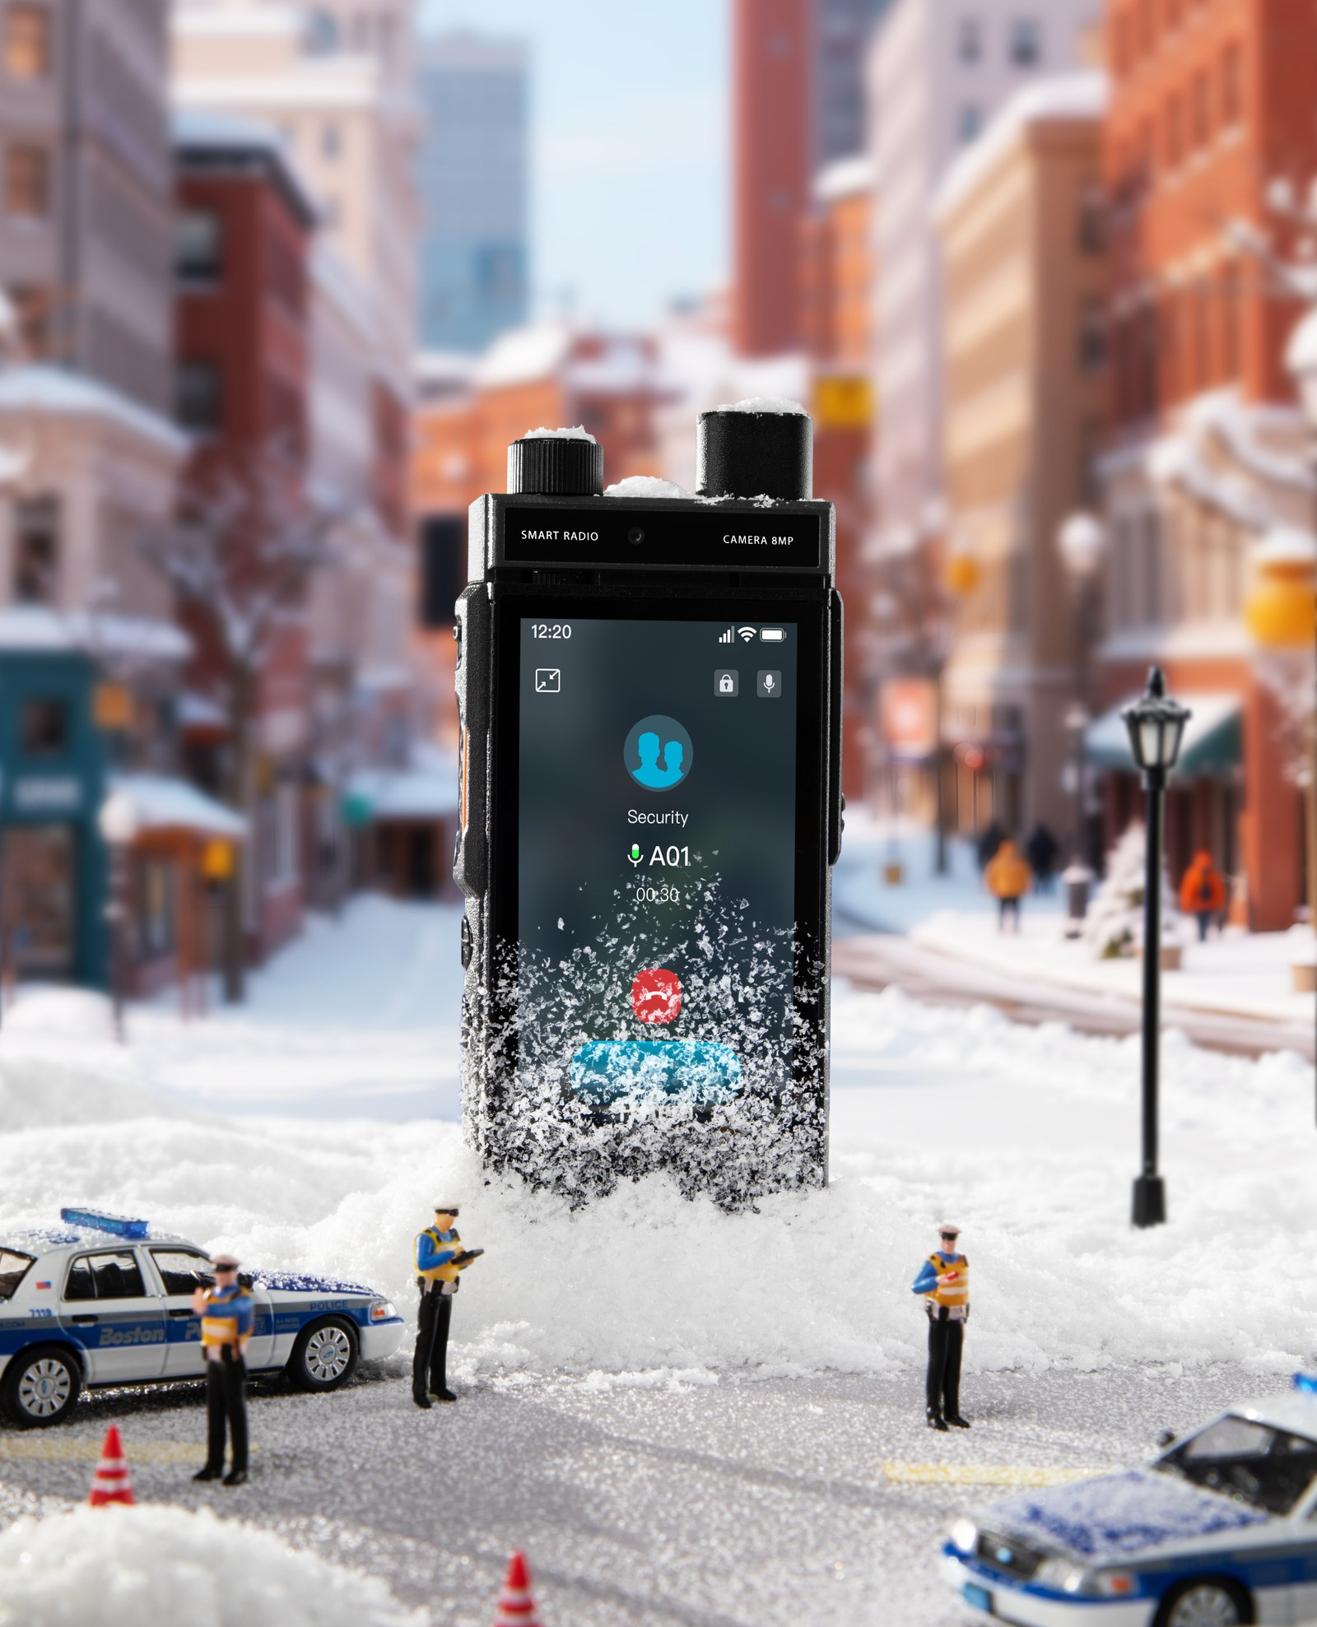
Police: one group call across the agencies
10
INDUSTRY 3 OF 6 · POLICE
The requirement is not another private network. It is interoperability between the agencies that already have one.
PAIN POINT
Different agencies cannot talk to each other, and the public network congests exactly at the moment it is needed most.
WHAT 450 MHZ DOES
One group call across police, fire and civil defence
Live video from the scene, with priority and pre-emption when the network congests
Interworking with the DMR and TETRA networks already in service
A district police station. Illustrative imagery.
Reference: Singapore has assigned 450 MHz band 31 to public safety, in service.
Source: 450 MHz Alliance, Annual Global Update p8; Hytera public-safety references
Notes:
For police, the requirement is not another private network - it is interoperability between the agencies that already have one. One group call across police, fire and civil defence. Live video from the scene, with priority and pre-emption when the network congests. And interworking with the DMR and TETRA networks already in service. Singapore has assigned 450 MHz band 31 to public safety, and it is in service today.

Slide 11

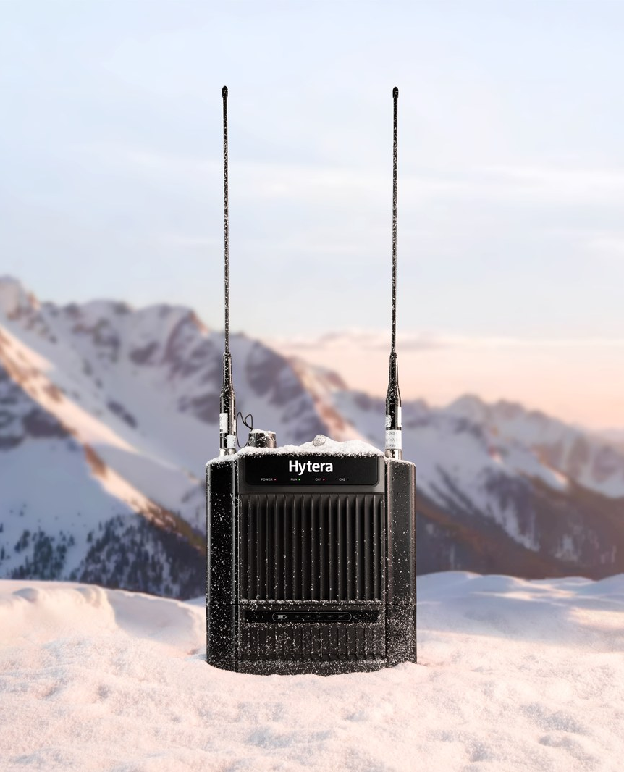
Emergency: coverage that survives the storm
11
INDUSTRY 4 OF 6 · EMERGENCY
After a typhoon the public network fails exactly where the response is needed. This is the layer that has to survive.
PAIN POINT
Rapid response needs communications within hours, not days - and it needs them where there is no grid and no backhaul.
WHAT 450 MHZ DOES
Portable base stations and satellite backhaul deployed within hours
A field command post that reaches the provincial EOC and the national agency
Sites that keep running on backup power when the grid does not
Fire, flooding and road clearance. Illustrative imagery.
Reference: rapid deployment kits and container command posts in service.
Source: Hytera emergency and rapid-deployment product documentation
Notes:
Emergency is where this band earns its name in the Philippines. After a typhoon the public network fails exactly where the response is needed, and rapid response needs communications within hours, not days. That means portable base stations and satellite backhaul deployed quickly, a field command post that reaches the provincial EOC and the national agency, and sites that keep running on backup power when the grid does not.

Slide 12

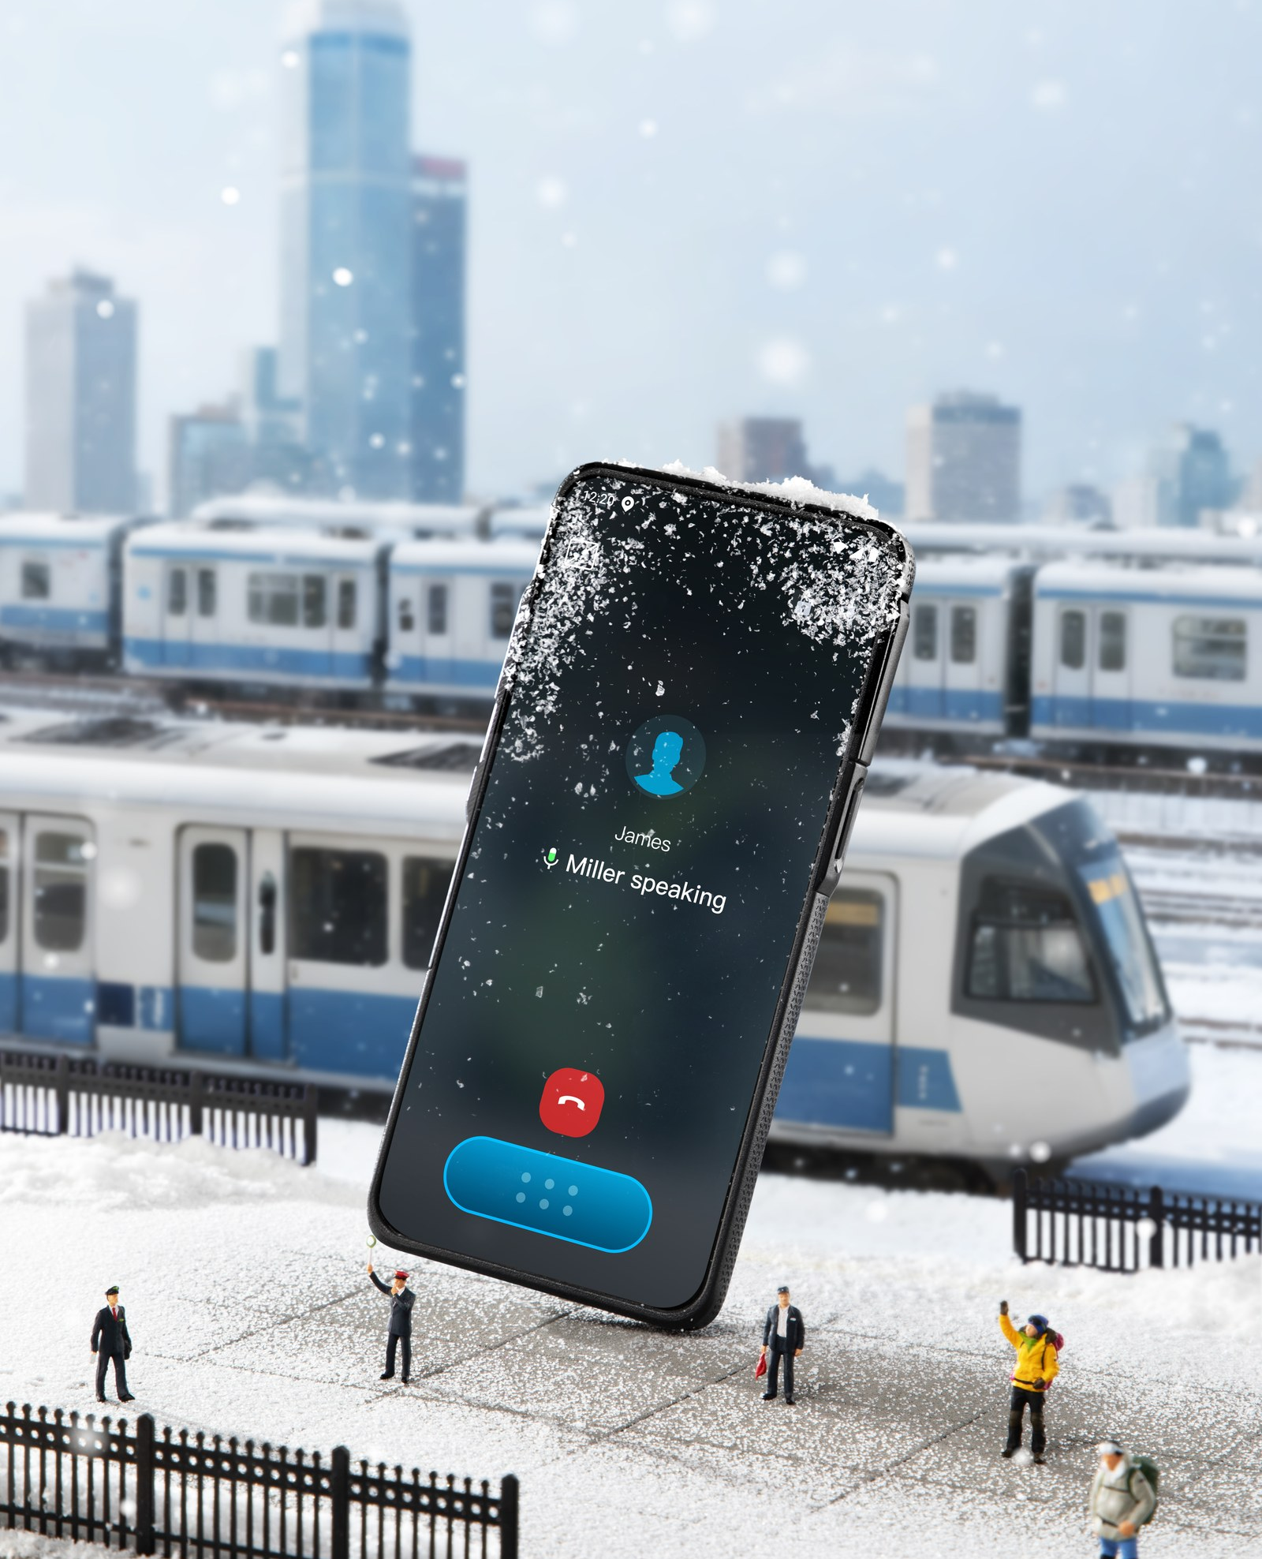
Rail: continuous coverage along a narrow corridor
12
INDUSTRY 5 OF 6 · RAIL
A rail corridor is a narrow strip, often in cuttings. It is one of the two shapes mid-band handles worst.
PAIN POINT
Coverage has to follow the track, not the population - so a network built for towns leaves the corridor uncovered.
WHAT 450 MHZ DOES
Continuous coverage along the corridor, including cuttings and tunnels
Train-to-ground voice, data and video for operations and security
Runs on the operator’s network rather than a separate private system
An interchange and a tunnel section. Illustrative imagery.
Reference: South Africa has assigned the band to Transnet for rail.
Source: 450 MHz Alliance, Annual Global Update 2025 p6; Hytera railway references
Notes:
Rail is a narrow strip, often in cuttings and tunnels, and coverage has to follow the track rather than the population. That is one of the two shapes mid-band handles worst. What it needs is continuous coverage along the corridor, train-to-ground voice, data and video for operations and security, and it should run on the operator's network rather than a separate private system. South Africa has assigned the band to Transnet for exactly this.

Slide 13

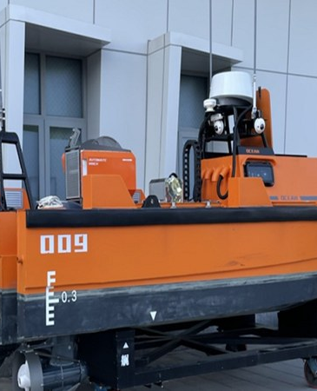
Port: from the quay out to sea
13
INDUSTRY 6 OF 6 · PORT
Ports are dense and metallic, and coast guard patrols run far beyond mid-band reach. One network covers both.
PAIN POINT
Quay operations, ship-to-shore traffic and patrol boats all need the same group call, across water and steel.
WHAT 450 MHZ DOES
Port and terminal dispatch on one group call across the quay
Ship-to-shore voice and data from coastal sites
Coast guard patrols covered far out to sea, on the same network as the port
A coastal terminal and a container command post. Illustrative imagery.
The same coastal sites also serve island and rural communities.
Source: 450 MHz Alliance (Dec 2025); Hytera transport and maritime references
Notes:
Port is the most literal fit for an archipelago. Quay operations, ship-to-shore traffic and patrol boats all need the same group call, across water and steel. Port and terminal dispatch on one group call, ship-to-shore voice and data from coastal sites, and coast guard patrols covered far out to sea on the same network as the port. The same coastal sites also serve island and rural communities.

Slide 14
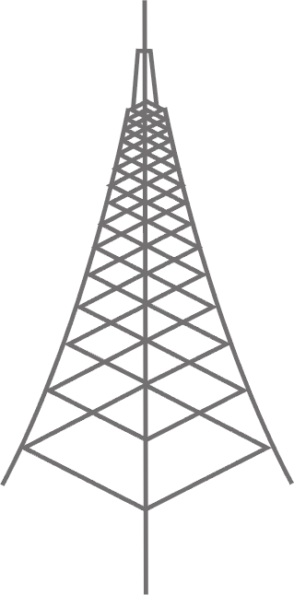



End to end: terminal - network - application
14
ARCHITECTURE
One architecture, in three layers. Each layer is described by what it contains, not by who supplies it.
TERMINAL
NETWORK
APPLICATION
What the field carries
Radio, core and backhaul
Dispatch, recording and management
PNC660 450M handheld
450 MHz macro eNB
MCS services
B31/B72, IP68, dual SIM
wide area coverage, few sites
MCPTT / MCVideo / MCData
MNC650 450M
Private core
Dispatch console
vehicle radio
or the operator’s own core
voice, video, GIS and presence
P70 5G+450M
Backhaul
Recording
radio-style handheld, 2026 Q4
fibre, microwave or satellite
multimedia capture and playback
PNC660Ex
Rapid deployment
Device management
ATEX variant, 2027 Q2
portable base station and satellite kit
zero-touch deployment
THE SAME ARCHITECTURE SERVES ALL SIX INDUSTRIES
Power
Water
Police
Emergency
Rail
Port
Only the terminals, the applications and the coverage area change. The network layer is the same build.
Source: 450M Roadmap; HyTalk MC V6.1; 450 MHz Alliance, Equipment Report (May 2025)
Notes:
One architecture, in three layers. At the terminal layer: the PNC660 450M handheld on bands 31 and 72, the MNC650 vehicle radio, a radio-style 5G model in the fourth quarter, and an ATEX variant next year. At the network layer: the 450 MHz macro eNB, a private or operator core, backhaul over fibre, microwave or satellite, and a rapid deployment kit. At the application layer: MCS services, dispatch, recording and device management.

Slide 15
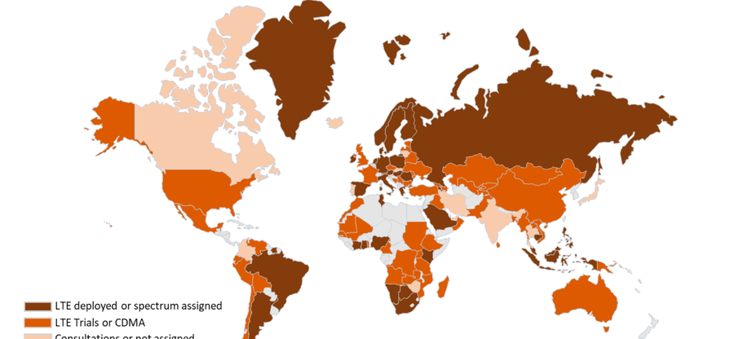
450 MHz operators worldwide: the model works
15
REFERENCE · 450 MHZ
Two things are the same in every market: a licensed operator carries the traffic, and utilities anchor the demand.
Germany
Band 72, nationwide utility network; more than 95% of Germany covered
450connect
Austria
Band 72; regional CDMA and LTE networks for utilities
ArgoNET
Poland
Band 31 and band 87; smart grid and field services
PGE / Polkomtel
Malaysia
Band 31; procurement for initial deployment in four regions
TNB
Indonesia
Rural connectivity and utility projects
SeaTelSat
South Africa
Band 31 allocated for rail, with wider use under discussion
Transnet
Figure 2. The world map of 380 MHz, 410 MHz and 450 MHz deployment.
Singapore
Band 31 allocated for public safety, in service
Public safety
The pattern is the same everywhere. A licensed operator carries the traffic; utilities and public safety anchor the demand.
Source: 450 MHz Alliance, Annual Global Update (Dec 2025) p7-p9, p14; RFI for devices (2025) p5-p7
Notes:
This is the model working, market by market. Germany: 450connect holds band 72 and covers more than ninety-five percent of the country. Austria: ArgoNET, band 72. Poland: PGE and Polkomtel. Malaysia: TNB is procuring for four regions. Indonesia: SeaTelSat for rural connectivity. South Africa: band 31 allocated to Transnet for rail. And Singapore: band 31 for public safety, in service. In every one of them, a licensed operator carries the traffic and utilities anchor the demand.

Slide 16

Sri Lanka Railways: a national network on public LTE
16
CASE 1 OF 3 · 450 MHZ LICENCE HOLDER
Nine lines and 403 stations on a public LTE network. Dialog, the operator, also holds Sri Lanka’s 450 MHz licence.
1,950+
MCS terminals delivered across the island network
9 / 403
lines and stations covered, in three provinces
450 MHz
the operator, Dialog, holds Sri Lanka’s 450 MHz licence
Sri Lanka Railways - the customer’s own network, photographed on site.
−10%
−60%
−40%
30 min
train delays
management cost
track repair time
landslide response
Source: Hytera showroom briefing (SRC-0134/0135) L211; Hytera PNC660 450MHz&MCX case records; 450 MHz Alliance, Annual Global Update p8 (Dialog holds the 450 MHz licence in Sri Lanka)
Notes:
This is the closest match to your model. Sri Lanka Railways runs mission-critical services across nine lines and four hundred and three stations, with more than one thousand nine hundred and fifty terminals - on a public LTE network rather than a separate private system. The measured outcomes are worth noting: train delays down ten percent, management cost down sixty, track repair time down forty, and a landslide alert handled in thirty minutes.

Slide 17
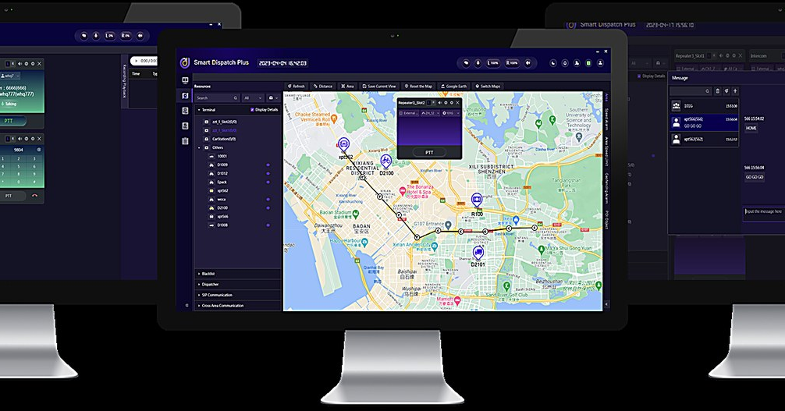
Hong Kong Light Rail: the first MCS over 5G
17
CASE 2 OF 3 · RAILWAY MCX OVER 5G
The world’s first railway MCS over 5G - replacing TETRA rather than overlaying it.
810
terminals: 511 handheld, 152 bus-mounted and 147 vehicle
5G
the world’s first railway MCS running over 5G
Full
redundancy, including the wireless links between sites
Illustrative operations imagery; the customer’s own site photography is not cleared for external use.
TETRA
Shared
Train-borne
One
replaced, not overlaid
operator core network and RAN
MCS-compliant dispatch
network for operations and security
Source: Hytera showroom briefing L170; Hytera PNC660 450MHz&MCX case records
Notes:
And the technical frontier. Hong Kong's Light Rail is the world's first railway MCS over 5G - eight hundred and ten terminals across handheld, bus-mounted and vehicle, with full redundancy including the wireless links. It replaced TETRA rather than overlaying it, and it shares the operator's own core network and radio access. That is where 450 megahertz and 5G complement each other, and it is the direction this market is moving.

Slide 18

Papua New Guinea: a national command centre
18
CASE 3 OF 3 · PUBLIC SAFETY
A police headquarters command centre on Hytera ICC, used for daily operations and for APEC summit security.
3,000
police officers and 600 police vehicles served by one centre
APEC
summit security: 15,000 foreign visitors and more than 200 meetings
360°
city-wide video surveillance, with protection around the clock
Illustrative operations imagery; the customer’s own site photography is not cleared for external use.
60 s
VIP
City-wide
24/7
police dispatch after the alarm bell rings
automatic vehicle route monitoring
emergency video communication
protection during the summit
Source: Hytera case records (Papua New Guinea Police HQ command centre), slides 2-4
Notes:
A public safety case, on the same platform. Papua New Guinea's police headquarters runs its national command centre on Hytera ICC - three thousand officers and six hundred vehicles, city-wide video, and dispatch within sixty seconds of an alarm. It was also the security platform for the APEC summit: fifteen thousand foreign visitors and more than two hundred meetings, with automatic VIP route monitoring. One command centre, serving routine operations and a summit-level event.

Slide 19
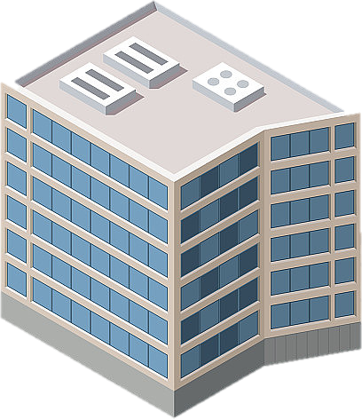
Who does what
19
BUSINESS MODEL
Three parties, one chain. The question is not whether the technology works, but who commits first.
Hytera
Globe Telecom
Anchor customers
supplies the radio, terminals, platform and integration
holds the spectrum, builds and operates the network, owns the customer relationship
utilities, public safety, transport and ports contract capacity before build-out
THREE WAYS TO CUT THE COST
Reuse what Globe already has
Far fewer sites for the same coverage
Contract the demand before the build
Towers, fibre, equipment rooms and power are already in place along the routes that matter.
The site count for the same area is a fraction of mid-band - which is what makes backup power affordable.
Anchor customers commit capacity first, so the network is built against revenue rather than in front of it.
The Alliance’s own assessment: the main risk in this band is commercial uptake, not deployment - which is why the sequencing matters more than the technology.
Source: 450 MHz Alliance, Annual Global Update (Dec 2025); Hytera proposal
Notes:
On the business model, three parties in one chain. Hytera supplies the radio, terminals, platform and integration. Globe holds the spectrum, builds and operates the network, and owns the customer relationship. The anchor customers - utilities, public safety, transport and ports - contract capacity before build-out. Three ways to cut the cost: reuse the towers, fibre, rooms and power Globe already has; take the site-count advantage of the low band; and contract the demand before the sites go up.

Slide 20

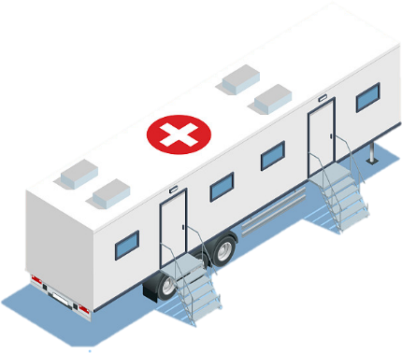
Six revenue streams on one network
20
BUSINESS MODEL
A single 450 MHz build supports six commercial lines. None of them depends on consumer take-up.
IoT connectivity
MCX as a service
Capacity packages
Monthly fee per meter, sensor or asset, on the same sites as the voice service.
Hosted push-to-talk, video and data, charged per user per month.
Reserved network share for an anchor customer, on a fixed annual fee.
Device as a service
Integration and O&M
Emergency readiness
Terminals bundled with the service, billed monthly rather than bought outright.
SCADA, telemetry and smart-city projects, delivered and maintained.
Rapid deployment kit on standby, retained by the province or the agency.
One build, six lines. The utility contract funds the coverage that the other five then use.
Source: Hytera proposal; 450 MHz Alliance business model material
Notes:
Six revenue streams on one build. IoT connectivity charged per meter or sensor. MCX as a service, per user. Capacity packages reserved for anchor customers. Device as a service, billed monthly. Integration and operations for SCADA and smart-city projects. And emergency readiness, with a rapid deployment kit on standby. None of them depends on consumer take-up - and the utility contract funds the coverage that the other five then use.

Slide 21
Roadmap: pilot first, then scale
21
NEXT STEPS
One typhoon-belt province, two anchor customers, and the data Globe needs for a national decision.
01
02
03
04
05
Confirm the spectrum
Pick the pilot region
Build the pilot
Prove the case
Scale nationwide
Band, bandwidth and licence term
One province, plus two anchors
Sites, platform, terminals, meters
Coverage, availability and cost data
Emergency, transport, smart city
What we need from Globe
Spectrum parameters
A candidate province
Anchor introductions
The band and bandwidth, so the coverage and capacity modelling is exact.
One region, ideally in the typhoon belt, where the gap is visible.
One electric cooperative and one water district willing to trial.
We are not proposing a build. The next step is a joint pilot design, so Globe can test the assumptions in its own terrain.
The technical case is settled. What decides the outcome is whether demand is contracted before build-out.
Source: Hytera proposal
Notes:
What we would need to go further is small. The band and bandwidth, so the coverage and capacity modelling is exact. One candidate province, ideally in the typhoon belt. And introductions to one electric cooperative and one water district willing to trial. The output would be coverage, availability and cost data measured against the public network. We are not proposing a build at this stage.

Slide 22
HYTERA × GLOBE TELECOM
Thank you
Mission First · Safety Always
Hytera × Globe Telecom · 450 MHz for critical infrastructure
and remote communities.
Next step: confirm the spectrum parameters and nominate a pilot region,
and we will design the pilot with you.
Hytera Communications Corporation Limited
Thank you for your time
Notes:
Thank you. To summarise: 450 megahertz is a coverage and resilience layer, not a capacity play. Utilities anchor it commercially, and public safety, emergency, rail and port add national value on the same sites. MCS is the service layer on top, and we are already through operator acceptance in Germany. The next step is confirming the spectrum parameters and nominating a pilot region.

