Slide 1

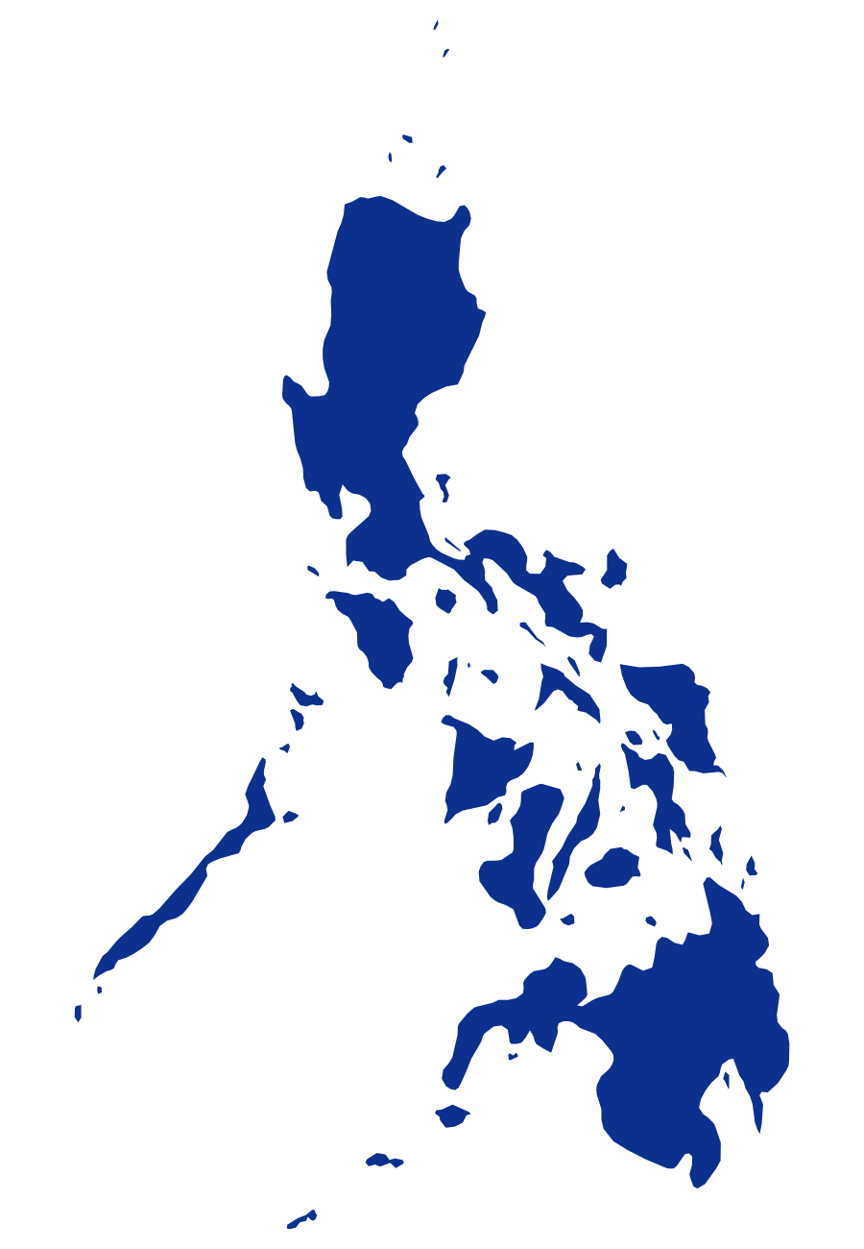

HYTERA × GLOBE TELECOM
Exploring Application
Scenarios for a 450 MHz
Mission-Critical Network
Coverage and resilience for utilities,
public safety and transport
Initial technical exchange · October 2026
Hytera Communications Corporation Limited
Notes:
Thank you for your time today. Globe already holds 450 MHz spectrum, so the interesting question is what it could be used for. Today is an exchange of ideas, not a proposal. We will look at four questions together, and please interrupt at any point.

Slide 2





AGENDA
02
Four questions for today’s discussion
01
02
03
04
CHAPTER 01
CHAPTER 02
CHAPTER 03
CHAPTER 04
450 MHz advantages
Target industries
Reference cases
Business model
What can this band do that mid-band cannot?
Who needs it, and who would pay first?
How is it built, and where does it run today?
How could the network pay for itself?
PAGES 3 – 6
PAGES 7 – 14
PAGES 15 – 19
PAGES 20 – 21
An open discussion: the spectrum is Globe’s; these are options to explore together.
Notes:
Four questions frame the discussion. First, what can this band do that mid-band cannot. Second, which industries need it, and who would pay first. Third, how such a network is built, and where it runs today. And fourth, how it could pay for itself. The spectrum is Globe's; these are options to explore together.

Slide 3



CHAPTER 01 OF 04
01
450 MHz advantages
01
02
Target industries
03
Reference cases
450 MHz advantages
What can this band do that mid-band cannot?
04
Business model
03
Notes:
Let us start with the band itself: what can 450 megahertz do that mid-band cannot?

Slide 4







01 POSITIONING
04
A scarce low band, best spent on B2B and B2G, not on consumer service
WHY NOT CONSUMER: THE CHANNEL IS NARROW
450 MHz (Band 31 / 72)
≈ 2×5 MHz
One typical LTE carrier
20 MHz
Critical infrastructure first
One typical 5G carrier (3.5 GHz)
100 MHz
THREE MORE REASONS
One 450 MHz cell covers a very large area, so this narrow channel
is shared by far more users than a mid-band cell.
No consumer handsets
Phones lack Band 31/72; devices are routers, meters, rugged handhelds.
FITS: B2B AND B2G
NOT FOR CONSUMERS
Licensed for critical infrastructure
Power, water, oil & gas, rail
Smartphone internet
Germany: energy & water. Singapore: public safety. South Africa: rail.
Emergency and public safety
Video streaming
Built for resilience, not consumer cost
IoT, SCADA, MCPTT
Home broadband
Long backup power (72 h at 450connect) and mission-critical priority.
Market signal: Norway’s ice began moving its 450 MHz consumer users to industrial service in 2024.
Source: 3GPP LTE / NR channel bandwidths; Bundesnetzagentur (Nov 2020, Mar 2021); 450 MHz Alliance, Equipment Report (May 2025) p4-p5; Annual Global Update (Dec 2025) p6-p9
Notes:
Before the industries, one point on positioning. 450 MHz is a scarce low band, and its value is in business and government use, not consumer service. The reason is simple: the channel is narrow. About two by five megahertz is a quarter of one ordinary LTE carrier, and one 450 cell covers a very large area, so that capacity is shared by many users. Consumer phones do not support the band, and Germany reserved it for critical infrastructure. Even Norway's ice moved its 450 consumers to industrial use.

Slide 5


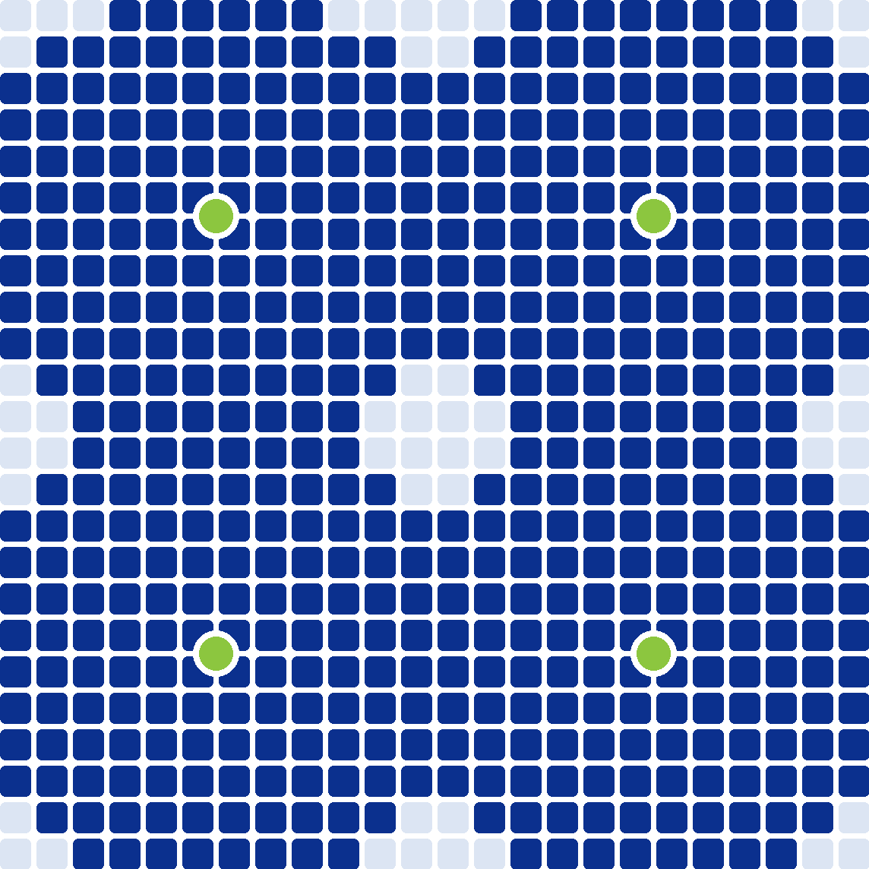




01 WHY 450 MHZ
05
Reach every island, cross the mountains, stay up through the storm
WHAT THE PHILIPPINES NEEDS
WHAT 450 MHZ DELIVERS · SAME SITE GRID
Reach far
450 MHZ
740 MHZ
2.35 GHZ
7,641 islands
One site where mid-band needs 2.5–15×
Cross rugged terrain
Mountainous island interiors
Bends over ridges and into valleys
100%
91%
59%
Survive the storm
#1 WorldRiskIndex · ~20 cyclones a year
covered
covered
covered
Few sites, so backup power is affordable
Baseline site grid
2.5–3× sites to close the gap
12–15× sites to close the gap
covered
not covered
site
Not a capacity layer: 3–5 MHz carries voice, telemetry and low-rate video, alongside 4G and 5G.
Source: NAMRIA; WorldRiskReport 2025; PAGASA; 450 MHz Alliance Brief (Jun 2022) p15, grid modelled at 410 MHz. Vs 410 MHz, 450 MHz adds ~1 dB path loss, 740 MHz ~7 dB (Hata).
Notes:
The Philippines asks three things of a network: reach more than seven thousand islands, cross mountainous terrain, and stay up through around twenty cyclones a year. On the right is the same site grid at three frequencies. At 450 the grid covers everything; at 740 megahertz about nine percent goes dark, at 2.35 gigahertz about forty-one percent. Fewer sites also makes backup power affordable. It is not a capacity layer: three to five megahertz carries voice, telemetry and low-rate video.

Slide 6




01 WHY NOW
06
The band is mainstream, and utilities lead the way
Russia
EUROPE
Armenia
Norway
Sweden
Finland
Tunisia
Bahrain
China
Mexico
Saudi Arabia
Philippines · Globe
Netherlands
Denmark
Cambodia
Ireland
Poland
Suriname
Ghana
Nigeria
Sri Lanka
Malaysia
Germany
Kenya
Singapore
Austria
Hungary
Brazil
Angola
Indonesia
Slovenia
Namibia
Italy
Spain
Greece
Argentina
South Africa
Utilities & industry 14
Public safety 8
Rail 1
Operator 12
Trial / consultation 17
86%
of people: allocated
or in consultation
77 / 39
countries with networks /
already on LTE
14M
sensor links by 2030,
plus 1.8M broadband
The common pattern: one licensed operator per country; utilities are the largest user group
Source: 450 MHz Alliance, Annual Global Update (Dec 2025) p4, p6-p9 country updates, p11-p12; countries coloured by main use
Notes:
The band is mainstream. Eighty-six percent of the world lives where it is allocated or under consultation, seventy-seven countries have networks, and thirty-nine already run LTE. The colours show what the networks are used for: dark blue is utilities and smart grid, which is the largest group. The pattern repeats: one licensed operator per country, and utilities are the largest group of users. The Philippines licence is Band 31, the same band as Malaysia and Singapore.

Slide 7

CHAPTER 02 OF 04
01
450 MHz advantages
02
02
Target industries
03
Reference cases
Target industries
Who needs it, and who would pay first?
04
Business model
07
Notes:
Second question: which industries need this network, and who would pay first?

Slide 8








02 WHO PAYS FIRST
08
Start with the utilities: they pay first and fit best
ABILITY TO PAY
FIT WITH 450
SPEED TO REVENUE
KEY POINT
1
Power
Proven anchor abroad
2
Water
Same sites as power
3
Emergency
Typhoon readiness
4
Police
Interoperate, not replace
5
Rail
Long project cycles
6
Port
No 450 MHz precedent yet
Green rows: the anchor customers
Our reading, to be tested with Globe
Source: Hytera assessment; 450 MHz Alliance, Annual Global Update (Dec 2025) p8-p9; LWUA NRW data (2025)
Notes:
Six industries can use this network, but they do not pay at the same speed. We rank power and water first: they have the budget, the fit is strong, and revenue comes quickly. Emergency is next, paid as standby readiness. Police budgets are large, but the path is slowest, because DMR and TETRA are already in service. Rail and port come later. This ranking is our reading, and we would like to test it against yours.

Slide 9






02 PRIORITY 1 OF 6 · POWER
09
Power anchors the network, as it does in Germany and Malaysia
121
1.4M
electric cooperatives
under NEA
consumers cut off
by Typhoon Tino
WHAT 450 MHZ DOES
SCADA &
feeder automation
Push-to-talk
for line crews
Smart meters,
deep indoors
Illustrative imagery
PROOF POINT
WHAT GLOBE SELLS
Germany 450connect
B72 · 90%+ area
Capacity package
IoT per meter
SCADA O&M
Malaysia TNB
B31 · 4 areas
Source: NEA; Department of Energy (5 Nov 2025); 450 MHz Alliance, RFI for devices (2025) p5, Annual Global Update (Dec 2025) p8
Notes:
Power is the anchor customer. There are one hundred and twenty-one electric cooperatives under NEA, and a single typhoon cut off one point four million consumers. The network gives them three things: a private data path for SCADA and feeder automation, push-to-talk for line crews, and smart meters deep indoors. This is exactly how 450connect in Germany and TNB in Malaysia started. For Globe it is a capacity package, IoT per meter, and integration.

Slide 10
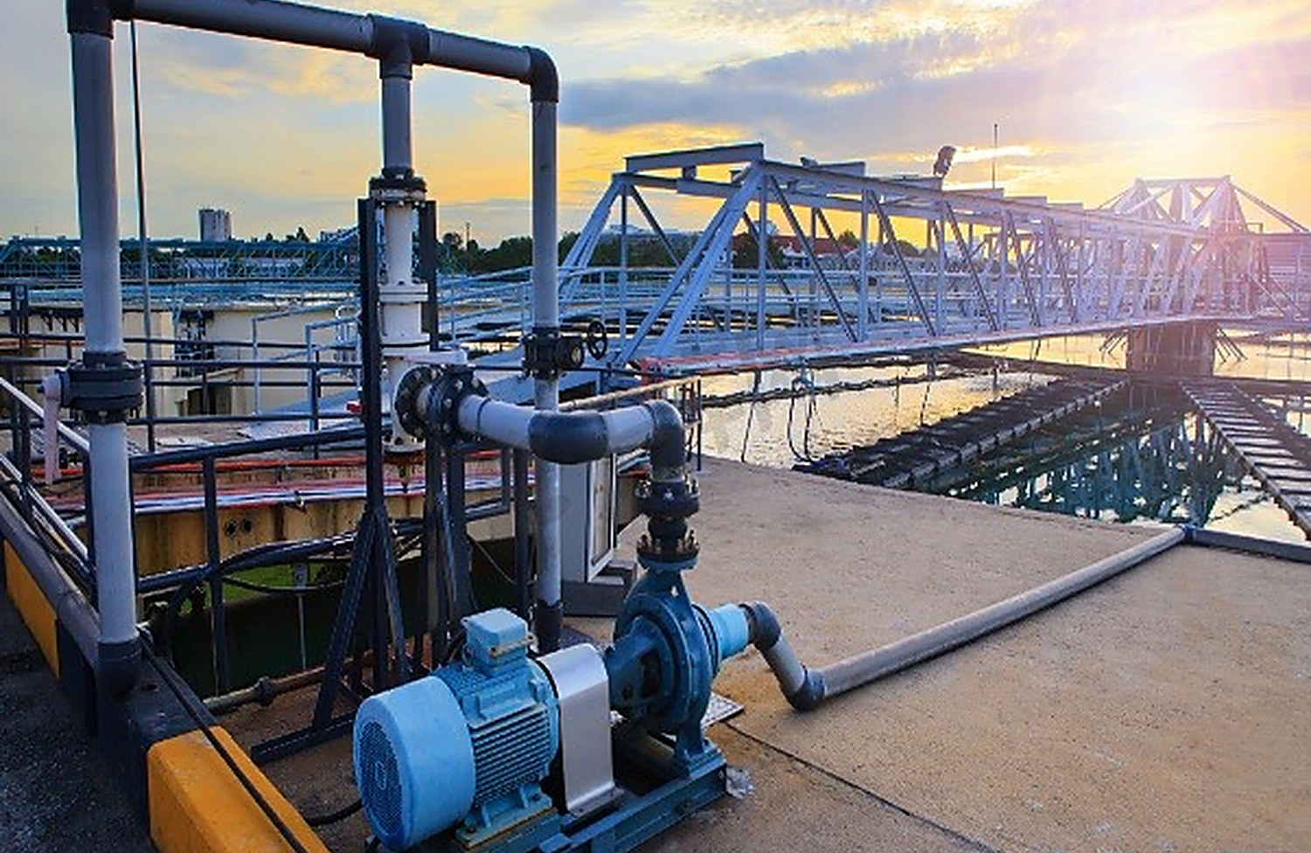

02 PRIORITY 2 OF 6 · WATER
10
Water: find the losses instead of estimating them
532
149
water districts
under LWUA
kept losses within
the 20% limit
WHAT 450 MHZ DOES
Meters that
report
Pressure sensing,
leak location
Pump & reservoir
telemetry
Illustrative imagery
PROOF POINT
WHAT GLOBE SELLS
Bahrain EWA
water-meter network
IoT per meter
Telemetry
Integration
Kenya
band reserved for utilities
Source: LWUA NRW data, end-2025 (reported Aug 2026); 450 MHz Alliance, Annual Global Update (Dec 2025) p6, p8
Notes:
Water uses the same sites as power with a different payoff. Of five hundred and thirty-two water districts, only one hundred and forty-nine kept their losses within LWUA's twenty percent limit. Most districts know their losses as a percentage, not as a location. On this network meters report, pressure sensors locate the leaks, and pump and reservoir sites send telemetry. Bahrain already runs a water-meter network in this band range.

Slide 11




02 PRIORITY 3 OF 6 · EMERGENCY
11
Emergency: the layer that has to survive the storm
#1
~20
WorldRiskIndex
2025
tropical cyclones
a year
WHAT 450 MHZ DOES
Deployed
within hours
Satellite
backhaul
Field command
post
Illustrative imagery
PROOF POINT
WHAT GLOBE SELLS
Indonesia SeaTelSat
B31 over satellite
Readiness retainer
Standby kits
MCX service
Hytera E-pack200
rapid-deployment kit
Source: WorldRiskReport 2025; PAGASA; 450 MHz Alliance, RFI for devices (2025) p5; Hytera product documentation
Notes:
Emergency is the industry that matches the typhoon risk most directly. When the public network fails, a 450 MHz layer with satellite backhaul can be extended within hours, with a field command post on the same network. In Indonesia, SeaTelSat is sourcing equipment for Band 31 rural LTE over satellite backhaul. For Globe this is a readiness retainer: kits on standby, paid by the province or the agency whether or not a storm comes.

Slide 12



02 PRIORITY 4 OF 6 · POLICE
12
Police: one group call across the agencies
Interop
Priority
with DMR and TETRA
already in service
when the public
network congests
WHAT 450 MHZ DOES
Cross-agency
group call
Live video
from the scene
DMR / TETRA
interworking
Illustrative imagery
PROOF POINT
WHAT GLOBE SELLS
Singapore
B31 · public safety
MCX per user
Devices as service
Integration
Russia Rostelecom
B31 · public safety
Source: 450 MHz Alliance, Annual Global Update (Dec 2025) p8-p9; Hytera public-safety references
Notes:
For police, the requirement is not another private network. It is one group call across agencies that already run DMR and TETRA, with priority when the public network congests. The network provides cross-agency group calls, live video from the scene, and interworking with the radio systems already in service. Singapore runs Band 31 for public safety today. For Globe it is MCX as a service, per user per month.

Slide 13


02 PRIORITY 5 OF 6 · RAIL
13
Rail: coverage that follows the track, not the towns
Corridor
Train
coverage, including
cuttings and tunnels
to ground voice,
data and video
WHAT 450 MHZ DOES
Dispatch
along the line
On-board
video
One network,
not a private one
Illustrative imagery
PROOF POINT
WHAT GLOBE SELLS
South Africa Transnet
B31 for rail
MCX per user
Devices as service
Capacity
Hytera Sri Lanka
MCS on 9 lines
Source: 450 MHz Alliance, Annual Global Update (Dec 2025) p6; Hytera showroom briefing L211
Notes:
Rail needs coverage that follows the track, not the towns, including cuttings and tunnels. A 450 MHz corridor gives dispatch along the line and on-board video on one network, rather than a separate private system. South Africa has assigned Band 31 to Transnet for rail, and our own MCS runs on nine lines in Sri Lanka. For Globe this is MCX as a service and devices as a service.

Slide 14



02 PRIORITY 6 OF 6 · PORT
14
Port: the case rests on coverage over open water
Quay
Coastal
to open sea on
one group call
sites also serve
island communities
WHAT 450 MHZ DOES
Quay
dispatch
Ship-to-shore
voice & data
Coast guard
patrols
Illustrative imagery
PROOF POINT
WHAT GLOBE SELLS
Precedent
no 450 MHz port yet
MCX per user
Capacity
Coastal coverage
Basis
low-band reach over sea
Source: 450 MHz Alliance reports (no port deployment listed); Hytera transport and maritime references
Notes:
Port is the last on our list, and we will be candid: there is no 450 MHz port network to point to yet. The case rests on coverage over open water: quay dispatch, ship-to-shore voice and data, and coast guard patrols on one group call. The same coastal sites also serve island communities. For Globe it is MCX as a service plus capacity, if the data supports it.

Slide 15
CHAPTER 03 OF 04
01
450 MHz advantages
03
02
Target industries
03
Reference cases
Reference cases
How is it built, and where does it run today?
04
Business model
15
Notes:
Third question: how is such a network built, and where does it run today?

Slide 16






03 HOW IT IS BUILT
16
One build serves all six industries; only terminals and apps change
Terminal
Network
Application
Fixed site · RRU5800M
Mobile site · iBS3800
PNC660 450M
handheld
RRU5800M
on tower, Band 31
MCS
PTT · video · data
MNC650 450M
vehicle radio
BBU5801M
baseband in shelter
Dispatch
voice, video, GIS
P70 5G+450M
2026 Q4
iBS3800
mobile, Band 31
Recording
playback
PNC660Ex
ATEX, 2027 Q2
Core
private or shared
Device mgmt
zero-touch
MCS
HYTERA
a 3GPP standard: runs on any LTE or 5G radio
Alliance-listed device and eNB supplier; 450connect whitelisted
Source: 450M Roadmap; RRU5800M Product Description V3.5.01 §6.5; iBS3800 Product Description V3.0; MNC650 EU DoC (B31/B72); HyTalk MC V6.1; Alliance Equipment Report (May 2025) p5
Notes:
One build serves all six industries. Only the terminals and the applications change. At the terminal layer: the PNC660 450M handheld, a vehicle radio, and a 5G plus 450 model coming in 2026. At the network layer: fixed eNodeBs on towers, mobile eNodeBs for rapid deployment, a private or shared core, and backhaul. On top sit the mission-critical services. MCS is a 3GPP standard and runs on any LTE or 5G radio, so it carries over to 450 MHz unchanged.

Slide 17



03 ECOSYSTEM AND COMPATIBILITY
17
A 450 MHz Alliance member, built to plug into the network Globe runs
IN THE 450 MHZ ECOSYSTEM
COMPATIBLE BY DESIGN · 3GPP STANDARD INTERFACES
450 MHz Alliance member
Hytera terminals
Joined August 2024
LTE Uu
Alliance device and macro eNB supplier lists
Globe’s existing core
Hytera 450 MHz eNB
Equipment Report 2025
S1
EPC / 5GC from
Operator-accepted terminal
Huawei
450connect whitelist, Germany (below)
Hytera MCS platform
ZTE
SIP / MCX
Nokia
Band 31 and Band 72 portfolio
Ericsson
Terminals, eNB and MCS platform
Multi-vendor by standard
The Alliance’s eNB list itself spans Ericsson, Huawei, Hytera, Nokia and ZTE.
For Globe: add Hytera radio and terminals without replacing the core you run today. Interoperability is verified per project.
Source: Hytera news release (Aug 2024); 450 MHz Alliance, Equipment Report (May 2025) p5 §4.1-4.2; 450connect whitelist; 3GPP TS 36.300 / 36.413 / 23.280
Notes:
We are part of the 450 MHz ecosystem, not a newcomer to it. Hytera joined the 450 MHz Alliance in 2024 and is on its supplier lists for both devices and macro base stations, and our handheld is accepted on 450connect's network in Germany. Just as important for Globe: everything is built on 3GPP standard interfaces, so our radio and terminals can plug into the core you already run, whether that is Huawei, ZTE, Nokia or Ericsson. Interoperability is verified for each project.

Slide 18
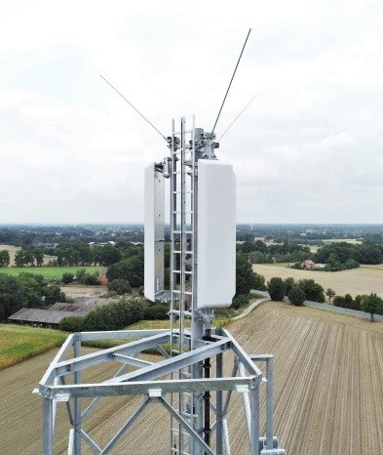


03 REFERENCE · GERMANY
18
450connect: one nationwide 450 MHz network, shared by Germany’s utilities
1,000+
10,000+
sites live (Oct 2025), ~1,600 planned
substations connected (Feb 2026)
70+
72 h
energy and water utilities behind it, via 4 equal shareholders
battery backup; data plus MCPTT voice with dispatch
Nokia
PNC660
radio, core, backhaul and power backup; O&M to 2040
Hytera handheld whitelisted (announced MWC 2026)
COVERAGE
90%+
of Germany’s area
by Q4 2025
FROM LICENCE TO NETWORK
Nov 2020
Mar 2021
Oct 2025
2026
Band 72 · 2×4.74 MHz · licence to 2040
Band reserved for energy & water
Licence awarded
1,000 sites, 90% area
Nationwide target
For Globe: one operator, one network, many utility customers — and no consumer service.
Source: Bundesnetzagentur (Mar 2021); Nokia (Feb 2022); 450connect press releases (Feb 2025, Oct 2025, Feb 2026); 50komma2 (Feb 2026); Hytera MWC 2026. Photo © Westfalen Weser Netz GmbH, via 450connect
Notes:
The best-documented 450 MHz network is Germany's 450connect. The regulator reserved the band for energy and water in 2020 and licensed 450connect in 2021, to 2040. Seventy-plus utilities stand behind it; Nokia supplies the network. During 2025 coverage rose from thirty to over ninety percent of Germany, on a thousand sites with seventy-two hours of backup, and over ten thousand substations are connected. One operator, one network, many utilities, no consumer service. Our PNC660 is on its whitelist.

Slide 19








03 REFERENCES
19
Three 450 MHz networks, three national mission-critical deployments
450 MHZ NETWORKS · OPERATOR NETWORKS
GERMANY
MALAYSIA
SINGAPORE
450connect
TNB
Public safety
B72
B31
B31
national utility network
utility network
public safety network
90%+ area (Q4 2025)
Phase 1: 4 areas
In service
PNC660 whitelisted
Phase 2 tendering
Same band as PH
HYTERA MISSION-CRITICAL DEPLOYMENTS AT NATIONAL SCALE
SRI LANKA
HONG KONG
PAPUA NEW GUINEA
Railways
Light Rail
Police HQ
1,950+
810
3,000
MCS terminals
MCS terminals
officers served
9 lines, 403 stations
1st railway MCS on 5G
APEC security
Dialog: 450 licence
Replaced TETRA
60 s dispatch
Top row: operator networks; Hytera’s link is the 450connect whitelist. PNG photo is illustrative.
Source: 450 MHz Alliance, Annual Global Update (Dec 2025) p7-p9; RFI for devices (2025) p5; 450connect whitelist; Hytera showroom briefing L170, L211; PNG case records
Notes:
Two kinds of evidence, three of each. Top row: 450 MHz operator networks. 450connect covers over ninety percent of Germany, with our PNC660 on its whitelist. TNB in Malaysia is rolling out Band 31, and Singapore's public safety network runs on Band 31, the same band as yours. Bottom row: our own mission-critical deployments. Sri Lanka Railways with one thousand nine hundred and fifty terminals, Hong Kong Light Rail, the first railway MCS on 5G, and the Papua New Guinea police command centre.

Slide 20
CHAPTER 04 OF 04
01
450 MHz advantages
04
02
Target industries
03
Reference cases
Business model
How could the network pay for itself?
04
Business model
20
Notes:
Last question: how could the network pay for itself?

Slide 21




04 BUSINESS MODEL
21
Utilities fund the coverage; every other industry builds on it
Hytera
Globe Telecom
Anchor customers
Radio, terminals, platform
Spectrum, network, customers
Contract capacity first
SIX REVENUE LINES · AND WHO BUYS THEM
IoT connectivity
MCX as a service
Capacity packages
Power · Water
Police · Rail · Port
Power · Port
Devices as a service
Integration & O&M
Emergency readiness
Police · Rail
Power · Water
Emergency
Sign demand before the build: Portugal’s 450 MHz trial stalled on commercial terms, not technology
Source: Hytera proposal; 450 MHz Alliance, Annual Global Update (Dec 2025) p9
Notes:
Three parties, one chain. Hytera supplies the radio, terminals and platform. Globe holds the spectrum, runs the network and owns the customer. The anchor customers contract capacity first. Utilities fund the coverage, and the other industries build on it: six revenue lines, each tied to an industry page you have seen. The lesson from Portugal is simple: the 450 MHz trial there stalled on commercial terms, not on technology. So the sequence matters: contract the demand before the build.

Slide 22

HYTERA × GLOBE TELECOM
Thank you
FOR DISCUSSION
Band and bandwidth
Which industries matter most
Where coverage is needed first
Mission First · Safety Always
Hytera Communications Corporation Limited
Notes:
Thank you. To open the discussion, three questions we would value your view on: the band and bandwidth you are considering, which industries matter most to Globe, and where coverage is needed first. We are happy to follow up with a technical workshop for your network planning team if that is useful.

