Slide 1
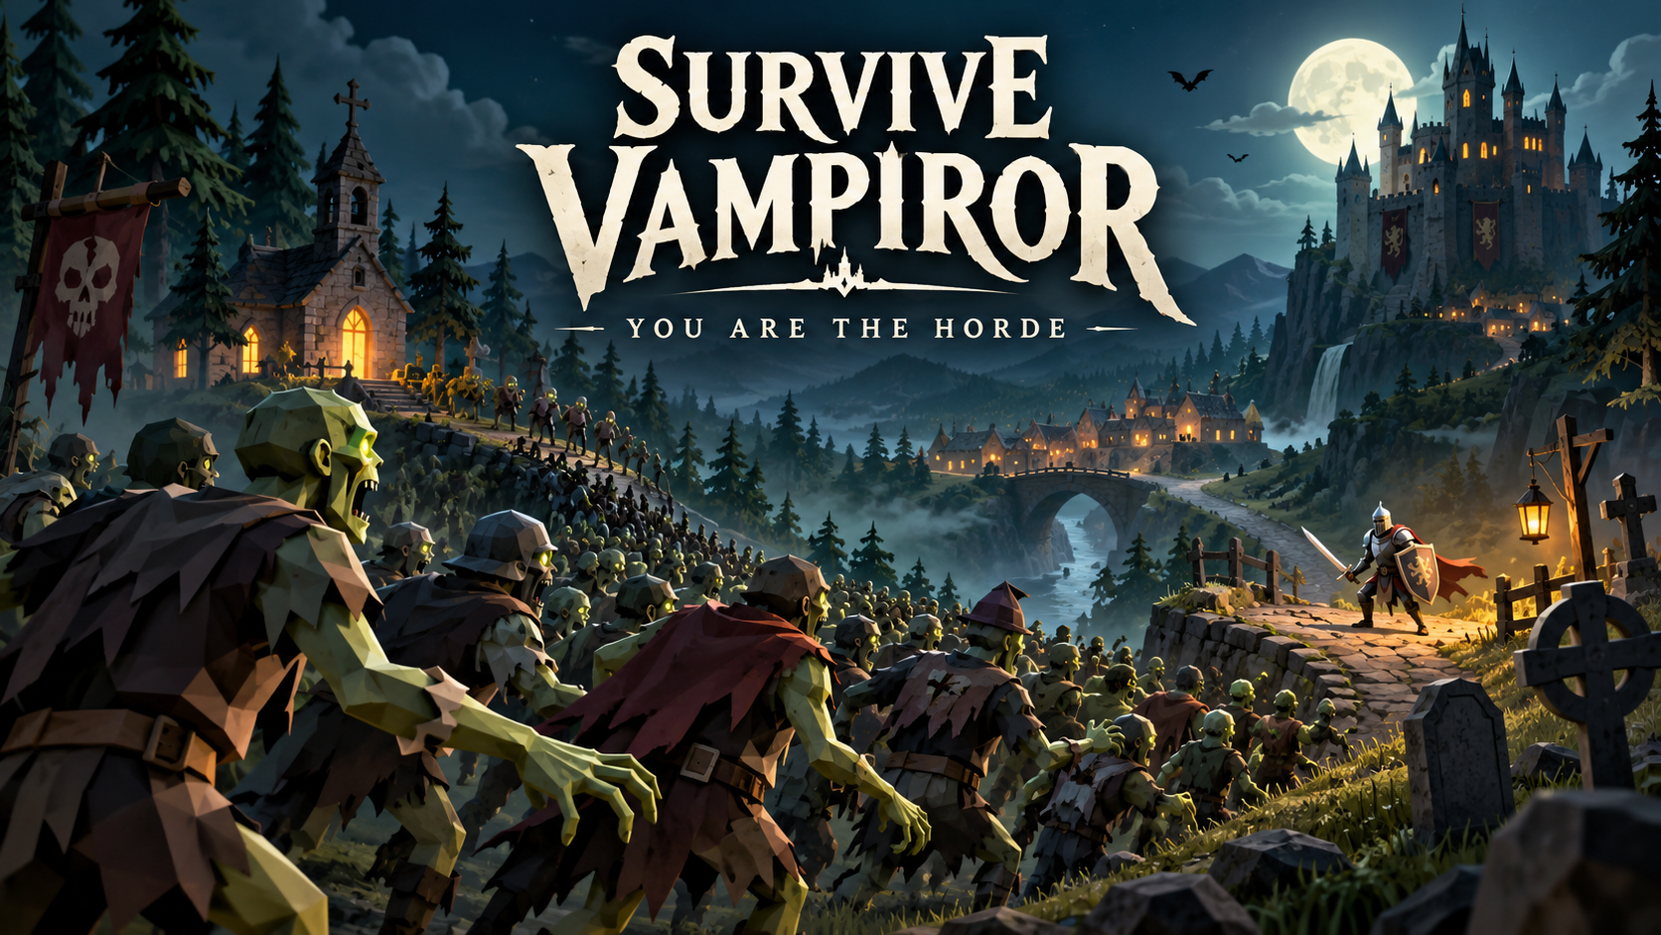
SURVIVE
VAMPIROR
You are the horde
A browser strategy game
by meatPigeon
Notes:
Survive Vampiror puts you in command of forty zombies. The goal is to carry your horde through five locations and conquer the kingdom. Cover art is an AI-generated promotional illustration, not gameplay footage.
Source: https://github.com/meatPigeon/survive-vampiror-web, campaign implementation and release notes, 11 October 2026. Screenshots show the local development build.

Slide 2
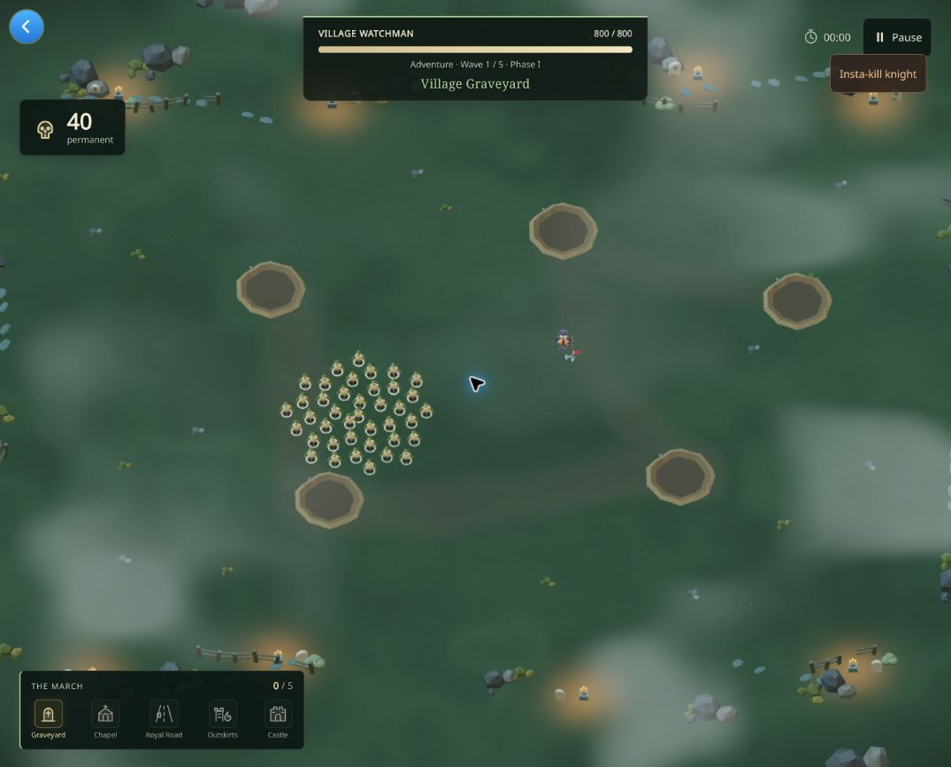
Forty zombies. One shared lifeline.
You steer the entire horde.
Zombies bite automatically.
Keep at least one permanent
zombie alive to continue
the march.
Notes:
The central decision is positioning. You move the whole group around the knight’s warnings, then close in while the defender recovers. Every permanent zombie you save carries into the next battle.
Source: https://github.com/meatPigeon/survive-vampiror-web, campaign implementation and release notes, 11 October 2026. Screenshots show the local development build.

Slide 3
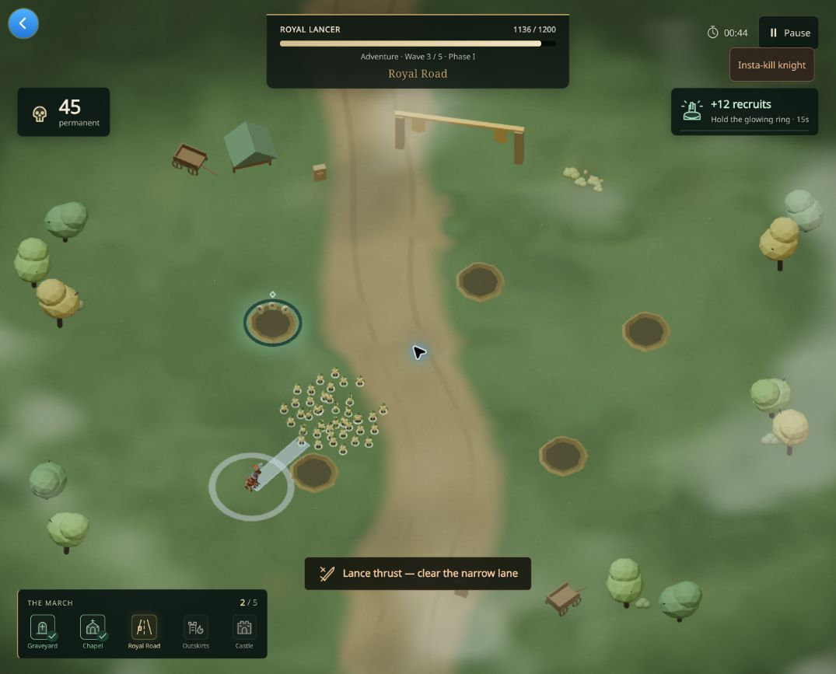
Temporary allies change the tactics
Recruit at scattered craters
Turn temporary recruits
into passable corpse mines.
Choose abilities and perks
between battles.
Notes:
Recruitment gives you expendable allies without replacing the permanent horde’s importance. Mines consume temporary recruits, and other zombies can walk through them. Nine perks support different approaches.
Source: https://github.com/meatPigeon/survive-vampiror-web, campaign implementation and release notes, 11 October 2026. Screenshots show the local development build.

Slide 4
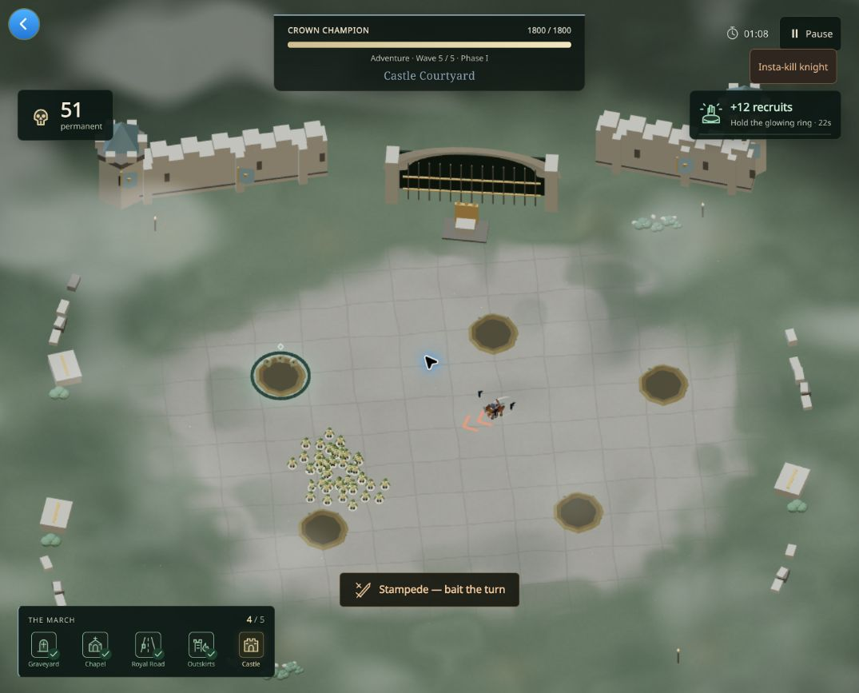
A kingdom worth conquering
Village Graveyard
Village Chapel
Royal Road
Fortress Outskirts
Castle Courtyard
5 defenders
10 knight attacks
Notes:
The campaign makes progress visible in the land itself. Each new arena brings a different defender and attack pattern. Irregular terrain, drifting clouds, flying creatures and occasional rain give the locations atmosphere.
Source: https://github.com/meatPigeon/survive-vampiror-web, campaign implementation and release notes, 11 October 2026. Screenshots show the local development build.

Slide 5
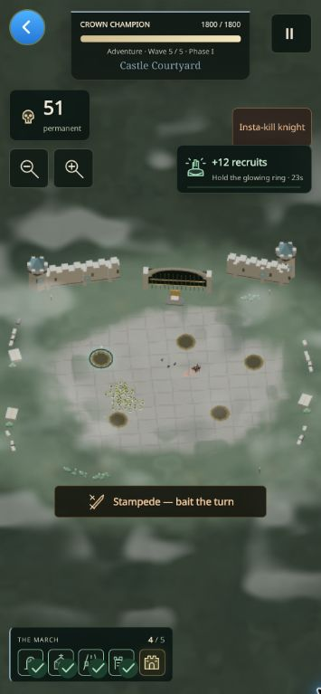
Built for a browser audience
Click, keyboard or touch controls
Cloud checkpoints and location retries
Adventure and Relentless difficulty
Remappable controls and motion settings
Five-location browser release
83 automated tests passed
Notes:
The game runs on the iDos host with Three.js and React. Players can continue a checkpoint and retry a location with the horde they brought into it. The release candidate passed 83 tests and real DEV save and Solana authentication checks. Version 8 is live. Physical device testing remains outstanding.
Source: https://github.com/meatPigeon/survive-vampiror-web, campaign implementation and release notes, 11 October 2026. Screenshots show the local development build.

Slide 6
Solana identity for your horde
Your wallet restores your march
HORDE on Solana
Sign an iDos login message.
Recover your campaign and records
on another browser.
No transaction fee to sign in.
Mainnet mint verified.
The token is separate from sign-in.
Gameplay stays open to guests.
Private cloud saves on iDos
Notes:
Implemented Solana Ed25519 signature authentication through the iDos SDK. Live DEV tests recover the same account in a fresh client and restore a paused forty-zombie checkpoint; invalid signatures are rejected. Saves are private off-chain iDos data. Guest and wallet accounts have separate saves. Standalone pages use installed Wallet Standard wallets; embedded games use the iDos bridge. No transaction or token purchase is required. HORDE mainnet mint verified via the Solana mainnet RPC: 9UB6DJsQncQoxQrBW8a6HyyDAfeWKoYN7WaHmukpidos. Source: https://solscan.io/token/9UB6DJsQncQoxQrBW8a6HyyDAfeWKoYN7WaHmukpidos . The game does not grant token rewards.
Source: https://github.com/meatPigeon/survive-vampiror-web, campaign implementation and release notes, 11 October 2026. Screenshots show the local development build.

Slide 7
The next march
Next development priorities
Play the game
Explore the source
Broader device and balance testing
More locations and enemy patterns
Community feedback and new content
idosgames.com/app/FYVPZFCO
github.com/meatPigeon/
survive-vampiror-web
Seeking playtest feedback and a community for the horde
Notes:
My next goal is to make the campaign hold up across devices and learn from real players before expanding it. Play version 8 at https://idosgames.com/app/FYVPZFCO/ and review the public source. Hosted browser verification is pending a local site-permission change; the compiled artifact passed local browser checks.
Source: https://github.com/meatPigeon/survive-vampiror-web, campaign implementation and release notes, 11 October 2026. Screenshots show the local development build.

