Slide 1
Variance
https://github.com/meatRay/RochDev_Variance
And promises to polymorphism
Presented by Shannon Cavanagh

Slide 2
Review
Back to basics…

Slide 3


Vocabulary
CO - variance
Contra - Variance
Interface<Base> = Interface<Derived>
Sure, that makes sense..
CO for “OK”
Interface<Derived> = Interface<Base>
To quote John Carmack.. “WTF?”
CONTRA for “Contradictory”
Notes:
Covariance is familiar like Ienumerable.
Covariance, as a property promise, follows traditional Object Polymorphism
Contravariance is a promise for a function, assigned to an object.
Contravariance follows function parameter polymorphism

Slide 4
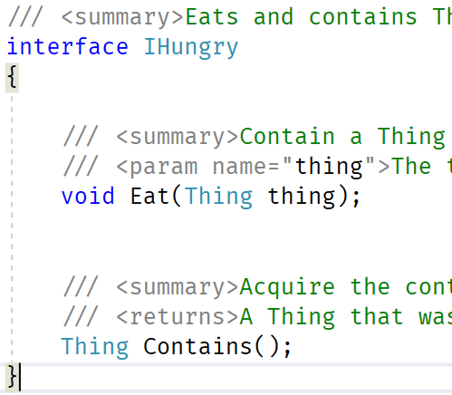
Interfaces
Not JUST a lighter class!
Promise for Functions
Promise for Properties (which are just cooler functions)
Promise dictates scope of boxing
Implicit Boxing can only happen in the correct direction
Objects INHERIT data
Objects IMPLEMENT functions

Slide 5
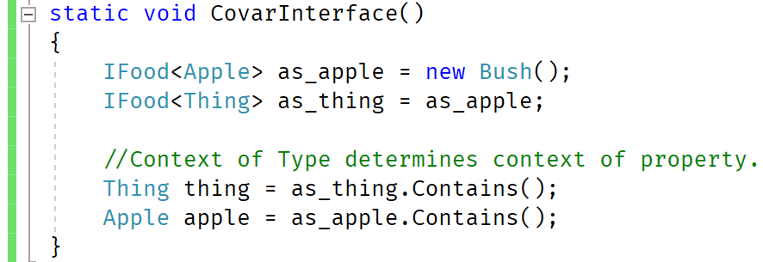
Covariance Example
Notes:
ALT + TAB

Slide 6
Covariance review
Covariant Interfaces follow expected “IEnumerable<T>” inheritance
Covariance can only be promised to returned values
Returned Values are propagating UP callstack
Returned Values can be implicitly boxed less derived UP callstack
Covariance does NOT make sense for parameters
Passed Values can not be implicity boxed more derived DOWN callstack

Slide 7
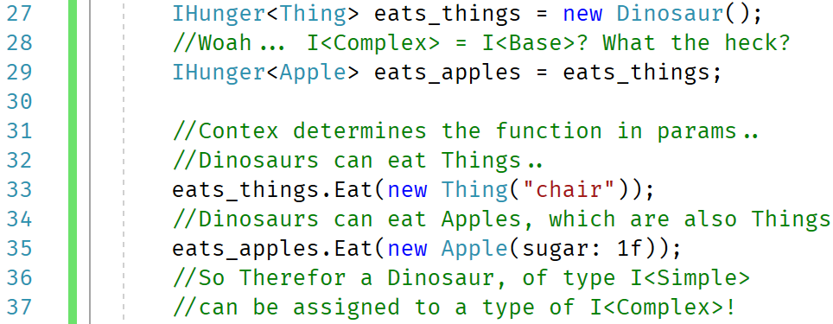
Contravariance Example
Notes:
ALT + TAB

Slide 8
Contravariance review
Contravariant Interfaces seem confusing from a Object oriented view
Contravariant Interfaces are promises on Functional views
Contravariant Interfaces are promises on Function Parameters
Contravariance can only be promised to passed values
Passed Values are propagating DOWN callstack
Passed Values can be implicitly boxed less derived DOWN callstack
Contravariance does NOT make sense for fields
Returned Values can not be implicity boxed more derived UP callstack

Slide 9
Bonus round
..and if you order now, we’ll include..
Notes:
Ask for Questions first.

Slide 10
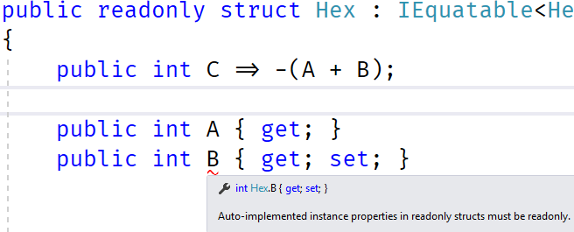
Property “Readonly”
Promise for immutable VALUE-TYPE
Cuts down on COPY instructions
Multithreaded optimizations
It’s just a good idea, ok??

Slide 11
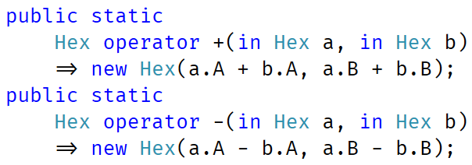
Parameter “IN”
Promise to not modify parameter
Objects may be copied to stack memory!
READONLY structs can be passed by ref!
Save copying large structs
REF structs could be mutable - gross

Slide 12
Generic Dependency Injection?
How far is too far?
Notes:
ALT + TAB, show off new features.

Slide 13
Variance
https://github.com/meatRay/RochDev_Variance
The end

