Slide 1
DRL-Based Dynamic Flexible Job Shop Scheduling in Spatially Constrained Environments
Michael Eaton (Student)
Dr. Michael Kuhl (Advisor)

Slide 2
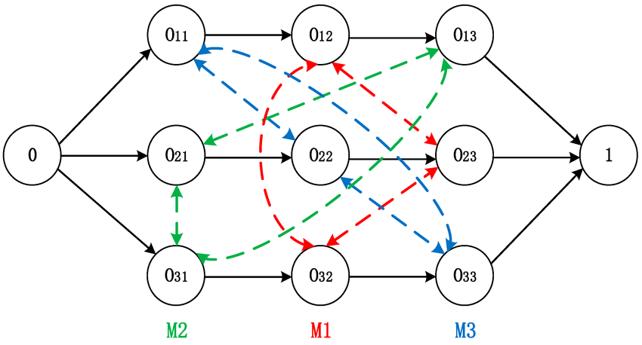
Background: DFJSP + DRL
n jobs with o operations, m machines
Assign job operations to machines to minimize total processing time (makespan)
DFJSP – more realistic
Markov Decision Process (MDP) for RL given by (S, A, P, R, γ)
[1, 2]
Notes:
Classical job shop: n jobs, m machines, minimize makespan
The "flexible" piece means one operation can run on multiple machine types, so machine assignment becomes a decision variable, not a fixed routing.
The "dynamic" piece is the one that actually drives the research: the factory changes mid-episode. Machines break down, new jobs arrive unpredictably, priorities shift. Any schedule you commit to at the start of an episode becomes stale the moment something disrupts it
That's why the field has moved toward DRL — instead of solving the full schedule combinatorially up-front, you train an agent to make one dispatching decision at a time, reacting to the current state of the floor

Slide 3
DES vs Unity
Machines as logical nodes; travel times are parameters (often triangular or uniform distributions).
Simulation clock jumps event-to-event. Continuous space between events is skipped entirely.
AGV modeled as a resource with a delay.
No native representation of: spatial congestion, acceleration/deceleration, aisle blocking, battery dynamics, path conflicts.
Result: schedules that are optimal in simulation but physically infeasible on a real floor.
Machines as positioned physical entities on an N×M grid.
Continuous physics tick; space between events exists and matters.
AGV has a kinematic model — rotate-then-translate, real acceleration, real pathfinding via NavMesh.
Congestion, routing conflicts, variable travel times are emergent properties of the environment, not hand-tuned parameters.
Deadlock-free routing via zone reservations (TrafficZoneManager) — the kind of thing you'd have to hand-code into Simio.
[4, 5, 6, 7, 8]
Notes:
DES tools, by construction, abstract away exactly the things this project cares about.
In Simio, an AGV is a resource with a travel time — usually drawn from a triangular distribution someone hand-tuned. The simulation clock jumps from one event to the next. Whatever happens in the continuous space between events — two AGVs approaching the same intersection, an aisle getting blocked by a broken-down vehicle, a battery depleting mid-route — is invisible to the simulator.
The result is a well-documented problem in the literature: schedules that look optimal in simulation and then fall apart when you try to execute them on a real floor
AGVs deadlock at intersections nobody modeled. Travel times balloon under congestion the simulator never saw.
What Unity gives me is the opposite construction. Machines have physical positions on a grid. AGVs have an actual kinematic model — they rotate before they translate, they accelerate, they path-plan on a NavMesh. Congestion isn't a parameter I tune — it's what happens when two vehicles try to use the same aisle.
In DES projects, AGV travel time is an input distribution you had to specify. In this project, it's an output of the simulation.

Slide 4
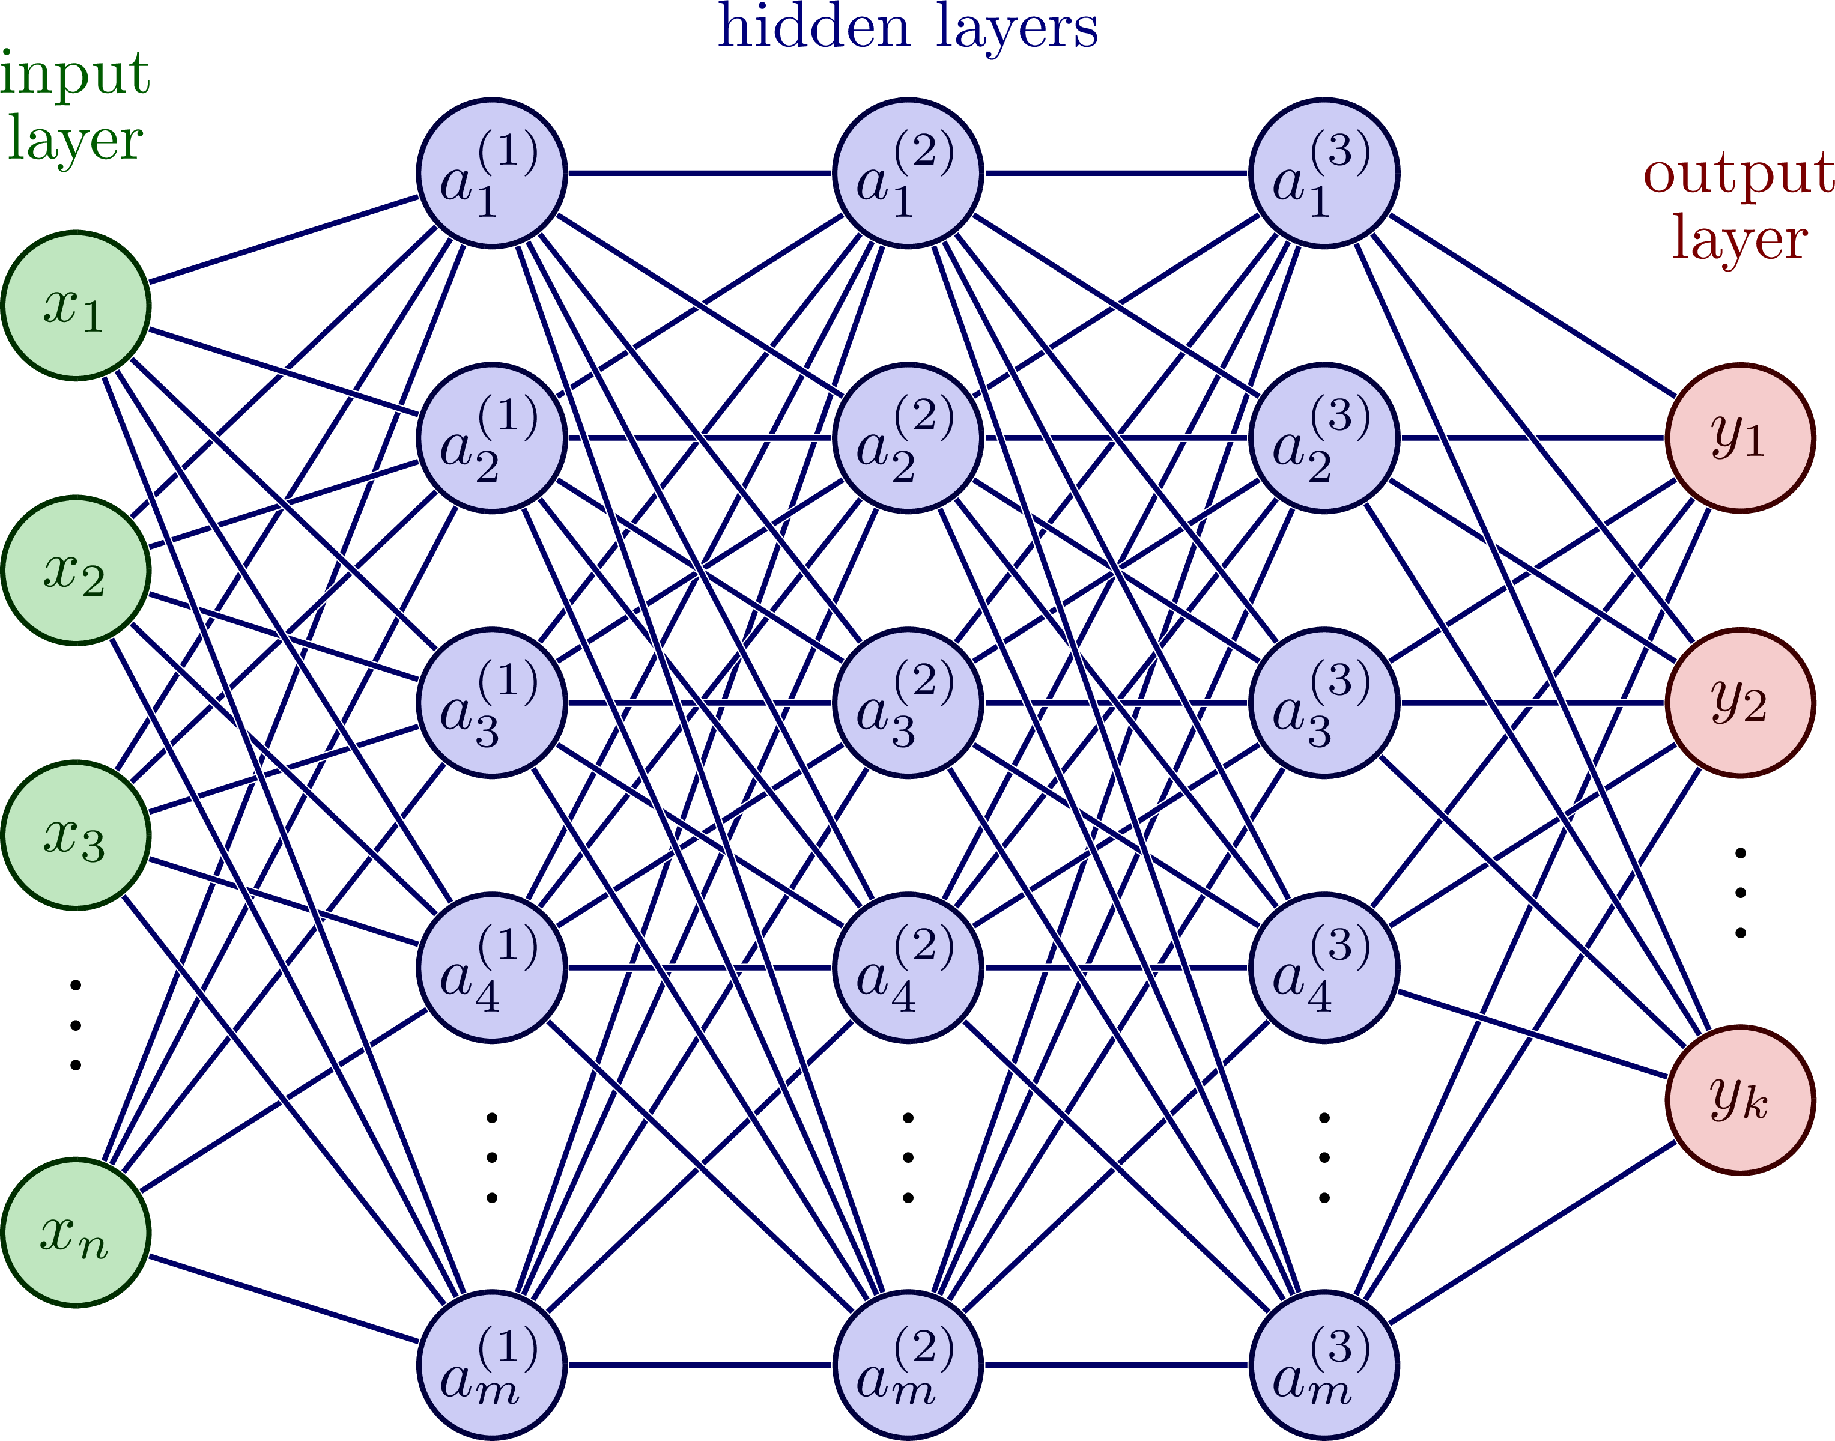
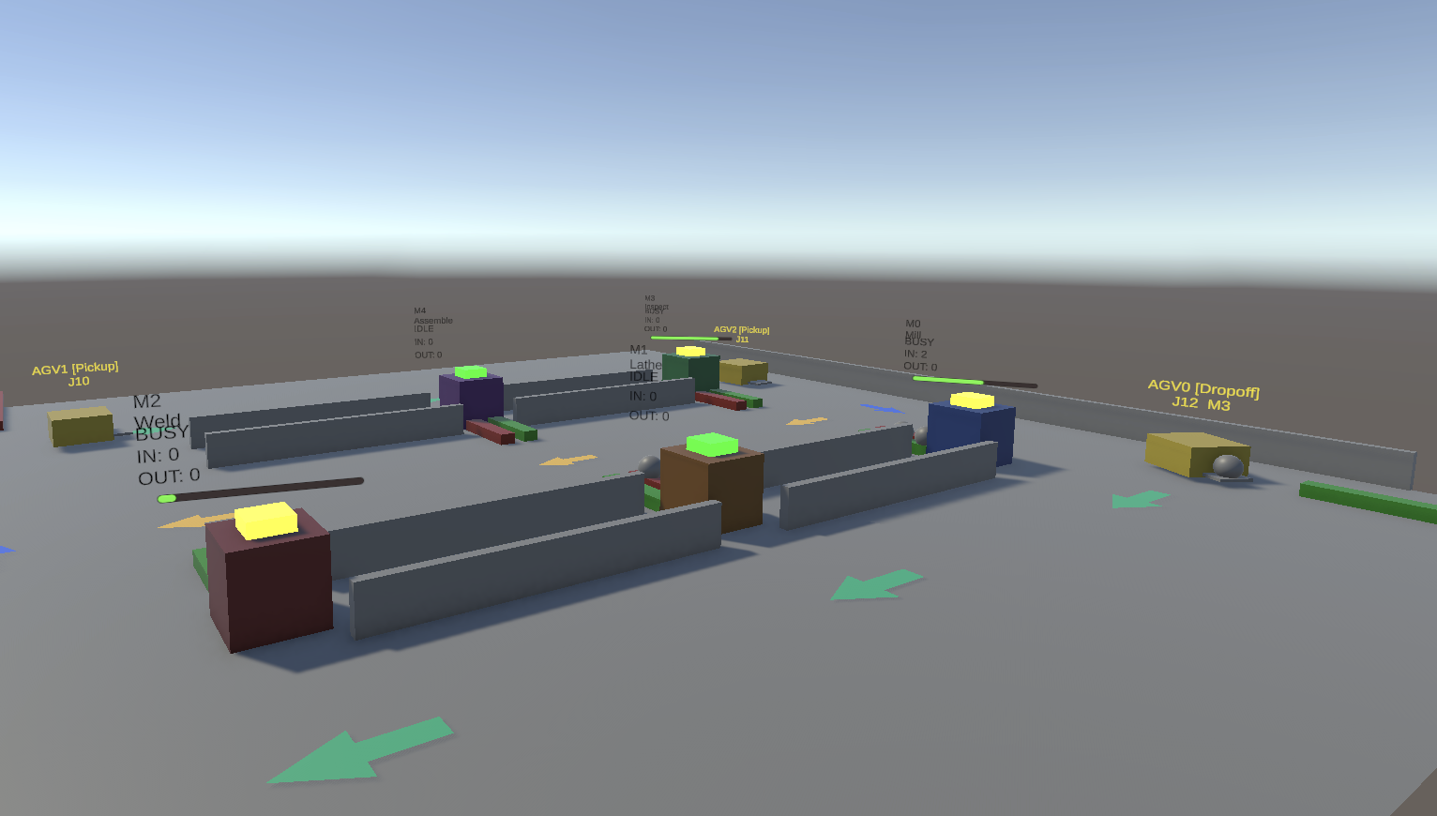
Project Overview
https://tikz.net/neural_networks/
Notes:
On the left in this slide is my Unity factory environment — AGVs navigating aisles between physical machines, jobs moving as tokens, live state overlays. On the right is the neural network that consumes observations from that environment.
The pipeline is: Unity simulates the physics, observations get extracted and sent via a Gymnasium-compatible API to Python, a multimodal neural network processes them, and the agent selects one of eight composite priority dispatching rules. What makes this novel is the bridge itself — to my knowledge no existing work combines a high-fidelity 3D physics simulation with a standard RL interface for the DFJSP. That combination is the primary contribution.

Slide 5
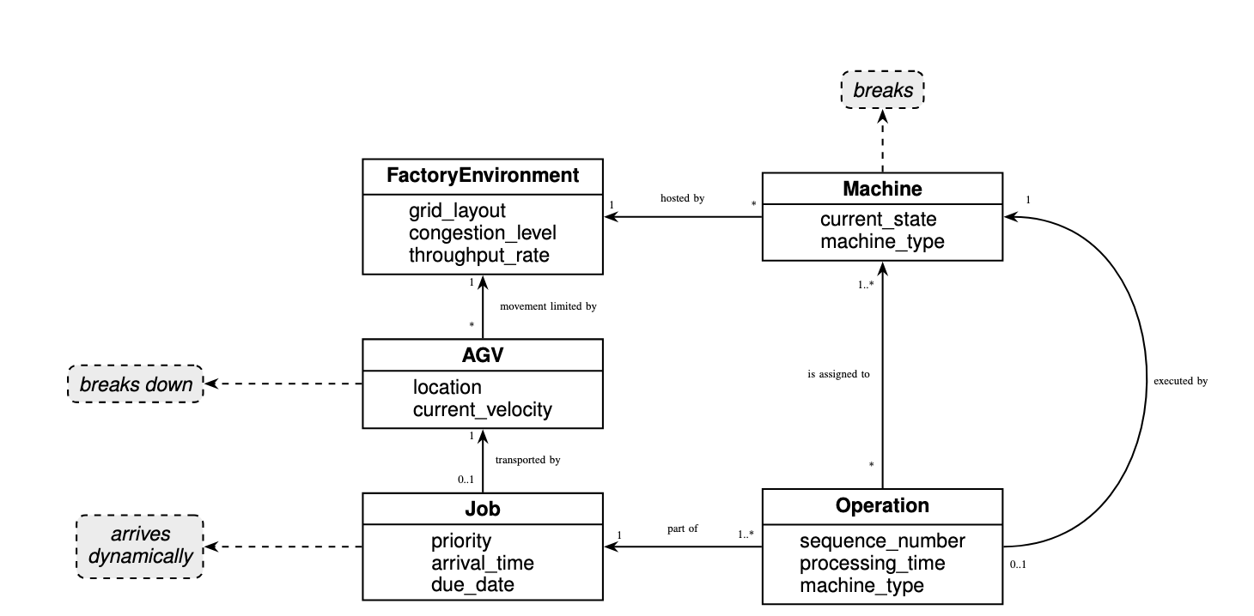
Domain Model
Notes:
The domain model is organized around the FactoryEnvironment as the aggregate root. It's an N-by-M grid that hosts every other entity
A Job is composed of ordered Operations, each requiring a specific machine type. Machines are stationary and cycle through four states — idle, processing, blocked, down
AGVs are the mobile entities that physically transport jobs between machines, subject to pathfinding and kinematic constraints
The key design point: the grid layout constrains AGV movement and makes congestion an emergent property, not a parameter. That's the structural shift from DES-based models.

Slide 6
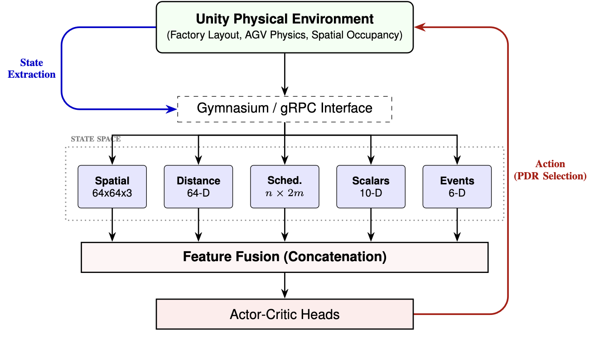
Architecture
Done:
Unity Environment (deterministic)
NN architecture
TODO:
Unity Environment (Stochastic)
Training
Notes:
This is the end-to-end picture. Unity on top generates the state. State extraction pulls observations across the Gymnasium/gRPC interface. Five parallel streams feed the state space — spatial grid, distances, scheduling matrix, scalars, event flags.
Those fuse via concatenation and feed actor-critic heads. The actor outputs a PDR selection, which loops back into Unity as an action.
What's done this semester: the deterministic Unity environment and the neural network architecture. What's left for next semester: stochastic events in the environment, and the actual PPO training loop. I'll walk through each layer over the next few slides, alternating between architecture and the code that implements it.

Slide 7
Unity Simulation Environment
Central orchestrator: SimulationBridge
Subsystems:
FactoryLayoutManager
TrafficZoneManager
PhysicalMachine
AGVController
Observation Builder: Beginning of bridge architecture
Notes:
The simulation is built around a single central orchestrator. It owns the episode lifecycle, holds authoritative state for every entity, and translates continuous physics events into discrete decision requests for the agent It delegates to specialized subsystems:
FactoryLayoutManager procedurally generates the machine grid and carves the NavMesh each episode;
TrafficZoneManager overlays a directed logical graph onto physical aisles and reserves zones to guarantee deadlock-free AGV routing;
PhysicalMachine manages localized queueing and processing timers with double-sided conveyor belts;
AGVController handles transport logistics with a custom rotate-then-translate kinematic model.

Slide 8
Unity Simulation Environment
Central orchestrator: SimulationBridge
Start:
https://github.com/meaton96/Capstone/blob/main/Capstone/Assets/Scripts/Simulation/SimulationBridge.cs#L130
Update:
https://github.com/meaton96/Capstone/blob/main/Capstone/Assets/Scripts/Simulation/SimulationBridge.cs#L217
Step + Dispatching
https://github.com/meaton96/Capstone/blob/main/Capstone/Assets/Scripts/Simulation/SimulationBridge.cs#L433
Episode End
https://github.com/meaton96/Capstone/blob/main/Capstone/Assets/Scripts/Simulation/SimulationBridge.cs#L666
Notes:
Start show start episode and factory spawn logic
Update steps through simulation
Step, build and execute dispatching/routing decisions, Apply dispatching rule

Slide 9
Unity Simulation Environment
AGVs: AGVController + AGVPool
Dispatch/PreDispatch:
https://github.com/meaton96/Capstone/blob/main/Capstone/Assets/Scripts/Simulation/AGV/AGVController.cs#L159
FixedUpdate
https://github.com/meaton96/Capstone/blob/main/Capstone/Assets/Scripts/Simulation/AGV/AGVController.cs#L298
Waypoint/Travel management:
https://github.com/meaton96/Capstone/blob/main/Capstone/Assets/Scripts/Simulation/AGV/AGVController.cs#L521
Notes:
Start show start episode and factory spawn logic
Update steps through simulation
Step, build and execute dispatching/routing decisions, Apply dispatching rule

Slide 10
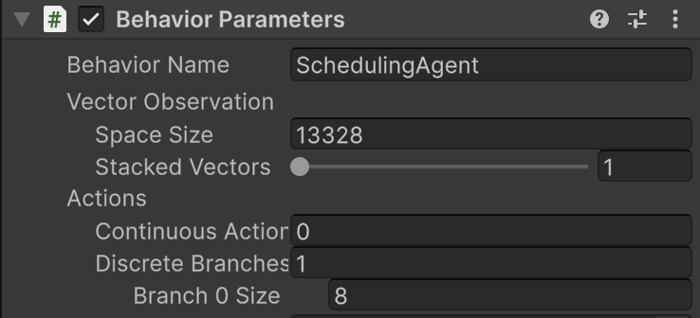
RL Interface (C# - Python Bridge)
Built on Unity ML-Agents
Flow: Orchestrator -> Observation Builder -> Scheduling Agent -> Floats transmitted via gRPC
decouples the simulation from the learning algorithm
Notes:
The bridge between Unity and Python uses Unity ML-Agents, which gives us an optimized gRPC (remote procedure call) layer for free
The data flow:
the orchestrator detects a decision trigger,
ObservationBuilder constructs a complete state snapshot,
SchedulingAgent serializes the observation into a flat float array, and that gets transmitted over a local gRPC port.
The critical design benefit: the simulation is completely decoupled from the learning algorithm.
The Python side sees a standard Gymnasium environment.
The Unity side doesn't know or care what's consuming observations. I could swap PPO for any other algorithm without touching Unity, and someone else could plug in a different simulation without touching my Python pipeline.

Slide 11
ML-Agents Bridge & Gymnasium Wrapper
Collect Observations: https://github.com/meaton96/Capstone/blob/main/Capstone/Assets/Scripts/Simulation/SchedulingAgent.cs#L150
Action Received:
https://github.com/meaton96/Capstone/blob/main/Capstone/Assets/Scripts/Simulation/SchedulingAgent.cs#L181
Python Side:
https://github.com/meaton96/Capstone/blob/main/env/mlagent_env/unity_env.py#L42

Slide 12
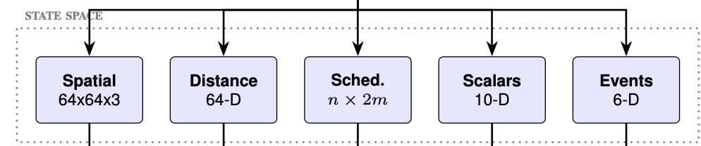
State Space Formulation
Spatial occupancy grid — 64 x 64 x 3 tensor
Scheduling matrix — n x 2m x 3
Global scalars — 10-D
Pairwise distance matrix — 64-D flattened
Event flags — 6-D
Notes:
The state is five parallel streams rather than one flat vector
A flat vector destroys geometric relationships that are critical for AGV routing. The spatial occupancy grid is a 64-by-64-by-3 image tensor mapping physical coordinates of machines, jobs, and AGVs — this is what lets the network reason spatially.
The scheduling matrix is n-by-2m-by-3, carrying processing times and completion flags — this is the temporal scheduling structure.
Three shorter vectors carry global scalars, pairwise distances, and event flags. Keeping them separate lets each one be processed by the encoder best suited to its shape, rather than forcing everything through the same layers.

Slide 13
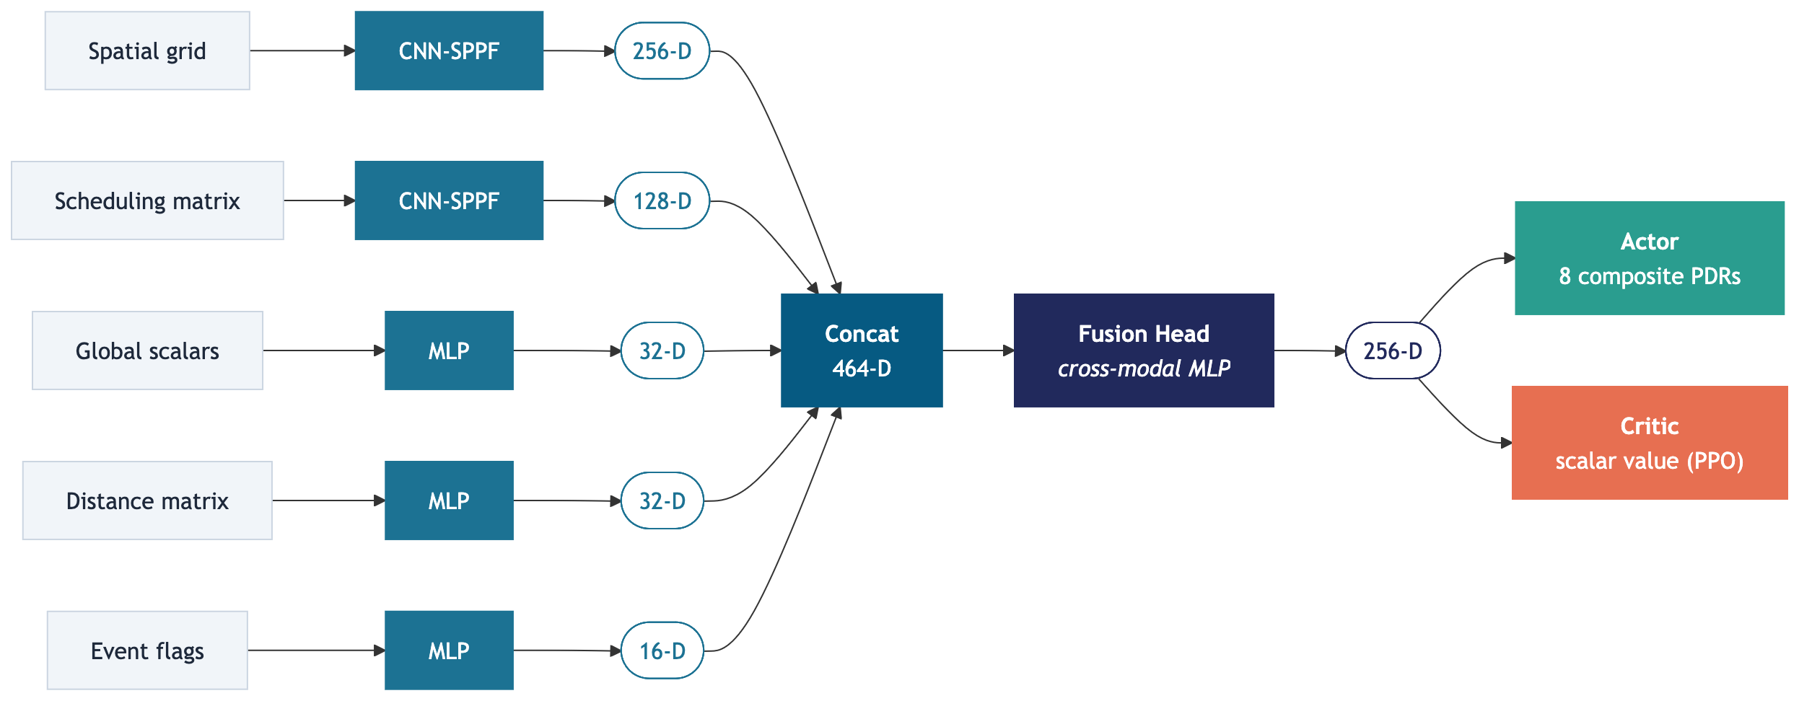
Neural Network
Notes:
Each stream has a dedicated encoder. The spatial grid and the scheduling matrix both use CNN-SPPF — Spatial Pyramid Pooling-Fast — which is the key architectural choice. SPPF produces fixed-size feature vectors regardless of the input grid dimensions, which means one trained policy can generalize across factory sizes without retraining
The spatial encoder outputs 256 dimensions, the scheduling encoder outputs 128. The three shorter streams go through MLPs.
All five concatenate into a 464-dimensional tensor, passed through a fusion head that reduces to 256 while correlating cross-modal features
Then standard actor-critic heads: the actor outputs a distribution over the eight PDRs, the critic outputs a scalar value estimate for PPO stabilization.

Slide 14
State Builder & Network Definition
Observation Builder:
https://github.com/meaton96/Capstone/blob/main/Capstone/Assets/Scripts/Simulation/ObservationBuilder.cs#L45
Python Encoders:
https://github.com/meaton96/Capstone/blob/main/env/models/encoder.py

Slide 15
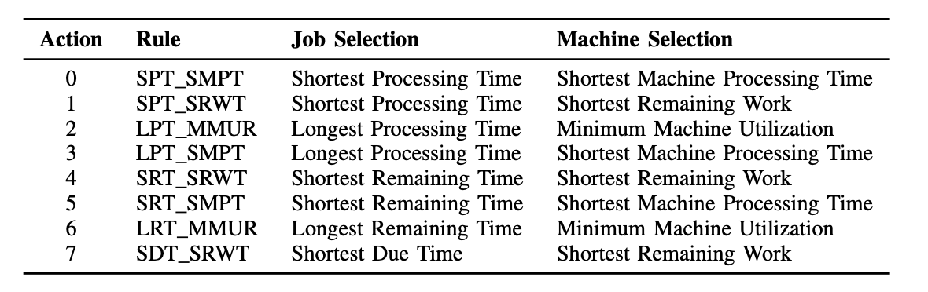
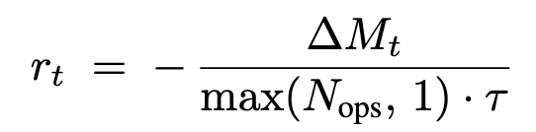
Action Space & Reward
Action space: 8 composite PDRs , Each action pairs a job-selection heuristic with a machine selection heuristic
Notes:
The action space is the other design compression. With 50 jobs and 20 machines, a raw job-machine assignment action space has a thousand discrete actions, most of which are invalid at any given moment which is much longer to train
Instead, the agent chooses among eight composite Priority Dispatching Rules, each pairing a job-selection heuristic with a machine-selection heuristic.
SPT-family rules pair with speed-oriented selectors to maximize throughput of quick jobs
LPT and LRT pair with MMUR — minimum machine utilization — to distribute heavy workloads evenly. SDT_SRWT targets urgent jobs.
The agent has access to fundamentally different scheduling philosophies, and learns to switch between them based on the current factory state. The reward is negative normalized makespan delta — penalize idle time, incentivize throughput.

Slide 16
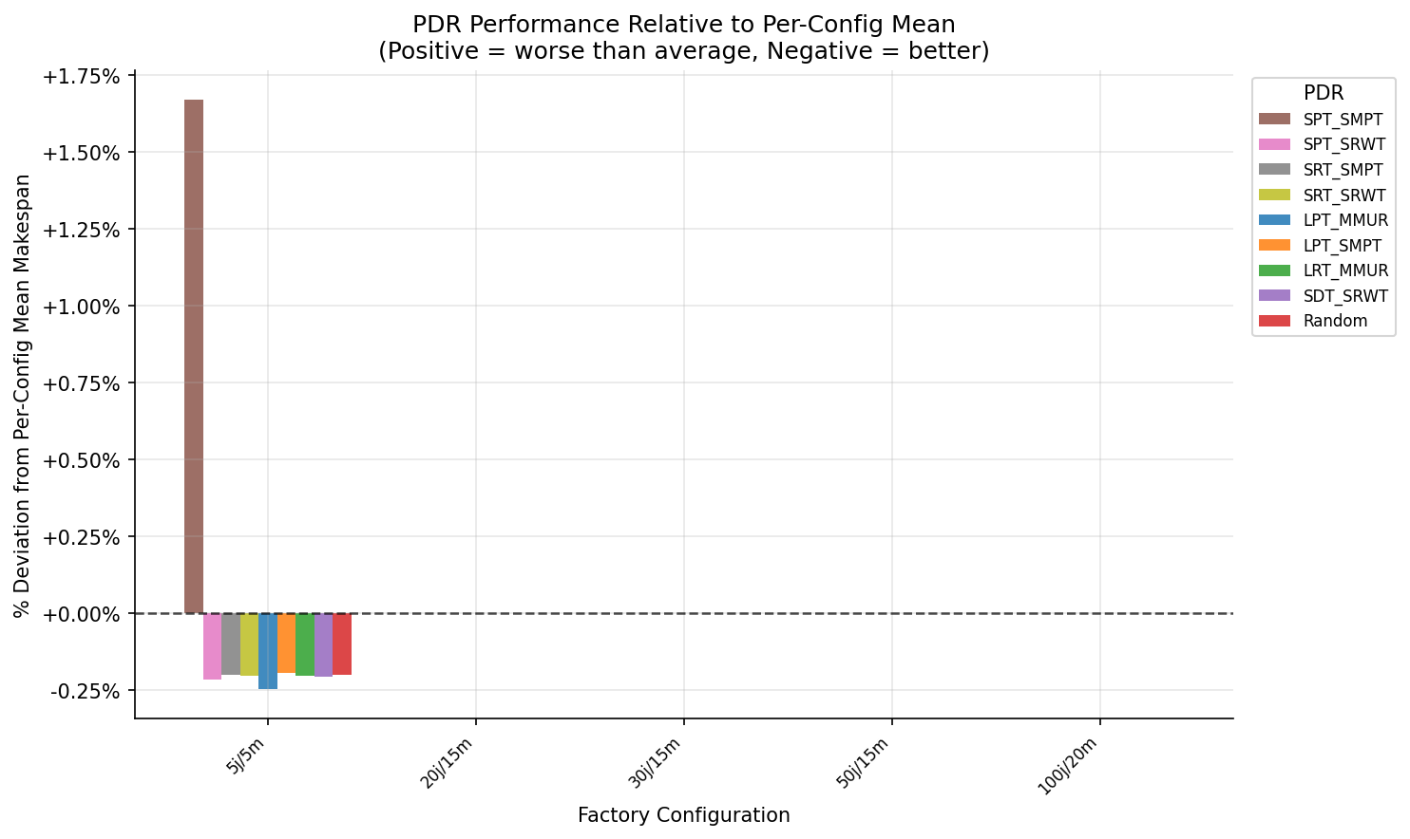
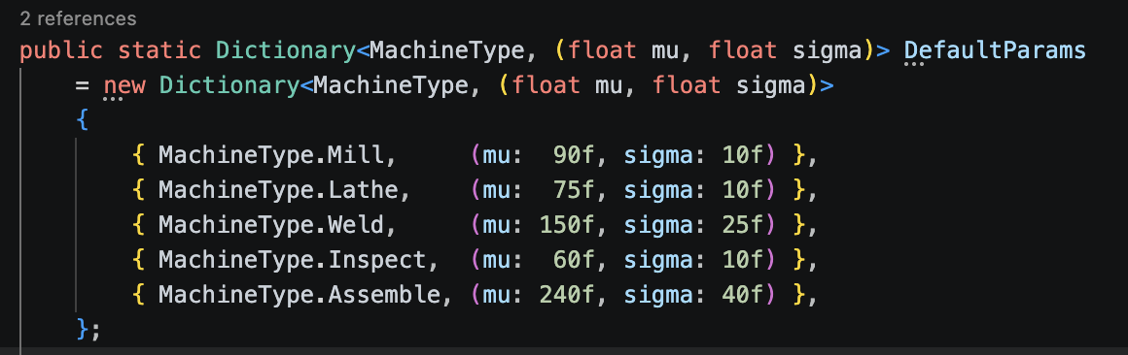
Preliminary Baseline Results
Random-generated instances
Notes:
First evaluation track: procedurally generated instances, five configurations from 5 jobs on 5 machines up to 100 jobs on 20 machines, three AGVs.
Processing times are sampled from machine-type-specific normal distributions — that's what you see in the code on the left: assembly ops have a mean of 240 time units, inspection is 60, creating a structural bottleneck at assembly
The chart shows deviation from per-configuration mean makespan across all eight PDRs plus a RANDOM policy. The key takeaway: at scale, every rule clusters within 2% of the mean. RANDOM matches the deterministic rules.
The current hypothesis is that the AGVs become the bottle neck given sufficient machine resources, and is one of the next areas I will be investigating
Only at 5 jobs on 5 machines does rule selection meaningfully differentiate — about 1.3% spread, and that's where LPT_SMPT shows up as the 1.6% outlier. Lesson: procedurally random instances are a weak benchmark for comparing dispatching policies..

Slide 17
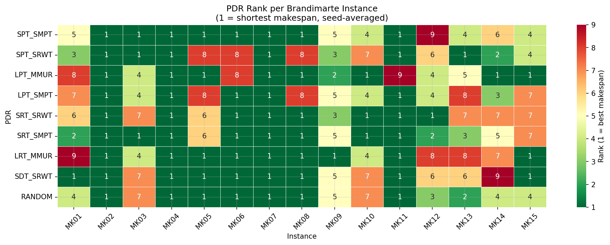
Preliminary Baseline Results
Notes:
Second track: the Brandimarte benchmark suite, several structured instances with deliberate machine contention. The heatmap shows PDR rank per instance — green is best, red is worst
Two things to notice. First, SPT_SMPT ranks first on the majority of instances — a good default rule
Second, and more important: no single PDR dominates across all 15. The best rule depends on the structural properties of each instance.
You can see it visually — the column of best-ranked rules shifts as you move across instances. This context-dependence is precisely the condition under which a state-observing DRL agent should outperform any fixed rule. The agent's job is to learn: for this factory state right now, which rule should I pick? That's the target performance floor for next semester.

Slide 18
Future Work
Stochasticity
Machine failures
Random job arrivals
AGV dynamics
PPO training pipeline
Complete a training loop
Evaluation
Size agnostic scaling
Improved Graphics
Replace primitives with nice looking models
Notes:
Three priority areas for next semester:
First, stochasticity: machine failures modeled with a Weibull time-to-failure, random job arrivals via Poisson process, richer AGV dynamics including battery-dependent speed degradation and aisle-blocking breakdowns
Baselines need to be rerun under these conditions — deterministic baselines understate the DRL advantage because fixed rules can approximate optimal behavior when nothing goes wrong mid-episode
Second, the PPO training loop itself: curriculum scheduling from small, low-noise configurations up to large, high-disruption ones, with ML-Agents environment parallelization so multiple Unity instances contribute rollouts to a shared update.
Third, evaluation — sensitivity analysis across AGV fleet size, grid dimensions, domain randomization intensity, and size-agnostic generalization using SPPF to verify transfer across unseen configurations.
Stretch goal if time allows: swap the primitive factory models for visually polished ones and possibly swapping the simulation for IoT sensor data from a live factory floor (or recorded data)

Slide 19
References

Slide 20
[1] Tian and X. Liu, “Improved hybrid heuristic algorithm inspired by tissue-like membrane system to solve job shop scheduling problem,” Processes, vol. 9, p. 219, 01 2021.
[2] I. G. Smit, J. Zhou, R. Reijnen, Y. Wu, J. Chen, C. Zhang, Z. Bukhsh, Y. Zhang, and W. Nuijten, “Graph neural networks for job shop scheduling problems: A survey,” 2024. [Online]. Available: https://arxiv.org/abs/2406.14096
[3] X. Zhang and G.-Y. Zhu, “A literature review of reinforcement learning methods applied to job-shop scheduling problems,” Computers Operations Research, vol. 175, p. 106929, 2025. [Online]. Available: https://www.sciencedirect.com/science/article/pii/S0305054824004015
[4] M. Schneevogt, K. Binninger, and N. Klarmann, “Optimizing job shop scheduling in the furniture industry: A reinforcement learning approach considering machine setup, batch variability, and intralogistics,” 2024. [Online]. Available: https://arxiv.org/abs/2409.11820
[5] J. Hoss, F. Schelling, and N. Klarmann, “A production scheduling framework for reinforcement learning under real-world constraints,” 2025. [Online]. Available: https://arxiv.org/abs/2506.13566
[6] X. Huang, Y. Chen, W. Yi, Z. Pei, and Z. Cheng, “Solving collaborative scheduling of production and logistics via deep reinforcement learning: Considering limited transportation resources and charging constraints,” Applied Sciences, vol. 15, no. 13, 2025. [Online]. Available: https://www.mdpi.com/2076-3417/15/13/6995
[7] Dong, G. Wan, and P. Zeng, “A heuristic-assisted deep reinforcement learning algorithm for flexible job shop scheduling with transport constraints,” Complex Intelligent Systems, vol. 11, 03 2025
[8] Zhang, Y. Zou, and X. Zhao, “Manufacturing resource scheduling based on deep q-network,” Wuhan University Journal of Natural Sciences, vol. 27, pp. 531–538, 01 2023.

Slide 21
[9] Ding, J. Xia, Y. Ye, and M. Chen, “Effective reinforcement learning-based dynamic flexible
job shop scheduling using two-stage dispatching,” Journal of systems architecture, vol. 172, p. 103664, 2026.
[10] Wu, X. Yan, M. Wei, and D. Guan, “An efficient deep reinforcement learning environment for flexible job-shop scheduling,” 2025. [Online]. Available: https://arxiv.org/abs/2509.07019
[11] J. Abou-Chakra, L. Sun, K. Rana, B. May, K. Schmeckpeper, N. Suenderhauf, M. V. Minniti, and L. Herlant, “Real-is-sim: Bridging the sim-to-real gap with a dynamic digital twin,” 2025. [Online]. Available: https://arxiv.org/abs/2504.03597
[12] Shakerimov, T. Alizadeh, and H. A. Varol, “Efficient sim-to-real transfer in reinforcement learning through domain randomization and domain adaptation,” IEEE Access, vol. 11, pp.136 809–136 824, 2023
[13] A. Juliani, V.-P. Berges, E. Teng, A. Cohen, J. Harper, C. Elion, C. Goy, Y. Gao, H. Henry, M. Mattar, and D. Lange, “Unity: A general platform for intelligent agents,” 2020. [Online]. Available: https://arxiv.org/abs/1809.02627
[14] Pernas-Álvarez and D. Crespo-Pereira, “Open-source 3d discrete event simulator based on the game engine unity,” Journal of Simulation, vol. 18, no. 5, pp. 886–902, 2024. [Online]. Available: https://doi.org/10.1080/17477778.2024.2314166
[15] Z. Hou, L. Zhang, Y. Wang, and Y. Hu, “Deep reinforcement learning for dynamic flexible
job-shop scheduling with automated guided vehicles,” in Proceedings of Industrial Engineering and Management, C.-F. Chien, R. Dou, and L. Luo, Eds. Singapore: Springer Nature Singapore, 2024, pp. 89–99
[16] H. Yu, W. Gu, N. Tang, and Z. Guo, “A deep reinforcement learning approach for dynamic job-shop scheduling problem considering time variable and new job arrivals,” Computers Operations Research, vol. 185, p. 107263, 2026. [Online]. Available: https://www.sciencedirect.com/science/article/pii/S030505482500292

