Slide 1
Dynamic Flexible Job Shop Scheduling via Deep Reinforcement Learning
Unity/AGV Simulation - Capstone Planning Presentation
Mike Eaton · Advisor: Dr. Michael Kuhl · Solo Capstone
Notes:
Solo capstone, no external sponsor. This talk covers what's changed since DSCI-601 last spring, the key methodological fixes from this summer, and the plan for this semester (reward rework, staged training, evaluation, and the thesis paper).

Slide 2
Project Overview
1
Dynamic Flexible Job Shop Scheduling (FJSP)
Machines fail mid-episode, jobs arrive unpredictably - any schedule committed at episode start goes stale
2
Jobs physically transported by a fleet of AGVs (Automated Guided Vehicles)
Emergent from simulation, not modeled, as in classic DES / scheduling literature
3
Built in Unity/C# with ML-Agents
Trained via a Python-side PPO (Proximal Policy Optimization) agent
Each decision point, the agent (or a baseline heuristic) picks from a set of composite Priority Dispatching Rules (PDRs)
Goal 1
Match standard heuristics under ideal, obstacle-free conditions
Goal 2
Outperform them under dynamic, transport-constrained conditions
Notes:
The core differentiator from textbook FJSP work is that material handling isn't abstracted away - AGVs take real simulated time and can contend for the same routes. The 'dynamic' piece is what actually drives the research: any schedule committed at the start of an episode becomes stale the moment something disrupts it, which is why the field has moved toward DRL - training an agent to make one dispatching decision at a time, reacting to the current state of the floor, instead of solving the full schedule combinatorially up front. Two goals: (1) can a PPO agent match or beat standard DFJSP dispatching heuristics under ideal conditions, and (2) can it beat them under realistic, dynamic, transport-constrained conditions - Poisson arrivals, AGV congestion, etc.

Slide 3
Why Simulate in Unity, Not DES?
Classical DES (Discrete-Event Simulation - e.g. Simio)
AGVs modeled as a resource with a hand-tuned travel-time distribution
Congestion, blocking, and path conflicts are invisible to the simulator
Schedules that look optimal in simulation can be physically infeasible on a real floor
This Project (Unity Physics)
Machines have real grid positions; AGVs run a real kinematic model (rotate-then-translate, NavMesh pathfinding)
Congestion and travel time are emergent outputs of the sim, not tuned inputs
Deadlock-free routing via zone reservations (TrafficZoneManager)
To the best of our knowledge, no existing work combines a high-fidelity 3D physics sim with a standard RL (Gymnasium-style) interface for the DFJSP - that combination is the primary contribution.
Notes:
DES tools, by construction, abstract away exactly the things this project cares about. In Simio, an AGV is a resource with a travel time drawn from a hand-tuned distribution - whatever happens in the continuous space between events (two AGVs approaching the same intersection, an aisle blocked by a stalled vehicle) is invisible to the simulator. The result is a well-documented literature problem: schedules that look optimal in simulation and then fall apart on a real floor. Unity gives the opposite construction - machines have physical grid positions, AGVs have an actual kinematic model, and congestion is what happens when two vehicles try to use the same aisle, not a parameter anyone tuned. This is the strongest novelty claim in the whole project: to our knowledge, no existing work combines a high-fidelity 3D physics simulation with a standard RL interface for the DFJSP.

Slide 4
Original Research Questions (from DSCI-601)
1
RQ1
Can PPO match standard heuristics under ideal, obstacle-free conditions?
2
RQ2
How does the heuristic/PPO gap evolve as spatial obstacles are introduced?
3
RQ3
Do spatial penalties trade machine utilization for better logistical flow?
Notes:
These haven't been formally restated since DSCI-601 - reintroducing them here for continuity. RQ2's hypothesis was that PPO would learn to reroute around congestion by favoring spatially accessible machines while heuristics keep choosing purely on processing efficiency, costing them in travel delay. Worth saying explicitly: this summer's central finding - that transport capacity, not machine capacity, is the real bottleneck - directly supports the premise behind RQ2 and RQ3. That's the throughline into the 'what's new this semester' section.

Slide 5
Progress - Realism & Failure Modeling (May-June)
1
Machine failure → repair → fix cycle added
2
Added Poisson job arrivals
The shop now stays continuously loaded
3
Logging expanded
Per-machine utilization, per-instance IDs, deterministic vs. dynamic failure comparisons
Notes:
First realism pass after DSCI-601 - made the shop model failures instead of assuming 100% machine availability, and made sure AGVs handle a machine going down mid-route.

Slide 6
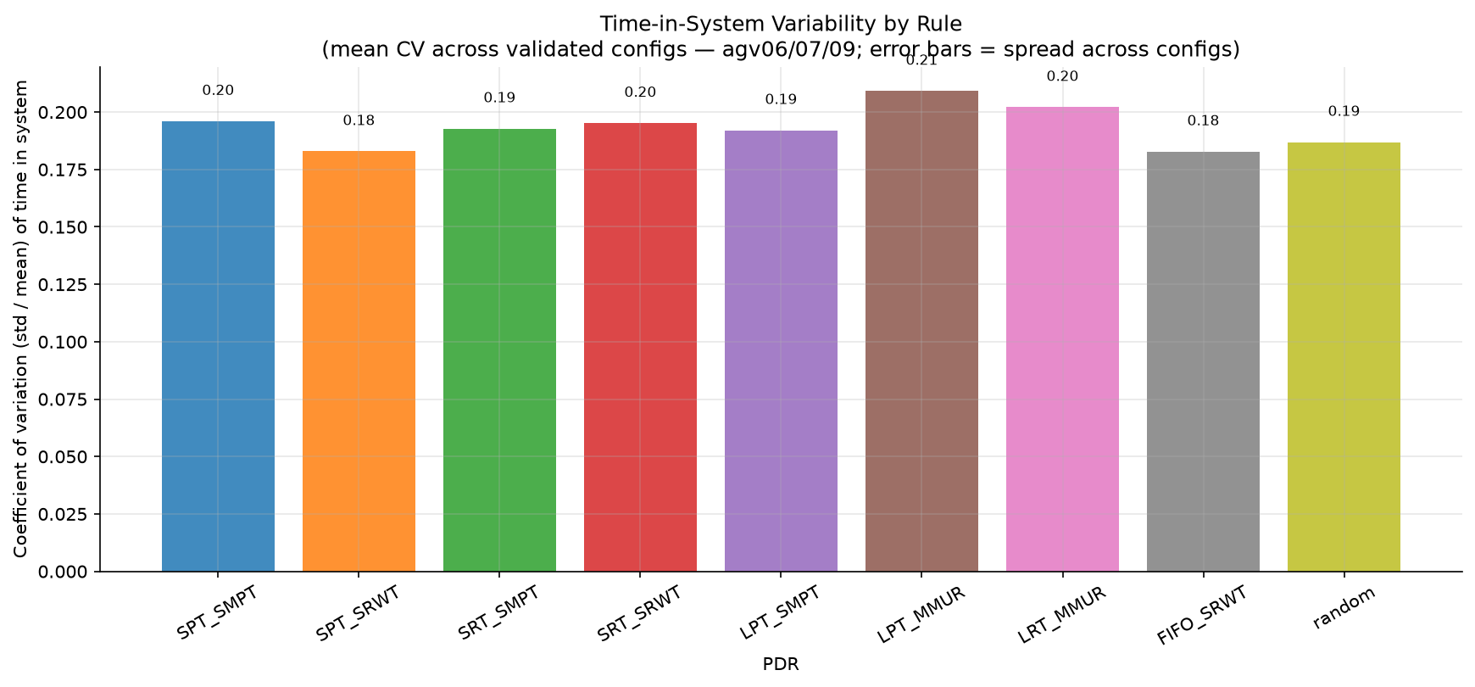
The Makespan-Convergence Saga
1
1. Jobs-in-transit undercounted
Jobs weren't counted toward the destination machine's in-progress work - first fix that stopped all 9 rules converging to identical makespan
2
2. Decision-per-frame artifact
Only one dispatching decision per simulated frame; at 100x speed that starved machines and AGVs. Fixed via a queue that drains all ready decisions per frame - convergence came back, pointing to a deeper confound
3
3. Queue-selection degeneracy
Proc times were short relative to inter-arrival time, so machine queues almost always had exactly one job - no real choice for any rule to make. Rebalancing that ratio finally produced real rule differentiation
7/9 rules converge near CV (coefficient of variation) ≈ 0.18–0.20; the two max-queue rules land near 0.20–0.21 post-fix - down from ~0.35–0.36 pre-fix
The fix that finally revealed real differences between rules
Notes:
This is the real narrative of the summer.
1: jobs in transit weren't counted toward the destination machine's in-progress work - fixing this was the first thing that got makespan to stop converging identically across all 9 rules.
2: the sim only ever made one dispatching decision per simulated frame (by design, for the DRL step boundary), but at 100x playback speed one frame is roughly 20 real seconds, during which many decisions should have fired - machines sat under 10% utilized, AGVs idle 80% of the time, a pure simulation-speed artifact, not a real scheduling effect. Fixed via a decision queue that drains all ready decisions per frame. After this fix, convergence came back - a sign there was still a second confound underneath.
3: job processing times (60-240s) were short relative to inter-arrival time (300-1900s), so a machine's queue almost always had exactly one job in it - no real choice for any dispatching rule to make. Fixed by increasing processing times relative to inter-arrival time - this is what finally produced real rule differentiation. Also found and fixed a minor routing-precedence bug (jobs were being routed FIFO instead of by the active PDR) - measured impact was small, conventional rules unaffected, so not a headline item.

Slide 7
Reframing: Maybe Convergence Isn't the Problem
1
The real question isn't why rules won't differentiate within a scenario
It's whether they differentiate across different factory-floor scenarios (machine breakdowns, burst arrivals) - the more meaningful test of whether rule choice, or a learned policy, actually matters
2
Built burst-arrival support this past week
Multiple jobs can now arrive in one event, not just one at a time - configurable mean burst size
3
Currently running a scenario-coverage sweep
Baseline / low machine-failure / high machine-failure / burst / high-failure+burst - to see where, if anywhere, rule choice actually shows up
Notes:
If all 9 rules still perform near-identically within one scenario, the real question isn't 'why won't they differentiate' - it's whether they differentiate across different factory-floor scenarios. That's the more meaningful test of whether rule choice - or a learned policy - actually matters. Early result: burst-only overload flattens completion to ~45-47% for every rule - that's just saturation, not differentiation; the failure+burst combined scenarios need a rerun before they're trustworthy. Two more RNG-related bugs surfaced and were fixed along the way: an RNG-stream bug that desynced arrivals per-rule when failures were enabled, and a crash where a stalled job on its last operation would silently kill the arrival clock for the rest of the episode.

Slide 8
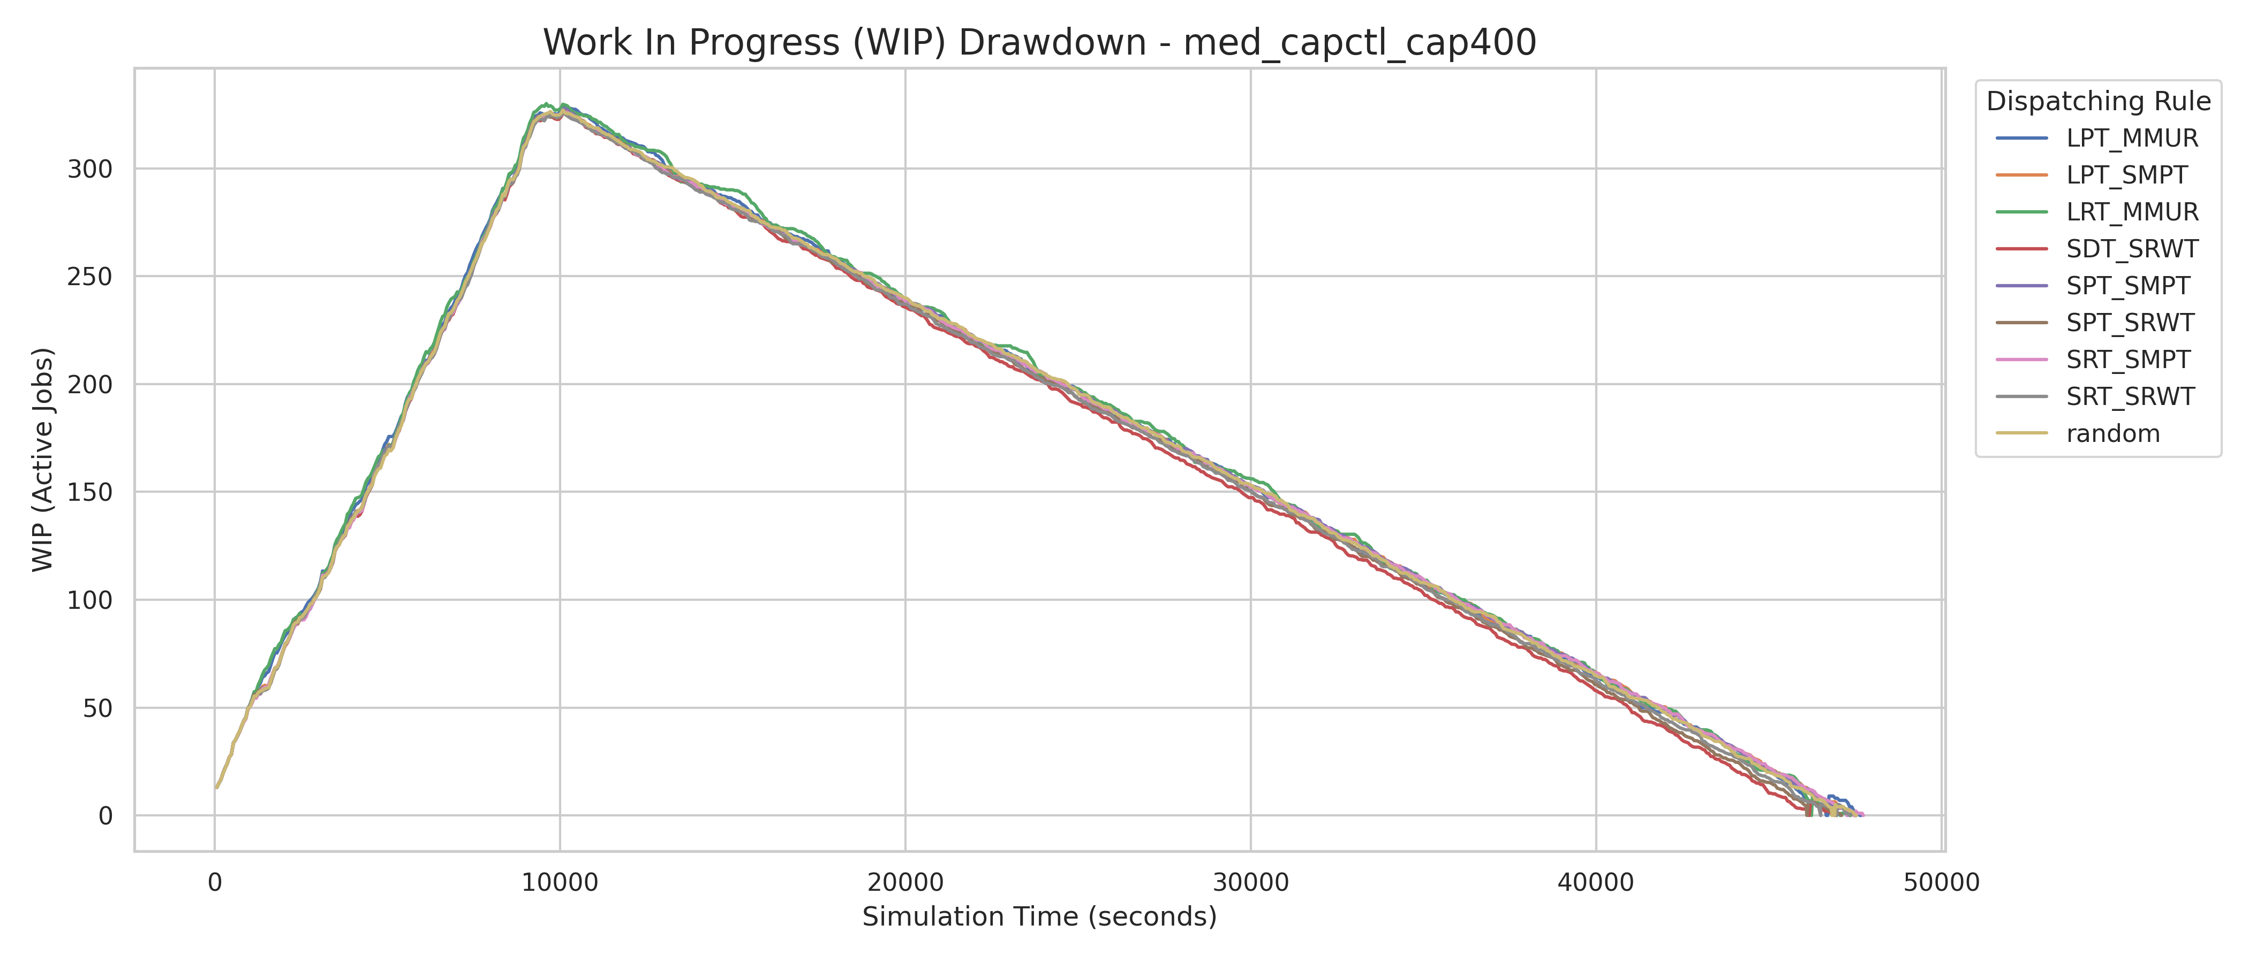
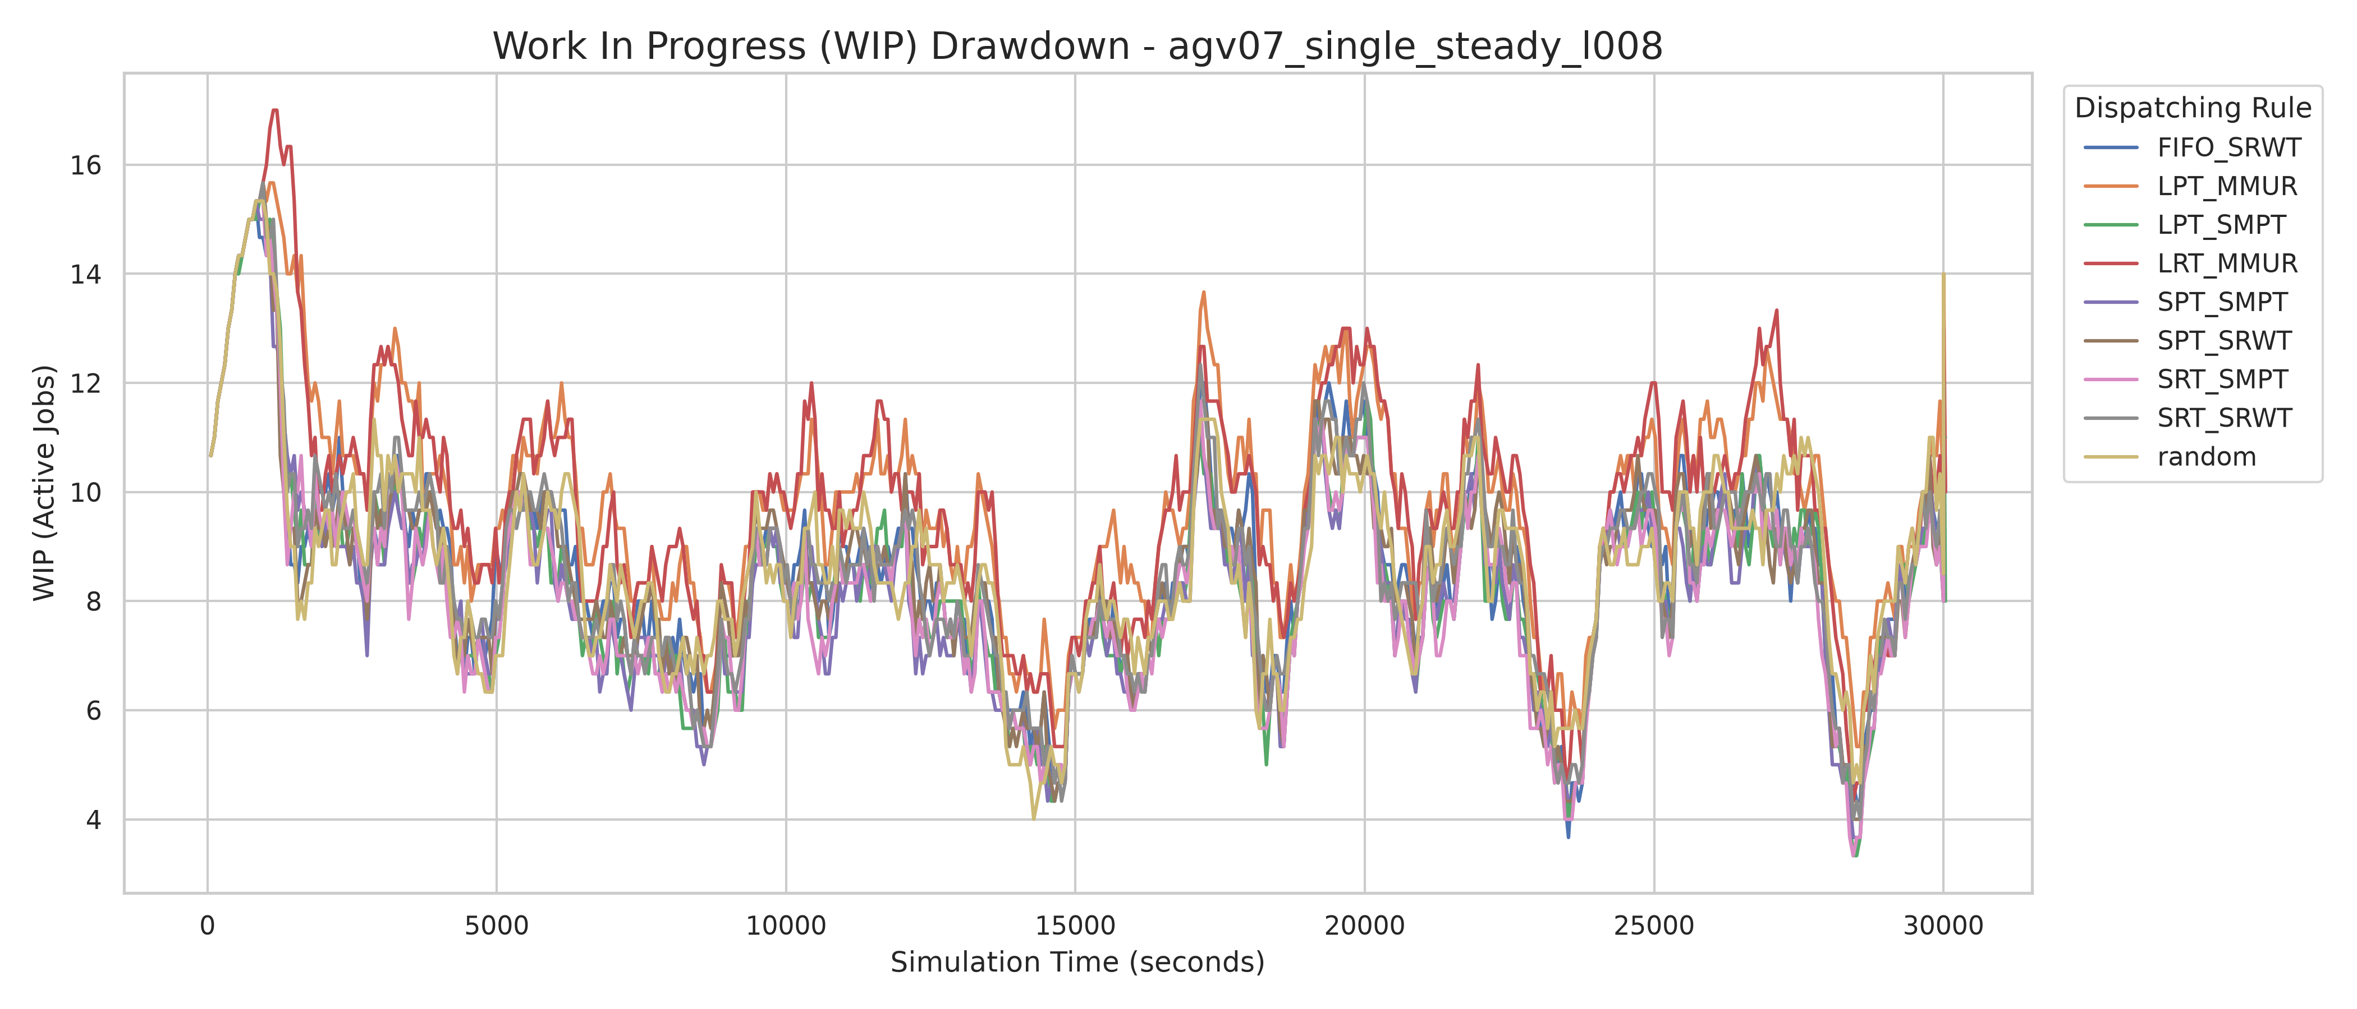
Methodology Fix: Steady-State Sampling
Swapped primary metric from makespan to time-in-system / flow-time - under continuous Poisson arrivals the shop never fully drains
Now analyze only steady-state, post-warmup behavior, for a fixed simulation duration instead of running until every rule's queue fully drains
Side benefit: full-sweep runtime dropped from 10+ hours to roughly 1–2 hours
BEFORE - uncapped, run-until-drain
AFTER - tuned rate, fixed duration
WIP (work-in-progress) ramps ~10,000s then drains ~38,000s more; all 9 rules overlap indistinguishably
Steady oscillating WIP that never drains; the two max-queue rules visibly separate (~10–14 WIP vs. 5–10 for the rest)
Notes:
Same underlying rules, same kind of instance - the only change is measurement methodology, and real rule differentiation only became visible once we stopped measuring a transient drain-out and started measuring steady state.

Slide 9
Research Questions for This Semester
1
RQ-A
Under a documented, realistic AGV:machine ratio, can a flow-time-aware PPO reward outperform static PDRs on flow time and transport efficiency?
2
RQ-B
Does incorporating the AGV congestion / transport-wait signals already available through the observation bridge into the reward function change dispatching behavior, relative to the original spatial-penalty hypothesis? (Reward design itself is still open - this hasn't been implemented yet.)
3
RQ-C
Under dynamic factory-floor stressors (machine breakdowns, burst arrivals), does dispatching-rule choice - or a learned policy - produce meaningfully different outcomes, and can a PPO agent learn to adapt across scenarios where static rules can't?
(Also profiling training compute this semester - CPU vs. GPU cost, parallelism - a practical planning check, not a primary research driver.)
Notes:
RQ-A and RQ-B carry the semester's research forward from RQ1-3, with the makespan language dropped in favor of flow time and transport efficiency, which are the metrics that actually mean something under continuous arrivals. RQ-B is deliberately framed as an open question, not a settled plan - the congestion/transport-wait signals are already available via the existing observation builder → Python bridge, but whether or how to use them in the reward is still undecided. RQ-C formalizes the question already worked out on the Reframing slide - whether rule choice (or a learned policy) matters across different factory-floor scenarios - and ties directly to the scenario-coverage sweep described there. Compute profiling remains a practical planning item this semester, not a lettered research question - see the aside note and the Deliverables section.

Slide 10
Deliverables Overview
DELIVERABLE 1
The Finished Simulation Software
A built, working executable - open-sourced on GitHub.
DELIVERABLE 2
A Capstone Thesis Paper
Conference submission as a subgoal - targeting the Winter Simulation Conference, paper deadline around April 2027.
Everything on the following slides is the path to these two things
COMPLETED SO FAR
Realistic Unity simulation (failure modeling, dynamic + burst arrivals, AGV logistics); corrected flow-time/steady-state measurement methodology; verified PDR differentiation under the fixed pipeline.
Notes:
Everything else in this section is the path to these two things, organized chronologically against this semester's standup/milestone/demo dates.

Slide 11
Stage 1 - Foundation: Rework Reward + Lock Down Remaining Bugs
1
Completes the simulation deliverable
Reward rework plus remaining bugfixes finish the working software project
2
Status
In progress - underway now
IN PROGRESS
Target: milestone, 10/19/2026
No related RQ - this stage is prerequisite work
Stretch goal: revisit AGV traffic-zone reservation logic (ordered lock acquisition / timeout-and-retry) so advanced users could stress-test past the documented AGV:machine ratio ceiling - optional, time-permitting, not committed.
Notes:
This stage is what actually completes the simulation deliverable - the reward rework and any remaining bugfixes need to land before real training begins. The stretch goal (traffic-zone reservation rework) is explicitly optional and not a committed date.

Slide 12
Stage 2 - Train on a Very Small Problem Subset
1
First real PPO training pass
Sanity-check that the agent learns anything at all before scaling up
2
Status
Not started - depends on Stage 1
NOT STARTED
Target: standup, 11/2/2026
Related RQ: RQ-A
Notes:
A deliberately small, low-complexity problem - the goal here is purely a sanity check that the training loop and reward produce a learning signal at all before spending compute on anything harder.

Slide 13
Stage 3 - Train on Basic Job Data with Dynamic Arrivals
1
Middle complexity step
Dynamic arrivals only - no machine failures, no burst arrivals yet
2
Status
Not started - depends on Stage 2
NOT STARTED
Target: milestone, 11/16/2026
Related RQ: RQ-A, RQ-C
Notes:
Adds dynamic arrivals back in while still holding failures and bursts fixed off, so any change in behavior can be attributed to arrivals specifically before stacking on more complexity.

Slide 14
Stage 4 - Train on the Full DFJSP
1
Full realism
Dynamic arrivals, machine failures, and burst arrivals all enabled together
2
Status
Not started - depends on Stage 3
NOT STARTED
Target: rough draft, 11/23/2026 (results in hand for the draft)
Related RQ: RQ-A, RQ-B, RQ-C
Notes:
This is the full, realistic training condition - everything from the reframing slide (failures, bursts, dynamic arrivals) enabled together. Results from this stage feed directly into the rough draft.

Slide 15
Stage 5 - Evaluate vs. Best Static PDR; Consolidate Paper Draft
1
Direct comparison
Trained agent vs. the best-performing static PDR from this summer's results
2
Ties back to original RQ1–RQ3
3
Status
Not started - depends on Stage 4
NOT STARTED
Target: standup, 11/30/2026
Related RQ: RQ-A, RQ-B, RQ-C, and the original RQ1–3
Notes:
This is where the semester's work closes the loop back to the DSCI-601 research questions - the evaluation results and the paper draft get consolidated together here.

Slide 16
Stage 6 - Final Demo: Simulation, Trained Model, Paper
1
All three deliverable pieces come together
Working simulation, trained agent, and capstone paper
2
Status
Not started - depends on Stage 5
NOT STARTED
Target: final demo, 12/9/2026
Related RQ: RQ-A, RQ-B, RQ-C, and the original RQ1–3
Notes:
The closing milestone - full simulation, trained model, and capstone paper presented together at the final demo.

Slide 17
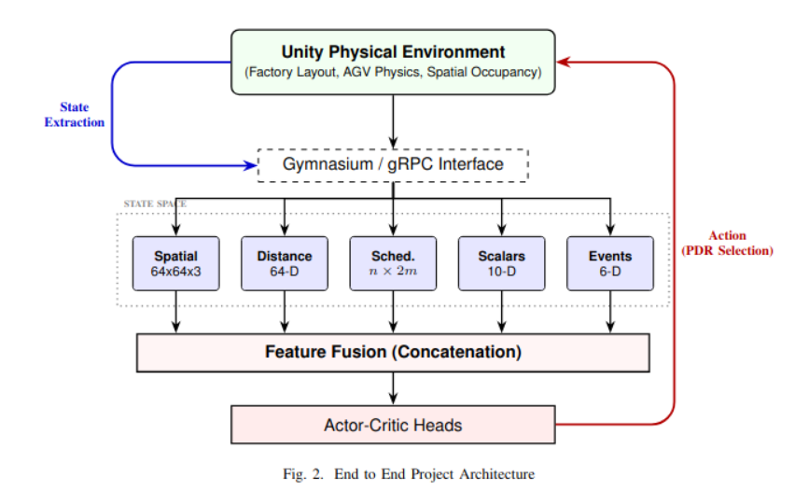
Architecture
Notes:
Unchanged from last semester - the end-to-end architecture hasn't needed revision. Unity generates state, state extraction pulls observations across the Gymnasium/gRPC interface, five parallel streams feed the state space, they fuse into actor-critic heads, and the actor's PDR selection loops back into Unity as an action.

Slide 18
Architecture: What’s New Since DSCI-601
The high-level architecture (Unity → Gymnasium/gRPC bridge → Python actor-critic) is stable - what’s grown is the orchestration and realism layer underneath it.
1
FailureCoordinator - new this cycle, orchestrates machine failure → repair → fix
2
FlagHarvester - recovers stalled AGVs/jobs after congestion or failure events
3
StochasticEventManager - two independent RNG streams (failures, arrivals) plus new burst-arrival sampling
4
FactoryOrchestrator’s decision loop - now drains a full queue of ready decisions per frame, not just one
5
EpisodeTracker + 8-file ResultsLogger - new this cycle (see “The Logging Explosion”)
UNITY / C#
Simulation + physics
ML-AGENTS GYMNASIUM/gRPC
The Unity ↔ Python bridge
PYTHON / PYTORCH
PPO actor-critic
Notes:
The high-level architecture didn't need to change this cycle - Unity generates state, the Gymnasium/gRPC bridge carries it to the Python actor-critic, actions flow back the same path shown on the previous slide. What grew is the orchestration and realism layer sitting underneath that stable picture: FailureCoordinator (machine failure→repair→fix), FlagHarvester (recovers stalled AGVs/jobs after congestion or failure events), StochasticEventManager (two independent RNG streams - one for failures, one for arrivals - plus new burst-arrival sampling), FactoryOrchestrator's decision loop (now drains a full queue of ready decisions per frame instead of one), and the EpisodeTracker + 8-file ResultsLogger pipeline (new this cycle - callback to the Logging Explosion slide). Stack, named explicitly: Unity/C# for simulation and physics, ML-Agents Gymnasium/gRPC for the bridge, Python/PyTorch for the PPO actor-critic.

Slide 19
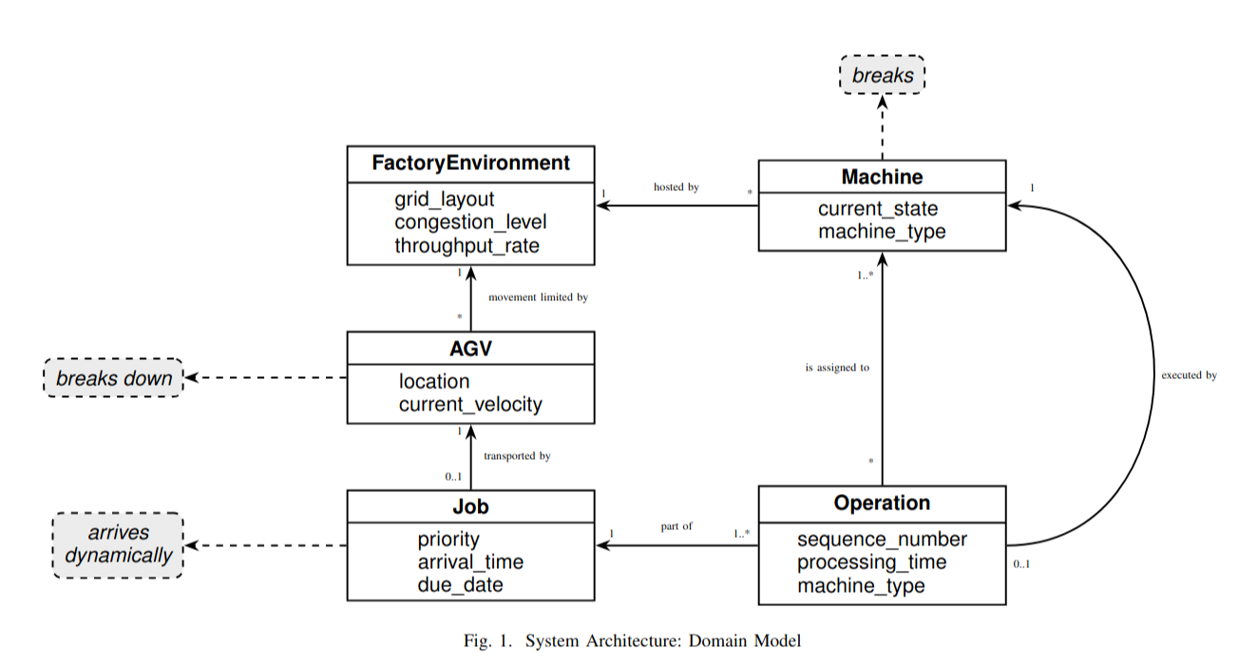
Domain Model
Notes:
Unchanged from last semester - the domain model hasn't needed revision. Useful to walk through Job → Operation → Machine → AGV → Traffic/Parking Zone → Episode as one path, since it mirrors how a job actually flows through the simulation.

Slide 20
Domain Model: What’s New Since DSCI-601
The entity structure (Job → Operation → Machine, AGV ↔ Traffic/Parking Zone) hasn’t changed - what’s grown is the state tracked on each entity.
Job - now carries is_dynamic, arrival_time/exit_time, flow_time, and burst-arrival group membership
1
Machine - now carries failure/repair state: Weibull time-to-failure, log-normal repair duration, availability_rate
2
AGV - now carries congestion_fraction, reroute_count, stall_recovery_count
3
Episode - now carries deadlock_detected / deadlock_sim_time, a new terminal-state outcome
4
Notes:
The entity structure itself - Job → Operation → Machine, AGV ↔ Traffic/Parking Zone - hasn't changed since last semester, which is why the diagram on the previous slide is untouched. What's grown is the state tracked on each entity. Job now carries is_dynamic, arrival_time/exit_time, flow_time, and burst-arrival group membership. Machine now carries failure/repair state - Weibull time-to-failure, log-normal repair duration, availability_rate. AGV now carries congestion_fraction, reroute_count, stall_recovery_count - transport-wait behavior is a first-class tracked property now, not an afterthought. Episode now carries deadlock_detected/deadlock_sim_time - an entirely new terminal-state outcome that didn't exist in the DSCI-601 version of the model.

Slide 21
Timeline / Gantt
Six stages from foundation to final demo
1. Foundation: reward + bugfixes
Reward redesign
Bug lockdown
2. Train: small subset
3. Train: dynamic arrivals
4. Train: full DFJSP
3 sub-steps - highest risk
5. Evaluate + paper draft
6. Final demo
Sep
Oct
Nov
Dec
Standup
9/28
Milestone
10/19
Standup
11/2
Milestone
11/16
Draft
11/23
Standup
11/30
Demo
12/9
Notes:
Six stages anchored to the same standup/milestone/rough-draft/demo dates as before (9/28, 10/19, 11/2, 11/16, 11/23, 11/30, 12/9) - 9/28 now falls as a checkpoint inside Stage 1's span rather than an end date, since the reward rework and remaining bugfixes are already underway. Stage 1 runs now through 10/19; each subsequent stage is a roughly two-week training step of increasing complexity, closing with the final demo on 12/9. Stage 1's bar now shows two parallel sub-deliverables (reward redesign, bug lockdown) both closing by 10/19; Stage 4's bar shows three sequential sub-steps (enable failures, enable bursts, combined full-stress run). Stage 4 carries the most schedule risk this term - three stochastic features have to compose correctly together, and it has the least buffer before the rough draft (11/23). If it slips, Stage 5's evaluation scope is what flexes, not the draft deadline.

Slide 22
Appendix - Full Logging Schema
For anyone who wants the gory detail - the full column list behind “The Logging Explosion”
OPEN ITEM
Exploring a research cluster for long-running PPO training.
Whether it supports scheduling multi-day jobs is still unresolved.
Feeds Stage 4 / the compute-profiling aside.
results.csv
timestamp, instance, rule, seed, makespan, jobs, machines, total_ops, agvCount, decisions, total_reward, timescale, parking_method, pre_dispatching_method, stochastic_tag, weibull_k, weibull_lambda, mean_ttf_theoretical, repair_log_mu, repair_log_sigma, episode_failures, total_repair_time, dynamic_arrivals, arrival_lambda, mean_interarrival_theoretical, mean_interarrival_realised, last_arrival_sim_time, mean_flow_time, p95_flow_time, max_flow_time, mean_transport_wait, jobs_censored, deadlock_detected, deadlock_sim_time
agv_performance.csv
timestamp, instance, rule, seed, makespan, agv_id, total_trips, mean_trip_duration, time_idle, time_waiting_route, time_traveling, time_loading, time_unloading, total_path_length, reroute_count, congestion_fraction, stall_recovery_count
decision_log.csv
timestamp, instance, rule, seed, makespan, sim_time, decision_index, decision_type, subject_id, chosen_id, candidate_count, is_degenerate, candidate_ids, candidate_stat_a, candidate_stat_b, candidate_stat_c
job_completions.csv
timestamp, instance, rule, seed, makespan, job_id, is_dynamic, completed, arrival_time, exit_time, flow_time, total_operations, completed_ops, work_content, time_needs_routing, time_waiting_pickup, time_in_transit, time_queued, time_processing
job_operations.csv
timestamp, instance, rule, seed, makespan, job_id, is_dynamic, arrival_time, op_index, machine_type_required, eligible_machine_count, min_proc_time, max_proc_time, mean_proc_time, proc_time_spread, travel_time, queue_entry_time, proc_start_time, proc_end_time, realized_proc_time, queue_wait_time
machine_utilization.csv
timestamp, instance, rule, seed, makespan, machine_id, machine_type, ops_completed, time_processing, time_operational, utilization_rate, idle_time, idle_rate, availability_rate, failure_count, total_repair_time
segment_congestion.csv
timestamp, instance, rule, seed, makespan, zone_id, zone_name, aisle_type, flow_direction, traversal_count, block_events, total_block_time, mean_block_time, block_rate
throughput.csv
timestamp, instance, rule, seed, makespan, window_start, window_end, window_seconds, jobs_completed, throughput_per_sec, throughput_per_min, cumulative_completed, work_in_progress
Notes:
Time-permitting appendix slide - hold for Q&A rather than presenting live unless there's time. The cluster-access question is still open: whether it supports scheduling multi-day jobs is unresolved and directly affects the local-vs-cluster decision on Stage 4 of the deliverables timeline.

Slide 23
Thank You
?
Questions?
Mike Eaton · meaton96@gmail.com
Notes:
Open for questions. Have the steady-state before/after figures, the CV payoff figure, and the deadlock-cliff sweep data ready in case of deep-dive questions.

