Slide 1
Rochester Motor vehicle thefts
Michael Eaton

Slide 2
The plan
Find data on cart thefts in Rochester from the Rochester Police Department
Take the csv data and covert it to shape files
Create dot maps and heatmaps to display the information geospatially
Upload created maps to Arcgis online
Create an interactive webpage to display the maps using the Javascript API

Slide 3
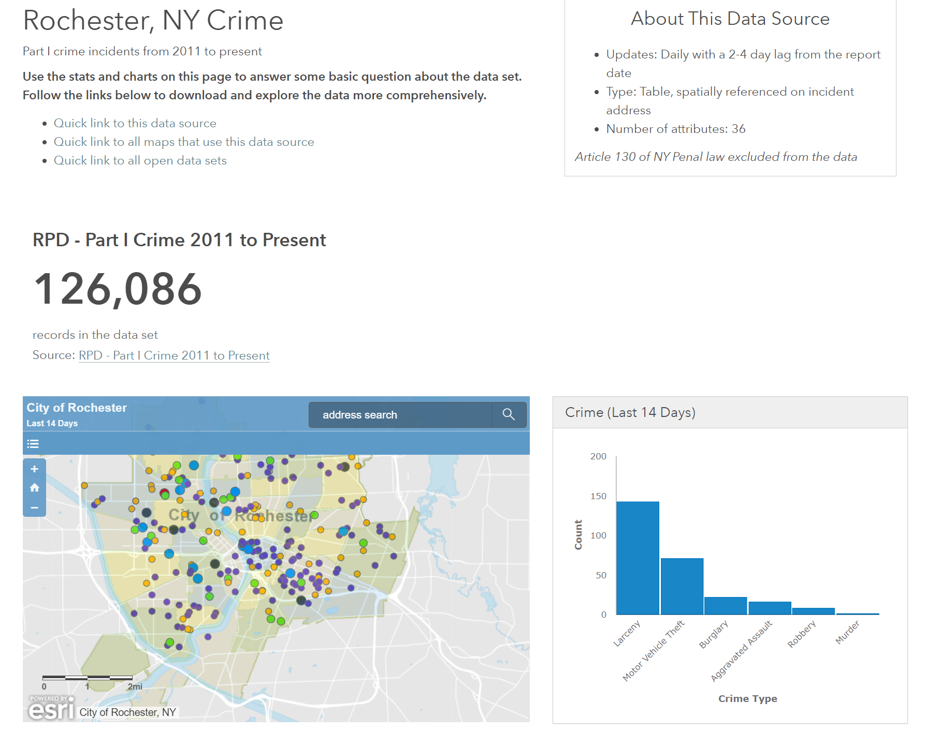
The Data

Slide 4
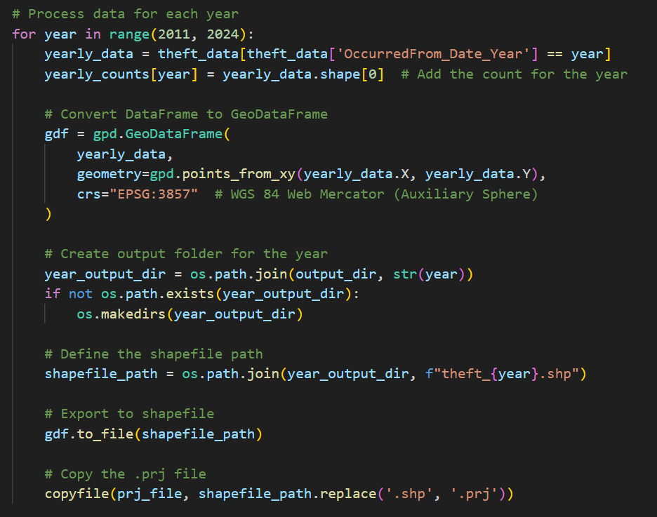
CSV Parsing
Turns our there is a much easier method than what we learned in class using the geopandas module in Arcgis

Slide 5
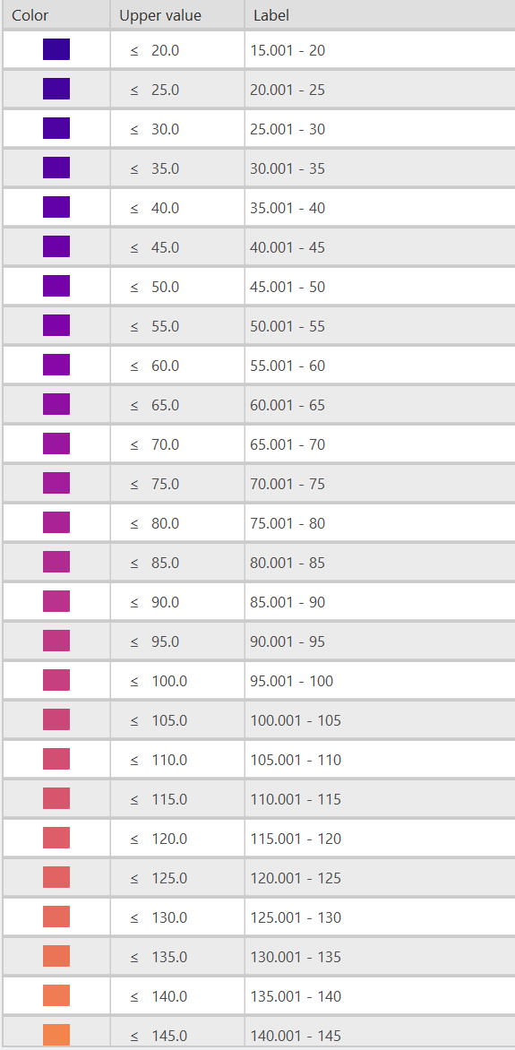
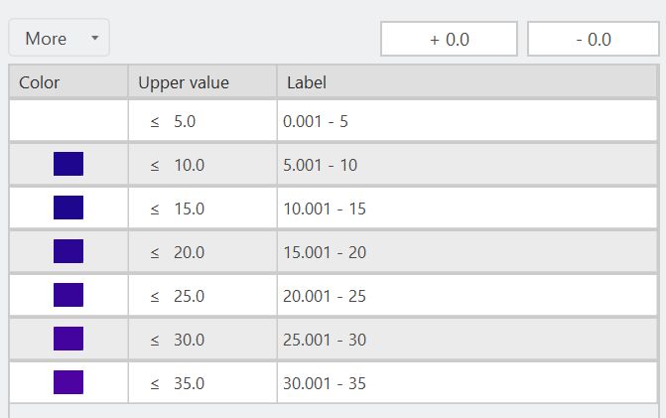
Map Creation
2023
2014
Manual Entry
Manually set the colors of the heatmaps

Slide 6
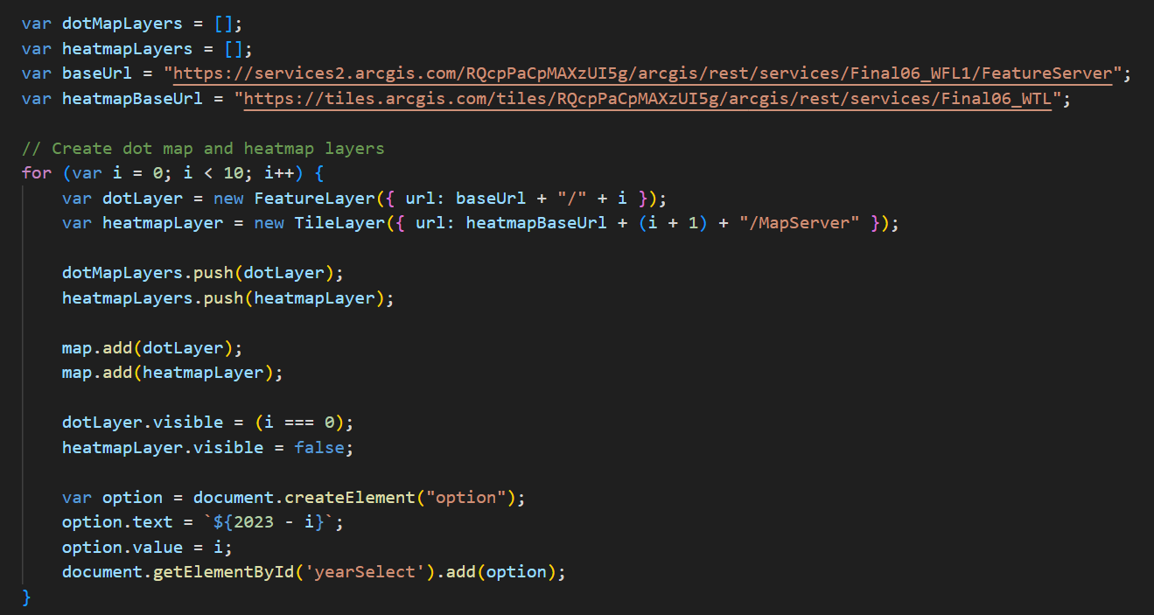
Create website

Slide 7

VIDEO DEMO

