Slide 1
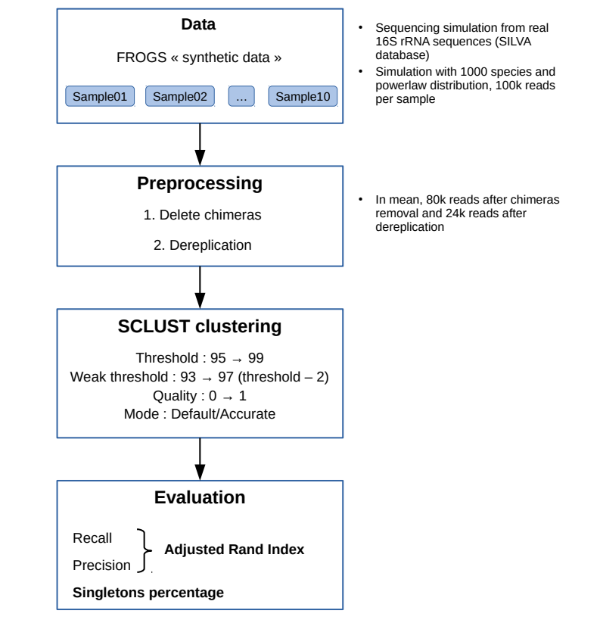
SCLUST evaluation

Slide 2
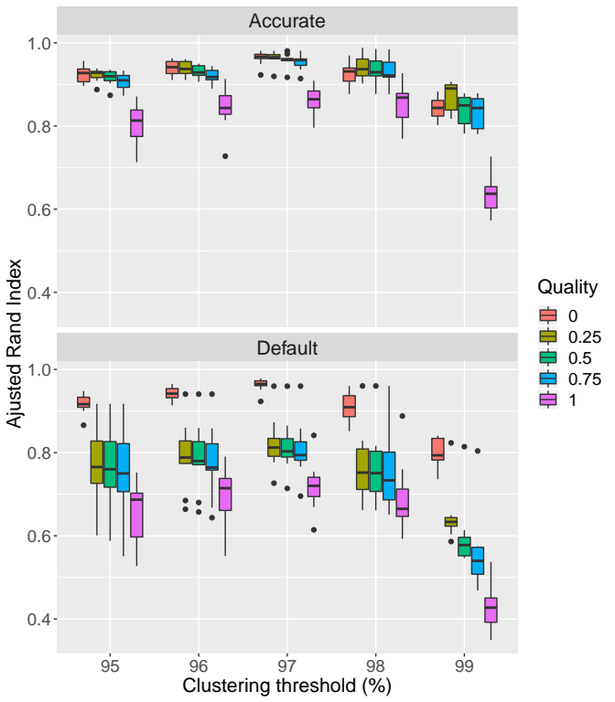
SCLUST evaluation
97 % threshold shows best clusters
Accurate mode leads to less variability and high ARI, mostly with quality parameters higher than 0
Accurate mode increases X time the computation time, for similar ARI when we take quality = 0.

Slide 3
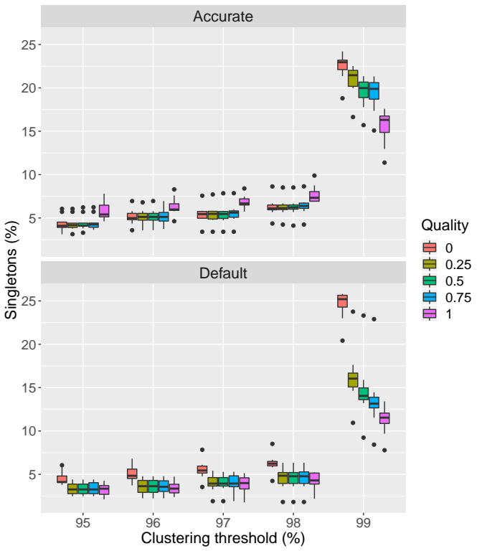
SCLUST evaluation
Jump between 95-98 and 99 % threshold
Highest singletons rate for quality = 0, but ARI was the best, mostly with 97 % threshold
=> Best parameters
Threshold = 97 %
Quality = 0
Default mode (for computation time)

Slide 4
SCLUST comparison with other tools

Slide 5
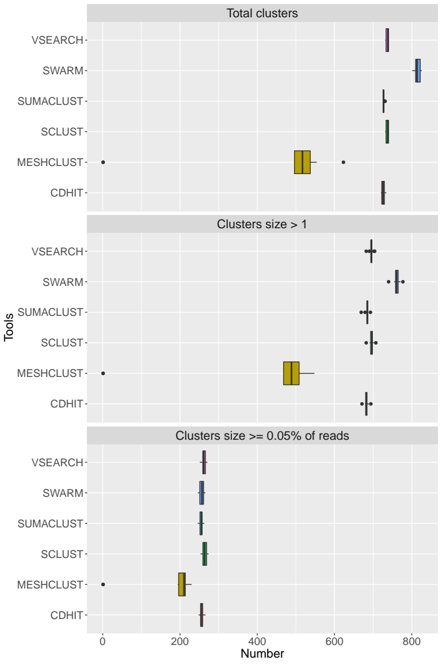
SCLUST comparison with other tools

Slide 6
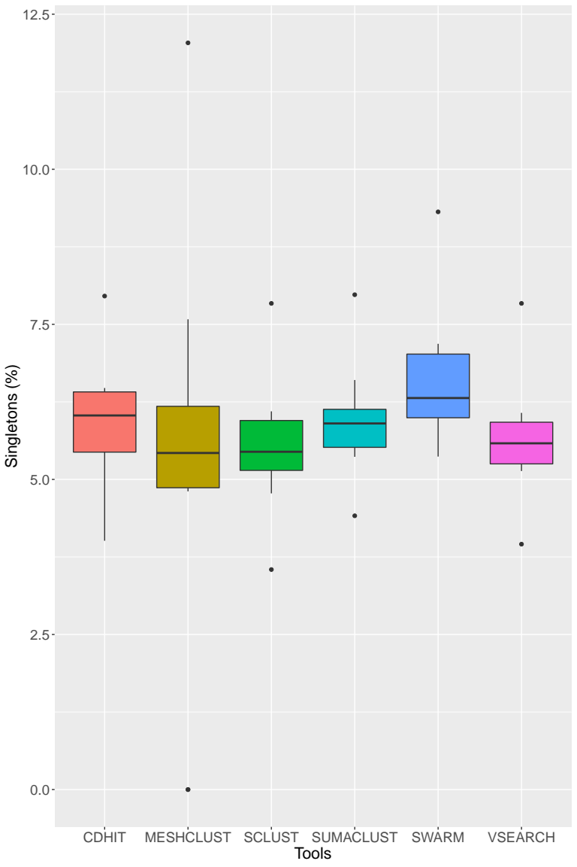
SCLUST comparison with other tools

Slide 7
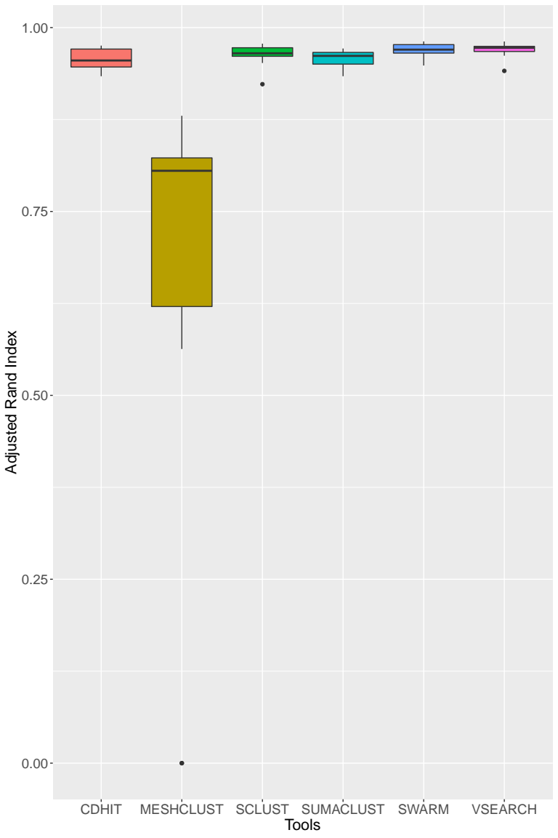
SCLUST comparison with other tools

