Slide 1
PaaS
A Lecture for A4M39WA2
Ing. Tomáš Vondra

Slide 2
Cloud Computing
A new form of IT outsourcing
  Replaces server rental, webhosting, managed applications
  Correspoding layers: IaaS, PaaS, SaaS
Brings new features
  Elasticity, automation, infinite scale
  Pay per use, accounting
  Self service, web services integration
Three layers:

Slide 3
IaaS
Computing infrastructure offered on the web
  CPU power, memory, storage, network
Enabling technology – Virtualization
  Flexible allocation and sharing of servers
  Separation of customers = multitenancy
  -> granularity – one VM instance and hour
Different usage model from raw virtualization
  Multiple VMs from one read-only image
  Agile infrastructure – 1 server, multiple purposes

Slide 4
PaaS
Public solution stacks for web applications
  OS, web server, language interpreters, provisions for automatic scaling, all shielded from the user
Each system only has a few supported languages
  Automatic deployment and scaling not trivial
Offers development tools
  Libraries for specific services
  IDE plugins, deployment tools
Two types – Instance PaaS, Framework PaaS

Slide 5
SaaS
A new form of application delivery
Global availability – web application, user data
Multitenancy – users use the same installation
Licensing – ideally pay per use
  When monthly payment, it should be elastic
Third layer of cloud doesn’t imply use of underlying layers, but elastic infrastructure is advisable
  <- No control over the number of users

Slide 6
PaaS properties
Gives the programmer a solution stack
  Web server, database engine, scripting language
Simple deployment, no worries about servers, storage, network, scaling, updates, …
Guarantees multitenancy for better security
Users isolated by virtualization or OS means
Accounting and billing of used resources
  Different at every vendor
Development tools

Slide 7
Comparison with IaaS
IaaS better for migrating existing applications
  More flexible, you install your environment
PaaS has lower demands on administration
PaaS will take care of scaling if applications use correct frameworks, also redundancy and CDN
-> PaaS better for new applications
BUT has dangers of vendor lock in if platform specific functions are used
  IaaS instance can be copied to your server.

Slide 8
Comparison with Webhosting
Webhosting essentially does the same – offers a platform for web sites / applications
Minus scalability, multitenancy, accounting
Plus personal contact – negotiation, support
Different languages, cloud focuses on scalability
  Hosting: PHP, ASP, some Perl and Python
  Cloud: Java, Ruby, PHP (due to demand), Node.js
Added value – e-mail and domain hosting
  vs. development tools and web services in PaaS

Slide 9
PaaS types
Instance PaaS
  Depends on IaaS layer for multitenancy
    Better security and performance guarantees
  Deploys applications to IaaS instances
Framework PaaS
  Uses OS capabilities for multitenancy
    Better resource utilization and accounting granularity
  Requires specific frameworks to be used
  Can benefit from cloud infrastructure, but is not dependent on it
Metadata PaaS
  Client configures his service through metadata

Slide 10
Available systems (selected)
Instance PaaS
  Amazon Elastic Beanstalk
  Microsoft Azure
Framework PaaS
  Google App Engine
  VMware Cloud Foundry

Slide 11
Google App Engine
Since Apr. 2008, commercial in Sep. 2011
Languages (in order) – Python, Java, Go
Typical Framework PaaS
  Multitenancy by limiting system library functions
    No filesystem writes and network sockets
    Must use specific database and network services
      High vendor lock-in potential (ex. emulation projects)
  Quotas needed to support massive multitenancy
    Daily quotas – billing, fair use
    Per minute quotas – spike prevention

Slide 12
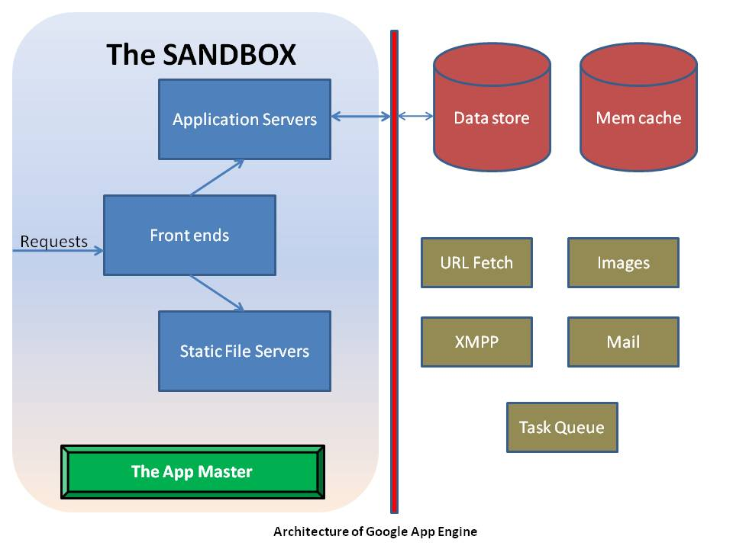

Slide 13
GAE - Quotas
Basic quota enough for development
  28 h CPU time per day (granularity 15 min)
  1 GB datastore, 5 GB blobstore, 1 GB network traf.
If billing enabled, minor service quotas raised
  $0.08 CPU hour 600 MHz (of what?), larger inst.
  $0.12 1 GB net traffic
  $0.24 datastore, $0.13 blobstore, $0.1 100k writes
If exceeded
  Main quotas: user gets HTTP 403
  Service quotas: OverQuotaError exception

Slide 14
GAE – Services
Data storage based on Google File System
  Over it BigTable noSQL database engine
    Providing Datastore and Blobstore APIs (GQL lang.)
      For Java JDO and JPA compatibility layers
        Problem – not SQL: no indexes, no joins –> very limited
  Datastore – Master-Slave or High Replication
Google Accounts, HTTP fetch, e-mail send, XMPP, Memcache, image manip. and others
Client libraries for all APIs in Eclipse plugin

Slide 15
GAE – Limitations
No state information between HTTP requests
  All sessions etc. in datastore
  Good for instance unloading and scalability
Event style programming, 30 s per request
  Last year: Single-threaded instances default
    Can be overriden with <threadsafe> in config
  Task queues (60s tasks) and backend instances
Specific programming style
  Practically impossible to deploy existing apps.
  Vendor lock-in

Slide 16
Amazon Elastic Beanstalk
Since beginning of 2011, still Beta
Initially only Java, extended by
  PHP and Python, Ruby, .NET
Amazon – major IaaS provider -> Instance PaaS
Other PaaSs on Amazon: Heroku, AppFog, ..
Multitenancy by virtualization
  Each user gets his own VM instances
  Some services shared, some need more instances
  Minimal limitations – can migrate to IaaS

Slide 17
Beanstalk – Pricing
Free – only a management tool for other services
  Prepares images with solution stacks, w/upgrades
Deploys images on EC2 instances:
  m1.small – $0.085 (1,7 GB RAM, 1 ECU)
  t1.micro – $0.02 (613 MB, 10% of 2 ECU)
Uses Elastic Load Balancer:
  $0.025 / 1 hour, $0.008 / 1 GB
Applications and logs are on S3:
  $0.14 / 1 GB and month
Uses Elastic Autoscaler, which needs CloudWatch
  $3.5 per instance and month
Data transfers outbound from cloud
  $0.12 / 1 GB basic price, degressive for larger volumes

Slide 18
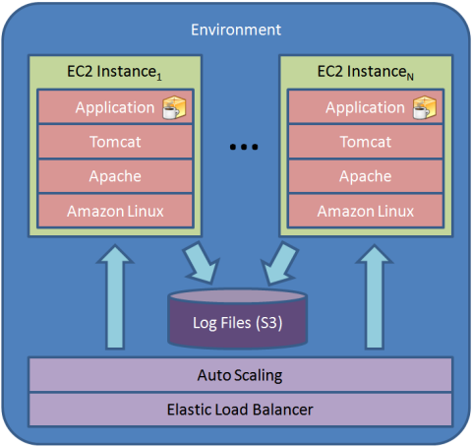

Slide 19
Beanstalk – Services
The service itself has no database, Amazon has:
Database VM instances
  per hour licensing for IBM DB2 and Informix, Oracle, MS SQL, Sybase, Postgres Plus, normal instance price for free DBs
RDS – automatically managed MySQL and Oracle
  does updates, backups, scaling, HA between av. zones
  Paid per hour, $0.11, 2x in hot-standby, $0.1 / 1 GB
Non-relational databases with variable row format & sharding
  SimpleDB - $0.25 / 1 GB, $0.14 / machine hour (shared)
    Max size 10 GB, automatic indexing, website use, 1 GB & 25 h free
  DynamoDB - $1 / 1 GB, $0.01 for 50 kB/s (granularity 1h)
    On SSD storage, guaranteed IOPS, for data mining
Other services: MapReduce, ElastiCache, Route 53, e―mail sending, Simple Queue Service, Simple Notification Service

Slide 20
Beanstalk – Limitations
Minimal.
  Applications are deployed to standard application servers (currently Apache Tomcat)
  Standard relational databases available
  Can disable the service and continue as IaaS only
Local storage is ephemeral, design for scalability
High price ~ $40 for minimal conf. + database
Eclipse plugin provided, API and CLI tools

Slide 21
Microsoft Azure
Since Oct. 2008, commercial in Feb. 2010
Languages: ASP.NET, PHP, Node.js, Java
Internally Instance PaaS, VM Role only recently
  Web Role – runs IIS server on W2k8 and Hyper-V
    Application is a web server root directory
  Worker Role – no IIS
    Application is a package with EXE file
    For services outside IIS, ie. Java, Node.js
  VM Role – runs your VHD images of W2k8
    Essentially IaaS

Slide 22
Azure – Pricing
Instance PaaS – accounting by instance hours
5 instance types, prices exactly as Amazon + Win
  Small: 1 CPU, 1,75 GB RAM, 230 GB disk, $0.12
  ExtraSmall, 768GB RAM, 20 GB disk, $0.04
Possible to buy discount packages
  Like Amazon’s Reserved Instances
Interesting SLA – 99.95% only if you have 2 inst.
  Automatic updates need reboot :-P

Slide 23
Azure – Services
noSQL storage
  Tables – variable row format, max. 255 attributes, manual sharding - “partition key”
  Blobs – for storing large objects
    Block blobs: 4 MB blocks, addressable individually or as a whole, max. size 200 GB, may use CDN
    Page blobs: 512 B pages, sparse writes, snapshots
      Azure Drives: page blobs containing VHD images
    Queues: 8 kB XML messages for IPC
  Counted together at $0.14 / 1 GB and $0.01 / 10k I/Os
SQL Azure – modified MS SQL Server with clustering
  Un-cloudlike flat fees, minimum $5 for max. 100 MB
AppFabric – Access Control, SOA bus; Connect (VPN), Market (apps and datasets), Caching, MPI

Slide 24
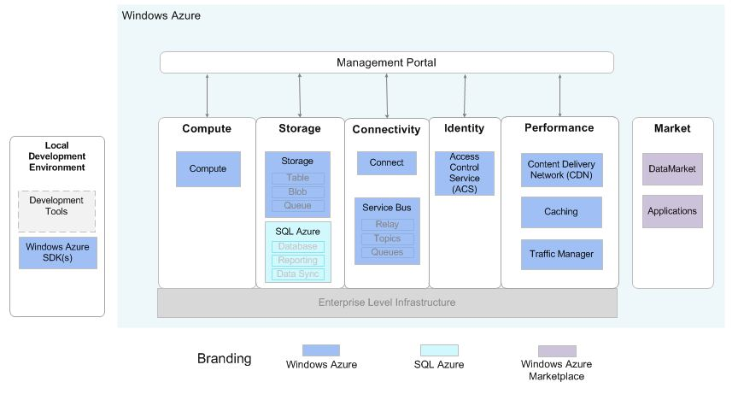

Slide 25
Azure – Limitations
MS technologies.
  Windows command line, T-SQL language, Caching is not memcached, MPI is not OpenMPI
  Some may view it as an advantage
A cloud classic – local storage is ephemeral
No e-mail sending service
Deployment requires writing an XML descriptor
  Also needed for scaling – no built-in automation
Prices higher than Amazon – need 2 instances
Plugins for MS Visual Studio and Eclipse

Slide 26
Cloud Foundry
Since beginning of 2011, still beta
The only open source PaaS to date
  Update – RedHat OpenShift now also available
  There will be multiple providers, private clouds
Supports Spring for Java, Ruby on Rails (and Sinatra), node.js, Grails and Scala on Lift
  Typical Framework PaaS
    Unlike Google, uses standard frameworks
  More added by companies and community
    PHP, Django on Python, Erlang
Three versions: cloudfoundry.com, private, micro (in a VMware Player image)

Slide 27
Cloudfoundry.com
Public version is free in beta
AppFog has a commercial public cloud already
Limits:
  2 GB total memory per user
    Apps can have from 64 MB to 2 GB per instance
  Maximum 20 applications
  128 MB data in MySQL
  16 MB Redis, 240 MB MongoDB
Which sums up the services, except RabbitMQ
  More may be added later

Slide 28
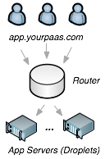
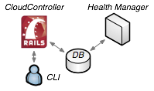
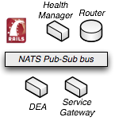
CloudFoundry – Structure
Droplet Execution Agent
Router
Cloud Controller
Health Manager
NATS message bus

Slide 29
Cloud Foundry – Limitations
Not significant if programmer adheres to framework’s design patterns
  For Java – contains Tomcat application server
Low Security – only standard UNIX user/group
  A local exploit will compromise the DEA, exposing other users’ apps and data
  Nimbula IaaS – launches a whole CF for each user
  ActiveState Stackato – a derivative using LXC
    (Iron Foundry – a derivative running .NET)
Scaling is manual, local storage ephemeral
Eclipse plugin available, “vmc” CLI tool

