Slide 1

Department of Cyber Security
2026-2027- Odd Semester
III Year /V Sem
CS23533-FOUNDATIONS OF ARTIFICIAL INTELLIGENCE
Review 1– 11/09/2026

Slide 2
Introduction
2
Background: Sokoban is a classic grid-based puzzle where a player pushes boxes onto target cells, with pushes only (no pulls) and one box at a time. This project builds a playable Sokoban game with an AI agent that solves levels using classical search algorithms.
Domain: Artificial Intelligence — specifically search-based problem solving (uninformed search, heuristic search, and knowledge-based deadlock rules) applied to an interactive puzzle-game setting.
Importance and Relevance:
Sokoban's large search space and irreversible moves make it a strong real-world example of why search strategy matters.
It shows how heuristics (A*) and domain knowledge (deadlock detection) drastically cut down search effort compared to blind search (BFS).
The techniques used (state-space search, pruning) generalize to practical problems like robotics and logistics planning.
The project pairs algorithm theory with a working GUI and benchmarking tools, making abstract AI concepts concrete and measurable.
[Department] | Project Review – 1 | [Academic Year]

Slide 3
Problem Statement
3
Problem Description: Solving a Sokoban level requires finding a sequence of pushes that moves every box onto a target cell, without ever pushing a box into a position it can no longer be moved out of. The state space grows extremely quickly with the number of boxes and the size of the board, making it impractical to solve levels by brute-force trial and error, especially as levels scale up in size and complexity.
Current Gaps: Blind search (BFS) explores states with no sense of progress, making it slow on larger levels. Without extra checks, a solver also wastes time exploring branches that are already dead ends (e.g., boxes stuck in corners). Most simple Sokoban tools only offer play or solving, not both together with performance comparison.
Why This Needs to Be Addressed: Without an informed and pruned search strategy, even moderately sized levels become computationally expensive or unsolvable in reasonable time, which limits both the playability of an AI-assisted game and its usefulness as a teaching tool for demonstrating search algorithm behavior.
Need for the Proposed Solution: A solver that combines heuristic guidance (A*) with domain-specific deadlock pruning is needed to make solving efficient and scalable, while also exposing the difference between search strategies (steps, nodes expanded, time) in a way that's visible and measurable — both to make the game usable (fast hints/solves) and to make the underlying AI concepts concrete for learning purposes.
[Department] | Project Review – 1 | [Academic Year]

Slide 4
Motivation
4
Why This Project Was Selected: Sokoban offers a simple rule set but a genuinely hard underlying search problem, making it an ideal vehicle for applying and comparing core AI search techniques — uninformed search, heuristic search, and knowledge-based pruning — within a single, hands-on project rather than studying them in isolation.
Research / Industry Motivation: Search and pathfinding algorithms similar to those used here underlie real-world systems such as warehouse and logistics robots (moving crates/pallets), automated planning systems, and puzzle-solving AI research. Sokoban is also a well-studied benchmark problem in AI literature (PSPACE-complete), making it a credible domain for demonstrating search performance rather than a purely toy example.
Expected Benefits:
A clear, measurable demonstration of how heuristics and pruning improve search efficiency over blind search.
A reusable, extensible codebase where new algorithms or heuristics can be added and benchmarked easily.
An interactive tool useful both for playing and for understanding how the AI reasons about the puzzle.
Practical Significance: Beyond the game itself, the project demonstrates transferable AI engineering skills — state-space modeling, search algorithm design, heuristic design, and performance benchmarking — that apply directly to broader planning and optimization problems in robotics, logistics, and automated decision-making systems.
[Department] | Project Review – 1 | [Academic Year]

Slide 5
Objectives
5
To design and implement an efficient state-space representation of Sokoban levels, encoding the player's position and the set of box positions as a compact, hashable state, so that visited states can be tracked and searched without redundant computation.
To implement uninformed search (BFS) as a baseline solver that guarantees a shortest-path solution when one exists, in order to establish a reference point for evaluating the performance of more advanced, informed search strategies.
To implement informed search (A*) using a Manhattan-distance heuristic, guiding the search toward promising states first and significantly reducing the number of nodes explored compared to blind search, while still preserving solution correctness.
To design and integrate knowledge-based deadlock detection rules (such as corner deadlocks and wall-line deadlocks) into the A* search, enabling the algorithm to recognize and prune states that can never lead to a solution, thereby further improving search efficiency.
To develop an interactive graphical user interface that supports manual play, step-by-step undo/redo, AI-generated hints, and full automatic solving with animated playback of the solution path.
[Department] | Project Review – 1 | [Academic Year]

Slide 6
Literature Survey
6
S.No. | Author & Year | Method / Technique | Key Findings | Limitations
1 | Junghanns & Schaeffer (1997) | IDA* with lower-bound heuristics (sum of box-to-goal distances) | Their work with IDA* aimed to demonstrate the inadequacy of single-agent search techniques for the Sokoban puzzle, using a simple lower bound based on the sum of distances from each box to its nearest goal | Even enhanced IDA* struggles to scale; establishes that plain heuristic search alone is insufficient for harder Sokoban levels.
2 | Rei & Teixeira — "Willy" solver | IDA* + Minimatching heuristic, hash tables, macro moves, relevance cuts | Willy combines IDA* search with a Minmatching heuristic and reduces the search space using techniques such as removing unsafe positions, hash tables to prevent loops, and macro moves that merge multiple states into one, along with relevance cuts to focus on pertinent moves. | The relevance-cuts technique, while speeding up search, can lead to non-optimal solutions.
3 | Peters (2023, Bachelor's Thesis) | Graph search algorithms with search-tree pruning; comparison with reinforcement learning approaches | The thesis presents multiple graph search algorithms and pruning techniques, along with a configurable GUI-based solver, to solve Sokoban levels faster and more efficiently. | Deep RL approaches require significant training data/time and may not generalize well across very different level structures.
[Department] | Project Review – 1 | [Academic Year]

Slide 7
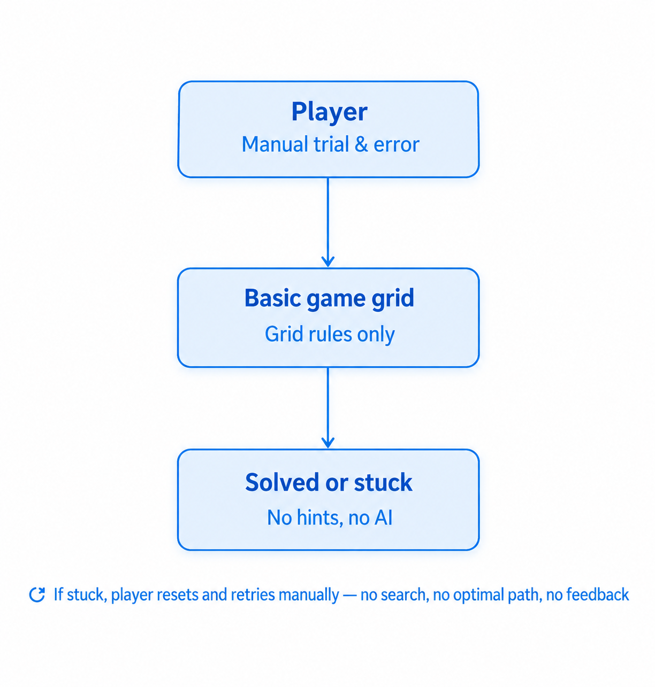
Existing System
7
Manual trial-and-error play, or plain uninformed search with no sense of progress.
Technologies
BFS/DFS on raw moves — no goal-awareness
No deadlock detection — explores dead states anyway
No benchmarking — no way to compare strategies
Advantages
Simple to implement
BFS guarantees an optimal solution when it finishes
Limitations
State explosion — slows down fast as boxes increase
Blind search — wastes effort with no heuristic
No performance data to justify improvements
[Department] | Project Review – 1 | [Academic Year]

Slide 8
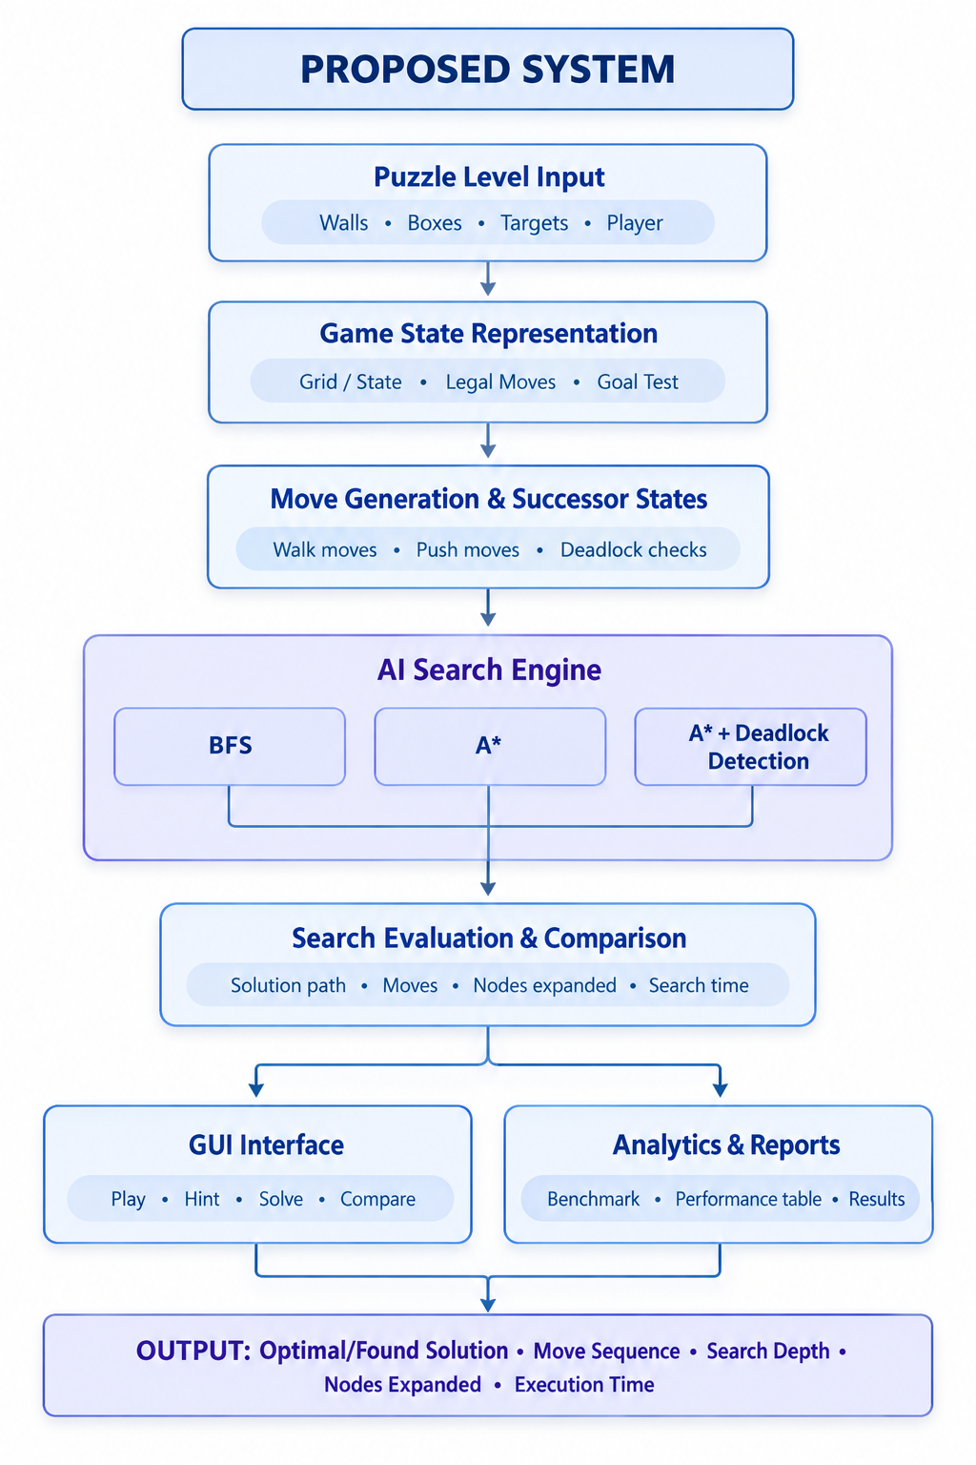
Proposed System
8
Proposed approach
Replace manual guesswork with a guided AI search pipeline — informed, prunable, measurable.
Key features
Push-based search — reasons over box pushes, not single steps
Heuristic-guided (A*) — always searches toward the goal
Deadlock pruning — skips states that can never be solved
Live comparison — BFS vs A* vs A*+Deadlock, side by side
How it improves the existing system
Blind search → goal-directed search
Wasted effort → pruned dead states
No feedback → measurable performance data
Expected outcome
Same optimal solution as brute-force search — found after exploring only about 1–2% of the states.
[Department] | Project Review – 1 | [Academic Year]

Slide 9
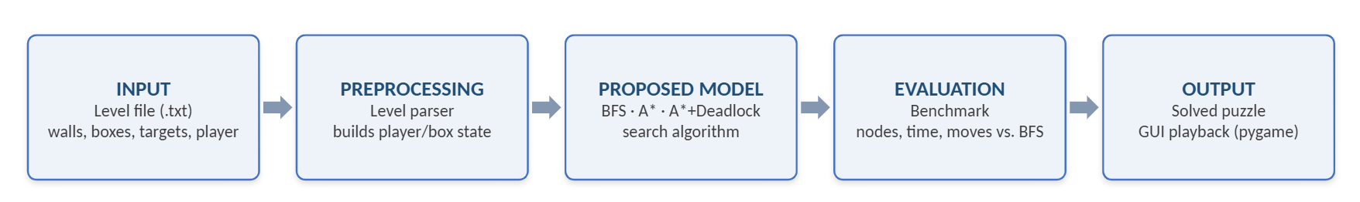
System Architecture / Block Diagram
9
Input — raw level file (.txt) defining walls, boxes, targets, and player position.
Preprocessing — parser reads the file and builds the initial player/box state.
Proposed model — search engine runs BFS, A*, or A*+Deadlock to find a solution.
Evaluation — benchmark compares nodes expanded, time, and moves against BFS.
Output — solved puzzle, played back visually in the pygame GUI.
[Department] | Project Review – 1 | [Academic Year]

Slide 10
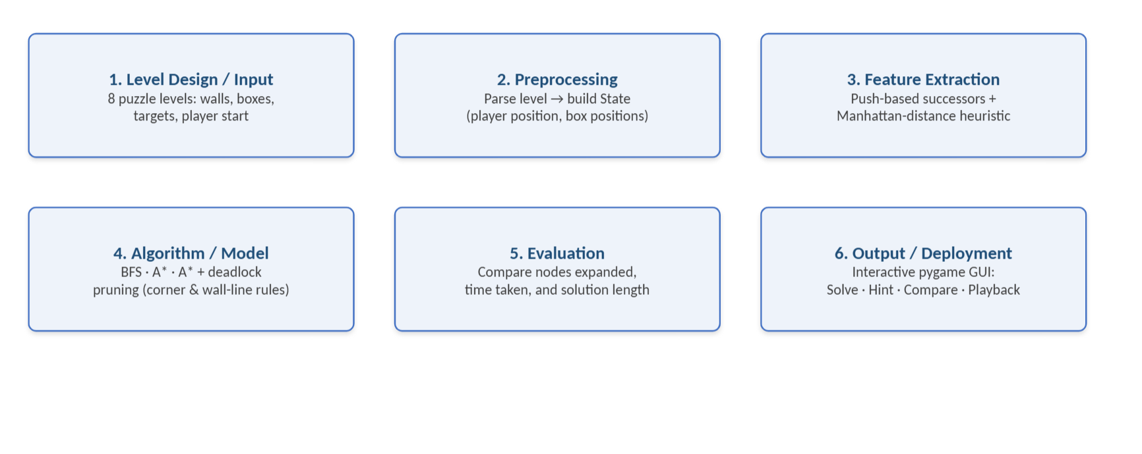
Methodology
10
[Department] | Project Review – 1 | [Academic Year]

Slide 11
Technologies Used
11
Programming Language
Python 3.9+ — used for the entire project. Chosen for its readable syntax, fast prototyping speed, and a standard library well suited to implementing search algorithms.
Framework / Library
pygame 2.6 — handles GUI rendering, input handling, and real-time animation/playback
Python Standard Library — heapq (priority queue for A*), collections (deque and namedtuple for BFS and state representation), time, os, math
Tools / IDE
VS Code / PyCharm — development, debugging, and code navigation
Git — version control across the codebase
pip + venv — dependency management and isolated environments
Custom CLI benchmark script — validates and times performance across all levels
Hardware Requirements
Runs on any standard PC or laptop — Windows, Linux, or macOS
CPU-only — no GPU required (classical search, not machine learning)
Under 100 MB RAM typical — state space is bounded by grid size
Display required only for GUI mode; benchmark mode runs headless
[Department] | Project Review – 1 | [Academic Year]

Slide 12
Module Description
12
Module 1 – Engine
Owns the game rules: level parsing
Module 2 – Solvers
The AI core: BFS, A*, and A*+Deadlock search algorithm
Module 3 – Interface
The pygame GUI: renders the grid
Module 4 – Puzzle
The level data: 8 puzzle files
Module 5 – Analytics
Benchmarking: runs every algorithm on every level
[Department] | Project Review – 1 | [Academic Year]

Slide 13
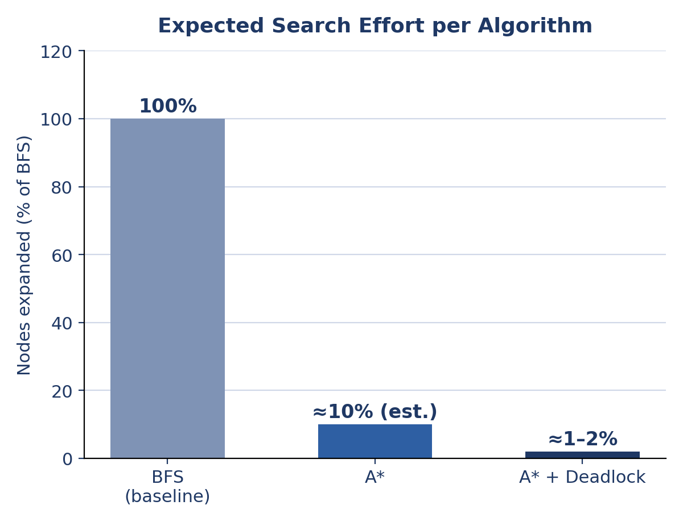
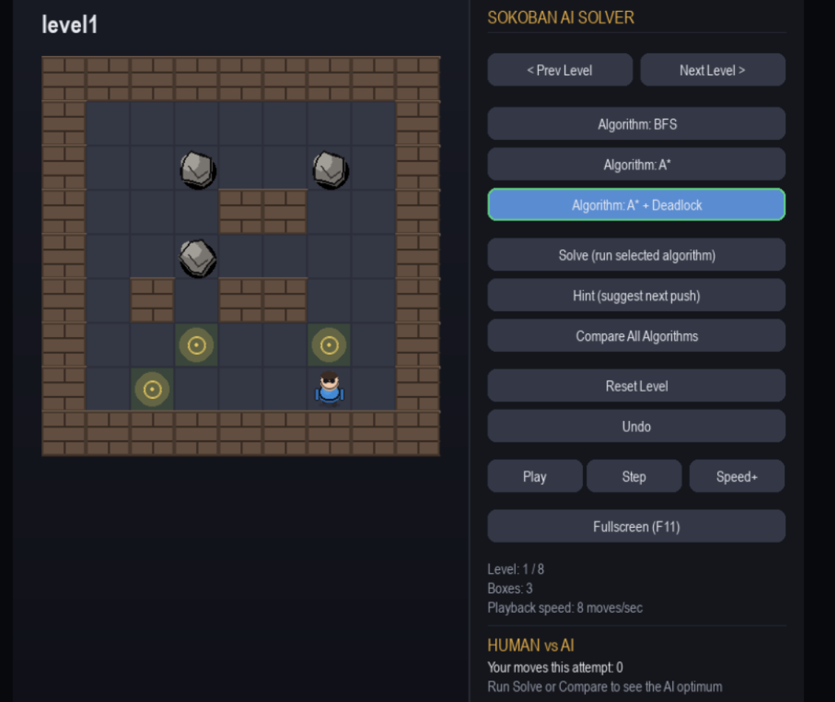
Preliminary / Expected Results
13
[Department] | Project Review – 1 | [Academic Year]

Slide 14
Project Schedule
14
Activity | Month 1 | Month 2 | Month 3 | Month 4
Literature Survey | ✓
Problem Identification | ✓
System Design | ✓ | ✓
Implementation |  | ✓ | ✓
Testing & Evaluation |  |  | ✓ | ✓
[Department] | Project Review – 1 | [Academic Year]

Slide 15
Current Progress
15
✓ Literature survey completed
✓ Problem identification completed
✓ Requirement analysis / methodology finalized
✓ Proposed architecture and core modules defined
☐ Implementation completed
☐ Testing completed
☐ Final evaluation completed
[Department] | Project Review – 1 | [Academic Year]

Slide 16
Future Work
16
Complete Implementation
Finalize search logic in the engine and solvers modules
Complete the Pygame interface — manual play, Solve, Hint, and Compare modes
Validate all 8 levels for correctness and solvability
Compare with Existing Methods
Benchmark A*+Deadlock against BFS (baseline) and plain A*
Quantify the gain from the heuristic and from deadlock pruning separately
Reference standard Sokoban approaches (e.g. pattern databases, macro-moves) where relevant
Perform Performance Evaluation
Evaluate on three metrics: nodes expanded, time taken, solution optimality
Compute speed-up factor and % reduction in nodes vs. BFS
Present results as comparison tables and charts
Prepare Final System / Documentation
Consolidate codebase into final modular form
Write setup/usage documentation (README),Prepare final report: problem formulation, methodology, results, conclusion
[Department] | Project Review – 1 | [Academic Year]

Slide 17
Conclusion
17
Brief Summary of the Project
This project implements an AI-based Sokoban puzzle solver that models each puzzle as a search problem over player and box positions, and solves it using classical search algorithms. The system includes an interactive graphical interface built with Pygame, allowing a user to play manually, request AI hints:
AI-based Sokoban solver modeling the puzzle as a search problem over player/box positions
Solved using classical search algorithms (BFS, A*, A*+Deadlock)
Interactive Pygame GUI: manual play, AI hints, auto-solve, and algorithm comparison
Key Contribution / Novelty
Side-by-side comparison of BFS, A*, and A*+Deadlock on identical puzzle instances
Deadlock detection layer (corner + wall-line rules) prunes unsolvable states before they're explored
Shows how domain knowledge improves search efficiency without sacrificing optimality
Clean 5-module architecture — algorithms fully decoupled from and reusable without the GUI
Expected Outcome and Significance
A working system where efficiency gains of smarter search are directly visible and measurable
Results shown both numerically (benchmark tables) and interactively (in-game comparison panel)
Demonstrates core AI concepts — state-space search, heuristic design, knowledge-based pruning
Illustrates how classical AI search scales from toy examples to real combinatorial puzzles
[Department] | Project Review – 1 | [Academic Year]

Slide 18
References
18
[1] A. Junghanns and J. Schaeffer, "Sokoban: A Challenging Single-Agent Search Problem," in Proc. IJCAI Workshop on Using Games as an Experimental Testbed for AI Research, 1997.
[2] L. Rei and R. Teixeira, "Willy: A Sokoban Solving Agent," Technical Report / Academic Project, Faculdade de Engenharia da Universidade do Porto (FEUP), 2010.
[3] [First name initial. Surname] Peters, "[Thesis title]," Bachelor's Thesis, [University], 2023.
[4] J. Culberson, "Sokoban is PSPACE-Complete," Technical Report TR 97-02, Dept. of Computing Science, University of Alberta, 1997.
[Department] | Project Review – 1 | [Academic Year]

