Slide 1

Department of Computer Science and Engineering
(Cyber Security)
CS23533– Foundations of Artificial Intelligence
2026-2027
A Heuristic and Deadlock-Aware Search System for Sokoban Puzzle Solving — Review 2
Supervisor
Dr. S. Bhuvana
Assistant Professor (SG)
Team Members
Mettu Mani Chandhan Sai (241901054)
Mebish V D (241901053)

Slide 2
Problem Statement and Motivation
Problem: find the fewest pushes that put every crate on a goal, without ever creating a deadlocked position.
Why it is hard: Sokoban is PSPACE-complete; positions explode with each extra crate, so blind search runs out of time.
Who is affected: AI learners who need measurable evidence, and planners of push-only tasks such as warehouse robots.
Motivation: combine heuristic search with deadlock knowledge, and make every gain visible in a playable lab.

Slide 3
Objectives
# | Objective | Measurable outcome | Status
1 | Model Sokoban as a push-level state space (crates + keeper region) | Duplicate states merged: Storeroom BFS 62,560 → 9,952 positions | Completed
2 | BFS as the uninformed, optimal baseline | Fewest pushes on every level it finishes (27 / 34) | Completed
3 | A* with an admissible, consistent Manhattan heuristic | Same optimum; 84.1% fewer positions than BFS (median) | Completed
4 | Deadlock rules: corner, wall-line, dead square, freeze | Sound pruning (fuzz-tested); 34 / 34 solved; 92.6% fewer | Completed
5 | Sharper heuristic: push distance + Hungarian matching (added) | 34 / 34 solved; 99.5% fewer positions than BFS | Completed
6 | Interactive lab: play, hint, solve, race, benchmark | Live web app on GitHub Pages | Completed
7 | Final evaluation, report and documentation | Final report and model-review deck | In progress

Slide 4
Project Progress Since Review 1
All five modules implemented in plain Python (standard library only) and published on GitHub.
State identity fixed (crates + keeper region): Storeroom BFS fell from 62,560 to 9,952 positions.
Fourth rung added: A* + Deadlock + Matching (Hungarian assignment heuristic).
Desktop pygame window replaced by a web app; Pyodide runs the same Python in the browser.
Level set grown to 34 levels in four packs, with a level editor and a level generator.
Full benchmark run: 4 algorithms × 34 levels, plus 59 passing unit and fuzz tests.
5 / 5
modules implemented
4
search algorithms
34
levels in 4 packs
59
tests passing
Current status
Completed: design, coding, testing, benchmark
In progress: final evaluation and report

Slide 5
Literature Survey
S. No. | Author(s) & Year | Paper Title | Methodology / Algorithm | Limitations
1 | P. E. Hart, N. J. Nilsson, B. Raphael (1968) | A Formal Basis for the Heuristic Determination of Minimum Cost Paths | A* best-first search, f(n) = g(n) + h(n); proves optimality with an admissible heuristic | Efficiency rests entirely on h; keeps every generated node in memory; no notion of irreversible dead ends
2 | J. C. Culberson (1997) | Sokoban is PSPACE-complete | Formal complexity analysis of Sokoban by reduction | Theoretical only: offers no solving method, and shows blind search cannot scale
3 | A. Junghanns, J. Schaeffer (2001) | Sokoban: Enhancing General Single-Agent Search Methods Using Domain Knowledge | IDA* with a minimum-matching lower bound, transposition table, deadlock tables, macro moves, relevance cuts | Heavily hand-tuned; relevance cuts can lose optimality; still leaves part of the 90-level test suite unsolved

Slide 6
Literature Survey
S. No. | Author(s) & Year | Paper Title | Methodology / Algorithm | Limitations
4 | A. Botea, M. Müller, J. Schaeffer (2002) | Using Abstraction for Planning in Sokoban | Abstraction planning: the maze is split into rooms and tunnels and solved as smaller sub-problems | No optimality guarantee; the gain depends on maze-like structure and is small in open rooms
5 | A. G. Pereira, M. Ritt, L. S. Buriol (2015) | Optimal Sokoban Solving Using Pattern Databases with Specific Domain Knowledge | A* with instance-dependent pattern databases, intermediate-goal decomposition and domain tie-breaking | Costly per-instance precomputation and memory; complex to build; does not explain its search to a user

Slide 7
Research Gap and Project Response
1. Literature findings
A* is optimal with an admissible heuristic [1]; Sokoban is PSPACE-complete [2]; strong solvers rely on domain knowledge: deadlock tables, matching bounds, abstraction, pattern databases [3]–[5].
2. Limitations
Strong solvers are heavily engineered and opaque; some trade optimality for speed; none isolates what each idea contributes on identical levels.
3. Refined research gap
A compact, explainable system that measures the value of each classical idea (heuristic, deadlock knowledge, matching) under one cost model, and lets a learner watch it work.
4. Progress toward the solution
Built: a four-rung ladder with one push-cost model; every pruned push names its rule; a live race and benchmark lab report positions, time, pushes and moves vs BFS.

Slide 8
System Architecture / Proposed System
Web interface — HTML5 · CSS3 · JavaScript
Play · Race · Lab · Build · Guide | canvas board, overlays, graphs
How the components interact
The page sends every action as a JSON call; the bridge answers with the new position, search progress or results.
Searches run in short time slices, so the board keeps animating while BFS works and four searches can race.
Dependencies point one way: the engine knows nothing about solvers or the page.
Improvements over the existing system
Goal-directed search instead of trial and error
Hopeless pushes pruned, and the rule is named
Every result measured against the BFS baseline
One Python code base for CLI, tests and browser
JSON calls through Pyodide (CPython compiled to WebAssembly)
Interface bridge — bridge.py (M3)
game session · timeline (undo, redo, replay) · time-sliced search jobs
Solvers (M2)
BFS · A* · deadlock rules · matching
Puzzles (M4)
34 levels · reverse-play generator
Analytics (M5)
benchmark · CSV / Markdown
Engine (M1)
level parsing and validation · push-level state space · LURD moves

Slide 9
DFD Diagram – Level 0
Level 0 – context diagram: the whole system as one process and the people who exchange data with it.
0
Sokoban Search Lab
AI solver + interactive web lab
level choice, moves, algorithm, custom level
benchmark request: level pack, time / node budget
Player
(student / user)
Evaluator
(reviewer / tester)
board, hints, deadlock warnings, solution animation
results table, CSV and Markdown reports
Notation:
external entity
process
D
data store
data flow

Slide 10
DFD Diagram – Level 1
Level 1: process 0 broken into six processes and three data stores.
1.0
Load & Validate Level
level text (XSB)
D2
Session Timeline
D1
Level Library
positions, moves
level id / Level, start
levels
Player
2.0
Play & Track Moves
position /
rule
3.0
Detect Deadlocks
Evaluator
level choice, moves, requests
view state
position /
solution
pack, budget
dead-square map
CSV, MD
board, overlays, animation
6.0
Render & Animate
4.0
Search Solution
5.0
Benchmark & Report
D3
Benchmark Results
search
trace
runs /
results
Notation:
external entity
process
D
data store
data flow

Slide 11
Methodology / Workflow Diagram
1
INPUT
2
PREPROCESSING
3
PREPROCESSING
4
DESIGN
Level input
Parse & validate
Precompute
Formulate
XSB text: walls #, crates $, goals ., keeper @
One keeper, crates = goals, enclosed room, every crate reachable
Floor graph, dead-square map by reverse pulls, push-distance tables
State = crates + keeper region; action = push; cost = pushes
5
IMPLEMENTATION
6
IMPLEMENTATION
7
TESTING
8
EVALUATION · OUTPUT
Search
Prune & rebuild
Verify
Evaluate
BFS → A* → A* + Deadlock → A* + Deadlock + Matching
Rules discard hopeless pushes; plan expanded to LURD moves
59 unit + fuzz tests: equal optimal pushes, sound pruning, admissible h
34 levels × 4 algorithms vs BFS; animation, race, benchmark lab
Feedback loop: findings from testing and benchmarking go back into steps 4–6 (e.g., the state-identity and timing fixes after Review 1).

Slide 12
Tools and Technologies
Programming languages: Python 3.9+ for the solver, tests and benchmark; JavaScript (ES6), HTML5 and CSS3 for the interface.
Frameworks / libraries: Python standard library only (heapq, collections, itertools, time, unittest); Pyodide; HTML5 Canvas and Web Audio.
Software / hardware / dataset: VS Code, Git, GitHub Pages; any CPU-only PC with a modern browser; 34 XSB levels in four packs.
Why these tools: no third-party packages, so the same code runs in the terminal, the tests and the browser; classical search needs no GPU.
Python 3.9+
JavaScript ES6
HTML5 Canvas
Pyodide · WebAssembly
unittest
Git · GitHub Pages

Slide 13
List of Modules
Module | Folder / files | Responsibility | Status
M1 Engine | engine/ – level.py, state.py | Parse and validate levels; push-level state space; pushes → moves | Completed
M2 Solvers | solvers/ – bfs, astar, heuristics, deadlock, solve, compare | BFS, A*, deadlock rules, matching heuristic; pausable search; race | Completed
M3 Interface | interface/ – bridge.py, site.py, web/ | Browser UI (Play, Race, Lab, Build, Guide); Python bridge; site build | Completed
M4 Puzzles | puzzles/ – library.py, generator.py, 4 packs | 34-level catalogue; reverse-play level generator | Completed
M5 Analytics | analytics/ – benchmark.py, report.py | Every algorithm on every level; table, CSV, Markdown, summary | Completed
Testing | tests/ – 6 test files | 59 unit and fuzz tests across all five modules (all passing) | Completed
Final report | README.md, report | Write-up of formulation, method and results | In progress

Slide 14
Module Implementation – Part 1
M1
Engine – the rules
M2
Solvers – the AI
Purpose
Turns a level into a searchable, hashable state space.
Input → output
XSB text → Level (walls, goals, floor) + State (keeper, crates).
Key functions
parse_level() rejects broken levels; reachable() flood-fills the keeper region; legal_pushes(), push(); arrivals() merges keeper positions; pushes_to_moves() gives LURD moves.
Design choice
Cells are integers (y × width + x), so a step is one addition; states are immutable and hashable.
Status and tests
Completed. 10 engine tests pass: parsing, illegal levels, pushes, replay.
Purpose
Four searches of growing intelligence, all minimising pushes.
Input → output
Level, start, algorithm, limits → moves, pushes, positions expanded, pushes pruned by rule, time.
Key functions
bfs(); astar() with f = g + h; Deadlocks (dead-square map + freeze); manhattan(), matching() with Hungarian min_assignment(); Search.advance(seconds).
Design choice
Every search is a generator that yields every 32 expansions, so the page can pause, draw or race it.
Status and tests
Completed. 18 tests incl. fuzzing: identical optimal pushes; every pruned position proven unsolvable.

Slide 15
Module Implementation – Part 2
A* + Deadlock – core loop (solvers/astar.py)
M3
Interface completed · 19 bridge + 3 site tests
frontier ← {start}; g[start] ← 0
while frontier not empty:
s ← pop lowest f = g + h (ties: lower h)
if all crates on goals: return path(s)
region ← flood_fill(keeper, s.crates)
closed ← closed ∪ states(s.crates, region)
for each push (crate, dir) from region:
c ← apply(push)
if c in closed or g[s]+1 ≥ g[c]: skip
if rule ← dead(c, crate+dir):
pruned[rule] += 1; skip
if h(c) is None: skip # no matching
g[c] ← g[s] + 1; push c on frontier
return UNSOLVABLE
bridge.Game keeps the timeline and runs searches in time slices; the page draws the board, overlays and graphs from JSON replies.
M4
Puzzles completed · 5 tests
34 plain-text levels; the generator pulls crates back from the solved position, so every new level is solvable.
M5
Analytics completed · 4 tests
Runs the whole ladder on every level under one budget; reports savings vs BFS as table, CSV and Markdown.

Slide 16
Preliminary Results and Discussion
Algorithm | Levels solved | Positions expanded | Total time | Median saving vs BFS
BFS | 27 / 34 | 1,585,175* | 193.9 s | baseline
A* | 33 / 34 | 479,526 | 61.2 s | 84.1%
A* + Deadlock | 34 / 34 | 225,947 | 40.8 s | 92.6%
A* + Deadlock + Matching | 34 / 34 | 4,930 | 0.9 s | 99.5%
Same answer, less work. All four always return the same, optimal push count; they differ only in how much they search.
Each idea pays off. Median saving vs BFS: 84.1% → 92.6% → 99.5% fewer positions.
Knowledge matters in tight rooms. Dead Stock: A* 23,707 → A* + Deadlock 2,969 positions.
Test set: 34 levels; budget 200,000 positions / 20 s per search. * BFS hit the budget on 7 levels, so its totals are lower bounds.

Slide 17
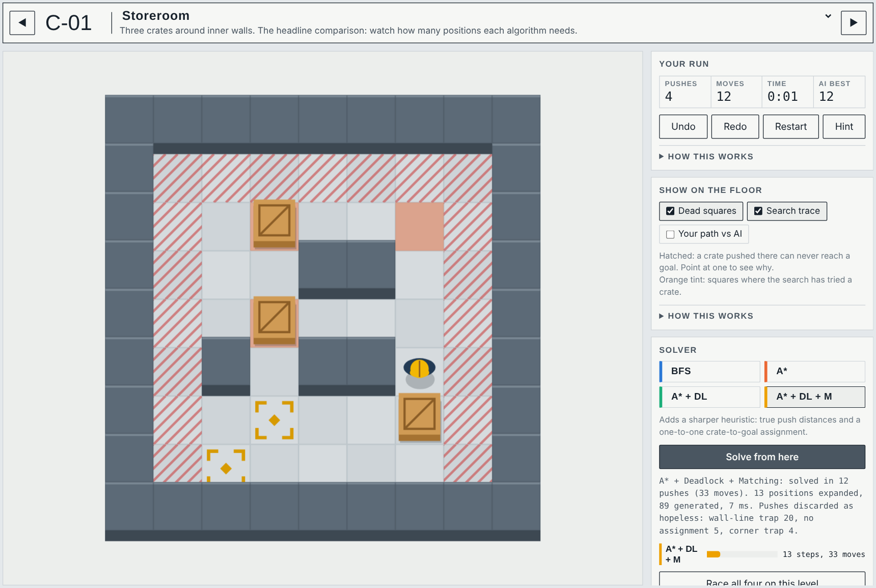
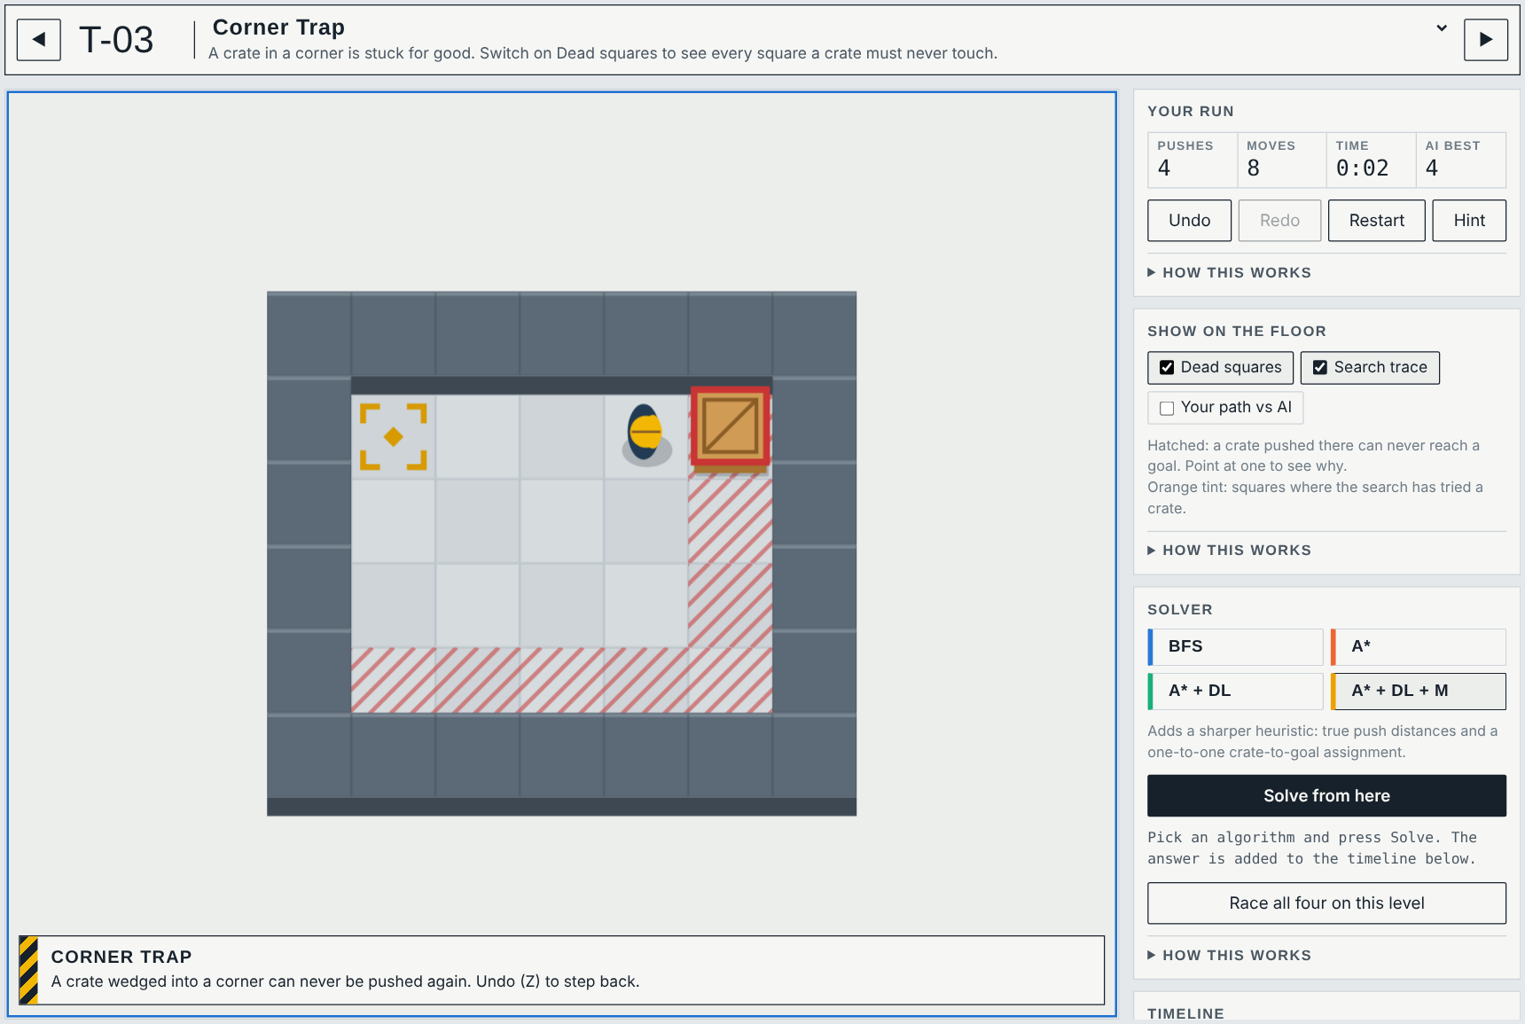
User Interface / Implementation Screenshots
Play + solver – A* + Deadlock + Matching solves Storeroom in 12 pushes after expanding 13 positions; hatched squares are dead squares, the timeline replays the answer.
Deadlock coach – the moment a push makes the level unwinnable, the rule is named (here: corner trap) and the crate is outlined; Undo steps back.

Slide 18
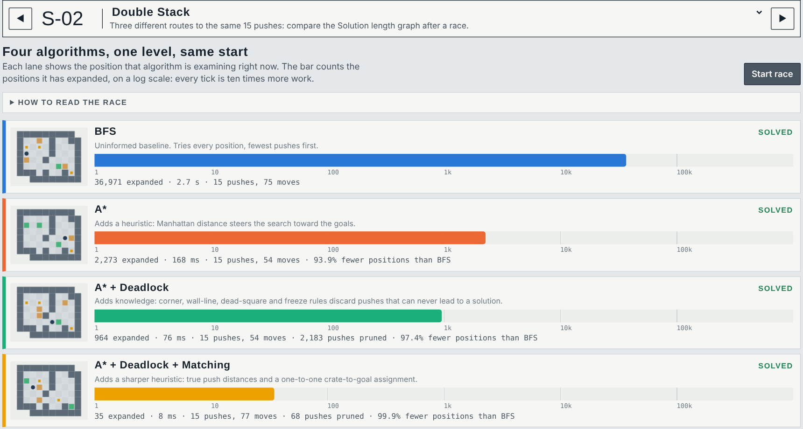
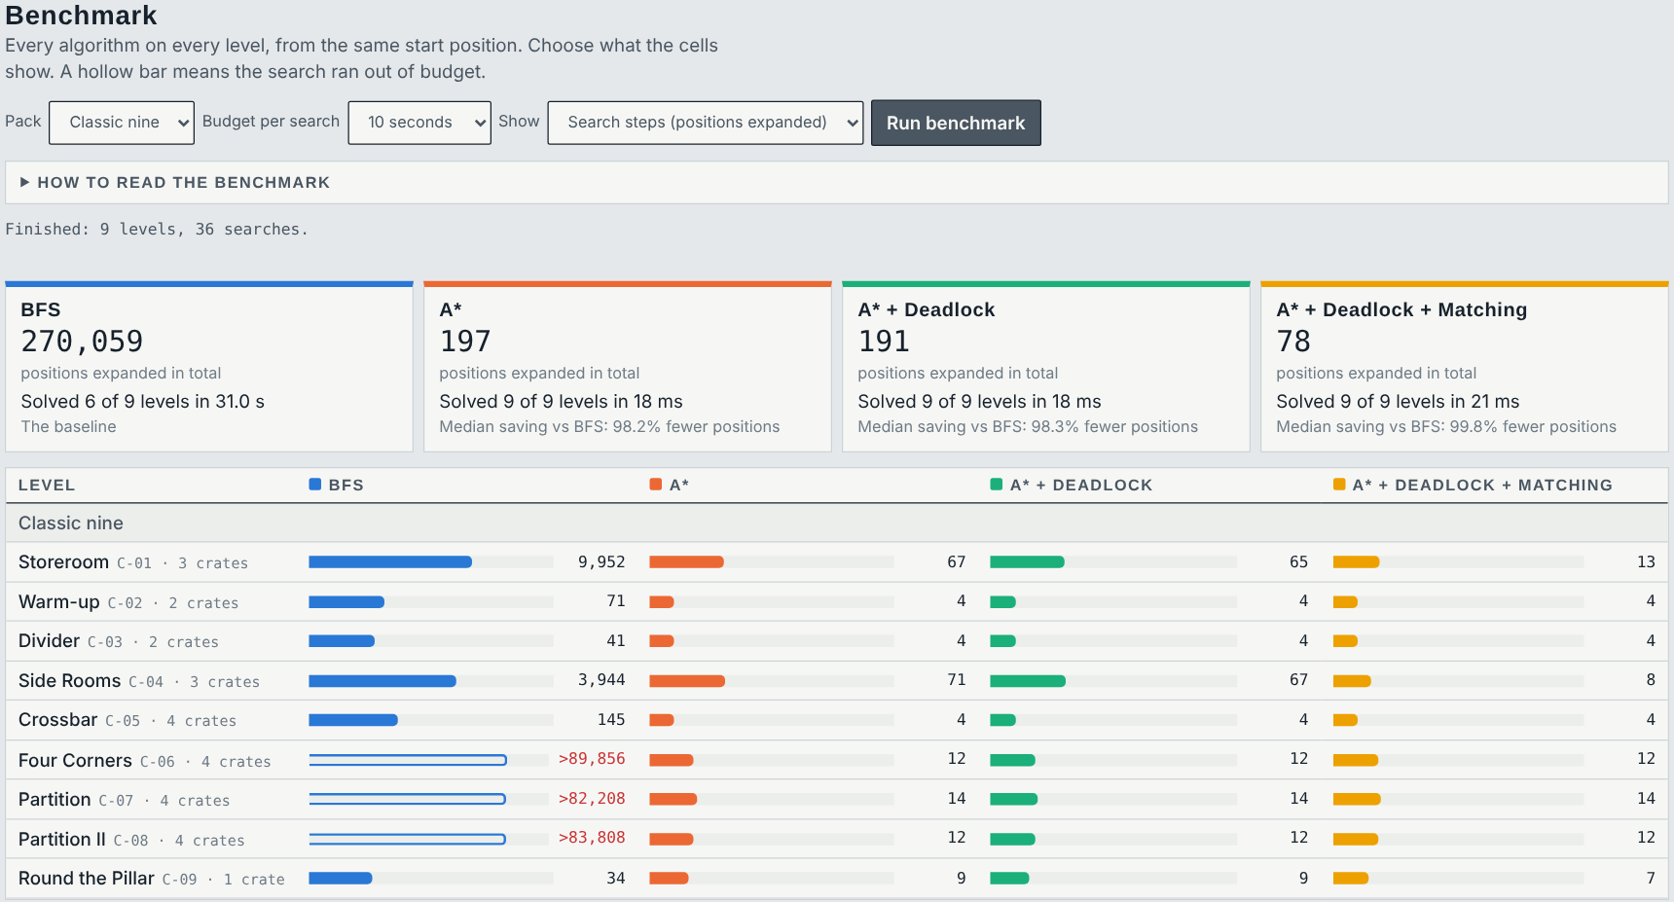
User Interface / Implementation Screenshots
Race – all four algorithms on Double Stack at once: 36,971 vs 2,273 vs 964 vs 35 positions expanded, the same 15 pushes.
Benchmark lab – every algorithm on every level of a pack with totals and median savings; copy as CSV or Markdown.

Slide 19
Challenges Faced and Solutions
Challenge faced | Solution adopted
Same crates with the keeper elsewhere were treated as different states, multiplying the work | States keyed by crates + keeper region: Storeroom BFS 62,560 → 9,952, A* 1,000 → 67 positions
Deadlock checks re-derived for every crate made A* + Deadlock slower than A* | Dead squares precomputed once per level; freeze rule added; warehouse pack where pruning matters
Reports called the move count optimal, though the search minimised pushes | Pushes are the stated cost; pushes and moves reported separately; a test checks all agree on pushes
Speed-ups such as “39,121,151×” came from a timer that read zero | High-resolution perf_counter timing that includes each algorithm’s set-up
A timed-out BFS left its row blank, so the comparison was lost | Savings reported as lower bounds when BFS hits its budget
A level was accepted whenever crate and goal counts matched | Validation: one keeper, walls all round, every crate and goal reachable; the editor shows why
Desktop-only pygame window with a 5 MB music file | Web app via Pyodide running the same Python; synthesised sound; nothing to install
Remaining issues: BFS cannot finish the largest levels within 200,000 positions; Python in the browser runs a few times slower than native; the freeze rule does not catch every multi-crate deadlock.

Slide 20
Work Plan Until Final Review
Week 1
Week 2
Week 3
Week 4
Extended evaluation
• Re-run the benchmark on a second machine
• Add a public level subset (e.g. Microban)
• Record time variance per level
Solver refinement
• Study corral deadlocks and tunnel macros
• Keep every optimality test green
• Profile the browser build
Documentation
• Final report: formulation, admissibility, results
• Screenshots and figures
• README and code comments
Final testing & presentation
• Cross-browser test of the live site
• Final slides and demo rehearsal
• Submit report and code
At the final review: working system, final benchmark tables, report, presentation and live demo.

Slide 21
References
[1] P. E. Hart, N. J. Nilsson and B. Raphael, “A formal basis for the heuristic determination of minimum cost paths,” IEEE Trans. Systems Science and Cybernetics, vol. 4, no. 2, pp. 100–107, 1968.
[2] J. C. Culberson, “Sokoban is PSPACE-complete,” Tech. Rep. TR 97-02, Dept. of Computing Science, University of Alberta, 1997.
[3] A. Junghanns and J. Schaeffer, “Sokoban: Enhancing general single-agent search methods using domain knowledge,” Artificial Intelligence, vol. 129, no. 1–2, pp. 219–251, 2001.
[4] A. Botea, M. Müller and J. Schaeffer, “Using abstraction for planning in Sokoban,” in Computers and Games (CG 2002), LNCS 2883, Springer, 2003, pp. 360–375.
[5] A. G. Pereira, M. Ritt and L. S. Buriol, “Optimal Sokoban solving using pattern databases with specific domain knowledge,” Artificial Intelligence, vol. 227, pp. 52–70, 2015.
[6] H. W. Kuhn, “The Hungarian method for the assignment problem,” Naval Research Logistics Quarterly, vol. 2, no. 1–2, pp. 83–97, 1955.
[7] S. Russell and P. Norvig, Artificial Intelligence: A Modern Approach, 4th ed. Pearson, 2020.
[8] Pyodide project, “Pyodide: Python in the browser via WebAssembly,” documentation, https://pyodide.org
[9] Mettu Mani Chandhan Sai and Mebish V D, “Sokoban Search Lab” (source code and live demo), https://github.com/MettuManiChandhanSai/sokoban-search-lab

Slide 22
Thank You
Live demo: mettumanichandhansai.github.io/sokoban-search-lab
Source code: github.com/MettuManiChandhanSai/sokoban-search-lab

