Slide 1

Department of Computer Science and Engineering
(Cyber Security)
CS23533– Foundations of Artificial Intelligence
2026-2027
A Heuristic and Deadlock-Aware Search System for Sokoban Puzzle Solving
Supervisor
Dr. S. Bhuvana
Assistant Professor (SG)
Team Members
Mettu Mani Chandhan Sai (241901054)
Mebish V D (241901053)

Slide 2
Problem Statement and Motivation
Problem: find the fewest pushes that put every crate on a goal, without ever creating a deadlocked position.
Why it is hard: Sokoban is PSPACE-complete; positions explode with each extra crate, so blind search runs out of time.
Who is affected: AI learners who need measurable evidence, and planners of push-only tasks such as warehouse robots.
Motivation: combine heuristic search with deadlock knowledge, and make every gain visible in a playable lab.

Slide 3
Objectives
To model Sokoban as a deterministic, fully observable search problem whose actions are pushes and whose cost is the number of pushes.
To implement Breadth-First Search as the uninformed, optimal baseline.
To implement A* with an admissible, consistent heuristic that finds the same optimum with far fewer positions.
To encode deadlock knowledge as sound rules that prune hopeless pushes before they are explored.
To sharpen the heuristic with true push distances and min-cost crate-to-goal matching.
To deliver an interactive lab (play, hints, live race, benchmark) that measures every gain against BFS.

Slide 4
Abstract
Sokoban is a PSPACE-complete puzzle in which a keeper pushes crates onto goal squares, and one careless push can make a level unsolvable. This project models Sokoban as a deterministic search problem over push-level states and solves it with a four-rung ladder: BFS, A* with a Manhattan heuristic, A* with knowledge-based deadlock pruning, and A* with a Hungarian min-cost matching heuristic. All four return the optimal push count. On 34 benchmark levels the complete solver solves every level and expands 99.5% fewer positions than BFS (median). The same Python code runs in the browser through Pyodide, inside an interactive lab for play, hints, live algorithm races and benchmarking.
Keywords: state-space search, A*, admissible heuristics, deadlock detection, Hungarian algorithm, Sokoban

Slide 5
Literature Survey
S. No. | Author(s) & Year | Paper Title | Methodology / Algorithm | Limitations
1 | P. E. Hart, N. J. Nilsson, B. Raphael (1968) | A Formal Basis for the Heuristic Determination of Minimum Cost Paths | A* best-first search, f(n) = g(n) + h(n); proves optimality with an admissible heuristic | Efficiency rests entirely on h; keeps every generated node in memory; no notion of irreversible dead ends
2 | J. C. Culberson (1997) | Sokoban is PSPACE-complete | Formal complexity analysis of Sokoban by reduction | Theoretical only: offers no solving method, and shows blind search cannot scale
3 | A. Junghanns, J. Schaeffer (2001) | Sokoban: Enhancing General Single-Agent Search Methods Using Domain Knowledge | IDA* with a minimum-matching lower bound, transposition table, deadlock tables, macro moves, relevance cuts | Heavily hand-tuned; relevance cuts can lose optimality; still leaves part of the 90-level test suite unsolved

Slide 6
Literature Survey
S. No. | Author(s) & Year | Paper Title | Methodology / Algorithm | Limitations
4 | A. Botea, M. Müller, J. Schaeffer (2002) | Using Abstraction for Planning in Sokoban | Abstraction planning: the maze is split into rooms and tunnels and solved as smaller sub-problems | No optimality guarantee; the gain depends on maze-like structure and is small in open rooms
5 | A. G. Pereira, M. Ritt, L. S. Buriol (2015) | Optimal Sokoban Solving Using Pattern Databases with Specific Domain Knowledge | A* with instance-dependent pattern databases, intermediate-goal decomposition and domain tie-breaking | Costly per-instance precomputation and memory; complex to build; does not explain its search to a user

Slide 7
Research Gap / Existing System
1. What existing studies do
Pair search with domain knowledge: A* with admissible bounds [1]; IDA* with deadlock tables and matching bounds [3]; room-and-tunnel abstraction [4]; pattern databases [5].
2. Limitations observed
Complex, hand-tuned systems; some trade optimality for speed; heavy precomputation; results reported as final totals. Casual Sokoban games offer no AI help at all.
3. Research gap
No compact, explainable tool isolates what each idea (heuristic, deadlock rule, matching) contributes on identical levels, under one cost model.
4. How our project responds
A four-rung solver ladder with a shared push cost, rule-attributed pruning, and a web lab that races the algorithms and benchmarks them against BFS.

Slide 8
Proposed System
A guided search ladder replaces trial and error. Each rung adds exactly one idea to the rung below, so the gap between two rungs is the value of that idea.
4
A* + Deadlock + Matching
3
A* + Deadlock
+ sharper heuristic: true push distances and Hungarian crate-to-goal matching.
2
A*
+ knowledge: corner, wall-line, dead-square and freeze rules prune hopeless pushes.
1
BFS
+ heuristic: Manhattan distance to the nearest goal (admissible, consistent).
Uninformed baseline: expands positions in order of pushes.
27 / 34 solved
baseline
33 / 34 solved
84.1% fewer positions
34 / 34 solved
92.6% fewer positions
34 / 34 solved
99.5% fewer positions
Around the solver:
Play & hints
Deadlock coach
Live race
Benchmark lab
Level editor & generator
Median saving in positions expanded vs BFS over 34 levels; every rung returns the same optimal push count.

Slide 9
DFD Diagram – Level 0
Level 0 – context diagram: the whole system as one process and the people who exchange data with it.
0
Sokoban Search Lab
AI solver + interactive web lab
level choice, moves, algorithm, custom level
benchmark request: level pack, time / node budget
Player
(student / user)
Evaluator
(reviewer / tester)
board, hints, deadlock warnings, solution animation
results table, CSV and Markdown reports
Notation:
external entity
process
D
data store
data flow

Slide 10
DFD Diagram – Level 1
Level 1: process 0 broken into six processes and three data stores.
1.0
Load & Validate Level
level text (XSB)
D2
Session Timeline
D1
Level Library
positions, moves
level id / Level, start
levels
Player
2.0
Play & Track Moves
position /
rule
3.0
Detect Deadlocks
Evaluator
level choice, moves, requests
view state
position /
solution
pack, budget
dead-square map
CSV, MD
board, overlays, animation
6.0
Render & Animate
4.0
Search Solution
5.0
Benchmark & Report
D3
Benchmark Results
search
trace
runs /
results
Notation:
external entity
process
D
data store
data flow

Slide 11
Methodology / Workflow Diagram
1
INPUT
2
PREPROCESSING
3
PREPROCESSING
4
DESIGN
Level input
Parse & validate
Precompute
Formulate
XSB text: walls #, crates $, goals ., keeper @
One keeper, crates = goals, enclosed room, every crate reachable
Floor graph, dead-square map by reverse pulls, push-distance tables
State = crates + keeper region; action = push; cost = pushes
5
IMPLEMENTATION
6
IMPLEMENTATION
7
TESTING
8
EVALUATION · OUTPUT
Search
Prune & rebuild
Verify
Evaluate
BFS → A* → A* + Deadlock → A* + Deadlock + Matching
Rules discard hopeless pushes; plan expanded to LURD moves
59 unit + fuzz tests: equal optimal pushes, sound pruning, admissible h
34 levels × 4 algorithms vs BFS; animation, race, benchmark lab
Feedback loop: findings from testing and benchmarking go back into steps 4–6 (e.g., the state-identity and timing fixes after Review 1).

Slide 12
Tools and Technologies
Category | Used in this project | Why
Programming languages | Python 3.9+ · JavaScript (ES6) · HTML5 · CSS3 | Readable search code; a browser UI that needs no install
Libraries / frameworks | Python standard library only (heapq, collections, itertools, time, unittest) · Pyodide · HTML5 Canvas · Web Audio | Same code runs in the terminal, the tests and the browser
Software / tools | VS Code · Git and GitHub · GitHub Pages | Version control and free static hosting of the live demo
Hardware | Any CPU-only PC or laptop (4 GB RAM) with a modern browser | Classical search needs no GPU
Dataset | 34 Sokoban levels in XSB text: Training 7 · Classic 9 · Warehouse 9 · Showdown 9, plus generated levels | From one-idea lessons to deadlock-heavy rooms that separate the algorithms

Slide 13
List of Modules
Engine
engine/ · 263 lines
Dependencies point one way
M1
Rules of Sokoban: level parsing, validation and the push-level state space
M3 Interface
M2
Solvers
solvers/ · 578 lines
BFS, A*, deadlock rules and the matching heuristic; pausable search and race
M2 Solvers
M4 Puzzles
M5 Analytics
M3
Interface
interface/ · 423 + 1,869 lines
Browser UI (Play, Race, Lab, Build, Guide) and the Python bridge
M1 Engine
M4
Puzzles
puzzles/ · 138 lines
34-level catalogue in four packs and the reverse-play level generator
The engine knows nothing else; solvers use the engine; puzzles and analytics use both; the interface sits on top.
All five modules: completed, 59 tests passing.
M5
Analytics
analytics/ · 179 lines
Benchmark of every algorithm on every level; table, CSV and Markdown

Slide 14
Module Description – M1 Engine
Purpose: owns the rules of Sokoban and turns a level into a searchable state space.
parse_level() rejects broken levels: one keeper, crates = goals, walls all round, every crate and goal reachable.
Cells are integers (y × width + x), so a step is one addition; a State (keeper, frozenset of crates) is hashable.
reachable() flood-fills the keeper’s region; legal_pushes() lists every crate the keeper can get behind.
arrivals() treats all keeper positions in one region as one state: Storeroom BFS fell from 62,560 to 9,952 positions.
pushes_to_moves() expands a push plan into a playable LURD move string.
INPUT
Level text in XSB: # $ . @ * +
M1 · Engine
OUTPUT
Level (walls, goals, floor, neighbours) and the start State
FILES
engine/level.py, engine/state.py
10
tests passing

Slide 15
Module Description – M2 Solvers
Purpose: the AI: four searches of growing intelligence, all minimising pushes.
BFS: FIFO frontier, goal test on generation; optimal but blind.
A*: f = g + h, ties to the smaller h; optimal because h is admissible and consistent.
Deadlocks: dead squares precomputed by pulling crates back from every goal, plus a freeze check on the crate just pushed.
Matching: true push distances and a one-to-one crate-goal assignment by the Hungarian algorithm, O(n³).
Search.advance(seconds) makes every run pausable; Race interleaves four runs.
INPUT
Level, start State, algorithm, node and time limits
M2 · Solvers
OUTPUT
Moves, pushes, positions expanded / generated, pushes pruned by rule, time
FILES
solvers/ bfs, astar, heuristics, deadlock, solve, compare
18
tests passing

Slide 16
Module Description – M3 Interface
Purpose: everything the player sees, plus the bridge that lets the browser call Python.
bridge.Game keeps one session: the level, a timeline of positions (undo, redo, replay, scrub) and search jobs.
Jobs run in short time slices, so the board keeps animating while BFS works and four searches can race.
call(name, json) is the single JSON door; a bad request returns an error instead of crashing.
Five views: Play, Race, Lab, Build, Guide, with dead-square overlay, search trace and deadlock coach.
Pyodide runs the unchanged Python in the browser; the site is hosted on GitHub Pages.
INPUT
Keys, clicks, level text, algorithm choice
M3 · Interface
OUTPUT
Board, overlays, race lanes, benchmark matrix, CSV / Markdown
FILES
interface/bridge.py, site.py, web/
22
tests passing

Slide 17
Module Description – M4 Puzzles
Purpose: the level catalogue, and a generator for new levels that are always solvable.
34 levels in XSB text, one file each, in four packs: Training 7, Classic 9, Warehouse 9, Showdown 9.
A new file in a pack folder appears in the game, the benchmark and the tests with no code change.
The generator plays Sokoban backwards: from the solved position the keeper pulls crates, and every pull reverses a legal push.
Generate and test: 12 candidate rooms are solved optimally and the one needing the most pushes is kept; a seed makes it repeatable.
INPUT
Level id, or seed, room size and crate count
M4 · Puzzles
OUTPUT
(Level, State) for any catalogue id; XSB text of new levels
FILES
puzzles/library.py, generator.py + 34 levels
5
tests passing

Slide 18
Module Description – M5 Analytics
Purpose: turns searches into evidence.
Runs every algorithm on every level from the same start, under one node limit and one time limit.
Pausable like a search, so the browser’s Lab fills the table row by row.
Each row: status, pushes, moves, positions expanded and generated, pushes pruned, time, % fewer positions and speed-up vs BFS.
If BFS gives up, savings are reported as lower bounds (“> x”).
Renders a terminal table, CSV, Markdown and a per-algorithm summary with the median saving.
INPUT
Level pack, node budget, time budget
M5 · Analytics
OUTPUT
Result rows, summary, benchmark.csv, benchmark.md
FILES
analytics/benchmark.py, report.py
4
tests passing

Slide 19
Results & Discussion
Algorithm | Levels solved | Positions expanded | Total time | Median saving vs BFS
BFS | 27 / 34 | 1,585,175* | 193.9 s | baseline
A* | 33 / 34 | 479,526 | 61.2 s | 84.1%
A* + Deadlock | 34 / 34 | 225,947 | 40.8 s | 92.6%
A* + Deadlock + Matching | 34 / 34 | 4,930 | 0.9 s | 99.5%
Same answer, less work. All four return the same, optimal push count on every level they finish.
Every idea pays off. Median saving vs BFS: 84.1% → 92.6% → 99.5% fewer positions.
Coverage. The complete solver solves 34 / 34 levels in 0.9 s in total; BFS solves 27.
Benchmark: 34 levels, 200,000 positions / 20 s per search. * BFS hit the budget on 7 levels, so its total is a lower bound.

Slide 20
Results & Discussion
Showdown pack – positions expanded per level
What the numbers show
Pushes never differ: every algorithm is optimal in pushes.
Moves can differ: on Aisle Nine BFS walks 40 moves, A* 61, matching 37; several optimal push plans exist.
Deadlock rules cut dead ends only: A* + DL returns A*’s exact route with up to 8× fewer positions (Dead Stock).
Explained pruning: on Double Stack the rules removed 1,170 corner, 846 wall-line and 167 freeze pushes.
Matching is the biggest jump: Rush Hour 38,453 → 344 positions.
Red: BFS hit the 200,000-position budget, so the true count is higher.
Level | Crates | Pushes | BFS | A* | A* + DL | A* + DL + M
Aisle Nine | 4 | 14 | 20,170 | 2,298 | 928 | 165
Double Stack | 4 | 15 | 36,971 | 2,273 | 964 | 35
Tight Turn | 4 | 15 | 38,746 | 3,822 | 1,340 | 31
Long Haul | 4 | 19 | 39,882 | 8,952 | 5,350 | 130
Bottleneck | 4 | 16 | 66,692 | 3,293 | 1,715 | 31
Four-way Stop | 4 | 18 | 59,926 | 11,336 | 5,078 | 1,365
Dead Stock | 4 | 21 | 77,568 | 23,707 | 2,969 | 79
Backlog | 5 | 17 | ≥ 200,000 | 18,343 | 7,907 | 532
Rush Hour | 6 | 21 | ≥ 188,064 | 107,759 | 38,453 | 344

Slide 21
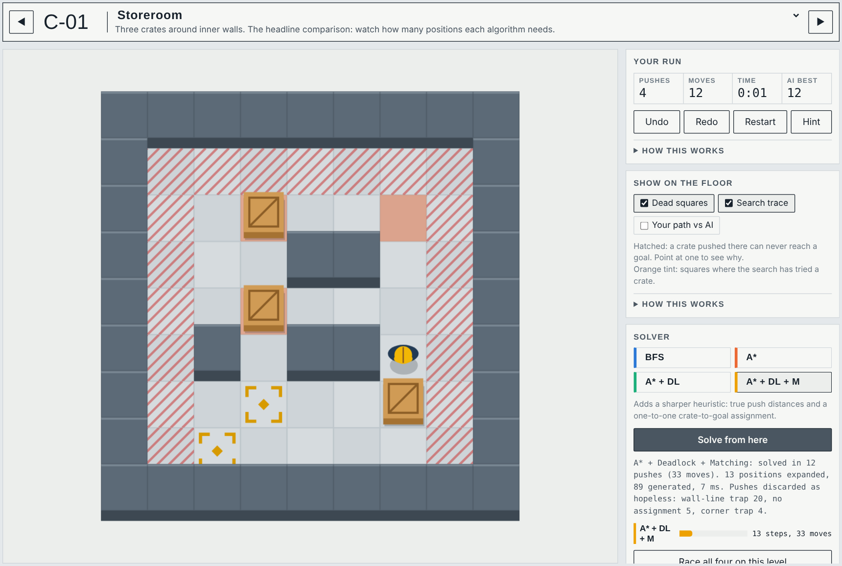
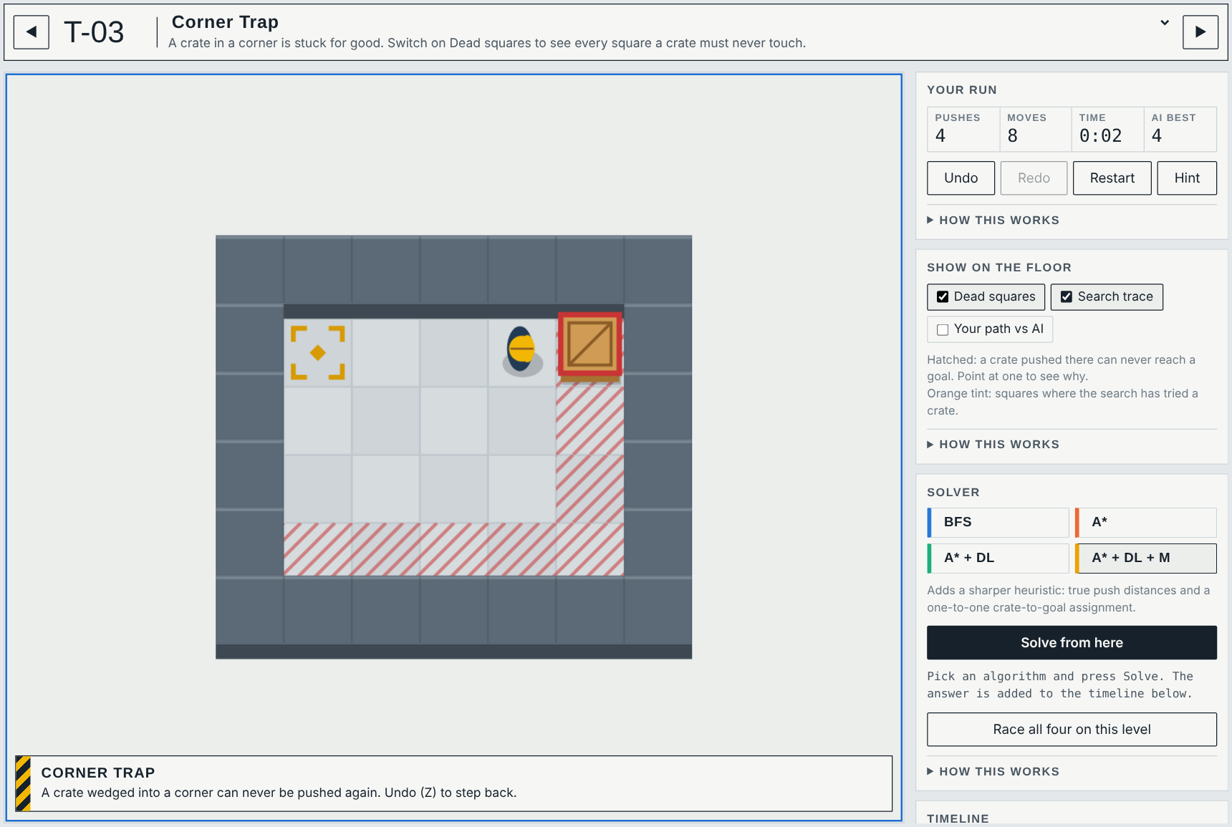
User Interface / Screenshots
Play + solver – A* + Deadlock + Matching solves Storeroom in 12 pushes after expanding 13 positions; hatched squares are dead squares, the timeline replays the answer.
Deadlock coach – the moment a push makes the level unwinnable, the rule is named (here: corner trap) and the crate is outlined; Undo steps back.

Slide 22
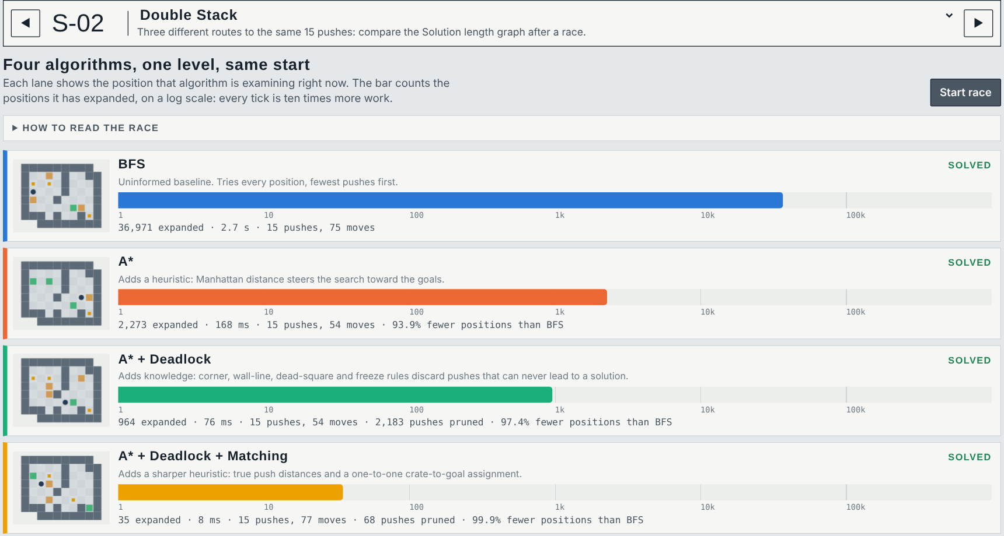
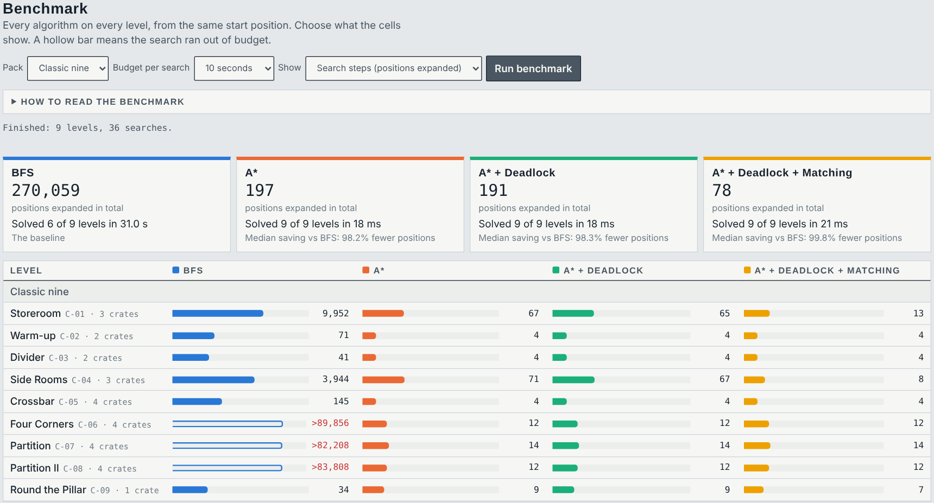
User Interface / Screenshots
Race – all four algorithms on Double Stack at once: 36,971 vs 2,273 vs 964 vs 35 positions expanded for the same 15 pushes.
Benchmark lab – every algorithm on every level of a pack, with totals, median savings and CSV / Markdown export.

Slide 23
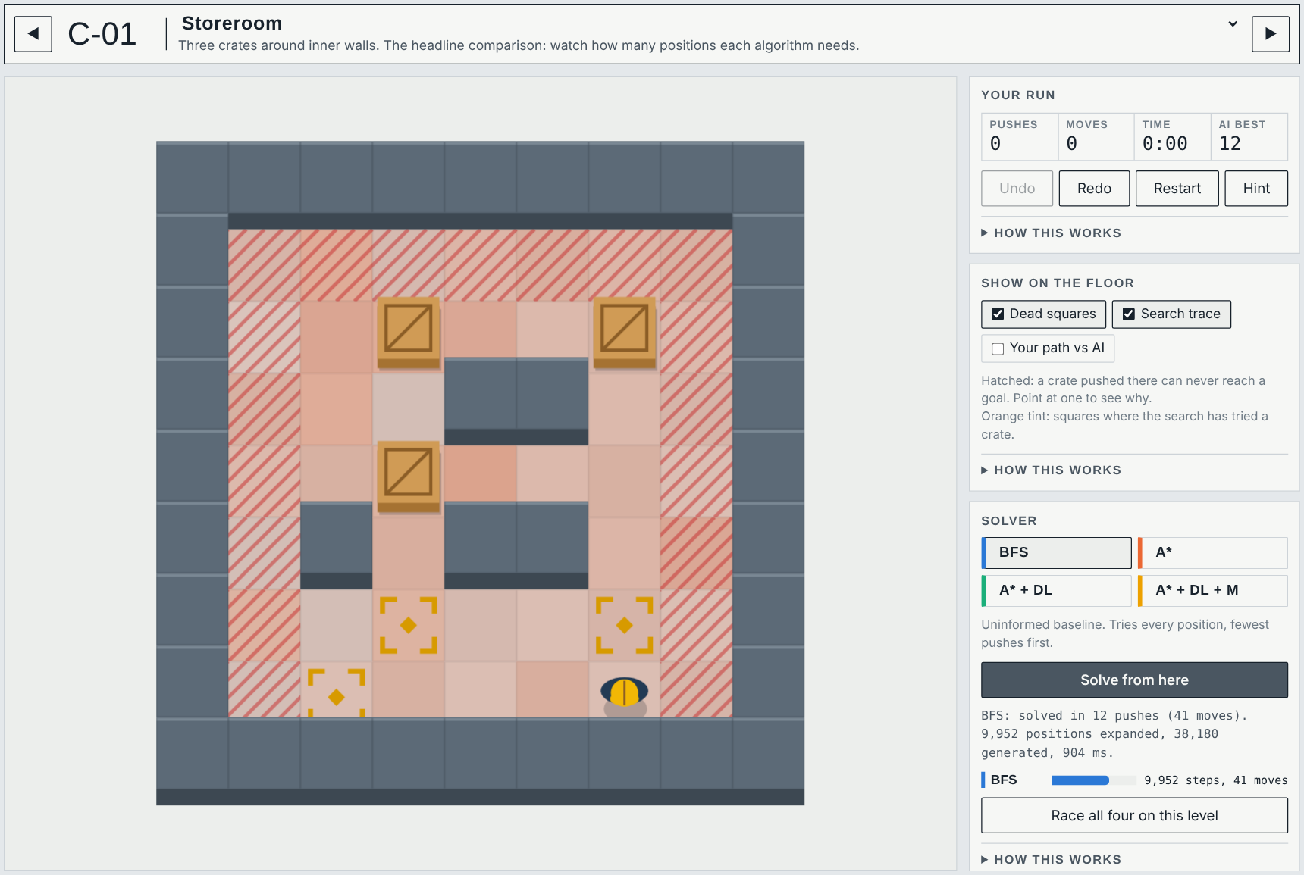
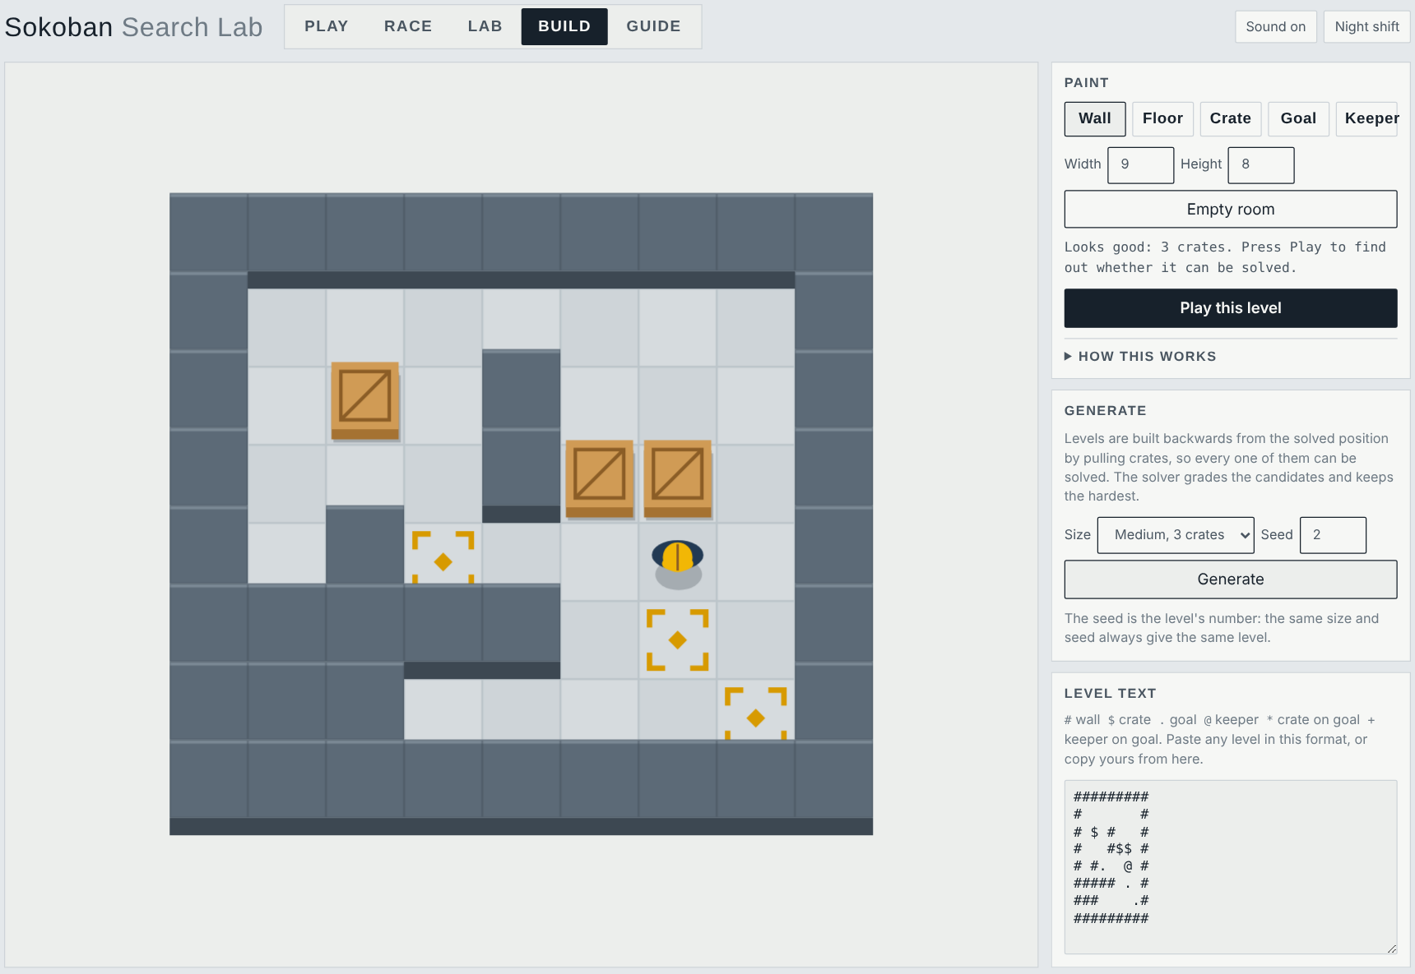
User Interface / Screenshots
Search trace – after BFS, the orange tint shows every square where it tried a crate; the informed searches touch only a few.
Build – level editor with instant validation, and a generator that builds solvable levels by reverse play.

Slide 24
Conclusion
Searching over pushes, with keeper positions merged by region, keeps the state space small enough for exact search on all 34 levels.
Each classical idea earns its place: median savings of 84.1%, 92.6% and 99.5% fewer positions than BFS, with the same optimal push count.
Deadlock rules are sound (fuzz-tested against exhaustive search) and explainable: every pruned push names its rule.
One Python code base drives the tests, the benchmark and the browser lab, so the numbers on screen are the numbers in the report.

Slide 25
Future Work
Stronger deadlock detection: corral analysis and deadlock patterns learned on small sub-boards.
Larger levels: IDA* with transposition tables, tunnel and goal-room macros.
Public benchmarks: evaluate on XSokoban and Microban and compare with published solvers.
Learned move ordering: a small model ranks pushes while A* keeps the optimality guarantee.
Teaching mode: step through f, g and h for every expanded position.

Slide 26
References
[1] P. E. Hart, N. J. Nilsson and B. Raphael, “A formal basis for the heuristic determination of minimum cost paths,” IEEE Trans. Systems Science and Cybernetics, vol. 4, no. 2, pp. 100–107, 1968.
[2] J. C. Culberson, “Sokoban is PSPACE-complete,” Tech. Rep. TR 97-02, Dept. of Computing Science, University of Alberta, 1997.
[3] A. Junghanns and J. Schaeffer, “Sokoban: Enhancing general single-agent search methods using domain knowledge,” Artificial Intelligence, vol. 129, no. 1–2, pp. 219–251, 2001.
[4] A. Botea, M. Müller and J. Schaeffer, “Using abstraction for planning in Sokoban,” in Computers and Games (CG 2002), LNCS 2883, Springer, 2003, pp. 360–375.
[5] A. G. Pereira, M. Ritt and L. S. Buriol, “Optimal Sokoban solving using pattern databases with specific domain knowledge,” Artificial Intelligence, vol. 227, pp. 52–70, 2015.
[6] H. W. Kuhn, “The Hungarian method for the assignment problem,” Naval Research Logistics Quarterly, vol. 2, no. 1–2, pp. 83–97, 1955.
[7] S. Russell and P. Norvig, Artificial Intelligence: A Modern Approach, 4th ed. Pearson, 2020.
[8] Pyodide project, “Pyodide: Python in the browser via WebAssembly,” documentation, https://pyodide.org
[9] Mettu Mani Chandhan Sai and Mebish V D, “Sokoban Search Lab” (source code and live demo), https://github.com/MettuManiChandhanSai/sokoban-search-lab

Slide 27
Thank You
Live demo: mettumanichandhansai.github.io/sokoban-search-lab
Source code: github.com/MettuManiChandhanSai/sokoban-search-lab

