Slide 1
Step by Step Procedure for Decision Tree Construction

Slide 2
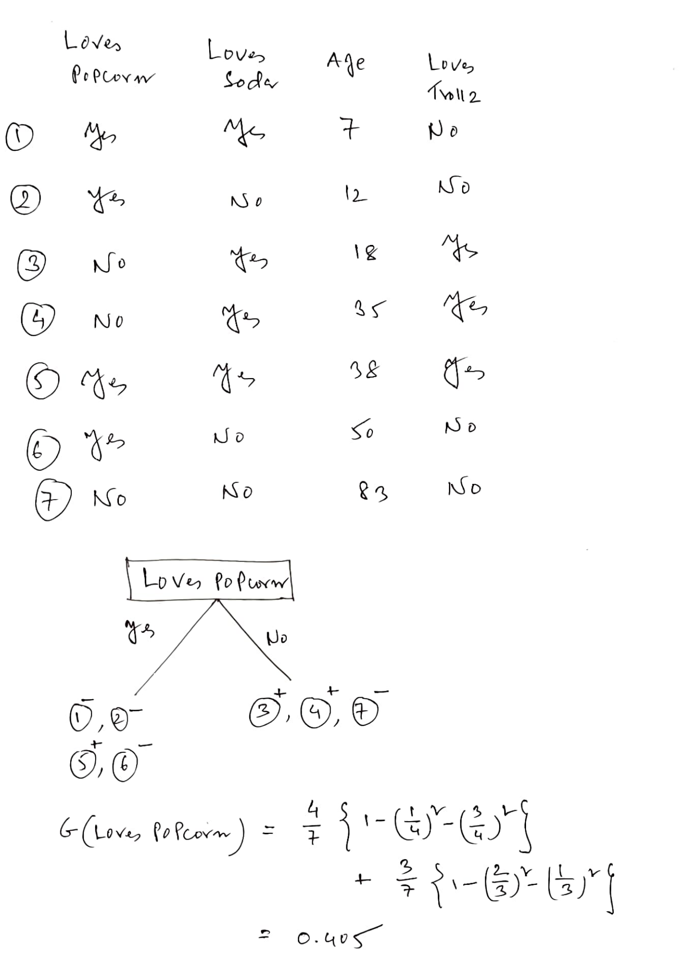
3 P, 4N

Slide 3
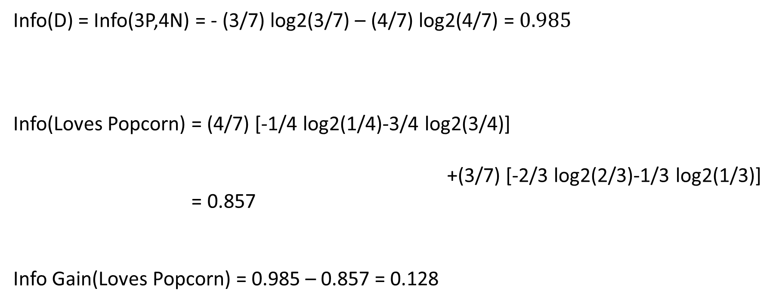
Info(D) = Info(3P,4N) = - (3/7) log2(3/7) – (4/7) log2(4/7) = $0.985$
Info(Loves Popcorn) = (4/7) [-1/4 log2(1/4)-3/4 log2(3/4)]
+(3/7) [-2/3 log2(2/3)-1/3 log2(1/3)]
= 0.857
Info Gain(Loves Popcorn) = 0.985 – 0.857 = 0.128

Slide 4
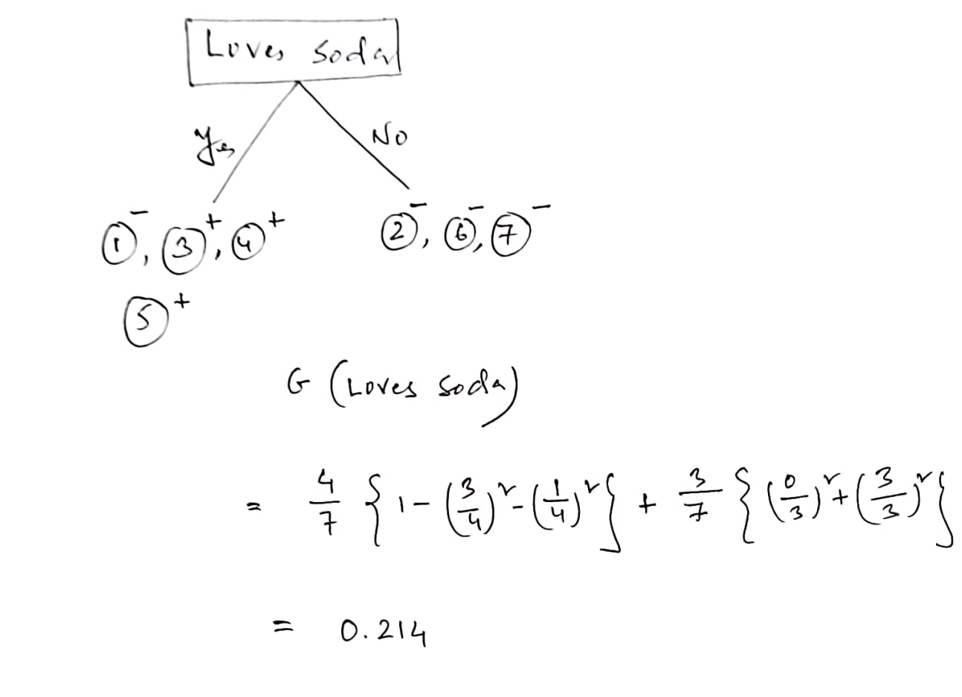
3 P, 4N

Slide 5
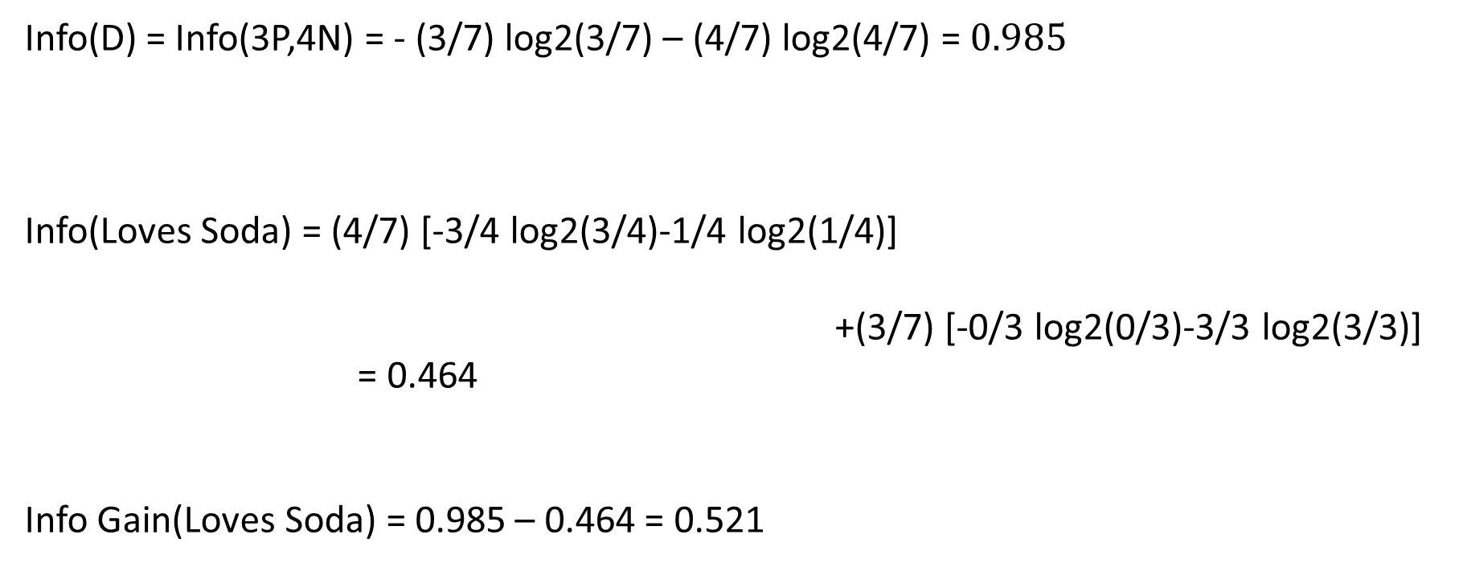
Info(D) = Info(3P,4N) = - (3/7) log2(3/7) – (4/7) log2(4/7) = $0.985$
Info(Loves Soda) = (4/7) [-3/4 log2(3/4)-1/4 log2(1/4)]
+(3/7) [-0/3 log2(0/3)-3/3 log2(3/3)]
= 0.464
Info Gain(Loves Soda) = 0.985 – 0.464 = 0.521

Slide 6
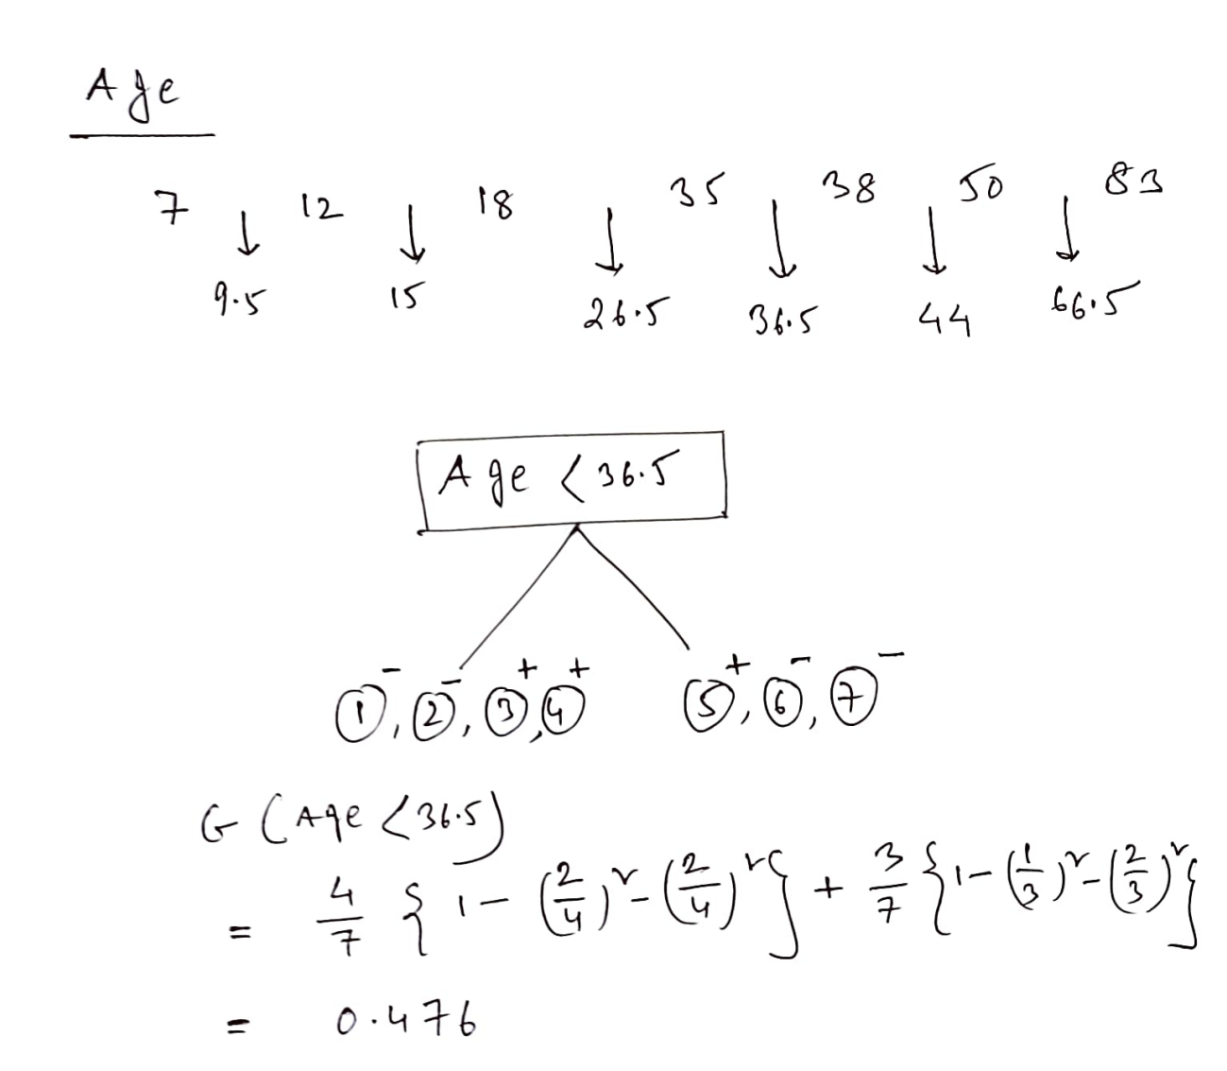
3 P, 4N

Slide 7
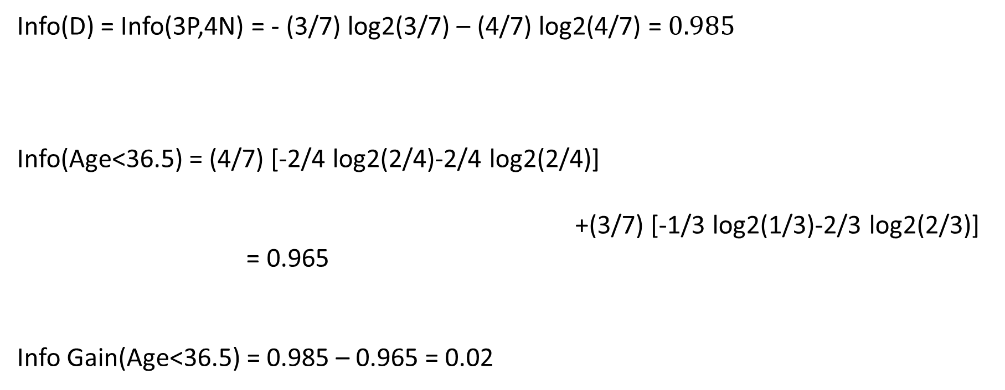
Info(D) = Info(3P,4N) = - (3/7) log2(3/7) – (4/7) log2(4/7) = $0.985$
Info(Age<36.5) = (4/7) [-2/4 log2(2/4)-2/4 log2(2/4)]
+(3/7) [-1/3 log2(1/3)-2/3 log2(2/3)]
= 0.965
Info Gain(Age<36.5) = 0.985 – 0.965 = 0.02

Slide 8
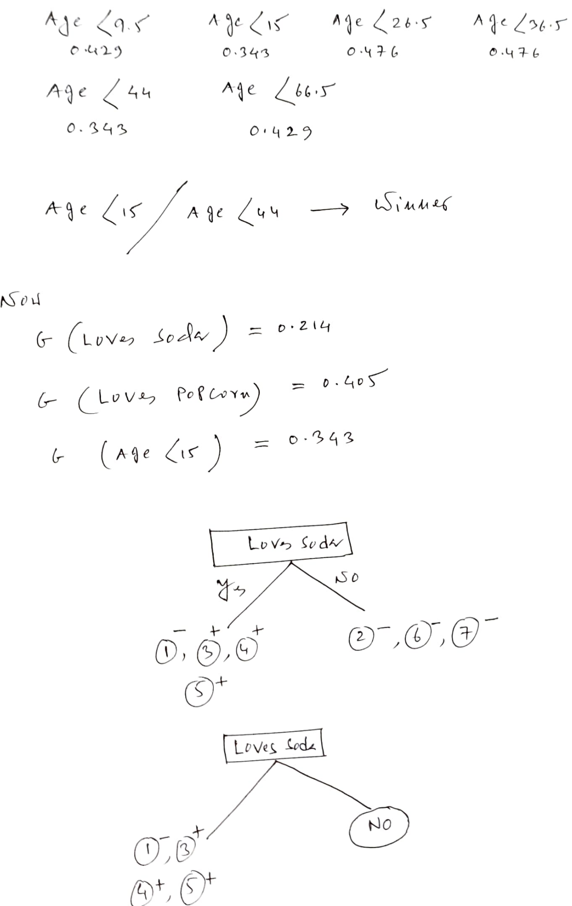
Info Gain(Loves Popcorn) = 0.128
Info Gain (Loves Soda) =0.521
Info Gain (Age <15) = 0.291

Slide 9
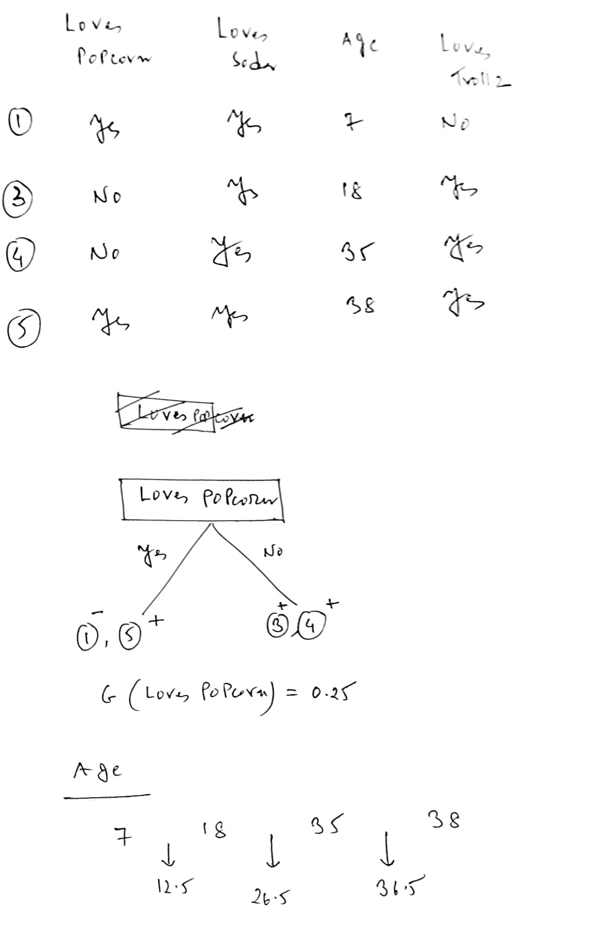
3P, 4N
Loves Soda
3 N
No

Slide 10
Info(D) = Info(3P,1N) = - (3/4) log2(3/4) – (1/4) log2(1/4) = 0.811
Info(Loves Popcorn) = (2/4) [-1/2 log2(1/2)-1/2 log2(1/2)]
+(2/4) [-2/2 log2(2/2)-0/2 log2(0/2)]
= 0.50
Info Gain(Loves Popcorn) = 0.811 – 0.50 = 0.311

Slide 11
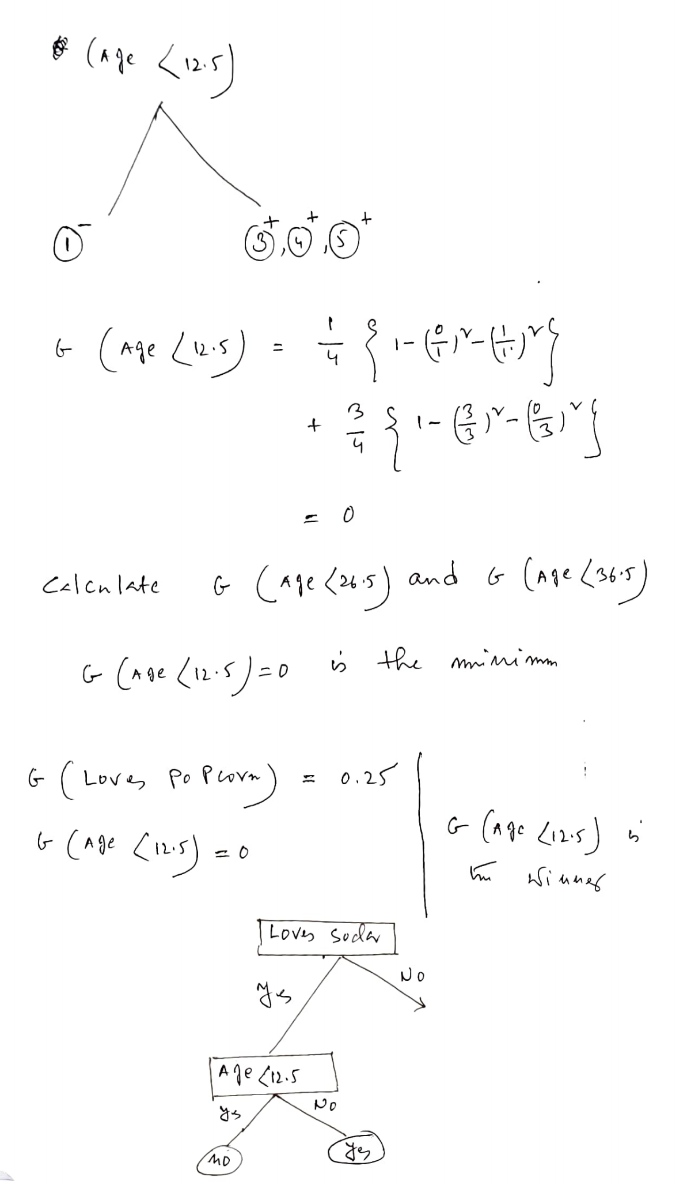

Slide 12
Info(D) = Info(3P,1N) = - (3/4) log2(3/4) – (1/4) log2(1/4) = 0.811
Info(Age<12.5) = (1/4) [-0/1 log2(0/1)-1/1 log2(1/1)]
+(3/4) [-3/3 log2(3/3)-0/3 log2(0/3)]
= 0.00
Info Gain(Age<12.5) = 0.811 – 0.00 = 0.811
Info gain of other mid points are less than 0.811
Info Gain(Loves Popcorn) = 0.811 – 0.50 = 0.311
Age<12.5 is the winner

Slide 13
