Slide 1
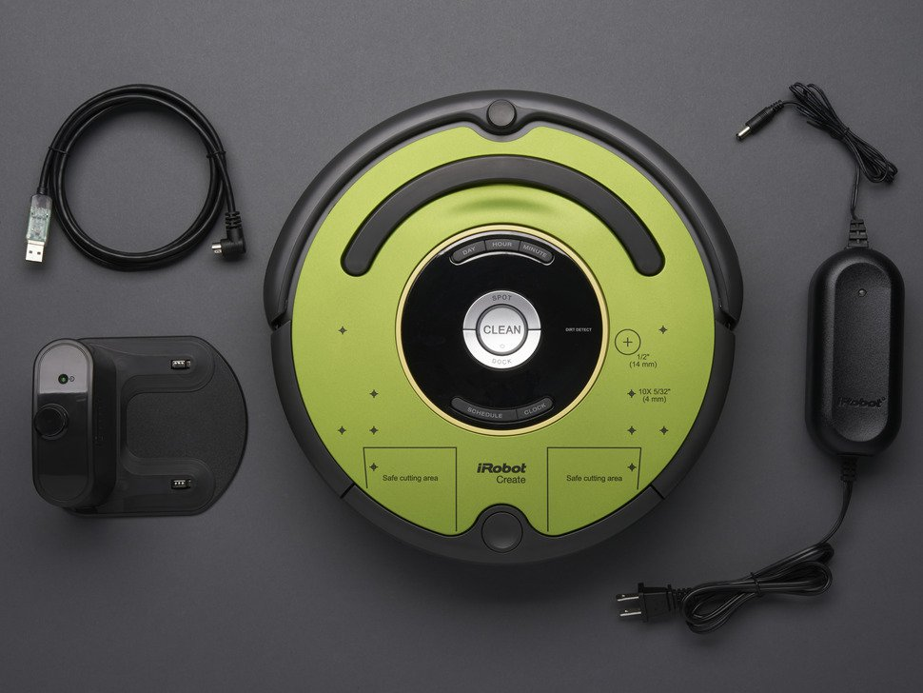
Path Planning & Obstacle Avoidance
Milad Ebrahimi
Hamilton Chevez

Slide 2
Project Objectives
Integrate Raspberry Pi as device controller instead of Arduino.
Path Planning: Traverse a maze from a given entry point to a final location.
Obstacle Avoidance: Avoid making contact with walls while traversing the path.
Along the path, use OpenCV to detect images on the maze’s wall.

Slide 3
Technologies Used:
iRobot Create 2
Open Interface
Raspberry Pi 3
Raspberry Pi Camera Module 2
Arduino Uno
Ultrasonic Proximity Sensor
Python 3
Opencv

Slide 4
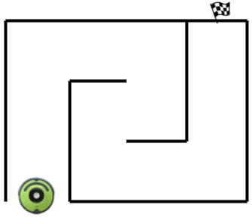
Algorithm
Check Distance
Move forward
Stop
Turn 90 left
Turn 180 Right
Ending Condition

Slide 5
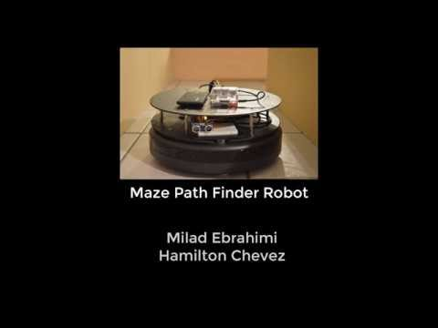
Video

Slide 6
Risks and Contingencies
Project was started 1 month before finals.
We were not well versed with OpenCV.
Raspberry pi was too slow to capture and process the frame with OpenCV with a usb webcam.
Proposed to use Raspberry Pi Camera Module, but experienced picamera library compatibility issues with OpenCV code.

Slide 7
Future Endeavors
Integrate the Pi Camera Module
With image detection, capture images and tweet them.
Create a voronoi mapping of our maze using 1 or 2 ultrasonic proximity sensors.
Given a map of a more complex environment, use exact cell decomposition to create a tree of possible paths and test paths with:
A*
Depth-First
Breadth-First

