Slide 1
SQL Practice 2 Multiple tables Joins Nested Queries
Link: https://www.w3resource.com/sql-exercises/

Slide 2
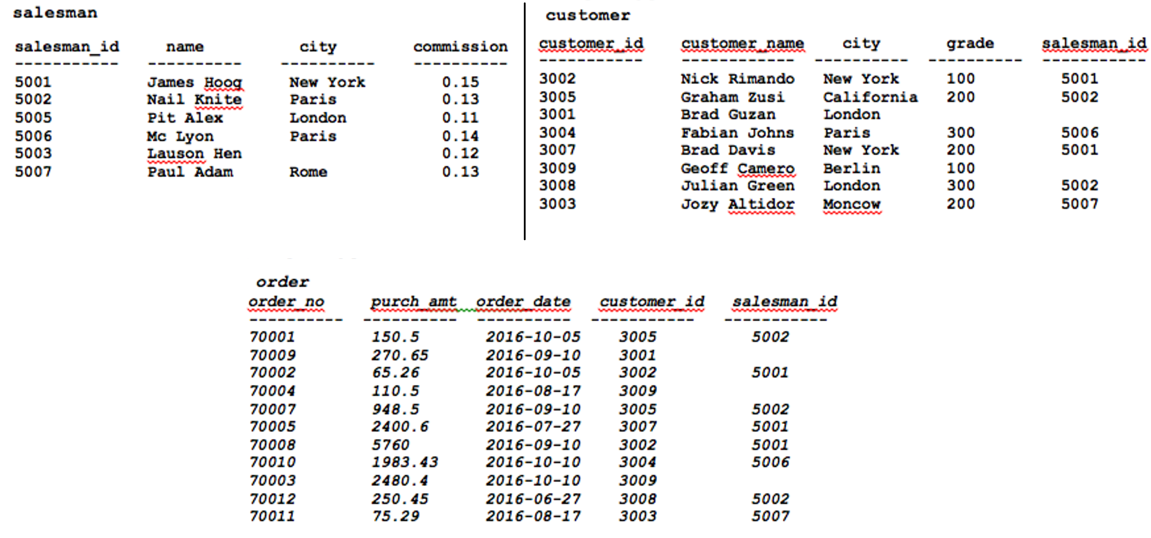

Slide 3
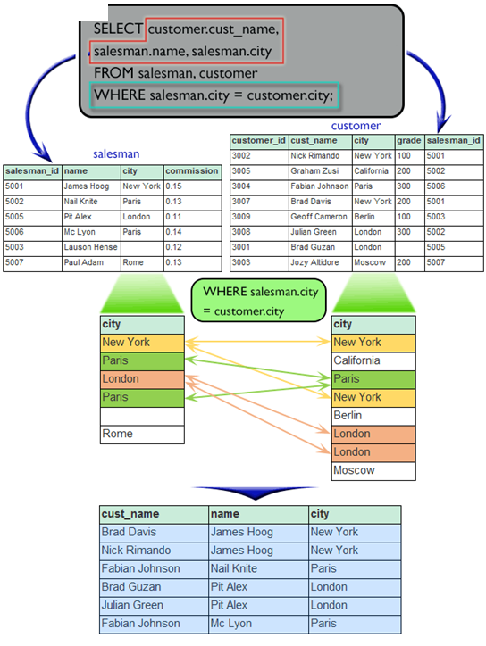
Query 1
Find the name and city of those customers and salesmen who lives in the same city.
salesman (salesman_id, name, city, commission)
customer(customer_id, cust_name, city, grade, salesman_id)
orders(ord_no, purch_amt, ord_date, customer_id, salesman_id)
cust_name name city
Nick Rimando James Hoog New York
Brad Davis James Hoog New York
Julian Green Pit Alex London
Fabian Johnson Mc Lyon Paris
Fabian Johnson Nail Knite Paris
Brad Guzan Pit Alex London
SELECT C.cust_name, S.name, S.city
FROM salesman AS S customer AS C
WHERE S.city = C.city

Slide 4
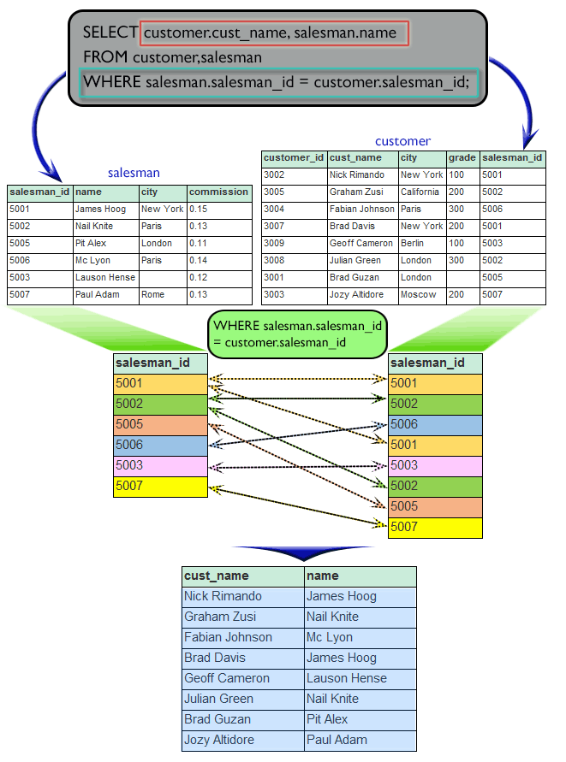
Query 2
Find the names of all customers along with the salesmen who works for them.
salesman (salesman_id, name, city, commission)
customer(customer_id, cust_name, city, grade, salesman_id)
orders(ord_no, purch_amt, ord_date, customer_id, salesman_id)
cust_name name
Nick Rimando James Hoog
Brad Davis James Hoog
Graham Zusi Nail Knite
Julian Green Nail Knite
Fabian Johnson Mc Lyon
Geoff Cameron Lauson Hen
Jozy Altidor Paul Adam
Brad Guzan Pit Alex
SELECT customer.cust_name salesman.name
FROM customer, salesman
WHERE salesman.salesman_id = customer.salesman_id;

Slide 5
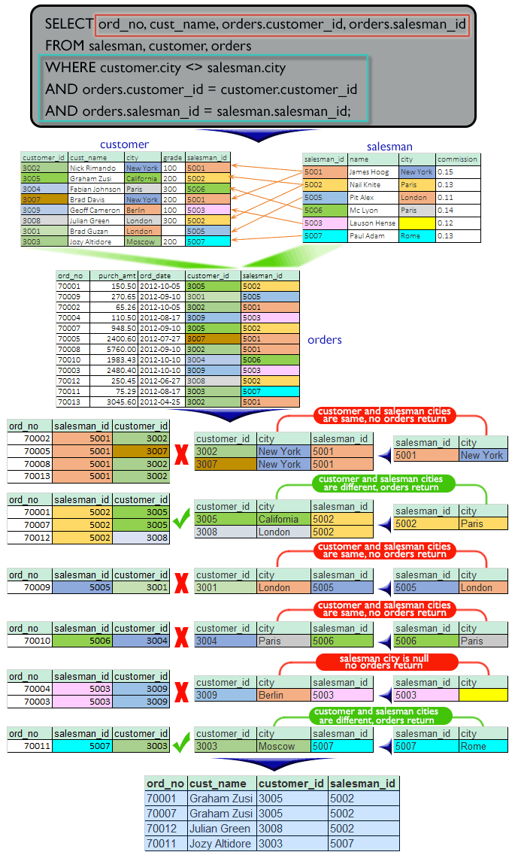
Query 3
Display all those orders by the customers not located in the same cities where their salesmen live.
salesman (salesman_id, name, city, commission)
customer(customer_id, cust_name, city, grade, salesman_id)
orders(ord_no, purch_amt, ord_date, customer_id, salesman_id)
ord_no cust_name customer_id salesman_id
70004 Geoff Cameron 3009 5003
70003 Geoff Cameron 3009 5003
70011 Jozy Altidor 3003 5007
70001 Graham Zusi 3005 5002
70007 Graham Zusi 3005 5002
70012 Julian Green 3008 5002
SELECT ord_no cust_name orders.customer_id orders.salesman_id
FROM salesman, customer, orders
WHERE customer.city <> salesman.city
AND orders.customer_id = customer.customer_id
AND orders.salesman_id = salesman.salesman_id;

Slide 6
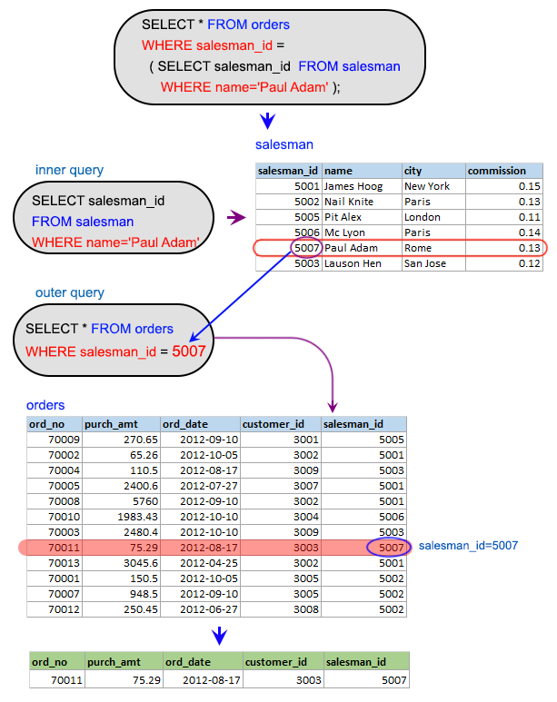
Query 4 (using subquery)
Display all the orders issued by the salesman 'Paul Adam' from the orders table.
salesman (salesman_id, name, city, commission)
customer(customer_id, cust_name, city, grade, salesman_id)
orders(ord_no, purch_amt, ord_date, customer_id, salesman_id)
ord_no purch_amt ord_date customer_id salesman_id
70011 75.29 2012-08-17 3003 5007
SELECT *
FROM orders
WHERE salesman_id =
(SELECT salesman_id
FROM salesman
WHERE name = 'Paul Adam');
Can we make this query unnested? If yes how?

Slide 7
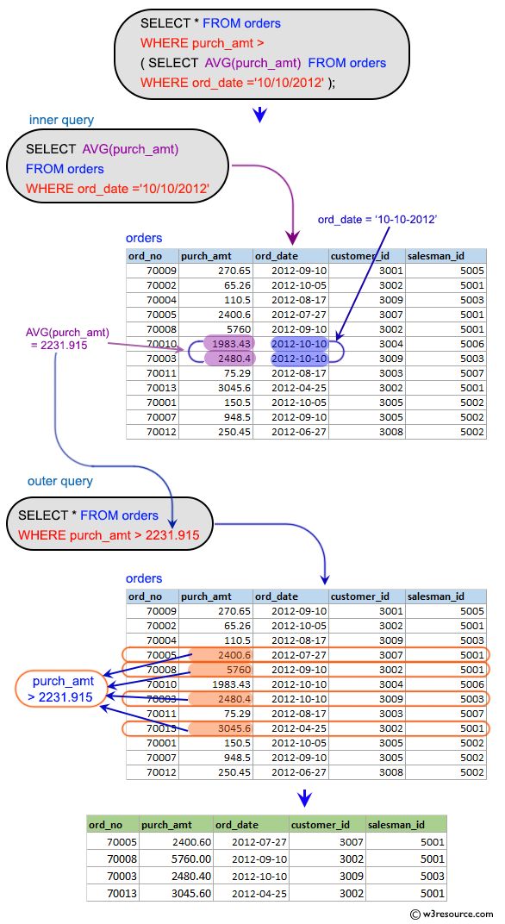
Query 5 (using subquery)
Display all the orders which values are greater than the average order value for 10th October 2012.
salesman (salesman_id, name, city, commission)
customer(customer_id, cust_name, city, grade, salesman_id)
orders(ord_no, purch_amt, ord_date, customer_id, salesman_id)
ord_no purch_amt ord_date customer_id salesman_id
70005 2400.60 2012-07-27 3007 5001
70008 5760.00 2012-09-10 3002 5001
70003 2480.40 2012-10-10 3009 5003
70013 3045.60 2012-04-25 3002 5001
SELECT *
FROM orders
WHERE purch_amt >
(SELECT AVG(purch_amt)
FROM orders
WHERE ord_date = '2012-10-10');
Can we make this query unnested? If yes how?

Slide 8
Query 6 (using subquery)
Find all orders attributed to salesmen in Paris.
salesman (salesman_id, name, city, commission)
customer(customer_id, cust_name, city, grade, salesman_id)
orders(ord_no, purch_amt, ord_date, customer_id, salesman_id)
ord_no purch_amt ord_date customer_id salesman_id
70001 150.50 2012-10-05 3005 5002
70007 948.50 2012-09-10 3005 5002
70012 250.45 2012-06-27 3008 5002
70010 1983.43 2012-10-10 3004 5006
SELECT *
FROM orders
WHERE salesman_id IN
(SELECT salesman_id
FROM salesman
WHERE city ='Paris');
Can we make this query unnested? If yes how?

Slide 9
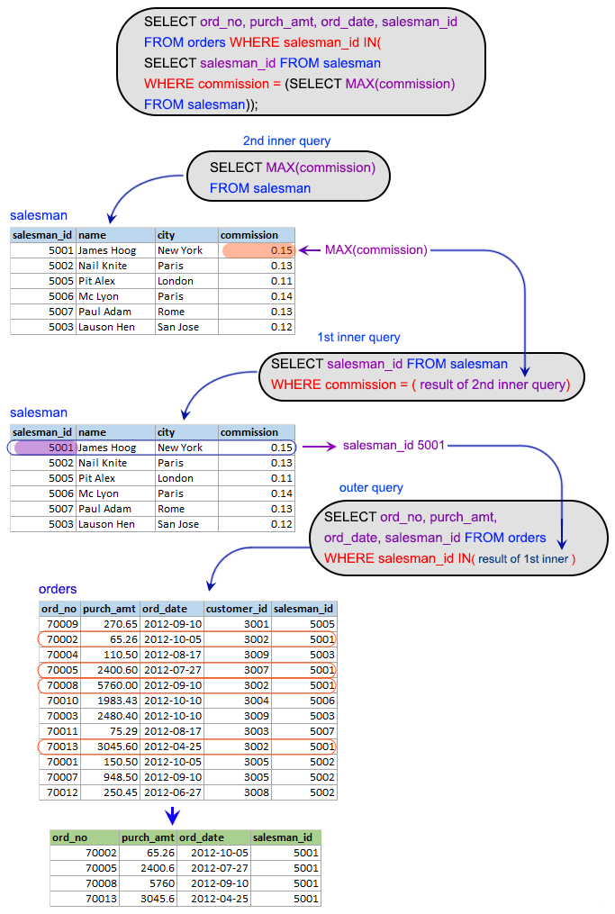
Query 7 (using subquery)
Extract the data from the orders table for the salesman who earned the maximum commission.
salesman (salesman_id, name, city, commission)
customer(customer_id, cust_name, city, grade, salesman_id)
orders(ord_no, purch_amt, ord_date, customer_id, salesman_id)
ord_no purch_amt ord_date salesman_id
70002 65.26 2012-10-05 5001
70005 2400.60 2012-07-27 5001
70008 5760.00 2012-09-10 5001
70013 3045.60 2012-04-25 5001
SELECT ord_no, purch_amt, ord_date, salesman_id
FROM orders
WHERE salesman_id IN (
SELECT salesman_id
FROM salesman
WHERE commission = (
SELECT MAX(commission)
FROM salesman)
);

Slide 10
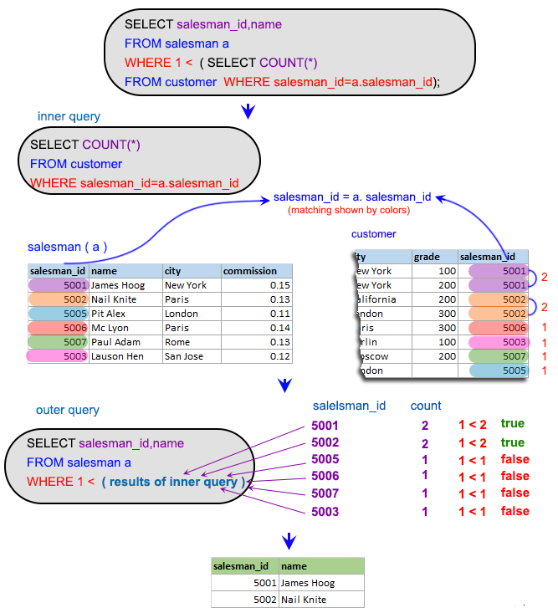
Query 8 (using subquery)
Find the name and ids of all salesmen who
had more than one customer.
salesman (salesman_id, name, city, commission)
customer(customer_id, cust_name, city, grade, salesman_id)
orders(ord_no, purch_amt, ord_date, customer_id, salesman_id)
salesman_id name
5001 James Hoog
5002 Nail Knite
SELECT salesman_id, name
FROM salesman AS a
WHERE 1 <
(SELECT COUNT(*)
FROM customer AS c
WHERE c.salesman_id = a.salesman_id);
Can we make this query unnested? If yes how?
SELECT c.salesman_id, s.name FROM salesman AS s, customer AS c where s.salesman_id = c.salesman_id
group by c.salesman_id, s.name Having count(c.salesman_id) > 1;

Slide 11
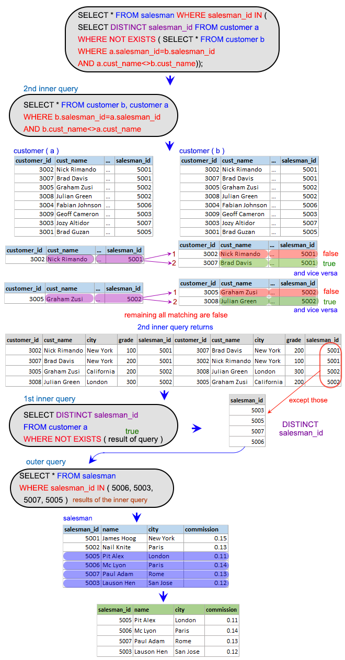
Query 9 (using subquery)
Write a query to find all the salesmen who worked for only one customer.
salesman (salesman_id, name, city, commission)
customer(customer_id, cust_name, city, grade, salesman_id)
orders(ord_no, purch_amt, ord_date, customer_id, salesman_id)
salesman_id name city commission
5005 Pit Alex London 0.11
5006 Mc Lyon Paris 0.14
5007 Paul Adam Rome 0.13
5003 Lauson Hen San Jose 0.12
SELECT *
FROM salesman
WHERE salesman_id IN (
SELECT DISTINCT salesman_id
FROM customer a
WHERE NOT EXISTS (
SELECT * FROM customer b
WHERE a.salesman_id = b.salesman_id
AND a.cust_name <> b.cust_name));

Slide 12
Query 9: Equivalent Queries
Write a query to find all the salesmen who worked for only one customer.
salesman (salesman_id, name, city, commission)
customer(customer_id, cust_name, city, grade, salesman_id)
orders(ord_no, purch_amt, ord_date, customer_id, salesman_id)
salesman_id name city commission
5005 Pit Alex London 0.11
5006 Mc Lyon Paris 0.14
5007 Paul Adam Rome 0.13
5003 Lauson Hen San Jose 0.12
SELECT *
FROM salesman
WHERE salesman_id NOT IN (
SELECT a.salesman_id
FROM customer a, customer b
WHERE a.salesman_id = b.salesman_id AND a.cust_name <> b.cust_name);
SELECT c.salesman_id, s.name, s.city, s.commission
FROM salesman s, customer c
where s.salesman_id = c.salesman_id
group by c.salesman_id, s.name
Having count(c.salesman_id) = 1;

Slide 13
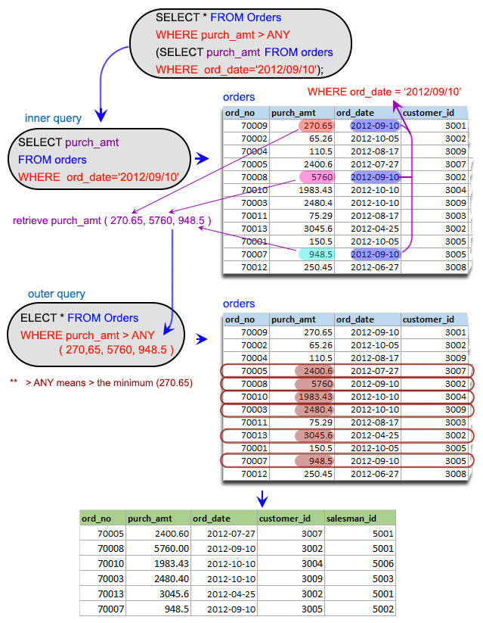
Query 10 (using subquery)
Display all the orders that had amounts that were greater than at least one of the orders from September 10th 2012.
salesman (salesman_id, name, city, commission)
customer(customer_id, cust_name, city, grade, salesman_id)
orders(ord_no, purch_amt, ord_date, customer_id, salesman_id)
ord_no purch_amt ord_date customer_id salesman_id
70005 2400.60 2012-07-27 3007 5001
70008 5760.00 2012-09-10 3002 5001
70010 1983.43 2012-10-10 3004 5006
70003 2480.40 2012-10-10 3009 5003
70013 3045.60 2012-04-25 3002 5001
70007 948.50 2012-09-10 3005 5002
SELECT *
FROM Orders
WHERE purch_amt > ANY
(SELECT purch_amt
FROM orders
WHERE ord_date = '2012-09-10');

Slide 14
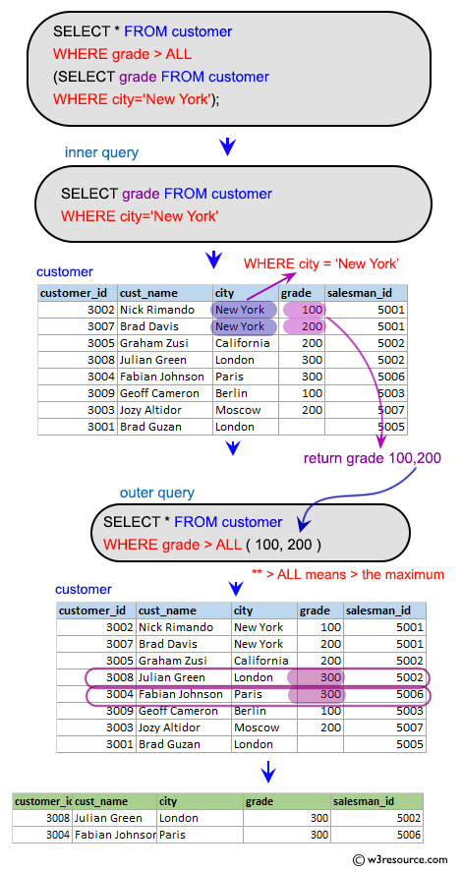
Query 11 (using subquery)
display only those customers whose grade are, in fact, higher than every customer in New York.
salesman (salesman_id, name, city, commission)
customer(customer_id, cust_name, city, grade, salesman_id)
orders(ord_no, purch_amt, ord_date, customer_id, salesman_id)
customer_id cust_name city grade salesman_id
3008 Julian Green London 300 5002
3004 Fabian Johnson Paris 300 5006
SELECT *
FROM customer
WHERE grade > ALL
(SELECT grade
FROM customer
WHERE city = 'NewYork');

