Slide 1
SQL Practice 1 One table, Aggregation, Group By 24 Queries
Database: DBSQLPractice.sql
Source Link: https://www.w3resource.com/sql-exercises/

Slide 2
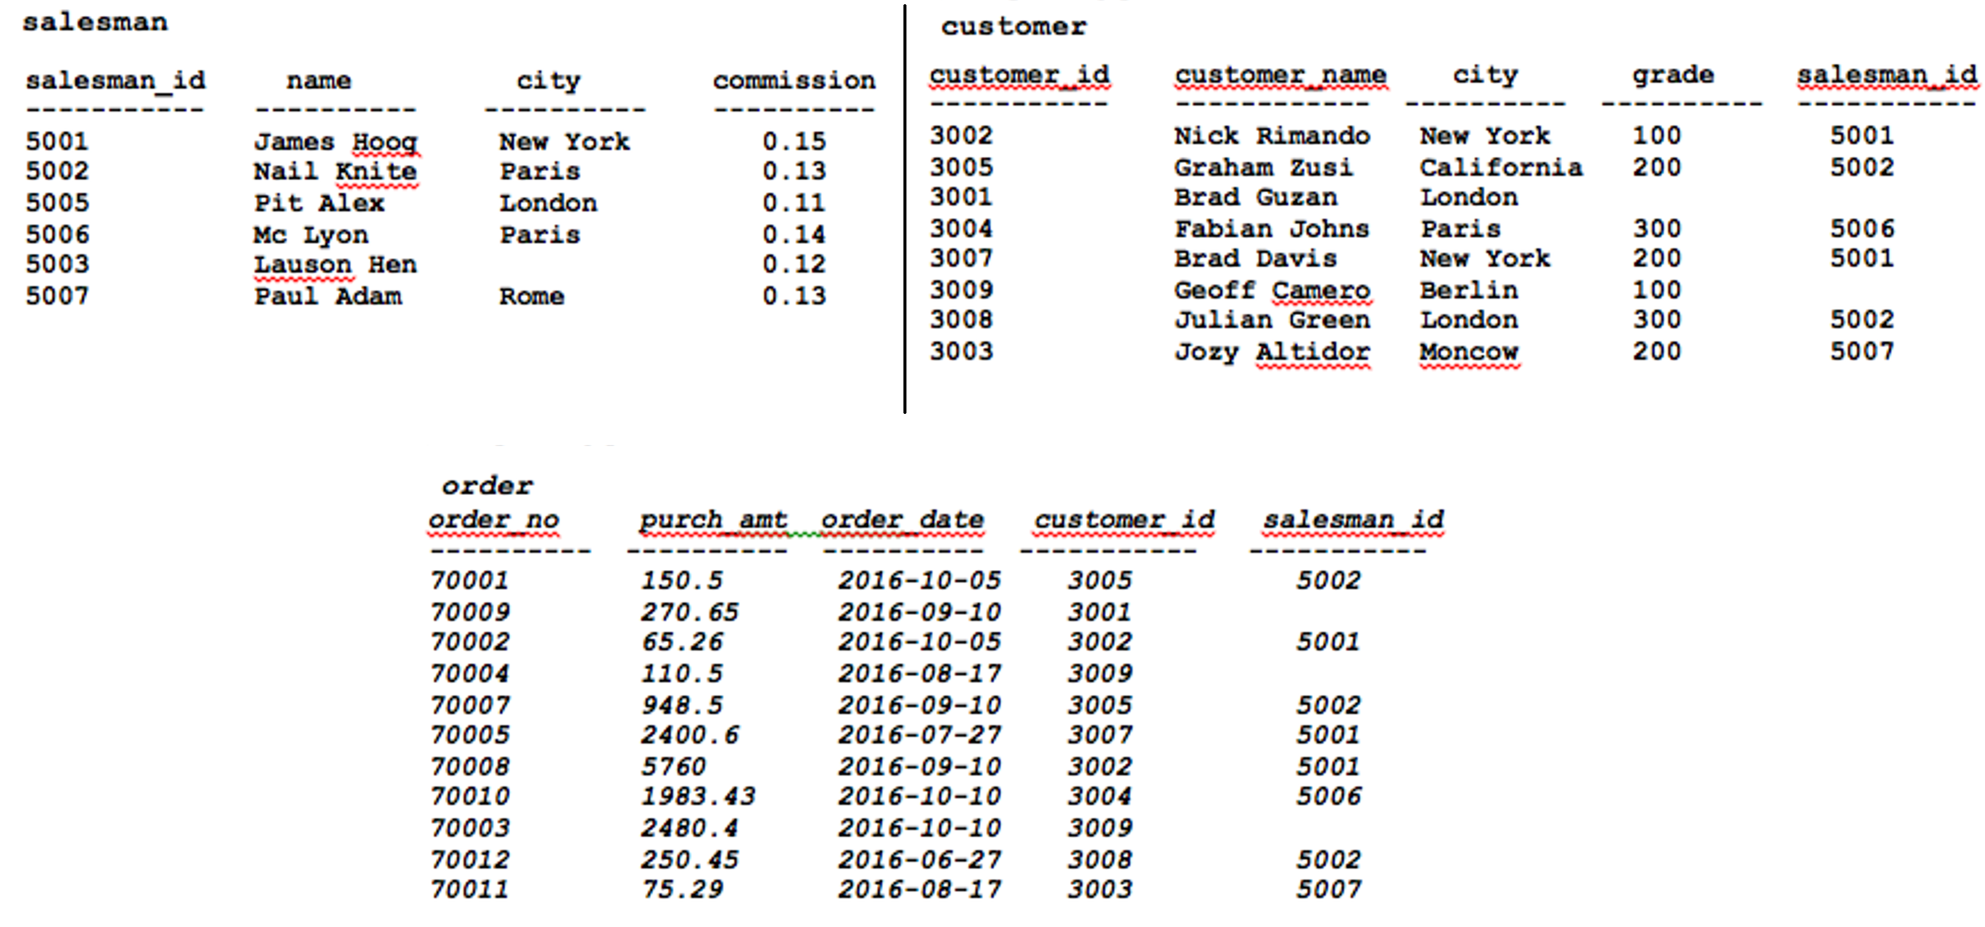

Slide 3
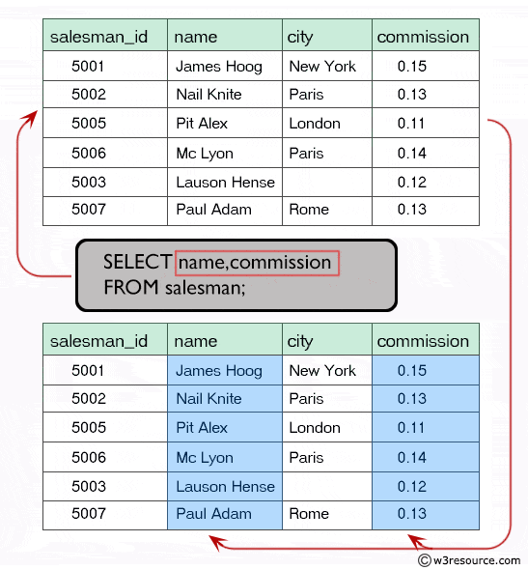
Query 1
Display name and commission for all the salesmen.
salesman (salesman_id, name, city, commission)
name commission
James Hoog 0.15
Nail Knite 0.13
Pit Alex 0.11
Mc Lyon 0.14
Paul Adam 0.13
Lauson Hen 0.12
SELECT name, commission
FROM salesman;

Slide 4
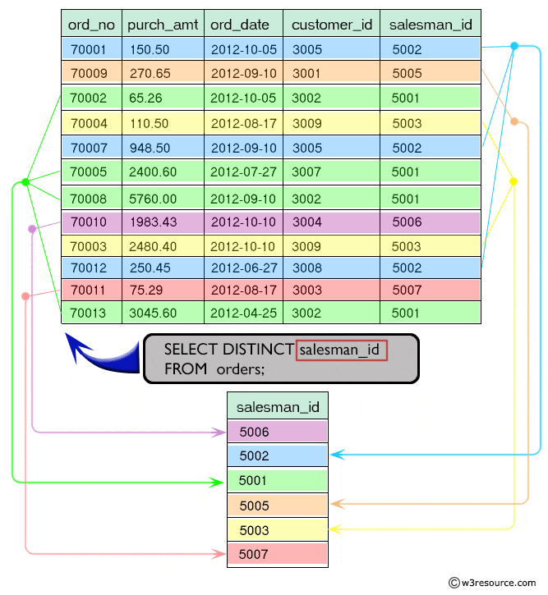
Query 2
Retrieve salesman id of all salesmen from orders table without any repeats.
orders(ord_no, purch_amt, ord_date, customer_id, salesman_id )
salesman_id
5002
5003
5006
5001
5005
5007
SELECT DISTINCT salesman_id
FROM orders;

Slide 5
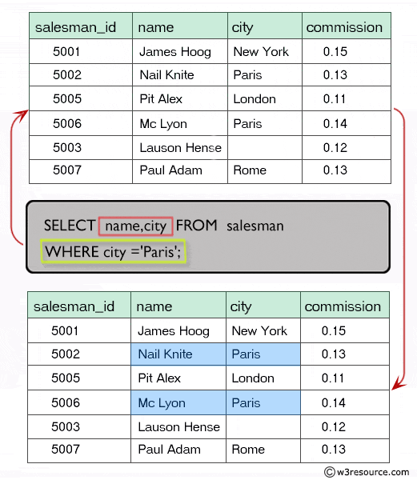
Query 3
Display names and city of salesman, who belongs to the city of Paris.
salesman(salesman_id, name, city, commission)
name city
Nail Knite Paris
Mc Lyon Paris
SELECT name,city
FROM salesman
WHERE city='Paris';

Slide 6
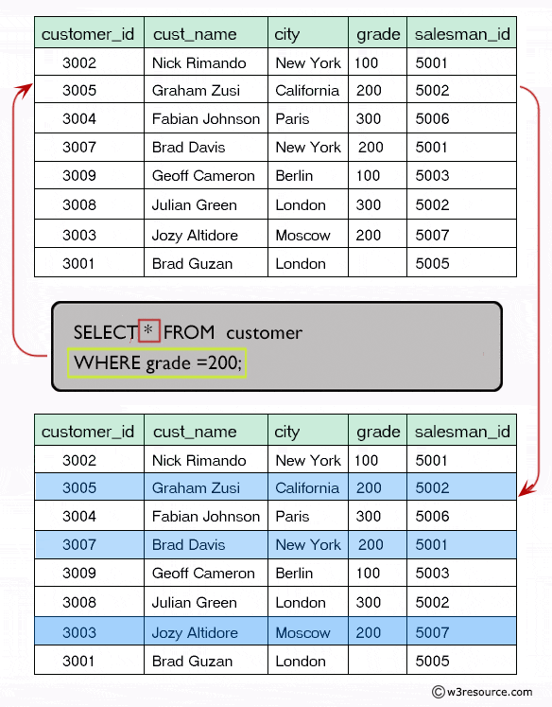
Query 4
Display all the information for those customers with a grade of 200.
customer(customer_id, cust_name, city, grade, salesman_id)
customer_id cust_name city grade salesman_id
3007 Brad Davis New York 200 5001
3005 Graham Zusi California 200 5002
3003 Jozy Altidor Moscow 200 5007
SELECT *
FROM customer
WHERE grade = 200;

Slide 7
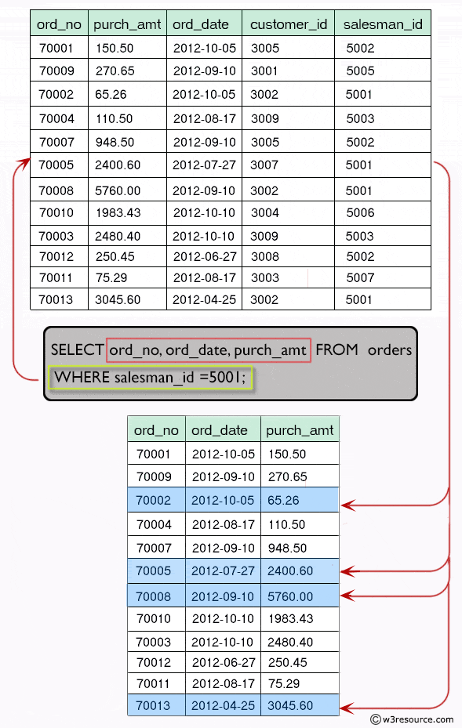
Query 5
Display the order number, order date and the purchase amount for order(s) which will be delivered by the salesman with ID 5001.
orders(ord_no, purch_amt, ord_date, customer_id, salesman_id )
ord_no ord_date purch_amt
70002 2012-10-05 65.26
70005 2012-07-27 2400.60
70008 2012-09-10 5760.00
70013 2012-04-25 3045.60
SELECT ord_no, ord_date, purch_amt
FROM orders
WHERE salesman_id = 5001;

Slide 8
Query 6
Show the winner of the 1971 prize for Literature.
nobel_win(year, subject, winner, country, category)
winner
Pablo Neruda
SELECT winner
FROM nobel_win
WHERE year = 1971
AND subject = 'Literature';

Slide 9
Query 7
Show all the details of the winners with first name Louis.
nobel_win(year, subject, winner, country, category)
year subject winner country category
1970 Physics Louis Neel France Scientist
SELECT *
FROM nobel_win
WHERE winner LIKE 'Louis%';

Slide 10
Query 8
Show all the winners in Physics for 1970 together with the winner of Economics for 1971.
nobel_win(year, subject, winner, country, category)
year subject winner country category
1970 Physics Hannes Alfven Sweden Scientist
1970 Physics Louis Neel France Scientist
1971 Economics Simon Kuznets Russia Economist
SELECT *
FROM nobel_win
WHERE (subject = 'Physics' AND year = 1970)
UNION
(SELECT *
FROM nobel_win
WHERE (subject = 'Economics' AND year = 1971)
);

Slide 11
Query 9
Show all the winners of Nobel prize in the year 1970 except the subject Physiology and Economics.
nobel_win(year, subject, winner, country, category)
year subject winner country category
1970 Physics Hannes Alfven Sweden Scientist
1970 Physics Louis Neel France Scientist
1970 Chemistry Luis Federico Leloir France Scientist
1970 Literature Aleksandr Solzhenitsyn Russia Linguist
SELECT *
FROM nobel_win
WHERE year = 1970
AND subject NOT IN ('Physiology','Economics');

Slide 12
Query 10
Find all the details of the Nobel winners for the subject not started with the letter 'P' and arranged the list as the most recent comes first, then by name in order.
nobel_win(year, subject, winner, country, category)
year subject winner country category
1994 Literature Kenzaburo Oe Japan Linguist
1994 Economics Reinhard Selten Germany Economist
1987 Chemistry Donald J. Cram USA Scientist
1987 Chemistry Jean-Marie Lehn France Scientist
1987 Literature Joseph Brodsky Russia Linguist
1987 Economics Robert Solow USA Economist
1971 Chemistry Gerhard Herzberg Germany Scientist
1971 Literature Pablo Neruda Chile Linguist
1971 Economics Simon Kuznets Russia Economist
1970 Literature Aleksandr Solzhenitsyn Russia Linguist
1970 Chemistry Luis Federico Leloir France Scientist
1970 Economics Paul Samuelson USA Economist
SELECT *
FROM nobel_win
WHERE subject NOT LIKE 'P%'
ORDER BY year DESC, winner;

Slide 13
Query 11
Find the name and price of the cheapest item(s).
item_mast(pro_id, pro_name, pro_price, pro_com)
pro_name pro_price
ZIP drive 250.00
Mouse 250.00
SELECT pro_name, pro_price
FROM item_mast
WHERE pro_price = (SELECT MIN(pro_price)
FROM item_mast);

Slide 14
Query 12
Display all the customers, who are either belongs to the city New York or not had a grade above 100.
customer(customer_id, cust_name, city, grade, salesman_id)
customer_id cust_name city grade salesman_id
3002 Nick Rimando New York 100 5001
3007 Brad Davis New York 200 5001
3009 Geoff Cameron Berlin 100 5003
SELECT *
FROM customer
WHERE city = 'New York' OR NOT grade > 100;

Slide 15
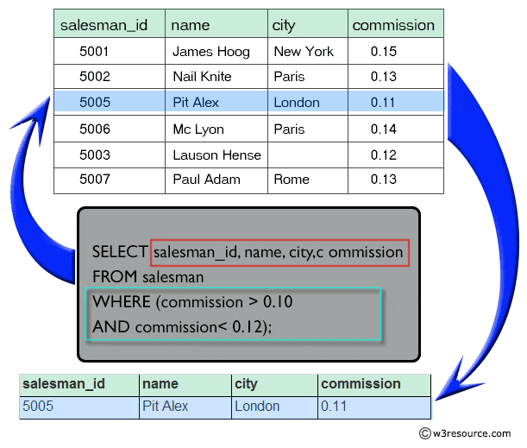
Query 13
Find those salesmen with all information who gets the commission within a range of 0.10 and 0.12.
salesman(salesman_id, name, city, commission)
SELECT salesman_id, name, city, commission
FROM salesman
WHERE (commission > 0.10 AND commission < 0.12);
SELECT salesman_id, name, city, commission
FROM salesman
WHERE commission between 0.10 AND 0.12;

Slide 16
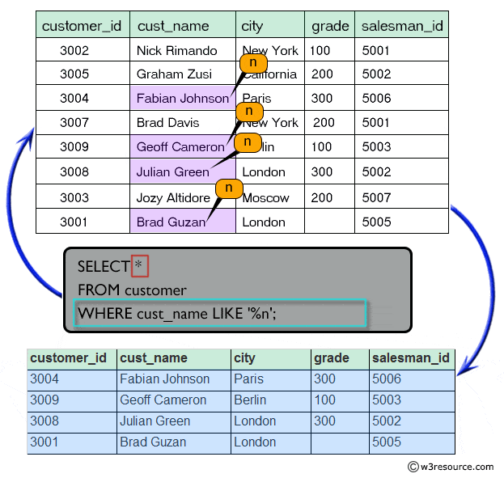
Query 14
Find all those customers with all information whose names are ending with the letter 'n'.
customer(customer_id, cust_name, city, grade, salesman_id)
SELECT *
FROM customer
WHERE cust_name LIKE '%n';

Slide 17
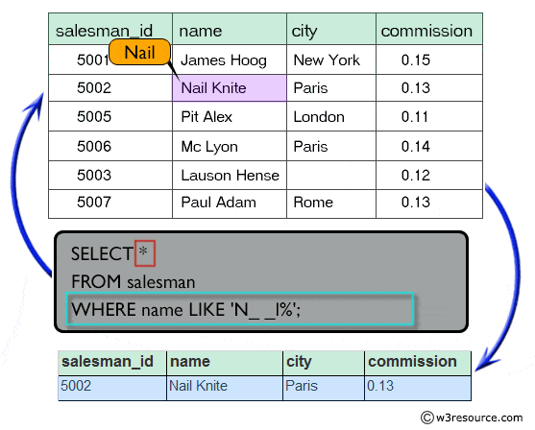
Query 15
Find those salesmen with all information whose name containing the 1st character is 'N' and the 4th character is 'l' and rests may be any character.
salesman(salesman_id, name, city, commission)
SELECT *
FROM salesman
WHERE name LIKE ‘N__l%';

Slide 18
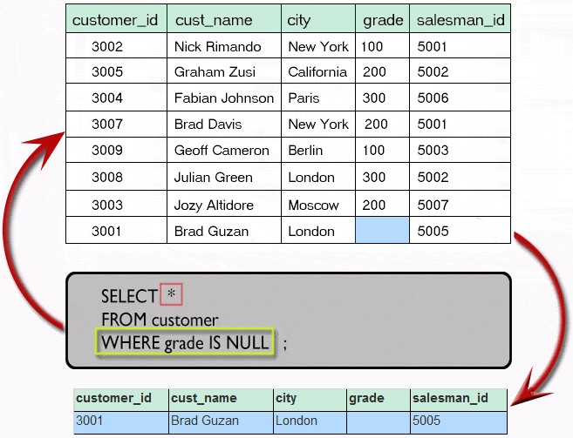
Query 16
Find that customer with all information who does not get any grade except NULL.
customer(customer_id, cust_name, city, grade, salesman_id)
SELECT *
FROM customer
WHERE grade IS NULL;

Slide 19
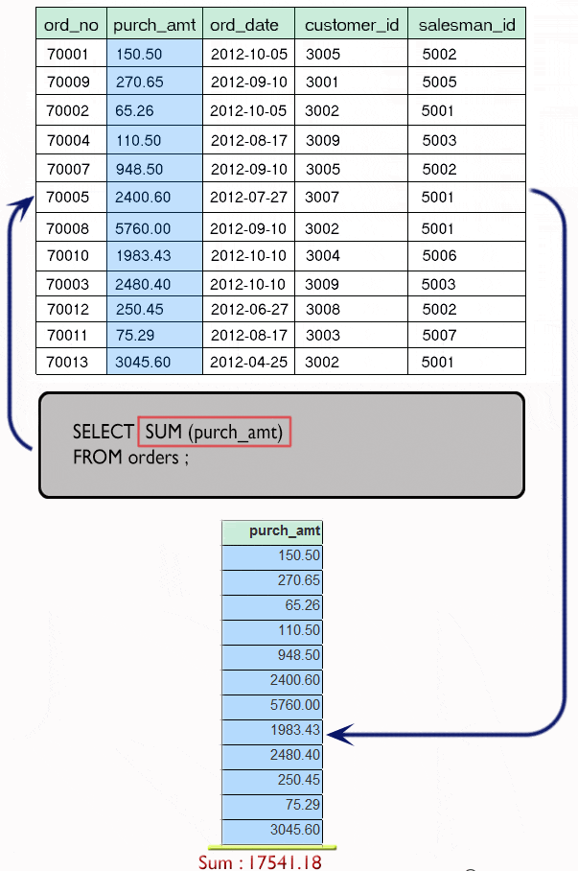
Query 17
Find the total purchase amount of all orders.
orders(ord_no, purch_amt, ord_date, customer_id, salesman_id )
SELECT SUM (purch_amt)
FROM orders;

Slide 20
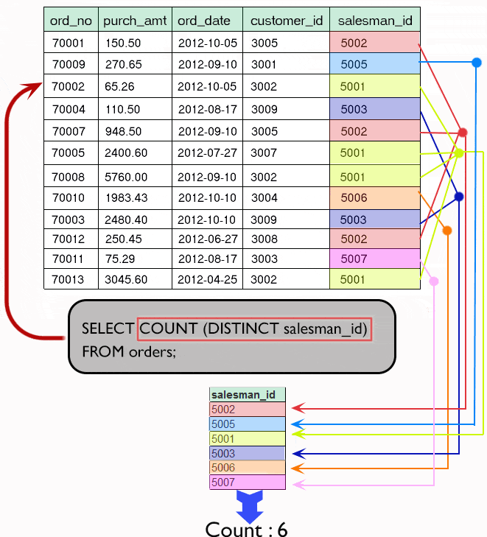
Query 18
Find the number of salesman currently listing for all of their customers.
orders(ord_no, purch_amt, ord_date, customer_id, salesman_id )
SELECT COUNT (salesman_id)
FROM orders;
SELECT COUNT (DISTINCT salesman_id)
FROM orders;

Slide 21
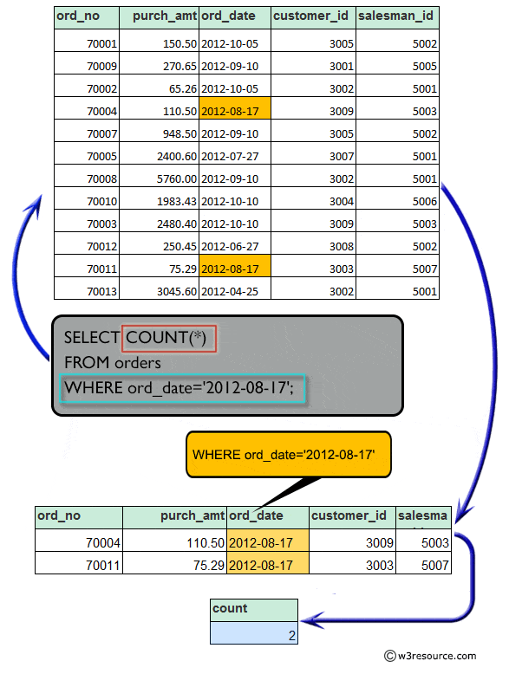
Query 19
Write a SQL statement that counts all orders for a date August 17th, 2012.
orders(ord_no, purch_amt, ord_date, customer_id, salesman_id )
SELECT COUNT(*)
FROM orders
WHERE ord_date = '2012-08-17';

Slide 22
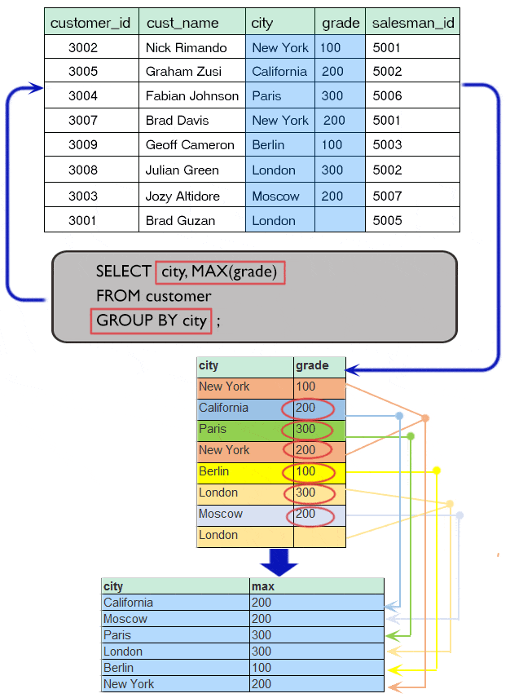
Query 20
Find the highest grade for each of the cities of the customers.
customer(customer_id, cust_name, city, grade, salesman_id)
SELECT city, MAX(grade)
FROM customer
GROUP BY city;

Slide 23
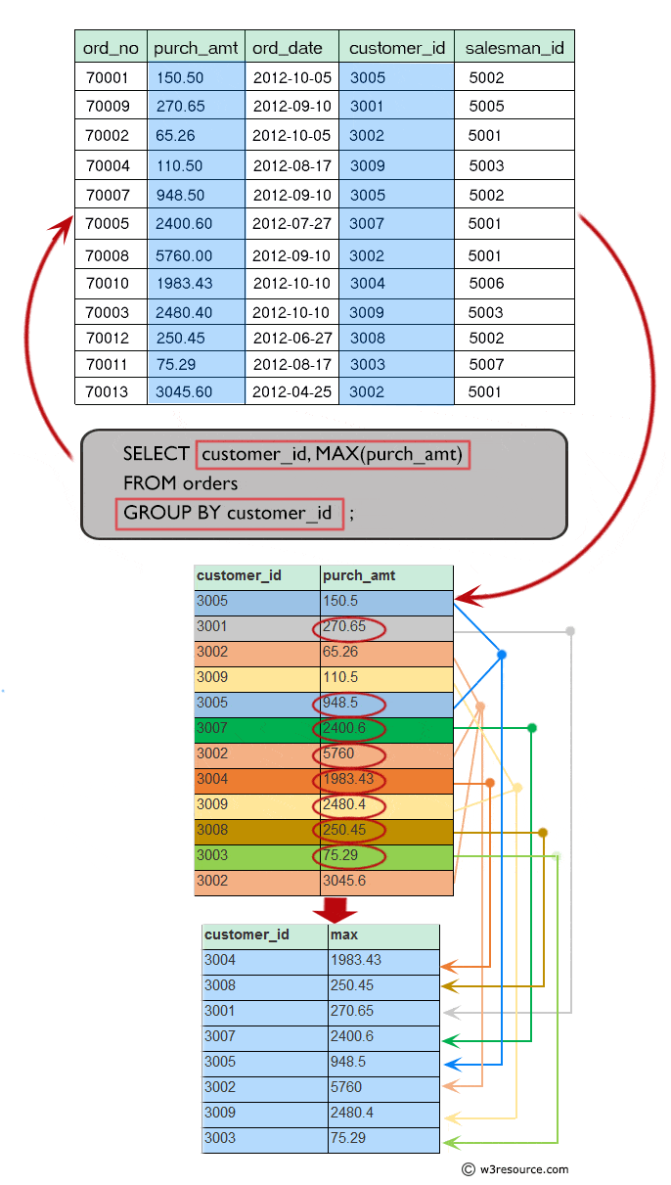
Query 21
Find the highest purchase amount ordered by each customer with their ID and highest purchase amount.
orders(ord_no, purch_amt, ord_date, customer_id, salesman_id )
SELECT customer_id, MAX(purch_amt)
FROM orders
GROUP BY customer_id;

Slide 24
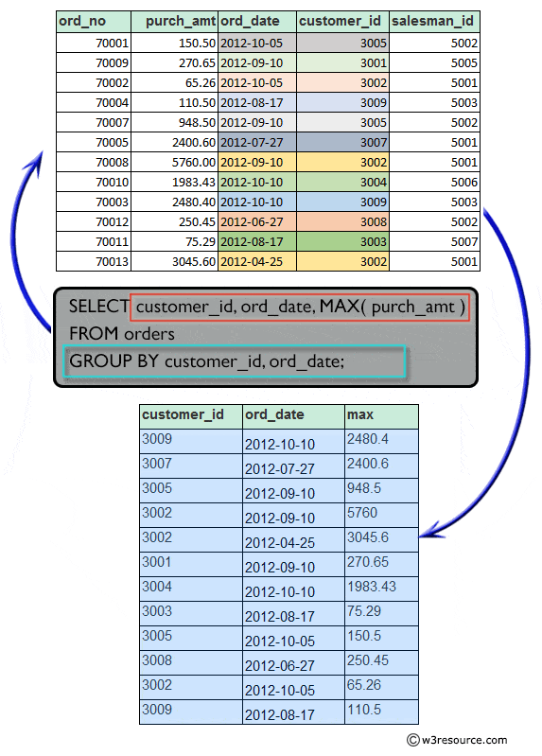
Query 22
Find the highest purchase amount ordered by each customer on a particular date with their ID, order date and highest purchase amount.
orders(ord_no, purch_amt, ord_date, customer_id, salesman_id )
SELECT customer_id, ord_date, MAX(purch_amt)
FROM orders
GROUP BY customer_id, ord_date;

Slide 25
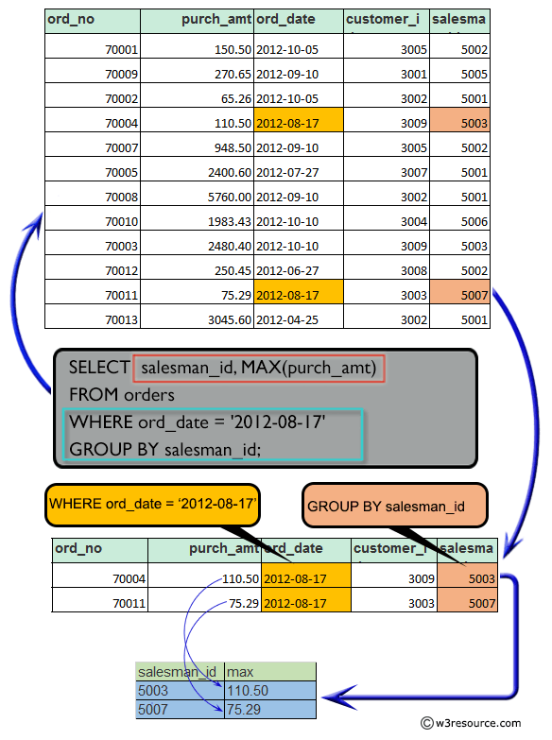
Query 23
Find the highest purchase amount on a date '2012-08-17' for each salesman with their ID.
orders(ord_no, purch_amt, ord_date, customer_id, salesman_id )
SELECT salesman_id, MAX(purch_amt)
FROM orders
WHERE ord_date = '2012-08-17'
GROUP BY salesman_id;

Slide 26
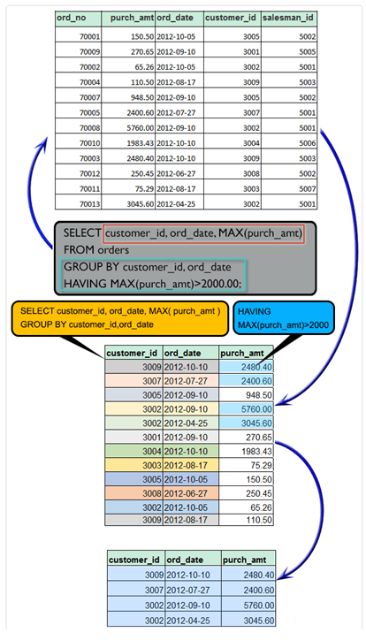
Query 24
Find the highest purchase amount with their customer ID and order date, for only those customers who have the highest purchase amount in a day is more than 2000.
orders(ord_no, purch_amt, ord_date, customer_id, salesman_id )
SELECT customer_id, ord_date, MAX(purch_amt)
FROM orders
GROUP BY customer_id, ord_date
HAVING MAX(purch_amt) > 2000.00;

