Slide 1
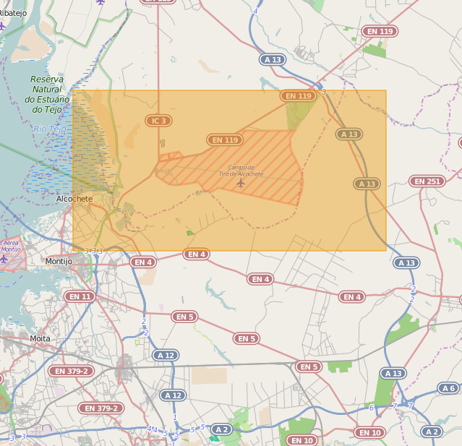
Select Area and Layers

Slide 2
Copy the data from Oracle to Spatialite (minimal code)
Client Intf SP
Notam SP
Notam DAO
Oracle Dialect
SpatiaLite Dialect
Oracle
SpatiaLite
https://github.com/crousson/spatialite-hibernate/

Slide 3

Move the SpatialLite DB to Android
Single file DB
USB
SpatiaLite

Slide 4
Create a SpatialLite DB

Slide 5
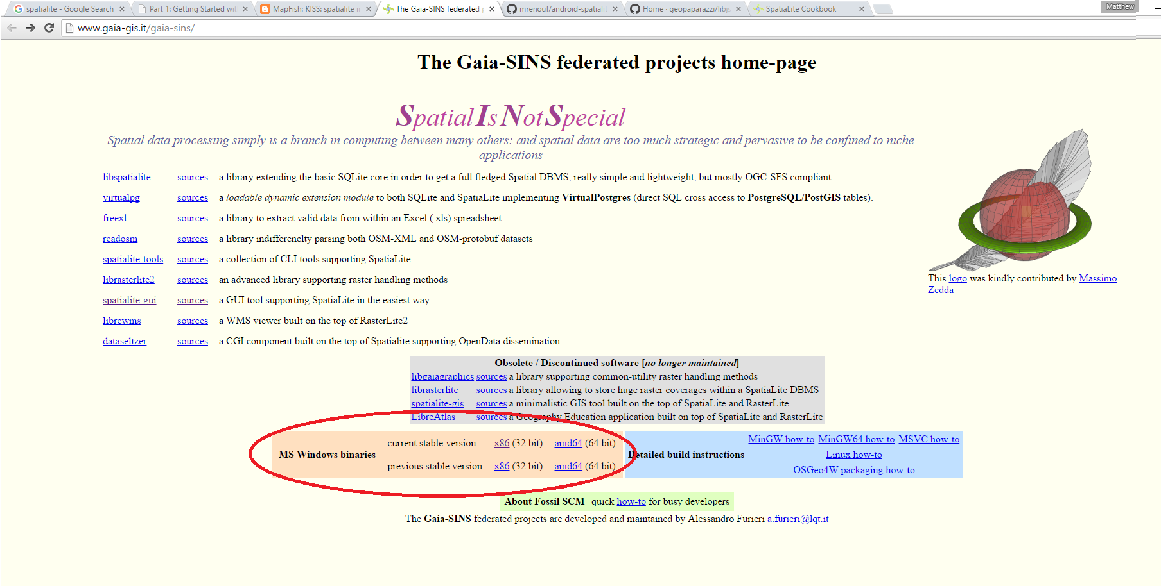
Download The SpatiaLite GUI

Slide 6
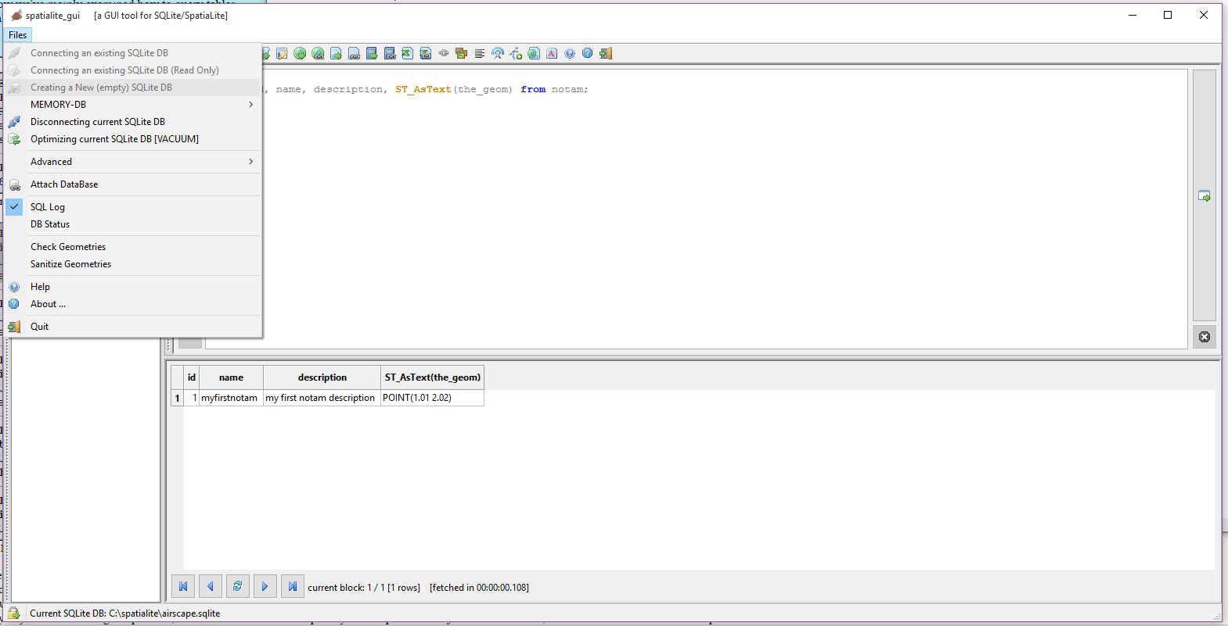
Create the DB file

Slide 7
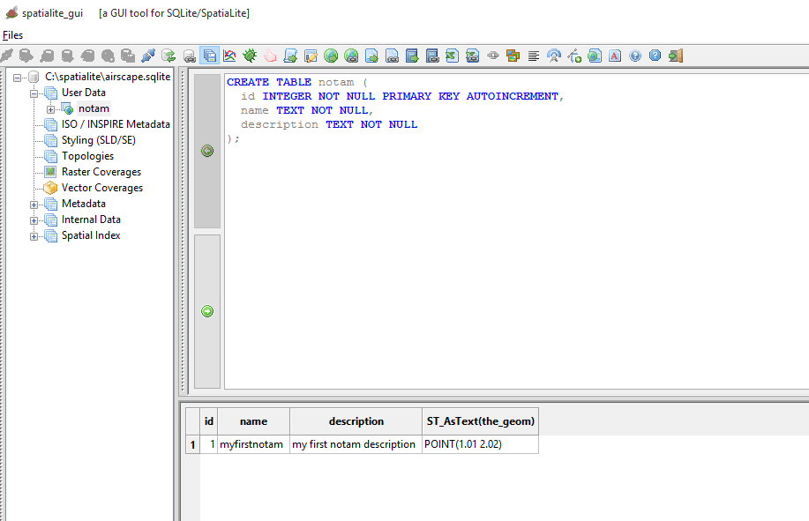
Create a Table

Slide 8
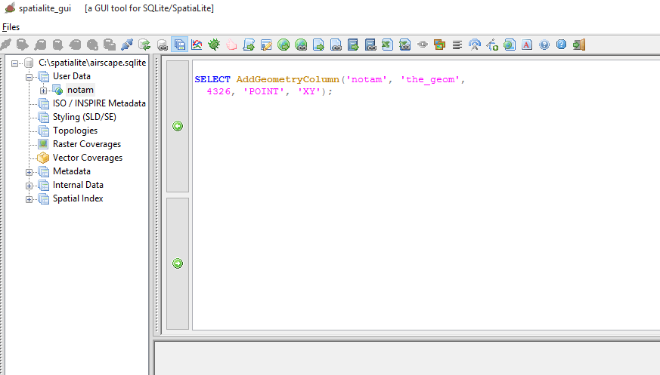
Add the Geometry Column

Slide 9
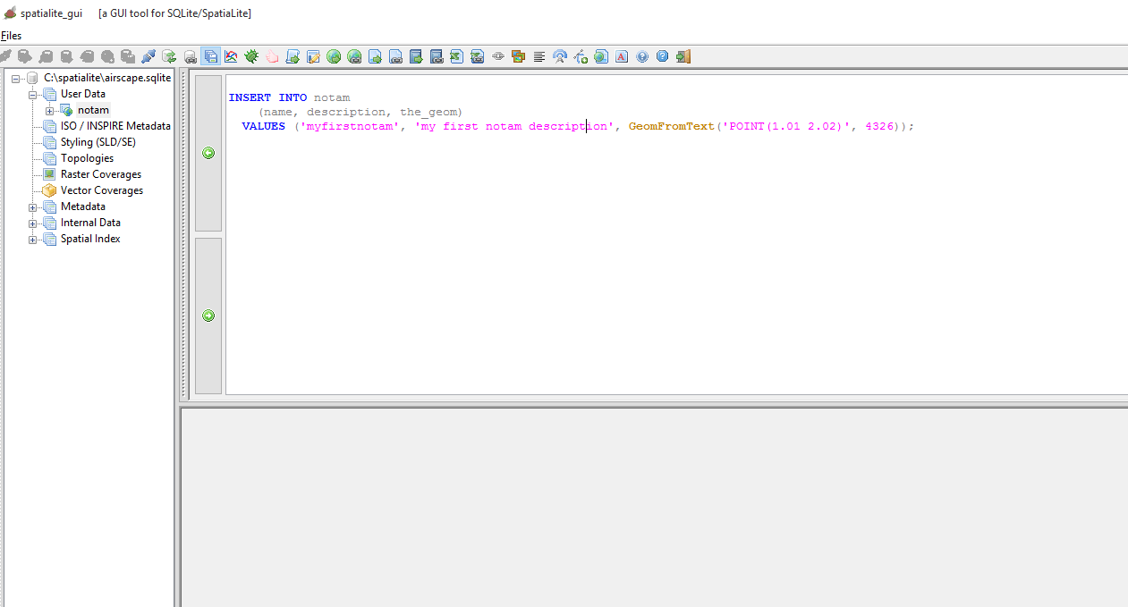
Insert some data

Slide 10
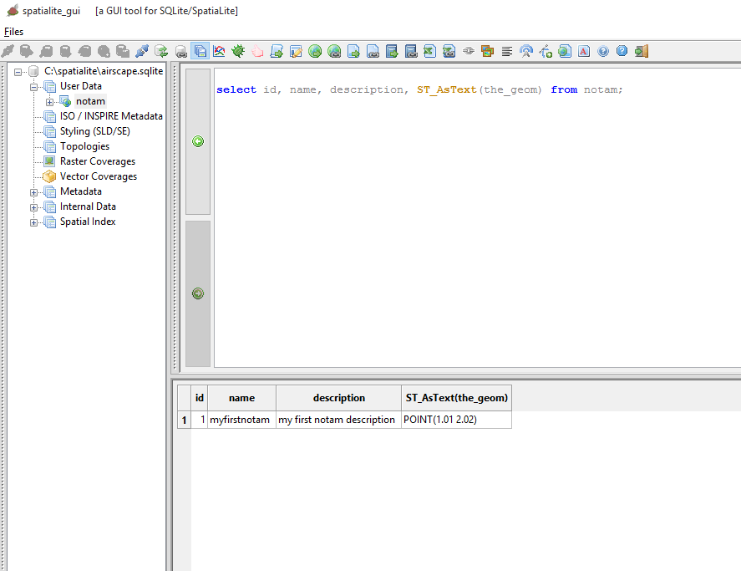
Select Data

Slide 11
Links
http://www.gaia-gis.it/gaia-sins/spatialite-cookbook/index.html#common
http://www.gaia-gis.it/gaia-sins/
http://www.bostongis.com/PrinterFriendly.aspx?content_name=spatialite_tut01
http://mapfishblog.blogspot.co.uk/2009/02/kiss-spatialite-in-5-minutes.html

Slide 12
SpatialLite Android

Slide 13
Install Eclipse Android Plugin
Install Android SDK
Install Eclipse
Install Android Developer Plugin

Slide 14
Create Android Project

Slide 15
Copy In the SpatiaLite Library
To the libs folder

Slide 16
Gain Inspiration
From Cookbook and US Army examples

Slide 17
SpatiaLite Android
Download from:
https://bitbucket.org/moovida/spatialite-android-example/downloads
Tutorial here:
https://www.gaia-gis.it/fossil/libspatialite/wiki?name=spatialite-android-tutorial

