Slide 1
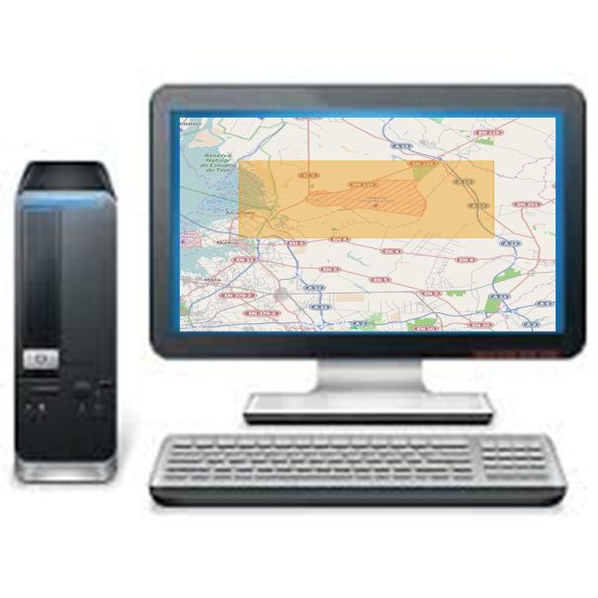


Now with bigger buttons

Slide 2




Slide 3
No WiFi / 3G / SatCom available
Crypto issues

Slide 4
Wired Tablet…not very practical

Slide 5
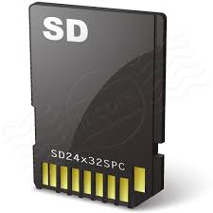
View Data
Edit Data
Snapshot Data
Synchronise Data

Slide 6

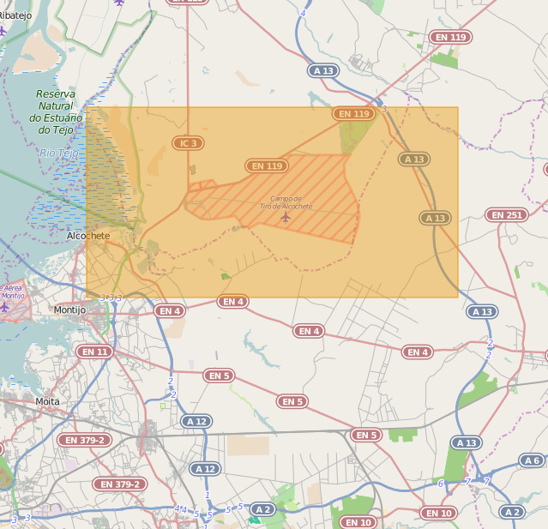

Select Raster and Vector Layers

Slide 7
What is SpatiaLite?
Single file database
Cross platform Android/IOS/Windows
Spatial extension of SQLite
Support for Raster and Vector Data

Slide 8

SpatiaLite
(SQLite + Spatial)
MBTiles
(Mobile Tiles)
Vector
Raster
GeoPackage
OGC Standard 2014
SpatiaLite v 4.2.0
(GeoPackage Reference Implementation)

Slide 9
How do we integrate it?

Slide 10
Copy the data from Oracle to SpatiaLite (minimal code)
Client Intf SP
Notam SP
Notam DAO
Oracle Dialect
SpatiaLite Dialect
Oracle
SpatiaLite
https://github.com/crousson/spatialite-hibernate/

Slide 11

Move the SpatialLite DB to Android
Single file DB
USB
SpatiaLite

Slide 12
Create a SpatialLite DB

Slide 13
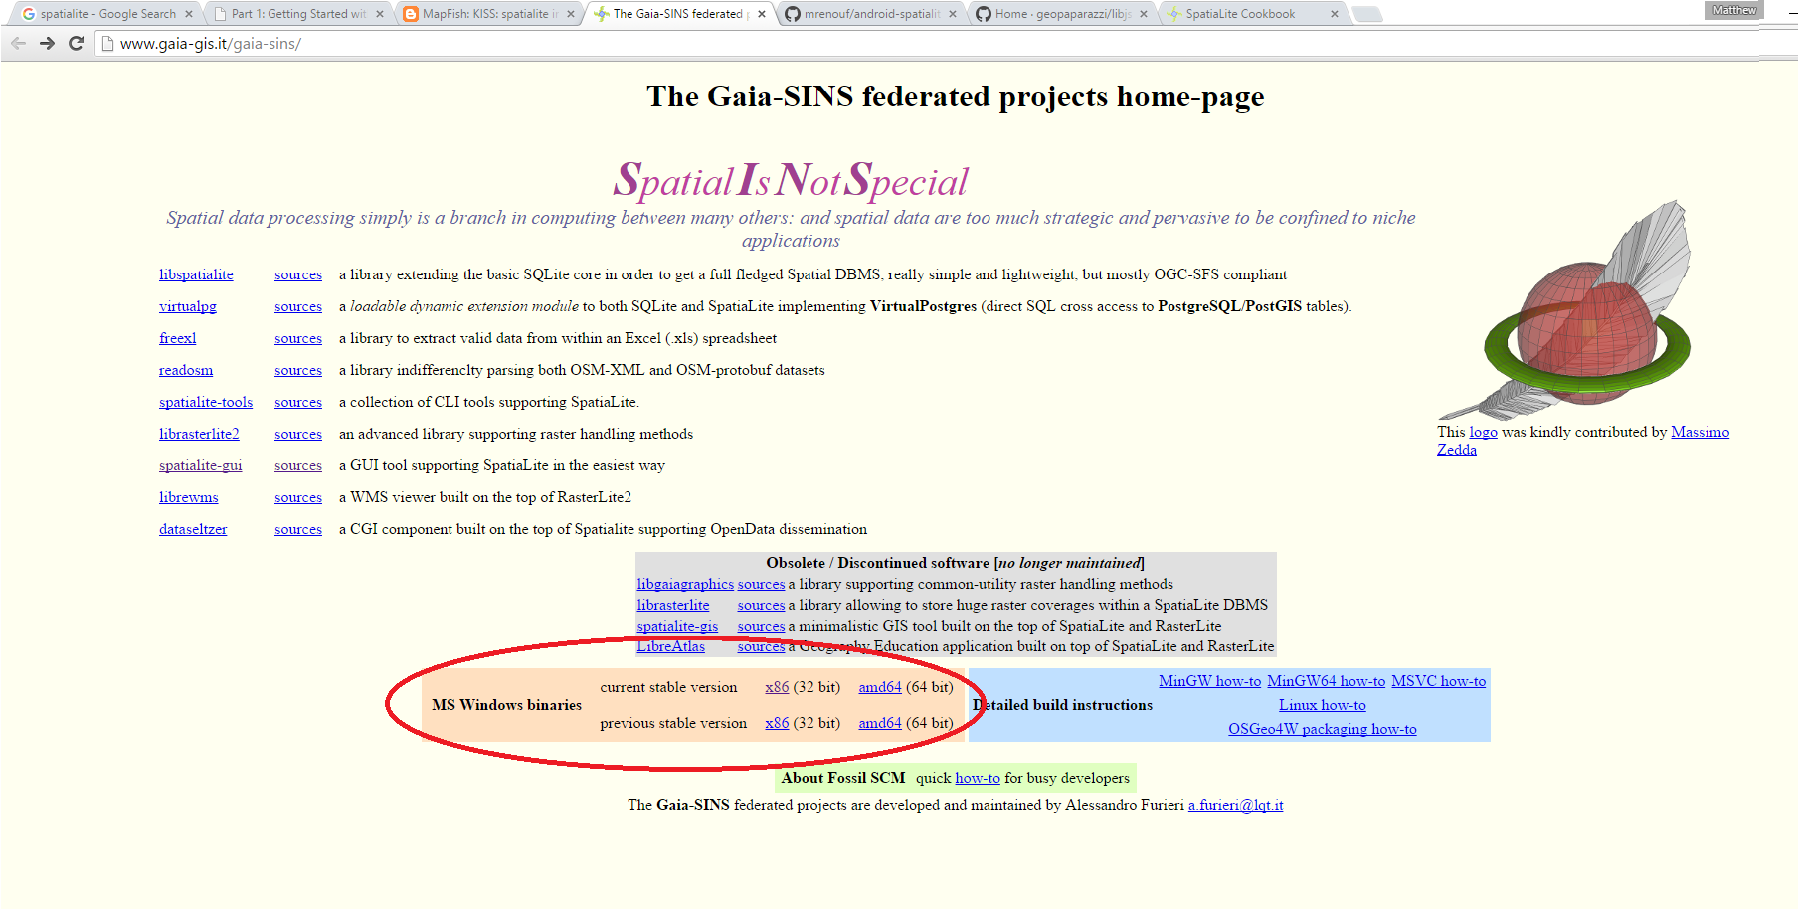
Download The SpatiaLite GUI

Slide 14
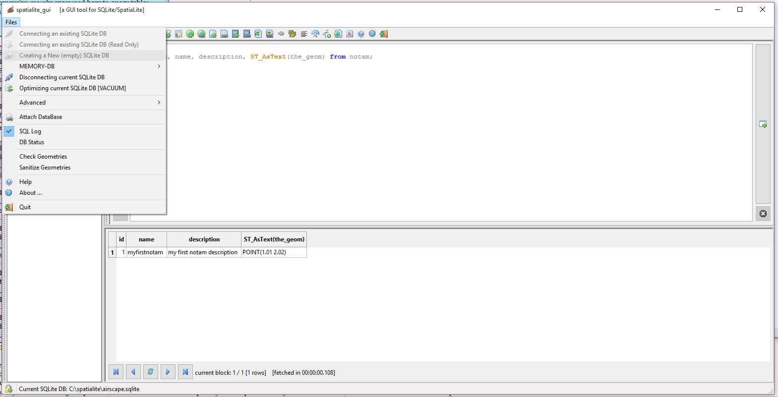
Create the DB file

Slide 15
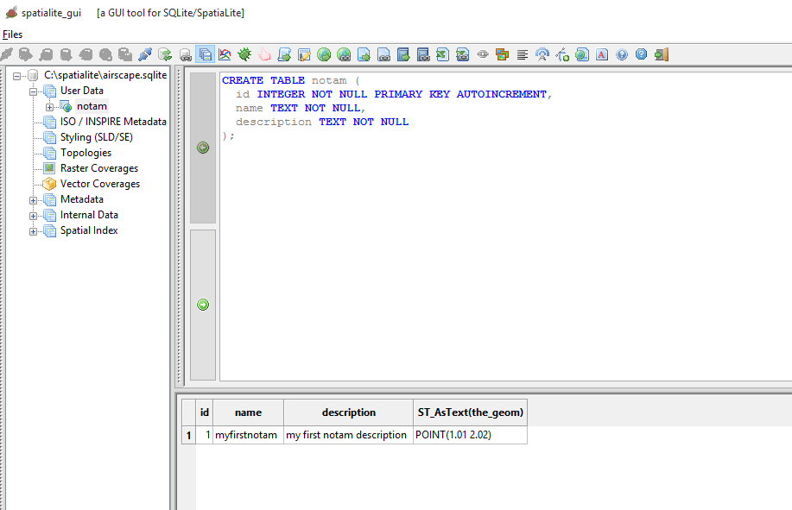
Create a Table

Slide 16
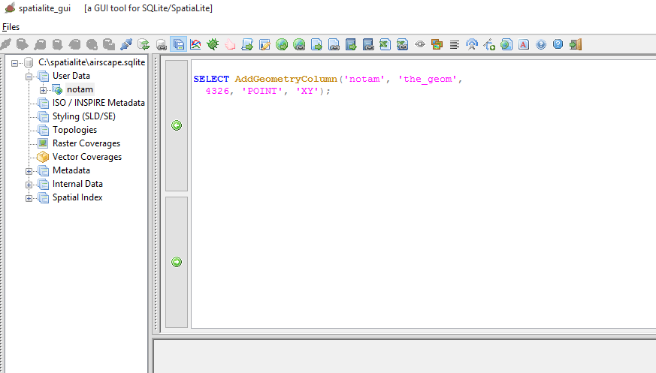
Add the Geometry Column

Slide 17
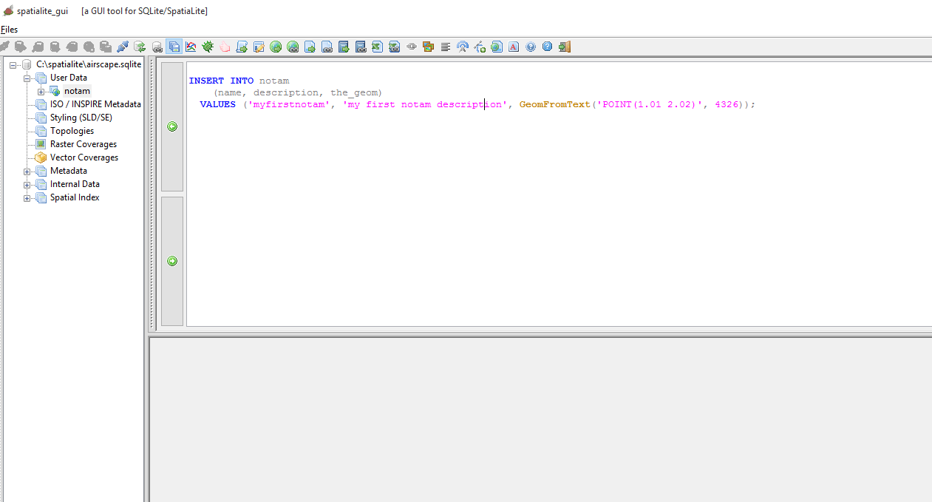
Insert some data

Slide 18
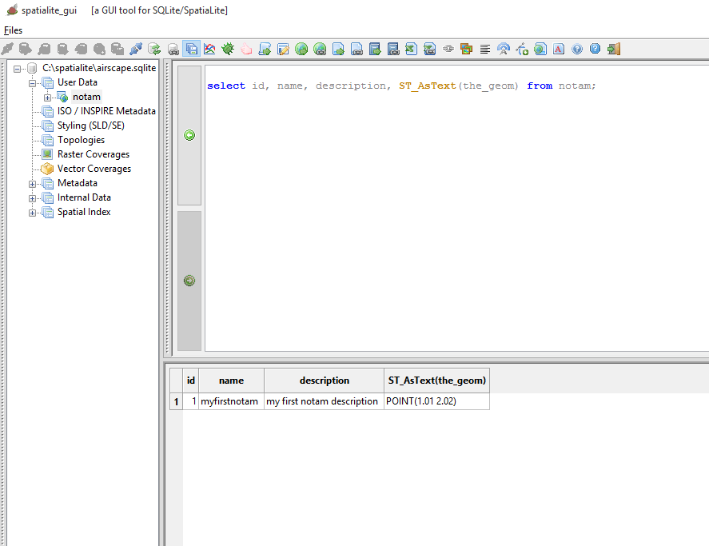
Select Data

Slide 19
Links
http://www.gaia-gis.it/gaia-sins/spatialite-cookbook/index.html#common
http://www.gaia-gis.it/gaia-sins/
http://www.bostongis.com/PrinterFriendly.aspx?content_name=spatialite_tut01
http://mapfishblog.blogspot.co.uk/2009/02/kiss-spatialite-in-5-minutes.html

Slide 20
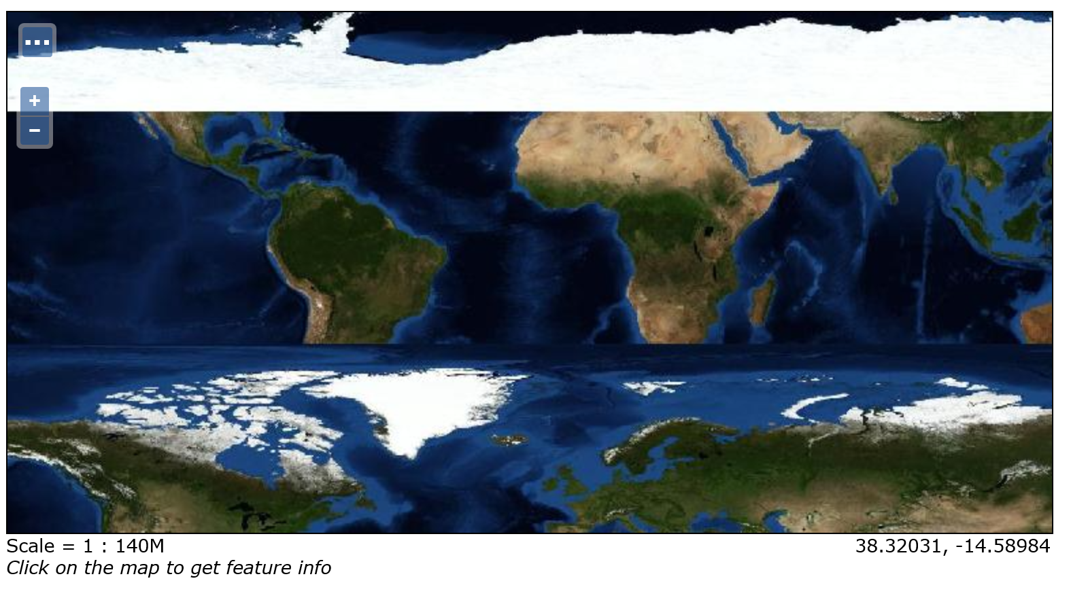
Teething Troubles – Luciad GPKG in OpenLayers/Geoserver

Slide 21
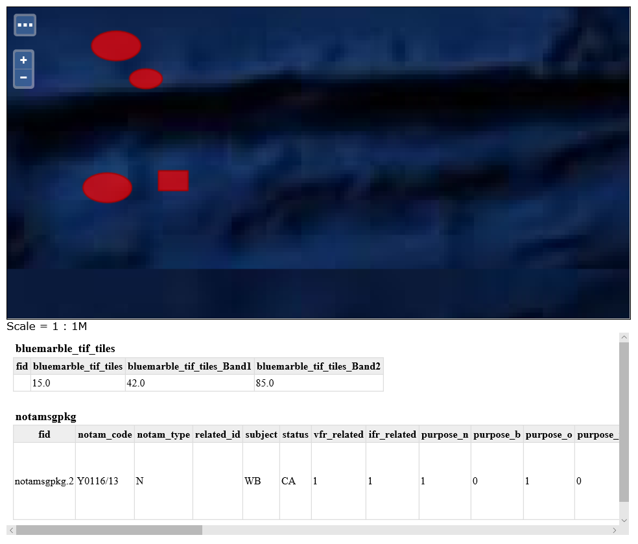
Teething Troubles – Luciad GPKG in OpenLayers/Geoserver – Antarctic Notams!

Slide 22
SpatialLite Android

Slide 23
Install Eclipse Android Plugin
Install Android SDK
Install Eclipse
Install Android Developer Plugin

Slide 24
Create Android Project

Slide 25
Copy In the SpatiaLite Library
To the libs folder

Slide 26
Gain Inspiration
From Cookbook and US Army examples

Slide 27
SpatiaLite Android
Download from:
https://bitbucket.org/moovida/spatialite-android-example/downloads
Tutorial here:
https://www.gaia-gis.it/fossil/libspatialite/wiki?name=spatialite-android-tutorial

