Slide 1
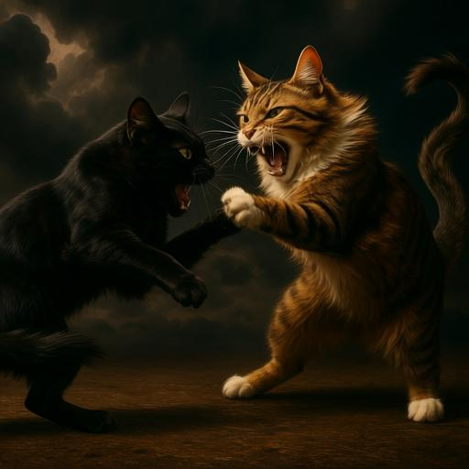
Slide 1 大标题
Hello World
Body Placeholder here!

Slide 2
Slide Two
Hello World from PptxGenJS!
ShapeType.rect
ShapeType.ellipse
ShapeType.line

Slide 3
Top Lft | Top Ctr | Top Rgt
Bottom Lft | Bottom Ctr | Bottom Rgt

