Slide 1

FPGA-Based Pulse Oximetry Device
Team: Matthew Capuano
Advisor: Dr. Nashwa Elaraby

Slide 2
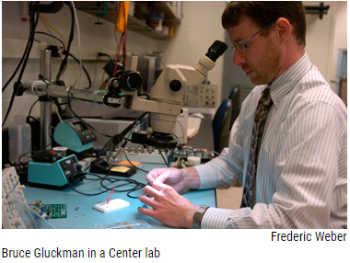
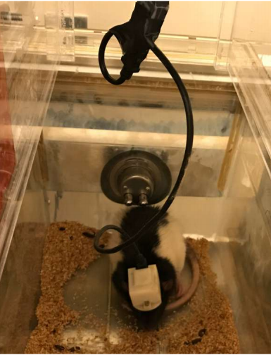
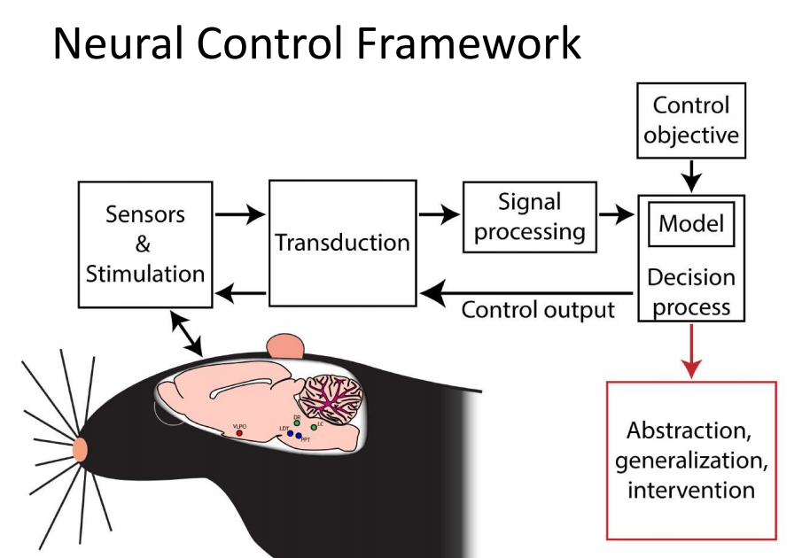
Motivation
Penn State’s Neural Engineering Group designs brain-machine interfaces (BMI) for seizure research.
One of their current goals: to expand on the existing BMI system and fix some of its existing problems.
Image credit: Bruce Gluckman, “Spreading Depolarization Happens Spontaneously in models of Epilepsy”

Slide 3
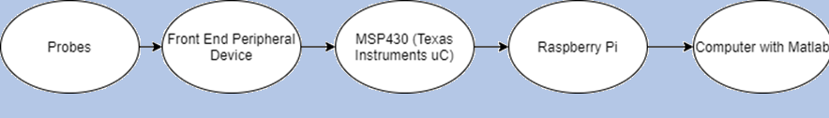
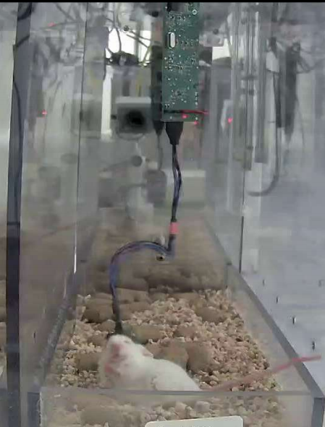
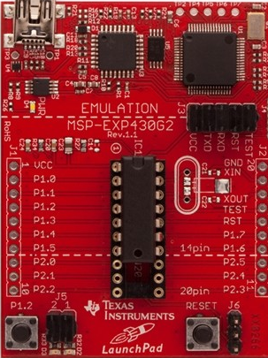
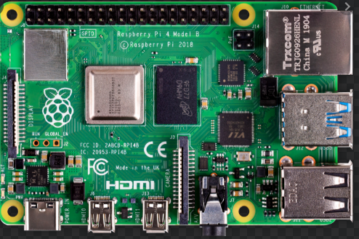
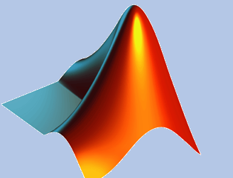
Existing Design

Slide 4
Problem
Neural Engineering Group wants…
Increase # of peripherals
Be able to interface in parallel
Real time processing on board
Be able to process multiple algorithms in parallel
Wireless data transmission and cloud storage
Be able to sent out large packets of data wirelessly
Small form factor, low power device

Slide 5
Solution
FPGA for parallel peripheral interfacing and real time, on-board parallel processing.
WIFI interface to send raw and processed data out wirelessly.
Proof of concept server development.
Implement with front-end pulse oximeter device (desired peripheral expansion)

Slide 6

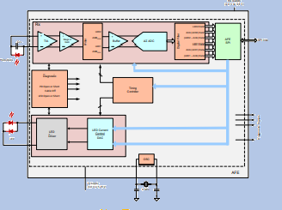
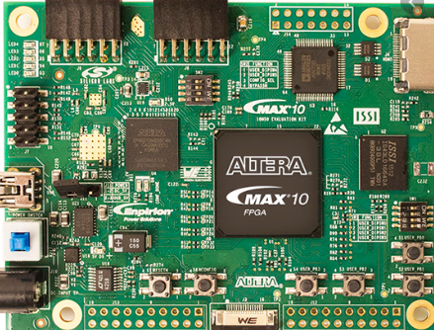


New Design

Slide 7
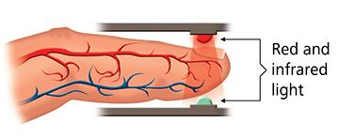
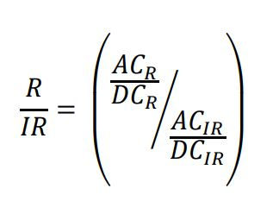
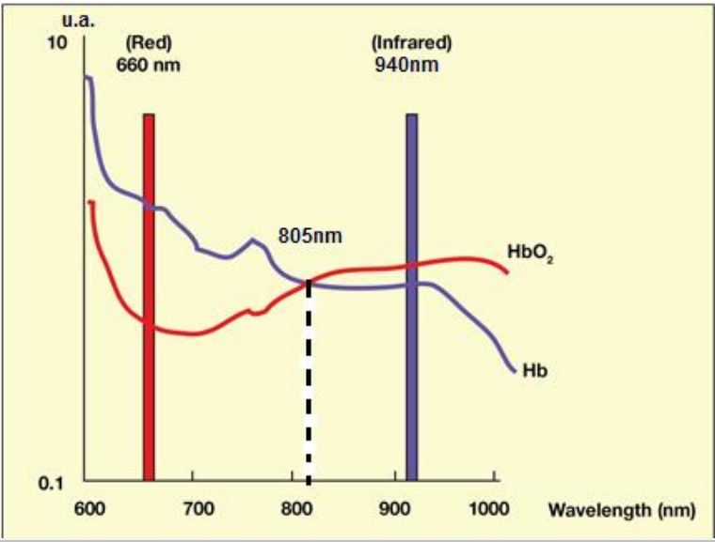
Pulse Oximetry Concept

Slide 8
Specifications
Marketing Requirements | Engineering Requirements | Justification | Specification Type
Process data in parallel and in real time | Use Intel Max 10 FPGA | FPGA’s are programmable devices capable of parallel, real time processing; MAX 10 series chip has flash memory to keep designed system non-volatile | Performance Functional
Implement WIFI communication for cloud server storage | Use ESP8266 WIFI module | Simple WIFI module that is highly configurable for wireless data transmission | Standard Requirement
PCB design for customer and general use | Master board PCB design, general PCB design | Master board design for use in embedded brain-machine interface system. General PCB design for human use. | Performance Functional Operational
Interface with analog front-end device | Use AFE4490 mixed signal chip | Chip specifically designed by Texas instruments for pulse-oximetry. | Performance Functional Standard Requirement
Clinically accurate data computation | Extensive calibration process involving simulation and testing with MATLAB | Processed/computed data must be highly accurate, so a systematic calibration process must be implemented | Reliability
Remote FPGA control | Modification of web server/wifi module system to accommodate for two-way/remote system control | Allows for the functionality of the FPGA to be controlled wirelessly through implemented WIFI system. This allows for control of sampling rate, data streaming time, resets, ect. | Usability Performance Functional Operational
Visual Signal Display | Thin-film-transistor (TFT) display driven by FPGA using VGA interface | System capable of displaying the pulse signal in real time | Performance Functional Operational

Slide 9
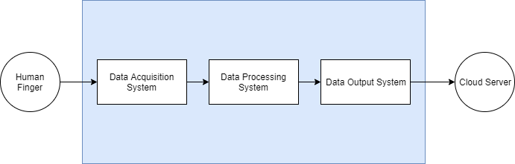
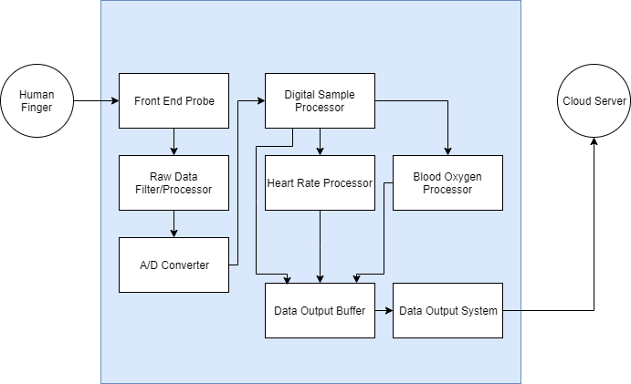
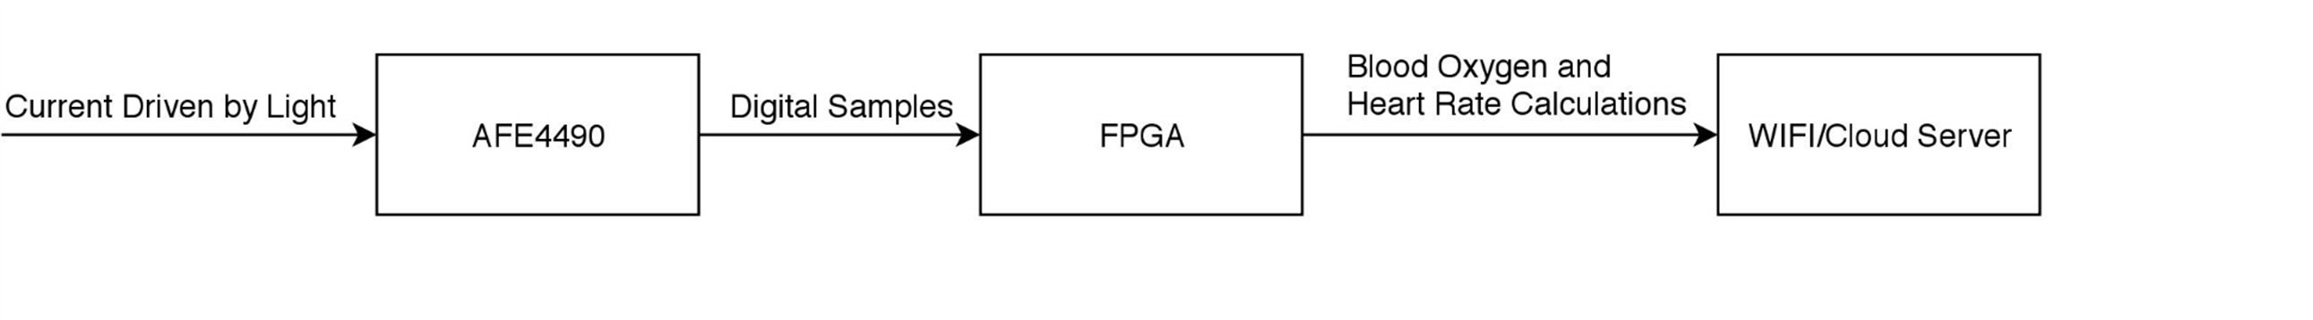
Functional Decomposition

Slide 10
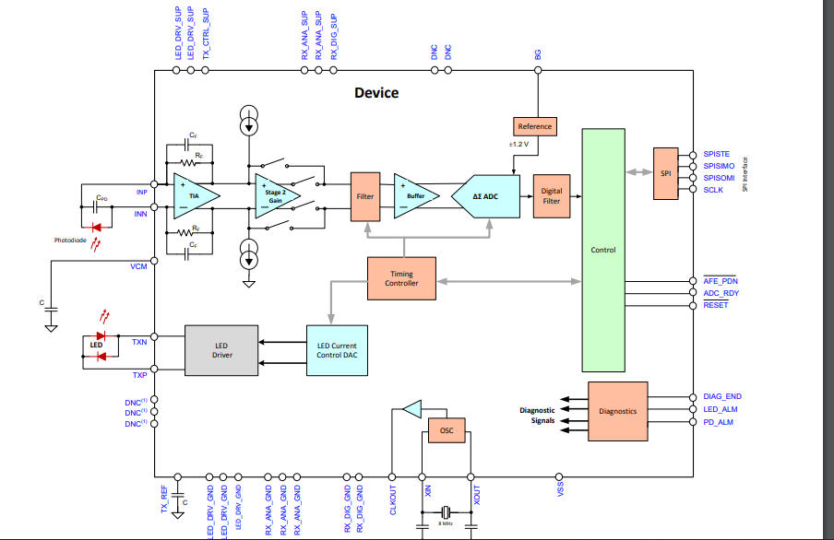
How Do We Pull Analog Information from the Animal and Convert it to Digital Information? (Subsystem 0)

Slide 11
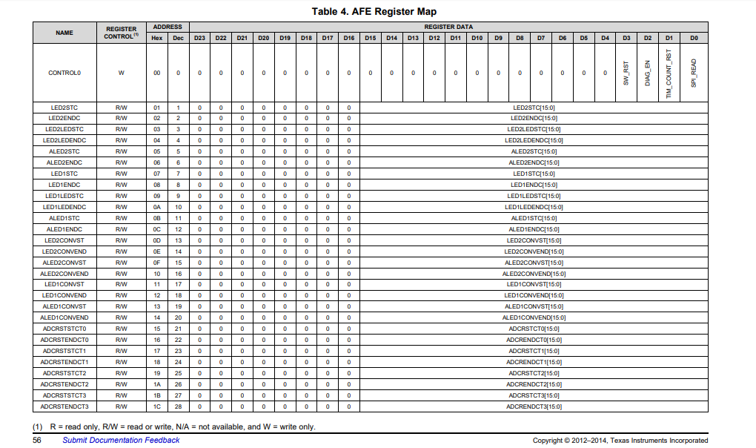

Slide 12
FPGA Hierarchy
Top Module
SPI
ADDR
WRITE RAM
Read RAM
FSM
Data Buffer
Submodules
FIFO
WIFI
Submodules (Uart)
Circular Buffer
FFT
Post-Buffer
Square Root
Final Computation
Sorting Algorithm
RED – AFE4490 INTERFACE
GREEN – DATA PROCESSING ALGORITHM
PURPLE – WIFI INTERFACE

Slide 13
Complete System

Slide 14
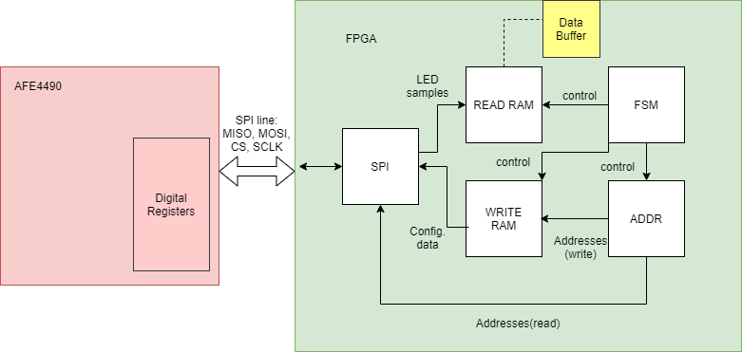
How Do We Get Data from the AFE4490? (Subsystem I)
FPGA – AFE4490 Interconnect

Slide 15
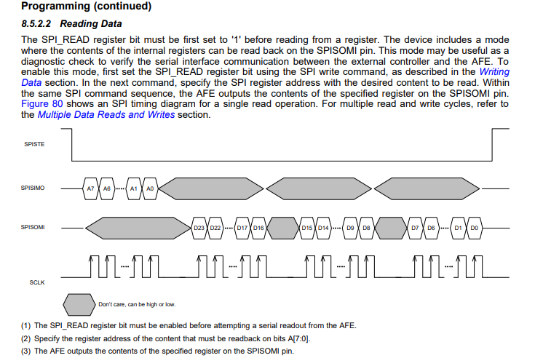
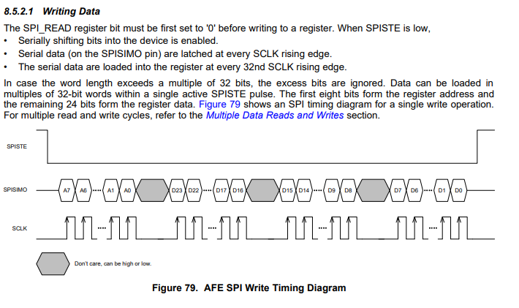

Slide 16
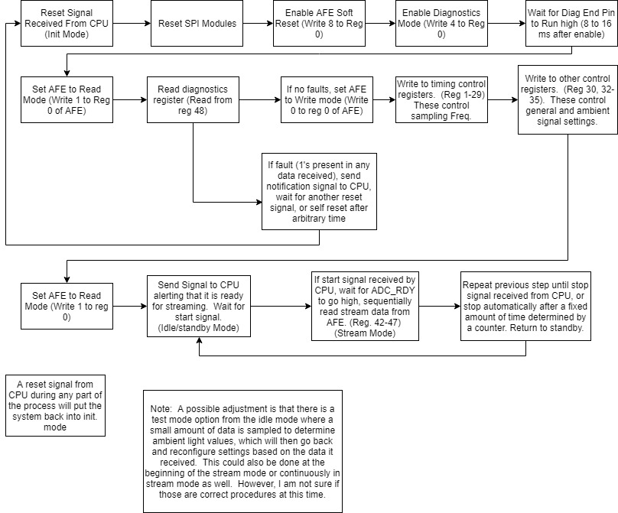

Slide 17
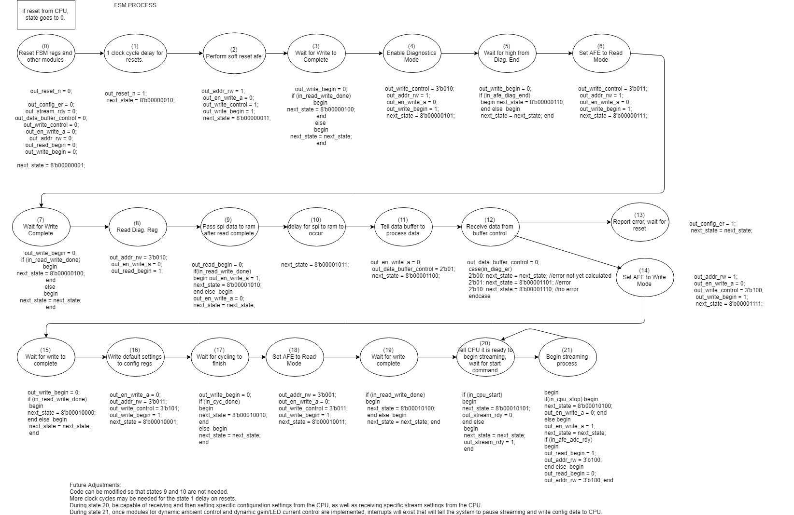

Slide 18
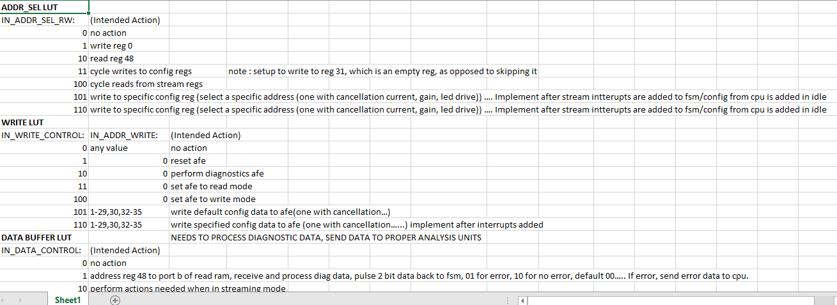

Slide 19
Add code, state machine, simulations

Slide 20
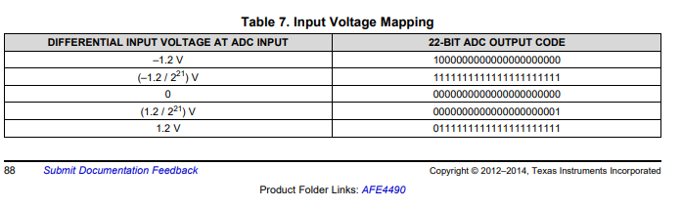
What does our incoming data look like?

Slide 21
Matlab Testing/Simulation

Slide 22
How Do We Process this Data? (Subsystem II)
FPGA Data Processing Algorithm

Slide 23
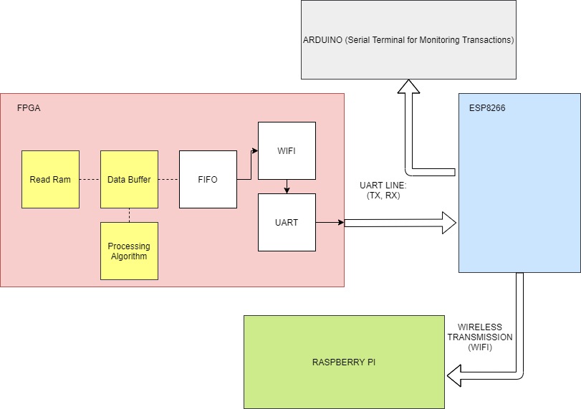
Where Does the Processed Data Go? (Subsystem III)
FPGA-WIFI Interconnect, Cloud Server

Slide 24
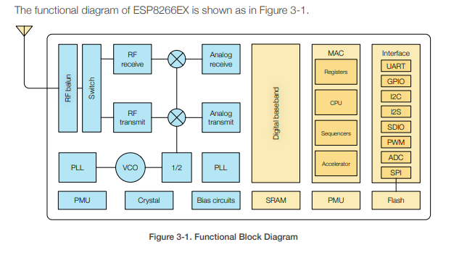
ESP8266

Slide 25
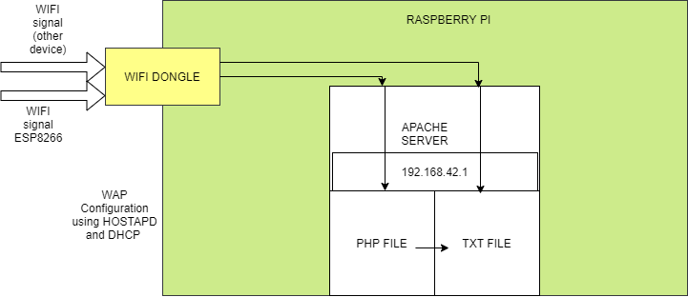
Server Setup

Slide 26
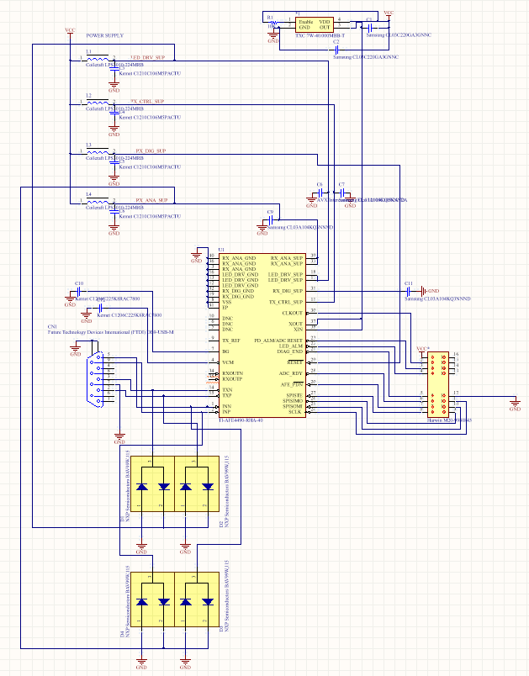
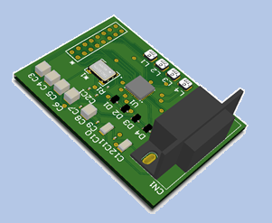
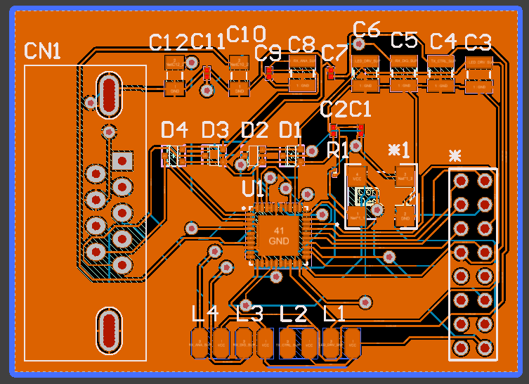
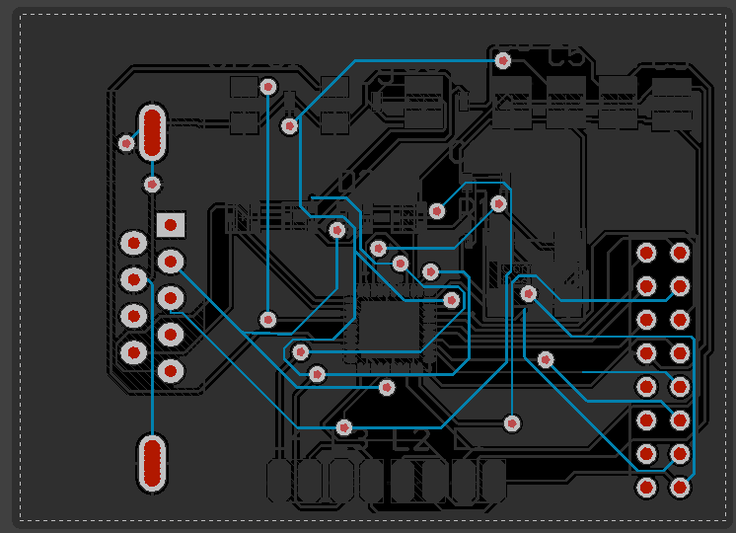
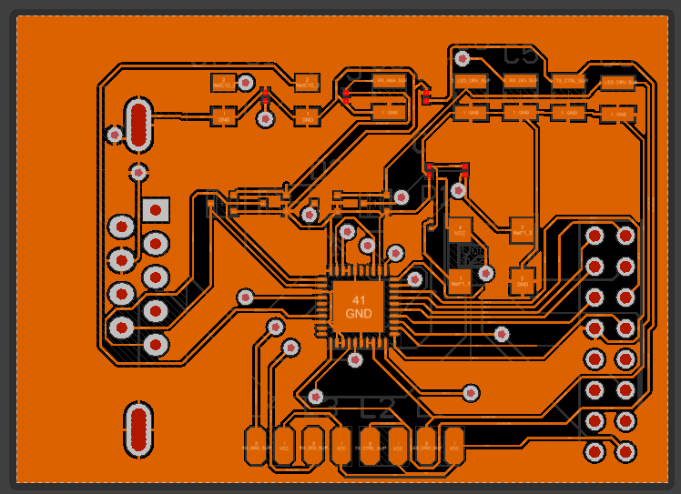
PCB Design
Full PCB design credit goes to Charlie Wischner

Slide 27
Thank you

